Slide 1

Vocabulary Flashcards Units A1-01 to A1-07
©2020-2022 Literacy International

Slide 2
How to Use the Flashcards
Download file in PowerPoint.
Play in Slide Show mode.
Click once to hear the audio.
Click again to see the word.
Try to say the words without listening.
Try to spell the words without reading.
You may also print, cut, and fold to make paper flashcards. (Print 1 slide per page, landscape).
Have fun, and may the Lord bless you!

Slide 3


ABCDEFGHIJKLMNOPQRSTUVW XYZ | 0123456789 | Adam | A-d-a-m
a letter
a number
to say
to spell

Slide 4
A a
B b
C c
D d
A
B
C
D

Slide 5
E e
F f
G g
H h
E
F
G
H

Slide 6
I i
J j
K k
L l
I
J
K
L

Slide 7
M m
N n
O o
P p
M
N
O
P

Slide 8
Q q
R r
S s
T t
Q
R
S
T

Slide 9
U u
V v
W w
X x
U
V
W
X

Slide 10
Y y
Z z
0
1
Y
Z
zero
one

Slide 11
2
3
4
5
two
three
four
five

Slide 12
6
7
8
9
six
seven
eight
nine

Slide 13



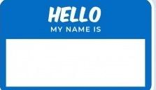
Adam
a name
a hand
hello
goodbye

Slide 14




bad
good
to meet
to hug

Slide 15




to wave
to shake hands
to love
to smile

Slide 16
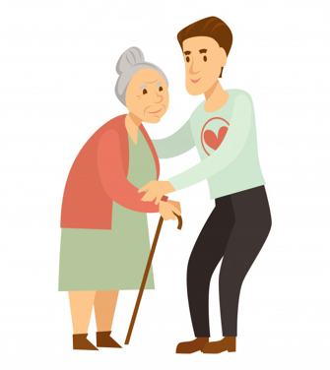
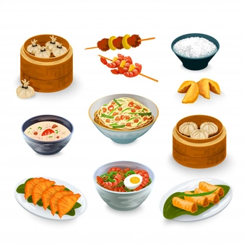

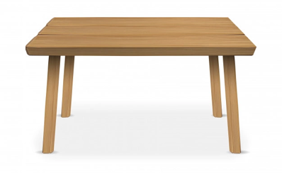
water
to help
food
a table

Slide 17




to drink
to eat
a spoon
a fork

Slide 18




a bathroom
a bottle
a ball
bread

Slide 19
Mr. Noah Dan Lee
Mr. Noah Dan Lee
Mr. Noah Dan Lee
123 New St.
Newton, NY USA
a first name
a middle name
a last name
an address

Slide 20



DOB:06/09/1999
Lee@Dmail.com
217-555-1234
a phone
a phone number
a birth date
an email

Slide 21




a language
a class
English
to write

Slide 22



a person
an animal
an adult
a child

Slide 23


a man
a woman
a boy
a girl

Slide 24




a friend
an enemy
a chair
to look

Slide 25





a dog
a church
a school
an office

Slide 26




the world
money
light
dark/
darkness

Slide 27







to turn on
to turn off
to lose
to find

Slide 28
Acknowledgements
We would like to thank the entire Light of the World volunteer team for their hard work and creativity in making this project possible. For all those around the world who prayed, wrote, edited, narrated, illustrated, sang, tested, and gave generously for this curriculum, we appreciate you sharing the love of Jesus through the gift of English. Our team members include:
Sara Scazzero
Hannah Schmokel
Ashlyn Shrimplin
Macie Stuckman
Leah Sprague
Ellie Talalight
Peter Talalight
Weston Talalight
Rachel Tamang
Darrell Turner
Graham Whitmore
Cheri Wilke
Mackenzie Williams
Muchun Yin
Ted York
Anita Zeifert
Anonymous
Jean Ato
Bradley Baurain
Joshua Blake
Rachael Braggs
Larry Buell
Cindy Campbell
Christian Cha
Olivia Cheney
Hannah Clark
Nancy Cobb
Emily Cox
Marilyn Dano
Susanna Diallo
Alyssa Dokolas
EasyReadEnglish.com
Don Edic
Peggy Fergus
MaryBeth Gahan
Melina Gallo
Alicia Gentile
Prakash Chandra Giri
Ellenor Gopal
Jill Gramzow
Rachel Grijincu
Carol Hale
Emily Hamilton
Patty Hickman Lyudmila Ivanyuk
Debbie Johnson
Carey Jo Johnston
Nancy Kingdon
Dorothy Konadu
Macy Lake
Martha Lane
Audrey Larsen
Tai Young Lee
Aden Lewis
Bruce Lewis
Elena Lewis
James Lewis
Micah Beth Lewis
Tim Lewis
Ward Lewis
Johnny Lukashevich
Gail MacMillan
Ivan Mader
Amy Martin
Diana Martz
Christy McPherson
Tracy Meddaugh
Barbara Newsome
Brenda Nielsen
Danielle Nowe
Deborah O’Donnell
Georg Ort
Martha Ort
Deb Payne
Linda Petrie
Joan Phelps
For more information, visit LiteracyInternational.net
©2020-2022 Literacy International

