Slide 1
Vocabulary Flashcards Units A1-08 to A1-014
©2020-2022 Literacy International

Slide 2
How to Use the Flashcards
Download file in PowerPoint.
Play in Slide Show mode.
Click once to hear the audio.
Click again to see the word.
Try to say the words without listening.
Try to spell the words without reading.
You may also print, cut, and fold to make paper flashcards. (Print 1 slide per page, landscape).
Have fun, and may the Lord bless you!
©2020-2022 Literacy International
©2020-2022 Literacy International

Slide 3
12:00-12:01
1:00-2:00
a clock
a minute
an hour
the sky
©2020-2022 Literacy International

Slide 4
a day
a night
the sun
the moon
©2020-2022 Literacy International

Slide 5
the land
the sea
a breakfast
a lunch
©2020-2022 Literacy International

Slide 6
a notebook
a pencil
a pen
an eraser
©2020-2022 Literacy International

Slide 7
scissors
a wall
paper
a book
©2020-2022 Literacy International

Slide 8
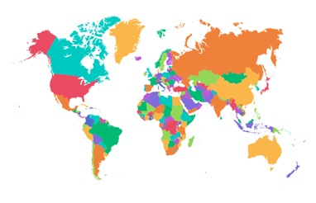
a board
a map
a shelf
a pencil sharpener
©2020-2022 Literacy International

Slide 9
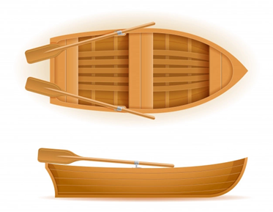
a window
a boat
a door
a rainbow
©2020-2022 Literacy International

Slide 10
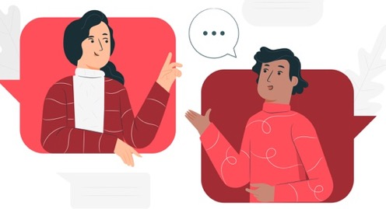
a floor
to talk
to sing
to learn
©2020-2022 Literacy International

Slide 11
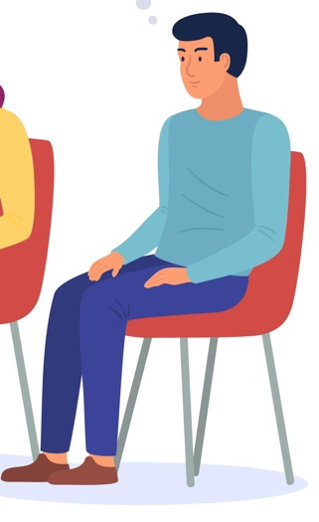
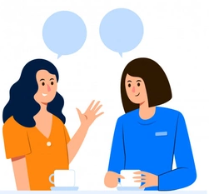
or
or
to read
to listen
to sit
to repeat
©2020-2022 Literacy International

Slide 12
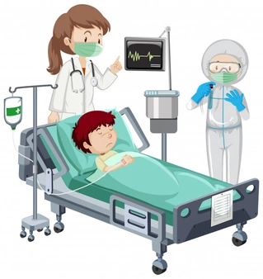
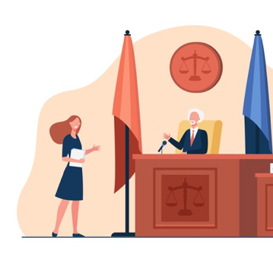
123 Main St.
New York, NY
12304
a form
a zip code
a hospital
a lawyer
©2020-2022 Literacy International

Slide 13
the police
sex/gender
a male
a female
©2020-2022 Literacy International

Slide 14
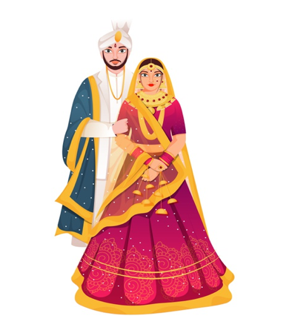
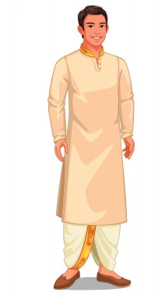
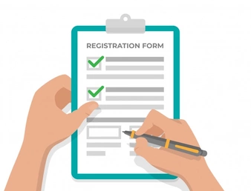
married
single
to fill out
to sign
©2020-2022 Literacy International

Slide 15
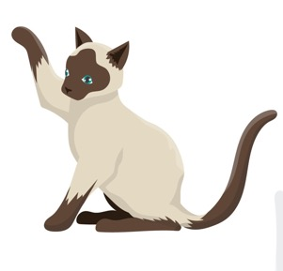
2%
milk
a kettle
a cat
soccer
©2020-2022 Literacy International

Slide 16
a country
tea
a star
a cup
©2020-2022 Literacy International

Slide 17
to pray
to move
to like
to dislike
©2020-2022 Literacy International

Slide 18
a kitchen
a stove
a sink
a faucet
©2020-2022 Literacy International

Slide 19
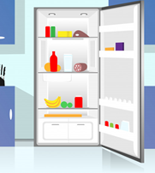
a fridge
a countertop
a pan
a sofa
©2020-2022 Literacy International

Slide 20
a washing machine
a toilet
a bathtub
a bed
©2020-2022 Literacy International

Slide 21
Acknowledgements
We would like to thank the entire Light of the World volunteer team for their hard work and creativity in making this project possible. For all those around the world who prayed, wrote, edited, narrated, illustrated, sang, tested, and gave generously for this curriculum, we appreciate you sharing the love of Jesus through the gift of English. Our team members include:
Sara Scazzero
Hannah Schmokel
Ashlyn Shrimplin
Macie Stuckman
Leah Sprague
Ellie Talalight
Peter Talalight
Weston Talalight
Rachel Tamang
Darrell Turner
Graham Whitmore
Cheri Wilke
Mackenzie Williams
Muchun Yin
Ted York
Anita Zeifert
Anonymous
Jean Ato
Bradley Baurain
Joshua Blake
Rachael Braggs
Larry Buell
Cindy Campbell
Christian Cha
Olivia Cheney
Hannah Clark
Nancy Cobb
Emily Cox
Marilyn Dano
Susanna Diallo
Alyssa Dokolas
EasyReadEnglish.com
Don Edic
Peggy Fergus
MaryBeth Gahan
Melina Gallo
Alicia Gentile
Prakash Chandra Giri
Ellenor Gopal
Jill Gramzow
Rachel Grijincu
Carol Hale
Emily Hamilton
Patty Hickman Lyudmila Ivanyuk
Debbie Johnson
Carey Jo Johnston
Nancy Kingdon
Dorothy Konadu
Macy Lake
Martha Lane
Audrey Larsen
Tai Young Lee
Aden Lewis
Bruce Lewis
Elena Lewis
James Lewis
Micah Beth Lewis
Tim Lewis
Ward Lewis
Johnny Lukashevich
Gail MacMillan
Ivan Mader
Amy Martin
Diana Martz
Christy McPherson
Tracy Meddaugh
Barbara Newsome
Brenda Nielsen
Danielle Nowe
Deborah O’Donnell
Georg Ort
Martha Ort
Deb Payne
Linda Petrie
Joan Phelps
For more information, visit LiteracyInternational.net
©2020-2022 Literacy International

