Slide 1

Vocabulary Flashcards Units A1-015 to A1-21
©2020-2022 Literacy International

Slide 2
How to Use the Flashcards
Download file in PowerPoint.
Play in Slide Show mode.
Click once to hear the audio.
Click again to see the word.
Try to say the words without listening.
Try to spell the words without reading.
You may also print, cut, and fold to make paper flashcards. (Print 1 slide per page, landscape).
Have fun, and may the Lord bless you!
©2020-2022 Literacy International
©2020-2022 Literacy International

Slide 3
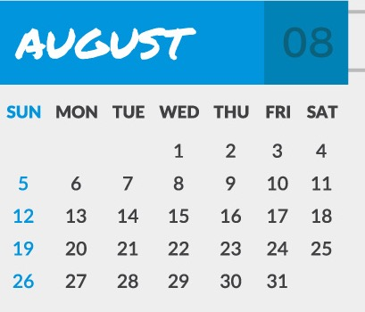
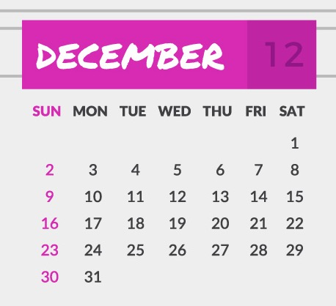

today
yesterday
tomorrow
a week

Slide 4
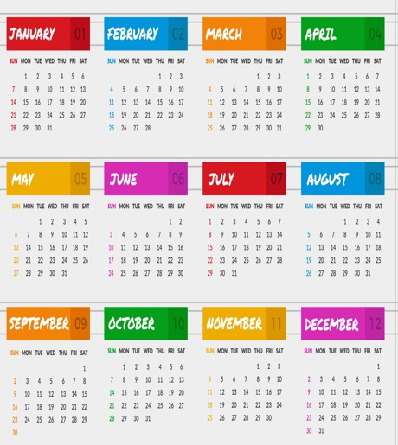
Jan.
Feb.
a month
a year
January
February

Slide 5
Mar.
Apr.
May
Jun.
March
April
May
June

Slide 6
Jul.
Aug.
Sep.
Oct.
July
August
September
October

Slide 7
Nov.
Dec.
Sun.
Mon.
November
December
Sunday
Monday

Slide 8
Tue.
Wed.
Thu.
Fri.
Tuesday
Wednesday
Thursday
Friday

Slide 9
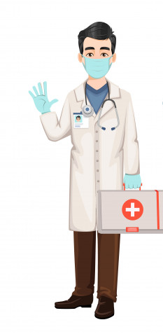
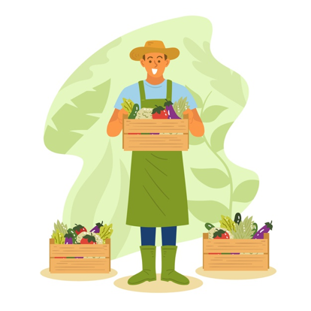
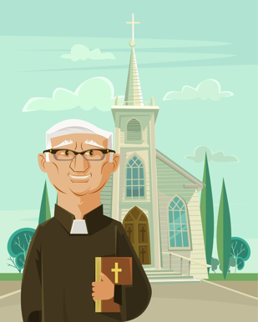
Sat.
Saturday
a doctor
a farmer
a pastor

Slide 10
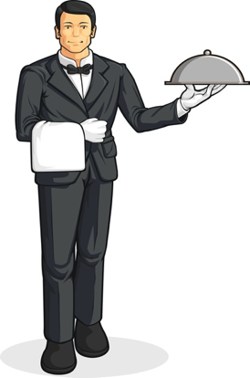
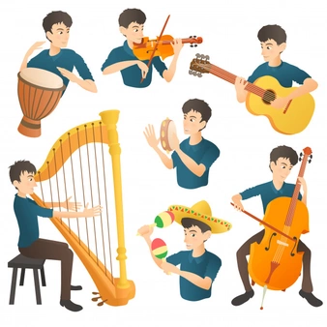

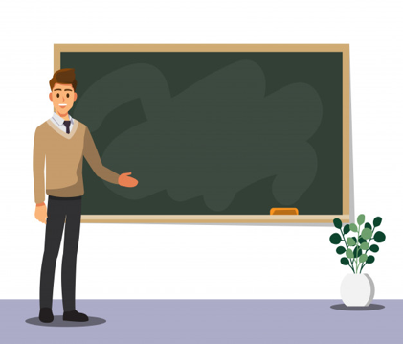
a server
a musician
a nurse
a teacher

Slide 11
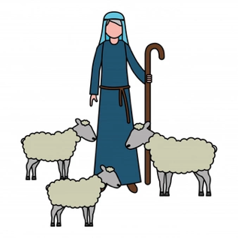
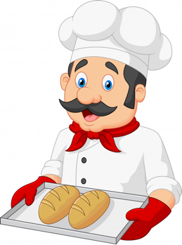

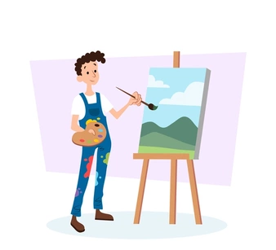
a shepherd
a baker
a store owner
an artist

Slide 12




an engineer
on
in
out of

Slide 13




around
in front of
behind
above

Slide 14




below
beside
between
at

Slide 15




across
a grocery store
a hair salon
a bank

Slide 16
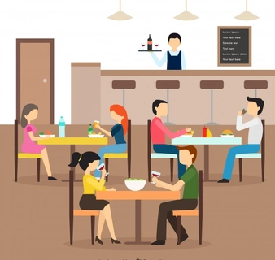
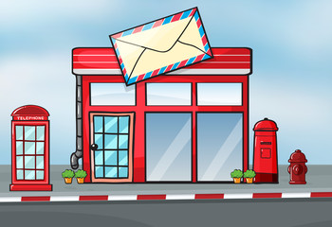


a restaurant
a post office
a park
a kid

Slide 17

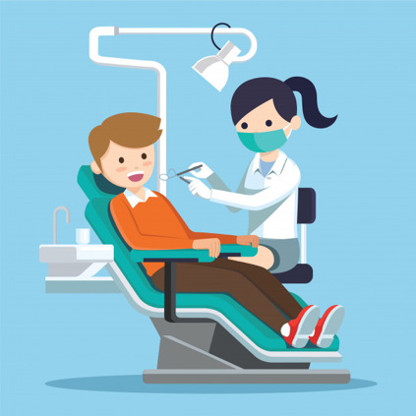


a library
a doctor’s office
a bakery
a dentist’s office

Slide 18


a pharmacy
north
south
east

Slide 19
west
right
left
an intersection

Slide 20
to turn
near
far
ugly

Slide 21



beautiful
a morning
an afternoon
an evening

Slide 22




fire
glasses
blood
a heart

Slide 23

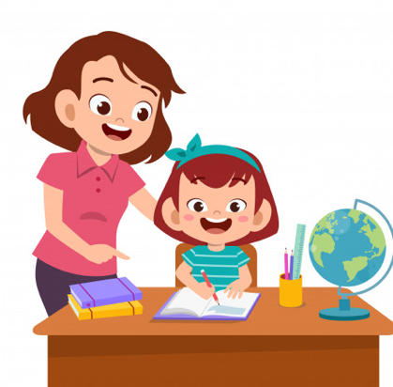
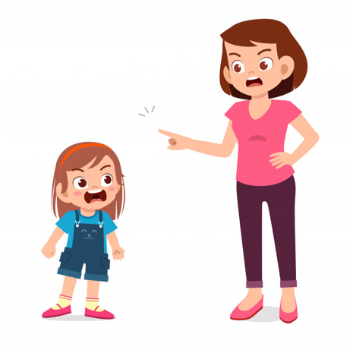
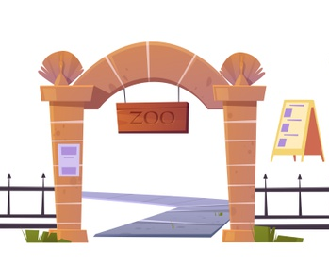
to change
to obey
to disobey
an entrance

Slide 24

an exit

Slide 25
Acknowledgements
We would like to thank the entire Light of the World volunteer team for their hard work and creativity in making this project possible. For all those around the world who prayed, wrote, edited, narrated, illustrated, sang, tested, and gave generously for this curriculum, we appreciate you sharing the love of Jesus through the gift of English. Our team members include:
Anonymous
Jean Ato
Bradley Baurain
Joshua Blake
Rachael Braggs
Larry Buell
Cindy Campbell
Christian Cha
Olivia Cheney
Hannah Clark
Nancy Cobb
Emily Cox
Marilyn Dano
Susanna Diallo
Alyssa Dokolas
Hephzi Davidson
EasyReadEnglish.com
Don Edic
Peggy Fergus
MaryBeth Gahan
Melina Gallo
Alicia Gentile
Prakash Chandra Giri
Ellenor Gopal
Jill Gramzow
Rachel Grijincu
Carol Hale
Emily Hamilton
Patty Hickman
Lyudmila Ivanyuk
Debbie Johnson
Carey Jo Johnston
Nancy Kingdon
Dorothy Konadu
Macy Lake
Martha Lane
Audrey Larsen
Tai Young Lee
Aden Lewis
Bruce Lewis
Elena Lewis
James Lewis
Micah Beth Lewis
Tim Lewis
Ward Lewis
Johnny Lukashevich
Gail MacMillan
Ivan Mader
Amy Martin
Diana Martz
Christy McPherson
Tracy Meddaugh
Barbara Newsome
Brenda Nielsen
Danielle Nowe
Deborah O’Donnell
Georg Ort
Martha Ort
Deb Payne
Linda Petrie
Joan Phelps
Sara Scazzero
Hannah Schmokel
Ashlyn Shrimplin
Macie Stuckman
Leah Sprague
Ellie Talalight
Peter Talalight
Weston Talalight
Rachel Tamang
Darrell Turner
Graham Whitmore
Cheri Wilke
Mackenzie Williams
Muchun Yin
Ted York
Anita Zeifert
For more information, visit LiteracyInternational.net
©2020-2022 Literacy International

