Slide 1
Vocabulary Flashcards Units A1-29 to A1-35
©2020-2022 Literacy International

Slide 2
How to Use the Flashcards
Download file in PowerPoint.
Play in Slide Show mode.
Click once to hear the audio.
Click again to see the word.
Try to say the words without listening.
Try to spell the words without reading.
You may also print, cut, and fold to make paper flashcards. (Print 1 slide per page, landscape).
Have fun, and may the Lord bless you!
©2020-2022 Literacy International
©2020-2022 Literacy International

Slide 3
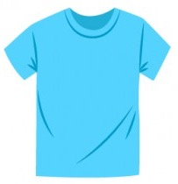
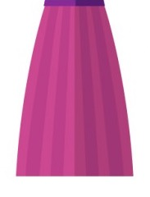
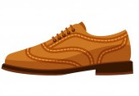
a t-shirt
a dress
a skirt
a shoe
©2020-2022 Literacy International

Slide 4
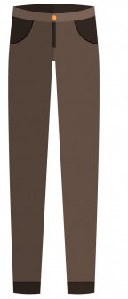
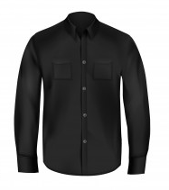
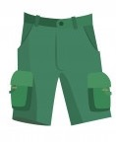
shorts
pants
a jacket
a black shirt
©2020-2022 Literacy International

Slide 5
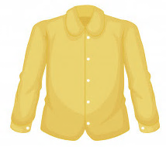
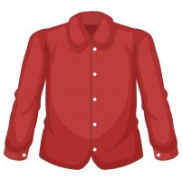
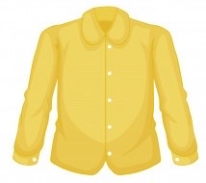
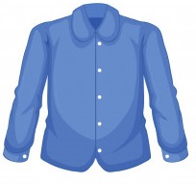
a white shirt
a red shirt
a yellow shirt
a blue shirt
©2020-2022 Literacy International

Slide 6
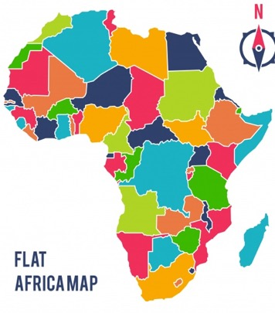
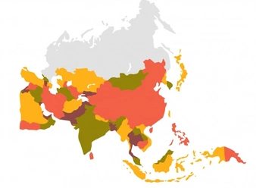
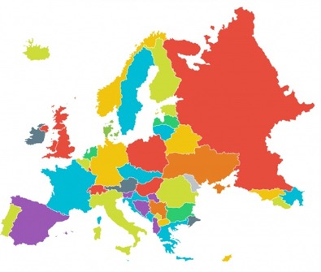
Africa
Asia
Australia
Europe
©2020-2022 Literacy International

Slide 7
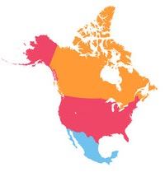
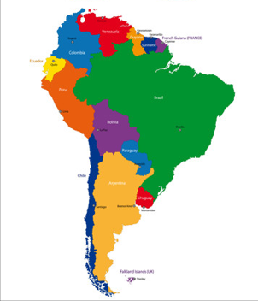
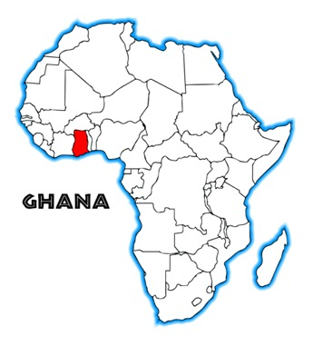
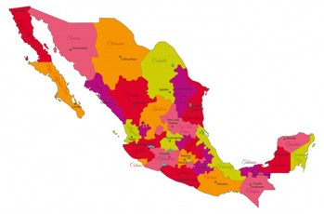
North America
South America
Ghana
Mexico
©2020-2022 Literacy International

Slide 8
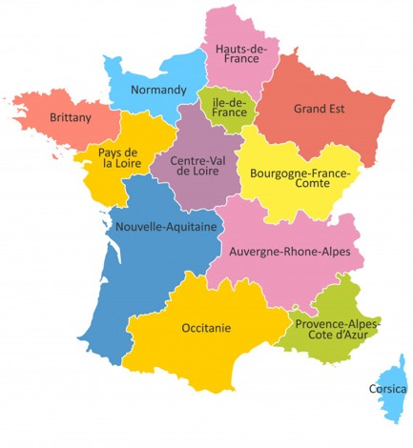
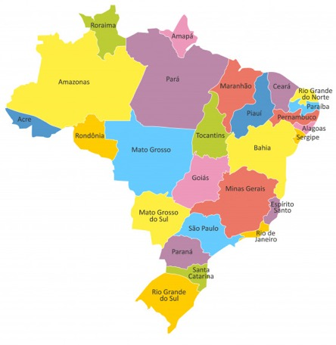
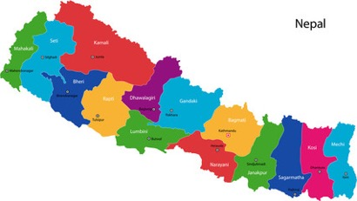
Nepal
France
Brazil
Switzerland
©2020-2022 Literacy International

Slide 9
a lake
a mountain
a river
a valley
©2020-2022 Literacy International

Slide 10
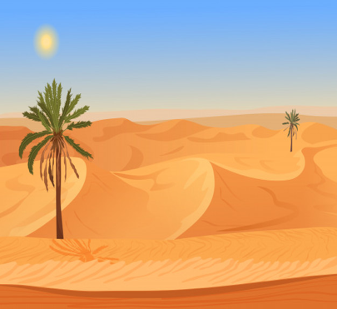
a forest
a meadow
a desert
a beach
©2020-2022 Literacy International

Slide 11
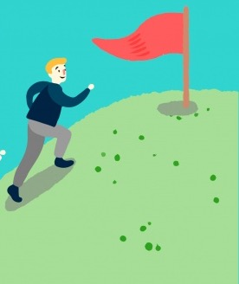
a city
a hill
a tourist
to climb
©2020-2022 Literacy International

Slide 12
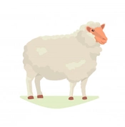
a bird
a sheep
an insect
a flower
©2020-2022 Literacy International

Slide 13
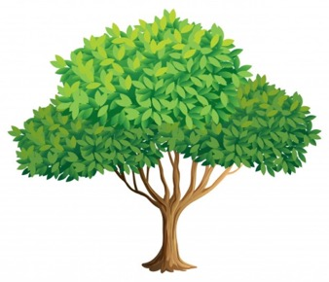
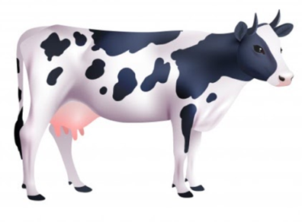
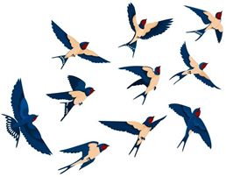
a tree
a leaf
a cow
a flock
©2020-2022 Literacy International

Slide 14
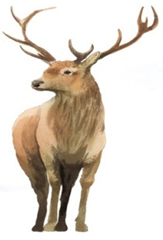
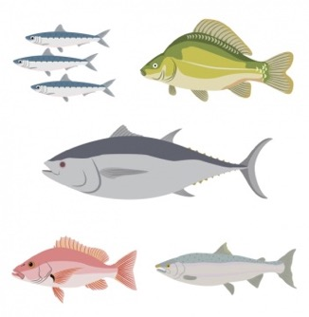
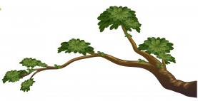
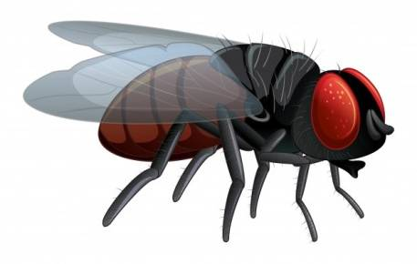
a branch
a deer
fish
a fly
©2020-2022 Literacy International

Slide 15
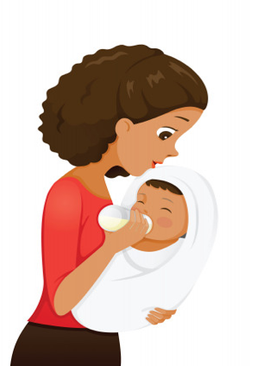
to feed
to shop
to go
to come
©2020-2022 Literacy International

Slide 16
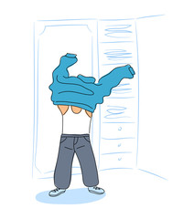
to use
to give
to take
to get dressed
©2020-2022 Literacy International

Slide 17
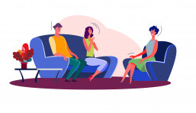
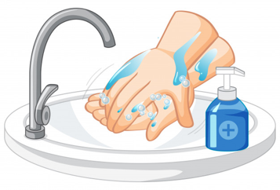
to blow
to celebrate
to visit
to wash
©2020-2022 Literacy International

Slide 18
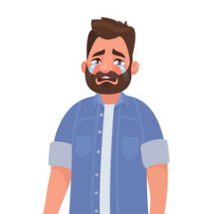
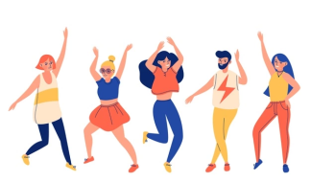
I sinned.
to worship
to confess
to cry
to dance
©2020-2022 Literacy International

Slide 19
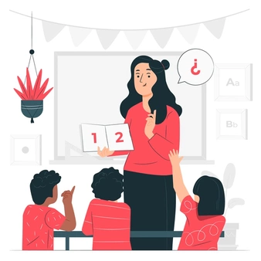
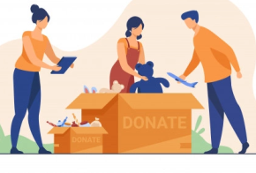
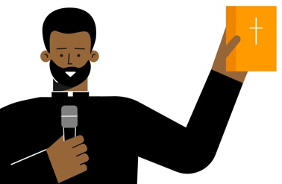
to teach
to preach
to kneel
to donate
©2020-2022 Literacy International

Slide 20
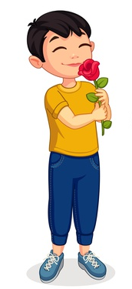
You are so good!
to praise
holy communion
to smell
to sneeze
©2020-2022 Literacy International

Slide 21
Acknowledgements
We would like to thank the entire Light of the World volunteer team for their hard work and creativity in making this project possible. For all those around the world who prayed, wrote, edited, narrated, illustrated, sang, tested, and gave generously for this curriculum, we appreciate you sharing the love of Jesus through the gift of English. Our team members include:
Sara Scazzero
Hannah Schmokel
Ashlyn Shrimplin
Macie Stuckman
Leah Sprague
Ellie Talalight
Peter Talalight
Weston Talalight
Rachel Tamang
Darrell Turner
Graham Whitmore
Cheri Wilke
Mackenzie Williams
Muchun Yin
Ted York
Anita Zeifert
Anonymous
Jean Ato
Bradley Baurain
Joshua Blake
Rachael Braggs
Larry Buell
Cindy Campbell
Christian Cha
Olivia Cheney
Hannah Clark
Nancy Cobb
Emily Cox
Marilyn Dano
Susanna Diallo
Alyssa Dokolas
EasyReadEnglish.com
Don Edic
Peggy Fergus
MaryBeth Gahan
Melina Gallo
Alicia Gentile
Prakash Chandra Giri
Ellenor Gopal
Jill Gramzow
Rachel Grijincu
Carol Hale
Emily Hamilton
Patty Hickman Lyudmila Ivanyuk
Debbie Johnson
Carey Jo Johnston
Nancy Kingdon
Dorothy Konadu
Macy Lake
Martha Lane
Audrey Larsen
Tai Young Lee
Aden Lewis
Bruce Lewis
Elena Lewis
James Lewis
Micah Beth Lewis
Tim Lewis
Ward Lewis
Johnny Lukashevich
Gail MacMillan
Ivan Mader
Amy Martin
Diana Martz
Christy McPherson
Tracy Meddaugh
Barbara Newsome
Brenda Nielsen
Danielle Nowe
Deborah O’Donnell
Georg Ort
Martha Ort
Deb Payne
Linda Petrie
Joan Phelps
For more information, visit LiteracyInternational.net
©2020-2022 Literacy International

