Slide 1
Vocabulary Flashcards Units A1-36 to A1-42
©2020-2022 Literacy International

Slide 2
How to Use the Flashcards
Download file in PowerPoint.
Play in Slide Show mode.
Click once to hear the audio.
Click again to see the word.
Try to say the words without listening.
Try to spell the words without reading.
You may also print, cut, and fold to make paper flashcards. (Print 1 slide per page, landscape).
Have fun, and may the Lord bless you!
©2020-2022 Literacy International
©2020-2022 Literacy International

Slide 3
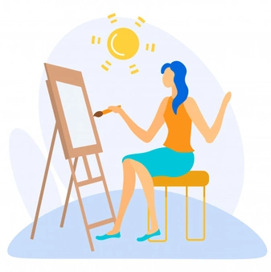
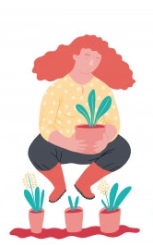
to cook
to paint
to drive
to plant

Slide 4
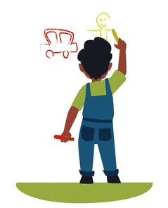
to draw
to fix
to run
to swim

Slide 5
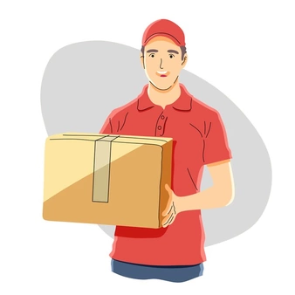
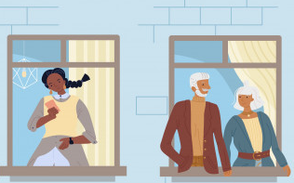
to play
to jump
to carry
a neighbor

Slide 6
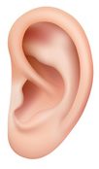
an eye
an ear
a nose
a mouth

Slide 7
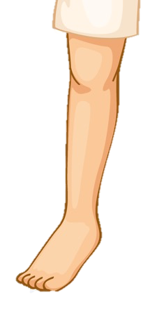
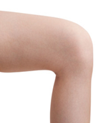
a leg
a knee
a foot
a toe

Slide 8
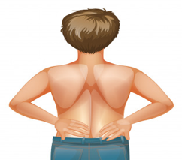
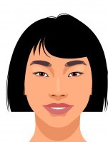
an arm
a back
a head
to wait

Slide 9
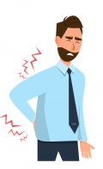
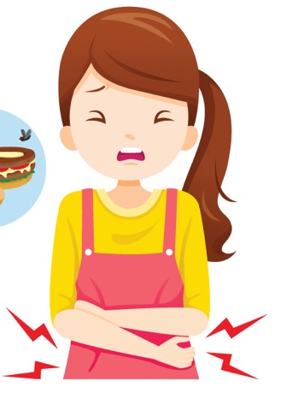
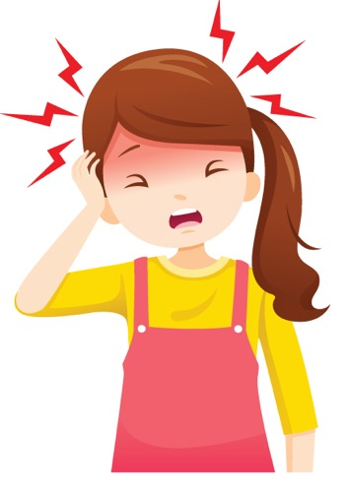
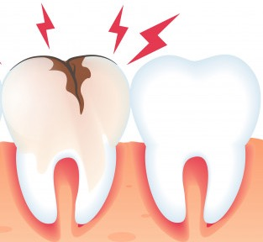
a toothache
a stomach-ache
a headache
a backache

Slide 10
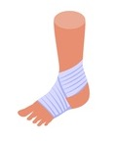
a fever
a cold
healthy
to sprain

Slide 11
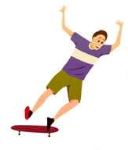
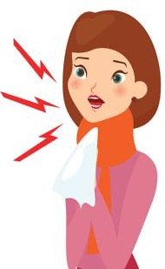
to break
to fall
to cough
to cut

Slide 12
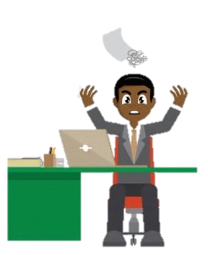
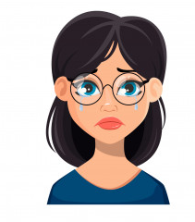
happy
sad
angry
calm

Slide 13
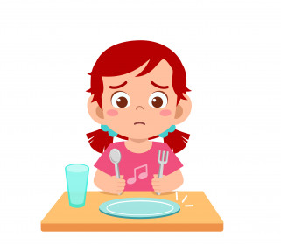
in prison
free
hungry
full

Slide 14
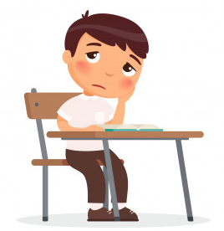
tired
energetic
bored
interested

Slide 15
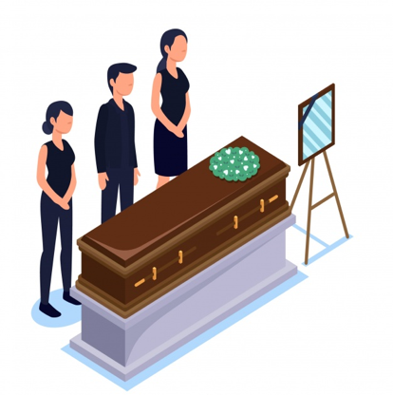
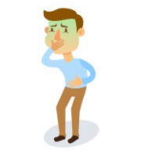
to get sick
to get well
to die
to get married

Slide 16
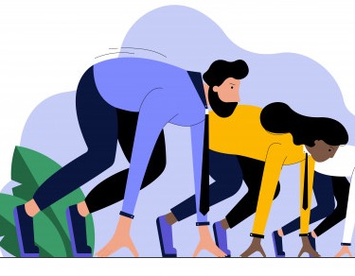
to divorce
to graduate
to serve
to start

Slide 17
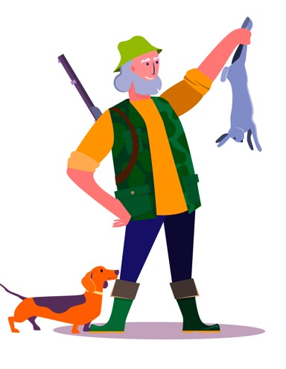
to leave
to pass
to join
to kill

Slide 18
hard
soft
hot
cold

Slide 19
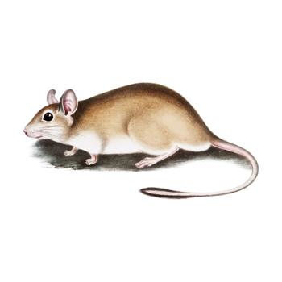
tall
short
big
small

Slide 20
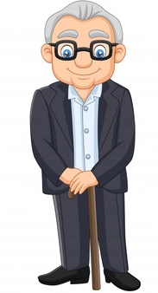
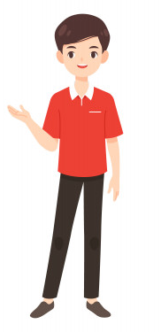
old
young
up
down

Slide 21
Acknowledgements
We would like to thank the entire Light of the World volunteer team for their hard work and creativity in making this project possible. For all those around the world who prayed, wrote, edited, narrated, illustrated, sang, tested, and gave generously for this curriculum, we appreciate you sharing the love of Jesus through the gift of English. Our team members include:
Sara Scazzero
Hannah Schmokel
Ashlyn Shrimplin
Macie Stuckman
Leah Sprague
Ellie Talalight
Peter Talalight
Weston Talalight
Rachel Tamang
Darrell Turner
Graham Whitmore
Cheri Wilke
Mackenzie Williams
Muchun Yin
Ted York
Anita Zeifert
Anonymous
Jean Ato
Bradley Baurain
Joshua Blake
Rachael Braggs
Larry Buell
Cindy Campbell
Christian Cha
Olivia Cheney
Hannah Clark
Nancy Cobb
Emily Cox
Marilyn Dano
Susanna Diallo
Alyssa Dokolas
EasyReadEnglish.com
Don Edic
Peggy Fergus
MaryBeth Gahan
Melina Gallo
Alicia Gentile
Prakash Chandra Giri
Ellenor Gopal
Jill Gramzow
Rachel Grijincu
Carol Hale
Emily Hamilton
Patty Hickman Lyudmila Ivanyuk
Debbie Johnson
Carey Jo Johnston
Nancy Kingdon
Dorothy Konadu
Macy Lake
Martha Lane
Audrey Larsen
Tai Young Lee
Aden Lewis
Bruce Lewis
Elena Lewis
James Lewis
Micah Beth Lewis
Tim Lewis
Ward Lewis
Johnny Lukashevich
Gail MacMillan
Ivan Mader
Amy Martin
Diana Martz
Christy McPherson
Tracy Meddaugh
Barbara Newsome
Brenda Nielsen
Danielle Nowe
Deborah O’Donnell
Georg Ort
Martha Ort
Deb Payne
Linda Petrie
Joan Phelps
For more information, visit LiteracyInternational.net
©2020-2022 Literacy International

