Slide 1
Vocabulary Flashcards Units A1-43 to A1-49
©2020-2022 Literacy International

Slide 2
How to Use the Flashcards
Download file in PowerPoint.
Play in Slide Show mode.
Click once to hear the audio.
Click again to see the word.
Try to say the words without listening.
Try to spell the words without reading.
You may also print, cut, and fold to make paper flashcards. (Print 1 slide per page, landscape).
Have fun, and may the Lord bless you!
©2020-2022 Literacy International
©2020-2022 Literacy International

Slide 3
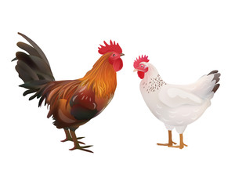
a backpack
a chicken
thick
thin

Slide 4
to leave
long
correct
wrong

Slide 5
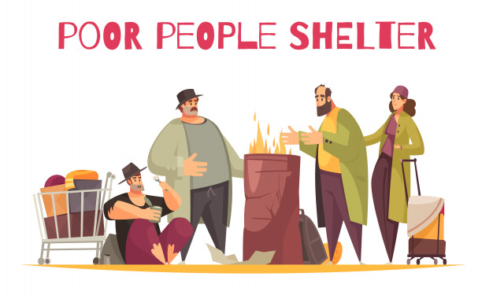
weak
strong
rich
poor

Slide 6
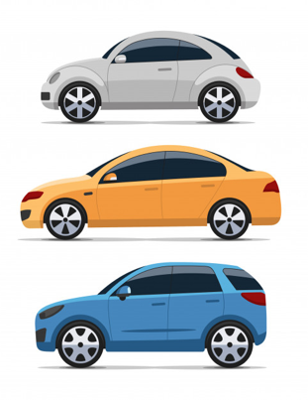
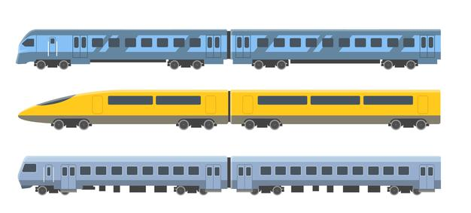
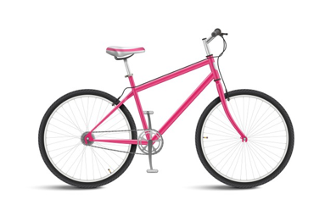
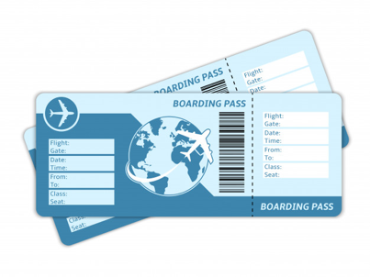
a bicycle
a ticket
a car
a train

Slide 7
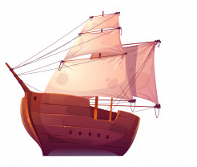
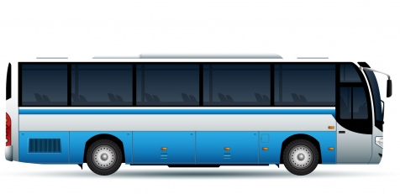
a bus
a motorcycle
an airplane
to sail

Slide 8
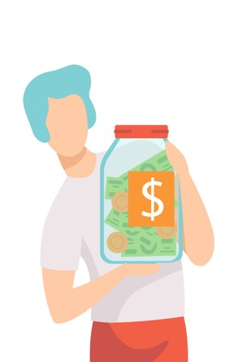
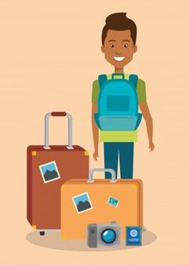
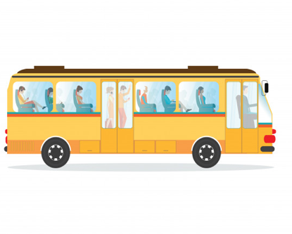
to ride
to spend
to save
to travel

Slide 9
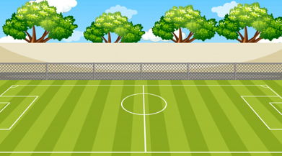
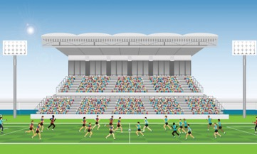
a field
a stadium
a student
a street

Slide 10
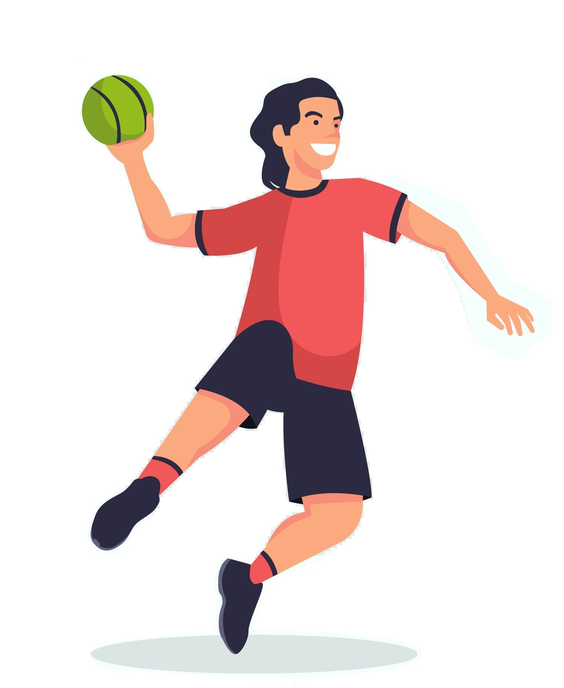
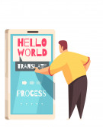
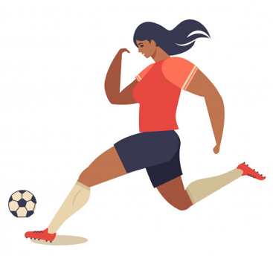
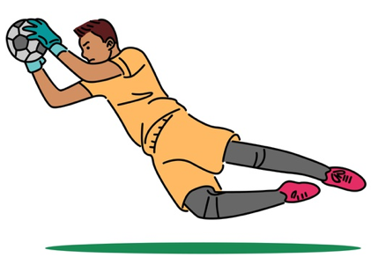
to throw
to catch
to kick
to practice

Slide 11
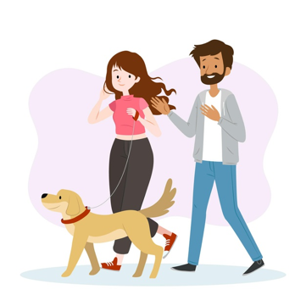
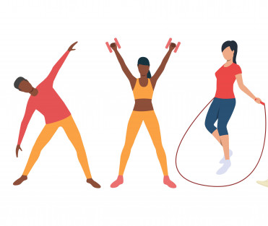
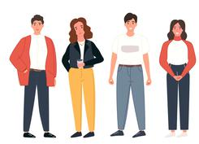
to exercise
to stand
to study
to walk

Slide 12
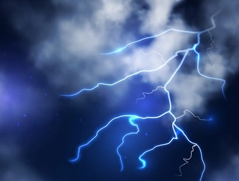
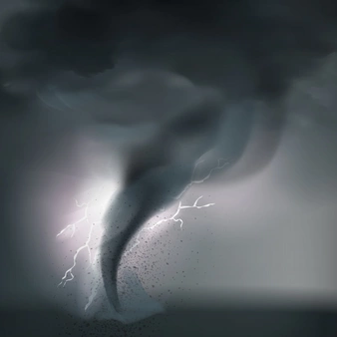
a cloud
a storm
a season
a tornado

Slide 13
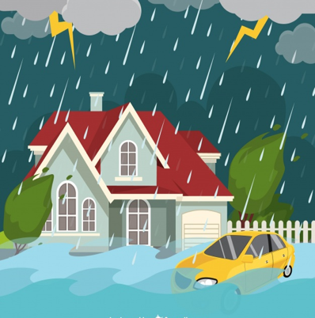
a flood
a drought
the wind
to rain

Slide 14
wet
dry
to snow
to golf

Slide 15
an assignment
an experiment
a computer
a list

Slide 16
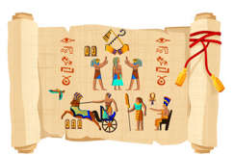
a primary/
grade school
a secondary/ high school
a university/
college
history

Slide 17
math
science
a diploma
to post

Slide 18
a cake
a glass
fireworks
a ribbon

Slide 19
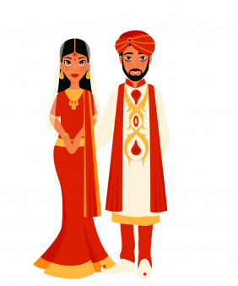
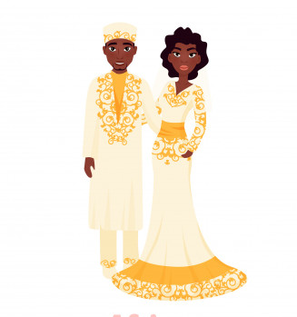
a groom
a bride
a gate
a party

Slide 20
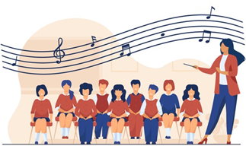
a balloon
to lift
a gift
music

Slide 21
Acknowledgements
We would like to thank the entire Light of the World volunteer team for their hard work and creativity in making this project possible. For all those around the world who prayed, wrote, edited, narrated, illustrated, sang, tested, and gave generously for this curriculum, we appreciate you sharing the love of Jesus through the gift of English. Our team members include:
Sara Scazzero
Hannah Schmokel
Ashlyn Shrimplin
Macie Stuckman
Leah Sprague
Ellie Talalight
Peter Talalight
Weston Talalight
Rachel Tamang
Darrell Turner
Graham Whitmore
Cheri Wilke
Mackenzie Williams
Muchun Yin
Ted York
Anita Zeifert
Anonymous
Jean Ato
Bradley Baurain
Joshua Blake
Rachael Braggs
Larry Buell
Cindy Campbell
Christian Cha
Olivia Cheney
Hannah Clark
Nancy Cobb
Emily Cox
Marilyn Dano
Susanna Diallo
Alyssa Dokolas
EasyReadEnglish.com
Don Edic
Peggy Fergus
MaryBeth Gahan
Melina Gallo
Alicia Gentile
Prakash Chandra Giri
Ellenor Gopal
Jill Gramzow
Rachel Grijincu
Carol Hale
Emily Hamilton
Patty Hickman Lyudmila Ivanyuk
Debbie Johnson
Carey Jo Johnston
Nancy Kingdon
Dorothy Konadu
Macy Lake
Martha Lane
Audrey Larsen
Tai Young Lee
Aden Lewis
Bruce Lewis
Elena Lewis
James Lewis
Micah Beth Lewis
Tim Lewis
Ward Lewis
Johnny Lukashevich
Gail MacMillan
Ivan Mader
Amy Martin
Diana Martz
Christy McPherson
Tracy Meddaugh
Barbara Newsome
Brenda Nielsen
Danielle Nowe
Deborah O’Donnell
Georg Ort
Martha Ort
Deb Payne
Linda Petrie
Joan Phelps
For more information, visit LiteracyInternational.net
©2020-2022 Literacy International

