Slide 1


Unit A2-33
©2020-2026 Light of the World Learning
Notes:
Teacher’s Notes:
Bible Reading: The Servant Who Wouldn’t Forgive
Matthew 18:21-35
Theme: Food
Pronunciation: /oo/ spelled u and /u/ spelled o
Grammar: Apologize and Forgive. Irregular verbs.
Preparation:
Pray
Read the Bible passages.
Preview slides and game.
Optional: Bring samples of food, plates, and restaurant menus.

Slide 2
Pray, Review, and Preview
Bible Reading: The Servant Who Did Not Forgive
Matthew 18:21-35
Theme: Food & Drink
Pronunciation: /oo/ spelled u and /u/spelled o
Grammar: Apologize and Forgive. Irregular verbs.
Notes:
Pray
Pray for the class. You may want to thank the Lord for the wonderful variety of food and drink that he created for us to enjoy.
Check Homework and Review
Ask students to read aloud or recite their homework from the last class. Check written work.
Be sure they have read Matthew 18:21-35; in their first languages in preparation for the lesson.
Review the main points of the previous lesson and ask if there are any questions.

Slide 3
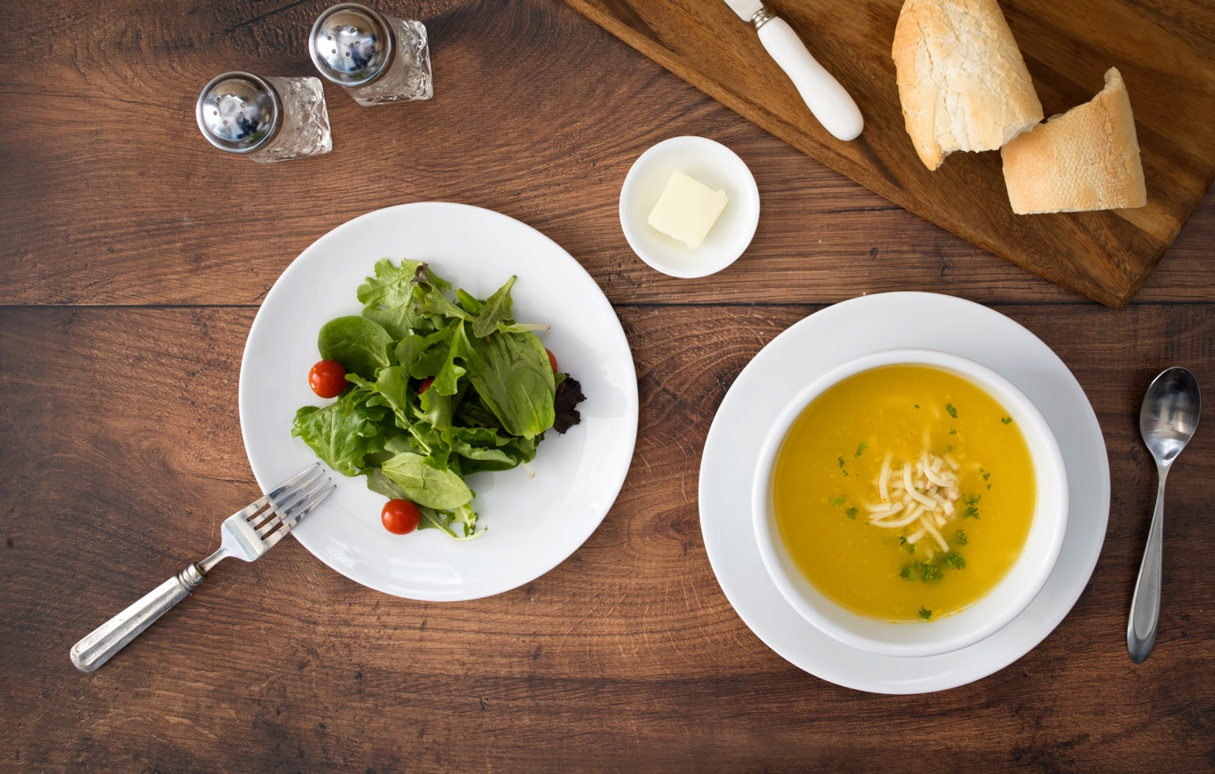
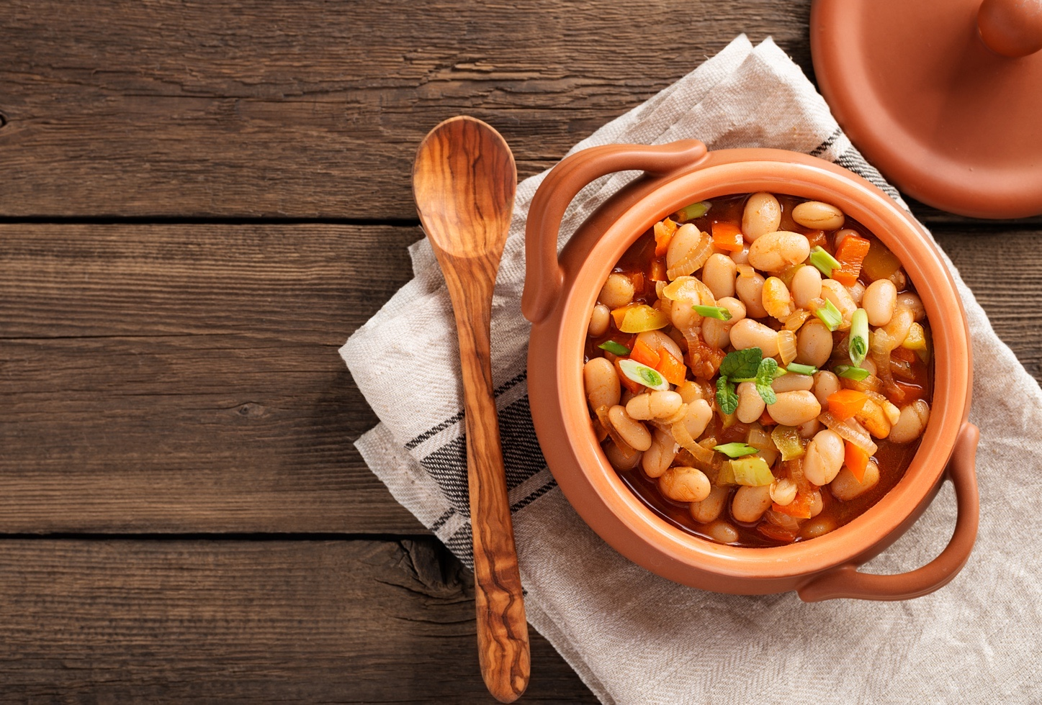
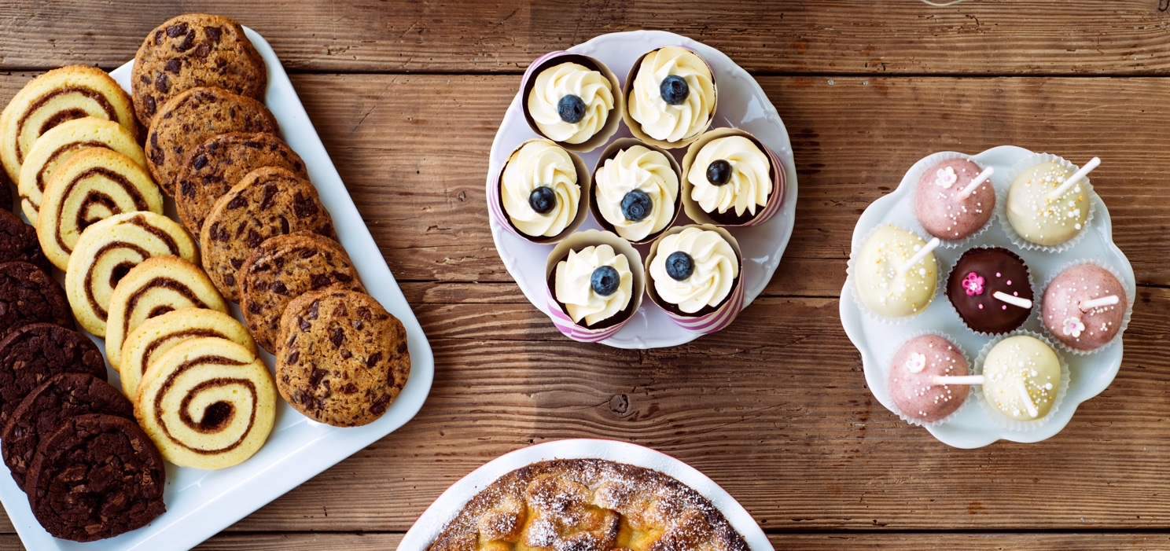
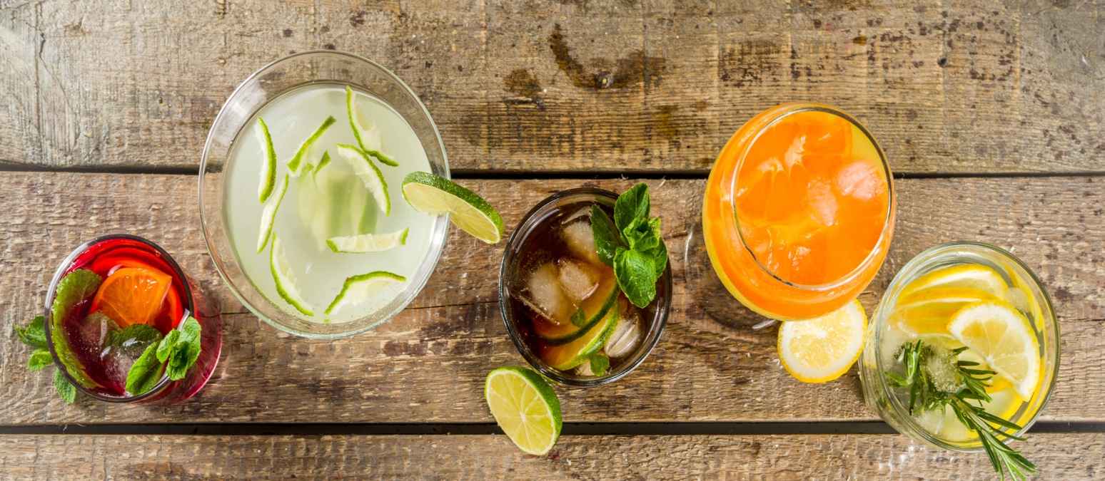
What would you like?
Notes:
1A. Discuss Theme Picture
Ask “What would you like to eat or drink from this picture?” and “What else?” to elicit vocabulary they already know.
Repeat and write their words or show the words on the next slide.
Answers may include: soda, chocolate, wine, soup, salad, beans, beef, dessert etc.
More advanced students can be encouraged to make complete sentences:
I would love to have the beans and a glass of fruit juice. I’d like the chocolate cookies and the soup.

Slide 4



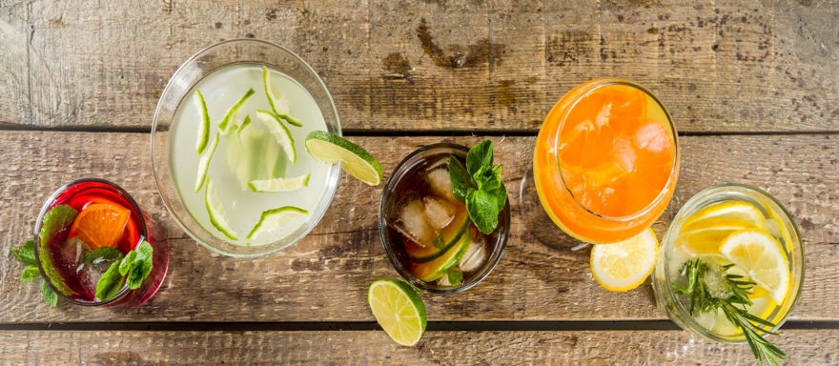
Hey folks! Welcome to Ricky’s Restaurant. My name is Sonny, and I will be your server. Our specials today are: tasty chicken soup, fresh green garden salad, and spicy beef with beans. I’m sorry we just ran out of sweet and sour shrimp. It always sells out quickly. But be sure to save room for our famous chocolate desserts!
To drink we have water, soda, juice, and wine. I’ll let you look over the menu now. When you are ready to order, just let me know! Enjoy your meal!
Notes:
1B. Read about the Theme Picture
Please read the description of the theme picture to the students and point to the pictured vocabulary. If students ask about words, give simple definitions.
Practice of vocabulary begins with the following slide.

Slide 5
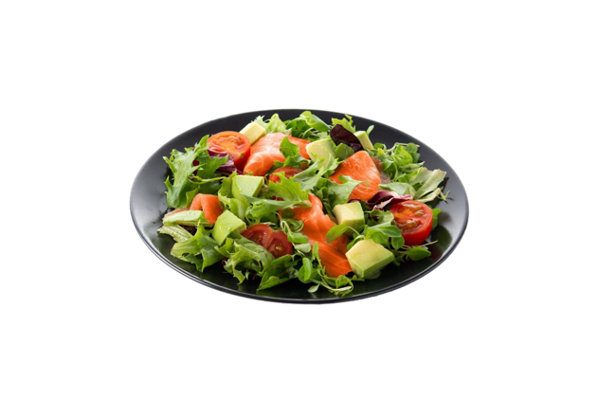
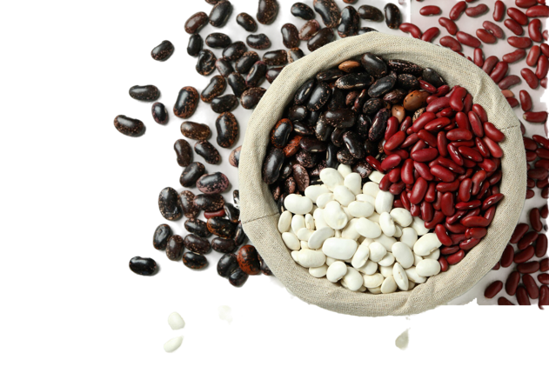

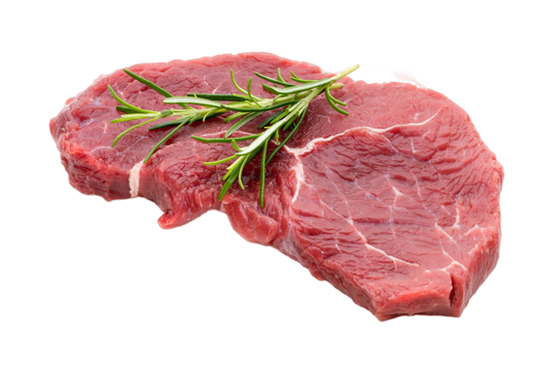
Match the beginning and end of each sentence.
A salad is healthy food
2. Beans are a type
3. Beef is the
4. We can eat soup
A. of seed that grow in pods.
B. with a spoon.
C. because it is made with fresh vegetables.
D. meat of cows.
Notes:
2A. Vocabulary
1. Say the beginning of the sentence a few times, as you indicate the picture. For example, say, ”We can eat soup, We can eat soup.” Have your students then repeat the phrase after you a few times.
2. Ask students to match the beginning and end of each sentence and say the complete sentence. For example, ”We can eat soup with a spoon.”
3. Check students’ comprehension further by asking direct questions. For example, “What kind of soup do you like to eat?”
Answers
1. C
2. A
3. D
4. B

Slide 6

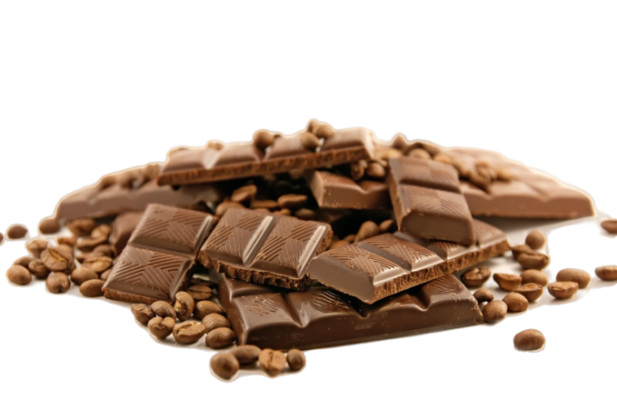
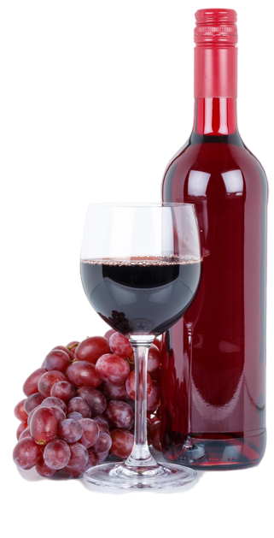
Match the beginning and end of each sentence.
5. A soda is a
6. Chocolate is made
7. Wine comes
8. After dinner we eat a dessert, like
E. from cocoa beans.
F. cookies, donuts or cake.
G. sweet, fizzy drink such as cola.
H. from grapes.
Notes:
2B. Vocabulary
1. Say the beginning of the sentence a few times, as you indicate the picture. For example “A soda, a soda.” Have your students then repeat the phrase after you a few times.
2. Ask students to match the beginning and end of each sentence and say the complete sentence. For example, ”A soda is a sweet, fizzy drink such as cola.”
3. Check students’ comprehension further by asking direct questions. For example, “What kind of desserts do you enjoy?”
Answers
5. G
6. E
7. H
8. F

Slide 7
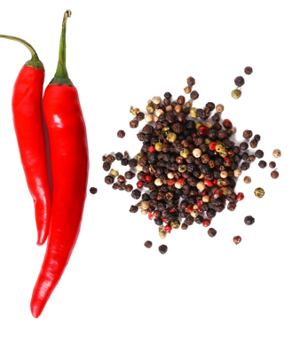
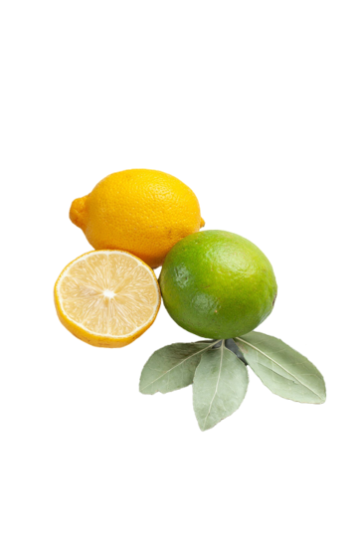
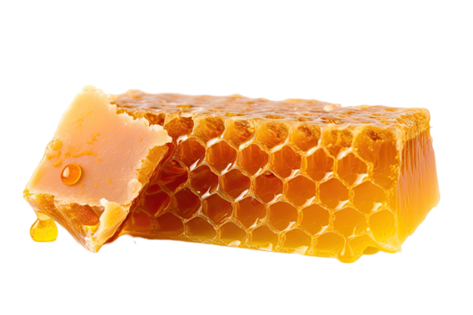
Match the beginning and end of each sentence.
9. Spicy food has
10. Lemons and limes
11. Bees make
12. I order food
I. are sour tasting fruits.
J. honey that tastes sweet.
from the server at the cafe.
strong flavor from spices or hot peppers.
Notes:
2C. Vocabulary
1. Say the beginning of the sentence a few times, as you indicate the picture. For example, say, ”I order food, I order food.” Have your students then repeat the phrase after you a few times.
2. Ask students to match the beginning and end of each sentence and say the complete sentence. For example, “I order food from the server at the cafe.”
3. Check students’ comprehension further by asking direct questions. For example, “Do you prefer sweet or spicy food?”
Answers
9. L
10. I
11. J
12. K

Slide 8
How to Apologize
 | 1. Apologize. | 2. Confess what you did wrong. | 3. Promise what you will do in the future.
A. | I’m sorry. | I don’t have the money I owe you. | I’ll pay you next week.
B. | I apologize. | I told you a lie. | I won’t lie again.
C. | Please forgive me. | I ate all your chocolate candy. | I’ll buy you a new box.
Notes:
2D. Grammar
Apologizing
When we do something wrong we need to apologize. This chart shows the steps of a basic apology.
Model, Repeat, and Solo all forms shown on the chart.

Slide 9
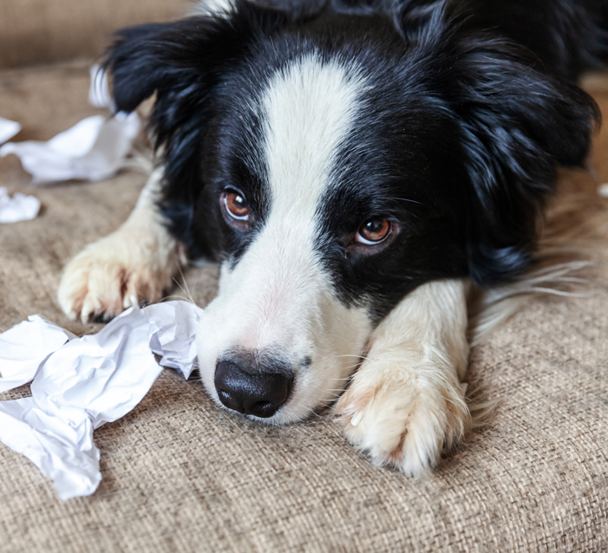
How to Accept an Apology
1. Respond | 2. Forgive
Thank you for apologizing. | I forgive you.
I understand. It is okay. | I accept your apology.
I’m very sorry. I don’t have my homework today. My dog chewed it. I will do it tomorrow.
Thank you for apologizing. I forgive you.
Notes:
2E. Grammar
Accepting Apologies.
When someone apologizes we need to forgive them. This chart shows the basic steps of accepting an apology.
Model, Repeat, and Solo all forms shown on the chart. Then practice the conversation with person A apologizing and person B forgiving.

Slide 10


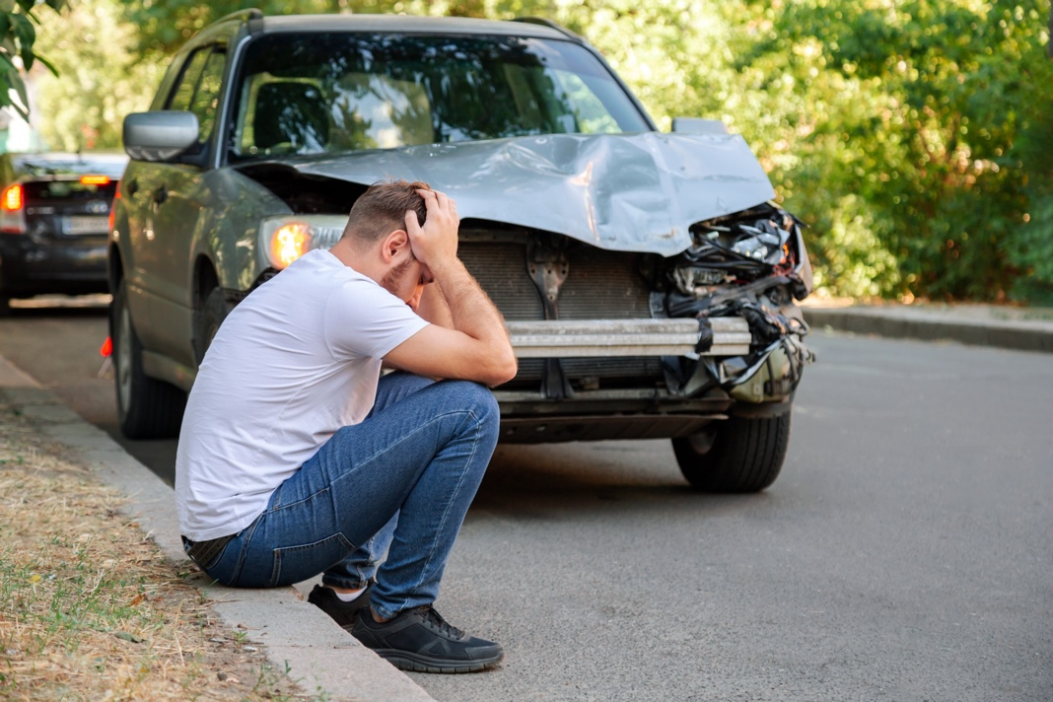
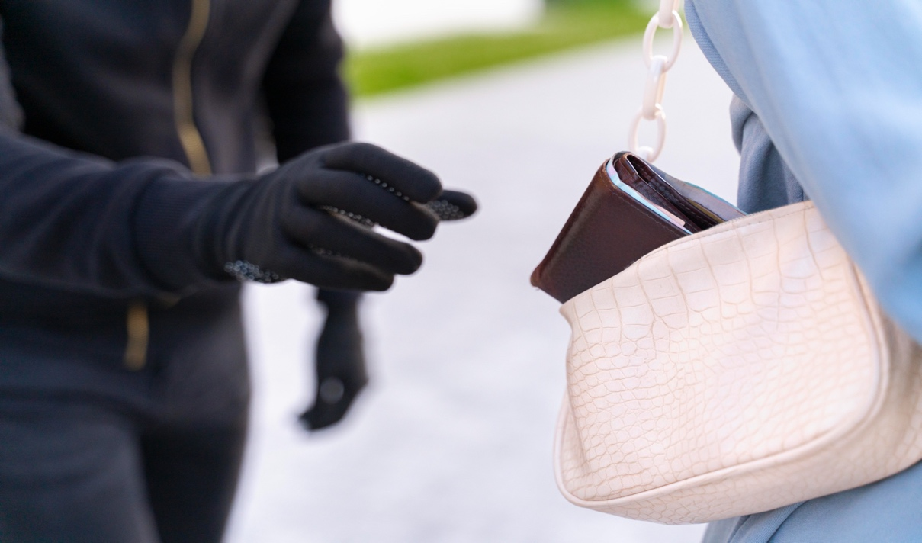
Practice apologizing and forgiving.
1
2
3
4
Notes:
2F. Grammar
Discuss the problem in each picture. Who needs to apologize and why?
Students will practice in pairs apologizing (person A) and forgiving (person B) for each situation.
Answers will vary but may include:
1A. I’m sorry I laughed at you. I was rude to you and I won’t do it again. Please forgive me.
1B. I was hurt but I accept your apology.
2A. I apologize because I left a mess in the kitchen. I will clean it up. Please forgive me.
2B. I understand. Thank you for cleaning it up. I forgive you.
3A. I’m sorry I damaged your car. I will pay to fix it. Please forgive me.
3B.Thank you for offering to pay. I forgive you.
4A. I’m sorry I stole your wallet. I will return it. Please forgive me.
4B. Thank you for apologizing. I accept your apology.

Slide 11
Irregular Verbs. Tell what you did last week.
 | Base form | Simple past | Simple Past Tense Sentence
1 | put | put | I put a lot of honey in the dessert.
2 | read /rEd/ | read /red/
3 | run | ran
4 | say | said
5 | see | saw
Notes:
2G. Grammar
Irregular simple past verbs
Irregular verbs do not form the simple past tense by adding -ed to the end. There is no pattern to form irregular simple past tense verbs. They just need to be memorized. Note that the word “read” is spelled the same in the present and past but pronounced differently.
Model, Repeat, and Solo the pronunciation of all forms shown on the chart. Then ask students to fill in past tense sentences about what they did last week. Answers will vary but should use the irregular past tense verbs.

Slide 12
Irregular verbs. Tell what you did last month.
 | Base form | Simple past | Simple Past Tense Sentence
6 | sell | sold | I sold sweet ice cream from a cart.
7 | send | sent
8 | sing | sang
9 | sit | sat
10 | sleep | slept
Notes:
2H. Grammar
Irregular simple past verbs
Irregular verbs do not form the simple past tense by adding -ed to the end. There is no pattern to form irregular simple past tense verbs. They just need to be memorized.
Model, Repeat, and Solo the pronunciation of all forms shown on the chart. Then ask students to fill in past tense sentences about what they did last month. Answers will vary but should use the irregular past tense verbs.

Slide 13

A. Oops! I broke your glass!
Oh no! It's my special wine glass. And now the tablecloth is stained.
I'm so sorry. I'll buy a new glass and clean the stain. Please forgive me.
B. It’s okay. I forgive you.
A. Thank you.
Listen and repeat.
Notes:
3 Conversation:
1. Model: Say both parts of the conversation several times. Use A and B cards, stick figures, or change your physical position to indicate the dual parts. Role-play the parts to convey the meaning of the conversation. Students are to watch and listen.
2. Repeat: Say one line at a time and have students repeat until they can be understood.
3. Solo: You begin the conversation and call on individual students to respond. Then reverse the roles (students are A, you are B).
4. Once students can do both parts, encourage free conversation (students substitute their own words for the blue words).

Slide 14
Listen and repeat.
1. /oo/ spelled u | 2. /u/ spelled o | 3. Challenge
sugar | son
put | honey
push | brother
pull | month
full | Monday
4. The son put some sugar in his mother’s tea.
5. I fully forgive my brothers who pushed me.
Notes:
4A. Pronunciation - Sound and Spelling
1. Model: Say the sound several times while pointing to it. (For example, point to the oo and say /oo/ /oo/ /oo/. Then say the sound and quickly read the entire list, pointing to each item as you read it (/oo/ sugar put push pull full). Students just watch and listen.
2. Repeat: Say the sound and each word several times, having students repeat each time after you in unison. Be sure to use your normal voice and rate of speed. Do one column at a time, top to bottom. Then read the sentences.
3. Solo: Call on individuals to say a sound and its word group. Give lots of praise. Then ask students to read the sentences.
4. Challenge: Choose another sound from the lesson that is challenging for your particular students to pronounce. Use words from this lesson and from previous lessons to make a group of 3-5 words. You may repeat the same challenging sounds in several lessons. Students need a lot of practice on sounds that do not exist in their first language.

Slide 15
Listen and repeat.
A. | B. | C.
tomatoes | soda | beef
example | salad | beans
delicious | spicy | soup
continue | sugar | wine
Forgive them. | order | slept
Notes:
4B. Pronunciation - Hum and clap the stress.
Begin by humming the stress of a column of words. Hum higher, longer, and louder for big dashes and lower, shorter, and quieter for small dashes.
You may use hand gestures to indicate that the stressed syllable is higher in pitch, longer in duration, and louder. Invite your students to join in humming the rhythm. Once the class is humming the rhythm in unison, you can begin saying the words. You may also wish to clap the syllables while you say the words.
1. Model: Hum and then say each word in the column several times. Students listen.
2. Repeat: Students repeat words after you in unison.
3. Solo: Call on individuals to read the entire column of words.

Slide 16
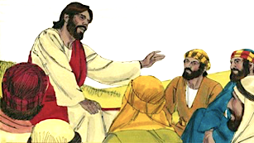
Read Matthew 18:21-35 in your language. Then read: The Servant Who Did Not Forgive.
One day, Peter came to Jesus and asked, “Lord, how many times do I have to forgive someone who sins
against me? Up to seven times?”
Jesus answered, “I tell you, you must forgive them more than seven times. You must continue to forgive them even if they sin against you seventy-seven times.”
By this, Jesus meant that we should always forgive. Then Jesus told this story:
© 2020-2026 Light of the World Learning
Notes:
5A. Bible Reading
Students should have already read this story in their first language (L1) as part of their homework, so it will be familiar even if they do not know all the vocabulary yet. However, if they have not yet read it in their L1, be sure they do so now before reading it in English. The hyperlinks of the Bible verses connect to https://live.bible.is/ so students can read and hear the scripture in their own languages.
A. Read the story out loud to the class.
B. If students ask about words, give simple definitions.
C. Encourage students to read aloud paragraphs from the story.
D. Ask if there are any questions or comments about the story.
E. Ask the story questions and discuss as a group.
F. Optional - You may hide the words and ask students to tell the story again in their own words, using the pictures to help them.

Slide 17
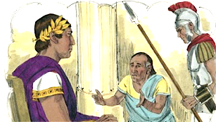
The kingdom of God is like a
king who decided to collect the money
his servants owed him. One of his
servants owed a huge debt worth more
than several thousand pounds of silver but he did not have enough money to pay this debt. So the king said, “Sell this man and everything he owns, even his wife and children, to pay his debt.”
The servant fell on his knees before the king and begged, “Please be patient with me. I will pay the full amount that I owe you.”
© 2020-2026 Light of the World Learning
Notes:
5B. Bible Reading
Students should have already read this story in their first language (L1) as part of their homework, so it will be familiar even if they do not know all the vocabulary yet. However, if they have not yet read it in their L1, be sure they do so now before reading it in English. The hyperlinks of the Bible verses connect to https://live.bible.is/ so students can read and hear the scripture in their own languages.
A. Read the story out loud to the class.
B. If students ask about words, give simple definitions.
C. Encourage students to read aloud paragraphs from the story.
D. Ask if there are any questions or comments about the story.
E. Ask the story questions and discuss as a group.
F. Optional - You may hide the words and ask students to tell the story again in their own words, using the pictures to help them.

Slide 18
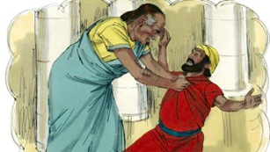
The king felt sorry for the servant, so he forgave all his debt. He let the servant go free and told him he did not have to pay.
But when the servant left the king, he
found another servant who owed him a hundred silver coins. The servant grabbed him around the neck and said, “Pay me the money you owe me!”
The other servant fell on his knees and begged him, “Please be patient with me. I will pay the full amount that I owe you.” But the first servant refused. He told the judge that the other servant owed him money and had him put in prison.
Notes:
5C. Bible Reading
Students should have already read this story in their first language (L1) as part of their homework, so it will be familiar even if they do not know all the vocabulary yet. However, if they have not yet read it in their L1, be sure they do so now before reading it in English. The hyperlinks of the Bible verses connect to https://live.bible.is/ so students can read and hear the scripture in their own languages.
A. Read the story out loud to the class.
B. If students ask about words, give simple definitions.
C. Encourage students to read aloud paragraphs from the story.
D. Ask if there are any questions or comments about the story.
E. Ask the story questions and discuss as a group.
F. Optional - You may hide the words and ask students to tell the story again in their own words, using the pictures to help them.

Slide 19
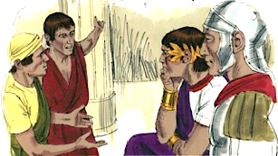
Some other servants saw what had happened and were very upset. They felt sorry for the man in prison. So they went to the king and told him everything that had happened.
The king called the servant and said, “You evil servant. You begged me to forgive your debt and I let you go without paying anything! You should have done the same. You should have given that other man who serves with you the same mercy and forgiveness I gave you.”
© 2020-2026 Light of the World Learning
Notes:
5D. Bible Reading
Students should have already read this story in their first language (L1) as part of their homework, so it will be familiar even if they do not know all the vocabulary yet. However, if they have not yet read it in their L1, be sure they do so now before reading it in English. The hyperlinks of the Bible verses connect to https://live.bible.is/ so students can read and hear the scripture in their own languages.
A. Read the story out loud to the class.
B. If students ask about words, give simple definitions.
C. Encourage students to read aloud paragraphs from the story.
D. Ask if there are any questions or comments about the story.
E. Ask the story questions and discuss as a group.
F. Optional - You may hide the words and ask students to tell the story again in their own words, using the pictures to help them.

Slide 20
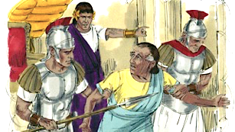
The king was so angry that he threw the evil servant into prison to be punished until he could pay back all of his debt.
After he told this story, Jesus said, “This is what my heavenly Father will do to every one of you if you do not forgive your brother from your heart. You must forgive your brother or sister with all your heart or my heavenly father will not forgive you.”
© 2020-2026 Light of the World Learning
Notes:
5E. Bible Reading
Students should have already read this story in their first language (L1) as part of their homework, so it will be familiar even if they do not know all the vocabulary yet. However, if they have not yet read it in their L1, be sure they do so now before reading it in English. The hyperlinks of the Bible verses connect to https://live.bible.is/ so students can read and hear the scripture in their own languages.
A. Read the story out loud to the class.
B. If students ask about words, give simple definitions.
C. Encourage students to read aloud paragraphs from the story.
D. Ask if there are any questions or comments about the story.
E. Ask the story questions and discuss as a group.
F. Optional - You may hide the words and ask students to tell the story again in their own words, using the pictures to help them.

Slide 21
Answer the questions.
What was Peter’s question to Jesus?
How many times did Peter think we should forgive?
What did Jesus mean by “Forgive seventy-seven times”?
What did the servant do after the king forgave him?
How do you think God feels when we refuse to forgive those who offend us?
Is there anyone you need to forgive?
Has God forgiven your sins? How many times?
© 2020-2026 Light of the World Learning
Notes:
5F. Bible Reading Questions
Ask the questions and discuss as a group. You may go back to the story to help students find the answer.
Answers:
How many times do I have to forgive someone who sins against me?
Peter wondered if we should forgive up to seven times.
He meant you should always forgive.
He found a man who owed him money and had him sent to prison.
He is angry.
Answers will vary for 6 and 7.

Slide 22
6A. Listen and answer the questions.
What was the problem with the coffee?
Why didn't the brother sleep well?
What did the sister say forgiveness is like?
How does the brother feel about his sons?
What are they going to do next Monday?
Notes:
6A. Activities – Listening to sound/spelling words /oo/ spelled u and /u/ spelled o.
Read the dialogue at least 2 times as students listen and answer the questions.
Script:
A: Hey, brother! How was your morning?
B: Hi, Sis! It was full of surprises. My son Stuart put too much sugar in my coffee and it tasted weird.
A: Oh no! Did you sleep well last night?
B: Not really. My other son kept me up with his snoring and then I slept too late.
A: That's tough. But you know, forgiveness can be like honey. It's sweet and good for you.
B: Yeah, I guess you're right. I love my sons but they can annoy me. I need to forgive my boys.
A: Exactly! And don’t push them too hard.
B: That's a good idea. Thanks for the advice.
A: No problem. Remember, forgiveness isn't always easy, but God forgives us!
B: You're so right. He does. By the way, have you tasted the sweet and sour, spicy noodles they sell at the market?
A: Yes, I tried them! They were so good. Want to grab some together next week?
B: Sure thing. Let's plan for it soon.
A: Great! Forgiveness and spicy noodles, what a combo!
B: Indeed! Let’s eat a full bowl of noodles next Monday.
Answers:
His son put too much sugar in the coffee.
His other son kept him up snoring.
3. Forgiveness is like honey.
4. The brother loves his sons.
5. They are going to eat a full bowl of noodles next Monday.

Slide 23
6B. Role Play – Restaurant Server
A.
Welcome! My name is ____, and I’ll be your server.
Can I get you something to drink? We have soda and wine.
Would you like a salad or soup to start?
Our special dish today is _____. Would you like to order?
Do you prefer your food extra spicy or mild?
What would you like for dessert?
Let me repeat your order to be sure it’s correct: _______
Can I get you anything else?
Did you enjoy your meal?
Notes:
6B. Activities – Pair work role-play part A.
Ask the students to role play the parts of a server and a customer by asking the questions to one another and answering them. Partner A is the server and asks the questions on this slide. Partner B is the customer and asks the questions on the next slide.
For extra fun, use props such as plates, forks, food, and play money.

Slide 24
6C. Role Play – Restaurant Customer
B.
What kind of soda do you have?
What kind of soup do you have?
Does the soup have beans in it?
What dish do you recommend?
May I have some more water, please?
I’m sorry, I dropped my fork. May I have a clean one?
Do you have any chocolate desserts?
Can I get some more napkins, please?
Can you please bring me the check?
Notes:
6C. Activities – Pair work role-play part B.
Ask the students to role play the parts of a server and a customer by asking the questions to one another and answering them. Partner A is the server and asks the questions on the previous slide. Partner B is the customer and asks the questions on this slide.
For extra fun, use props such as plates, forks, food, and play money.

Slide 25
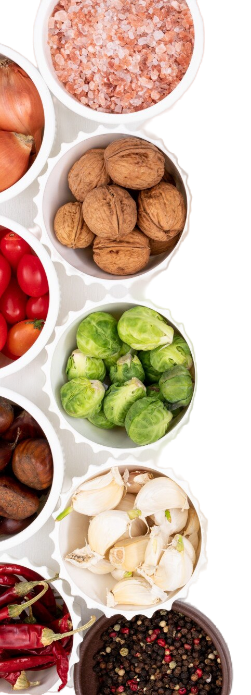
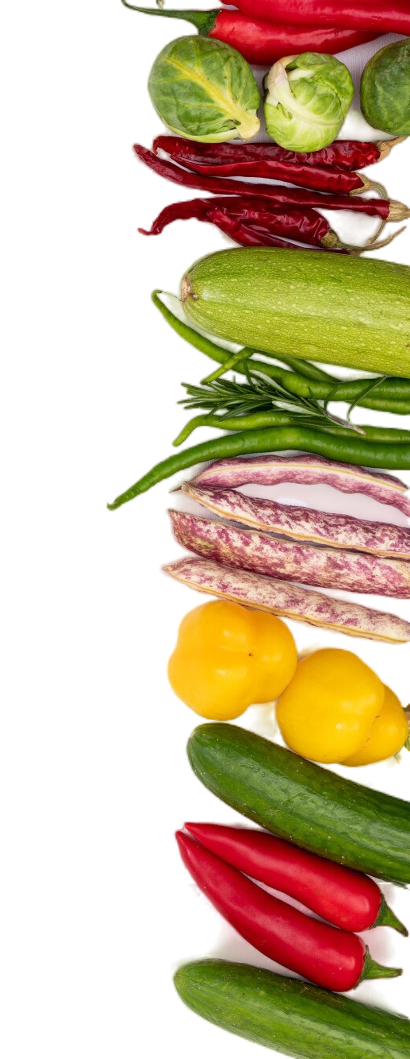
Song
God is great, God is good,
Let us thank him for our food.
By his hands, we are fed.
We thank you, Lord, for our daily bread.
You provide the sun and rain,
To give us harvests of new grain,
Fruits and vegetables, fish and meat,
Flavors spicy, sour, and sweet.
Amen!
Notes:
7. Song
Learners will learn the new song. Explain that this song is a prayer that can be said before a meal, thanking God for the food.
1. Model: Read the song lyrics out loud to the class. Ask if there are any questions. Write words that learners ask about on the board and give simple definitions. Then sing it two or three times, while they just listen.
2. Repeat: Sing the selection again, a line or sentence at a time, as learners repeat after you. Then play the recording and sing the song together in unison.
3. Solo: The learner sings solo (or if shy, can just read the words aloud) with the accompanying actions.

Slide 26
1A. Homework – Read and create your own restaurant menu on the next slide.
Appetizers
Chips & Salsa $4.00
Guacamole $6.00
Chicken soup $4.00
Nachos $5.00
Side Orders
Spicy peppers $2.00
Beans $2.00
Rice $2.00
Fried onions $2.00
Salads - $5.00
Taco salad
Green salad
Fruit salad
Chicken salad
Drinks
Juice $2.00
Soda $2.00
Wine $8.00
Hot chocolate $2
Tanya’s Mexican Restaurant Menu
Main Courses
Beef tacos $8.00
Vegetables $6.00
Fish tacos $9.00
Peppers & Eggs $7.00
Desserts
Mango ice cream $3.00
Cinnamon churro $3.00
Sweet custard $3.00
Apple pie $3.00
Notes:
Homework 1A. - Create a menu using the vocabulary words.
Model. Go over each of the homework assignments to be sure the student understands what to do.
Repeat. Encourage students to practice speaking and reading the completed homework assignments with a friend. They may use a bilingual dictionary.
Solo. Students will share their homework when they are finished. After they have shared their homework, be sure to check it for correctness, including spelling. Explain mistakes, while providing praise and encouragement.
This slide is an example of a restaurant menu. Encourage students to create their own menu on the following slide.

Slide 27
1B.
Appetizers
Side Orders
Salads
Drinks
Main Courses
Desserts
Notes:
Homework 1B. - Create a menu using the vocabulary words.
Encourage students to create their own menu with prices on this slide.
Answers will vary.

Slide 28
2A. Fill in the blanks to apologize and forgive.
Hello __________. Can we talk? I need to apologize to you.
What happened?
A. I’m very sorry because _____________________________ .
B. Oh no! Why ______________________________________ ?
I made a mistake. But I promise I will _________________ and I will not _____________________________________ .
B. I _______________________________________________ .
Notes:
Homework 2A. – Grammar and Vocabulary Review
Apologizing and Forgiving
Fill in the blanks to complete the sentences. Answers will vary.

Slide 29
2B. Fill in the blanks with the correct past tense form of the irregular verbs.
sleep
1. He ___slept_____ in a boat during a storm.
2. Jesus _____________ we must forgive others.
3. She ___________ sweet chocolate in the dessert.
4. He ____________ everything and bought a field.
5. I _____________ a letter to my aunt yesterday.
6. We _____________ quickly and finished the race.
send
run
say
put
sell
Notes:
Homework 2B. – Grammar Review
Irregular verbs
Learners will select a word from the list to complete each sentence. They will change each verb into the proper irregular past tense form.
Number 1 is the example.
Answers:
2. said
3. put
4. sold
5. sent
6. ran

Slide 30
3. Fill in the blanks and ask your partner.
on
at
in
1. What do you eat ____ 7:00 ____ the morning?
_____________________________________________
2. What would you order _____ the evening?
_____________________________________________
3. Which desserts do you enjoy _____ special holidays?
_____________________________________________
4. What do you prefer eating _____ noon?
_____________________________________________
Notes:
Homework 3. – Conversations - Pair work
First, ask students to fill in the blanks to complete the sentences. The word “in” is used for centuries, decades, years, months, morning, afternoon, and evening. The word “on” is used for days and specific dates. The word “at” is used with hours and night.
Fill in the Blanks Answers:
What do you eat at 7:00 in the morning?
What do you enjoy drinking in the evening?
Which desserts do you eat on special holidays?
What do you prefer eating at noon?
Then ask each student to interview a partner and write their partner’s answers. Then they will switch roles and answer their partner’s questions.
Check answers for correct grammar and punctuation.

Slide 31
4. Read the verses. Then write the bold words in the correct pronunciation column.
Jesus said, “So I tell you, don’t worry about the things you need to live—what you will eat, drink, or wear. Life is more important than food, and the body is more important than what you put on it. Look at the birds. They don’t plant, harvest, or save food in barns, but your heavenly Father feeds them…
What you should want most is God’s kingdom and doing what he wants you to do. Then he will give you all these other things you need.”
-- From the book of Matthew, Chapter 6 ERV
/u/ | /oo/
Jesus
Notes:
Homework 4. – Write the bold words in the correct pronunciation column.
Learners may first read Matthew 6 in their own language to understand the scripture.
This homework practices the short /oo/ and short /u/ sounds. These sounds may be spelled in a variety of ways.
Answers
/u/ - Jesus, but, what, other
/oo/ - put, look, should, book

Slide 32
5. Bible Reading Application
Write a paragraph about one of these topics:
1. The time I forgave someone and how it made me feel.
2. How forgiveness helped me mend a broken friendship.
3. What Jesus taught us about forgiveness.
4. A time when I needed to ask for forgiveness from someone.
5. How God’s forgiveness brings peace into my life.
6. Is it easier to forgive someone or to ask for forgiveness? Why?
7. Who do you need to ask to forgive you?
Notes:
Homework 5. – Bible Reading Application
Model. Write something about your own experiences with forgiveness.
Answers will vary, but should be grammatically correct.

Slide 33
6A. Choose 1 verse to memorize.
A
Then Peter came to Jesus and asked, “Lord, when someone won’t stop doing wrong to me, how many times must I forgive them? Seven times?” Jesus answered, “I tell you, you must forgive them more than seven times. You must continue to forgive them even if they do wrong to you seventy-seven times.”
Matthew 18:21-22 ERV
Yes, if you forgive others for the wrongs they do to you, then your Father in heaven will also forgive your wrongs.
Matthew 6:14 ERV
B
Notes:
Homework 6A. – Memorize a Verse
Learners get to choose A, B, or C (on the next slide) to memorize. Please notice that the memory work is not long. Everyone, regardless of skill level, should be able to do it.
1. Model. Recite a verse from memory.
2. Repeat. Encourage students to find someone with whom to practice conversing and reading the completed homework assignment.
3. Solo. Students will recite the verse from memory at the next class.

Slide 34
6B. Choose 1 verse to memorize and read the next verses.
But, Lord our God, you are kind and forgiving, even though we rebelled against you.
Daniel 9:9 ERV
          Read the next lesson’s Bible verses: Matthew 14:13-33 in your language.
C
Notes:
Homework 6B. – Memorize a verse and read the next lesson’s verses.
Learners get to choose A, B, (from the previous slide) or C to memorize.
Students will always read the Bible lesson in their first language (L1) before reading it in English the following lesson. Help them get a Bible in their own language if they don’t have one. They may also use Bible.IS or other Bible translation resources.

Slide 35
7A. Healthy Eating - Read and answer the questions.
Good food is delicious, satisfying, and gives us energy. But did you know that some food choices nourish us better than others? Let's dive into the exciting world of healthy eating!
Healthy food, like fresh fruits and vegetables, keeps our bodies strong and working properly. Fruits are the parts of a plant that contain seeds, such as lemons and apples. Vegetables are the other parts of a plant such as the roots, leaves, or stems. We can enjoy them raw, roasted, or cooked in soups.
Now, junk food such as chips, pizza, and packaged cookies might taste good but are full of grease. These processed sugary treats and salty snacks can be sneaky. They give a quick energy boost, but lack the vitamins and minerals our bodies need.
Notes:
Homework 7A. – Everyday Reading and Writing
The learners will read the article and answer the questions on the last slide.

Slide 36
7A. Healthy Eating - Read and answer the questions.
So, what delicious options do we have? Water, refreshing and good for our skin, is a great substitute for soda. For dessert, try fruit or yogurt with honey – sweet and nourishing! Choose protein from beans or fish instead of beef or pork – they’re delicious and contain less fat.
Healthy eating doesn't have to be boring. Try new fruits and vegetables, experiment with recipes, and learn to cook. It’s a fun, delicious way to share good food with the people you love! Remember, healthy choices taste great and can make us feel good.
Notes:
Homework 7A. – Everyday Reading and Writing
The learners will read the article and answer the questions on the last slide.

Slide 37
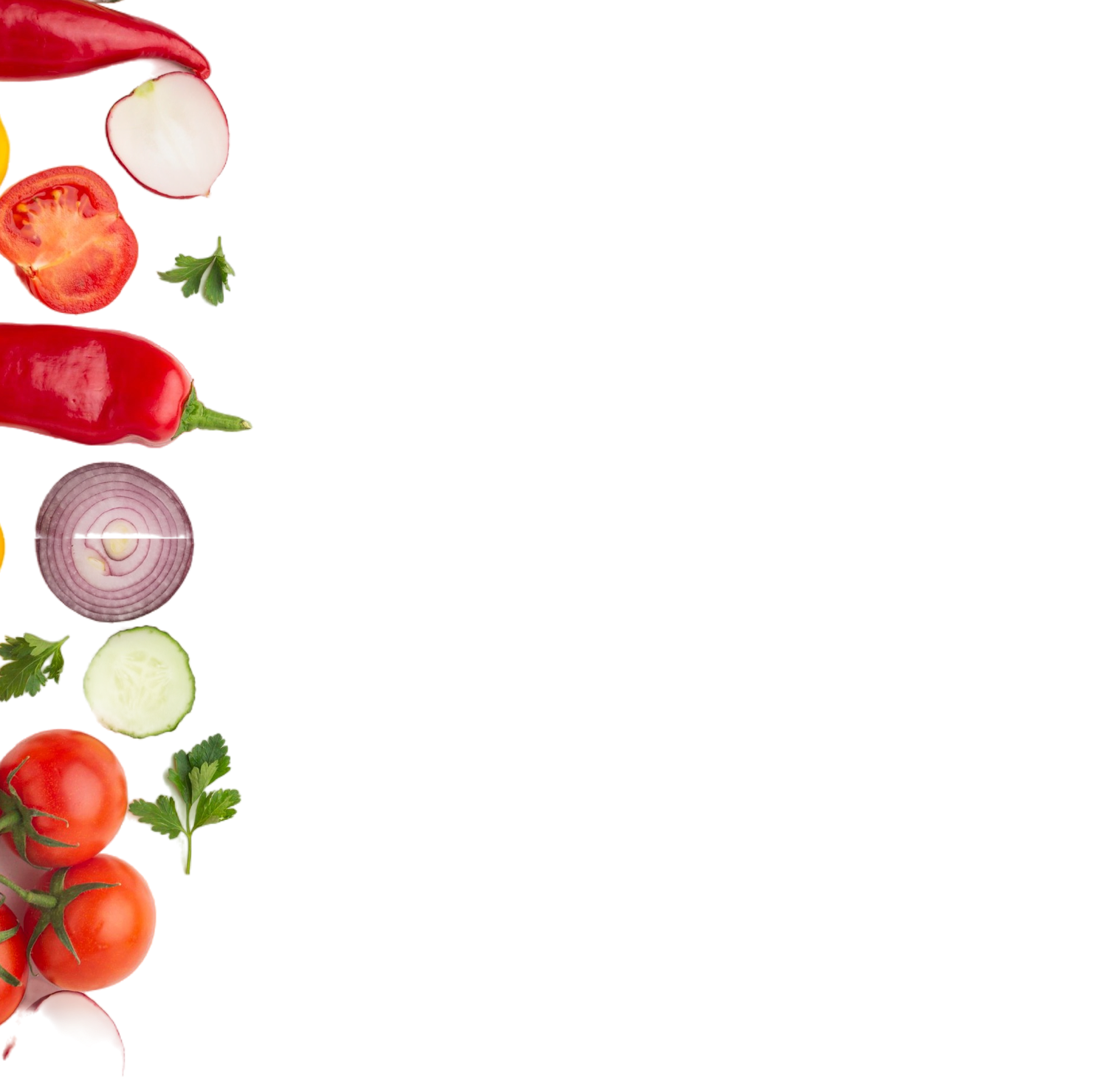
7B. Answer the questions.
Why is it important to eat healthy food?
What is junk food?
What do we call the part of a plant with seeds?
What kinds of protein do you like?
What do you like to cook?
What are your favorite vegetables?
Do you eat mostly healthy food? Why or why not?
Notes:
Homework 7B. – Everyday Reading and Writing
The learners will read the questions and answer them on a separate piece of paper.
Answers:
It keeps our bodies healthy, strong and working properly.
Junk food is food with lots of salt, sugar, and grease.
Fruit is the part of the plant with seeds.
4. Answers will vary but may include meat, fish, or beans.
5. Answers will vary.
6. Answers will vary.
7. Answers will vary.

Slide 38
8. Write a restaurant recommendation.
Write an email to a friend recommending a good place to eat. Describe the food, and suggest a time to meet.
Notes:
Homework 8. – Writing
Model. Write something about your own recommendations of a good place to eat. For example, “I love to eat at Sonny’s Café because the food is healthy, delicious and not expensive.”
Answers will vary.

Slide 39
9. Now I Can…
I can talk about food and order from a menu.
I can use new words including: _____ ______ _____
_____ ______ _______ _______ ______ and _______
I can use simple past tense irregular verbs.
I can apologize and offer forgiveness.
I can understand that we should forgive others because God forgives us.
Notes:
Homework 9. – I can statements
The student must be able to achieve all of these skills before the next lesson. If not, the lesson can be repeated or additional practice materials can be used.
Review all of the skills at the beginning of the next lesson. Be sure to give lots of praise and encouragement!

Slide 40

Reflections and Closing Prayer
Notes:
Reflections and Closing Prayer
You may want to thank the Lord for what we have learned, ask for special prayer requests, then pray for your students and bless them. Students may write reflections and their prayers here.

Slide 41

Help us share the Light of the World!
Thank you for using our materials. If these lessons are a blessing to you, please give or volunteer to help others learn English through the Bible.
For more information, visit LightOfTheWorldLearning.org

Slide 42
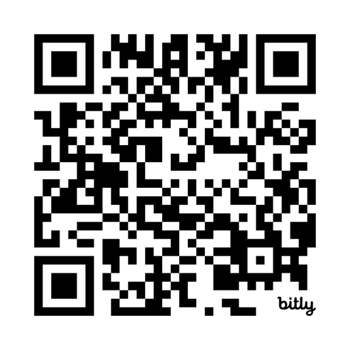
Appendix
How to Use Lessons: bit.ly/UseLOTW
Irregular Verb List: bit.ly/ListVerbs
Lesson Downloads: LightOfTheWorldLearning.org
Order Books: bit.ly/BooksLOTW
Share Your Feedback: bit.ly/FeedbackLOTW
Table of Contents: bit.ly/TocLOTW
Video Channel: youtube.com/@LightOfTheWorldLearning
Vocabulary List: bit.ly/VocabUS
Website: LightOfTheWorldLearning.org

Slide 43
Acknowledgements
We would like to thank the entire Light of the World volunteer team for their hard work and creativity in making this project possible. For all those around the world who prayed, wrote, edited, narrated, illustrated, sang, tested, and gave generously for this curriculum, we appreciate you sharing the love of Jesus through the gift of English. Our team members include:
Anonymous | Emily Cox | Jill Gramzow | Martha Lane
Jean Ato | Marilyn Dano | Tanya Griffin | Audrey Larsen
Bradley Baurain | Hephzi Davidson | Rachel Grijincu | Aden Lewis
Ana Biederman | Susanna Diallo | Lauren Haines | Bruce Lewis
Bob Biederman | Alyssa Dokolas | Carol Hale | Elena Lewis
Joshua Blake | EasyReadEnglish.com | Emily Hamilton | James Lewis
Rachael Braggs | Don Edic | Patty Hickman | Micah Beth Lewis
Hannah Brendel | Peggy Fergus | Juliette Hyer | Tim Lewis
Larry Buell | MaryBeth Gahan | Lyudmila Ivanyuk | Ward Lewis
Cindy Campbell | Melina Gallo | Debbie Johnson | Cosette Lindsay
Christian Cha | Alicia Gentile | Carey Jo Johnston | Johnny Lukashevich
Olivia Cheney | Prakash Chandra Giri | Nancy Kingdon | Gail MacMillan
Hannah Clark | Ellenor Gopal | Dorothy Konadu | Ivan Mader
Nancy Cobb | Henrietta Grajcar | Macy Lake | Amy Martin
(continued on the next slide)

Slide 44
Acknowledgements - Continued
Diana Martz | Joan Phelps | Lorna Tatomir
Hannah McMahan | Megan Rahn | Darrell Turner
Christy McPherson | Sara Scazzero | Leigha Wachter
Tracy Meddaugh | Hannah Schmokel | Joseph Waite
Barbara Newsome | Ashlyn Shrimplin | Graham Whitmore
Brenda Nielsen | Leah Sprague | Cheri Wilke
Danielle Nowe | Noah Staal | Mackenzie Williams
Deborah O’Donnell | Macie Stuckman | Allison Wright
Evelyn Ocasio | Jia Le Su | Tiffany Yeh
Georg Ort | Carole Svensson | Muchun Yin
Martha Ort | Ellie Talalight | Ted York
Barb Park | Peter Talalight | Tai Lee Young
Deb Payne | Weston Talalight | Abigail Zawisza
Linda Petrie | Rachel Tamang | Anita Zeifert
Bible story and pictures on slides 16-20 adapted from the original work by unfoldingWord available from https://openbiblestories.org
Bible Verses on slides 33-34 Taken from the HOLY BIBLE: EASY-TO-READ VERSION ©2014 by Bible League International. Used by permission.

