Slide 1
Unit A2-35
©2020-2024 Light of the World Learning
Notes:
Teacher’s Notes: Review of A2 Lessons 29-34 Visit LightOfTheWorldLearning.org for more resources.
Bible Readings:
Jesus is Tempted in the Wilderness, Jesus Starts His Ministry, The Good Samaritan, The Rich Young Ruler, The Servant Who Did Not Forgive, Jesus Feeds 5,000 and Walks on Water
Themes:
Parts of the Body and Senses, Healthcare, Appointments, Safety, Food & Drink, Religion and Faith
Pronunciation:
/t/ /d/ /id/ spelled -ed
/th/ voiced and unvoiced
/yU/ spelled open u, /A/ spelled open a
Unstressed /u/ spelled a or e
/oo/spelled u, /u/ spelled o
/z/ spelled s, /E/ spelled y
Grammar:
Past Simple Regular Verbs, Time Expressions, Past Simple Negative, Reflexive Pronouns, Apologize and Forgive, Count and Non-count Nouns
Preparation:
Pray. Preview slides and game.
Optional: Bring objects and pictures related to the lessons.
©2020-2024 Light of the World Learning

Slide 2
Pray, Review, and Preview
Bible Readings:
Jesus is Tempted
Jesus Starts His Ministry
The Good Samaritan
The Rich Young Ruler
The Unforgiving Servant
Jesus Feeds 5,000 and Walks on Water
Themes:
Body Parts and Senses
Healthcare
Appointments
Safety
Food and Drink
Religion and Faith
©2020-2024 Light of the World Learning
Notes:
Pray
Pray for the class. You may want to thank the Lord for the opportunity to learn.
Check Homework and Review
Ask each student to read aloud or recite their homework from the last class. Check written work.
Review the main points of the previous lesson and ask if there are any questions.
©2021-2024 Light of the World Learning

Slide 3
Preview
Pronunciation:
/t/ /d/ /id/ spelled -ed
/th/ voiced and unvoiced
/yU/ spelled open u, /A/ spelled open a
Unstressed /u/ spelled a or e
/oo/spelled u, /u/ spelled o
/z/ spelled s, /E/ spelled y
Grammar:
Past Simple Regular Verbs
Time Expressions
Past Simple Negative
Reflexive Pronouns
Apologize and Forgive
Count and Non-count Nouns
©2020-2024 Light of the World Learning
Notes:
These are the sounds, spellings and grammar points that will be reviewed in this lesson.
©2021-2024 Light of the World Learning

Slide 4
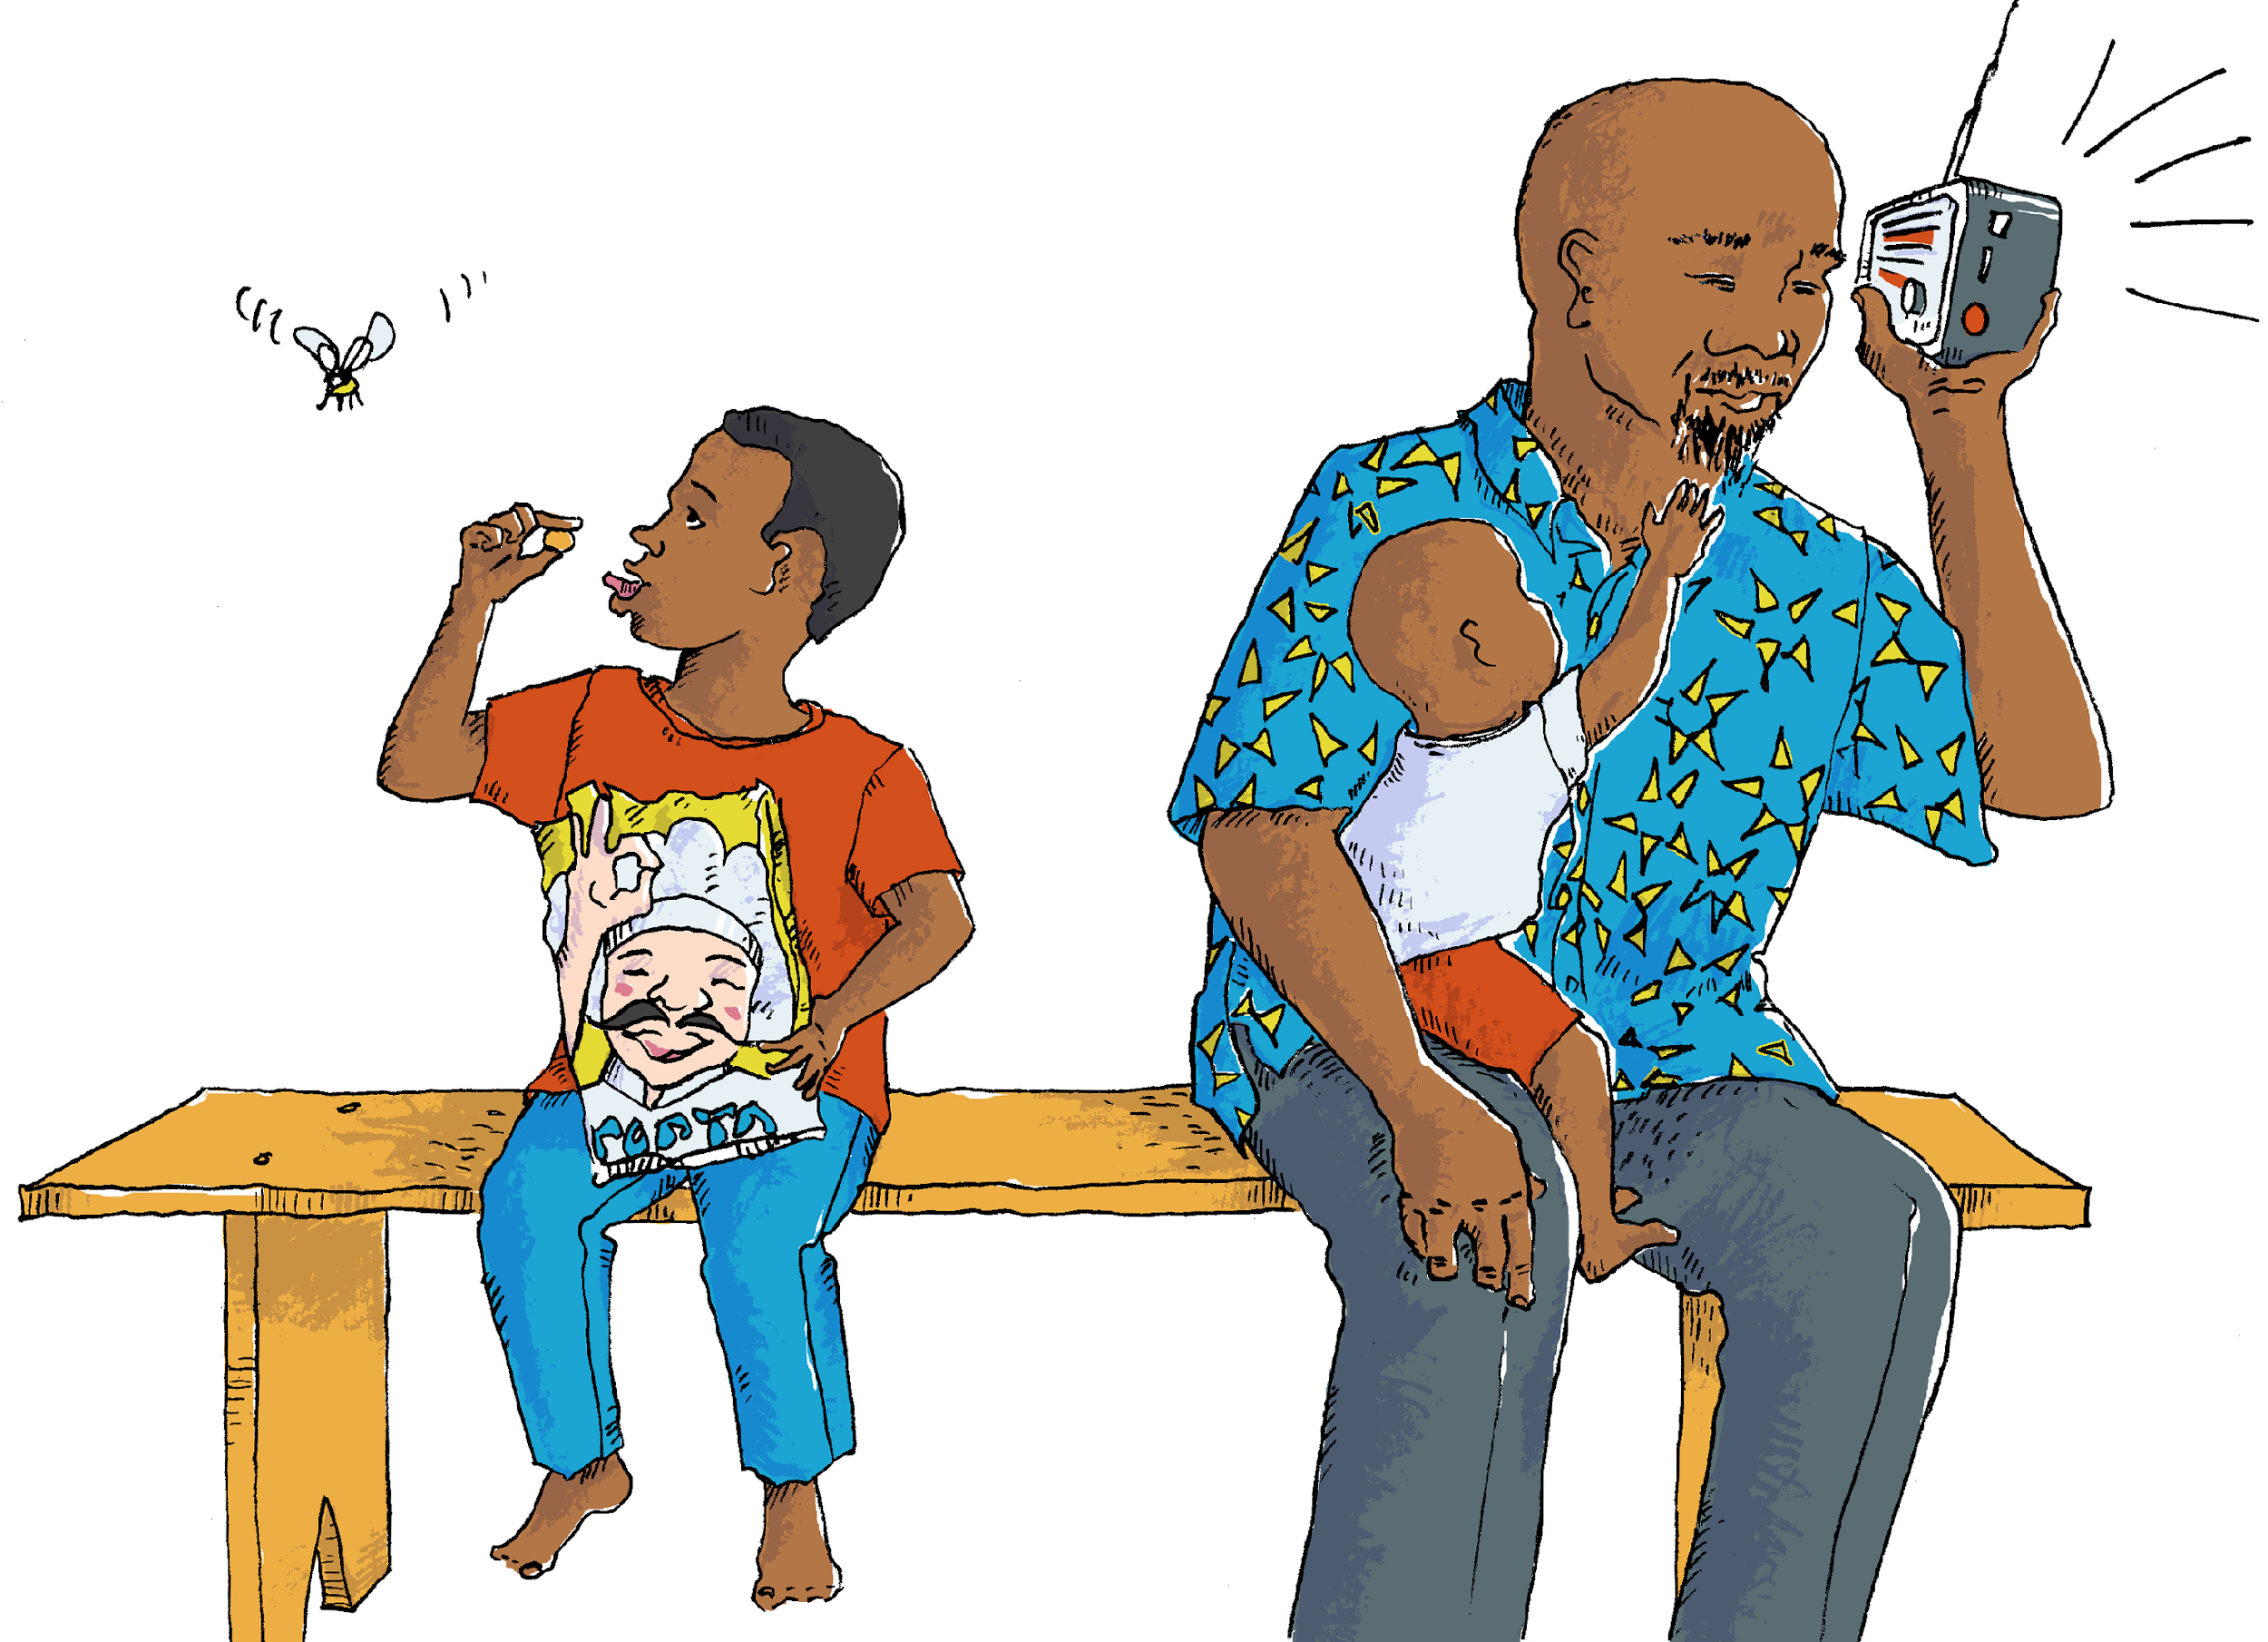
What do you see?
Notes:
1A. Discuss Theme Picture
Ask “What do you see in this picture?” and “What else?” to elicit vocabulary they already know.
Repeat and write their words.
Answers may include: face, neck, fingers, mustache, thumb, lips, beard etc.
More advanced students can be encouraged to make complete sentences:
The baby wants to touch his father’s beard. The boy holds a snack between his thumb and finger.

Slide 5
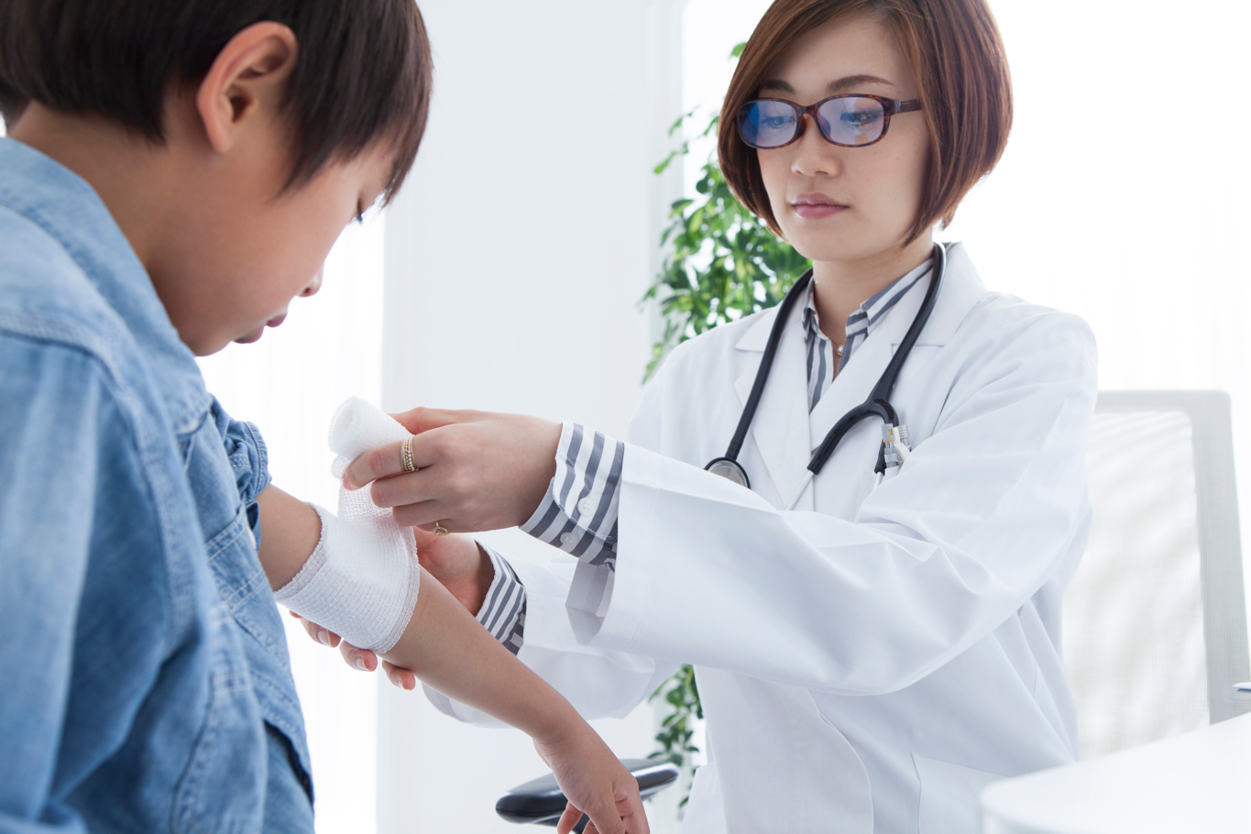
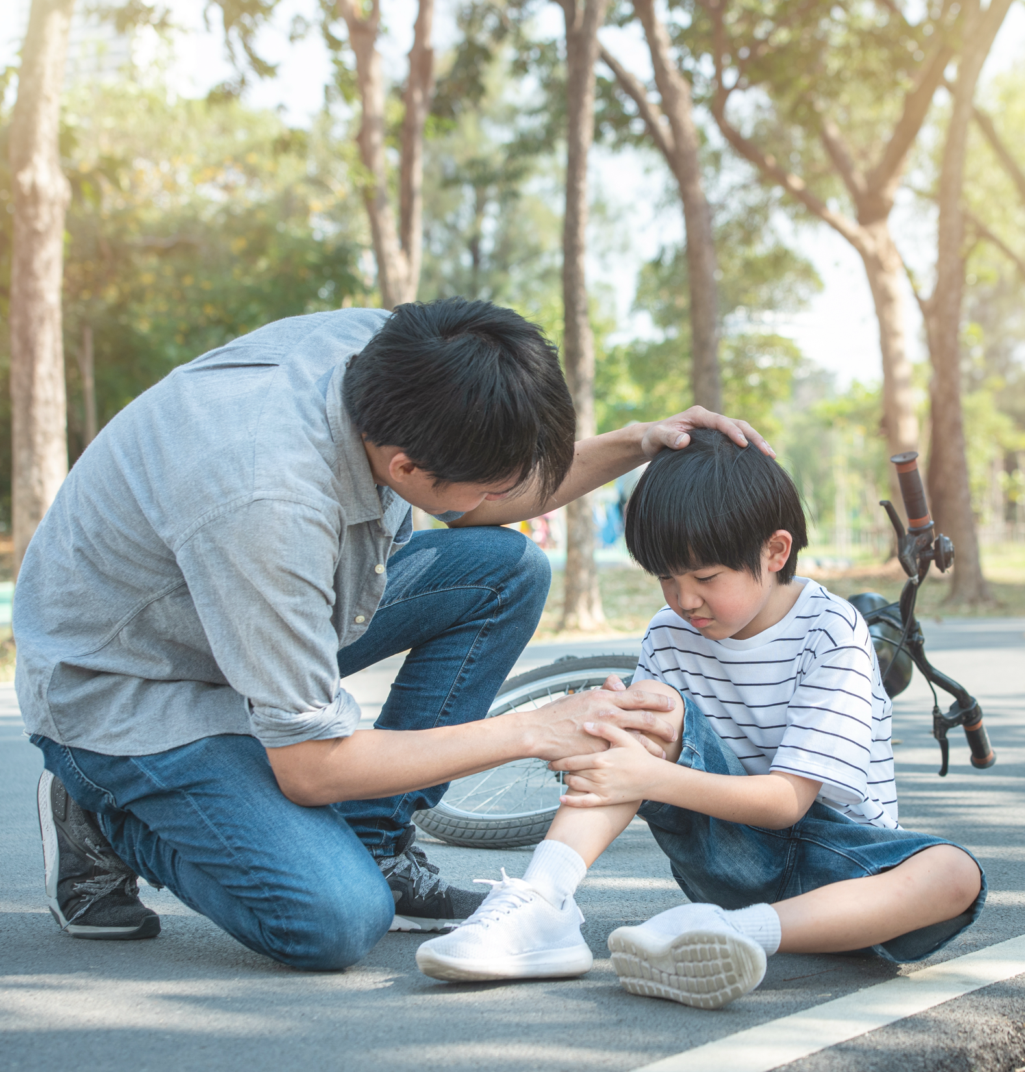
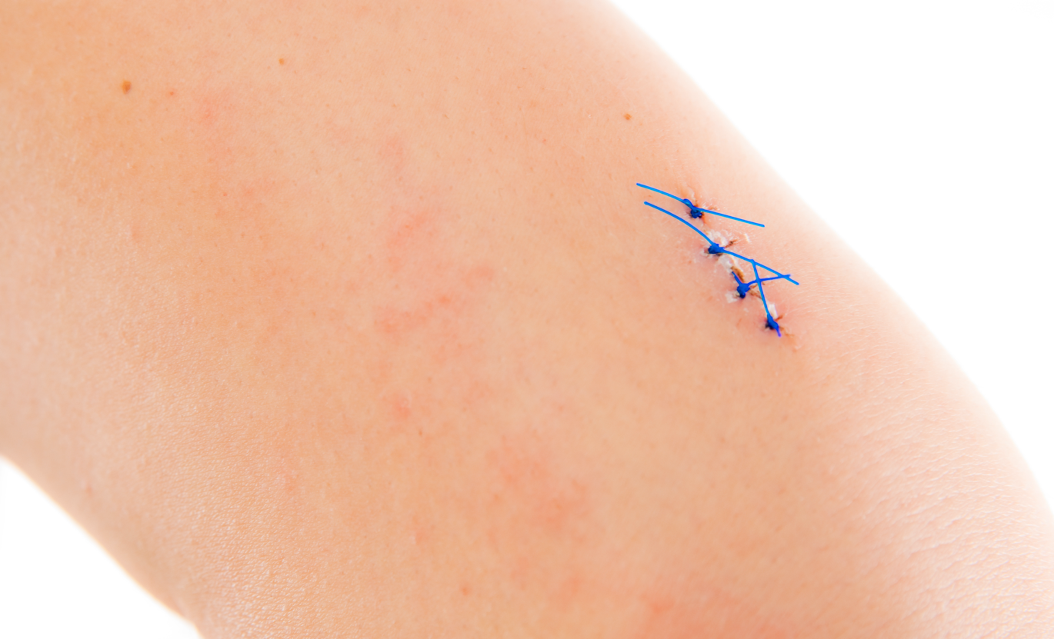
What happened?
Notes:
1B. Discuss Theme Picture
Ask “What happened?” and “What else?” to elicit vocabulary students already know.
Repeat and write their words.
Answers may include: pain, a bandage, an accident, stiches, elbow, etc.
More advanced students can be encouraged to make complete sentences:
The boy fell off his bicycle and was hurt. The doctor gave him stitches.

Slide 6
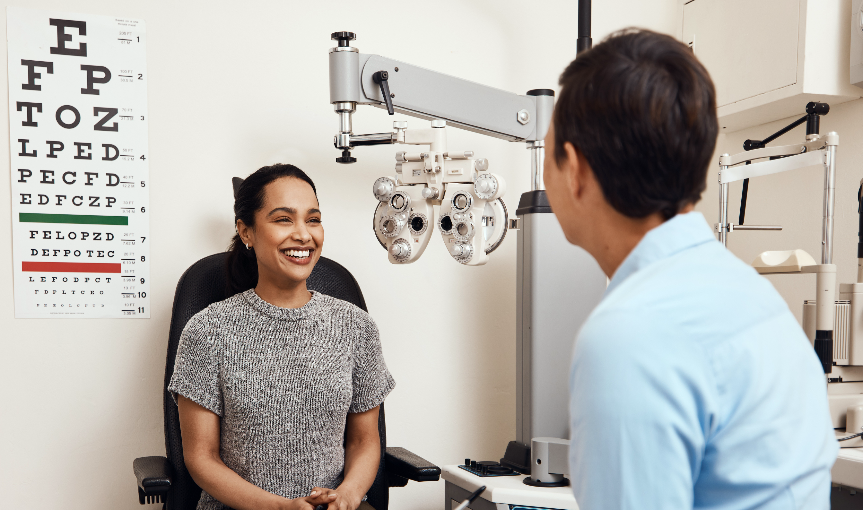
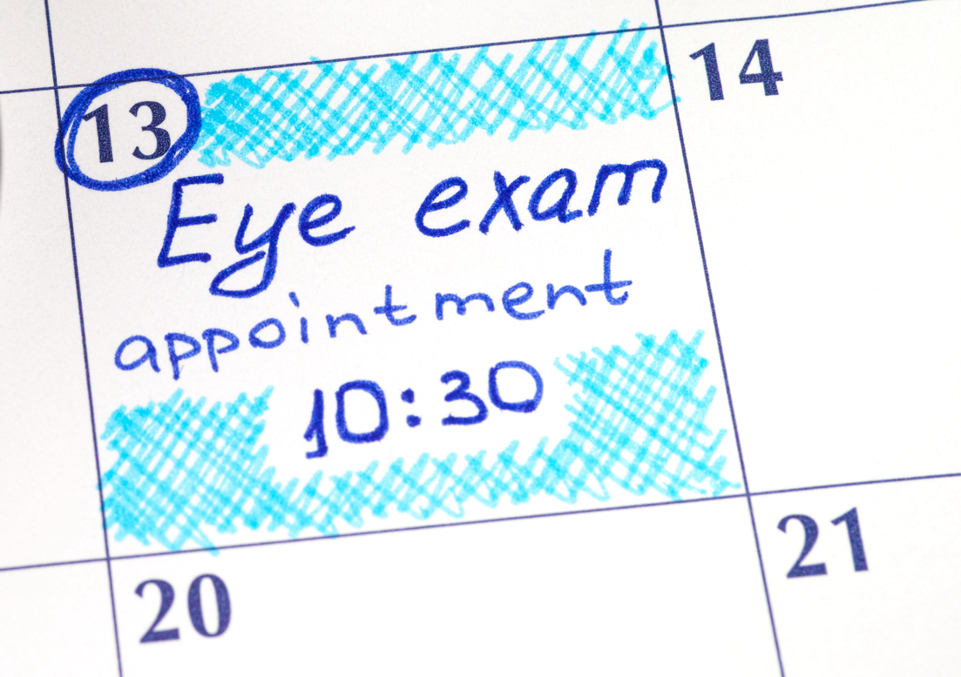
What do you see?
Notes:
1C. Discuss Theme Picture
Ask “What do you see in this picture?” and “What else?” to elicit vocabulary they already know.
Repeat and write their words.
Answers may include: patient, appointment, eye chart, etc.
More advanced students can be encouraged to make complete sentences:
The patient saw the doctor to get new glasses. She didn’t feel nervous. The doctor examined her eyes.
©2021-2024 Light of the World Learning

Slide 7
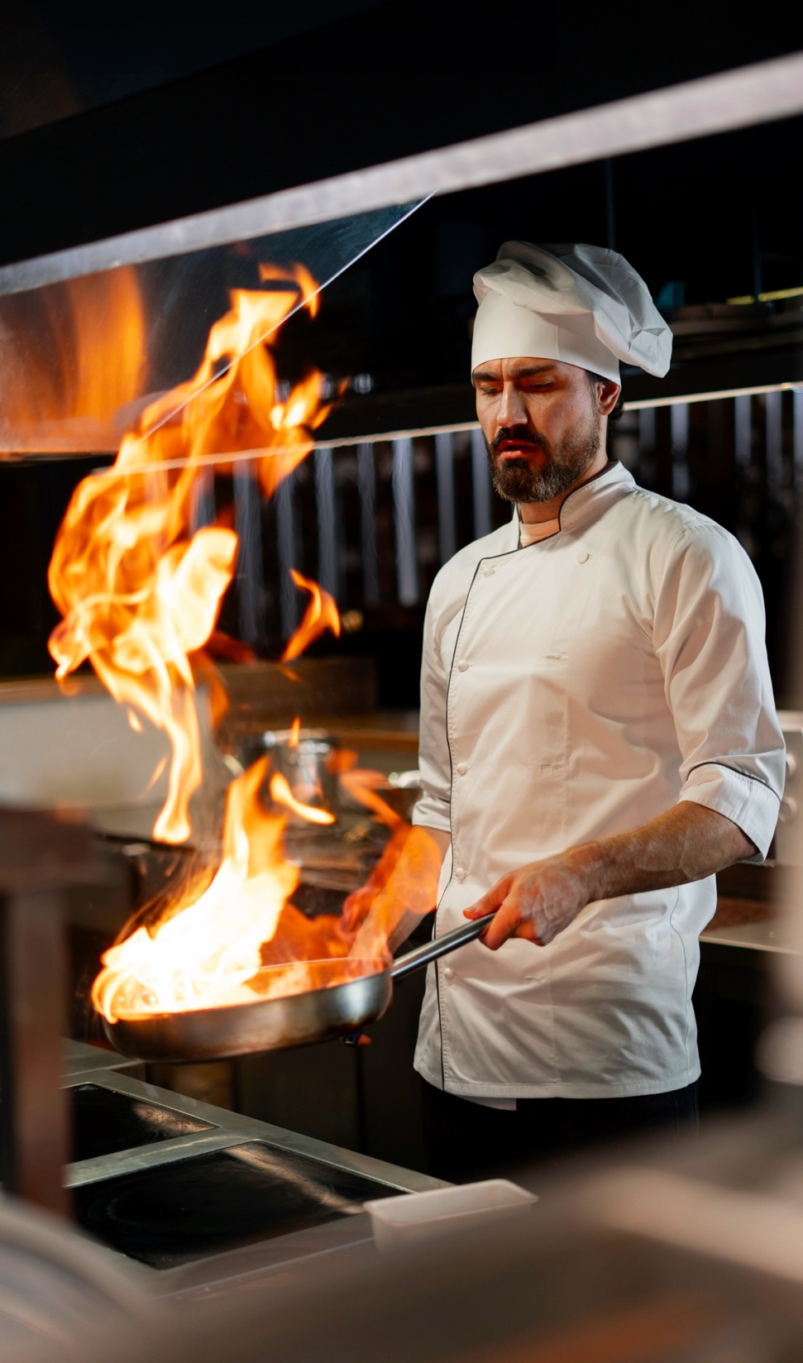
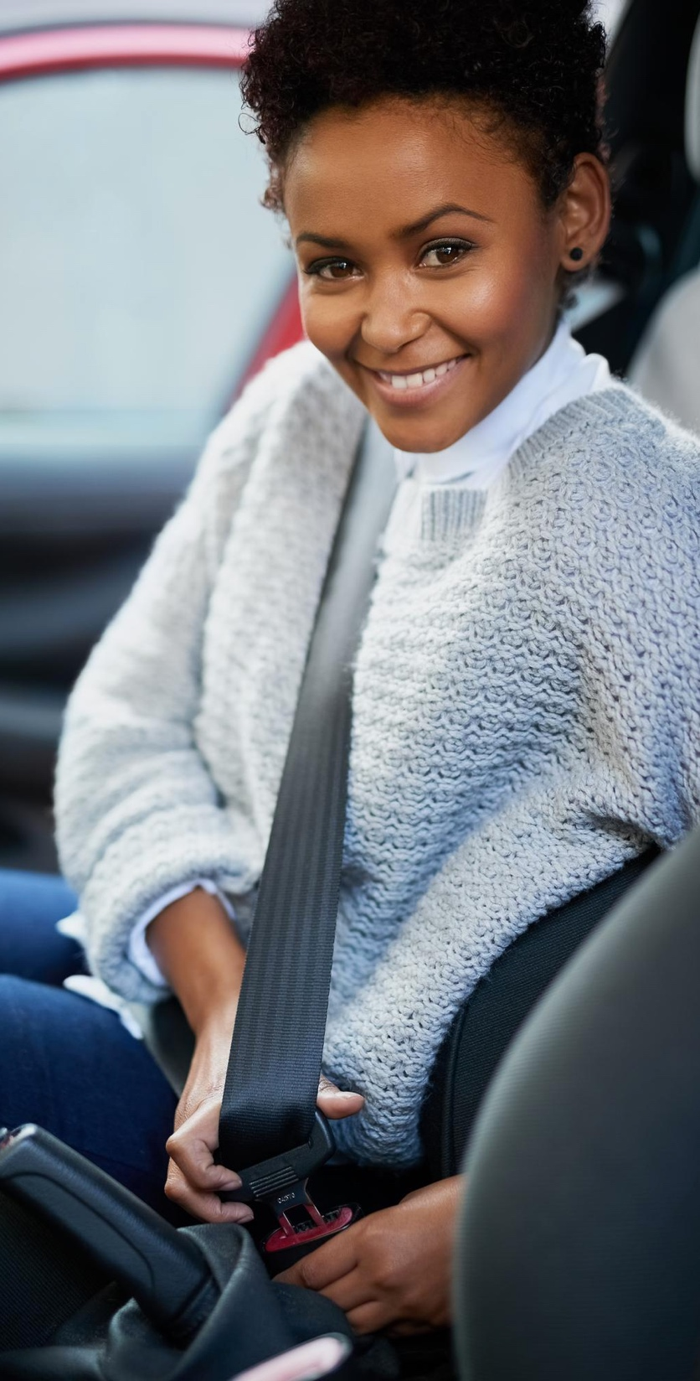
What do you see?
Notes:
1D. Discuss Theme Picture
Ask “What do you see in this picture?” and “What else?” to elicit vocabulary they already know.
Repeat and write their words.
Answers may include: helmet, flammable, seatbelt, careful, careless, etc.
More advanced students can be encouraged to make complete sentences:
She is careful and puts on her seatbelt in the car. The cooking oil is flammable. The motorcycle rider wears a helmet.
©2020-2024 Light of the World Learning

Slide 8
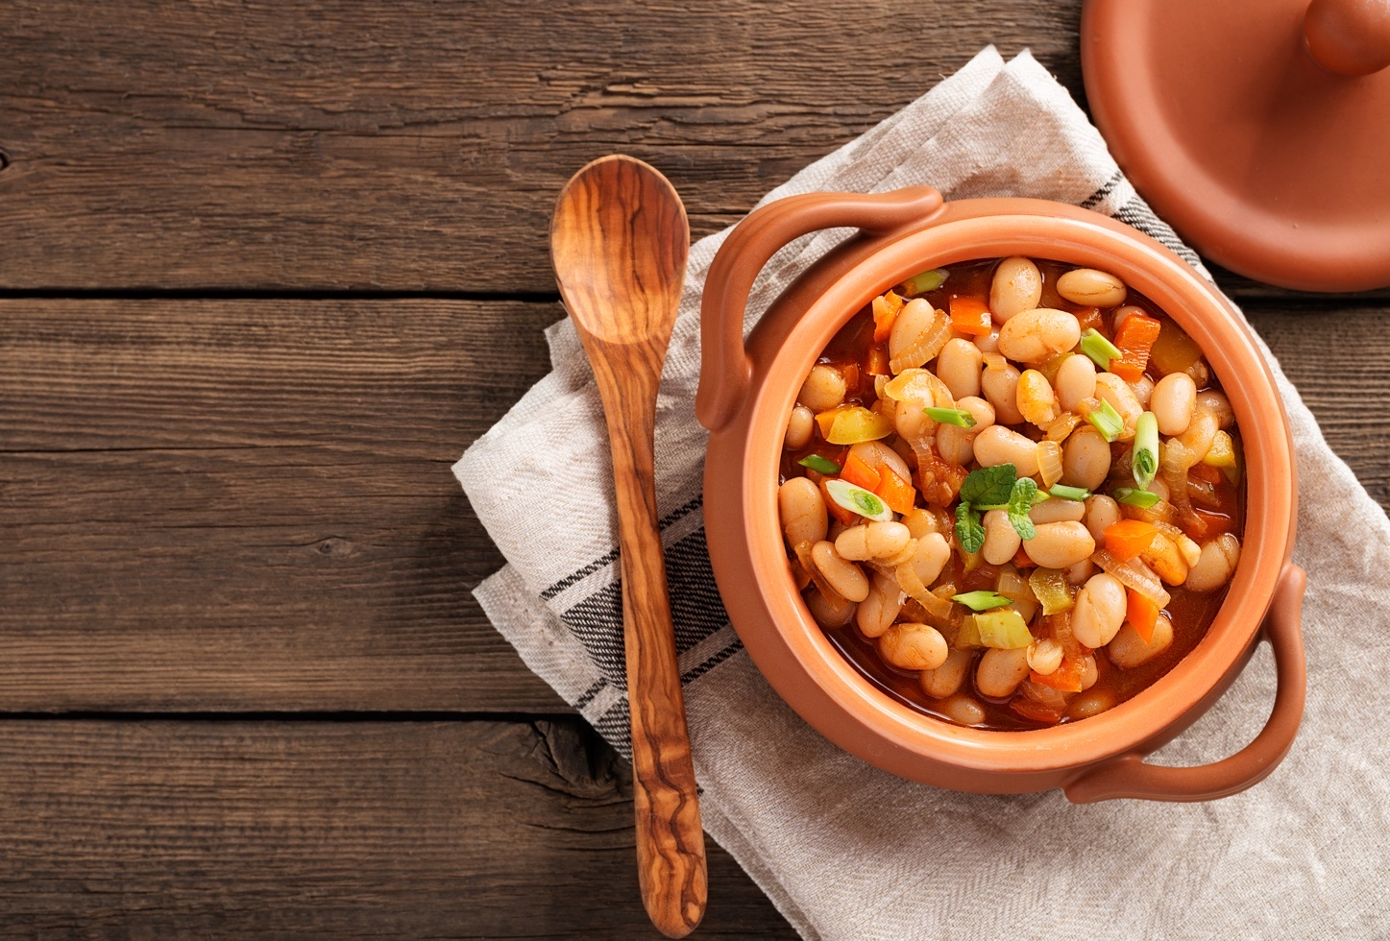
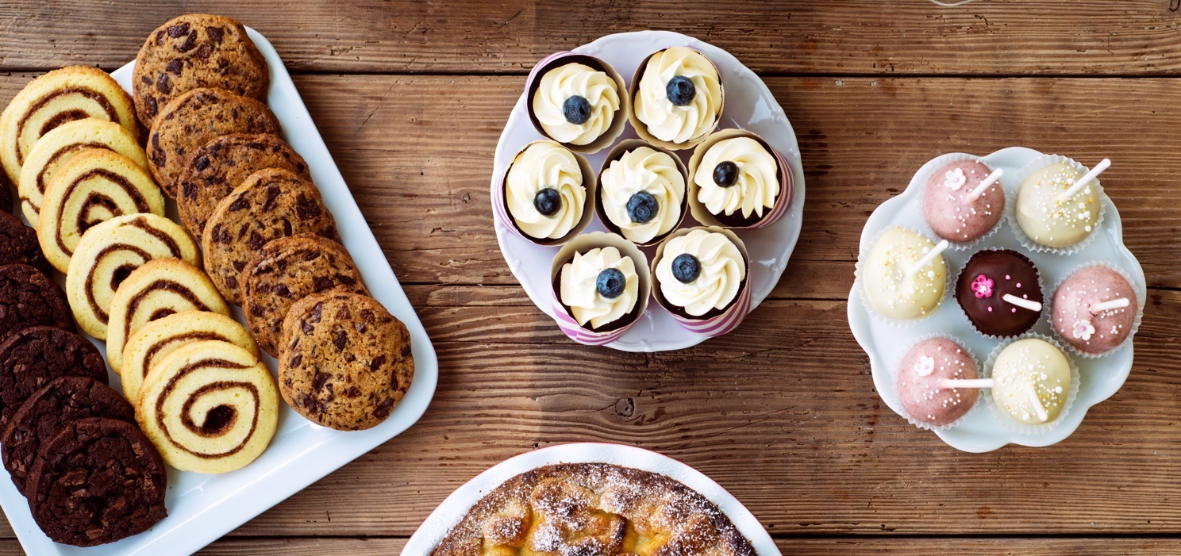
What would you like?
Notes:
1E. Discuss Theme Picture
Ask “What would you like to eat or drink from this picture?” and “What else?” to elicit vocabulary they already know.
Repeat and write their words.
Answers may include: soda, chocolate, wine, soup, salad, beans, beef, dessert etc.
More advanced students can be encouraged to make complete sentences:
I would love to have the beans and a glass of fruit juice. I’d like the chocolate cookies and the soup.

Slide 9
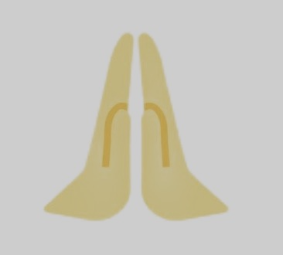
What faith symbols do you see?
Notes:
1F. Discuss Theme Picture
Ask “What do you see in this picture?” and “What else?” to elicit vocabulary they already know.
Repeat and write their words.
Answers may include (from top left to bottom right): Bible, church, Jewish Star of David, candle, Muslim crescent moon and star symbol, Buddhist temple, praying hands, Hindu oil lamp, Christian cross, Muslim mosque.
More advanced students can be encouraged to make complete sentences:
I see many religious symbols from different faiths.

Slide 10
Regular past simple verbs end in -ED.
 | Question ? | Positive + | Negative -
1 | Did she smell the flower? | Yes, she smelled it. | No, she didn’t smell it.
2 | Did you burn the food? | ______________ | __________________
3 | __________the paint? | Yes, I touched it.
4 | Did you yawn a lot? | ______________ | __________________
Notes:
2A. Grammar – Regular Past Simple Tense Verbs
Note: Past simple tense verbs are used for a past action that is finished. The form is the same in all persons.
Regular simple past verbs end in –ed. Irregular verbs do not end in -ed. They can be found on the list in the appendix.
The -ed ending is used in the positive form but not in the question or negative form.
To spell many simple past regular verbs we just add the letters –ed to the end of the word. However, the next slide shows 3 rules where this pattern is different.
Model, Repeat, and Solo row number 1. Then ask students to complete the sentences for rows 2-4.
Answers:
2. Yes, I burned it. No, I didn’t (did not) burn it.
3. Did you touch the paint? No, I didn’t (did not) touch it.
4. Yes, I yawned a lot. No, I didn’t (did not) yawn a lot.
©2020-2024 Light of the World Learning

Slide 11
Spelling Rules for Regular Past Simple Verbs
 | Base Verb | Past Simple | Spelling Rule
1 2 3 | vote create type | voted __________ __________ | If the word ends in E, just add D.
4 5 6 | worry study multiply | __________ __________ __________ | If the word ends in a consonant + Y, change the Y to I and add ED
7 8 9 | clap hug plan | __________ __________ __________ | If a 1 syllable word ends in 1 vowel and 1 consonant, double the last consonant and add ED.
Notes:
2B. Grammar: The spelling rules of regular past simple verbs
If the word already ends in silent E, just add D.
If the word ends in a consonant + Y, change the Y to I and add ED.
If the verb has one syllable and ends in one vowel and one consonant (-vc) the final consonant is doubled: stopped, planned. However, do not double w, x, y (sowed, boxed, played).
Model, Repeat, and Solo row number 1. Then ask students to fill in the blanks for rows 2-9.
Answers:
2. created
3. typed
4. worried
5. studied
6. multiplied
7. clapped
8. hugged
9. planned
©2020-2024 Light of the World Learning

Slide 12
Descriptive adjectives describe the size, shape, color, or other features of nouns.
 | Adjective before a noun | Adjective after a noun + To Be verb
1 | The hungry lions ran. | The lions were hungry.
2 | We swam in a round pool. | The pool was round.
3 | We have a full classroom. | The _______ is ________.
4 | There aren’t any ____ _____. | The trucks aren’t red.
5 | They finished a hard exam. | The _______ was _______ .
6 | I’ll move the ______ _____. | The sofa will be heavy.
Notes:
2C. Grammar -Descriptive adjectives
Note: Descriptive adjectives are words that describe the size, shape, color, quantity or other features of nouns. Nouns are words for a person, place or thing. Descriptive adjectives usually go before nouns, but when they are used with the verb To Be, the adjective goes after the noun and To Be verb.
Model, Repeat, and Solo the pronunciation of rows 1 and 2. Then ask students to complete and read rows 3-6.
Answers
3. The classroom is full.
4. There aren’t any red trucks.
5. The exam was hard.
6. I’ll move the heavy sofa.
©2020-2024 Light of the World Learning

Slide 13
Time Expressions: Last, Yesterday, Ago
 | Time
last | night, Sunday, week, month, year, time
yesterday | morning, afternoon, evening
 | 1 week, 10 days, 3 months, 5 years | ago
I didn’t see you in class last night. What happened?
I had an accident yesterday afternoon and I needed stitches. The last time I got hurt was two years ago.
Notes:
2D. Grammar
Note: This chart shows time expressions for past events and words that can be used with them. Last and yesterday are placed before the time. Periods of time with numbers are placed before ago.
Ask students to try to make some of their own phrases using last, yesterday, and ago.

Slide 14
Ask & answer questions with irregular verbs.
 | Base | Simple Past | Sentence
1 | be (am/is/are) | was / were | When were you in an accident? We were in an accident last year.
2 | become | became | When did she become a doctor? She became a doctor in 2022.
3 | begin | began | When did you begin English classes? ____________________________
4 | bring | brought | What did you bring for lunch? ____________________________
5 | buy | bought | When did you buy a gift? ____________________________
Notes:
2E. Grammar – Irregular Verbs
Note: Irregular verbs do not end in ED in the past and participle forms. Students must memorize these irregular forms. The charts on this slide and the next show the first ten common irregular verbs from the list in the appendix. Have students listen and repeat the words.
You may also listen and have students sing the irregular verb song, available at: https://bit.ly/SongsLOTW
Ask students to answer questions 3, 4, and 5 using the simple past tense.
Answers will vary but must include the correct verb forms:
3. began
4. brought
5. bought

Slide 15
Ask & answer questions with irregular verbs.
 | Base | Simple Past | Sentence
6 | choose | chose | Which Bible verse did you ______ to say? I chose John 3:16.
7 | come | came | How _____ you ________ to class today? __________________________________
8 | do | did | What _____ you _________ a week ago? __________________________________
9 | drink | drank | When _____ you last _________ tea? __________________________________
10 | drive | drove | How well ____you ______ a car last year? __________________________________
Notes:
2F. Grammar – Irregular Verbs
Note: Irregular verbs do not end in ED in the past and participle forms. Students must memorize these irregular forms. The charts on this slide and the previous one show the first ten common irregular verbs from the list in the appendix. Have students listen and repeat the words.
Ask students to complete the questions and answers for 6-10 using the simple past tense.
Answers will vary but must include the correct verb forms:
6. choose
7. did/come/came
8. did/do/did
9. did/drink/drank
10. did/drive/drove

Slide 16
Past Simple Negative: Did Not / Didn’t | Simple Past Tense Did Not / Didn’t
1 | My blood pressure did not increase last week.
2 | The patient’s temperature didn’t decrease yet.
3 | Didn’t he examine the patient at 9:00 a.m.?
4 | Didn’t you help your neighbor when he fell?
5 | (schedule)
6 | (cancel)
Notes:
2G. Grammar – Simple Past tense negative
Note: Past simple tense verbs are used for a past action that is finished. The form is the same in all persons.
Regular simple past verbs end in –ed. Irregular verbs do not end in -ed. They can be found on the list in the appendix. We usually form the negative past tense by placing did not / didn’t before the base form of the verb. It is not necessary to put –ed at the end of the verb. Negative questions are often used to express surprise or to confirm something we believe is true.
Spoken English usually uses the contraction forms. Written English usually uses the full forms.
Model, Repeat, and Solo sentences 1-4. Then ask students to write a sentence using the given words in rows 5 and 6, and using "did not" or "didn't."
Answers will vary, but may include:
5. I did not/didn’t schedule an appointment with the receptionist.
6. We did not/didn’t cancel class during the snowstorm.
©2020-2024 Light of the World Learning

Slide 17
Complete the sentences with irregular verbs.
 | Base | Past | Sentence
1 | eat | ate | I didn’t eat any candy, but I ate some cake two hours ago.
2 | fall | fell | She fell off the bike a day ago, but she didn’t ____________________________.
3 | feel | felt | He felt sad yesterday evening, but he usually ___________________________.
4 | find | found | They found the cat three years ago, but they can’t _________________________.
5 | fly | flew | I don’t fly much now, but last year I often __________________________________.
Notes:
2H. Grammar
Spoken English usually uses the contraction forms. Written English usually uses the full forms.
Model, Repeat, and Solo row 1, then ask the students to complete the sentences in rows 2-5, using the given verb.
Answers may vary but should include the following:
2. fall
3. feels
4. find
5. flew
©2020-2024 Light of the World Learning

Slide 18
Complete the sentences with irregular verbs.
 | Base | Past | Sentence
6 | forget | forgot | I forgot to do my homework, but I didn’t ________________________.
7 | get | got | I rarely get new glasses, but I _____________________________.
8 | give | gave | She gave me a gift yesterday so I will _____________________________.
9 | go | went | We didn’t go to the mall but _____________________________.
10 | have | had | I had an appointment so I didn’t _____________________________.
©2020-2024 Light of the World Learning
Notes:
2I. Grammar
Spoken English usually uses the contraction forms. Written English usually uses the full forms.
Ask students to complete the sentences in rows 6-10 using the given verb.
Answers may vary but should include the following:
6. forget
7. got
8. give
9. went
10. have

Slide 19
Reflexive pronouns show the subject did and received the action.
Subject Pronoun |  | Subject Pronoun | Verb | Reflexive pronoun
Singular | 1 | I | hurt | myself.
 | 2 | You (singular) | burned
 | 3 |  | cut | himself.
 | 4 | She | drove
 | 5 | It | scratched
Plural | 6 |  | did it | ourselves.
 | 7 | You (plural) | wrote it
 | 8 |  | helped | themselves.
Notes:
2J. Grammar -Reflexive pronouns
Note: We use a reflexive pronoun to indicate that someone is doing an action to their own person or without help. In sentences, we use the reflexive pronoun that agrees with the subject pronoun.
The plural forms end with “selves;” the singular forms end with “self.” Sometimes reflexive pronouns are also used to add emphasis in a sentence: “I, myself, prefer to kneel when I pray, but others use different postures.”
Model, Repeat, and Solo the pronunciation of all forms shown on the chart. Then ask students to fill in the blanks to complete the sentences.
Answers:
2. yourself.
3. He
4. herself.
5. itself.
6. We
7. yourselves.
8. They

Slide 20
Create sentences with irregular verbs.
 | Base | Past | Past Simple Tense Sentence
1 | hear | heard | I heard an ambulance go by last night.
2 | keep | kept
3 | know | knew
4 | leave | left
5 | lend | lent
Notes:
2K. Grammar
Irregular simple past verbs
Note: Irregular verbs do not add -ed to the end in the past tense. They have different forms and need to be memorized
Model, Repeat, and Solo the pronunciation of all forms shown on the chart. Then have students make their own sentences for 2-5. Answers will vary but should use the irregular past tense verbs.

Slide 21
Create sentences with irregular verbs.
 | Base | Past | Simple Past Tense Sentence
6 | let | let | I know you let me win the game.
7 | lose | lost
8 | make | made
9 | meet | met
10 | pay | paid
Notes:
2L. Grammar
Irregular simple past verbs
Note: Irregular verbs do not add -ed to the end in the past tense. They have different forms and need to be memorized
Model, Repeat, and Solo the pronunciation of all forms shown on the chart. Then have students make their own sentences for 7-10. Answers will vary but should use the irregular past tense verbs.

Slide 22
Practice apologizing.
 | 1. Apologize. | 2. Confess what you did wrong. | 3. Promise what you will do in the future.
A. | I’m sorry. | I don’t have the money I owe you. | I’ll pay you next week.
B. | I apologize.
C. | Please forgive me.
Notes:
2M. Grammar
Apologizing
When we do something wrong we need to apologize. This chart shows the steps of a basic apology.
Model, Repeat, and Solo all forms shown on the chart. Then have students fill in the blanks for B and C using their own words.
Answers will vary, but should contain a confession and promise.

Slide 23
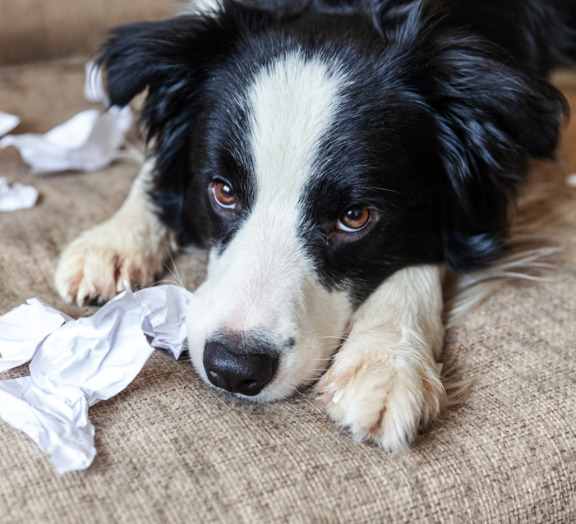
Practice accepting an apology.
1. Respond | 2. Forgive
Thank you for apologizing. | I forgive you.
I understand. It is okay. | I accept your apology.
I’m very sorry because _____________. I will ____________________________.
B. Thank you ________. I _____________.
Notes:
2N. Grammar
Accepting Apologies.
When someone apologizes we need to forgive them. This chart shows the basic steps of accepting an apology.
Model, Repeat, and Solo all forms shown on the chart. Then practice the conversation with person A apologizing and person B forgiving. Answers will vary.

Slide 24
Irregular Verbs: Tell what you did last week.
 | Base form | Simple past | Simple Past Tense Sentence
1 | put | put | I put a lot of honey in the dessert.
2 | read /rEd/ | read /red/
3 | run | ran
4 | say | said
5 | see | saw
Notes:
2O. Grammar
Irregular simple past verbs
Irregular verbs do not form the simple past tense by adding -ed to the end. There is no pattern to form irregular simple past tense verbs. They just need to be memorized. Note that the word “read” is spelled the same in the present and past but pronounced differently.
Model, Repeat, and Solo the pronunciation of all forms shown on the chart. Then ask students to fill in past tense sentences about what they did last week. Answers will vary but should use the irregular past tense verbs.
©2020-2024 Light of the World Learning

Slide 25
Irregular verbs: Tell what you did last month.
 | Base form | Simple past | Simple Past Tense Sentence
6 | sell | sold | I sold sweet ice cream from a cart.
7 | send | sent
8 | sing | sang
9 | sit | sat
10 | sleep | slept
Notes:
2P. Grammar
Irregular simple past verbs
Irregular verbs do not form the simple past tense by adding -ed to the end. There is no pattern to form irregular simple past tense verbs. They just need to be memorized.
Model, Repeat, and Solo the pronunciation of all forms shown on the chart. Then ask students to fill in past tense sentences about what they did last month. Answers will vary but should use the irregular past tense verbs.
©2020-2024 Light of the World Learning

Slide 26
Nouns and Adjectives for Religions
Noun for a Religion | Noun for a Person | Adjective
Christianity | a Christian | Christian
Judaism | a Jew | Jewish
Islam | a Muslim | Islamic or Muslim
Hinduism | a Hindu | Hindu
Buddhism | a Buddhist | Buddhist
He practices ______________. He is a ____________. He celebrates __________ holidays.
Notes:
2Q. Vocabulary and Grammar
Note:
It is easy to confuse the adjectives and various noun forms used with religions. The adjective “Muslim” usually refers to people (They are a Muslim family.); the adjective “Islamic” usually refers to a thing (I like Islamic art). All forms start with a capital letter.
Model, Repeat, and Solo all forms on the chart. Then ask students to fill in the blanks by saying the correct forms in the sentences below the chart.
Answers:
He practices (Noun for a Religion). He is a (Noun for a Person). He celebrates (Adjective) holidays.

Slide 27
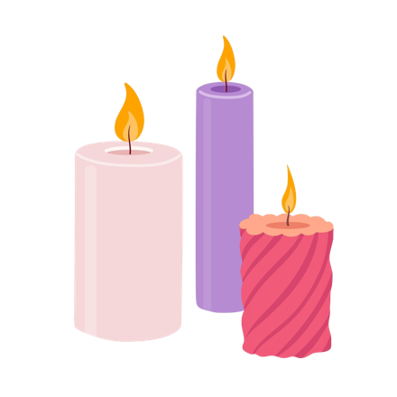
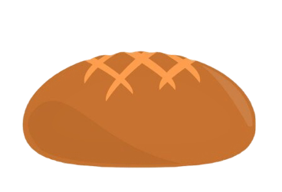
Noncountable nouns are often liquids or things too small to count. Countable nouns can be counted. Write NC or C by each word.
A. sand-NC | B. candle | C. milk | D. coffee | E. temple
F. cross | G. boat | H. water | I. loaf | J. flour
Notes:
2R. Grammar – Count and Noncount nouns
Note: A noun is the word for a person, place, idea, or thing. Nouns can be divided into “count” and “noncount” categories, also known as “countable” or “noncountable.” Count nouns can be easily counted and can be either singular or plural. For example, one chair, two chairs. Noncount nouns cannot be easily counted and are not used in the plural form. We instead use a container (one bucket of sand) or general quantifier (a little sand, a lot of sand) to describe the amount of noncount nouns. A few countable nouns only have a plural form ending in S. Here are a few examples:
scissors
clothes
pants
jeans
shorts
pajamas
We usually use “a pair of” or “some” with these words.
Answers: A. NC, B. C, C. NC, D. NC, E. C, F. C, G. C, H. NC, I. C, J. NC

Slide 28
Many/few are for countable nouns. Much/little are for noncountable nouns. Complete the sentences.
1 | How much rice is here? There’s a little rice. | 5 | How ____ kids like limes? A ____ kids like limes.
2 | Are there ____ boats? There are a ____ boats. | 6 | Do you have ____ money? I have a ____ money.
3 | How ____ milk is left? There’s only a ____ milk left. | 7 | Did you see ____ temples? We saw a ____ temples.
4 | Is there ____ snow today? There is a ____ snow. | 8 | How ____ baskets are full? A ____ baskets are full.
Notes:
2S. Grammar - Much/Little and Many/Few
Note: Nouns (the words for a person, place, idea, or thing) can be divided into “count” and “noncount” categories.
Count nouns are nouns that can be counted from one to another number. Count nouns can be either singular or plural. We use many and few to describe count nouns.
Noncount nouns cannot be counted or pluralized. We use much and little to describe noncount nouns.
Answers:
2. many/few
3. much/little
4. much/little
5. many/few
6. much/little
7. many/few
8. many/few

Slide 29
Any is for general questions or negative sentences. Some is for questions offering something or positive sentences.
Question |  | Answer
1. | Would you like some water? | Yes, I’d love some.
2. | Do you have any tea left? | Sorry, we don’t have any.
3. | Do you have ______candles? | Yes, we have ______ here.
4. | Did you buy ______ soda? | No, I didn’t buy _____ soda.
Notes:
2T. Grammar – Some/Any
Note: We use “some” in questions to offer things, as in question 1.
We use “some” in positive sentences, as in answers 1 and 3.
We use “any” in general questions, as in questions 2 - 4.
We use “any” in negative sentences as in answers 2 and 4.
Model, Repeat, and Solo lines 1 and 2. Then ask students to complete lines 3 and 4.
Answer:
3. Do you have any candles? Yes, we have some here.
4. Did you buy any soda? No, I didn’t buy any soda.

Slide 30
Conversation Questions A
What do you like to taste and smell?
What sounds do you like to hear?
Who can you call if you need an ambulance?
Did you ever hurt yourself in an accident? What happened?
What can you do if you need an appointment, but there are no times available?
What is your favorite story about Jesus? Why?
Notes:
3A. Conversation Practice – Pair work
With a partner, students will practice asking and answering the questions. Student A will ask the questions on this slide, student B will ask the questions on the following slide.
Answers will vary but may include:
1. I enjoy tasting sweet flavors and smelling flowers.
2. I like the sounds of birds singing and cello music.
3. I can call 911 or the emergency number in my area.
4. I fell off my bike and had to get stitches in my knee.
5. I can tell them it is important. I can ask them to call me if someone cancels. I can get an appointment somewhere else.
6. I like the story about Jesus walking on water and calming the storm.
©2020-2024 Light of the World Learning

Slide 31
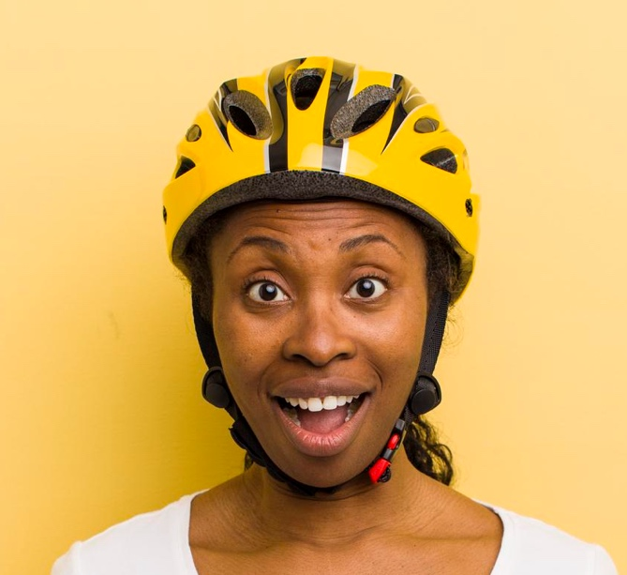
Conversation Questions B
How do you keep yourself safe?
How much English did you know a year ago?
What should you say if you step on someone’s foot?
What do you say when someone apologizes to you?
Which religions are most common in your area?
How much tea do you drink? How many siblings do you have?
Notes:
3B. Conversation Practice – Pair work
With a partner, students will practice asking and answering the questions. Student A will ask the questions on the previous slide; student B will ask the questions on this slide.
Answers will vary but may include:
1. I lock the doors of my home. I wear a bike helmet. I use a seatbelt.
2. I didn’t know any English a year ago.
3. I’m so sorry, please forgive me.
4. I accept your apology. Don’t worry about it.
5. There are many Christians, Jews and Muslims in my city.
6. I drink a lot of tea. I have two siblings, a sister and a brother.
©2020-2024 Light of the World Learning

Slide 32
Listen and repeat.
1. /t/ spelled -ed | 2. /d/ spelled -ed | 3. /id/ spelled -ed
touched | believed | tasted
looked | hugged | handed
4. /th/ voiced | 5. /th/ unvoiced | 6. /yU/ spelled open u
these | thought | university
that | thief | communion
7. I thought the thief handed the money to that man.
8. I looked at my friend and hugged him at the university.
Notes:
4A. Pronunciation- Sound and Spelling
1. Model: Say the sound several times while pointing to it. Then say the sound and quickly read the two examples. pointing to each item as you read it. Students just watch and listen.
2. Repeat: Say the sound and each word several times, having students repeat each time after you in unison. Be sure to use your normal voice and rate of speed. Then read the sentences at the bottom of the slide.
3. Solo: Call on individuals to say a sound and its word group. Provide praise and encouragement for successful attempts.

Slide 33
Listen and repeat.
1. /A/ spelled open a | 2. /u/ spelled a or e | 3. /oo/ spelled u
April | ago | put
vacation | problem | sugar
4. /u/ spelled o | 5. /z/ spelled s | 6. /E/ spelled -y
brother | was | happy
month | choirs | many
7. I went on vacation with my brother a month ago.
8. There was too much sugar in many of the desserts.
Notes:
4B. Pronunciation- Sound and Spelling
1. Model: Say the sound several times while pointing to it. Then say the sound and quickly read the two examples. pointing to each item as you read it. Students just watch and listen.
2. Repeat: Say the sound and each word several times, having students repeat each time after you in unison. Be sure to use your normal voice and rate of speed. Then read the sentences at the bottom of the slide.
3. Solo: Call on individuals to say a sound and its word group. Give lots of praise.
©2020-2024 Light of the World Learning

Slide 34
Say the word and the stress pattern.
A | B | C | D | E
▔ | ▔- | -▔ | ▔-- | -▔-
visited
finger
medicine
bandage
examined
patient
7. alarm
8. ambulance
9. forgive them
10. salad
11. Christian
12. religions
Notes:
4C. Hum the stress.
1. Model the first word: Hum the D pattern and then say “Visited, D.”
2. Repeat: students repeat words after you in unison.
3. Solo: call on individuals to say the words and pattern letters.
Answers: 1. visited, D
2. finger, B
3. medicine, D
4. bandage, B
5. examined, E
6. patient, B
7. alarm, C
8. ambulance, D
9. Forgive them, E
10. salad, B
11. Christian, B
12. religions, E

Slide 35
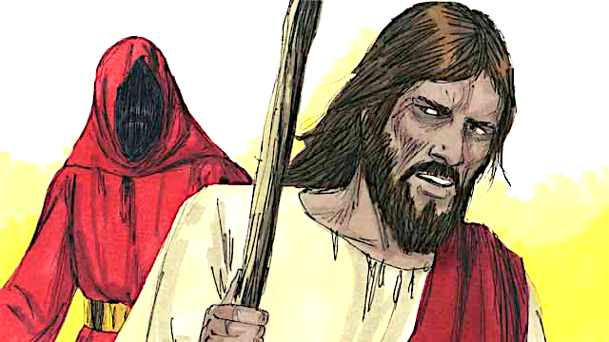
Jesus is Tempted in the Desert MT 4:1-11; LK 4:1-13
1. Who led Jesus into the desert?
2. How long did Jesus go without food?
3. What was the first thing the devil tempted Jesus to do?
4. Why do you think the devil tempted Jesus?
5. What happened after the devil left Jesus?
6. How did Jesus answer each of the temptations?
7. What can you do when you are tempted?
Notes:
5A. Bible Reading Questions
Ask the questions and discuss as a group.
Answers:
1. The Holy Spirit.
2. 40 days and 40 nights
3. To tell the rock to become bread.
4. Answers will vary but may include, to try make Jesus worship him.
5. Angels came to take care of Jesus.
6. He used the Word of God, the Scriptures.
7. Answers may vary but may include, pray, quote scripture, etc.

Slide 36
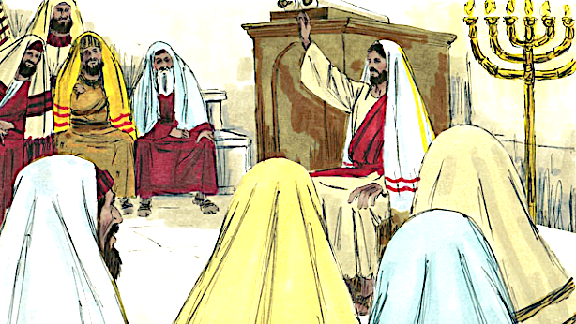
Jesus Starts His Ministry. MT 4:17-25; LK 4:14-41
1. Name 3 miracles Jesus did:
2. Which prophet did Jesus read from?
3. In which town did the people try to kill Jesus?
4. Why did some people want to kill Jesus?
5. Why do you think many people followed Jesus?
6. What amazes you about Jesus?
Notes:
5B. Bible Reading Questions
Ask the questions and discuss as a group. Students may go back to the story to help find the answers.
Answers:
1. He healed the mute, blind, deaf, and cast out demons.
2. Isaiah
3. Nazareth
4. Because they were angry about what he said.
Answers to 5 and 6 will vary

Slide 37
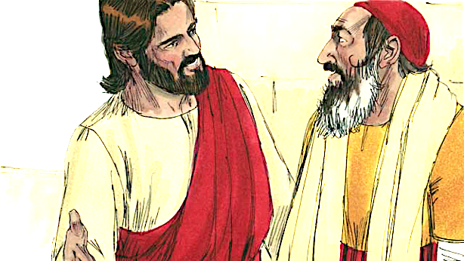
The Good Samaritan LK 10:25-37
Who came to ask Jesus questions?
Who ignored the dying man?
Why did the Samaritan help the injured man?
List all the things the Samaritan did for the man:
Who is your neighbor?
How can you love the Lord with all your heart, soul, strength, and mind?
©2020-2024 Light of the World Learning
Notes:
5C. Bible Reading Questions
Ask the questions and discuss as a group. For questions 1-4 you may go back to the story to help students find the answer.
Answers:
1. An expert in the Jewish Law came.
2. A Jewish Priest and a Levite ignored the man.
3. He had compassion on him. He felt sorry for him.
4. He poured olive oil and wine on his wounds. He bandaged them. He put the man on his own donkey. He took him to an inn. He continued to care for him. He gave money to the innkeeper to care for the man.
Answers will vary for questions 5 and 6.
©2020-2024 Light of the World Learning

Slide 38
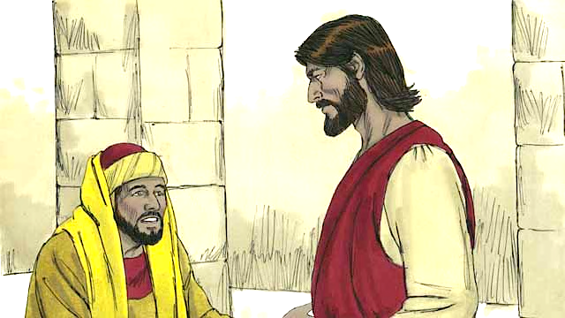
The Rich Young Ruler MT 19:16-30
1. Who came to Jesus?
2. What did he come to do?
3. What were three of the laws Jesus talked about?
4. What was Jesus’s final answer?
5. Why did he walk away after Jesus’ answer?
6. What does it mean for you to follow Jesus?
7. What do you feel Jesus wants you to give up for him?
Notes:
5D. Bible Reading Questions
Ask the questions and discuss as a group. You may go back to the story to help students find the answer.
Answers:
1. The rich young ruler came to Jesus.
2. He came to question Jesus about how to get eternal life. He wanted to live forever with God.
3. Answers may include: You must not murder, commit adultery, steal, tell lies about others. You must respect your father and mother, and love your neighbor as yourself.
4. Jesus said the man should give away all he has and come and follow him.
5. He did not want to give away his property because he was very rich.
Answers to questions 6 and 7 will vary.
©2020-2024 Light of the World Learning

Slide 39
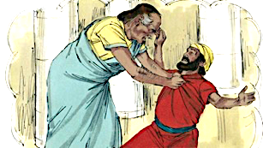
The Unforgiving Servant MT 18:21-35
What was Peter’s question to Jesus?
How many times did Peter think we should forgive?
What did Jesus mean by “Forgive seventy-seven times”?
What did the servant do after the king forgave him?
How do you think God feels when we refuse to forgive?
Is there anyone you need to forgive?
Has God forgiven your sins? How many times?
Notes:
5E. Bible Reading Questions
Ask the questions and discuss as a group. You may go back to the story to help students find the answer.
Answers:
How many times do I have to forgive someone who sins against me?
Peter wondered if we should forgive up to seven times.
He meant you should always forgive.
He found a man who owed him money and had him sent to prison.
He is angry.
Answers will vary for 6 and 7.
©2020-2024 Light of the World Learning

Slide 40
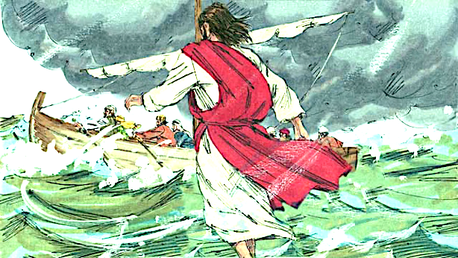
Jesus Feeds 5,000 and Walks on Water MT 14:13-33
1. How did Jesus feel towards the crowd?
2. What did Jesus do for the people?
3. Why do you think Jesus prayed on the mountain?
4. What difficulty did the disciples have on the lake?
5. Why did Peter begin to sink in the water?
6. How did the disciples respond when Jesus entered the boat?
7. What do you do when you feel afraid?
Notes:
5F. Bible Reading Questions
Ask the questions and discuss as a group. For some questions, you may go back to the story to help students find the answer.
Answers:
1. Jesus felt great compassion towards the people.
2. He taught them and healed the people among them who were sick.
3. Answers will vary.
4. The wind was blowing hard and there were strong waves so the disciples were having difficulty crossing the lake in the boat.
5. Peter began to sink when he took his eyes away from Jesus and looked at the waves instead.
The disciples were amazed. They all bowed down and worshipped Jesus as the Son of God.
Answers will vary.

Slide 41
Listen and answer the questions.
What should you say first when making an appointment over the phone?
Why should you explain why you are calling?
What kind of information might you need to give?
What should you do if you don’t understand something?
What should you do with the date and time of your appointment?
Notes:
6A. Activities – Dictation of sound/spelling words
Read the script at least two times as students listen and answer the questions. Students should NOT read the script.
Making an appointment over the phone is easy! First, say hello and introduce yourself. For example, you can say, "Hello, my name is Sarah." Next, say why you are calling. For example, "I would like to make an appointment with the doctor." Be ready to give your information, like your address, phone number, or the reason for your appointment. Listen carefully and write down the date and time of your appointment on a calendar so you don’t forget it. If you don’t understand, ask politely, "Can you say that again, please?" At the end of the call, say thank you and goodbye. You are now ready for your appointment!
Answers: 1. Say hello and introduce yourself. 2. So the person knows what you need.
3. Your address, phone number, or the reason for your appointment.
4. Ask politely, "Can you say that again, please?"
5. Write them down.

Slide 42
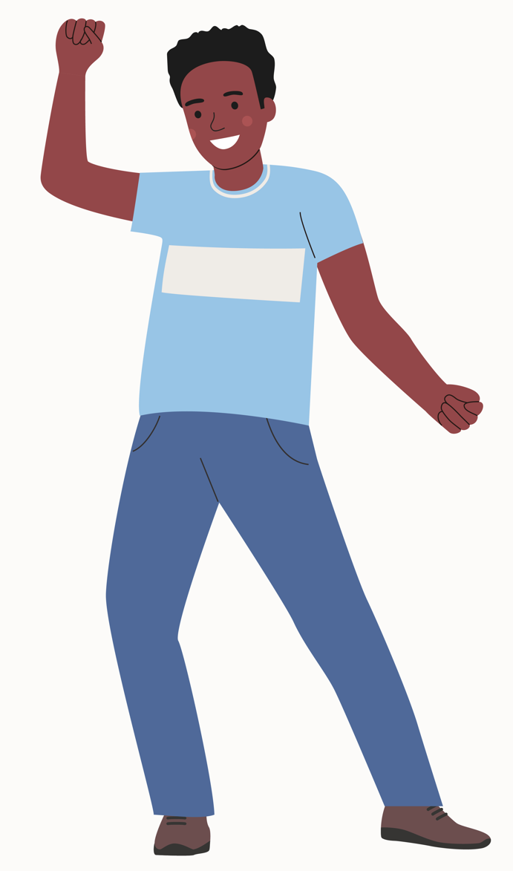
Game – Talk for 90 seconds!
I’d like to talk about food safety. There are some easy things you can do to make sure your food is safe to eat.
Always wash your hands with soap and water before touching food. Clean fruits and vegetables before eating them. Cook meat, chicken, and fish until they are hot and not pink inside.
Don’t eat food that smells bad or is rotten. Use clean plates, knives, and cutting boards when preparing food. Following these tips will help keep you and your family healthy.
Notes:
7. Game – Talk for 90 Seconds
Give each student a topic. They must talk about the topic for 90 seconds without stopping. If they are still talking when the timer goes off, they get 90 points. If they stop talking for more than 3 seconds they get zero points. The student with the most points wins.
Topics may include:
Jesus
Body Parts and Senses
Healthcare
Appointments
Safety
Food and Drink
Religion and Faith
Forgiveness

Slide 43
First Review Quiz
Take the listening, speaking and writing quiz with your
teacher.
Listen to the 5 speaking questions and say your answers.
Then look at the theme picture and write 5 sentences about it. Each sentence must have at least 6 words.
Notes:
First Review Quiz – Listening, Speaking, and Writing
There are two quizzes students will take to review. The first is in class, the second may be done as homework. Use the Rubric found in the appendix to score the student’s answers. You will give the first speaking, listening and writing quiz by asking the student the following questions. Students may not look at the questions. Encourage the students to answer in a complete sentence. Answers will vary.
1. What are some things you do to keep yourself safe?
2. What do you like to taste and smell?
3. What do you say to apologize? What do you say when someone apologizes to you?
4. Which religions are most common in your area? What religious holidays do they celebrate?
5. What is your favorite story about Jesus? Why?
6. Write five sentences about one theme picture. Each sentence must have at least 6 words. (The teacher may choose any one theme picture from slides 4 to 9 for the student to use in this writing exercise). The student may write on paper or an electronic device.
The second quiz (found on the next slide) is online. You may print the quiz or students can take it online with automatic scoring. Students may do the second quiz for homework.

Slide 44
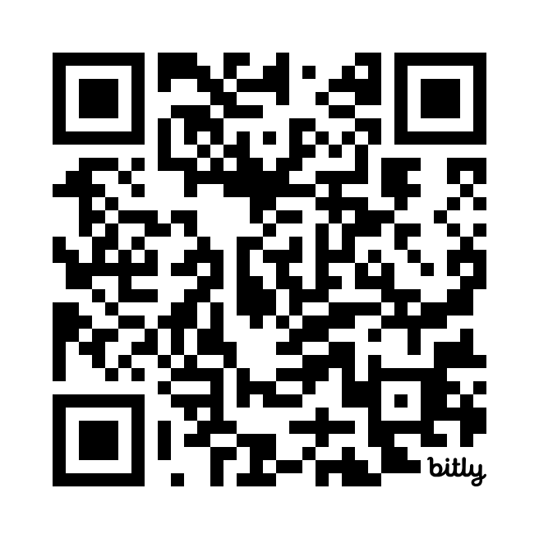
1 & 2 Homework
1. Read or listen to Mark 5:1-34 in your language.
Take the second review quiz at this link: https://bit.ly/QuizA2-35 or QR code. Write your score here ___
If you are not happy with your score, practice more. Then take the quiz again, and write your new score here ___
Notes:
8A. Homework 1 and 2
Students must always read the Bible lesson in their first language before reading it in English the following lesson.
Students may scan the QR code or go to the quiz link to access the multiple choice online quiz. Go over how to take the quiz, to be sure the student understands what to do. Encourage students to look at their quiz results and practice areas that they missed. They may take the quiz again if needed.
©2020-2024 Light of the World Learning

Slide 45
Now I Can…
I can understand how Jesus was tempted.
I can understand how Jesus started his ministry.
I can make, cancel, and reschedule appointments.
I can talk about safety.
I understand that we forgive others because God forgives us.
I can talk about religion and faith.
Closing Prayer
________________________________________________________________________________________________________________________________________________________________________
Notes:
Homework – I Can Statements & Closing Prayer
The student must be able to achieve all of these skills before the next lesson. If not, the lesson can be repeated or additional practice materials can be used.
Review all of the skills at the beginning of the next lesson. Be sure to give lots of praise and encouragement!
Pray
You may want to ask for any special prayer requests, then pray for your students and bless them.
©2020-2024 Light of the World Learning

Slide 46
Help us share the Light of the World!
Thank you for using our materials. If these lessons are a blessing to you, please give or volunteer to help others learn English through the Bible.
For more information, visit LightOfTheWorldLearning.org
Notes:
©2021-2024 Light of the World Learning

Slide 47
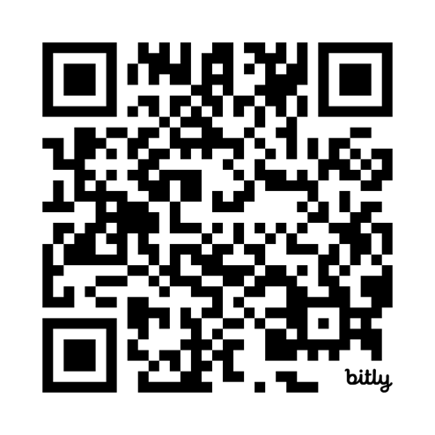
Appendix
How to Use Lessons: bit.ly/UseLOTW
Irregular Verb List: bit.ly/ListVerbs
Lesson Downloads: LightOfTheWorldLearning.org
Order Books: bit.ly/BooksLOTW
Share Your Feedback: bit.ly/FeedbackLOTW
Table of Contents: bit.ly/TocLOTW
Video Channel: youtube.com/@LightOfTheWorldLearning
Vocabulary List: bit.ly/VocabUS
Website: LightOfTheWorldLearning.org
Notes:
For more information, contact info@LOTWL.org
©2020-2024 Light of the World Learning

Slide 48
Rubric for Listening, Speaking and Writing Quiz
Student Name: Date:
Score for Listening, Speaking and Writing:
Score for Multiple Choice Quiz:
Total Score:
Listening and speaking | Question | Good - 3 points Answer is correct, clear and complete. | Okay - 1 point Answer is correct, but unclear or incomplete. | Not acceptable - 0 points Answer is not correct.
Examples: | Where do you live? | I live in an apartment in Tokyo. | I live apartment.
1. What are some things you do to keep yourself safe?
2. What do you like to taste and smell?
3. What do you say to apologize? What do you say when someone apologizes to you?
4. Which religions are most common in your area? What religious holidays do they celebrate?
5. What is your favorite story about Jesus? Why?
6. Write 5 sentences about the theme picture. Each sentence must have at least 6 words. |  | Good - 3 points Answer is correct, clear and complete. Sentence begins with a capital letter has at least 6 words and ends with punctuation. | Okay - 1 point Answer is correct, but incomplete. Sentence is missing capital letters or punctuation. | Not acceptable - 0 points Answer is not correct.
Examples: | Examples: | I see a man and a woman talking. This is a very busy street. The bees make some sweet honey. | see mans womens. This is street busy they are bees
Sentence 1.
Sentence 2.
Sentence 3.
Sentence 4.
Sentence 5.
Total Points out of 30
Notes:
Please use this rubric to score students’ responses.
©2020-2024 Light of the World Learning

Slide 49
Acknowledgements
We would like to thank the entire Light of the World volunteer team for their hard work and creativity in making this project possible. For all those around the world who prayed, wrote, edited, narrated, illustrated, sang, tested, and gave generously for this curriculum, we appreciate you sharing the love of Jesus through the gift of English. Our team members include:
Anonymous | Emily Cox | Jill Gramzow | Martha Lane
Jean Ato | Marilyn Dano | Tanya Griffin | Audrey Larsen
Bradley Baurain | Hephzi Davidson | Rachel Grijincu | Aden Lewis
Ana Biederman | Susanna Diallo | Lauren Haines | Bruce Lewis
Bob Biederman | Alyssa Dokolas | Carol Hale | Elena Lewis
Joshua Blake | EasyReadEnglish.com | Emily Hamilton | James Lewis
Rachael Braggs | Don Edic | Patty Hickman | Micah Beth Lewis
Hannah Brendel | Peggy Fergus | Juliette Hyer | Tim Lewis
Larry Buell | MaryBeth Gahan | Lyudmila Ivanyuk | Ward Lewis
Cindy Campbell | Melina Gallo | Debbie Johnson | Cosette Lindsay
Christian Cha | Alicia Gentile | Carey Jo Johnston | Johnny Lukashevich
Olivia Cheney | Prakash Chandra Giri | Nancy Kingdon | Gail MacMillan
Hannah Clark | Ellenor Gopal | Dorothy Konadu | Ivan Mader
Nancy Cobb | Henrietta Grajcar | Macy Lake | Amy Martin
(continued on the next slide)

Slide 50
Acknowledgements - Continued
Diana Martz | Joan Phelps | Lorna Tatomir
Hannah McMahan | Megan Rahn | Darrell Turner
Christy McPherson | Sara Scazzero | Leigha Wachter
Tracy Meddaugh | Hannah Schmokel | Joseph Waite
Barbara Newsome | Ashlyn Shrimplin | Graham Whitmore
Brenda Nielsen | Leah Sprague | Cheri Wilke
Danielle Nowe | Noah Staal | Mackenzie Williams
Deborah O’Donnell | Macie Stuckman | Allison Wright
Evelyn Ocasio | Jia Le Su | Tiffany Yeh
Georg Ort | Carole Svensson | Muchun Yin
Martha Ort | Ellie Talalight | Ted York
Barb Park | Peter Talalight | Tai Lee Young
Deb Payne | Weston Talalight | Abigail Zawisza
Linda Petrie | Rachel Tamang | Anita Zeifert
Bible story and pictures on slides 35-40 adapted from the original work by unfoldingWord available from https://openbiblestories.org

