Slide 1
Vocabulary Flashcards Units A2-01 to A2-07
©️ 2020-2025 Light of the World Learning

Slide 2
How to Use the Flashcards
Download file in PowerPoint.
Play in Slide Show mode.
Click once to hear the audio.
Click again to see the word.
Try to say the words without listening.
Try to spell the words without reading.
You may also print, cut, and fold to make paper flashcards. (Print 1 slide per page, landscape).
Have fun, and may the Lord bless you!
©️ 2020-2024 Light of the World Learning
©2020-2022 Literacy International

Slide 3
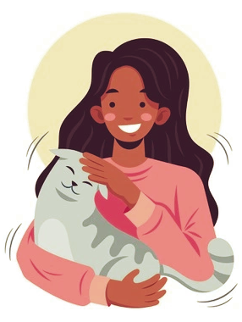
a flat
a room mate
a sport
a pet

Slide 4
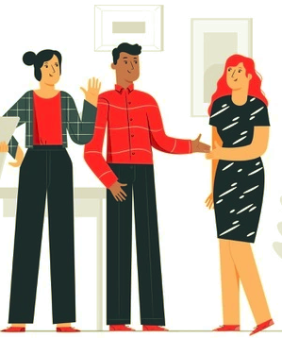
Sue, this is Eve.
the earth
a photograph
to introduce
to discuss

Slide 5
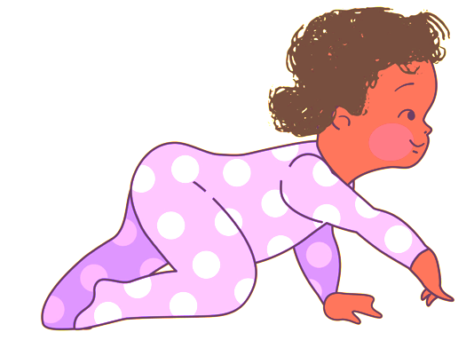
to invite
to crawl
alone
together

Slide 6
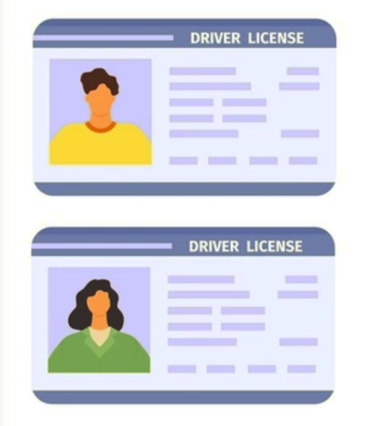
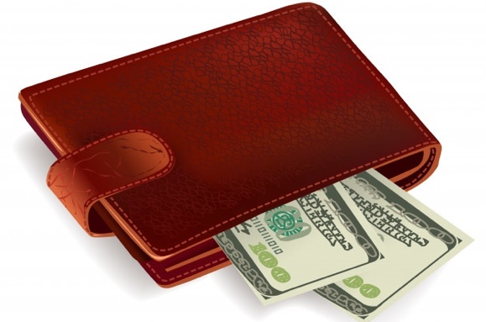
a bag
an ID
a key
a wallet

Slide 7
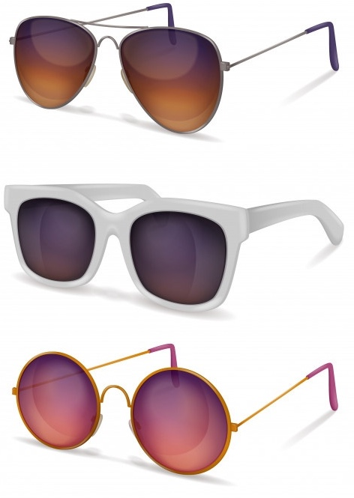
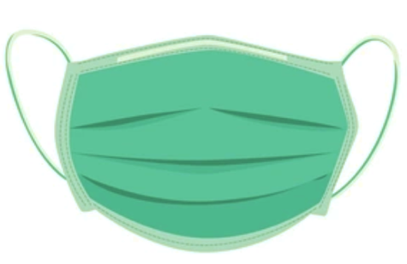
a face mask
sunglasses
luggage
bubble gum

Slide 8
to ring
to hold
to fill
to pack

Slide 9
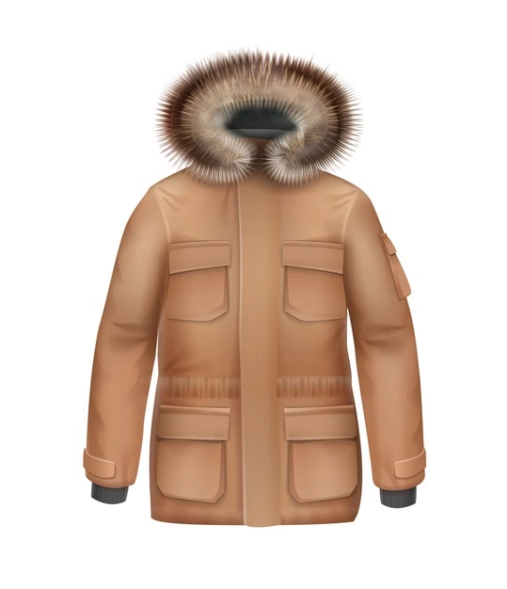
foggy
icy
snowy
a coat

Slide 10
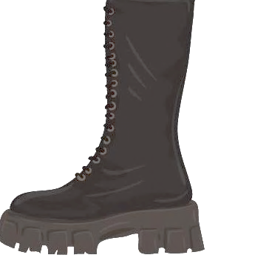
a boot
a hat
a glove
a scarf

Slide 11
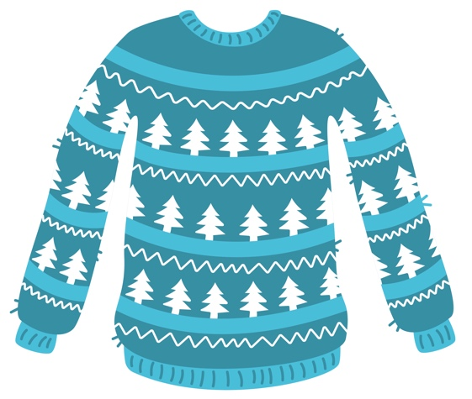
F
Hot
Warm
Cool
Cold
a jumper
temperature
warm
cool

Slide 12
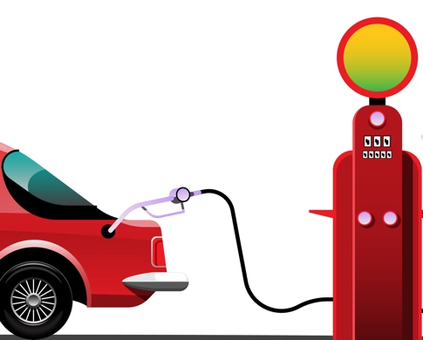
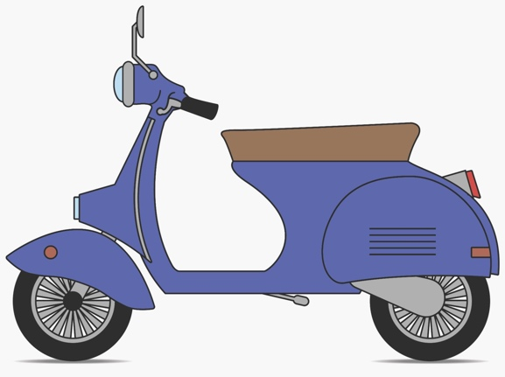
petrol
a ship
a moped
a van

Slide 13
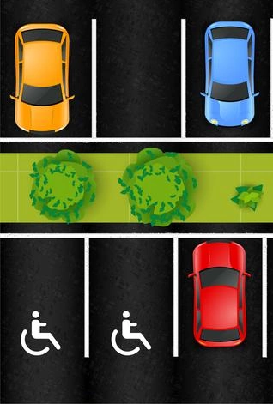
a motorway
a road
the tube
a car park

Slide 14
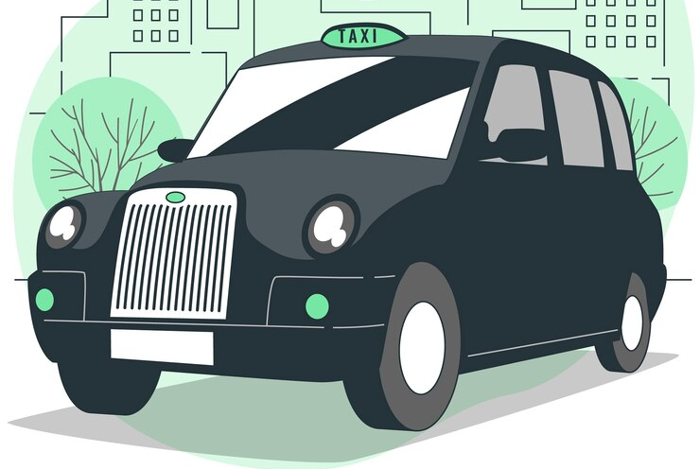
a taxi/cab
a bus stop
a passenger
to board

Slide 15
spring
summer
autumn
winter

Slide 16
6:00 -12:00 PM
a hotel
a holiday
today
a festival

Slide 17
midday/noon
midnight
early
late

Slide 18
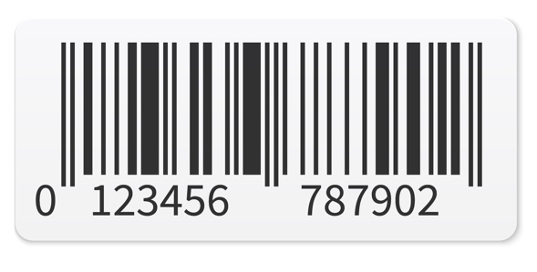
£39.99
£
a shopping trolley
a bar code
a shop assistant
a sale

Slide 19
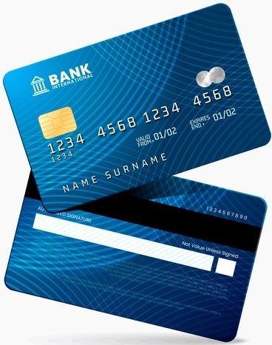
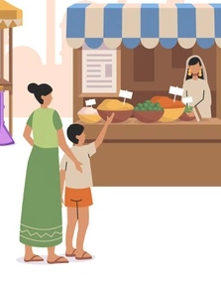
a credit card
a market
a receipt
cash

Slide 20
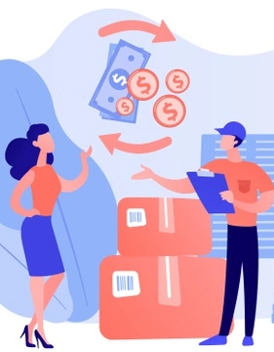
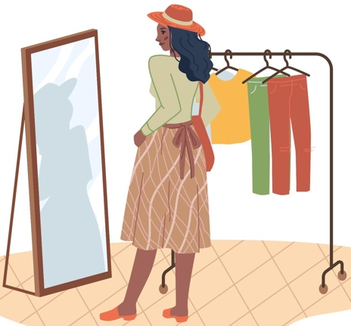
to return
to open
to close
to try on

Slide 21
Acknowledgements
We would like to thank the entire Light of the World volunteer team for their hard work and creativity in making this project possible. For all those around the world who prayed, wrote, edited, narrated, illustrated, sang, tested, and gave generously for this curriculum, we appreciate you sharing the love of Jesus through the gift of English. Our team members include:
Sara Scazzero
Hannah Schmokel
Ashlyn Shrimplin
Macie Stuckman
Leah Sprague
Ellie Talalight
Peter Talalight
Weston Talalight
Rachel Tamang
Darrell Turner
Graham Whitmore
Cheri Wilke
Mackenzie Williams
Muchun Yin
Ted York
Anita Zeifert
Anonymous
Jean Ato
Bradley Baurain
Joshua Blake
Rachael Braggs
Larry Buell
Cindy Campbell
Christian Cha
Olivia Cheney
Hannah Clark
Nancy Cobb
Emily Cox
Marilyn Dano
Susanna Diallo
Alyssa Dokolas
EasyReadEnglish.com
Don Edic
Peggy Fergus
MaryBeth Gahan
Melina Gallo
Alicia Gentile
Prakash Chandra Giri
Ellenor Gopal
Jill Gramzow
Rachel Grijincu
Carol Hale
Emily Hamilton
Patty Hickman Lyudmila Ivanyuk
Debbie Johnson
Carey Jo Johnston
Nancy Kingdon
Dorothy Konadu
Macy Lake
Martha Lane
Audrey Larsen
Tai Young Lee
Aden Lewis
Bruce Lewis
Elena Lewis
James Lewis
Micah Beth Lewis
Tim Lewis
Ward Lewis
Johnny Lukashevich
Gail MacMillan
Ivan Mader
Amy Martin
Diana Martz
Christy McPherson
Tracy Meddaugh
Barbara Newsome
Brenda Nielsen
Danielle Nowe
Deborah O’Donnell
Georg Ort
Martha Ort
Deb Payne
Linda Petrie
Joan Phelps
For more information, visit LiteracyInternational.net
©️ 2020-2025 Light of the World Learning

