Slide 1
Vocabulary Flashcards Units A2-08 to A2-14
©️ 2020-2025 Light of the World Learning

Slide 2
How to use the flashcards:
Download file in PowerPoint.
Play in Slide Show mode.
Click once to hear the audio.
Click again to see the word.
Try to say the words without listening.
Try to spell the words without reading.
You may also print, cut, and fold to make paper flashcards. (Print 1 slide per page, landscape).
Have fun, and may the Lord bless you!
©️ 2020-2025 Light of the World Learning
©2020-2022 Literacy International

Slide 3
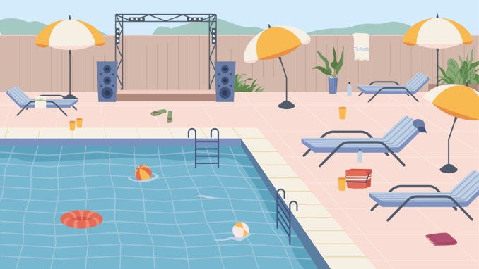
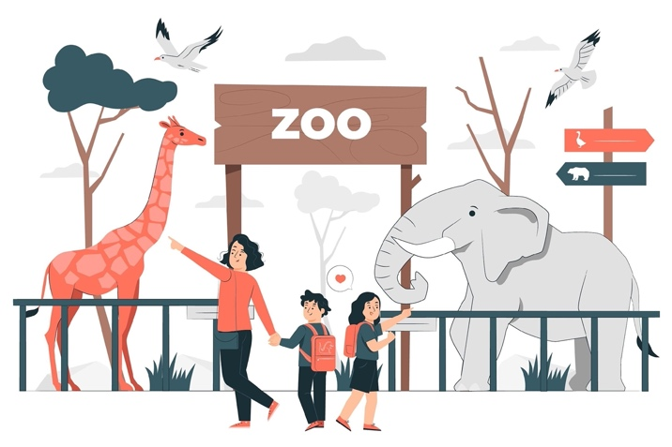
TOWN HALL
a swimming pool
a town hall
a zoo
a museum

Slide 4
a petrol station
a building
a playground
a pub

Slide 5
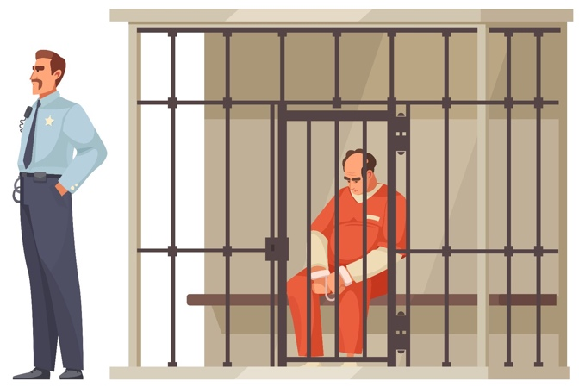
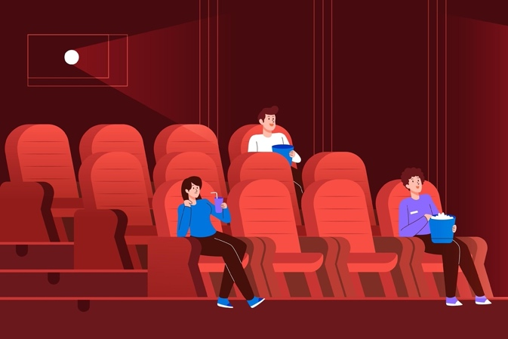
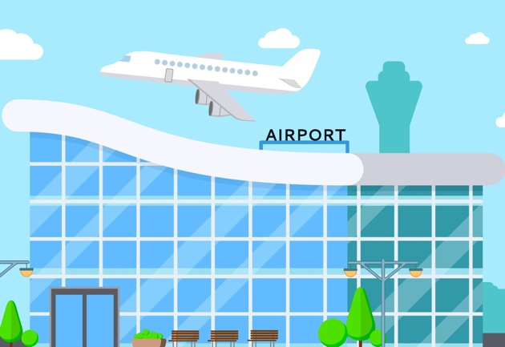
a jail/prison
a cinema
a police station
an airport

Slide 6
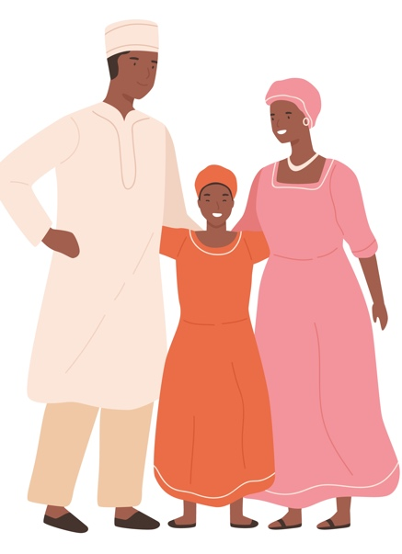
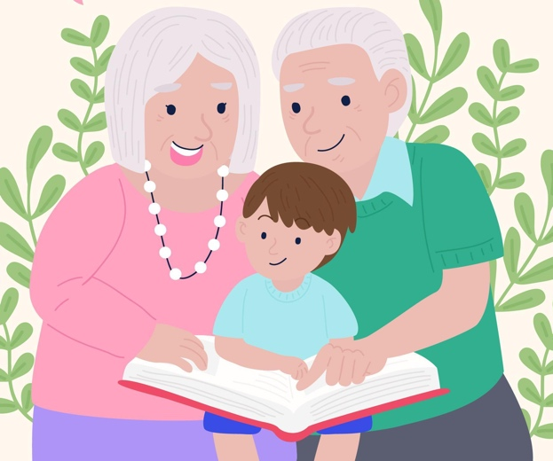
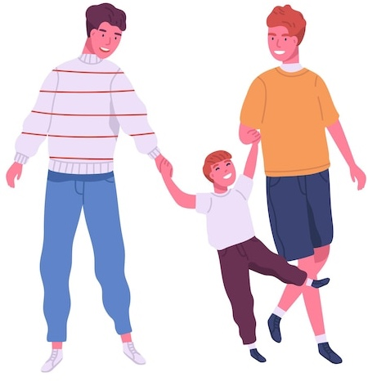
Dad
a parent
a grandparent
a sibling
an uncle

Slide 7
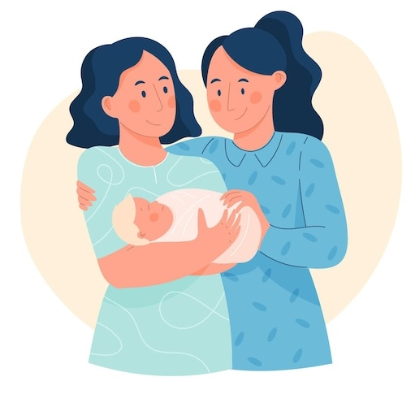
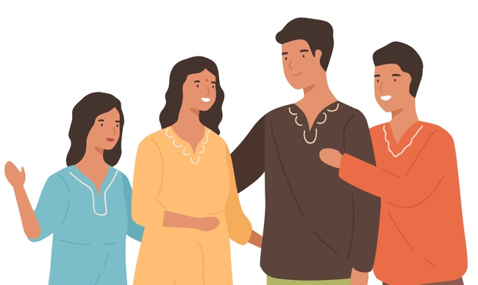
Aunt
Uncle
Mum
an aunt
a cousin
a home
a wedding

Slide 8
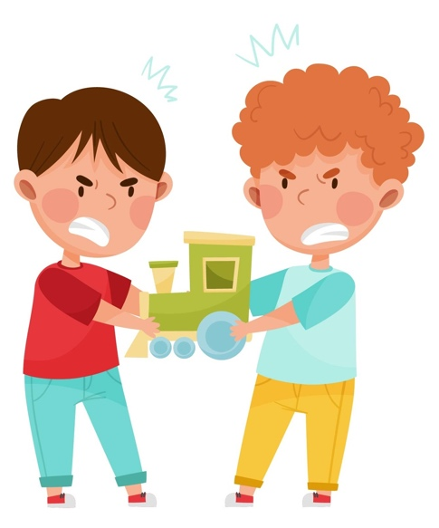
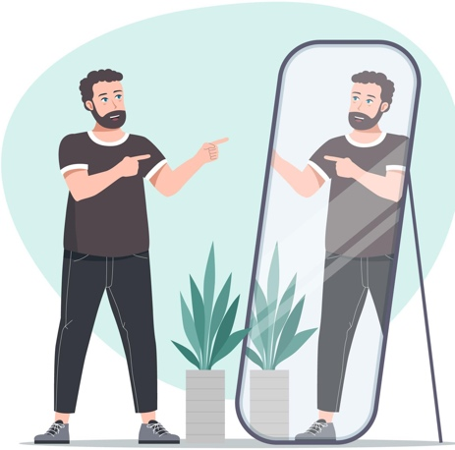
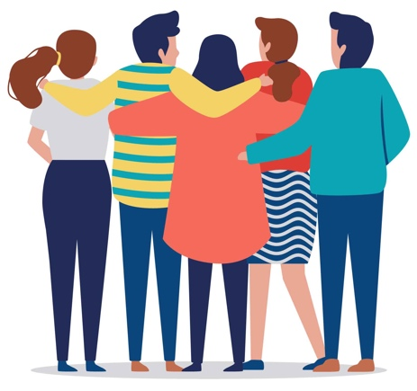
a guest
a mirror
to get along well
to fight

Slide 9
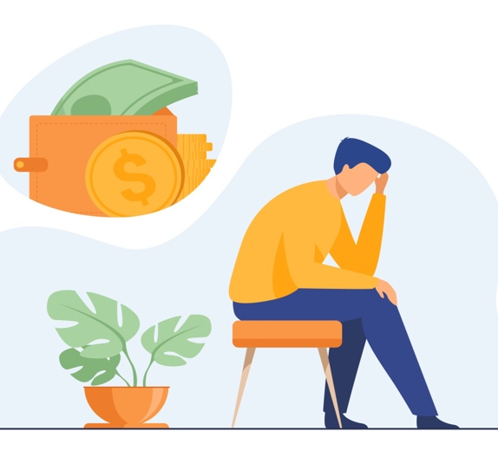
comfortable
uncomfortable
lonely
worried

Slide 10
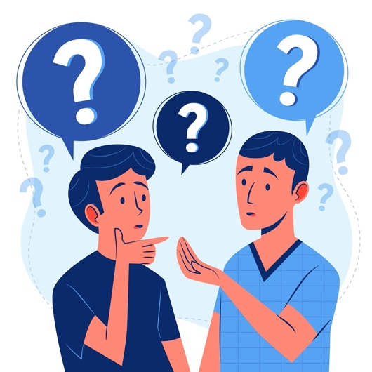
confused
excited
jealous
brave

Slide 11
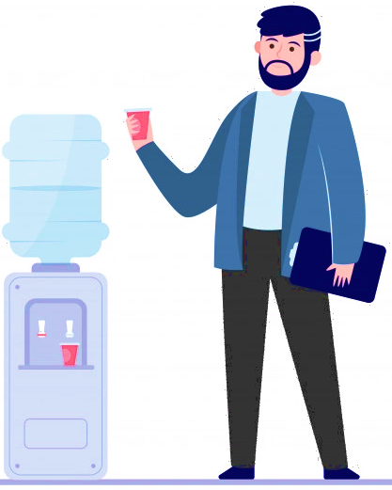
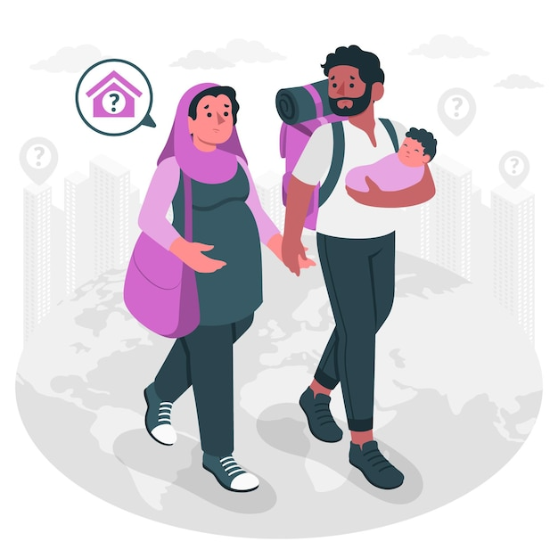
surprised
thirsty
upset
homesick

Slide 12
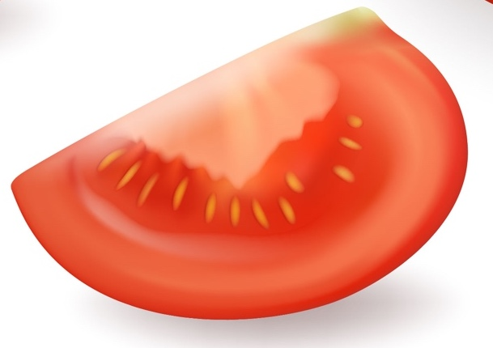
whole
half
quarter
a ruler

Slide 13
weighing scales
the volume
the width
the length

Slide 14
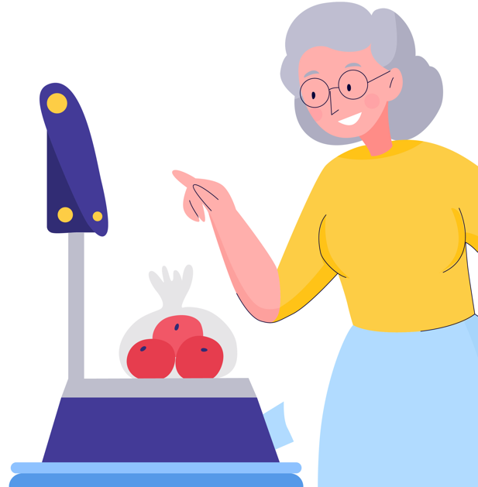
the height
the depth
to measure
to weigh

Slide 15
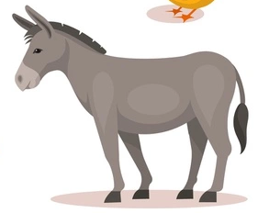
a donkey
a tomato
a pig
a seed

Slide 16
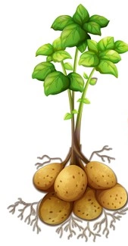
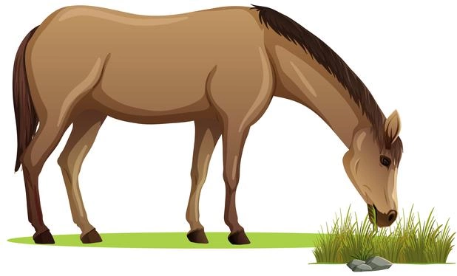
a horse
a potato
a bee
honey

Slide 17
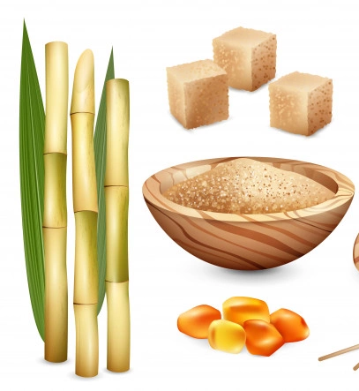
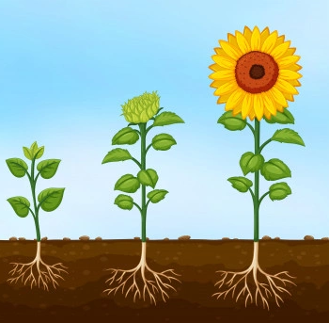
sugar
an orange
to pick
to grow

Slide 18
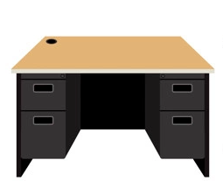
a factory
a machine
a desk
a co-worker

Slide 19
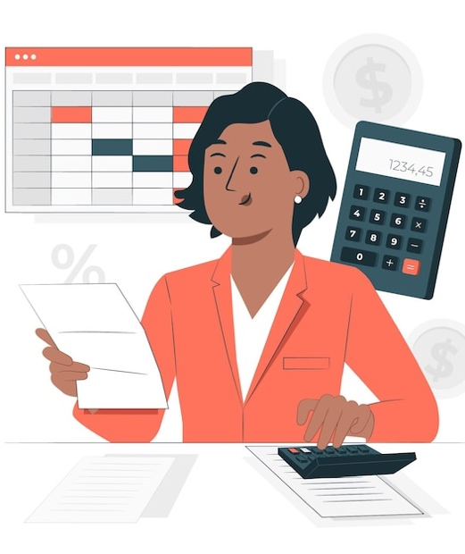
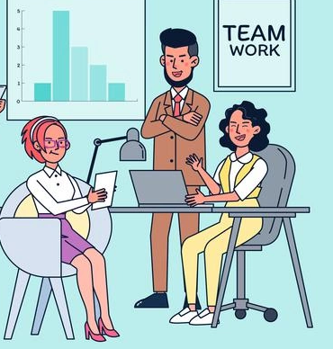
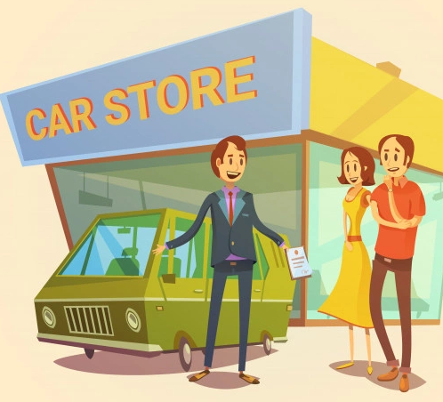
a boss
a salesperson
a chef
an accountant

Slide 20
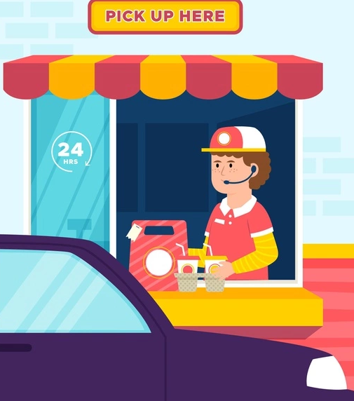
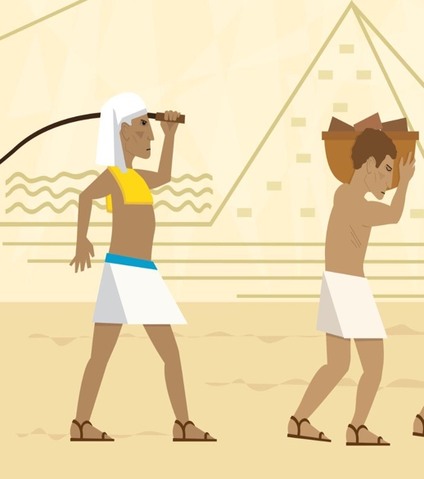
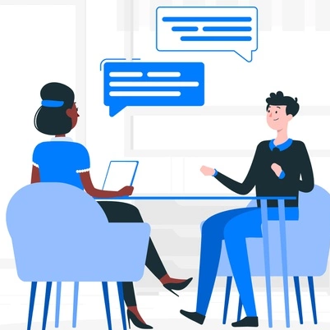
a customer services worker
a slave
to repair
to interview

Slide 21
Acknowledgements
We would like to thank the entire Light of the World volunteer team for their hard work and creativity in making this project possible. For all those around the world who prayed, wrote, edited, narrated, illustrated, sang, tested, and gave generously for this curriculum, we appreciate you sharing the love of Jesus through the gift of English. Our team members include:
Ashlyn Shrimplin
Leah Sprague
Macie Stuckman
Carole Svensson
Ellie Talalight
Peter Talalight
Weston Talalight
Rachel Tamang
Darrell Turner
Graham Whitmore
Cheri Wilke
Mackenzie Williams
Muchun Yin
Ted York
Anita Zeifert
Anonymous
Jean Ato
Bradley Baurain
Joshua Blake
Rachael Braggs
Larry Buell
Cindy Campbell
Christian Cha
Olivia Cheney
Hannah Clark
Nancy Cobb
Emily Cox
Marilyn Dano
Susanna Diallo
Alyssa Dokolas
Hephzi Davidson
EasyReadEnglish.com
Don Edic
Peggy Fergus
MaryBeth Gahan
Melina Gallo
Alicia Gentile
Prakash Chandra Giri
Ellenor Gopal
Jill Gramzow
Rachel Grijincu
Carol Hale
Emily Hamilton
Patty Hickman Lyudmila Ivanyuk
Debbie Johnson
Carey Jo Johnston
Nancy Kingdon
Dorothy Konadu
Macy Lake
Martha Lane
Audrey Larsen
Tai Young Lee
Aden Lewis
Bruce Lewis
Elena Lewis
James Lewis
Micah Beth Lewis
Tim Lewis
Ward Lewis
Johnny Lukashevich
Gail MacMillan
Ivan Mader
Amy Martin
Diana Martz
Christy McPherson
Tracy Meddaugh
Barbara Newsome
Brenda Nielsen
Danielle Nowe
Evelyn Ocasio
Deborah O’Donnell
Georg Ort
Martha Ort
Deb Payne
Linda Petrie
Joan Phelps
Sara Scazzero
Hannah Schmokel
For more information, visit LiteracyInternational.net
©️ 2020-2025 Light of the World Learning

