Slide 1
Unit B1-02
©2020-2024 Light of the World Learning
Notes:
Teacher’s Notes:
Bible Reading: Zechariah and Elizabeth.
Theme: Communication
Pronunciation: Minimal pairs /a/ & /e/.
Grammar: Review yes/no and wh-questions
Preparation:
Pray.
Read the Bible passages.
Preview slides and game.
Optional: Bring multiple real brochures as examples.

Slide 2
Pray, Review, and Preview
Bible Reading: Zechariah and Elizabeth Luke 1:5-25
and Psalm 104:24-35
Theme: Communication
Pronunciation: /a/ and /e/
Grammar: Review Yes/No and Wh- questions
Notes:
Pray
Pray for the class. You may want to thank the Lord for giving us the gift of communication.
Check homework and review.
Ask students to read aloud or recite their homework from the last class. Check written work.
Review the main points of the previous lesson and ask if there are any questions.
Be sure they have read the Bible passage in their native languages in preparation for the lesson.

Slide 3
What are the people doing?
Notes:
1A. Discuss Theme Picture
Ask “What are they doing?” and “What do you think will happen next?” to elicit vocabulary students already know.
Repeat and write their words or show the words on the next slide.
Answers may include: They are talking to each other. The people are communicating with each other. They are chatting.

Slide 4
Sarah and Emily are sisters. Sarah was feeling sad because her dog died. So Emily decided to show her a brochure about a trip to Italy. Emily wanted to offer to take Sarah on this trip to help her feel better. It was not hard for Emily to convince Sarah to come on the trip. Sarah completely agreed the trip would be fun.
So Sarah and Emily went to Italy. Emily was able to encourage Sarah while they were on their trip. They had a good time and had nothing to complain about.
Discuss with a partner:
How do you encourage your friends and family?
Tell about a time you convinced someone to do something.
Notes:
1B. Read about the theme picture and discuss with a partner
Please read the description of the theme picture to the students and point to the pictured vocabulary. If students ask about words, give simple definitions.
Then ask students to work in pairs and discuss the questions.

Slide 5
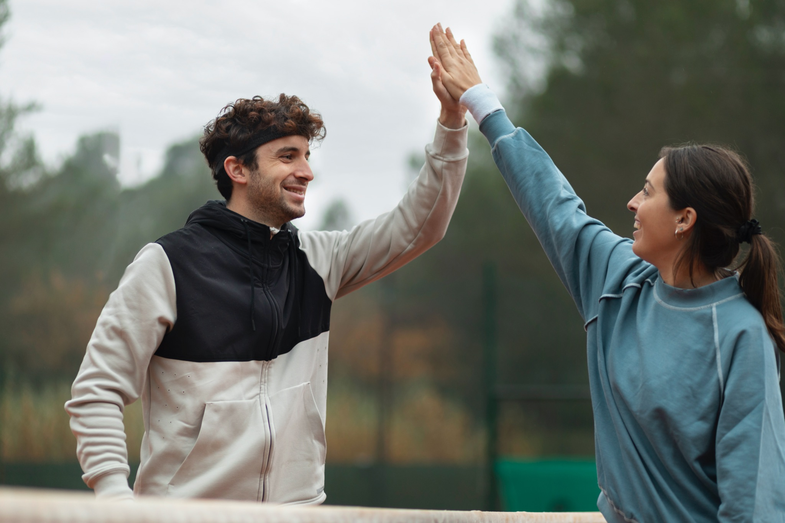
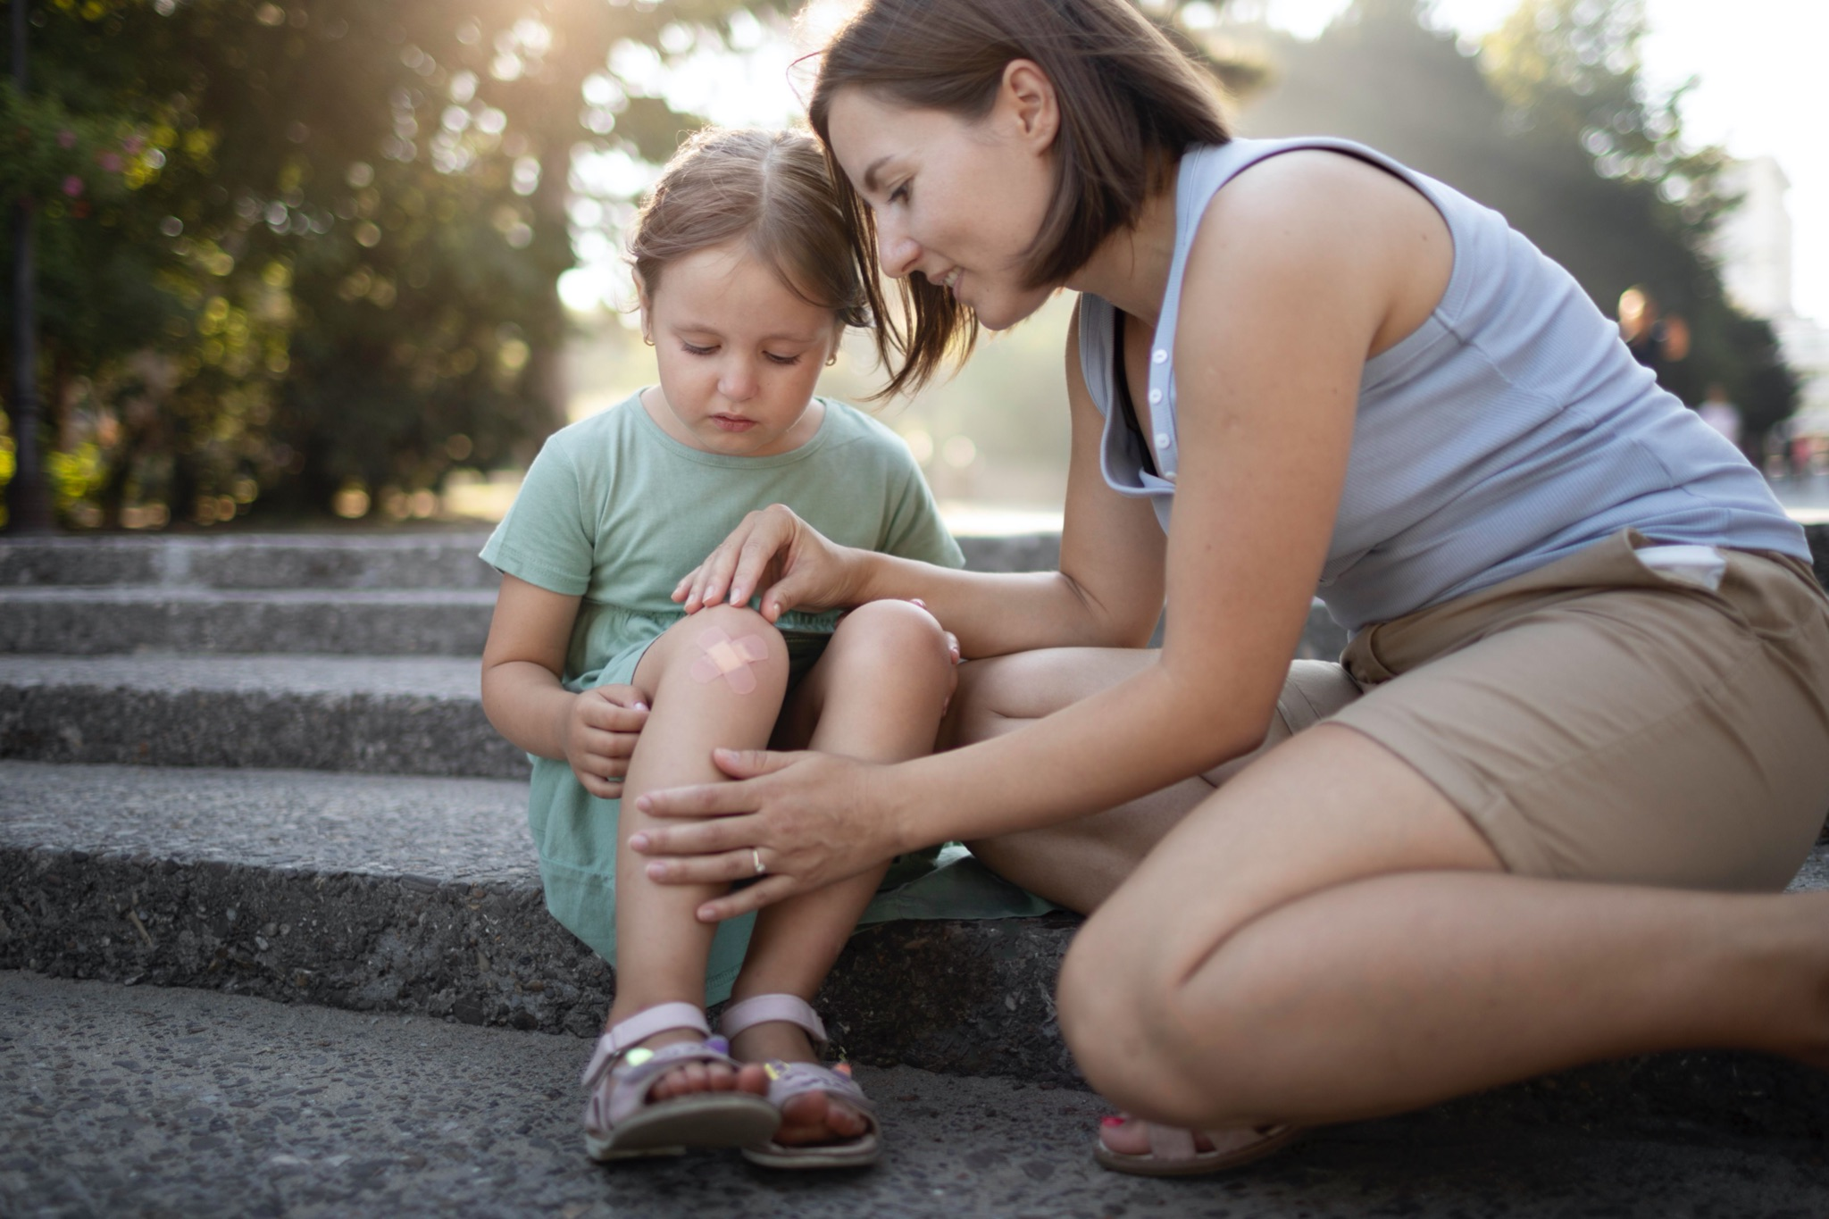
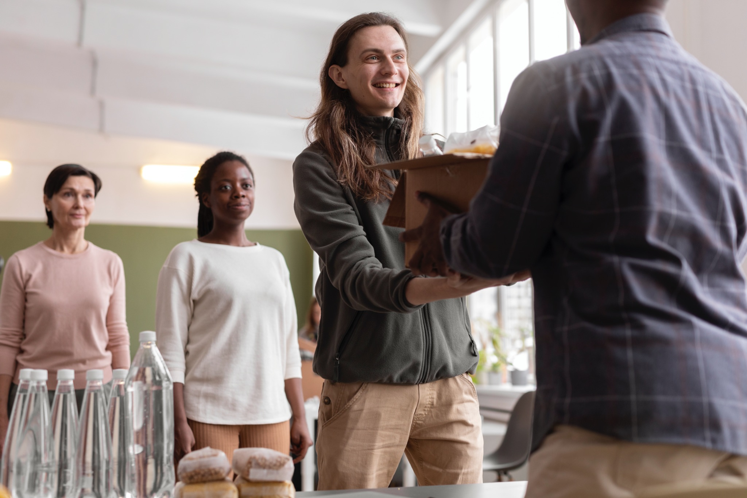
Match the definitions to the correct words.
1. to encourage | 2. to complain | 3. to offer | 4. to blame
To be hurt or annoyed and tell others
Saying someone else did wrong; not you
Telling someone “good job!” “you can do it!”
Asking if you can help someone
Notes:
2A. Vocabulary
1. Say the word a few times, as you indicate the picture. For example, say, ”encourage, encourage, encourage.” Have your students then repeat the word after you a few times.
2. Ask students to match the word to the correct definition and say the answer as a sentence. For example, “Encourage means telling someone “good job!”/”you can do it!”.
3. Check students’ comprehension further by asking direct questions. For example, “What can you say to encourage someone?” “Do I encourage you in class?” “Do you encourage your friends?”
Answers
1. C
2. A
3. D
4. B

Slide 6
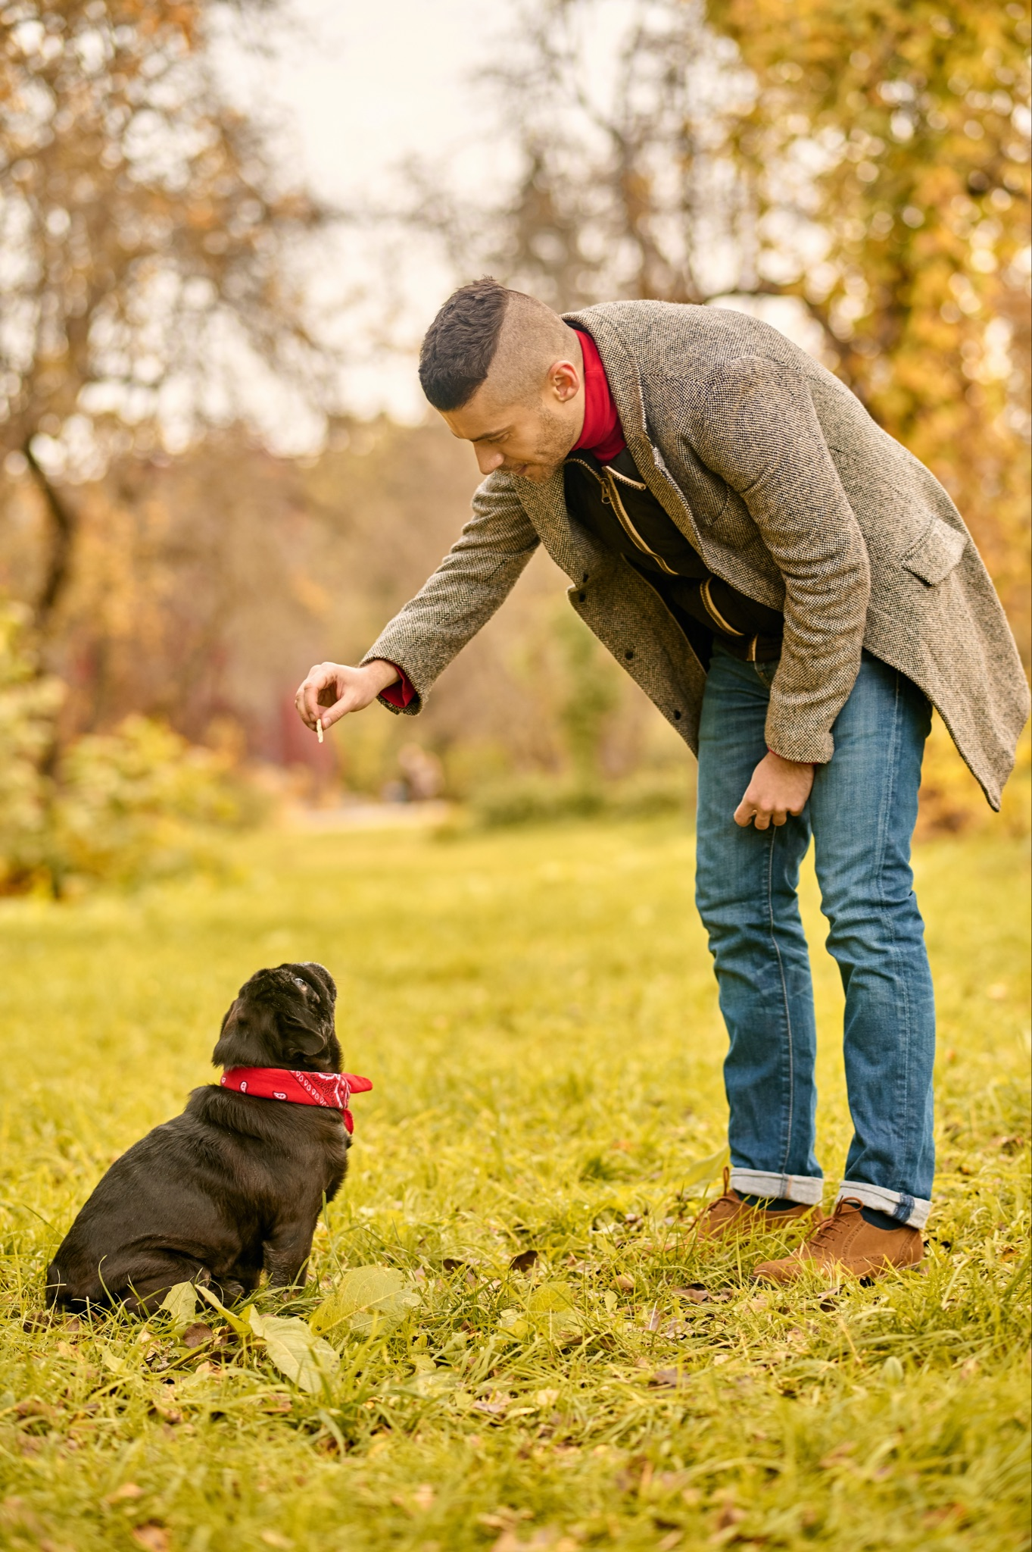
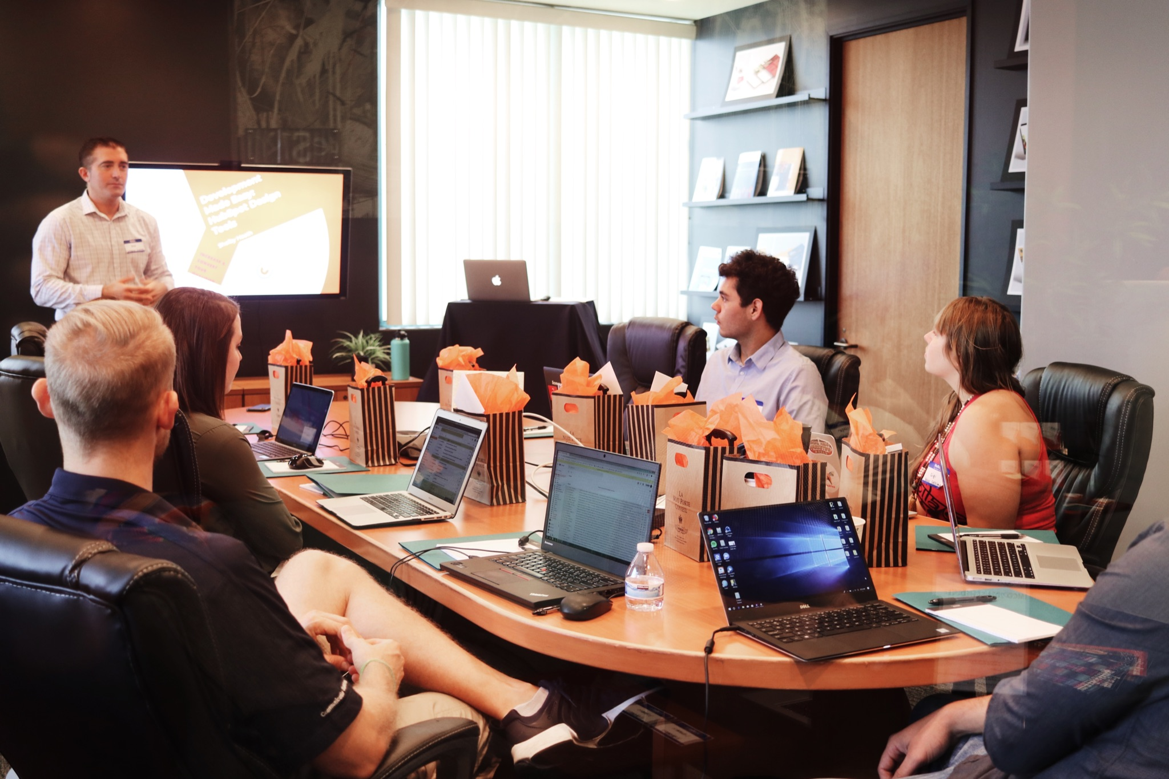
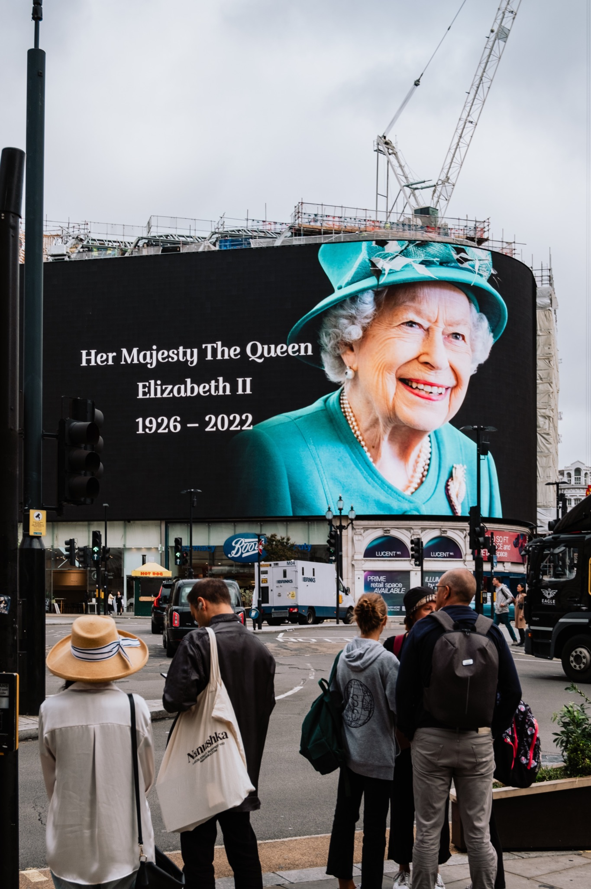
Match the definitions to the correct words.
5. to command | 6. to convince | 7. to rule | 8. to confirm
To help people see or think you are right
Telling someone to do something
To say something is true, or find out if it is true
To be in charge
Notes:
2B. Vocabulary
1. Say the word a few times, as you indicate the picture. For example, say, ”rule, rule, rule.” Have your students then repeat the word after you a few times.
2. Ask students to match the word to the correct definition and say the answer as a sentence. For example, “To rule means to be in charge.”
3. Check students’ comprehension further by asking direct questions. For example, “Who used to rule England?” “Who rules the United States?” “Can you think of someone else who rules?”
Answers
5. B
6. A
7. D
8. C

Slide 7
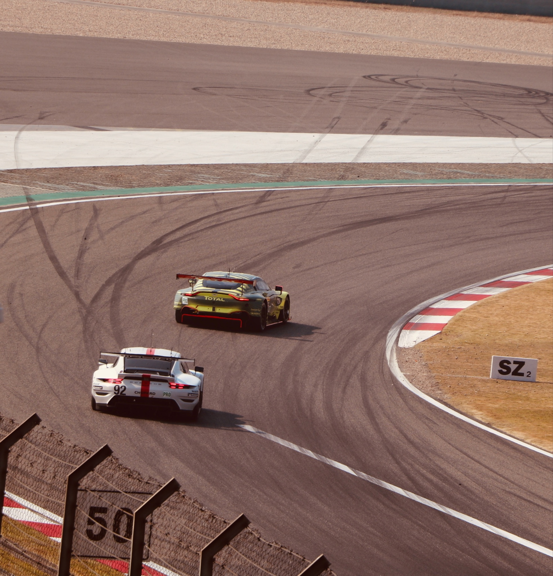
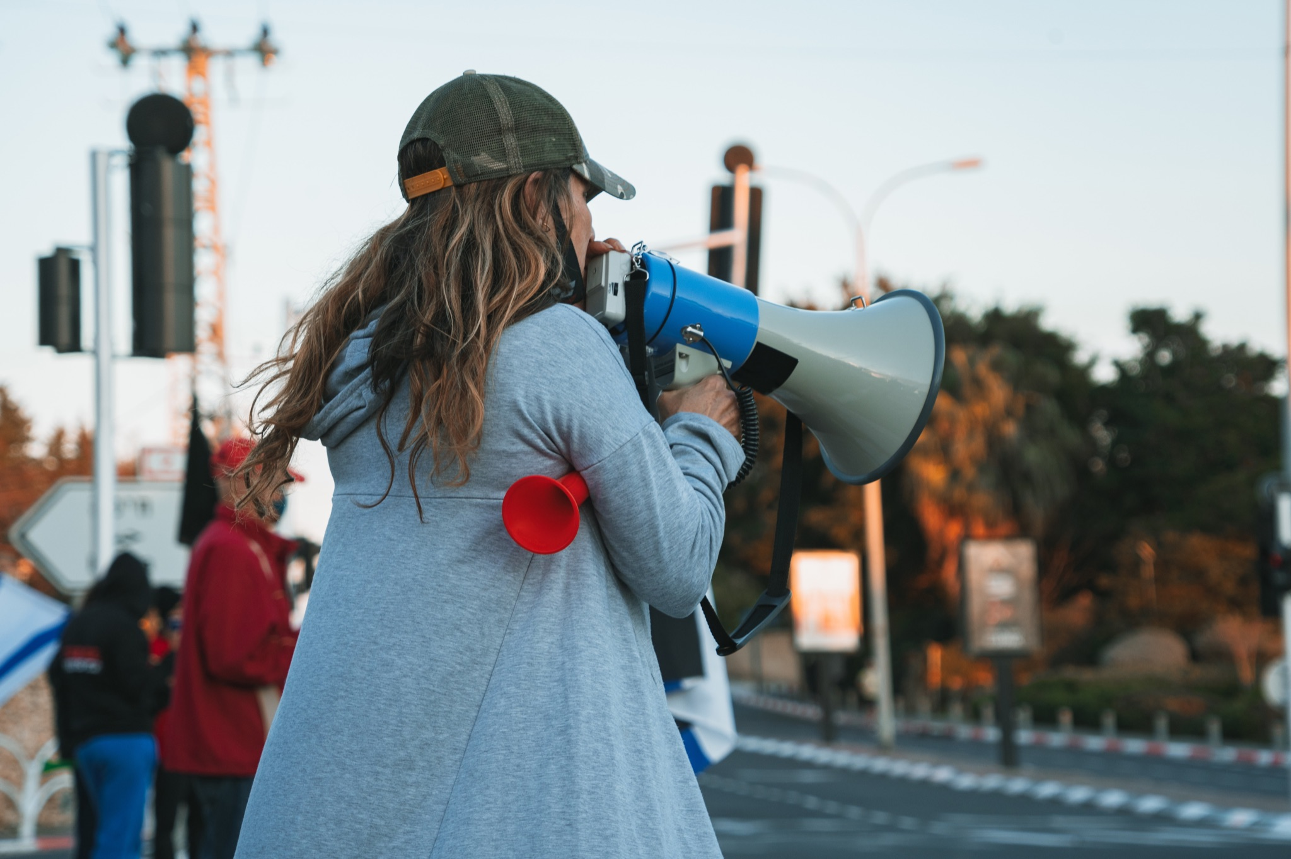
Match the definitions to the correct words.
9. to announce | 10. a brochure | 11. completely | 12. ahead
A paper advertisement with pictures
To tell people news or something important
In front of, doing better than someone else
Totally, in every way
Notes:
2C. Vocabulary
1. Say the word a few times, as you indicate the picture. For example, say, ”ahead, ahead, ahead.” Have your students then repeat the word after you a few times.
2. Ask students to match the word to the correct definition and say the answer as a sentence. For example, “Ahead means in front of, or doing better than someone else.”
3. Check students’ comprehension further by asking direct questions. For example, “Which car is ahead?” “Were you ever ahead of others in school?” “Can you show “ahead” using your hands?”
Answers
9. B
10. A
11. D
12. C

Slide 8
Wh-Questions
 | Wh- Questions | Auxiliary | Subject | Main Verb
1 | Who | had | you | blamed at first?
2 | ______ | is | she | offering?
3 | Where | did | ______ | confirm the deal?
4 | When | do | you | ______ the most?
5 | Why | ______ | you | encouraging me?
Notes:
2D. Grammar – Wh- Questions
Note: There are two types of questions, information (Wh-questions) and Yes/No Questions (covered on the next slide). The type of question, Wh- or Yes/No determines the kind of answer that the person asking the question is asking for and that the person answering the question should give.
This chart shows how to ask Wh-questions with auxiliary verbs. This is the formula we use. Auxiliary verbs are helping verbs, and in Wh-questions they are the first verb, and the main verb comes at the end. These Wh-questions would not be complete without the auxiliary verbs. When we add in an auxiliary verb to a Wh-question it allows us to ask Wh-questions in the present continuous, past continuous, past perfect, and the past tense.
Model, Repeat, and Solo row number 1. Then ask students to complete the sentences for rows 2-5.
Answers:
2. What
3. He/she/you/they/we (all subjects work here)
4. Complain
5. Were
Credit to Hannah Dalton for the explanations of the two types of questions.

Slide 9
Yes/No Questions
 | Auxiliary Verb | Subject | Main Verb
1 | Did | the brochure | give lots of information?
2 | ______ | you | encourage your friends?
3 | ______ | she | complained everyday?
4 | Have | ______ | ever ruled a country?
Notes:
2E. Grammar: Yes/No Questions
Note: Yes/No questions are different from Wh-Questions because, yes/no questions are questions asked that are answered with either Yes/No. Yes/No questions refer to the answer that should be given. Whereas Wh-Questions refer to which Wh-word is used at the beginning of the question and thus what kind of information should be given in the answer.
Yes/No questions are questions that are answered with either “Yes” or “No”. Yes/No questions are not asking for specific information like Wh-Questions. Most Yes/No questions can be answered with a simple “Yes” or “No”, and can also be answered with ‘Yes’ or ‘No’ at the beginning of the answer, followed by the subject and auxiliary verb, for example, “....I do”. The whole answer with that would be, “Yes, I do”. Some Yes/No questions can be answered personally, with what is true about you. Generally if the person asking the question asks a Yes/No question with “you” in it, you can answer the question personally. Some Yes/No questions require a right answer that is not personal and someone other than you may also be able to answer.
We also use auxiliary verbs in Yes/No questions. Unlike Wh-questions, Yes/No questions do not have a Wh-question word, so the first word in the question is the auxiliary verb. The subject comes next, then the main verb. In number one “the brochure” is the subject, because the question is being asked of the brochure, rather than a person (you, he, she etc.)
Model, Repeat, and Solo row number 1. Then ask students to fill in the blanks for rows 2-4.
Answers:
2. Do
3. Has
4. You

Slide 10
Listen and repeat.
A: Hi _______! I have some very _______ news!
B: Hi _______! I would ______to guess, but you are so _______ and you called to _______ it to me!
A: _______ called to _______ I got the _______!
B: _______ that is _______ news! When did _______ call?
A: _______ called _______. I am _______ surprised because I did not think I would be picked _______ of _______.
B. Well, good job!
Notes:
3. Conversation
Ask the students to brainstorm to fill in blanks of the conversation according to the pictures.
Model: Role-play the parts with a student to convey the meaning of the conversation.
3. Solo: You begin the conversation and call on individual students to respond. Then reverse the roles (students are A, you are B).
4. Once students can do both parts, encourage free conversation (students substitute their own words for the blanks).
Answers: (If students need help filling in the blanks)
(any name)
exciting
(any name other than the one used for the first blank)
offer
excited
announce
(any name other than the two already used)
confirm
job
(name of “A”, used for blank 3)
good
(Same name as used in blank 7)
(Same name as 7 and 12)
yesterday
very
ahead
(any name, but it needs to be a different name than the ones that have already been used)

Slide 11
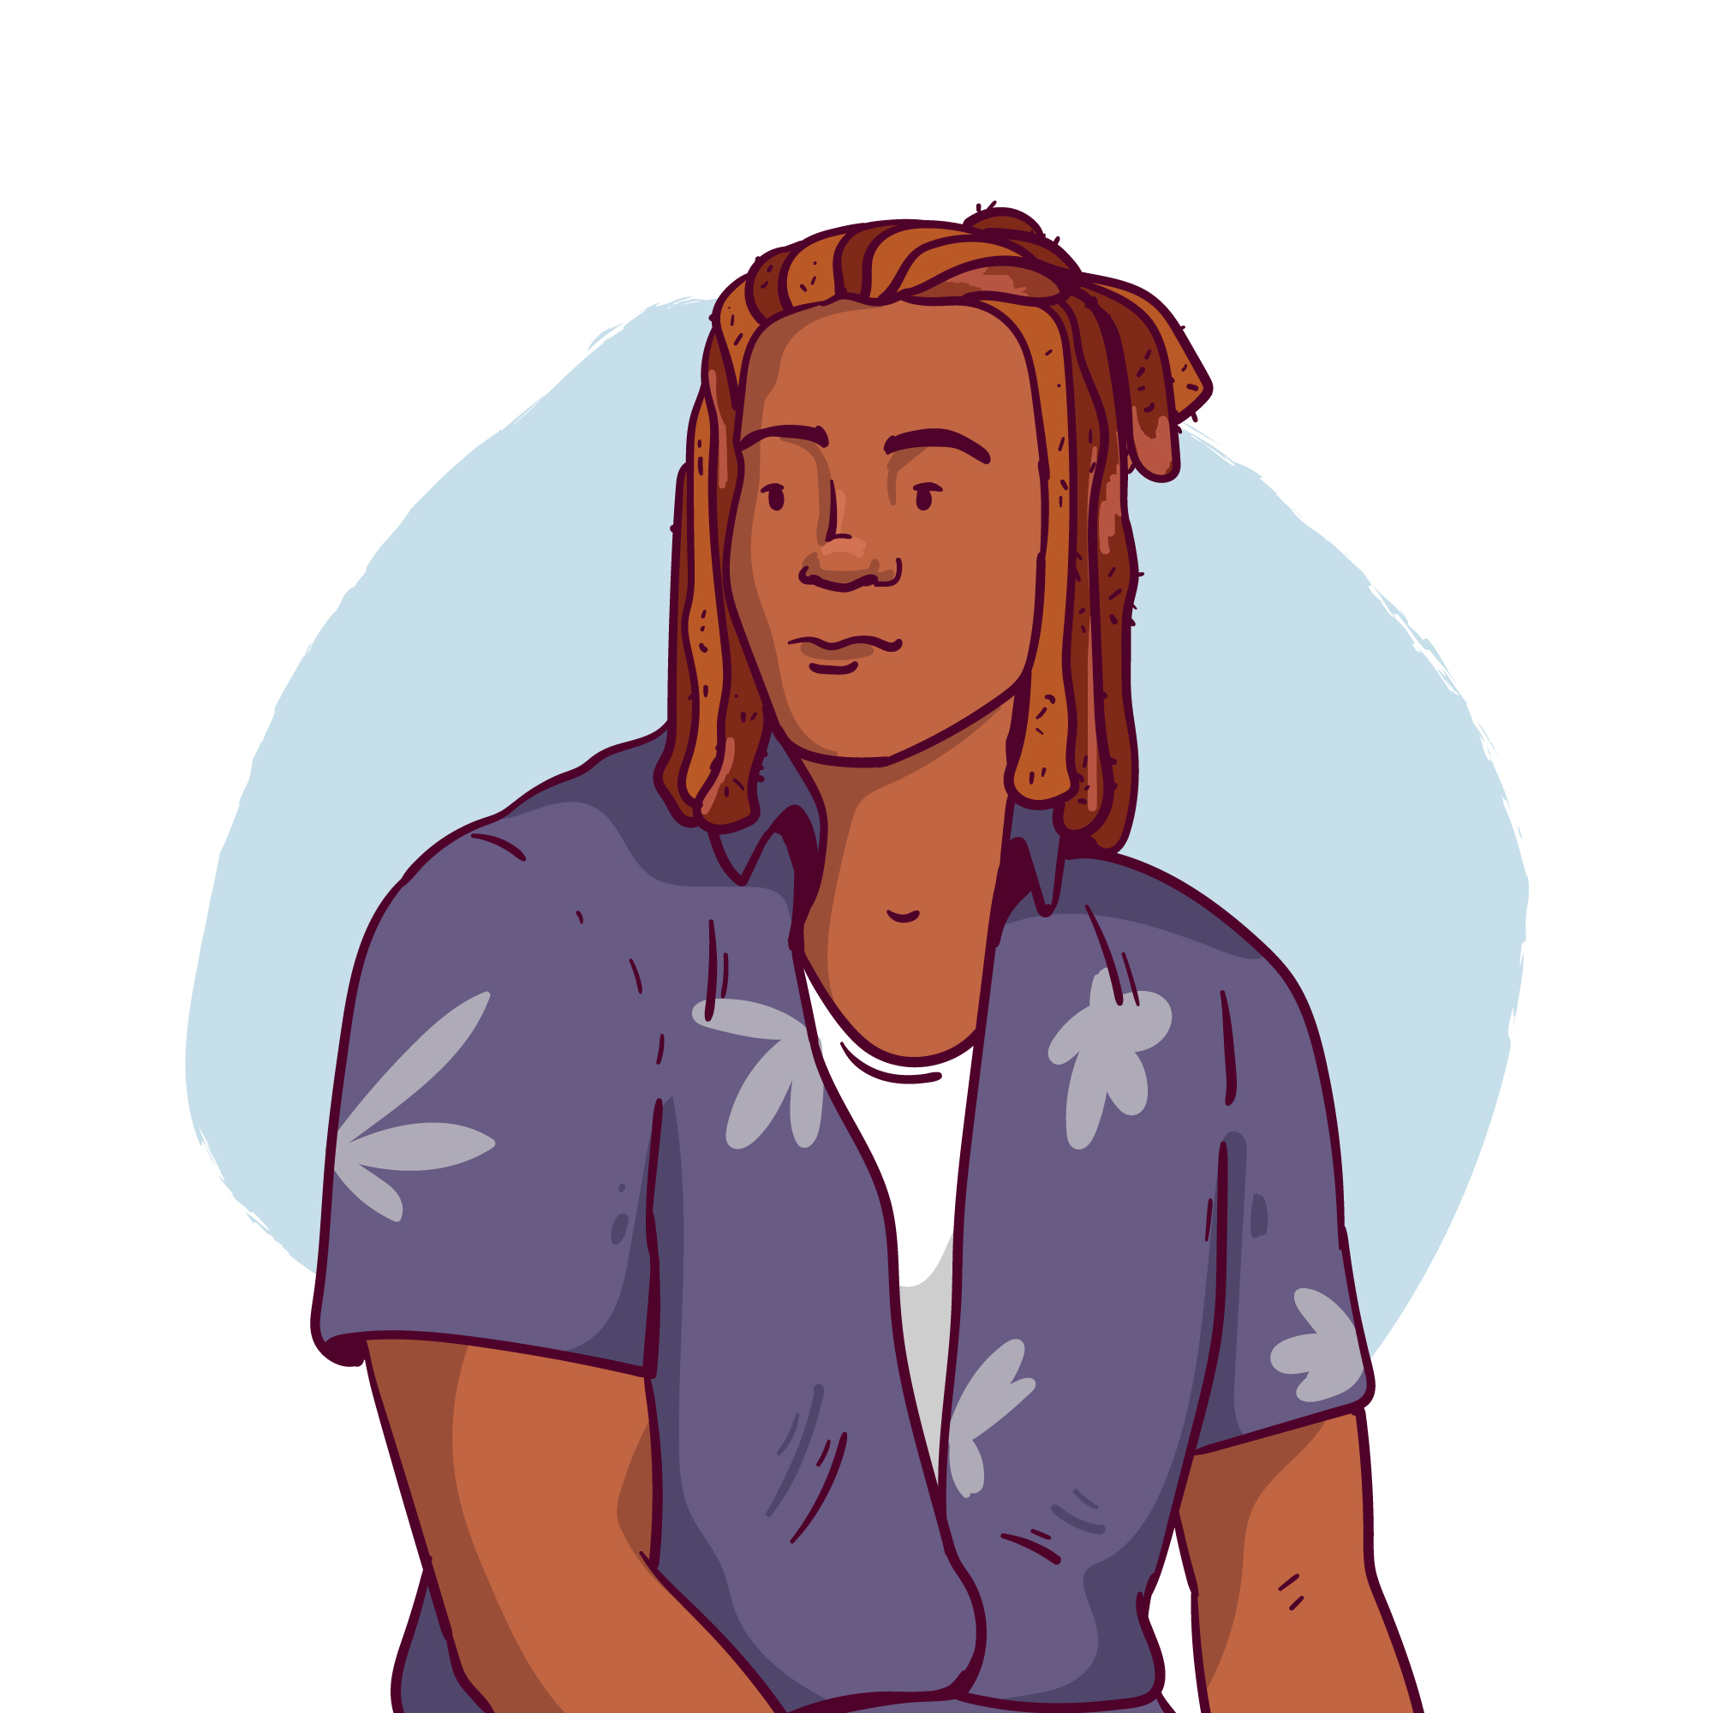
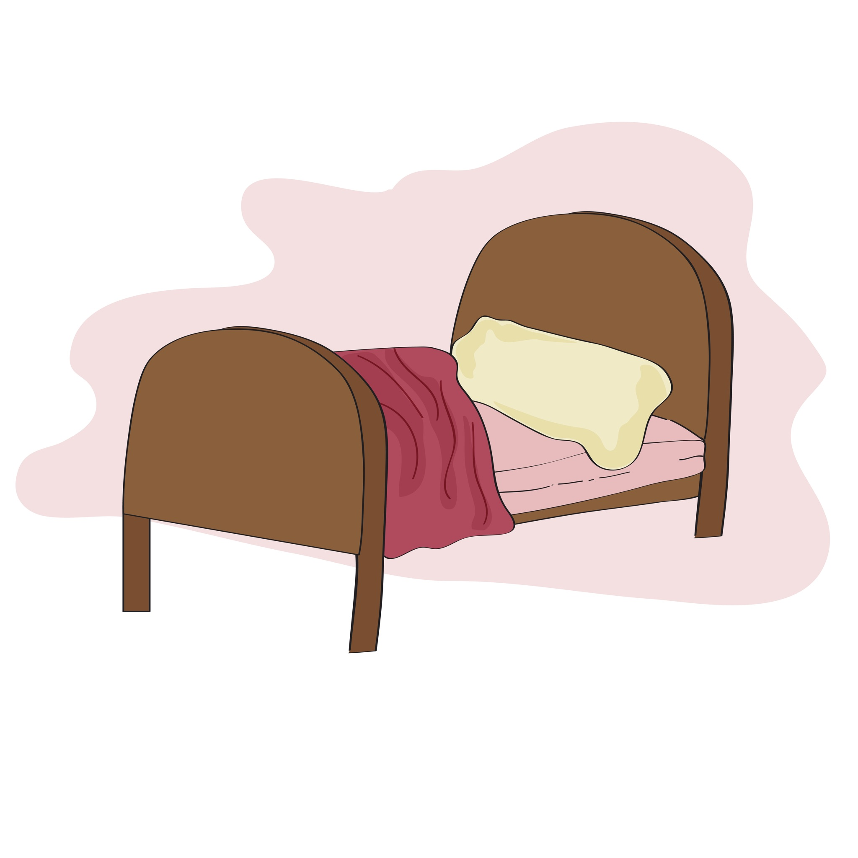
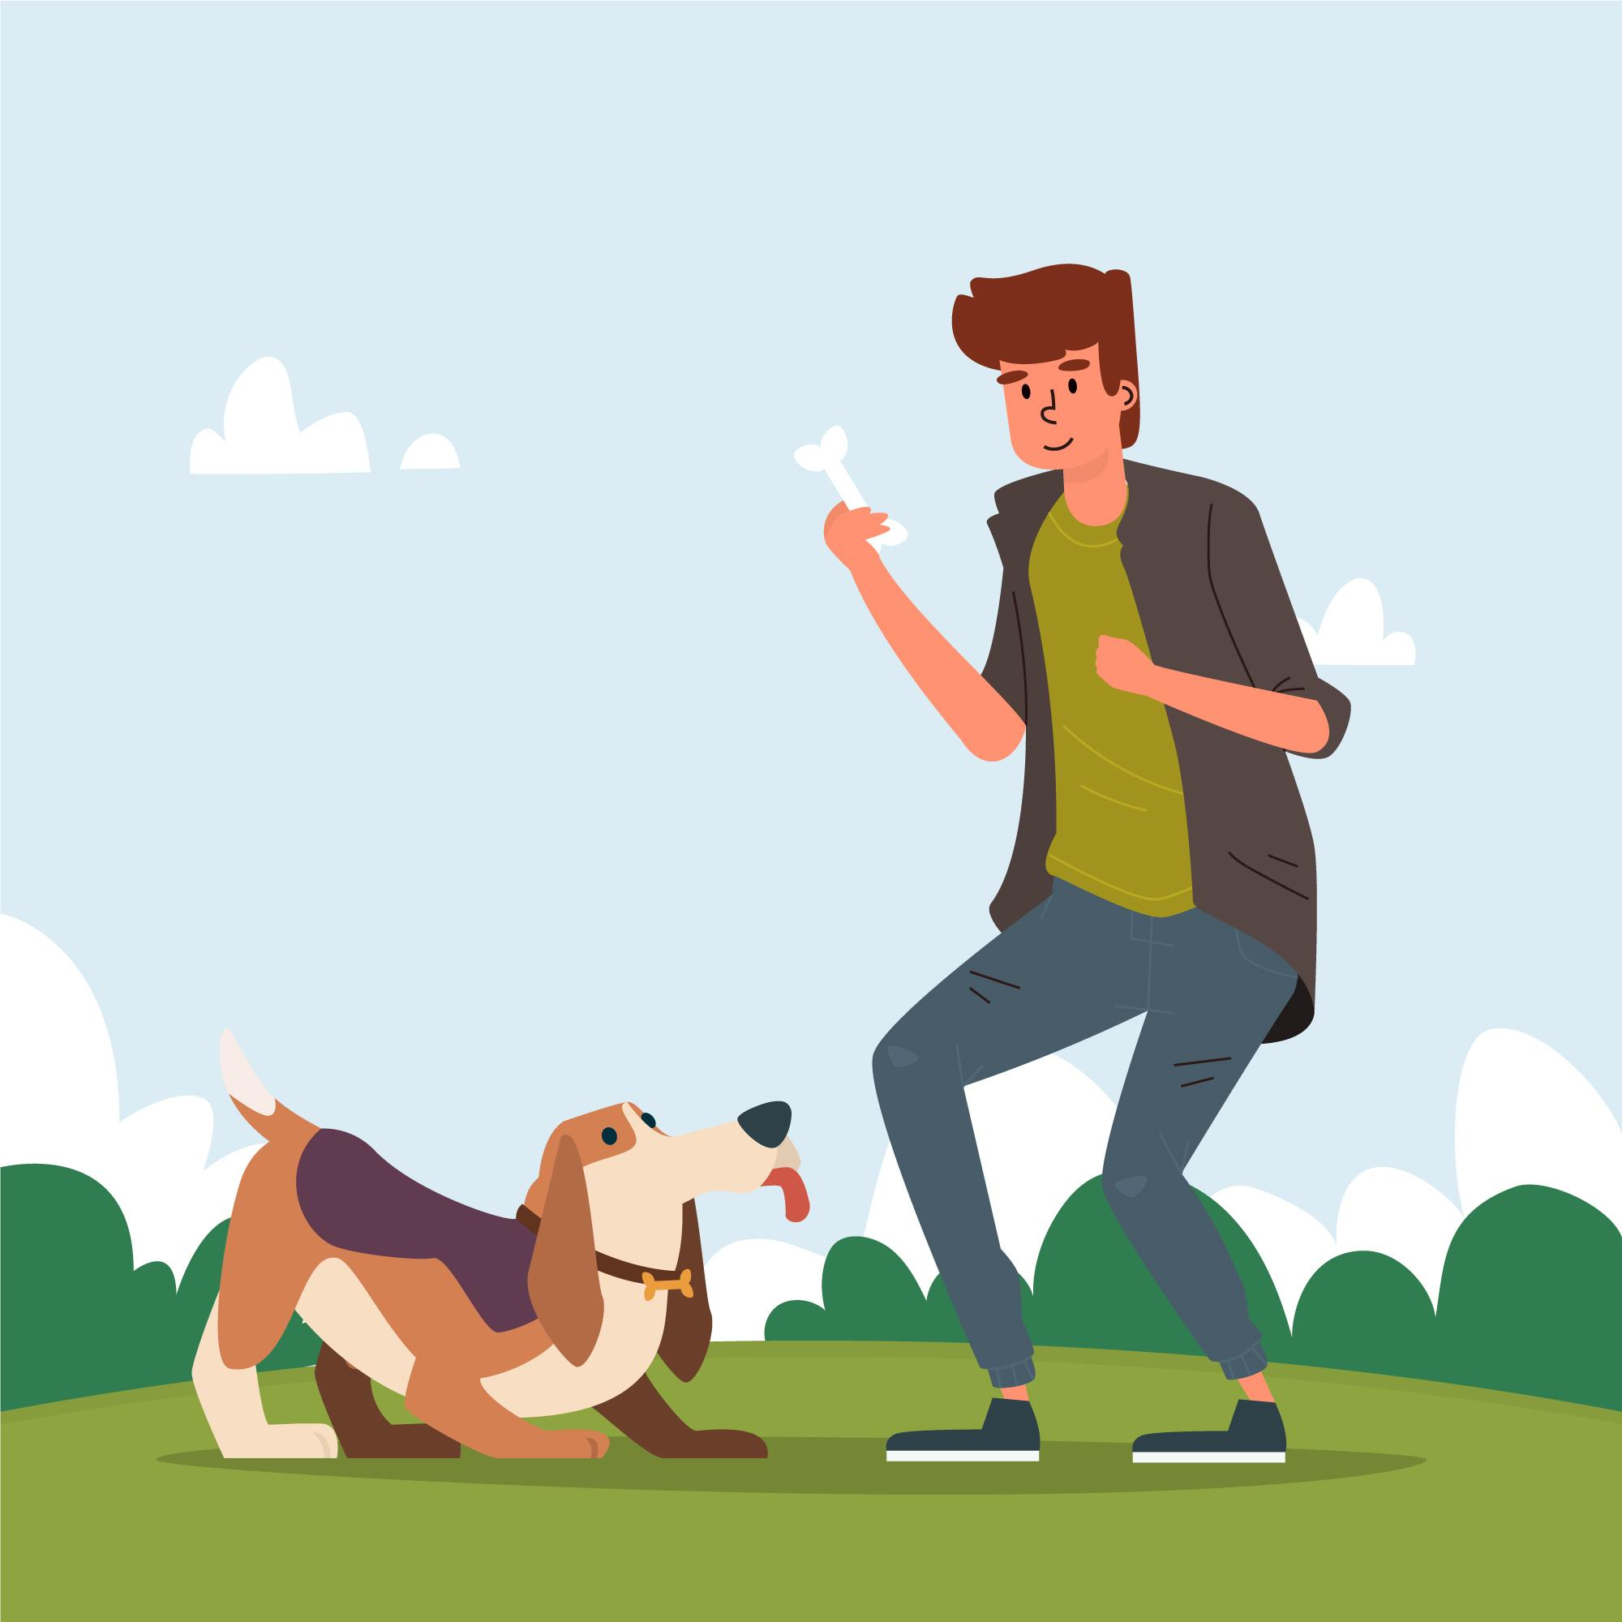
Practice the /a/ and /e/ sounds. Then listen to the sentences and circle the word you hear.
 |  | /a/ | /e/
1 |  | land | lend
2 |  | Brad | bread
3 |  | bad | bed
4 |  | command | commend
5 |  | man | men
Notes:
4A. Pronunciation – Minimal Pairs
In this section we will practice distinguishing between the /a/ and /e/ sounds.
1. Model: Read each row several times and point to the words while students listen. For example, ”Number 1, land, lend, land, lend, land, lend.” Then ask students to repeat the words
2. Read the sentences below and ask students to circle the word that they hear.
How do you say land in your language?
I like bread.
How do you spell bad?
We commend you.
The man went to the store.

Slide 12
Most 2-syllable nouns are stressed on the first syllable
 | A. ▔ - |  | B. ▔ - |  | C. ▔ - |  | D. - ▔ Nouns that are different
1 | water | 6 | listen | 11 | insect | 16 | brochure
2 | address | 7 | female | 12 | headache | 17 | Police
3 | people | 8 | breakfast | 13 | prison | 18 | report
4 | minute | 9 | August | 14 | student | 19 | hotel
5 | scissors | 10 | sister | 15 | subway | 20 | event
Notes:
4B. Pronunciation - Hum and clap the stress.
Most 2-syllable nouns in English are stressed on the first syllable. There are some 2-syllable nouns that are stressed on the second syllable though. The vocabulary word from today’s lesson, brochure, is an example.
Begin by humming the stress of Column A. Hum higher, longer, and louder for big dashes and lower, shorter, and quieter for small dashes. You may also use hand gestures to indicate that the stressed syllable is higher in pitch, longer in duration, and louder. Invite your students to join in humming or clapping the rhythm.
1. Model: Hum and then say each word in the columns A-C several times. Students listen. Then hum and say each word in column D.
2. Repeat: Students repeat words after you in unison.
3. Solo: Call on individuals to read the columns and words with the correct stress.
4. Listen: Read the following sentences and have students circle the word they hear.
1. He likes to eat a big breakfast. 2. A brochure came in the mail today. 3. We had fun at the event last week. 4. The water was very cold. 5. There is only one female in my class. 6. I will be home in one minute. 7. The weather report was interesting today. 8. The man went to prison for his crime. 9. My mom’s birthday is in August. 10. My friend has a bad headache. 11. Can you please listen to me? 12. The hotel was very big. 13. What is your address? 14. 10 people came to my party. 15. The police were guarding the bank. 16. A butterfly is an insect. 17. I need scissors to cut this paper. 18. Do you ride the subway? 19. I am a good student. 20. My sister likes loves ice cream.

Slide 13
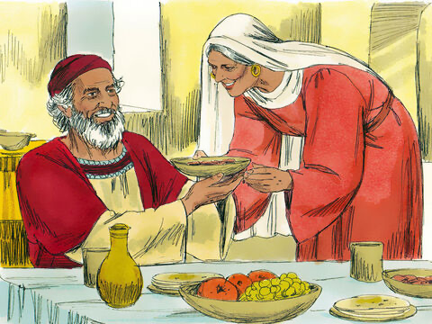
Luke 1:5-25 ERV
Zechariah and Elizabeth
⁵ During the time when Herod ruled Judea, there was a priest named Zechariah. He belonged to Abijah’s group.^{[a]} His wife came from the family
of Aaron. Her name was Elizabeth.
⁶ Zechariah and Elizabeth were both good people who pleased God. They did everything the Lord commanded, always following his instructions completely.
a: Abijah’s group Jewish priests were divided into 24 groups. See 1 Chron. 24
Notes:
5A. Bible Reading
Students should have already read this story in their first language (L1) as part of their homework, so it will be familiar even if they do not know all the vocabulary yet. However, if they have not yet read it in their L1, be sure they do so now before reading it in English. The hyperlinks of the Bible verses connect to https://live.bible.is/ so students can read and hear the scripture in their own languages. You may also watch videos of the passage at the website.
A. Read the story out loud to the class.
B. If students ask about words, give simple definitions.
C. Encourage students to read aloud verses from the story and act out the scene.
D. Ask if there are any questions or comments about the story.
E. Ask the story questions and discuss as a group.
F. Optional - You may hide the words and ask students to tell the story again in their own words, using the pictures to help them.

Slide 14
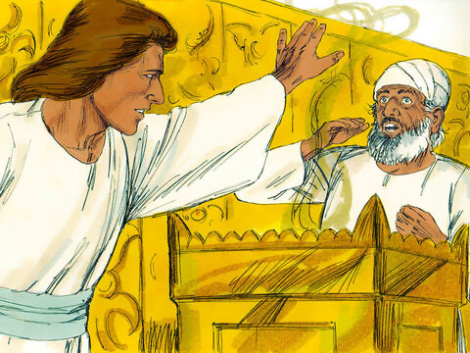
⁷ But they had no children. Elizabeth could not have a baby, and both of them were very old. ⁸ Zechariah was serving as a priest before God for his group. It was his group’s time to serve.
⁹ The priests always chose one priest to offer the incense, and Zechariah was the one chosen this time. So he went into the Temple of the Lord to offer the incense.¹⁰ There was a large crowd outside praying at the time the incense was offered.
¹¹ Then, on the right side of the incense table, an angel of the Lord came and stood before Zechariah.
Notes:
5B. Bible Reading
A. Read the story out loud to the class.
B. If students ask about words, give simple definitions.
C. Encourage students to read aloud paragraphs from the story and act out the scene.

Slide 15
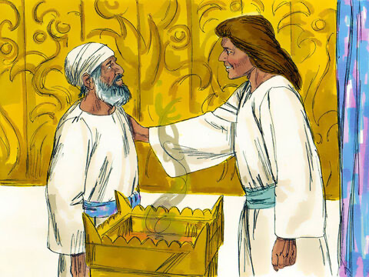
¹² When he saw the angel, Zechariah was upset and very afraid. ¹³ But the angel said to him, “Zechariah, don’t be afraid. Your prayer has been heard by God. Your wife Elizabeth will give birth to a baby boy, and you will name him John.
¹⁴ You will be very happy, and many others will share your joy over his birth. ¹⁵ He will be a great man for the Lord. He will never drink wine or beer. Even before he is born, he will be filled with the Holy Spirit.
©2020-2024 Bible League International
Notes:
5C. Bible Reading
A. Read the story out loud to the class.
B. If students ask about words, give simple definitions.
C. Encourage students to read aloud paragraphs from the story and act out the scene.

Slide 16
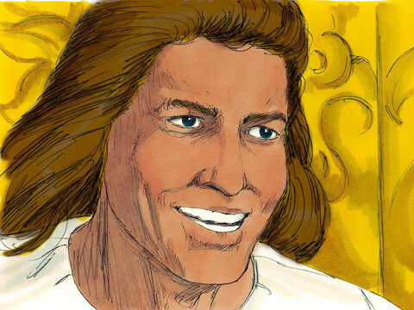
¹⁶ “John will help many people of Israel return to the Lord their God. ¹⁷ John himself will go ahead of the Lord and make people ready for his coming. He will be powerful like Elijah and will have the same spirit. He will make peace between fathers and their children. He will cause people who are not obeying God to change and start thinking the way they should.”
Notes:
5D. Bible Reading
A. Read the story out loud to the class.
B. If students ask about words, give simple definitions.
C. Encourage students to read aloud paragraphs from the story and act out the scene.

Slide 17
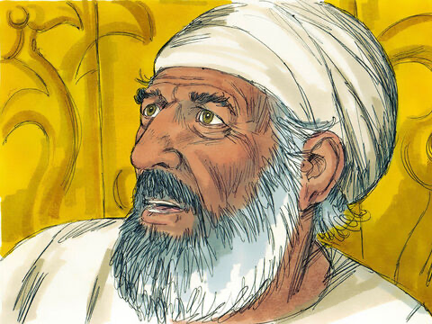
¹⁸ Zechariah said to the angel, “How can I know that what you say is true? I am an old man, and my wife is also old.”
¹⁹ The angel answered him, “I am Gabriel, the one who always stands ready before God. He sent me to talk to you and to tell you this good news. ²⁰ Now, listen! You will not be able to talk until the day when these things happen. You will lose your speech because you did not believe what I told you. But everything I said will really happen.”
Notes:
5B. Bible Reading
A. Read the story out loud to the class.
B. If students ask about words, give simple definitions.
C. Encourage students to read aloud paragraphs from the story and act out the scene.

Slide 18
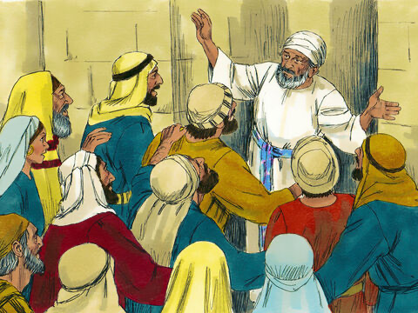
²¹ Outside, the people were still waiting for Zechariah. They were surprised that he was staying so long in the Temple.²² Then Zechariah came outside, but he could not speak to them. So the people knew that he had seen a vision inside the Temple. He was not able to speak, so he could only make signs to the people. ²³ When his time of service was finished, he went home.
Notes:
5B. Bible Reading
A. Read the story out loud to the class.
B. If students ask about words, give simple definitions.
C. Encourage students to read aloud paragraphs from the story and act out the scene.

Slide 19
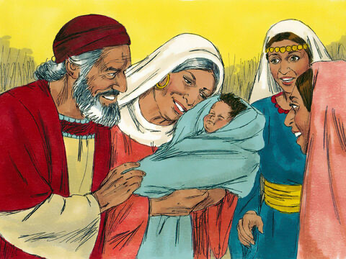
²⁴ Later, Zechariah’s wife Elizabeth became pregnant. So she did not go out of her house for five months. She said, ²⁵ “Look what the Lord has done for me! He decided to help me. Now people will stop thinking there is something wrong with me.”
Notes:
5B. Bible Reading
A. Read the story out loud to the class.
B. If students ask about words, give simple definitions.
C. Encourage students to read aloud paragraphs from the story and act out the scene.

Slide 20
Answer the questions.
1.Who was Zechariah’s wife?
2.What was the crowd doing when the incense was offered?
3.How did Zechariah feel when he saw the angel?
4.Who will John be powerful like?
5.Why do you think the angel took away Zechariah’s ability to speak when he could have disciplined him in any way?
6.When has God helped you with something big, like Elizabeth?
Notes:
5E. Bible Reading Questions
Ask the questions and discuss as a group.
Answers:
Elizabeth/Zechariah’s wife was Elizabeth
They were praying
He felt upset and very afraid
Elijah/He will be powerful like Elijah
Answers will vary for 5 and 6, but a possible answer for 5, is that the angel disciplined Zechariah by taking away his ability to speak, since Zechariah sinned with his mouth (by doubting the word from the Lord).

Slide 21
Read Psalm 104:24-35 in your language then read it in the English NIRV
²⁴ Lord, you have made so many things! How wise you were when you made all of them! The earth is full of your creatures. ²⁵ Look at the ocean, so big and wide! It is filled with more creatures than people can count. It is filled with living things, from the largest to the smallest. ²⁶ Ships sail back and forth on it. Leviathan, the sea monster you made, plays in it.
²⁷ All creatures depend on you to give them their food when they need it.
Notes:
5F. Bible Reading
Students should have already read this story in their first language (L1) as part of their homework, so it will be familiar even if they do not know all the vocabulary yet. However, if they have not yet read it in their L1, be sure they do so now before reading it in English. The hyperlinks of the Bible verses connect to https://live.bible.is/ so students can read and hear the scripture in their own languages. You may also watch videos of the passage at the website.
A. Read the story out loud to the class.
B. If students ask about words, give simple definitions.
C. Encourage students to read aloud verses from the story and act out the scene.
D. Ask if there are any questions or comments about the story.
E. Ask the story questions and discuss as a group.
F. Optional - You may hide the words and ask students to tell the story again in their own words, using the pictures to help them.

Slide 22
Psalm 104:24-35 NIRV continued
²⁸ When you give it to them, they eat it. When you open your hand, they are satisfied with good things. ²⁹ When you turn your face away from them, they are terrified. When you take away their breath, they die and turn back into dust. ³⁰ When you send your Spirit, you create them. You give new life to the ground.
Notes:
5G. Bible Reading
Students should have already read this story in their first language (L1) as part of their homework, so it will be familiar even if they do not know all the vocabulary yet. However, if they have not yet read it in their L1, be sure they do so now before reading it in English. The hyperlinks of the Bible verses connect to https://live.bible.is/ so students can read and hear the scripture in their own languages. You may also watch videos of the passage at the website.
A. Read the story out loud to the class.
B. If students ask about words, give simple definitions.
C. Encourage students to read aloud verses from the story and act out the scene.
D. Ask if there are any questions or comments about the story.
E. Ask the story questions and discuss as a group.
F. Optional - You may hide the words and ask students to tell the story again in their own words, using the pictures to help them.

Slide 23
Psalm 104:24-35 NIRV continued
³¹ May the glory of the Lord continue forever. May the Lord be happy with what he has made. ³² When he looks at the earth, it trembles. When he touches the mountains, they pour out smoke.
³³ I will sing to the Lord all my life. I will sing praise to my God as long as I live. ³⁴ May these thoughts of mine please him. I find my joy in the Lord. ³⁵ But may sinners be gone from the earth. May evil people disappear.
I will praise the Lord.
Praise the Lord.
Notes:
5H. Bible Reading
Students should have already read this story in their first language (L1) as part of their homework, so it will be familiar even if they do not know all the vocabulary yet. However, if they have not yet read it in their L1, be sure they do so now before reading it in English. The hyperlinks of the Bible verses connect to https://live.bible.is/ so students can read and hear the scripture in their own languages. You may also watch videos of the passage at the website.
A. Read the story out loud to the class.
B. If students ask about words, give simple definitions.
C. Encourage students to read aloud verses from the story and act out the scene.
D. Ask if there are any questions or comments about the story.
E. Ask the story questions and discuss as a group.
F. Optional - You may hide the words and ask students to tell the story again in their own words, using the pictures to help them.

Slide 24
Answer the questions about the Psalm.
Editor’s Note: please add Observation, Interpretation and Application questions here.
Notes:
5I. Bible Reading Questions
Ask the questions and discuss as a group.
Answers:
Elizabeth/Zechariah’s wife was Elizabeth
They were praying
He felt upset and very afraid
Elijah/He will be powerful like Elijah
Answers will vary for 5 and 6, but a possible answer for 5, is that the angel disciplined Zechariah by taking away his ability to speak, since Zechariah sinned with his mouth (by doubting the word from the Lord).

Slide 25
Listen and complete the sentences.
1. The interesting picture was posted by _______
2. “You’re pregnant?!” I _______ with joy.
3. _______ and Brandon are so _______.
4. “I _______, I’ll go call her now.”
5. _______ I hung up with Jessica I called my mom to _______ her the good news.
Notes:
6A. Activities – Listening to pronunciation words with /a/ and /o/ sounds.
Read the script below at least twice as students listen and answer the questions. The students should NOT look at the script.
“The other day when I was on Facebook I saw an interesting picture that my friend, Jessica posted. It was of picture of baby shoes with a sign under it that said, “Coming Soon!” I knew this could only mean one thing. So I picked up my phone and called Jessica. “You’re pregnant?!” I asked with joy. “Yes! Brandon and I are so excited!” “When are you due?” I asked. “In June!” she replied. “I’m so happy for you, Jessica, truly!” “Thank you Rebeca! Oh, did you tell your mom yet, since she’s not on Facebook?” She asked. “I haven’t, I’ll go call her now. Talk to you soon!” I said. “Bye Rebecca, thanks for calling.” After I hung up with Jessica I called my mom to tell her the good news. “Hey mom! You’ll never guess who’s pregnant?! “What? Someone’s pregnant?! Who?” she asked me. When I told her it was Jessica she was just as happy as I was to hear it.”
Answers 1. Jessica 2. asked 3. Jessica, excited 4. haven’t 5. After, tell

Slide 26
A. Role-Play – Dentist
You are a dentist at a children’s dental office. A dad/mom brought in his/her 4-year-old son because his tooth is hurting. Since her son is in pain and is young, you need to communicate with his mom to find out about the pain, so you know how to help.
When did he announce that his tooth was hurting?
Did you encourage him to show it to you?
Has he eaten a lot of sugar in the past week?
Have you helped him brush his teeth?
When does he complain about his tooth the most?
Do you want me to confirm what is going on with his tooth?
Do you want me to offer you some ideas to help the pain go away?
Do you want me to convince him that he will be fine?
Notes:
6B. Activities – Pair Work Partner A
Role-Play between dentist and a mom.
Partner A will play the part of a dentist talking to a mom. Partner A will ask questions from this slide and write Partner B’s answers.
Check answers for correct grammar and punctuation. Answers will vary.

Slide 27
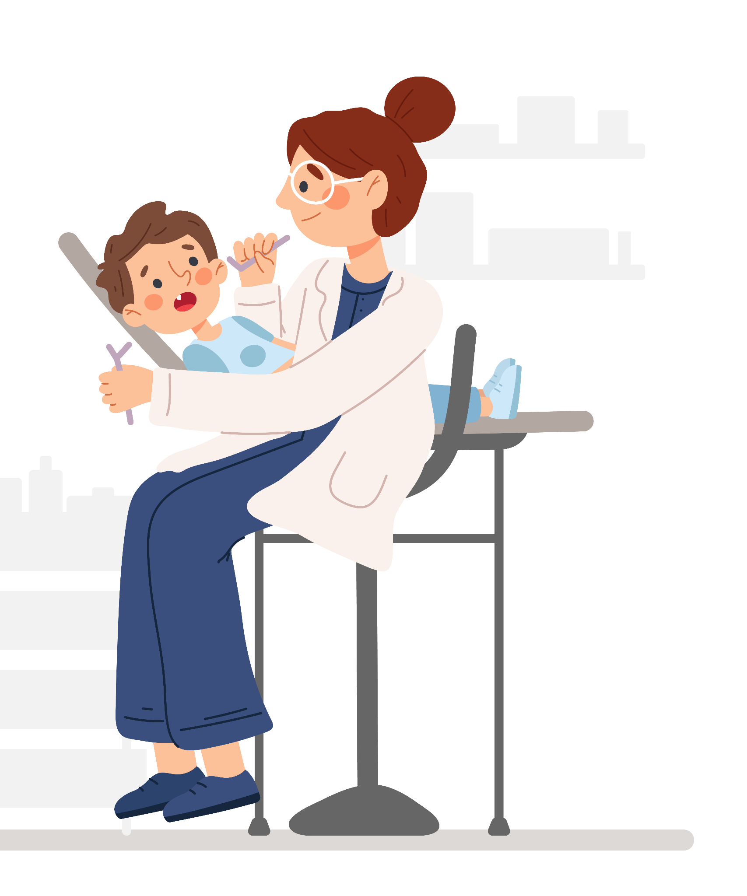
B. Role Play –dad/mom
You are a dad/mom who has a 4-year-old son. He has been complaining about his tooth hurting for a week, so you took him into the dentist. You want to help your son feel better. Ask the dentist these questions
Would you like me to put him in the chair so you can look at his tooth?
Have you heard of kids this young complaining about their teeth?
Do you have any ideas of completely helping the pain go away?
Should I convince him to stop eating sugar?
Could you check and see if he has a cavity?
Should I encourage him to drink warm water?
Do you blame me for bringing him in?
Should I go ahead and make an appointment to come get his teeth cleaned?
Notes:
6C. Activities – Pair Work Partner B
Role-Play between a dentist and a dad/mom.
Partner B will play the part of a dad/mom. Partner B will ask questions from this slide and write Partner A’s answers.
Check answers for correct grammar and punctuation. Answers will vary.
Give a simple explanation of the word cavity, if students ask: a small hole in your tooth normally from sugar or food staying on your teeth for too long

Slide 28
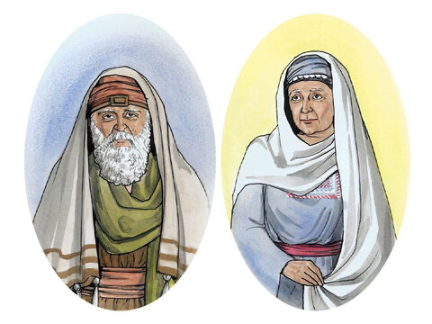
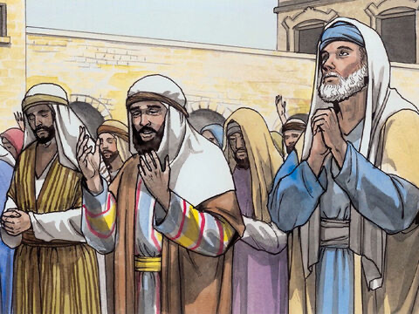
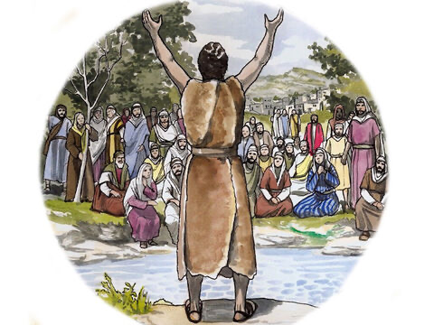
Game –Guess Who
?
?
?
Notes:
7. Game –Guess who
Give each student the name of a Bible character we have learned about in the previous lesson or this lesson (the ones mentioned in this lesson’s Bible portion: Zechariah, Elizabeth, the angel Gabriel, the people/crowd, and John). Students will become that character for the time of guessing that follows.
The student will then say one sentence that the Bible character they have become could have said. Or the student will say one statement about the Bible character (creativity/creative license will be needed). For example, if someone chose to be the angel, they could say, “Your wife will have a son”, or “I came from heaven.”
The rest of the class/the teacher will try and guess which Bible character their classmate/student is being for the game.
If the rest of the class/the teacher cannot guess who the their classmate/student is after 3 guesses, then the person who is “it” can say additional things that the character they are being may have said or give additional statements about who they are.
The person who guesses the correct character can go next, or you can go in a circle/certain order

Slide 29
1A. Homework – Write sentences about the pictures
1 | I found 3 travel brochures and kept them until I traveled to the countries they showed. | 4
2 |  | 5
3 |  | 6
Notes:
Homework 1A. - Write sentences using the pictured vocabulary words.
Model. Go over each of the homework assignments to be sure the student understands what to do.
Repeat. Encourage students to practice speaking and reading the completed homework assignments with a friend. They may use a bilingual dictionary.
Solo. Students will share their homework when they are finished. After they have shared their homework, be sure to check it for correctness, including spelling. Explain mistakes, while providing praise and encouragement.
Number one is an example.
Answers may vary, but will start with a capital letter, have a punctuation mark at the end, use the simple past tense, and use the following words:
2. convince
3. offer
4. rule
5. ahead
6. encourage

Slide 30
1B. Homework – Write sentences about the pictures
7 |  | 10
8 |  | 11
9 |  | 12
Notes:
Homework 1B. - Write sentences using the pictured vocabulary words.
Model. Go over each of the homework assignments to be sure the student understands what to do.
Repeat. Encourage students to practice speaking and reading the completed homework assignments with a friend. They may use a bilingual dictionary.
Solo. Students will share their homework when they are finished. After they have shared their homework, be sure to check it for correctness, including spelling. Explain mistakes, while providing praise and encouragement.
Number one is an example.
Answers may vary, but will start with a capital letter, have a punctuation mark at the end, use the simple past tense, and use the following words:
1. command
2. announce
3. complain
4.completely
5. confirm
6. blame

Slide 31
1C. Write about the communication vocabulary.
1. Who rules England now?
2. Was there a subject in school that you were ahead in?
3.How do you feel when a friend encourages you?
4. What is one thing you know is completely true?
5. What was the last thing you had to confirm?
6. If you could make a brochure about anything, what would you make it about?
Notes:
Homework 1C. - Write about the vocabulary words.
Students will write answers to the questions.
Answers will vary.

Slide 32
1D. Write about the communication vocabulary.
7. What is something important you want to convince people of?
8. What announcement have you heard or seen in the last week?
9. Who can you offer to help today?
10. Have you ever commanded a dog to sit?
11. Do you blame yourself or others more?
12. Is it good or bad for a child to complain about getting hurt?
Notes:
Homework 1D. - Write about the vocabulary words.
Students will write answers to the questions.
Answers will vary.

Slide 33
2A. Use the correct auxiliary verb.
Where __did_____ she eat dinner last night?
Who _______ your sister?
What _______ he do yesterday?
When _______ you want to go to the store?
_______ you been to Italy?
_______ they eat fruit everyday?
_______ you hear about the snow storm?
Notes:
Homework 2A. – Grammar and Vocabulary Review
Students will complete the sentences with the correct verb forms. Number 1 is an example.
Answers:
2. is
3. did
4. do
5. Have
6. do
7. did

Slide 34
2B: Write a Wh/question and a Yes/No question (with an auxiliary verb) for each topic:
Food
What did you eat for dinner last night?
Work
Your favorite movie
Notes:
Homework 2B. – Grammar and Vocabulary Review
Students will complete the sentences with the correct comparative and superlative forms.
A1 is an example.
Answers will vary but must include:
A2. Yes/No questions + aux. verb about food
B1. Wh/ question + aux. verb about work
B2. Yes/No question + aux. verb about work
C1. Wh/question + aux. verb about the student’s favorite movie
C2. Yes/No question + aux. verb about the student’s favorite movie

Slide 35
3. With a partner, discuss different types of announcements
Do you hear or see more announcements?
What is the last announcement you heard on the radio?
Have you ever made an announcement on Facebook/Instagram?
What are examples of good announcements?
What are examples of bad announcements?
Where do you see announcements?
When do people make announcements?
Notes:
Homework 3. – Conversations - Pair work
Students interview a partner and write their partner’s answers. They will also create two of their own follow-up questions for numbers 8 and 9. Check answers for correct grammar and punctuation.
Questions and answers will vary

Slide 36
4A. Say and write words with /a/ and /e/
2. /a/ | /e/
Notes:
Homework 4A. – Pronunciation
This homework practices pronouncing the /a/ and /e/ sounds.
Students will think of words with the /a/ and /e/ sounds. They will sound out each word first. Then they will write appropriate words in the correct vowel sound column.
Answers will vary.

Slide 37
4B. Say and write the nouns in the correct columns.
water | police
address | table
hospital | hamburger
brochure | minute
video | manager
event | gardener
people | breakfast
hotel | mystery
office | report
▔ -- | B. ▔ - | C. - ▔
Notes:
Homework 4B. – Pronunciation
Students will go through the list and say each word. Then they will write words in the correct columns for each stress pattern.
Answers:
A: orderly, easier, lovingly, manager, gardener, silently
B: brochure, event, hotel, create, police, report
C: water, address, people, listen, minute, breakfast

Slide 38
5. Write about Luke 1:5-25 in your own words. Use first, then, next, and finally.
©2021-2024 Light of the World Learning
Notes:
Homework 5. – Bible Reading Review
Students will write a short summary of the Bible reading using the words first, then, next and finally.
Answers will vary. Possible answers may include:
Zechariah and his wife, Elizabeth were good people and obeyed God. They were old, but they didn’t have any children. First, Zechariah went to the temple to serve as priest and offer incense. Then an angel came and told him that his wife would have a baby. Next the angel told Zechariah what his son would be like. But, then Zechariah asked the angel how his wife would become pregnant, since they were both so old. Then the angel made Zechariah not able to speak until his son would be born. Next, Zechariah went out to the crowd that was outside praying and used his hands to try and explain what he saw while he was in the temple. Finally, Elizabeth became pregnant and praised God.

Slide 39
6. Choose 1 verse to memorize and write it here. Then read the next verses in your language.
Read the next lesson’s Bible verses: Luke 1:26-56 in your language.
Notes:
Homework 6. – Memorize a verse and read the next lesson’s verses in your native language.
Learners get to choose one verse from the lesson’s reading to memorize. Please notice that the memory work is not long. Everyone, regardless of skill level, should be able to do it. Students will also read the next lesson’s Bible passage in their native language. Students will always read the Bible lesson in their first language before reading it in English the following lesson. Help them get a Bible in their own language if they don’t have one. They may also use https://live.bible.is/ or other Bible translation resources. The hyperlinks of the Bible verses connect to https://live.bible.is/ so students can read, hear and watch videos of the scripture in their own languages.
1. Model. Recite a verse from memory.
2. Repeat. Encourage students to find someone with whom to practice conversing and reading the completed homework assignment.
3. Solo. Students will recite the verse from memory at the next class.

Slide 40
7A. Read the brochure about a Spanish class
Have you always wanted to learn Spanish? Do you forget all the Spanish you learned in High School? Do you think learning Spanish is only something English speakers do?
Spanish 4 All is the class for you!
Contact Information
Spanish
4
All
¡Hola!
Teacher:Sara Lopez
Phone:000-123-9293
Email:SaraL@spanish4all.com
Address where class meets:
1012 N. Orange Road
Classroom, Illinois 33313
www.spanish4all.com
Class Information Guide
We offer Spanish classes for all levels of experience
We have affordable rates (starting at $10/hour)
www.spanish4all.com
Notes:
Homework 7A. – Everyday Reading and Writing
Students will read the brochure about a Spanish class and answer the questions.

Slide 41
7B. Answer the questions about the brochure
A. What is the main purpose of this brochure?
B. Can you compare this Spanish class with our English class? What is the same/different?
C. Can you explain who the target audience is for the brochure?
D. Do you agree that mostly English speakers learn Spanish? Explain.
E. Why do you think people want to/not want to learn Spanish?
F. Based off this brochure, would you want to take this Spanish class? Why/why not?
G. If you took this Spanish class what would your motive be for taking it?
Notes:
Homework 7B.– Everyday Reading and Writing
Students will answer the questions about the Spanish class brochure.
Answers:
Answers will vary for B, and D-G
A. To advertise for a Spanish class that is open to all people (perhaps not the regular type of people who tend to want to take Spanish classes)
C. People who tend to not look into taking Spanish classes for various reasons (never learned any, forget it from High school (and may be embarrassed to start over, or are not English speakers)

Slide 42
8. Create your own brochure about a class you could offer about a hobby you enjoy.
Notes:
Homework 8 – Writing
Model. Show students how the front of the brochure will be in the third column, the contact information will be in second column and the main information will be in the first column (Use the Spanish class one on slide 36 as an example).
Answers will vary.

Slide 43
9. Now I Can…
I can talk about communication, and sharing and responding to news.
I can understand, say, read, and write the 12 vocabulary words.
I can ask Wh/questions with auxiliary verbs.
I can ask Yes/No Questions with auxiliary verbs .
I can understand how Zechariah heard the news about Elizabeth having a baby.
Notes:
Homework 9. – I can statements
The student must be able to achieve all of these skills before the next lesson. If not, the lesson can be repeated or additional practice materials can be used.
Review all of the skills at the beginning of the next lesson. Be sure to give lots of praise and encouragement!

Slide 44
Closing Prayer
Notes:
Pray
You may want to ask for any special prayer requests, then pray for your students and bless them.

