Slide 1
Unit B1-03
©2020-2024 Light of the World Learning
Notes:
Teacher’s Notes:
Bible Reading: The Coming Birth of Jesus
Theme: Common actions
Pronunciation: /o/ and /oo/
Grammar: Present simple tense verbs, intransitive phrasal verbs
Preparation:
Pray.
Read the Bible passages.
Preview slides and game.
Optional: Bring objects to act out grab, reach, scatter, and arrange.

Slide 2
Pray, Review, and Preview
Bible Reading: The Coming Birth of Jesus Luke 1:26-56
and Psalm
Theme: Common actions
Pronunciation: /o/ and /oo/
Grammar: Present simple tense,
intransitive phrasal verbs
Notes:
Pray
Pray for the class. Thank the Lord for being with us everyday.
Check homework and review.
Ask students to read aloud or recite their homework from the last class. Check written work.
Review the main points of the previous lesson and ask if there are any questions.
Be sure they have read the Bible passage in their native languages in preparation for the lesson.

Slide 3
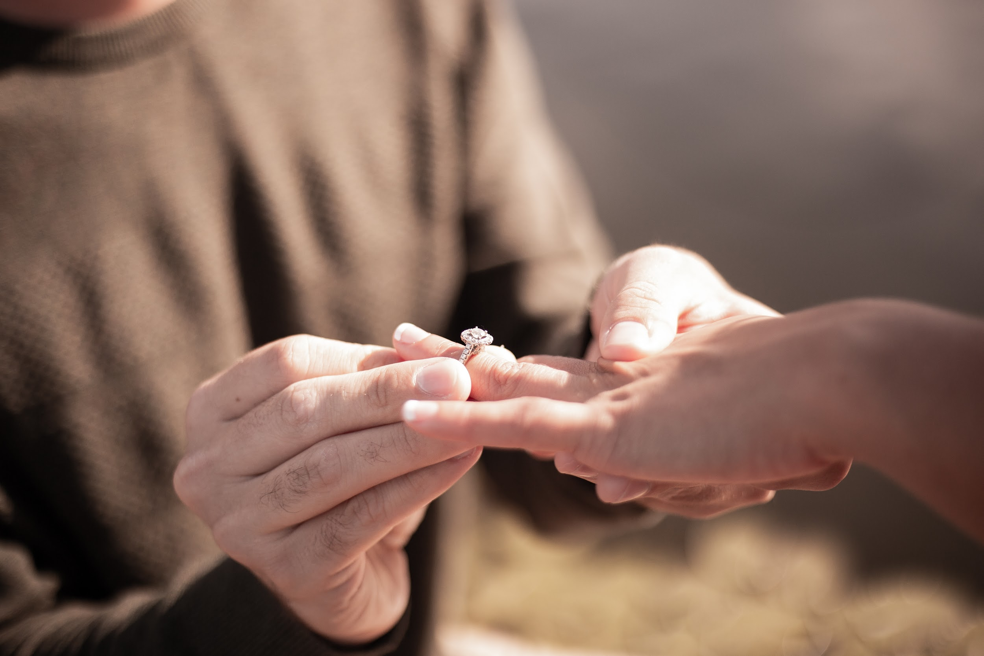
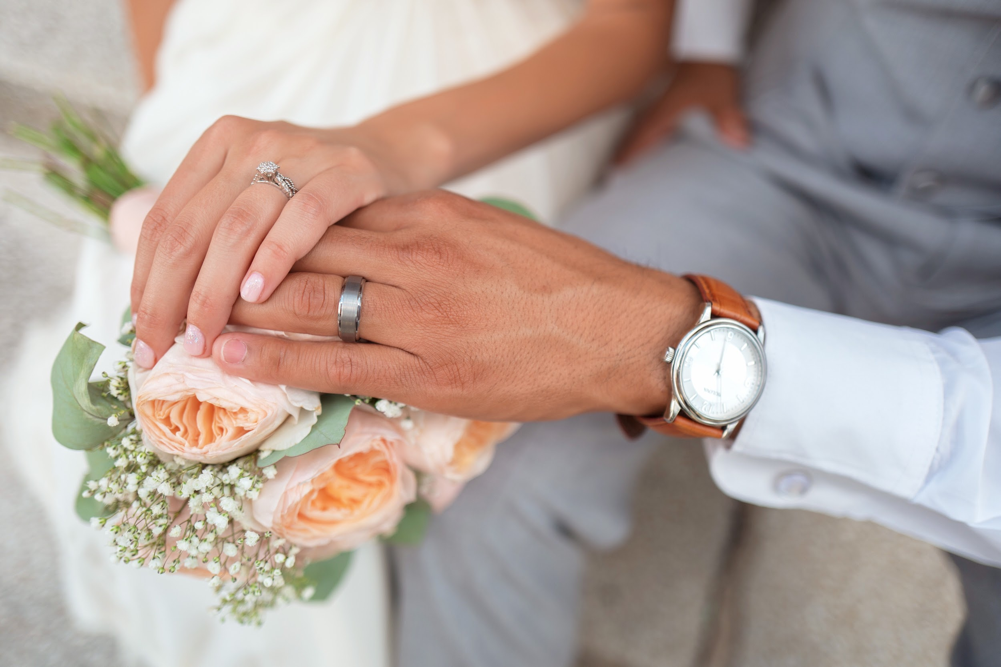
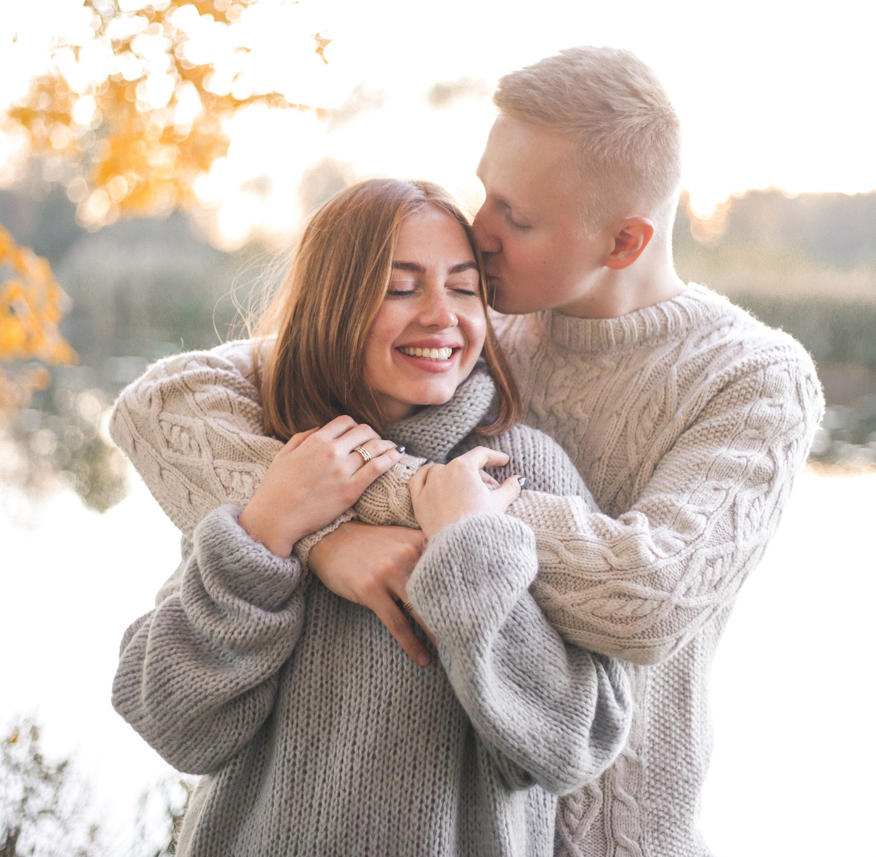
What do you see?
Notes:
1A. Discuss Theme Picture
Vocabulary eliciting
Ask students what they see to elicit engaged, promise, blessing, arrange (a wedding).
picture 1: https://unsplash.com/photos/IXLS59CTgDE
picture 2: https://unsplash.com/photos/MEfqMggMpaA
picture 3: https://unsplash.com/photos/llWjwo200fo

Slide 4
Discuss with a partner:
Why do people get married?
What are weddings like in your culture?
Sarah and Mark got engaged a few months ago. They are busy trying to arrange the details of their wedding day. Sarah tells Mark that she is very stressed. Mark reaches out and grabs Sarah’s hands. He promises that everything will work out and that they will have a beautiful wedding because their love for each other is what’s most important. Sarah is so excited to marry Mark. He is a true blessing.
Notes:
1B. Read about the theme picture and discuss with a partner
Read the description of the theme picture to the students. If students ask about words, give simple definitions.
Ask students to work in pairs and discuss the questions.
Call on students to share their answers with the class.

Slide 5
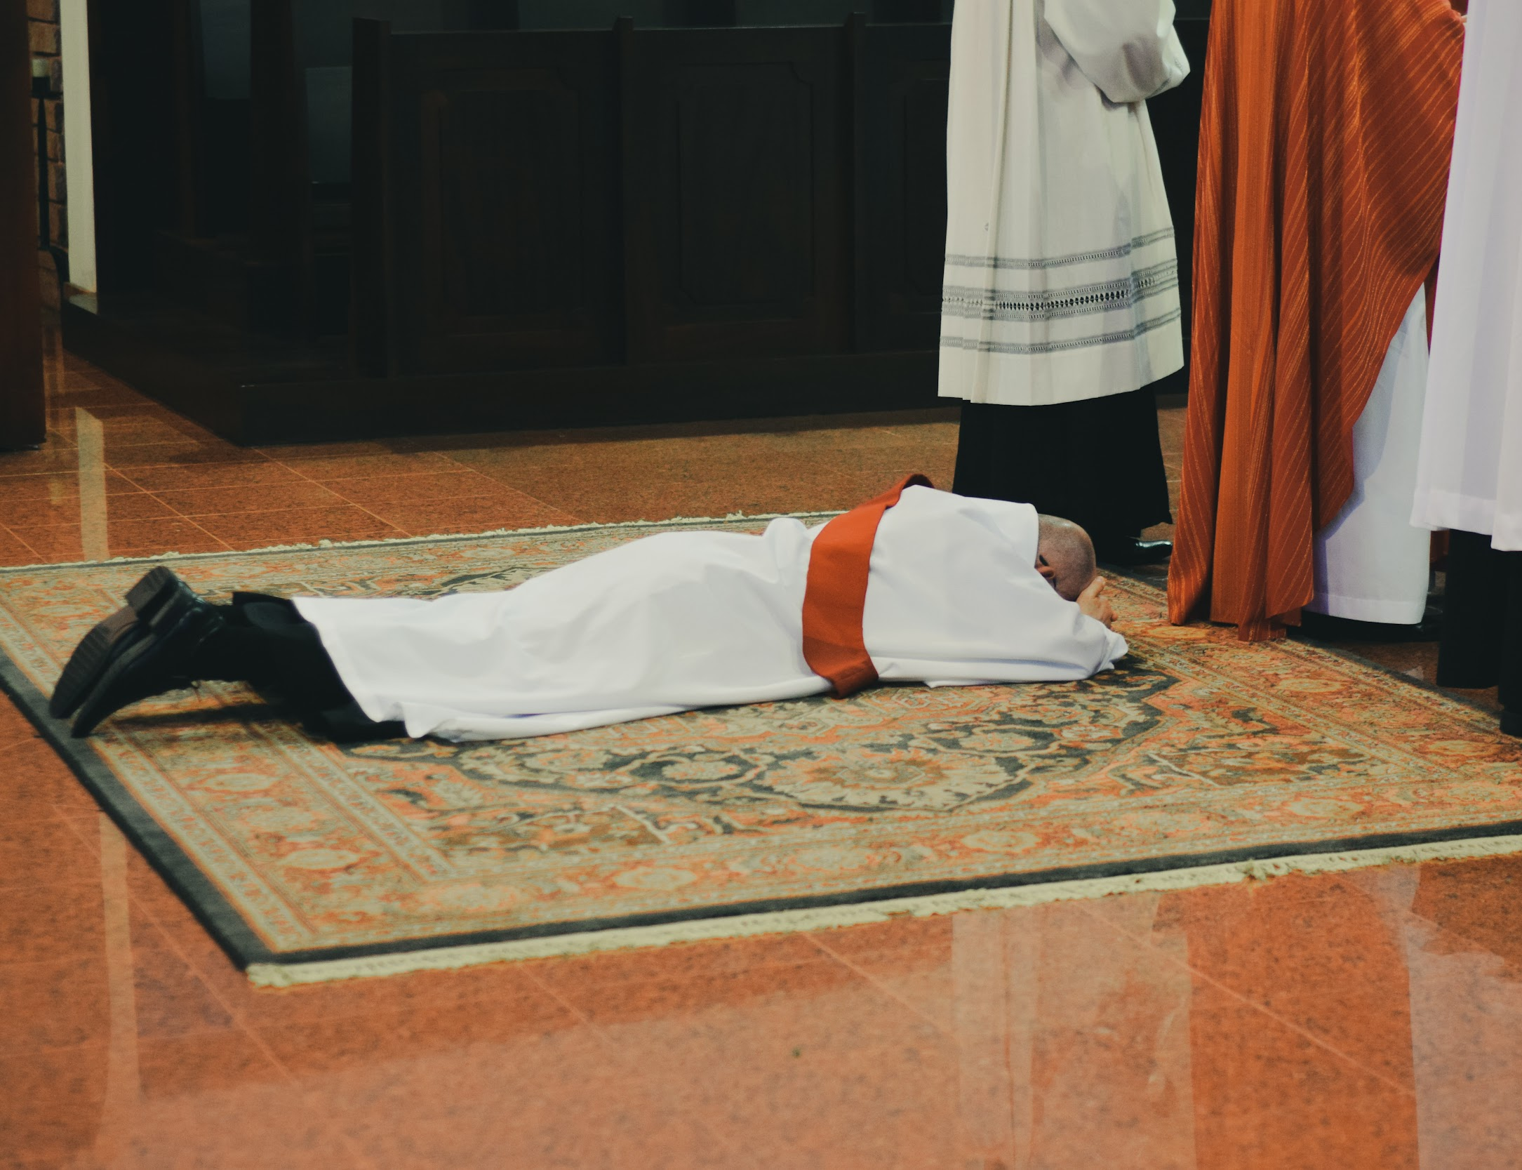
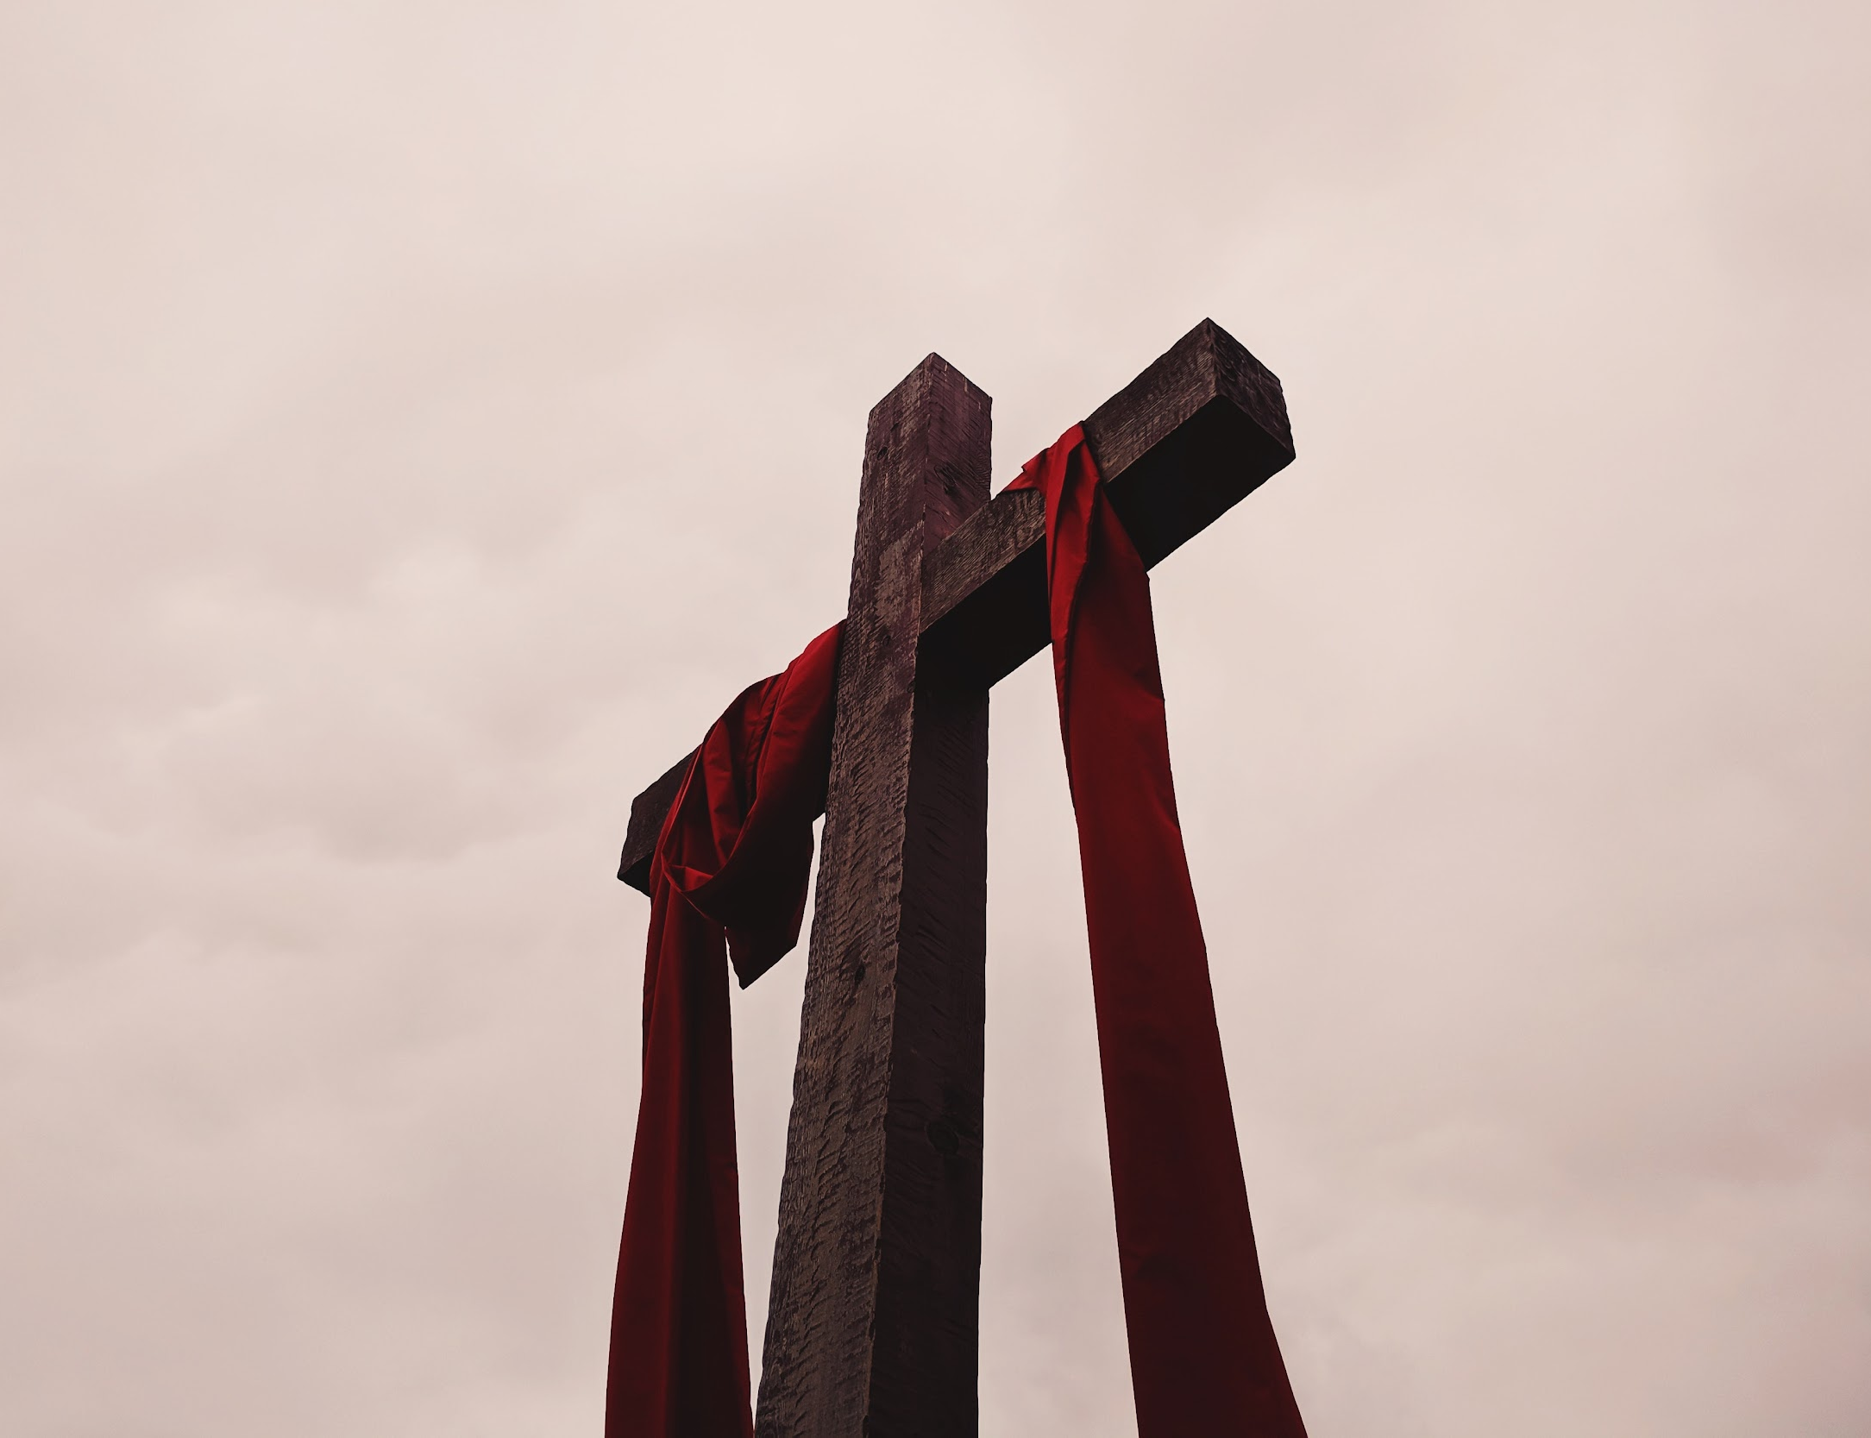
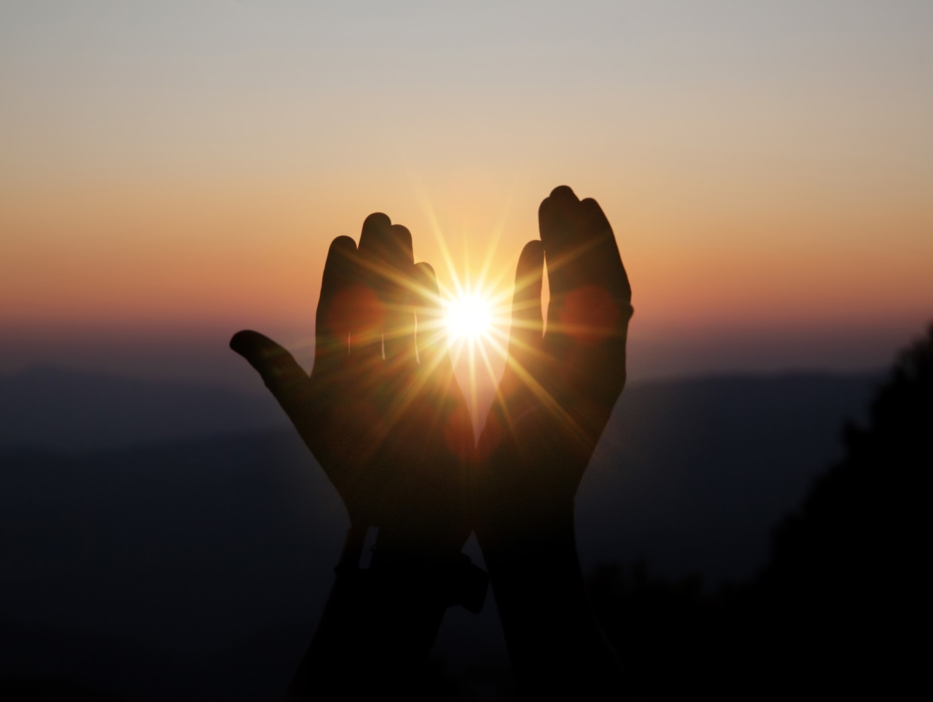
Match the definition to the correct words.
engaged 2. lowly 3. holy 4. blessing
agreed to be married
very pure
God’s help or protection
low in status
Notes:
2A. Vocabulary
1. Say the word a few times, as you indicate the picture. For example, say, “engaged, engaged, engaged.” Have your students then repeat the word after you a few times.
2. Ask students to match the word to the correct definition and say the answer as a sentence. For example, “When two people are engaged they have agreed to be married.”
3. Check students’ comprehension further by asking direct questions. For example, “Do you know anyone that‘s engaged?”
Answers
1. A
2. D
3. B
4. C
engaged:
lowly: https://unsplash.com/photos/5_W-EHfrkGI
holy: https://unsplash.com/photos/kBybHJ3CEWI
blessing: https://www.freepik.com/free-photo/spiritual-prayer-hands-sun-shine-with-blurred-beautiful-sunset_3952177.htm#query=blessing&position=0&from_view=search&track=sph

Slide 6
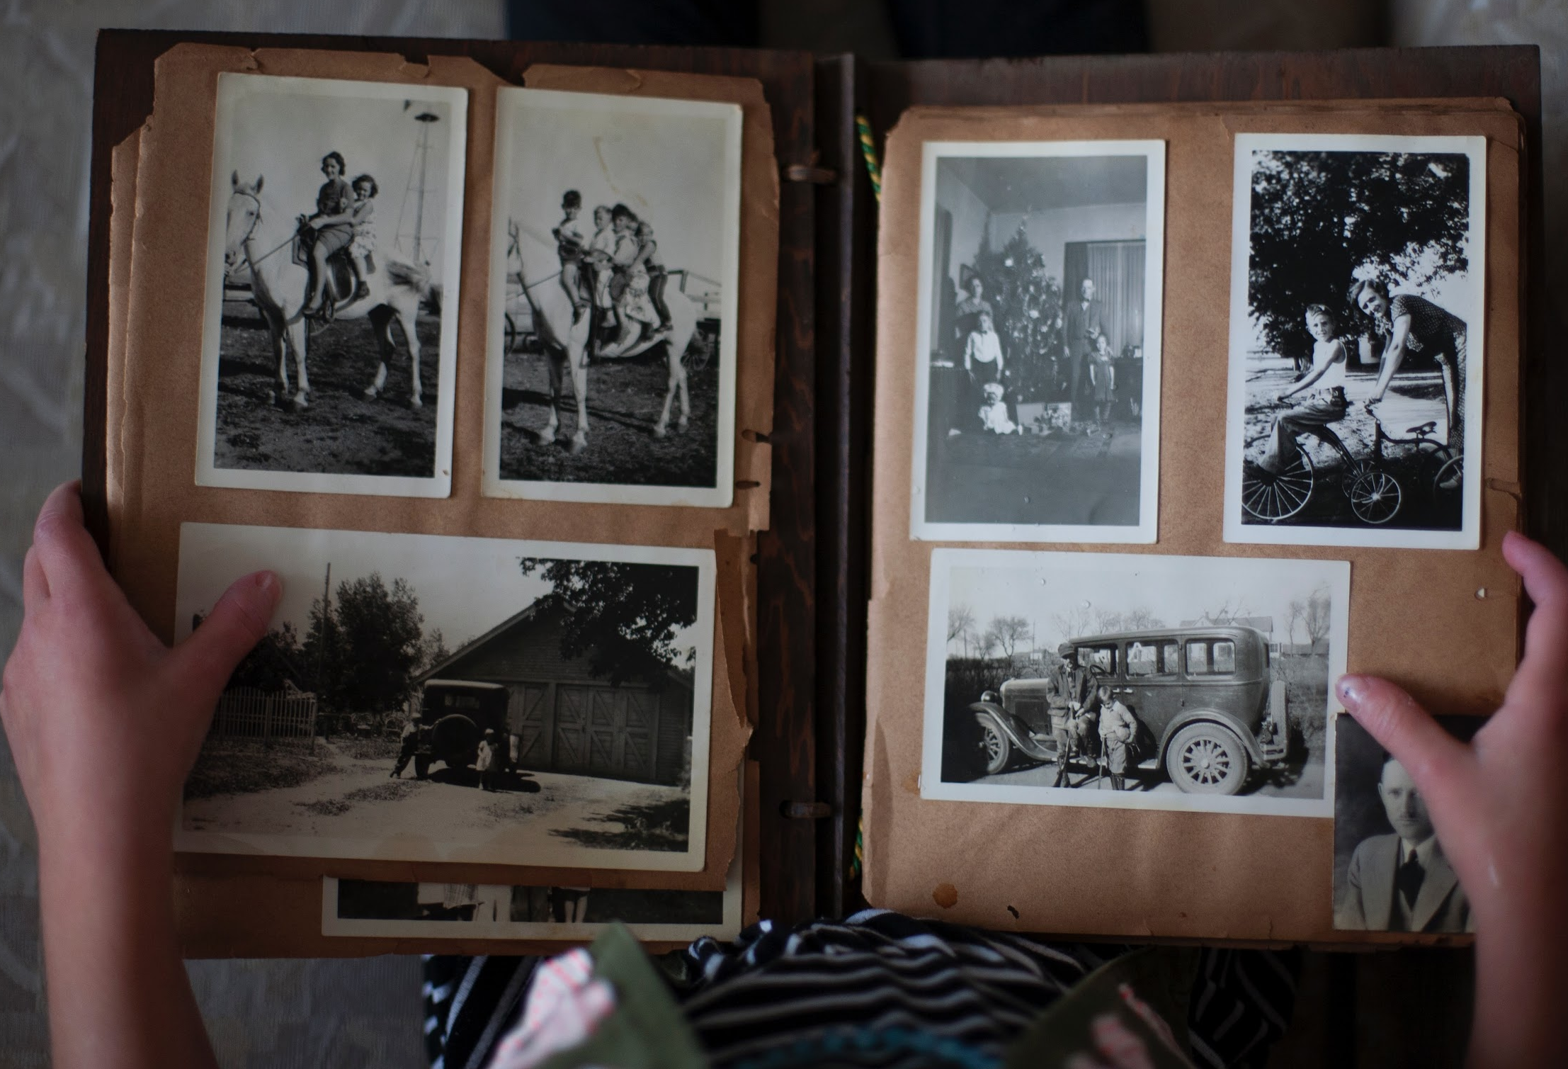
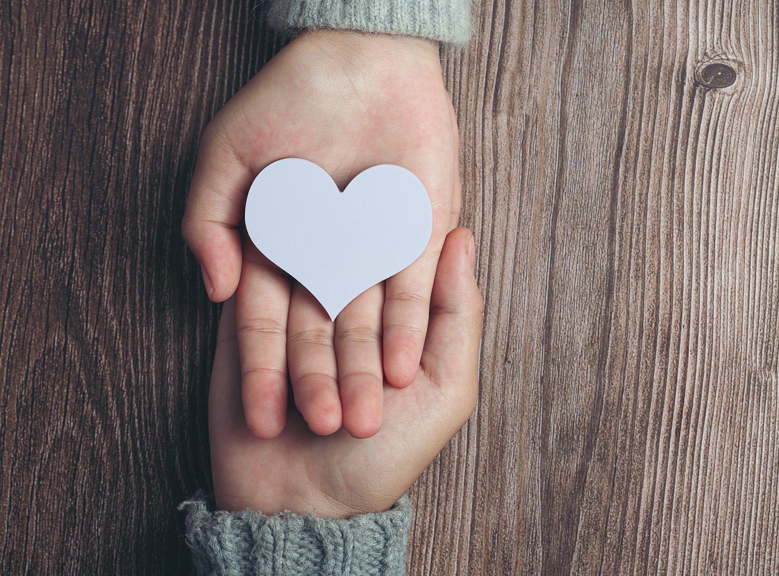
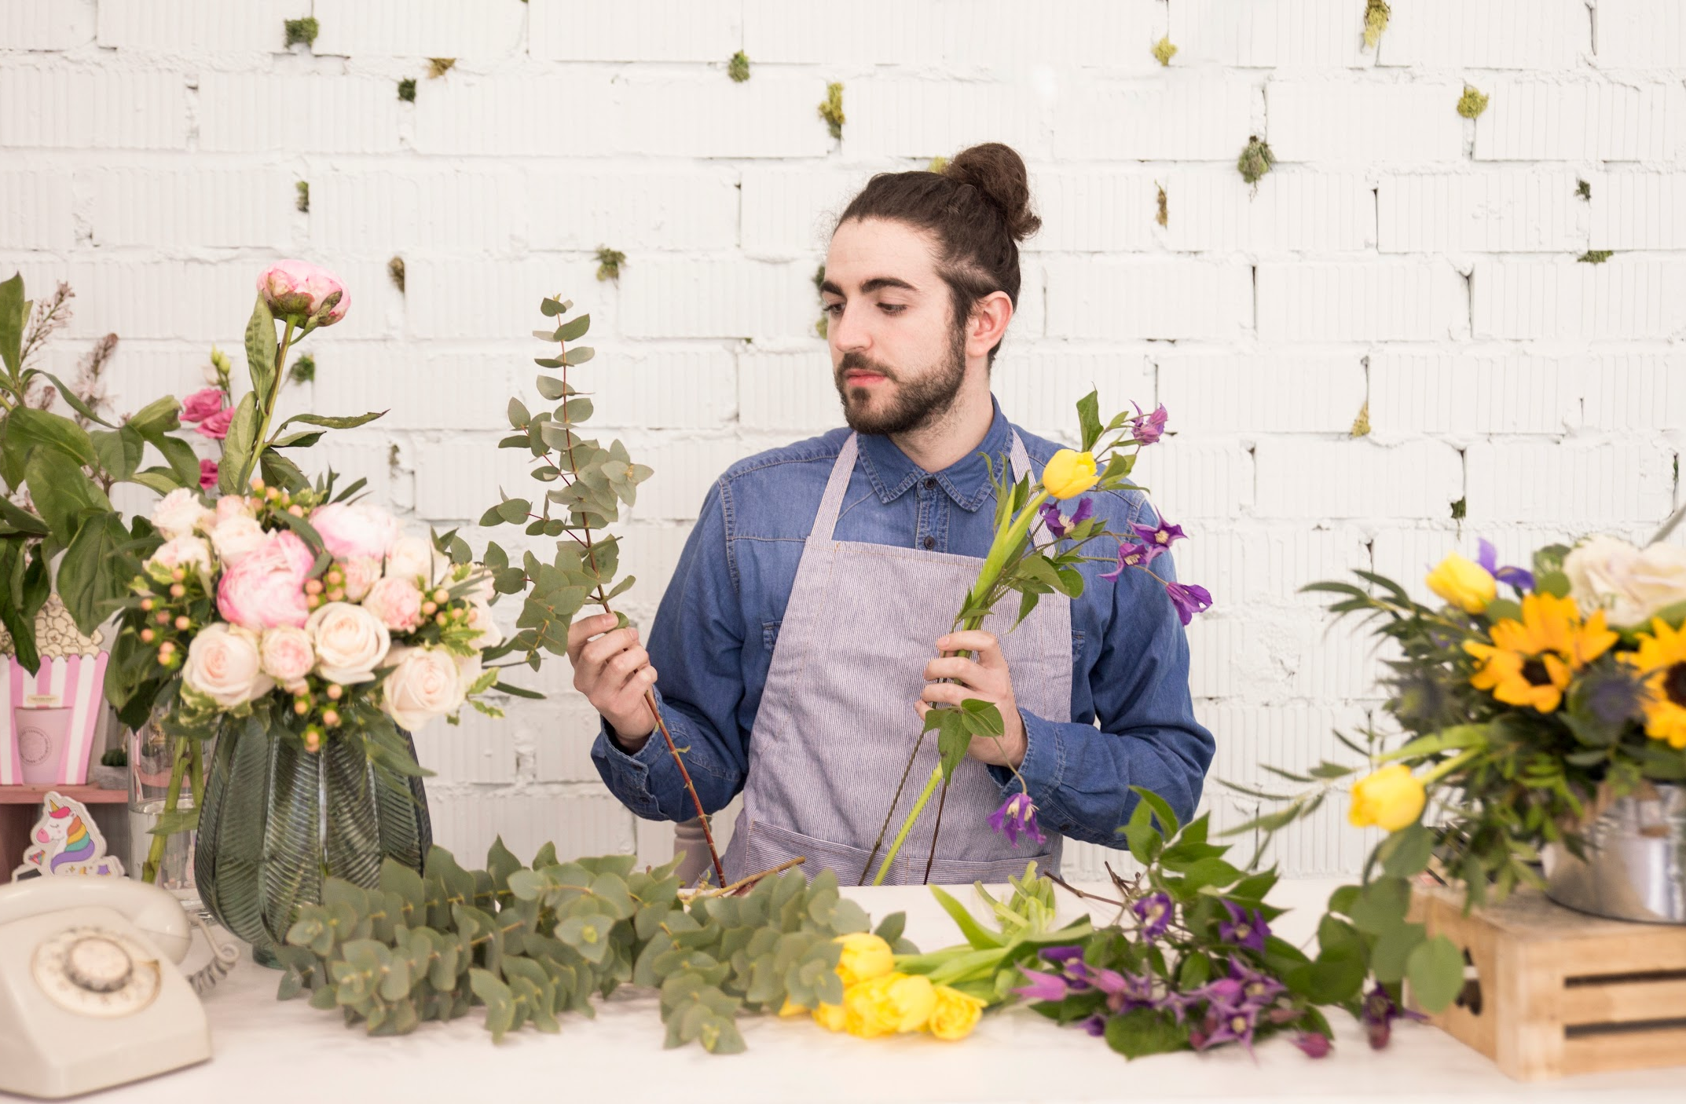
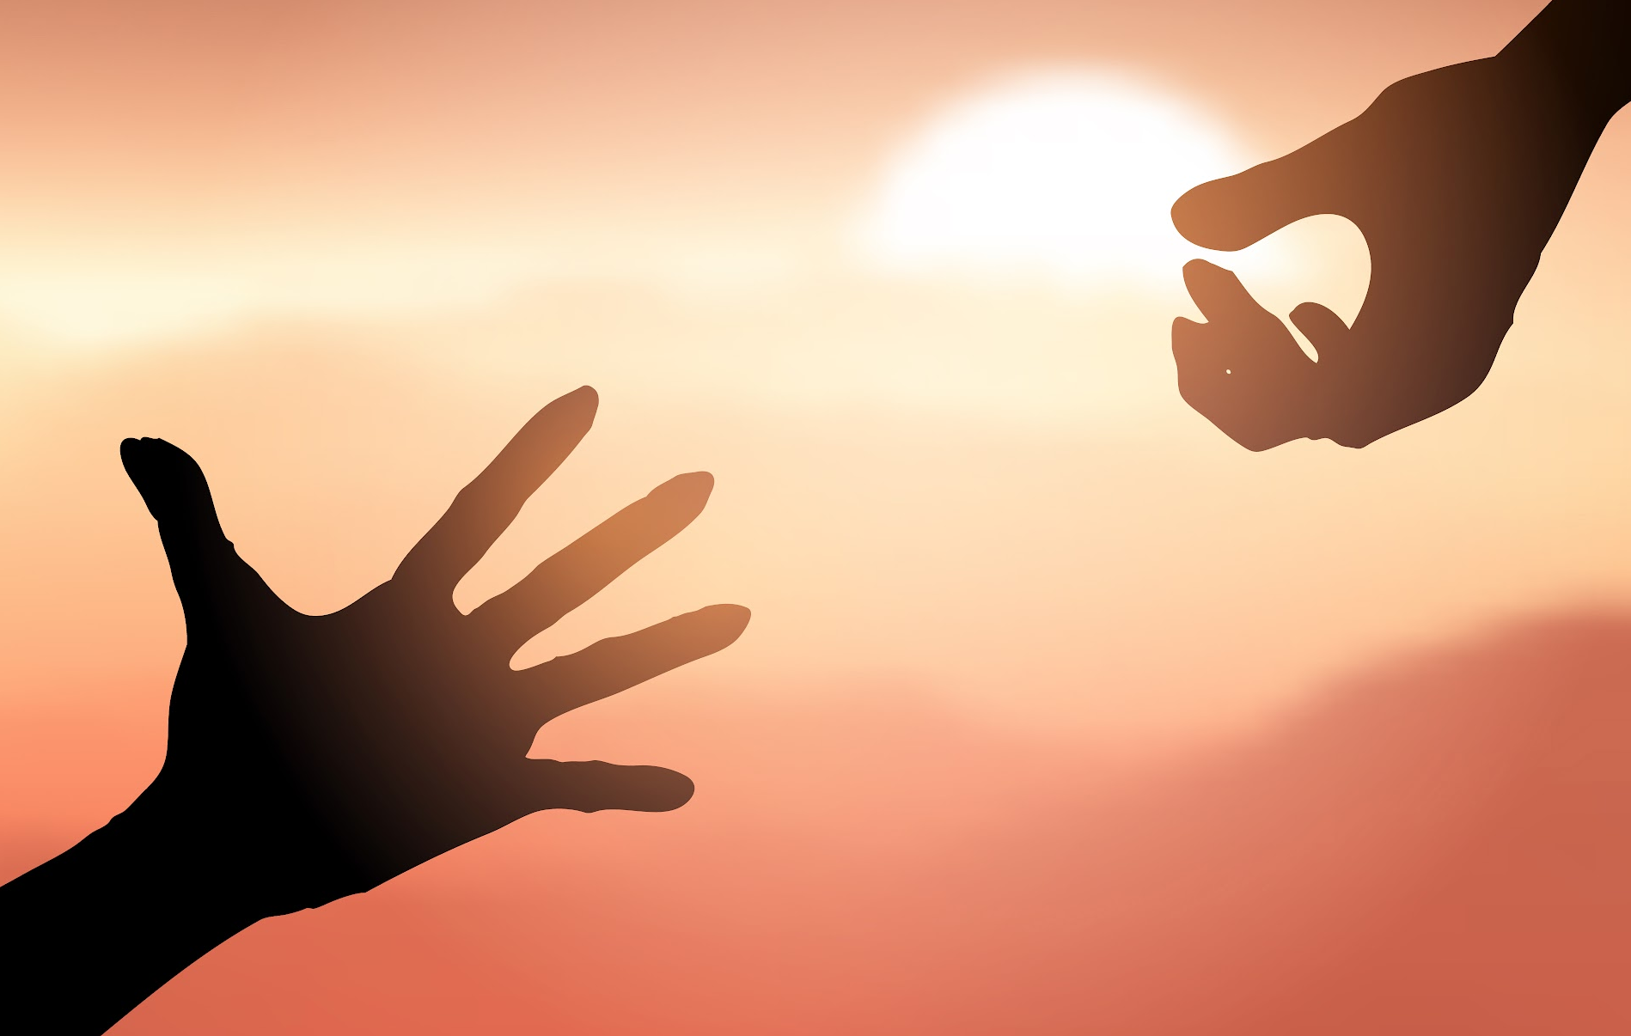
Match the definition to the correct words.
5. an ancestor 6. mercy 7. to arrange 8. to reach
to put things in order
a person who was in someone’s family a long time ago
to stretch out an arm to grab something
kindness shown to someone that has done
something wrong
Notes:
2A. Vocabulary
1. Say the word a few times, as you indicate the picture. For example, say, “ancestor, ancestor, ancestor.” Have your students then repeat the word after you a few times.
2. Ask students to match the word to the correct definition and say the answer as a sentence. For example, “a person who was in someone’s family a long time ago”
3. Check students’ comprehension further by asking direct questions. For example, “Do you know the names of any of your ancestors?”
Answers
5. B
6. D
7. A
8. C
ancestor pic: https://unsplash.com/photos/73OJLcahQHg
mercy: https://www.freepik.com/free-photo/closeup-two-young-lovers-holding-hands-table_10399596.htm#query=mercy&position=1&from_view=search&track=sph
arrange pic: https://www.freepik.com/free-photo/portrait-young-man-creating-flower-bouquet-flower-shop_4040963.htm#from_view=detail_serie
reach pic: https://www.freepik.com/free-vector/silhouette-hands-reaching-out-help_6910785.htm#query=reach&position=0&from_view=search&track=sph

Slide 7
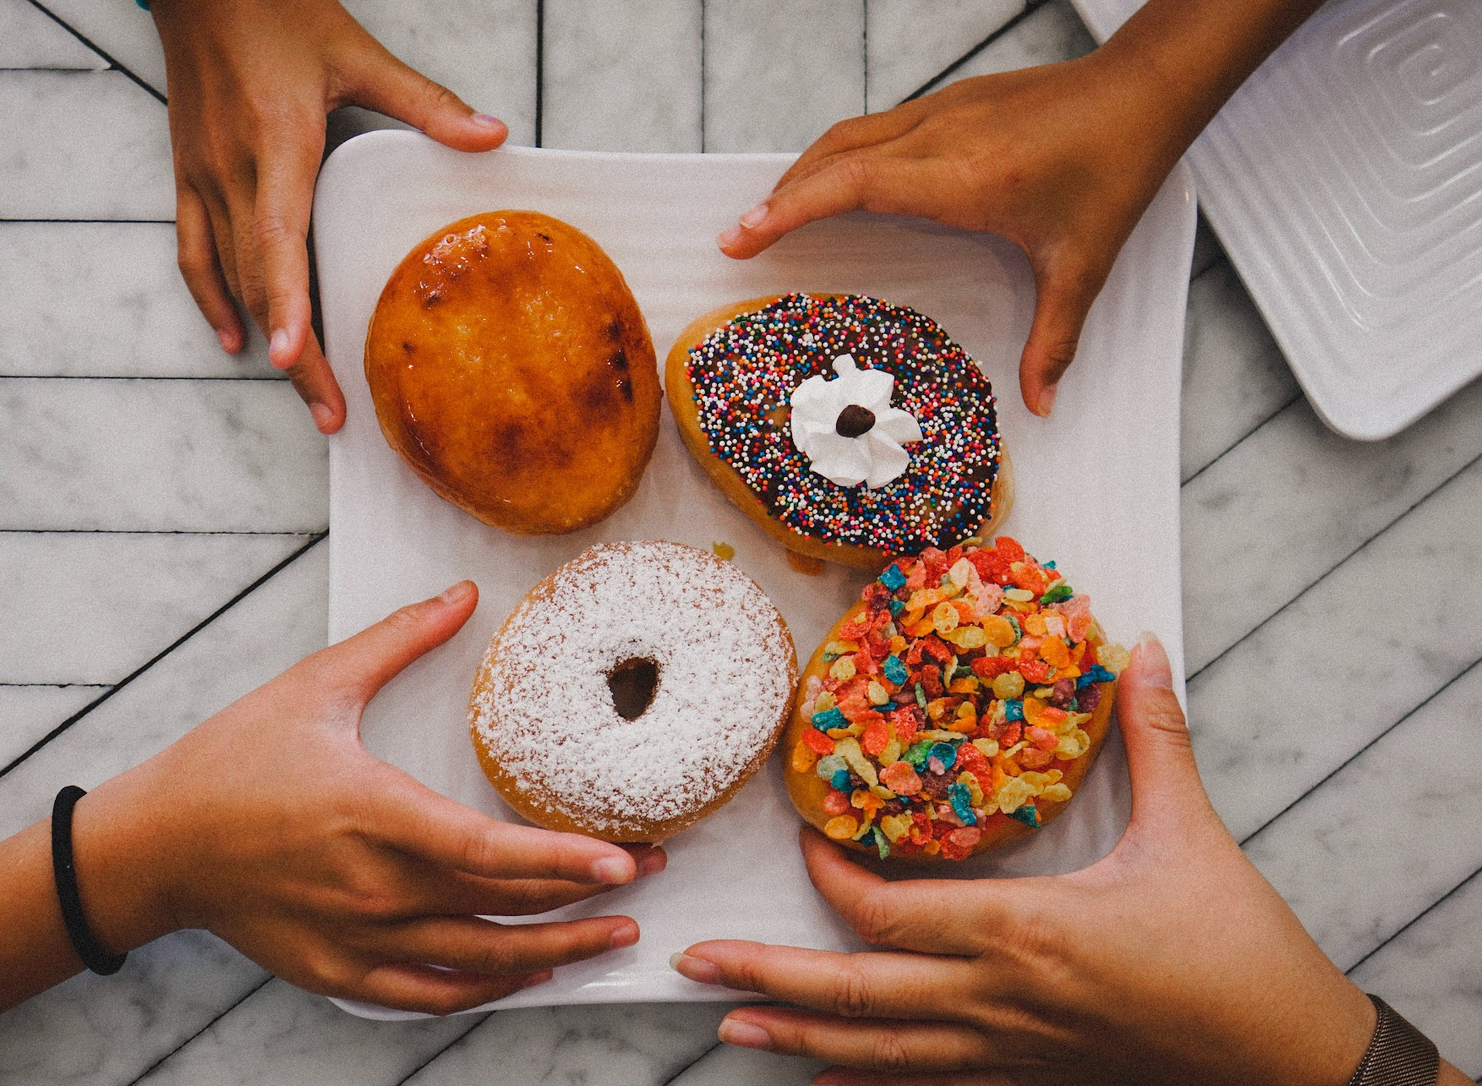
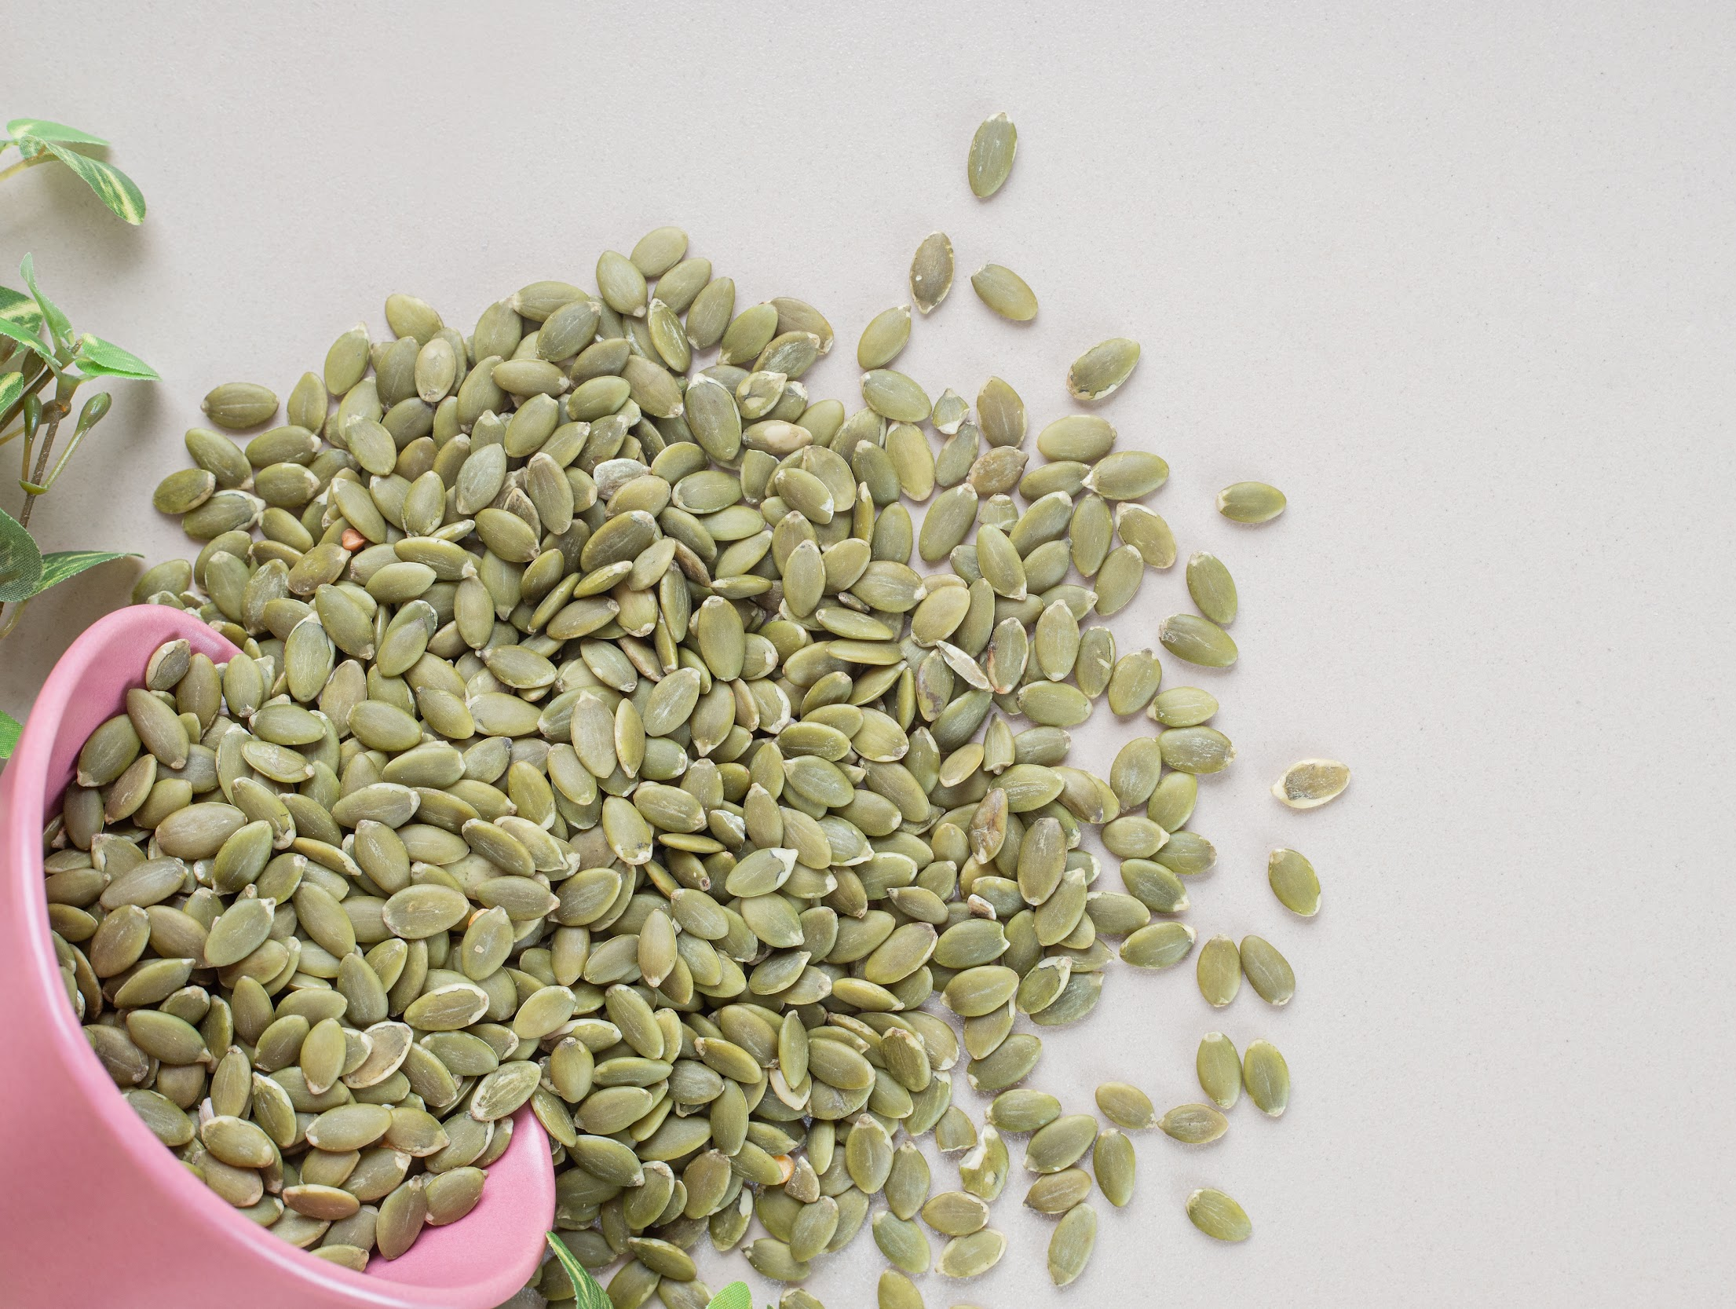
Match the definition to the correct words.
9. to grab 10. to behave 11. to scatter 12. to promise
to tell someone that something will definitely happen
to act well
to take hold of
to throw around randomly
Notes:
2A. Vocabulary
1. Say the word a few times, as you indicate the picture. For example, say, “to grab, to grab, to grab.” Have your students then repeat the word after you a few times.
2. Ask students to match the word to the correct definition and say the answer as a sentence. For example, “When you grab something you take hold of it.”
3. Check students’ comprehension further by asking direct questions. For example, “What are they grabbing in this picture.”
Answers
9. C
10. B
11. D
12. A
grab pic: https://unsplash.com/photos/peFEjuzDfQA
behave pic: https://www.freepik.com/free-psd/cute-happy-girl-portrait_37304195.htm#query=good%20kid&position=2&from_view=search&track=ais
scatter: https://www.freepik.com/free-photo/green-pumpkin-seeds-isolated-concrete_11624212.htm#page=2&query=seeds&position=39&from_view=search&track=sph
promise: https://www.freepik.com/free-photo/hr-handshaking-successful-candidate-getting-hired-new-job-closeup_3952580.htm#query=promise&position=11&from_view=search&track=sph

Slide 8
Match the beginning and end of each sentence:
1. I arrange…
2. I reach…
3. I grab…
for my mom so she will pick me up.
flowers to make a bouquet.
the keys off my kitchen counter so I can drive to work.
Notes:
2B. Vocabulary
1. Say the beginning of the sentence a few times. For example, say, ”I arrange.” Have your students then repeat the phrase after you a few times putting emphasis on the word arrange.
2. Ask students to match the beginning and end of each sentence and say the complete sentence. For example, “I arrange flowers to make a bouquet.”
3. Check students’ comprehension further by asking direct questions. For example, “What are some things you do often?”
Answers:
1. B.
2. A.
3. C.
arrange: https://www.freepik.com/free-vector/florist-concept-illustration_10042072.htm#query=arrange%20flowers&position=0&from_view=search&track=ais
reach: https://www.freepik.com/free-vector/little-son-reaching-arms-his-mom-woman-kid-walking-together-flat-illustration_11235630.htm#query=reach&position=29&from_view=search&track=sph
grab: https://www.freepik.com/free-vector/flat-hand-holding-car-key-background_1577588.htm#page=2&query=grab%20car%20keys&position=6&from_view=search&track=ais

Slide 9
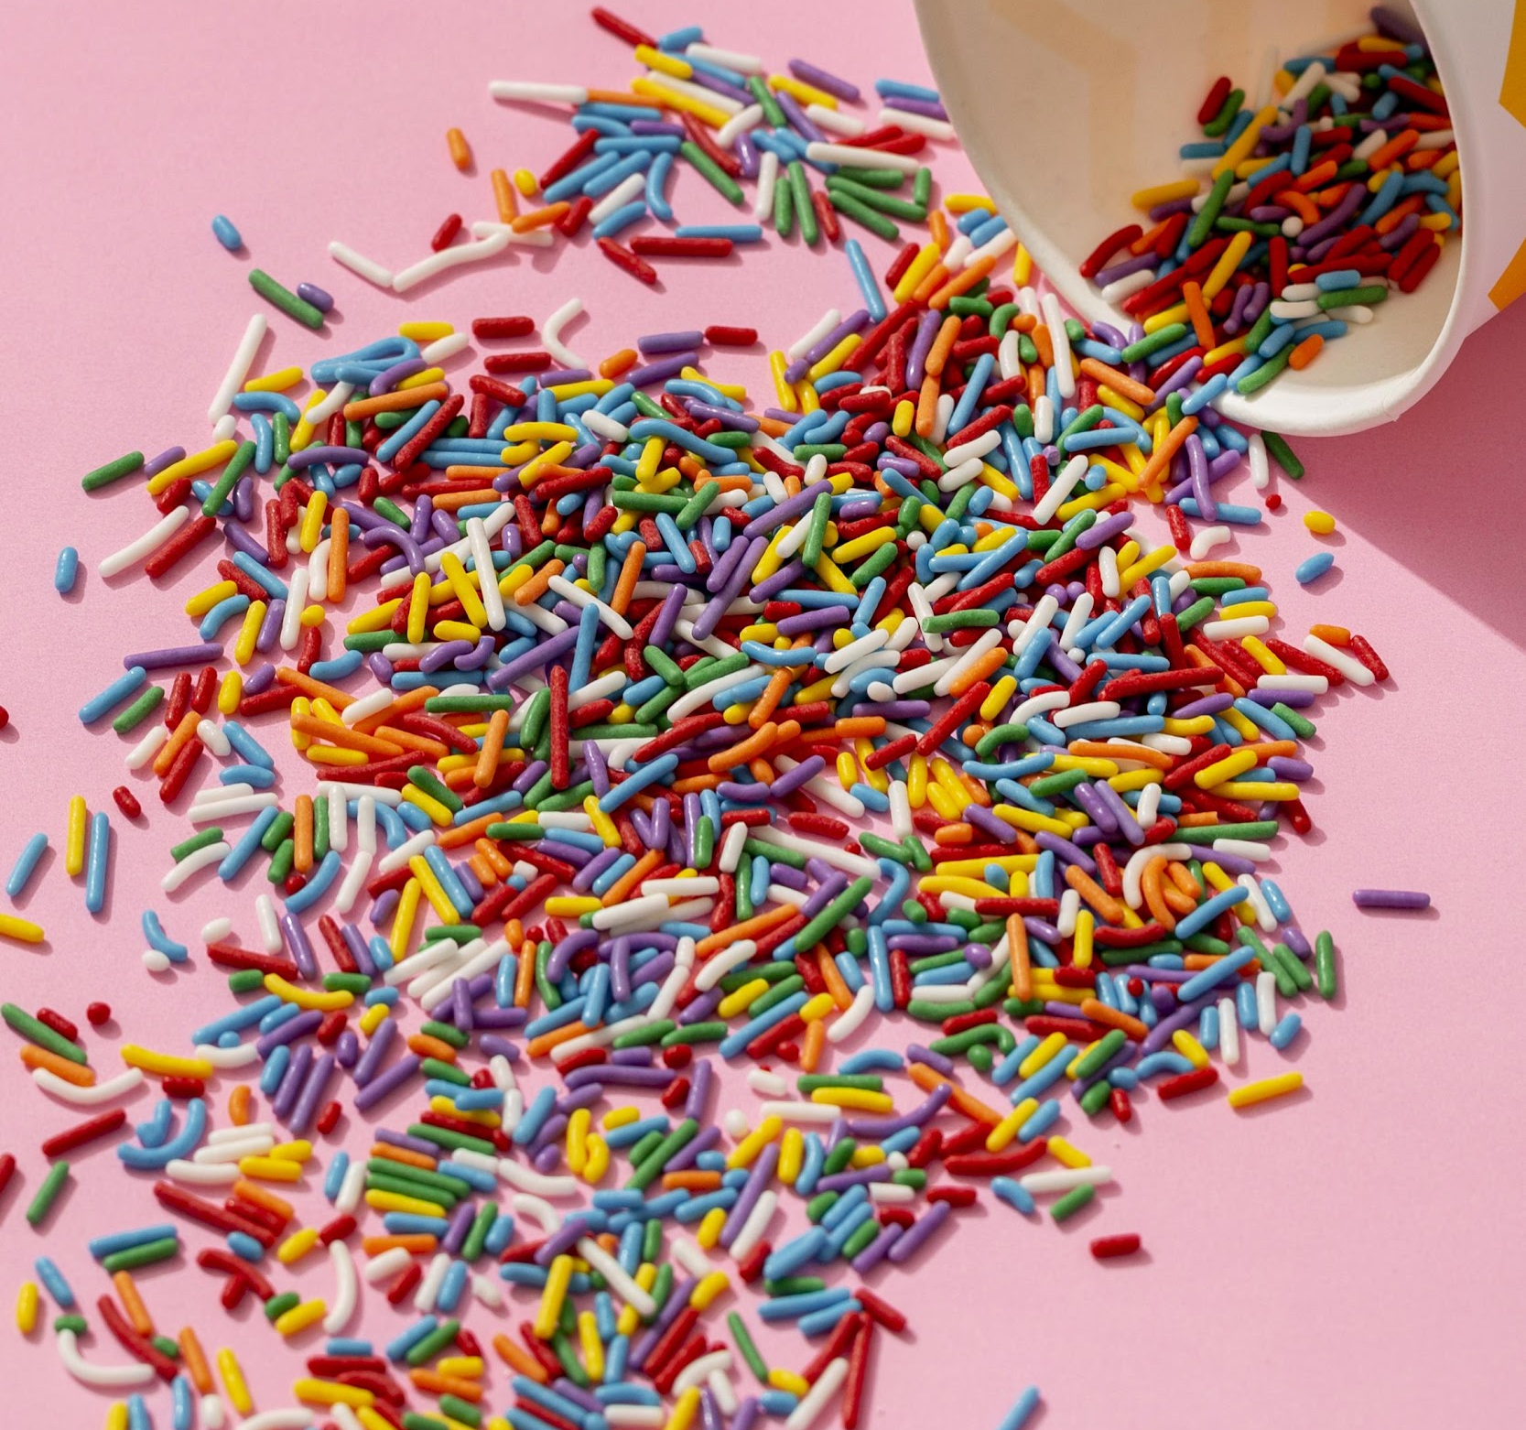
Match the beginning and end of each sentence:
4. I behave
5. I scatter
6. I promise
sprinkles on a cake.
that I will be home at 9:00.
like an adult by acting maturely.
Notes:
2B. Vocabulary
1. Say the beginning of the sentence a few times. For example, say, ”I behave.” Have your students then repeat the phrase after you a few times putting emphasis on the word arrange.
2. Ask students to match the beginning and end of each sentence and say the complete sentence. For example, “I behave like an adult by acting maturely.”
3. Check students’ comprehension further by asking direct questions. For example, “What are some things you do often?”
Answers
4. C.
5. A.
6. B.
behave: https://www.freepik.com/free-vector/public-approval-concept-woman-with-curly-hair_6660393.htm#query=good%20behavior&position=42&from_view=search&track=ais
scatter: https://www.freepik.com/free-photo/high-angle-colorful-cup-spill-sprinkles_10341757.htm#query=scatter%20sprinkles&position=9&from_view=search&track=ais
promise: https://www.freepik.com/free-vector/handshake-pinky-promise-friendship-love-hand-couple_32481036.htm#query=promise&position=40&from_view=search&track=sph

Slide 10
Present Simple Tense Verbs.
 | Question ? | Positive + | Negative -
1 | Do you promise you won’t tell anyone? | Yes, I promise I won’t tell anyone. | No, I don’t promise I won’t tell anyone.
2 | Does he arrange flowers? | _______________ | No, he doesn’t arrange flowers.
3 | Do they scatter sprinkles on the cake? | Yes, they scatter sprinkles on the cake. | _________________
4 | ____________________? | Yes, she does behave badly often. | No, she doesn’t behave badly often.
Notes:
2D. Grammar – Simple past tense verbs
Note:
Present simple tense verbs are used for actions that are currently happening or that happen regularly.
When the subject is I, you, we, or they the positive and negative simple present verbs are the same as the base verb.
When the subject is he, she, or it there is an s added to the end of the base verb to make the verb positive present simple. The negative simple present verbs are the same as the base verb.
Model, Repeat, and Solo row number 1. Then ask students to complete the sentences for rows 2-4.
Answers:
2. Yes, he arranges flowers.
3. No, they don’t scatter sprinkles on the cake.
4. Does she behave badly often?

Slide 11
Present Simple Tense Usage
 | Usage | Example
1 | Facts | Gardeners scatter seeds.
2 | Habits | Every day, I arrange my desk before starting work.
3 | Permanent situations | He works at a hospital.
4 | Timetables | The plane departs at 5:00.
Notes:
2E. Grammar: Present Simple Verbs
1. Say, the perfect present tense is used when we talk about facts, habits, permanent situations, and timetables
2. Say, a fact is something that is true. For example, gardeners scatter seeds is a fact so the verb, rises, is in the present simple tense.
3. Say, a habit is something that we do often. For example, everyday, I arrange my desk before starting starting work. If I do something every Tuesday, it is a habit so the verb, play, is in the present simple tense.
4. Say, a permanent situation is a circumstance that is intended to stay the same. For example, he works at a hospital. When someone works somewhere they are in a permanent situation so the verb, works, is in the present simple tense.
5. Say, a timetable is a chart that shows departure and arrival times. For example, our plane departs at 5:00 is talking about a departure time so the verb, leaves, is in the present simple tense.

Slide 12
3rd Person S in Present Simple Verbs
Subject | Positive Present Simple | Negative Present Simple
I You We They | arrange grab behave scatter promise | do not arrange do not grab do not behave do not scatter do not promise
He She It | arranges grabs behaves scatters promises | does not arrange does not grab does not behave does not scatter does not promise
Notes:
2F. Grammar: 3rd Person S in Present Simple Verbs
Say, “When the subject is I, you, we, or they the positive and negative simple present verbs are the same as the base verb.”
Say, “I arrange, I grab, I behave, I scatter, I promise, I don’t arrange, I don’t grab, I don’t behave, I don’t scatter, I don’t promise.”
Repeat 2. with you, we, and they.
Say, “When the subject is he, she, or it there is an s added to the end of the base verb to make the verb positive present simple. The negative simple present verbs are the same as the base verb.”
Say, “He arranges, he grabs, he behaves, he scatters, he promises, he doesn’t arrange, he doesn’t grab, he doesn’t behave, he doesn’t scatter, he doesn’t promise.”
Repeat 5. with she and it.

Slide 13
What do you think these phrasal verbs mean?
1. Behave yourself! Calm down and stop yelling!
2. My car broke down so I reached for my phone to call a tow truck.
3. Jesus grew up with his mother, Mary, and his father, Joseph.
4. I put my phone by my bed last night and woke up to my phone ringing in the middle of the night.
5. Watch out for animals on the road.
Notes:
2G. Grammar - Intransitive Phrasal Verbs
A phrasal verb is an idiomatic phrase that consists of a verb and a particle (either an adverb or a preposition). An intransitive phrasal verb is a phrasal verb that is made up of a verb and and a preposition that cannot have a direct object after it. The particle is stressed.
1. Read the sentences and have students guess what they think the phrasal verbs mean based on the context clues of the sentence.
Answers
1. calm down: become calm
2. broke down: suddenly stopped working
3. grow up: become older
4. woke up: became awake after sleeping
5. watch out: be vigilant or alert; pay attention

Slide 14
What do you think these phrasal verbs mean?
6. If you don’t drink water for a long time you could pass out and lose consciousness.
7. The other runners struggled to keep up with Usain Bolt.
8. Hold on, I’m busy. I promise I’ll call you back later.
9. The pilot announced that the plane could take off because the bad weather cleared up.
10. I’m going to wait for traffic to die down before I leave.
Notes:
2G. Grammar - Intransitive Phrasal Verbs
A phrasal verb is an idiomatic phrase that consists of a verb and a particle (either an adverb or a preposition). An intransitive phrasal verb is a phrasal verb that is made up of a verb and and a preposition that cannot have a direct object after it. The particle is stressed.
1. Read the sentences and have students guess what they think the phrasal verbs mean based on the context clues of the sentence.
Answers
6. pass out: faint
7. keep up: maintain a required pace
8. hold on: wait
9. take off: leave the ground
10. die down: fade or diminish

Slide 15
Listen and Repeat.
A: My students are so ornery. I can’t get them to _______!
B: What do they do?
A: They ______ my books everywhere because they think it’s funny!
B: I’m sorry. That must be frustrating.
A: Yes it is. I have to ______ them on the shelf again almost everyday. They ______ they’ll stop but then they do it again!
B: That is very immature of them.
Notes:
3. Conversation
Ask the students to brainstorm to fill in blanks of the conversation according to the pictures.
Model: Role-play the parts with a student to convey the meaning of the conversation.
3. Solo: You begin the conversation and call on individual students to respond. Then reverse the roles (students are A, you are B).
4. Once students can do both parts, encourage free conversation (students substitute their own words for the blanks).
behave
scatter
arrange
promise
first pic: https://www.freepik.com/free-vector/angry-boss-concept-illustration_33804214.htm#query=mad%20teacher&position=1&from_view=search&track=ais
second pic: https://www.freepik.com/free-vector/kids-reading-concept-illustration_23672901.htm?query=bad%20students#from_view=detail_alsolike

Slide 16
Practice the /o/ and /oo/ sounds. Then listen to the sentences and circle the word you hear.
 |  | /o/ | /oo/
1 |  | pot | put
2 |  | lock | look
3 |  | wad | wood
4 |  | God | good
5 |  | cod | could
Notes:
4A. Pronunciation – Minimal Pairs
In this section we will practice distinguishing between the /o/ and /oo/ sounds.
1. Model: Read each row several times and point to the words while students listen. For example, ”Number 1, pot, put, pot, put, pot, put.” Then ask students to repeat the words.
2. Read the sentences below and ask students to circle the word that they hear.
How do you spell put?
I lock up.
The wad is over there.
He is good.
How do you spell could?
pot: https://www.freepik.com/icon/pot_10717733#fromView=search&term=pot&page=1&position=38&track=ais&track=ais
lock: https://www.freepik.com/icon/padlock_2889676#fromView=search&term=lock&page=1&position=2&track=ais&track=ais
wad:https://www.freepik.com/icon/snowball_3725973
God: https://www.freepik.com/icon/jesus_2640113#fromView=search&term=God&page=1&position=37&track=ais
cod: https://www.freepik.com/icon/fish_3050536#fromView=search&term=fish&page=1&position=9&track=ais
put:https://www.freepik.com/icon/take_10688534#fromView=search&term=take&page=1&position=16&track=ais&track=ais
look: https://www.freepik.com/icon/cartoon-eyes_64945#fromView=search&term=look&page=1&position=44&track=ais&track=ais
wood: https://www.freepik.com/icon/firewood_1880883#fromView=search&term=wood&page=1&position=5&track=ais&track=ais
good: https://www.freepik.com/icon/like_126473#fromView=search&term=good&page=1&position=2&track=ais
could: https://www.freepik.com/icon/confused_5662983
Olivia is having some friends over to her house for dinner in a few hours and she wants to try a new recipe. She grabs a cookbook and flips through the pages. She decides to make potato and cod soup because it sounds very good and she has almost all of the ingredients already. The only ingredient she‘s missing is tomato paste. She asks her neighbor if she can borrow a little bit of tomato paste and her neighbor says yes. She takes a pot out of her cupboard and starts preparing the ingredients. She cuts up all the vegetables and cod. She puts the pot on the stove, turns the stove on, and puts a little bit of oil in the pot. Then, she puts the cut up vegetables, tomato paste, salt, and herbs in the pot. She lets them cook for a few minutes before adding the broth and potatoes. After about 15 minutes, she adds the cod. Five minutes later, she adds cream and then the soup is finished. The soup looks very good. She tastes it and decides to add a little more salt and herbs. She loves it and she’s excited for her friends to try it.

Slide 17
The stress is on the second word (the particle) in phrasal verbs.
 | A. — ▔ |  | B. — ▔
1 | calm down | 6 | pass out
2 | break down | 7 | keep up
3 | grow up | 8 | hold on
4 | wake up | 9 | take off
5 | watch out | 10 | die down
Notes:
4B. Pronunciation - Hum and clap the stress.
An intransitive verb is a verb that cannot have a direct object after it (for example, I smile, you cannot smile something). A phrasal verb is an idiomatic phrases that consists of a verb and a particle (either an adverb or a preposition). An intransitive phrasal verb is a phrasal verb that is made up of a verb and and a preposition that cannot have a direct object after it. The particle is stressed.
Begin by humming the stress of Columns A and B. Hum higher, longer, and louder for bolded dashes and lower, shorter, and quieter for unbolded dashes (the word in bold is the word that should be stressed). You may also use hand gestures to indicate that the stressed word is higher in pitch, longer in duration, and louder. Invite your students to join in humming or clapping the rhythm.
1. Model: Hum and then say each word in the columns A-D several times. Students listen. Then hum and say each pair of words in rows 1-10.
2. Repeat: Students repeat words after you in unison.
3. Solo: Call on individuals to read the columns and pairs of words with the correct stress.

Slide 18
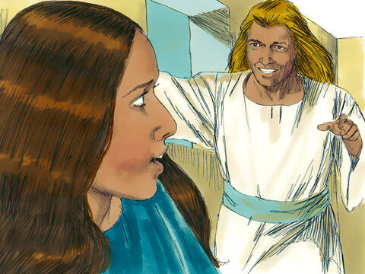
Luke 1:26-56 ERV
Birth of Jesus Foretold
²⁶⁻²⁷ During Elizabeth’s sixth month of pregnancy, God sent the angel Gabriel to a virgin girl who lived in Nazareth, a town in Galilee. She was engaged to marry a man named Joseph from the
family of David. Her name was Mary.²⁸ The angel came to her and said, “Greetings! The Lord is with you; you are very special to him.” ²⁹ But Mary was very confused about what the angel said. She wondered, “What does this mean?”
Notes:
5A. Bible Reading
Students should have already read this story in their first language (L1) as part of their homework, so it will be familiar even if they do not know all the vocabulary yet. However, if they have not yet read it in their L1, be sure they do so now before reading it in English. The hyperlinks of the Bible verses connect to https://live.bible.is/ so students can read and hear the scripture in their own languages. You may also watch videos of the passage at the website.
A. Read the story out loud to the class.
B. If students ask about words, give simple definitions.
C. Encourage students to read aloud verses from the story and act out the scene.
D. Ask if there are any questions or comments about the story.
E. Ask the story questions and discuss as a group.
F. Optional - You may hide the words and ask students to tell the story again in their own words, using the pictures to help them.

Slide 19
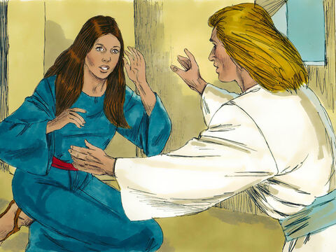
³⁰ The angel said to her, “Don’t be afraid, Mary, because God is very pleased with you. ³¹ Listen! You will become pregnant and have a baby boy. You will name him Jesus. ³² He will be great. People will call him the Son of
the Most High God, and the Lord God will make him king like his ancestor David. ³³ He will rule over the people of Jacob forever; his kingdom will never end.”
³⁴ Mary said to the angel, “How will this happen? I am still a virgin.”
Notes:
5B. Bible Reading
A. Read the story out loud to the class.
B. If students ask about words, give simple definitions.
C. Encourage students to read aloud paragraphs from the story and act out the scene.

Slide 20
³⁵ The angel said to Mary, “The Holy Spirit will come to you, and the power of the Most High God will cover you. The baby will be holy and will be called the Son of God. ³⁶ And here’s something else: Your relative Elizabeth is pregnant. She is very old, but she is going to have a son. Everyone thought she could not have a baby, but she has been pregnant now for six months. ³⁷ God can do anything!”
³⁸ Mary said, “I am the Lord’s servant. Let this thing you have said happen to me!” Then the angel went away.
©2020-2024 Bible League International
Notes:
5C. Bible Reading
A. Read the story out loud to the class.
B. If students ask about words, give simple definitions.
C. Encourage students to read aloud paragraphs from the story and act out the scene.

Slide 21
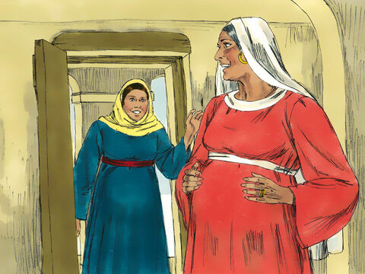
Mary visits Zechariah and Elizabeth
³⁹ Mary got up and went quickly to a town in the hill country of Judea. ⁴⁰ She went into Zechariah’s house and greeted Elizabeth. ⁴¹ When Elizabeth heard Mary’s greeting, the unborn baby inside her
jumped, and she was filled with the Holy Spirit.
⁴² In a loud voice she said to Mary, “God has blessed you more than any other woman. And God has blessed the baby you will have. ⁴³ You are the mother of my Lord, and you have come to me!
Notes:
5D. Bible Reading
A. Read the story out loud to the class.
B. If students ask about words, give simple definitions.
C. Encourage students to read aloud paragraphs from the story and act out the scene.

Slide 22
Why has something so good happened to me? ⁴⁴ When I heard your voice, the baby inside me jumped with joy.⁴⁵ Great blessings are yours because you believed what the Lord said to you! You believed this would happen.”
Mary Praises God
⁴⁶ Then Mary said, “I praise the Lord with all my heart. ⁴⁷ I am very happy because God is my Savior. ⁴⁸ I am not important, but he has shown his care for me, his lowly servant. From now until the end of time, people will remember how much God blessed me. ⁴⁹ Yes, the Powerful One has done great things for me. His name is very holy.
Notes:
5E. Bible Reading
A. Read the story out loud to the class.
B. If students ask about words, give simple definitions.
C. Encourage students to read aloud paragraphs from the story and act out the scene.

Slide 23
⁵⁰ He always gives mercy to those who worship him. ⁵¹ He reached out his arm and showed his power. He scattered those who are proud and think great things about themselves. ⁵² He brought down rulers from their thrones and raised up the humble people. ⁵³ He filled the hungry with good things, but he sent the rich away with nothing. ⁵⁴ God has helped Israel—the people he chose to serve him. He did not forget his promise to give us his mercy. ⁵⁵ He has done what he promised to our ancestors, to Abraham and his children forever.” ⁵⁶ Mary stayed with Elizabeth for about three months and then went home.
Notes:
5F. Bible Reading
A. Read the story out loud to the class.
B. If students ask about words, give simple definitions.
C. Encourage students to read aloud paragraphs from the story and act out the scene.

Slide 24
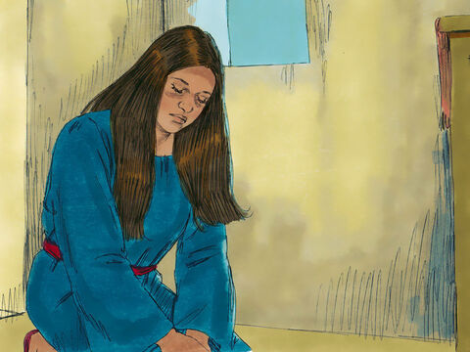
Answer the questions.
1. Who was Mary engaged to?
2. What did the angel tell Mary?
3. How would you feel if you saw an angel and it spoke to you?
4. Why did Elizabeth tell Mary that great blessings were Mary’s?
5. How does Mary describe God?
6. Have you ever faced a situation that was overwhelming or one you didn’t understand? How did you handle it?
Notes:
5G. Bible Reading Questions
Ask the questions and discuss as a group.
Answers:
She was engaged to a man named Joseph.
The angel told Mary that God is with her, that she is very special to God, and that she would become pregnant with Jesus, the son of God.
*answers will vary*
Elizabeth told Mary that great blessings were hers because Mary believed what God said to her.
She describes him as her savior, holy, he gives mercy to those who worship him, he scattered those who are proud, etc….
She sent home after staying with Elizabeth for 3 months

Slide 25
Psalm NIRV
Insert Psalm and questions here.
Notes:
5H. Bible Reading
Students should have already read this story in their first language (L1) as part of their homework, so it will be familiar even if they do not know all the vocabulary yet. However, if they have not yet read it in their L1, be sure they do so now before reading it in English. The hyperlinks of the Bible verses connect to https://live.bible.is/ so students can read and hear the scripture in their own languages. You may also watch videos of the passage at the website.
A. Read the story out loud to the class.
B. If students ask about words, give simple definitions.
C. Encourage students to read aloud verses from the story and act out the scene.
D. Ask if there are any questions or comments about the story.
E. Ask the story questions and discuss as a group.
F. Optional - You may hide the words and ask students to tell the story again in their own words, using the pictures to help them.

Slide 26
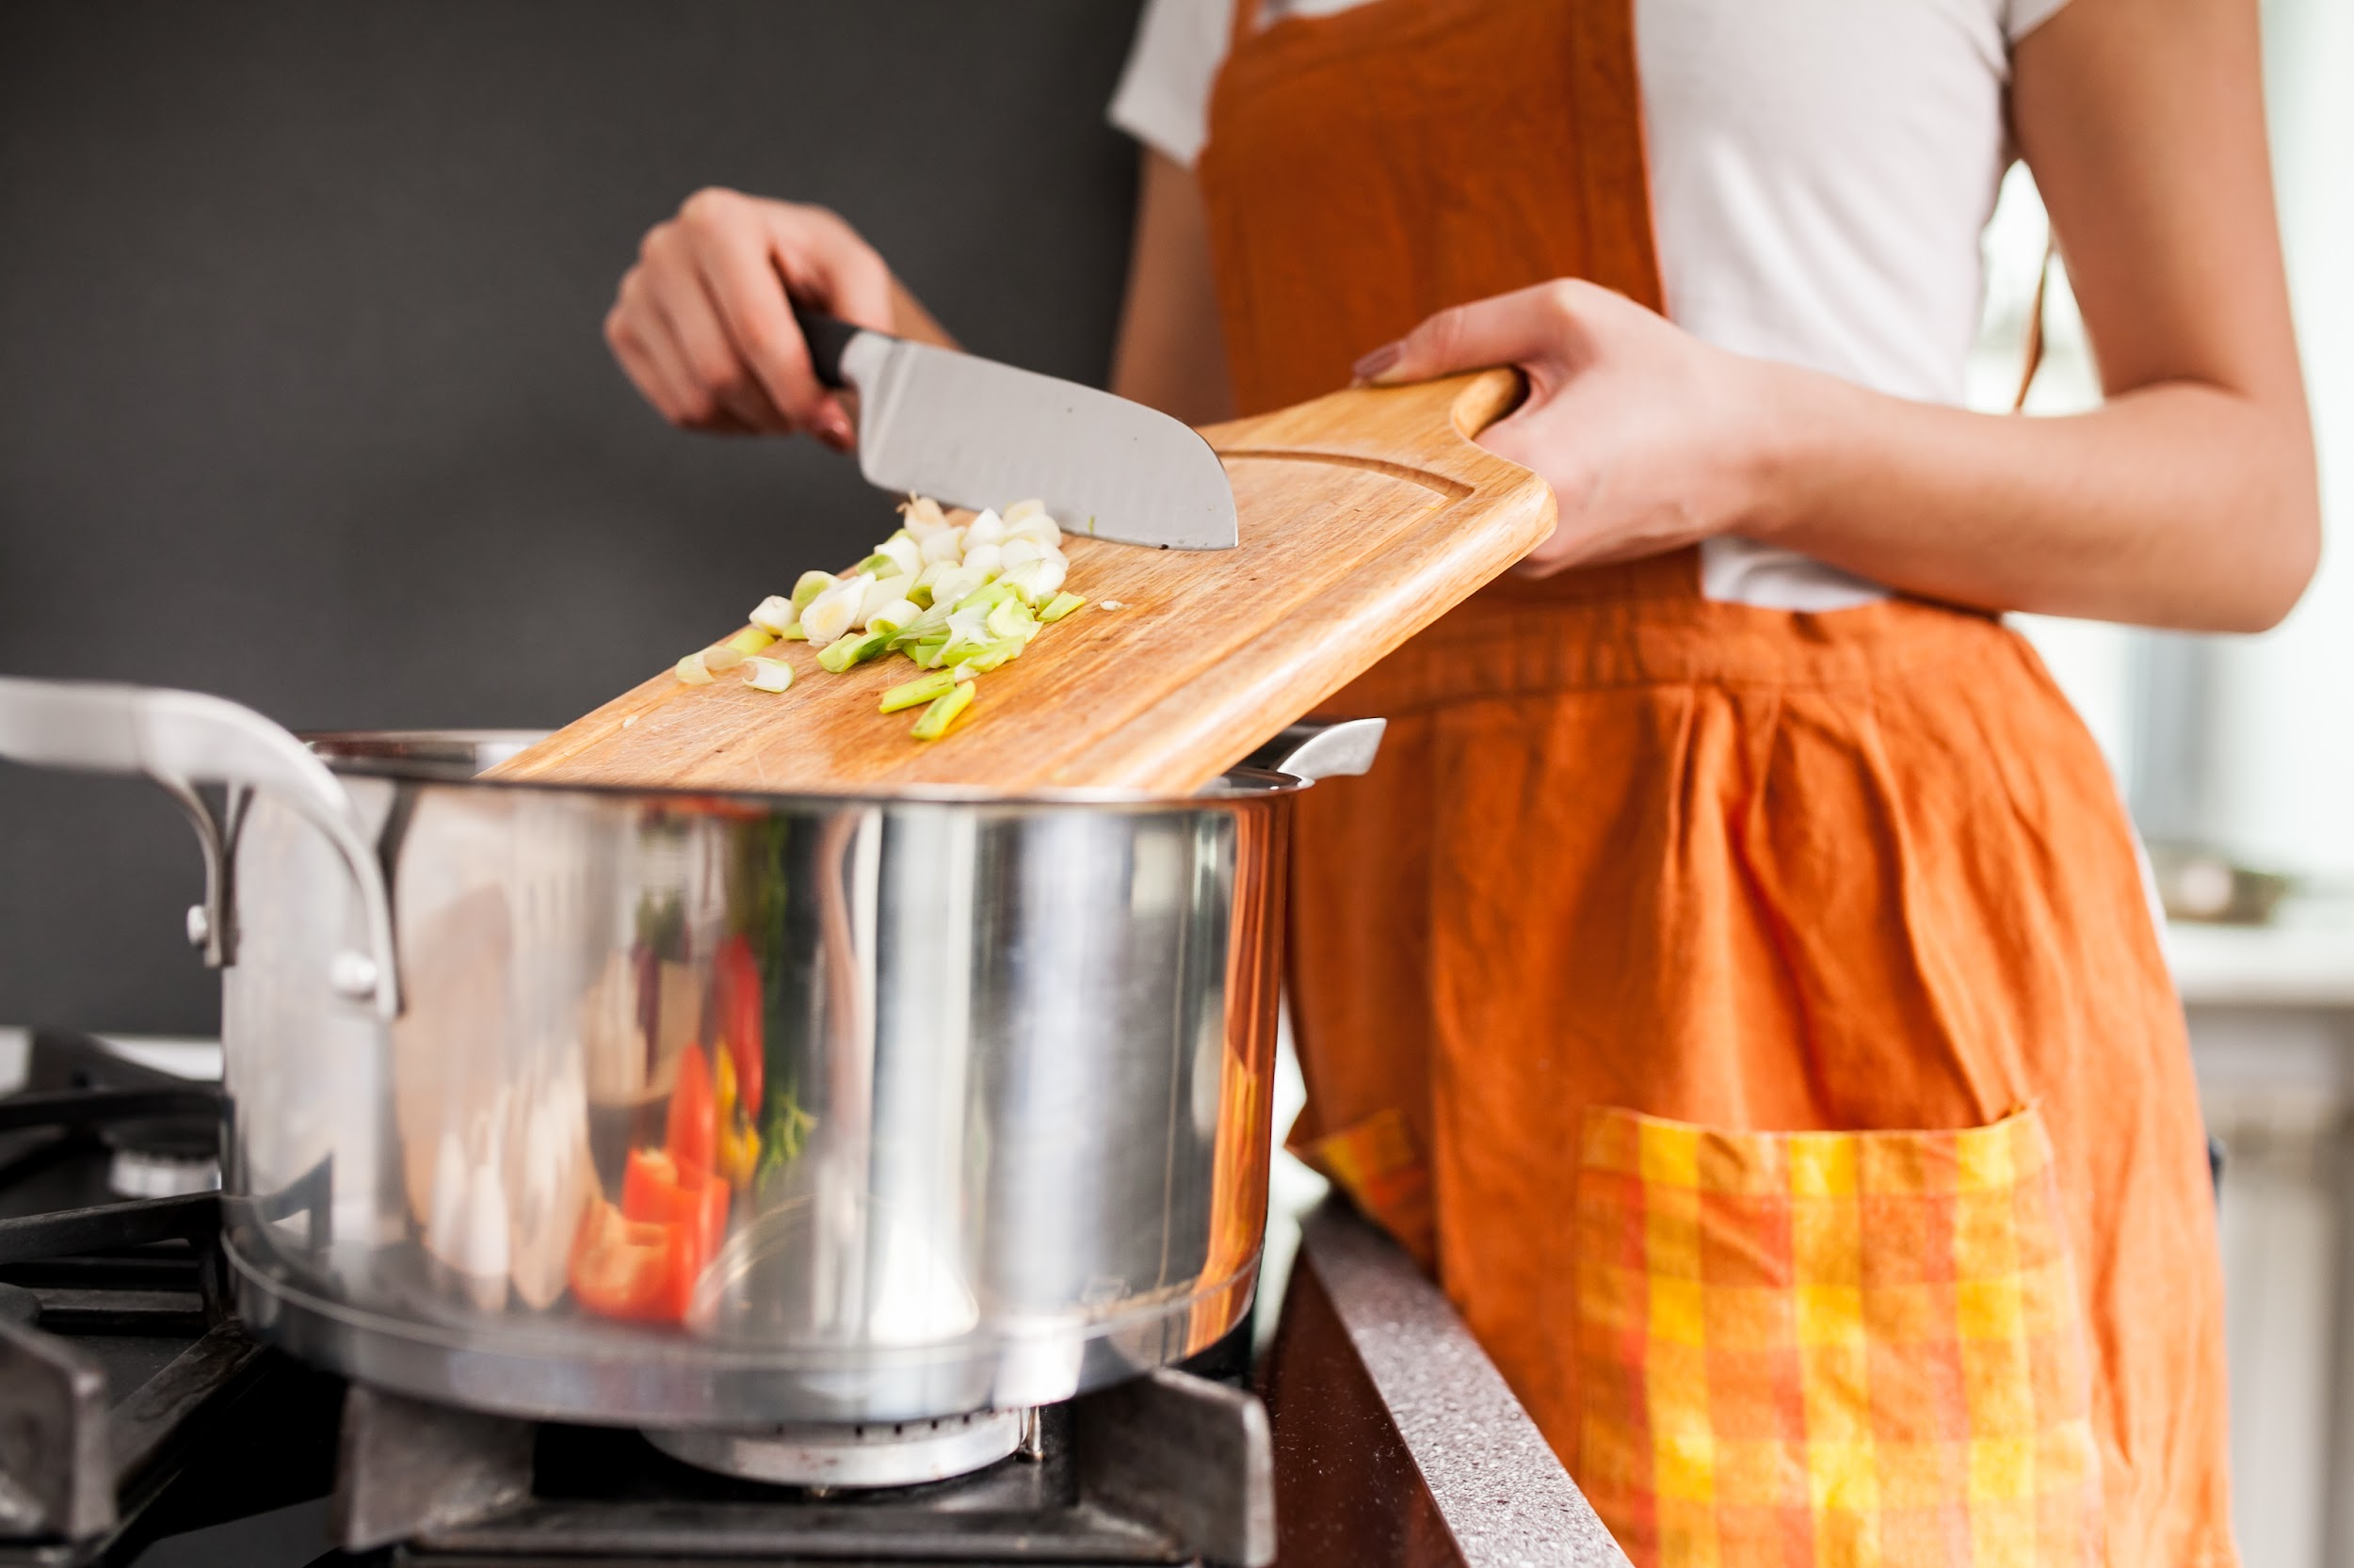
Listen and complete the sentences.
1. Olivia decides to make ______ and
______ soup because it sounds very ______.
2. She takes a ______ out of her cupboard.
3. She ______ the ______ on the stove.
4. She ______ the cut up ______, tomato paste, salt, and herbs in the ______.
5. The soup ______ very good and she’s ______ for her friends to try it.
Notes:
6A. Activities – Listening to pronunciation words with /o/ and /oo/ sounds.
Read the script below at least twice as students listen and answer the questions. The students should NOT look at the script.
“Olivia is having some friends over to her house for dinner in a few hours and she wants to try a new recipe. She reaches for a cookbook and flips through the pages. She decides to make potato and cod soup because it sounds very good and she has almost all of the ingredients already. The only ingredient she‘s missing is tomato paste. She asks her neighbor if she can borrow a little bit of tomato paste and her neighbor says yes. She takes a pot out of her cupboard and starts preparing the ingredients. She cuts up all the vegetables and cod. She puts the pot on the stove, turns the stove on, and puts a little bit of oil in the pot. Then, she puts the cut up vegetables, tomato paste, salt, and herbs in the pot. She lets them cook for a few minutes before adding the broth and potatoes. After about 15 minutes, she adds the cod. Five minutes later, she adds cream and then the soup is finished. The soup looks very good. She tastes it and decides to add a little more salt. She scatters herbs on top. She loves it and she’s excited for her friends to try it.
Answers:
1. potato, cod, good
2. pot
3. puts, pot
4. puts, vegetables, pot
5. looks, excited
pic: https://www.freepik.com/free-photo/home-beautiful-kitchen-food-cooking_1116501.htm#query=woman%20making%20soup&position=44&from_view=search&track=ais

Slide 27
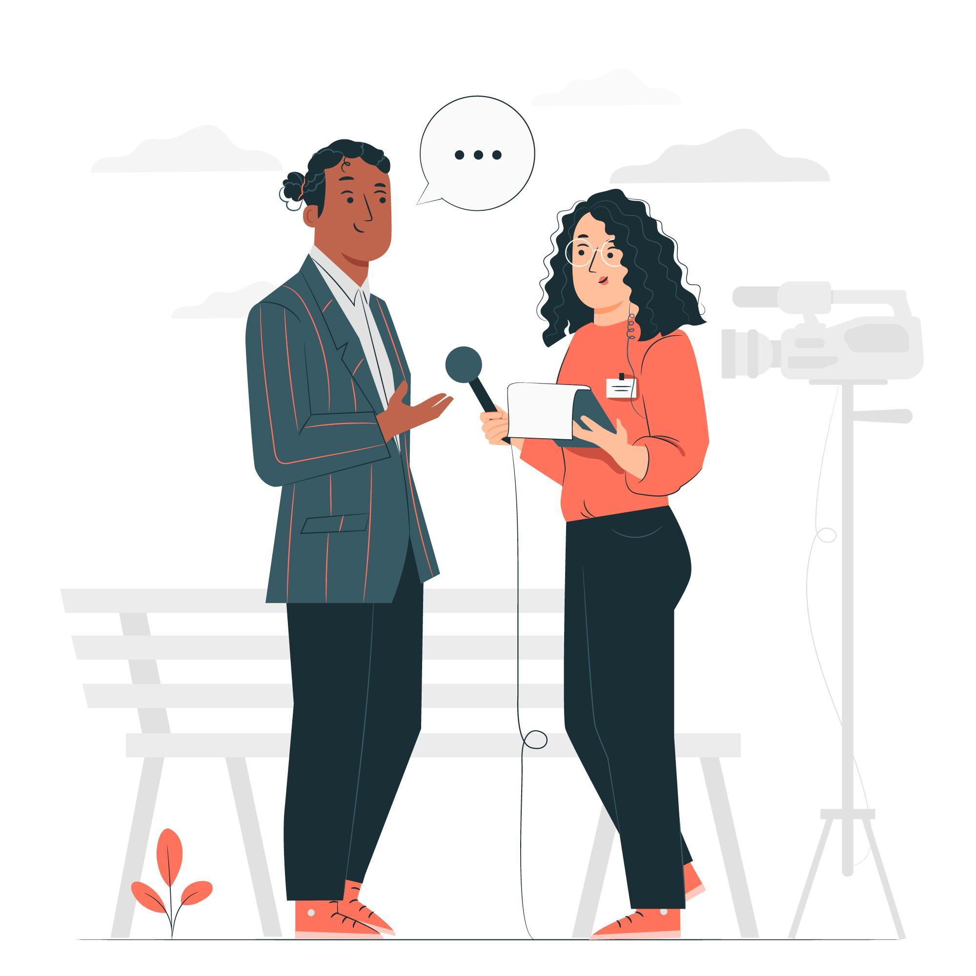
A. Role-Play – Interviewer
You are interviewing a celebrity. You are asking them questions about their daily routine. You ask the following questions:
What is the first thing you do when you wake up?
Do you eat breakfast? If so, what do you usually eat?
How long does it take you to get ready for the day?
What does a typical work day look like for you?
How do you spend your free time?
What kinds of fun things do you like to do on the weekends?
Do you have a bedtime routine?
What time do you usually go to bed?
Is there anything you wish you did more often?
Notes:
6B. Activities – Pair Work Partner A
Role-Play between an interviewer and celebrity.
1. Partner A will play the part of an interviewer interviewing a celebrity about their daily routine. Partner A will ask questions from this slide and write Partner B’s answers.
(Students can choose to give real answers about their actual lives or they can make up answers. Encourage the use of the present simple tense.)
Check answers for correct grammar and punctuation. Answers will vary.
pic: https://www.freepik.com/free-vector/journalist-concept-illustration_9558309.htm#query=celebrity%20interview&position=17&from_view=search&track=ais

Slide 28
A. Role-Play – Interviewer
You are interviewing a celebrity. You are asking them questions about their preferences and hobbies. You ask the following questions:
Are you a cat person or a dog person? Do you have any pets?
What kind of music do you listen to?
What languages do you speak?
Do you prefer cold weather or hot weather?
Do you prefer to travel to new places or revisit one’s you’ve already been to?
What is your favorite meal?
Do you like to read books? If so, what is your favorite book?
Are there any hobbies you want to try but haven’t yet?
What does your ideal day look like?
Notes:
6B. Activities – Pair Work Partner B
Role-Play between an interviewer and celebrity.
1. Partner B will play the part of an interviewer interviewing a celebrity about their daily routine. Partner B will ask questions from this slide and write Partner A’s answers.
(Students can choose to give real answers about their actual lives or they can make up answers. Encourage the use of the present simple tense.)
Check answers for correct grammar and punctuation. Answers will vary.
pic: https://www.freepik.com/free-vector/journalist-concept-illustration_9558309.htm#query=celebrity%20interview&position=17&from_view=search&track=ais

Slide 29
Song – The Angel Gabriel from Heaven Came
The angel Gabriel from heaven came,
his wings as drifted snow, his eyes as flame;
"All hail," said he to meek and lowly Mary,
"most highly favored woman." Gloria!
"I come from heaven to tell the Lord's decree:
a blessed holy mother you shall be.
Your Son shall be a blessing to the world,
most highly favored woman." Gloria!
Then gentle Mary meekly bowed her head;
"To me be as it pleases God," she said.
"My soul will praise and glorify his holy name."
Most highly favored woman, Gloria!
Notes:
7. Song
Learners will learn the new song for the lesson with the accompanying actions.
1. Model: Read the song lyrics out loud to the class. Ask if there are any questions. Write words that learners ask about on the board and give simple definitions. Then sing it two or three times (or play the song online) while they just listen.
2. Repeat: Sing the selection again, a line or sentence at a time, as learners repeat after you. Then play the recording and sing the song together.
3. Solo: The learner sings solo (or if shy, can just read the words aloud).
Song composed by Sabine Baring-Gould in 1924.

Slide 30
1A. Homework – Write sentences about the pictures.
1 | Mary and Joseph are engaged. | 4
2 |  | 5
3 |  | 6
engaged
holy
ancestor
blessing
lowly
mercy
Notes:
Homework 1A. - Write sentences using the pictured vocabulary words.
Model. Go over each of the homework assignments to be sure the student understands what to do.
Repeat. Encourage students to practice speaking and reading the completed homework assignments with a friend. They may use a bilingual dictionary.
Solo. Students will share their homework when they are finished. After they have shared their homework, be sure to check it for correctness, including spelling. Explain mistakes, while providing praise and encouragement.
Number one is an example.
Answers will vary.

Slide 31
1B. Write sentences about the pictures using the verbs in the present simple tense.
1. promise
2. grab
3. reach
4. behave
5. scatter
6. arrange
Notes:
Homework 1B. - Write sentences using the vocabulary words.
Students will write answers to the questions.
Answers will vary.
Example sentences:
1. I promise to have that report to you by noon today.
2. They grab donuts off the plate.
3. Omar reaches for Jeff’s hand.
4. My daughter behaves at school.
5. I scattered seeds on the floor on accident.
6. The florist arranges flowers for wedding bouquets.

Slide 32
2A. Use the verbs in the present simple tense.
I (reach)… I reach for the book on the top shelf.
He (grab) …
I (promise) …
She (arrange) …
We (scatter)…
They (behave)…
You (grab) …
Notes:
Homework 2A. – Grammar and Vocabulary Review
Students will complete the sentences with the correct verb forms. Number 1 is an example.
Answers will vary but must include:
2. he grabs
3. I promise
4. she arranges
5. we scatter
6. they behave
7. you grab
pic: https://www.freepik.com/free-photo/young-student-working-assignment_22377283.htm#query=reaching%20for%20book%20on%20shelf&position=33&from_view=search&track=ais

Slide 33
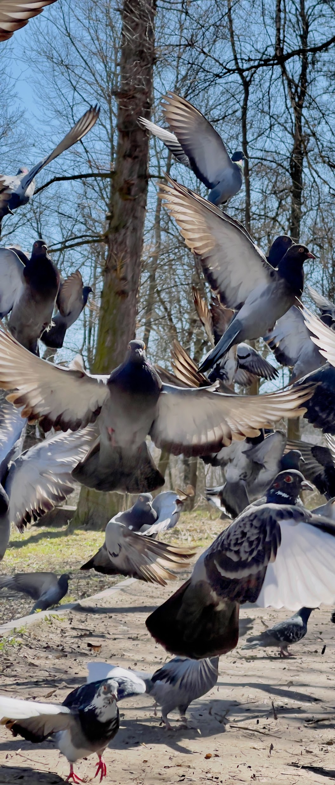
2B. Write 1 positive and 1 negative sentence for each verb.
scatter
Birds scatter when people come near them.
I don’t scatter coconut on the cupcakes because I don’t like coconut.
arrange
behave
grab
Notes:
Homework 2B. – Grammar and Vocabulary Review
Students will write positive and negative sentences using the verb assigned.
A1 and 2 is an example.
Answers will vary but may include:
B1. Liz arranges a meeting with her boss.
B2. I don’t arrange my pillows on my bed in the morning.
C1. The children behave at school.
C2. Simon doesn’t behave when his mom asks him to.
D1. He grabs his wife’s hand.
D2. They don’t grab coffee before going to work because they’re running late.
pic: https://www.freepik.com/free-photo/doves-flying-up-park-sunny-day-close-up_13838845.htm#query=pigeons%20scattering&position=1&from_view=search&track=ais

Slide 34
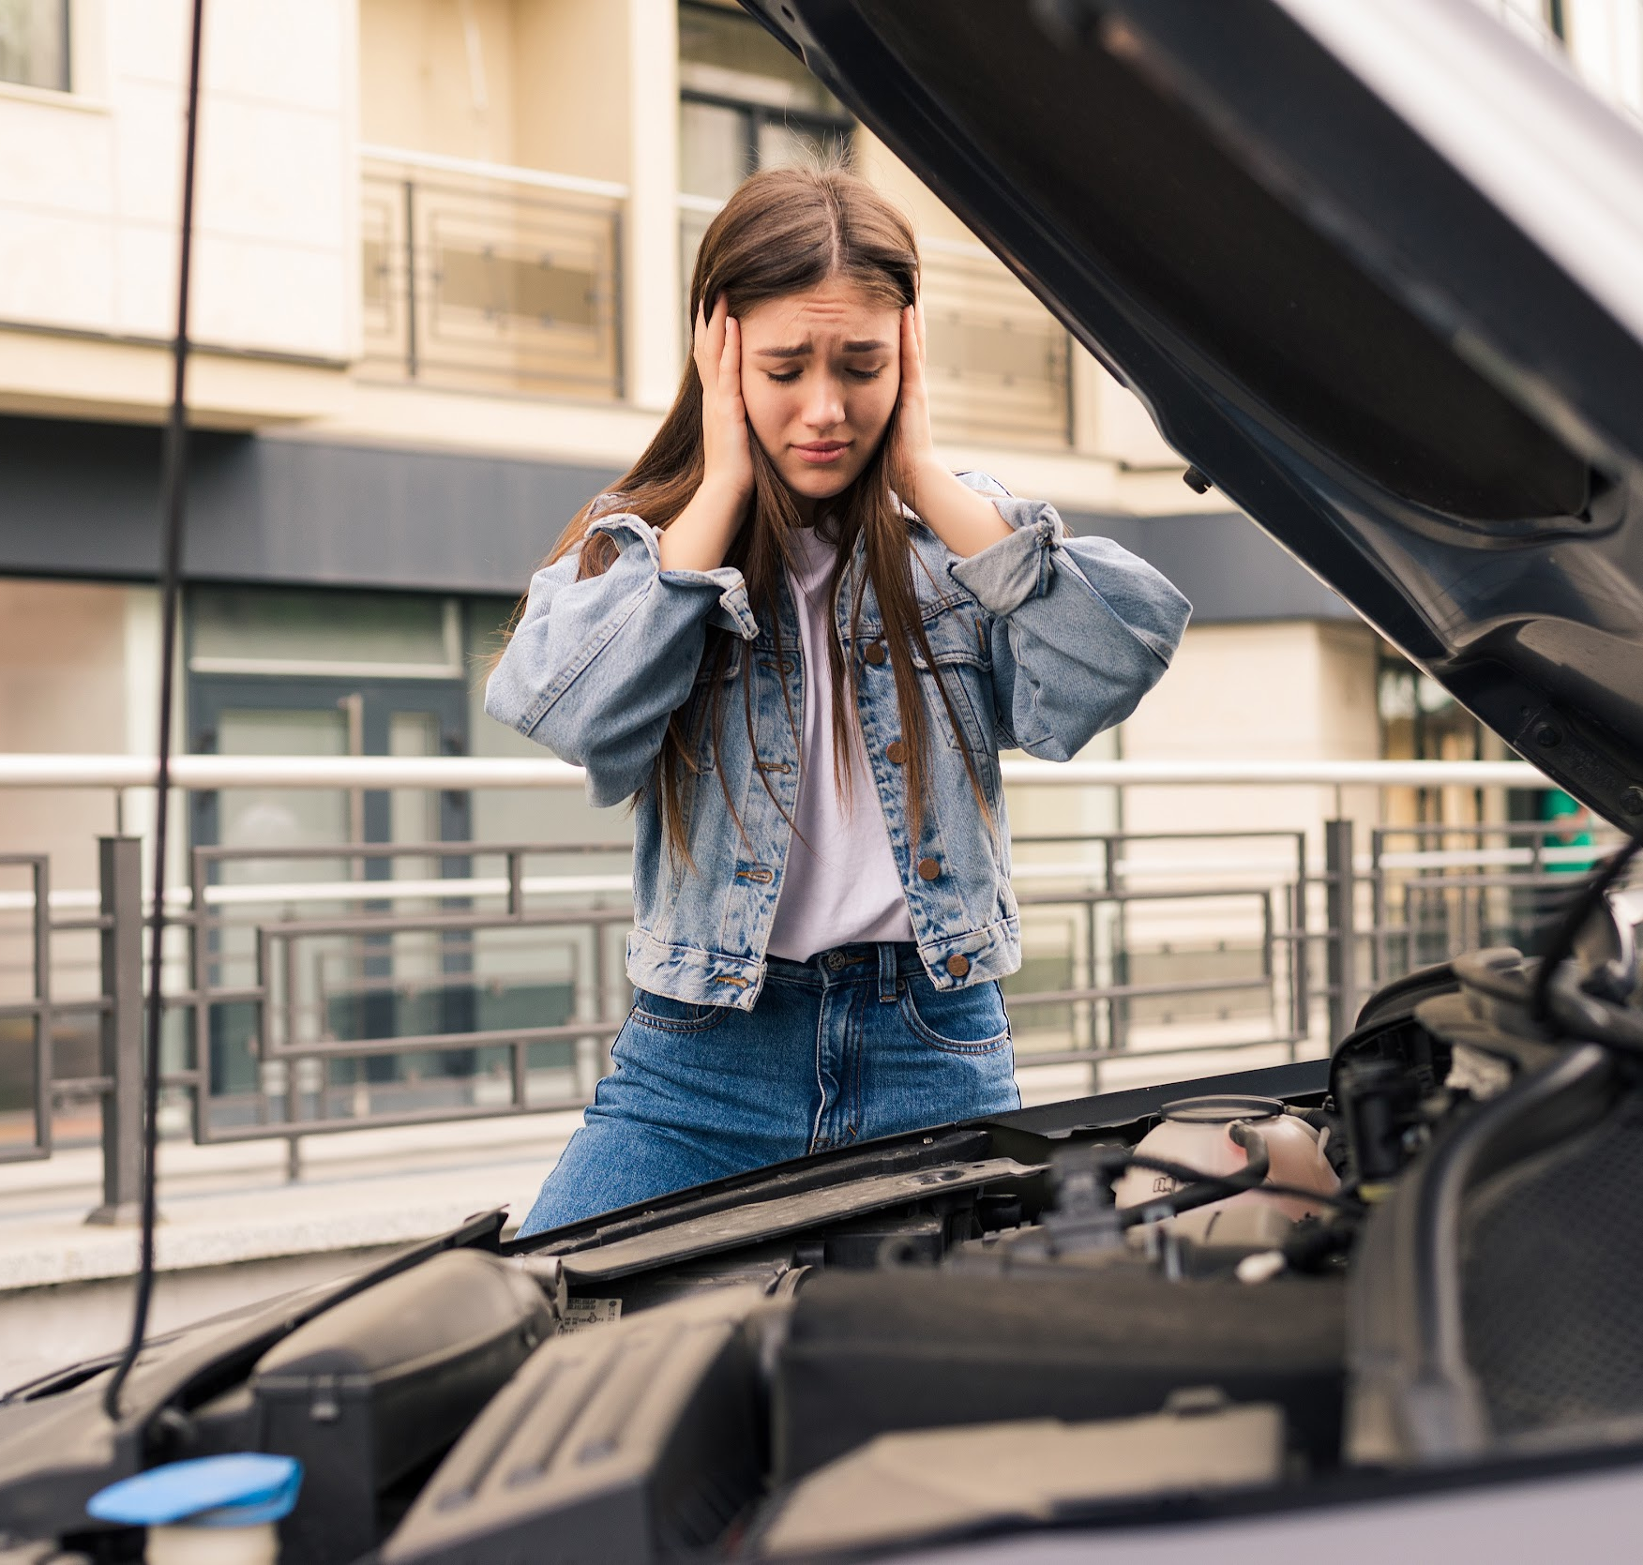
2C. Choose the correct phrasal verbs.
My car ________ every once in awhile
because it’s old.
passes out
breaks up
breaks down
Julie _______ to my house every weekend.
comes in
comes over
dies down
My dad ______ at 5:00 a.m. every morning.
wakes up
grows up
watches out
Notes:
Homework 2C. – Grammar and Vocabulary Review
Students will circle the errors and write the correct verbs. Number one is an example.
Answers:
breaks down
comes over
wakes up
pic: https://www.freepik.com/free-photo/young-worried-girl-is-using-phone-explain-mechanic-problem-with-car-that-she-has_14671631.htm#query=broken%20down%20car&position=2&from_view=search&track=ais

Slide 35
3. With a partner, discuss these questions.
What do you do for fun?
What is your job? Do you like it?
What are 3 things you do everyday?
What is something you do once a week?
What is something you do once a month?
What is something you do once a year?
What is something you want to do more often?
What is something you do often that you don’t like
to do?
Notes:
Homework 3. – Conversations - Pair work
Students interview a partner and write their partner’s answers. Check answers for correct grammar and punctuation.
Questions and answers will vary

Slide 36
4. Say and write the words in the correct columns.
pot | wood
look | low
could | wad
broke | cod
so | coat
lock | book
sock | put
cook | though
sew | mop
/o/ | /oo/ | /O/
Notes:
Homework 4. – Pronunciation
This homework practices pronouncing the /o/, /oo/, and /O/ sounds.
Students will go through the list and sound out each word. Then they will write words in the correct columns for each vowel sound.
Answers:
/o/: pot, wad, cod, lock, sock, mop
/oo/: wood, look, could, book, put, cook
/O/: low, broke, so, coat, though, sew

Slide 37
5. Write about Luke 1:26-56 in your own words. Use first, then, next, and finally.
©2021-2024 Light of the World Learning
Notes:
Homework 5. – Bible Reading Review
Students will write a short summary of the Bible reading using the words first, then, next and finally.
Answers will vary. Possible answers may include:
First, the angel, Gabriel, came to Mary and told her that she would become pregnant with the son of God. Then, she visited Zechariah and Elizabeth. The baby in Elizabeth’s womb jumped with joy when Mary spoke to Elizabeth. Elizabeth declared that Mary was blessed. Next, Mary praises God. Finally, Mary stayed with Elizabeth for three months before returning home.

Slide 38
6. Choose 1 verse to memorize and write it here. Then read the next verses in your language.
Read the next lesson’s Bible verses: Luke 1:57-80 in your language.
Notes:
Homework 6. – Memorize a verse and read the next lesson’s verses in your native language.
Learners get to choose one verse from the lesson’s reading to memorize. Please notice that the memory work is not long. Everyone, regardless of skill level, should be able to do it. Students will also read the next lesson’s Bible passage in their native language. Students will always read the Bible lesson in their first language before reading it in English the following lesson. Help them get a Bible in their own language if they don’t have one. They may also use https://live.bible.is/ or other Bible translation resources. The hyperlinks of the Bible verses connect to https://live.bible.is/ so students can read, hear and watch videos of the scripture in their own languages.
1. Model. Recite a verse from memory.
2. Repeat. Encourage students to find someone with whom to practice conversing and reading the completed homework assignment.
3. Solo. Students will recite the verse from memory at the next class.

Slide 39
7A. Read the letter.
Hi Olivia,
How have you been? As you know, I started college last week. It’s been a lot of fun but also hard work. Every morning I wake up at 6:00 a.m. and grab coffee. After that, I go to work from 7:00 a.m.-10:00 a.m. I work at a grocery store. My job is to arrange food on the shelves. On Mondays, Wednesdays, and Fridays I go back to my room for a little bit before going to a writing class at 11:00 a.m. That is my favorite class. After that class, I eat lunch and then I take a nap and then I go to French class at 2:00 p.m. French class is very hard but my professor is very nice.
Notes:
Homework 7A. – Everyday Reading and Writing
Students will read the letter and answer the questions.
A letter to a friend
Hi Olivia,
How have you been? As you know, I started college last week. It’s been a lot of fun but also hard work. Every morning I wake up at 6:00am and grab coffee. After that, I go to work from 7:00am-10:00am. I work at a grocery store. My job is to arrange food on the shelves. On Mondays, Wednesdays, and Fridays I go back to my room for a little bit before going to a writing class at 11:00am. That is my favorite class. I learn so much! After that class, I eat lunch and then I take a nap and then I go to French class at 2:00pm. French class is very hard but my professor is very nice. I have 3 classes on Tuesdays and Thursdays; algebra, biology, and public speaking. I do not like public speaking at all. I always cook dinner with my roommate on Tuesdays and Thursdays. We like to try new recipes that we find online. On the weekends, I go to coffee shops or the library a lot to do homework with friends. I can’t wait to see you in December! I promise I’ll write to you more often once I get a little more settled!
Best regards,
Frida

Slide 40
7B. Continue the letter.
I have 3 classes on Tuesdays and Thursdays; algebra, biology, and public speaking. On the weekends, I go to coffee shops or the library a lot to do homework with friends. College has been very good but I miss my family and friends from home. I can’t wait to see you in December! I promise I’ll write to you more often once I get a little more settled!
Love,
Frida
Notes:
Homework 7B. – Everyday Reading and Writing
Students will read the letter and answer the questions on the next slide.

Slide 41
7C. Answer the questions about the letter.
A. Why is Frida writing to Olivia?
B. Why do you think Frida’s writing class is her favorite?
C. What is Frida’s weekly schedule?
D. How do you think Frida feels about her busy schedule?
E. How do you think Olivia feels about being away from her friend?
F. If you were Frida's friend, what advice would you give her to improve her schedule or manage her time more effectively?
Notes:
Homework 7C.– Everyday Reading and Writing
Students will answer the questions about the pronunciation article.
Answers will vary.

Slide 42
8. Write a 200-word letter to a friend about things you do everyday.
Notes:
Homework 8 – Writing
Model. Write an example introduction such as:
Dear Maya,
How have you been? I want to tell you about my daily routine. Everyday, the first thing I do when I wake up is brush my teeth. After I brush my teeth, I decide what outfit I’m going to wear….
Answers will vary.

Slide 43
9. Now I Can…
I can talk about common actions.
I can understand, say, read, and write the 12 vocabulary words.
I can use the simple present tense to talk about facts, daily actions, and common actions.
I understand phrasal verbs and how to use them.
I can understand how Mary felt about becoming pregnant with Jesus.
Notes:
Homework 9. – I can statements
The student must be able to achieve all of these skills before the next lesson. If not, the lesson can be repeated or additional practice materials can be used.
Review all of the skills at the beginning of the next lesson. Be sure to give lots of praise and encouragement!

Slide 44
Closing Prayer
Notes:
Pray
You may want to ask for any special prayer requests, then pray for your students and bless them. Prayers may also be written on this slide.

Slide 45
Help us share the Light of the World!
Thank you for using our materials. If these lessons are a blessing to you, please consider giving to help others learn English through the Bible.
For more information, visit LightOfTheWorld Learning.org

