Slide 1

Unit B1-04
©2020-2024 Literacy International
Notes:
Teacher’s Notes
Bible Reading: The Birth of John the Baptist Luke 1:57-80
Theme: Emotions
Pronunciation: /a/ & /o/
Grammar: Present continuous tense; conjunctions so, then, plus, but, finally
Preparation: Pray. Preview vocabulary, simple definitions, and discussion prompts.

Slide 2

Pray, Review, and Preview
Bible Reading: The Birth of John the Baptist Luke 1:57-80
Theme: Emotions
Pronunciation: /a/ & /o/
Grammar: Present continuous tense; conjunctions so, then, plus, but, finally
Notes:
Pray
Pray for the class. You may want to thank God that we can express joy, sadness and other emotions with the people around us.
Check homework and review.
Ask students to read aloud or recite their homework from the last class. Check written work.
Review the main points of the previous lesson and ask if there are any questions.
Be sure they have read the Bible passage in their native languages in preparation for the lesson.

Slide 3
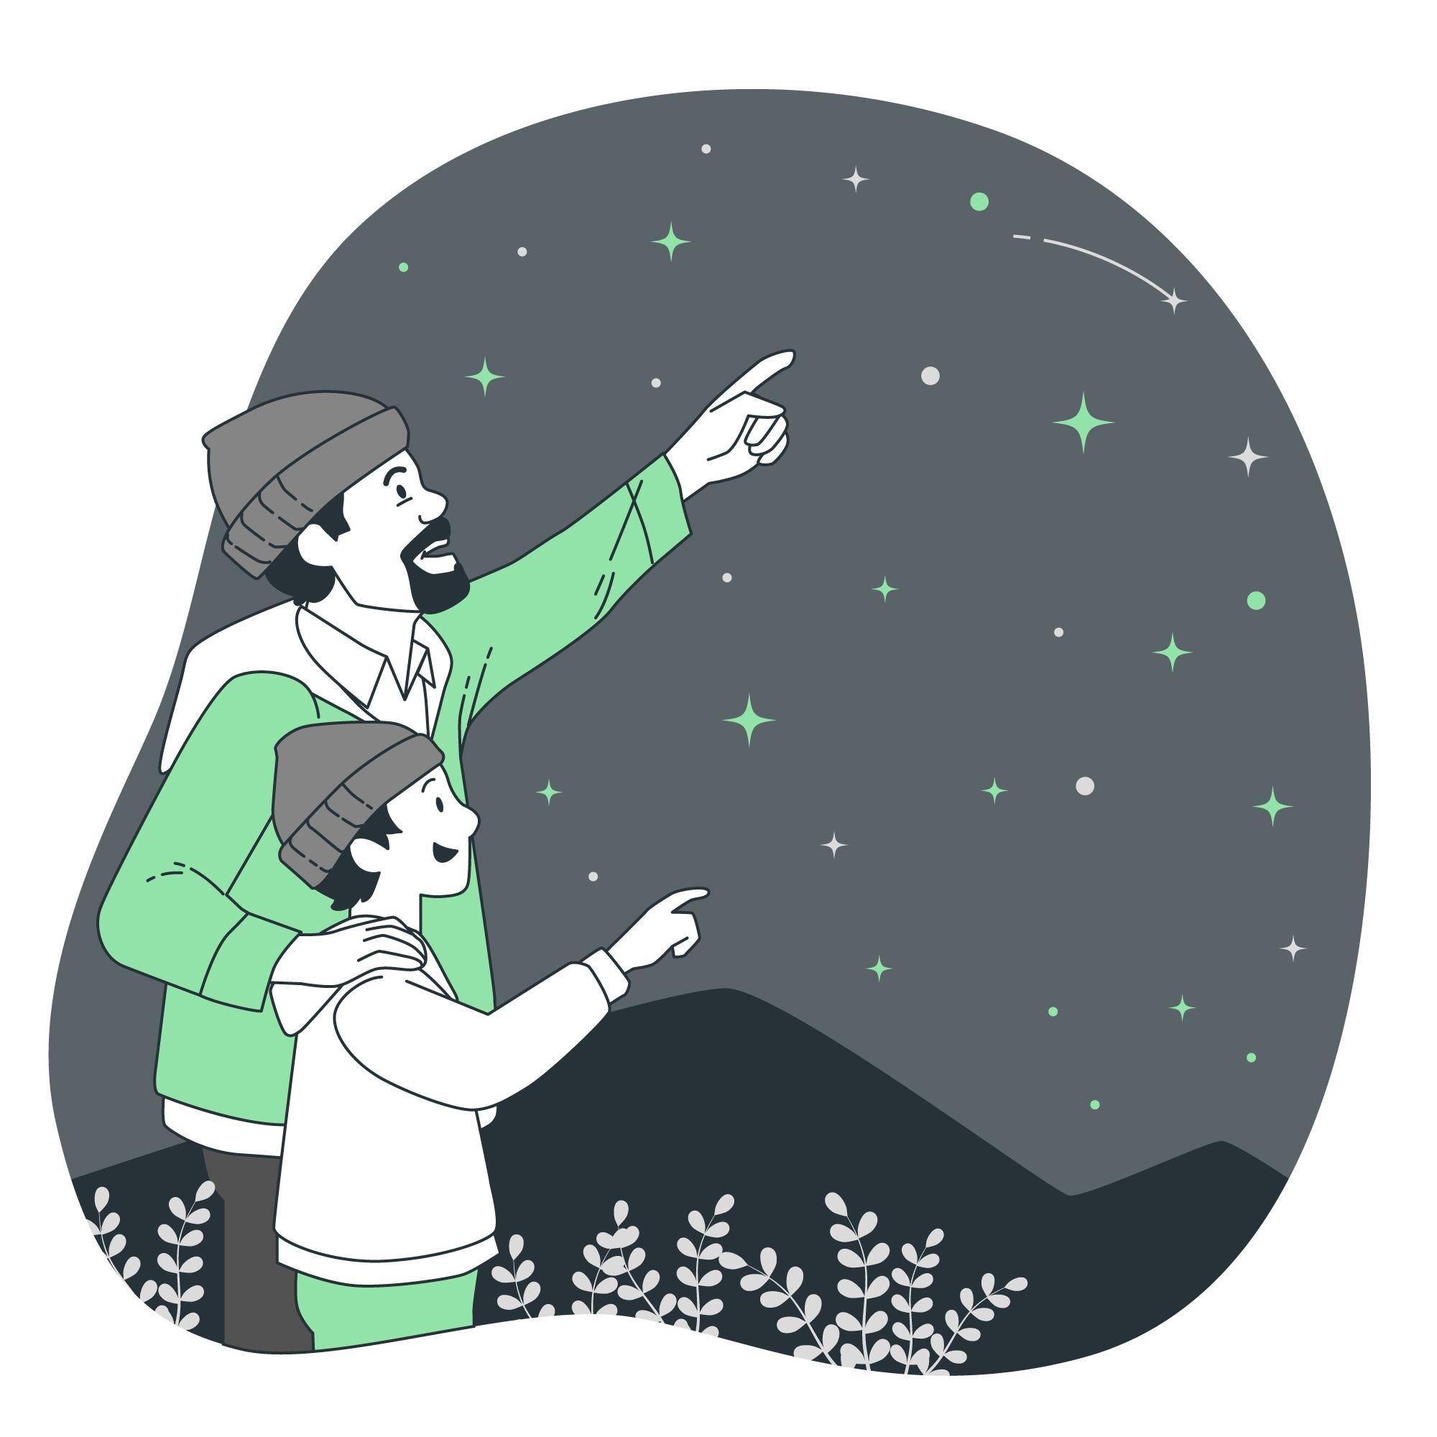
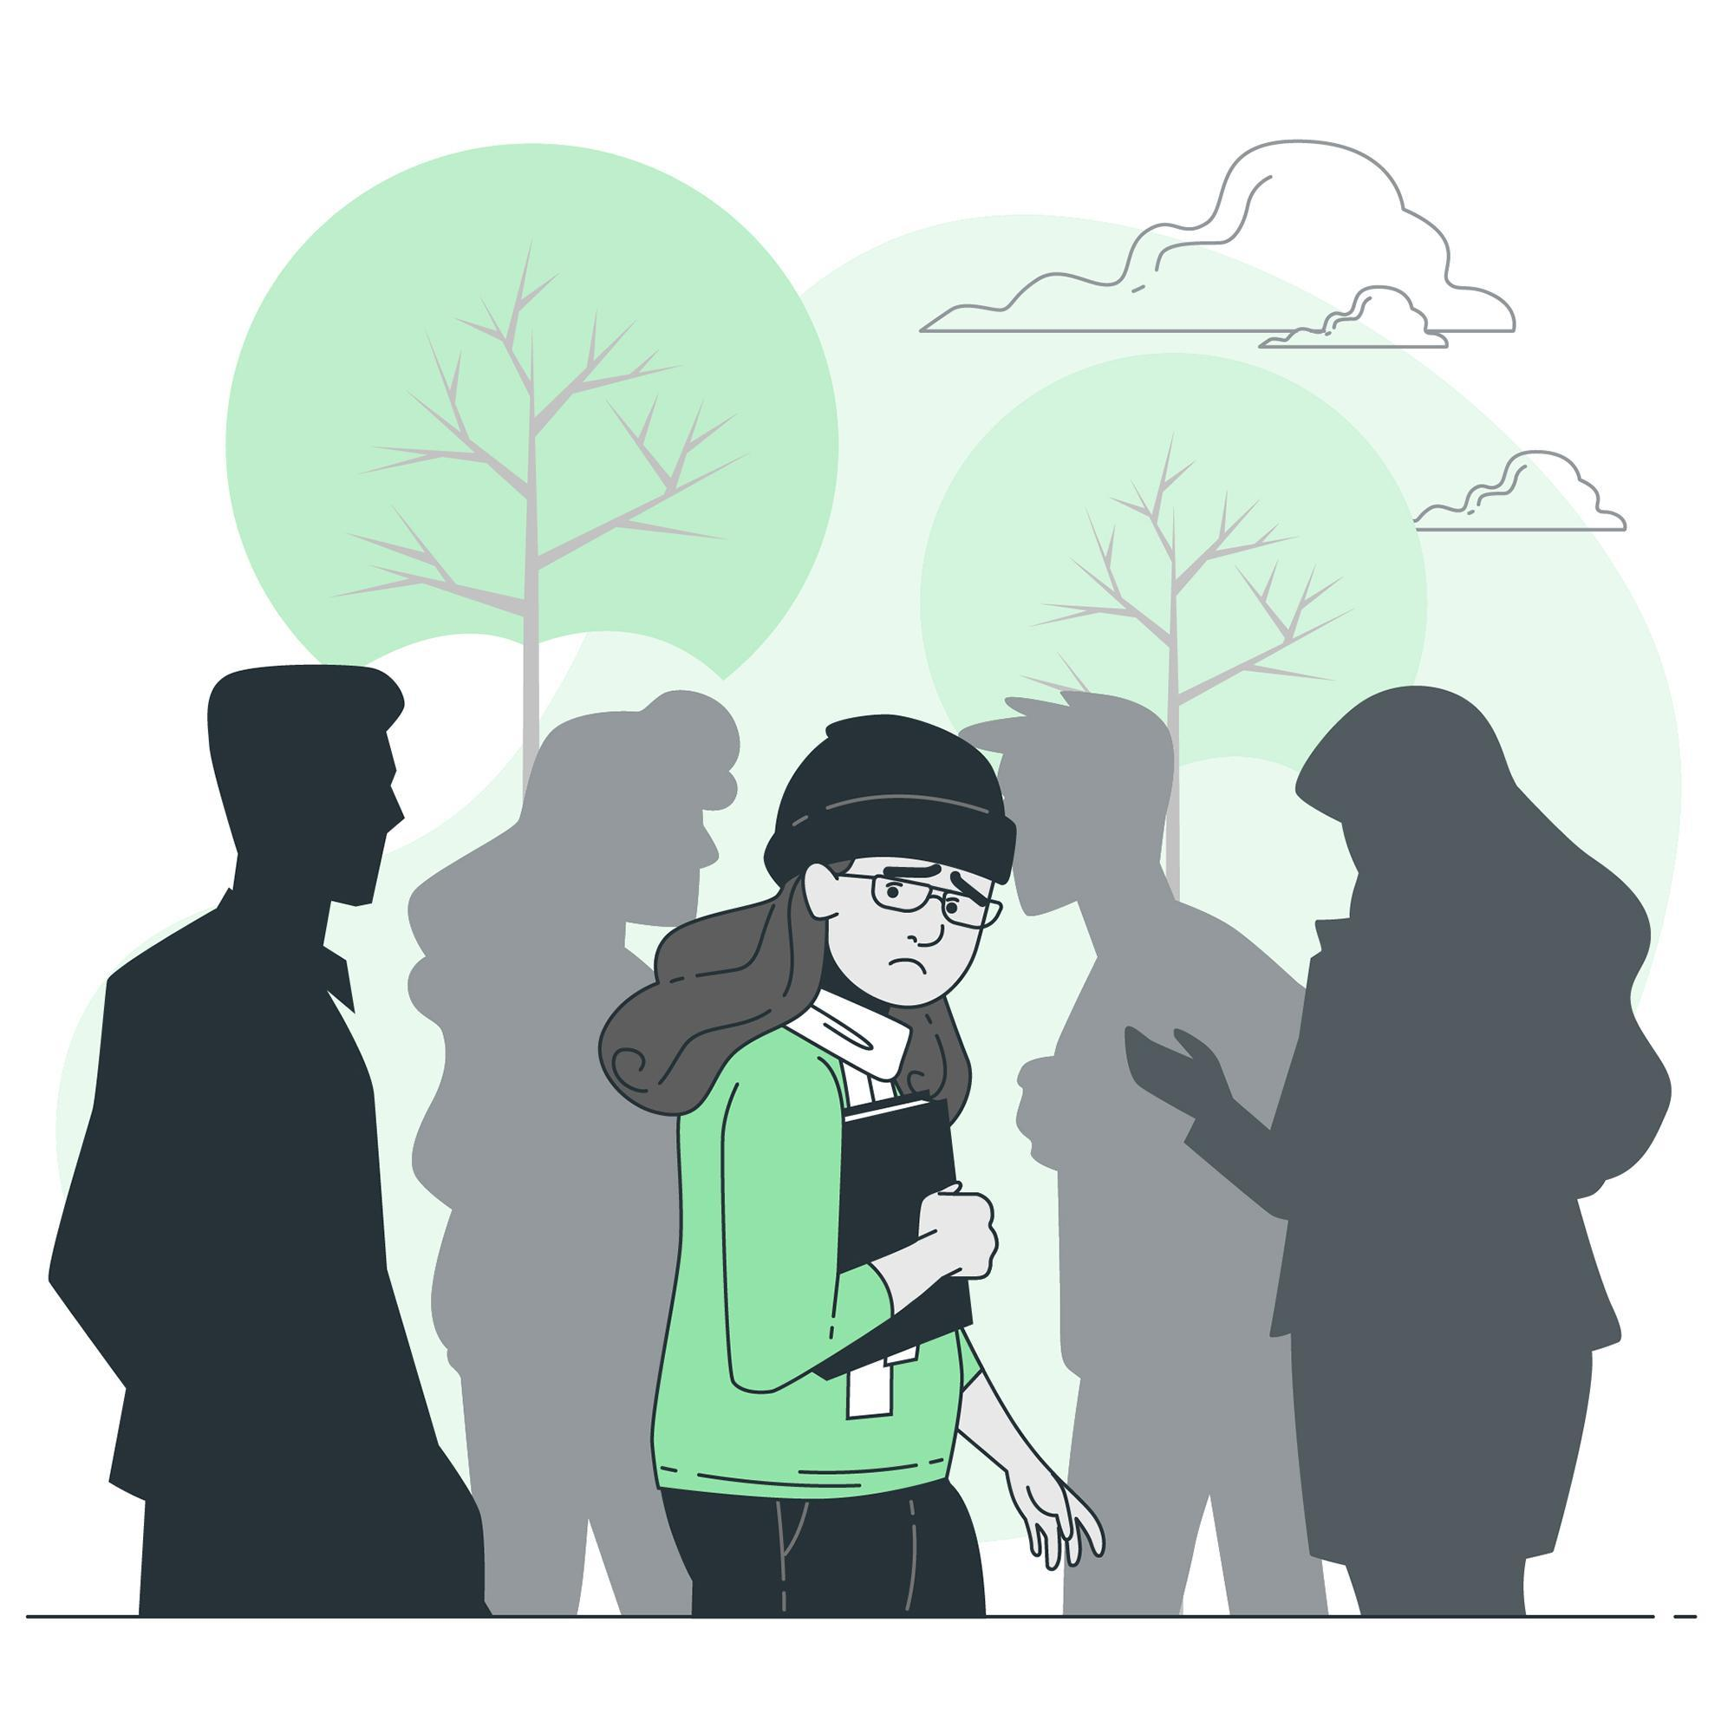
What do you see? How do they feel?
Notes:
1A. Discuss Theme Picture
Ask “What do you see?” and “How do they feel?” to elicit vocabulary students already know.
Repeat and write their words or show the words on the next slide.
Answers may include: I see a father and son. It is dark outside. The stars are shining. The father is teaching the son. The father looks excited because he is pointing at the sky. The son looks happy because he is smiling. A girl is standing outside. There are people around her. She looks afraid because her eyes are looking around. She is doubtful because she has her head down. I think she needs a friend because she is alone.
Stargazing Image:
<ahref="https://www.freepik.com/free-vector/counting-stars-concept-illustration_12217757.htm#query=stargazing&position=2&from_view=search&track=sph"> Image by storyset</a> on Freepik
Social Anxiety Image:
<ahref="https://www.freepik.com/free-vector/social-anxiety-concept-illustration_10385326.htm#query=anxiety%20fear%20alone%20crowd&position=3&from_view=search&track=ais"> Image by storyset</a> on Freepik

Slide 4
What do you see? How do they feel?
A man and his son are looking at the many stars that are shining brightly in the night sky. The curious son is wondering about the names of the different constellations, so he asks his confident Dad. His Dad is certain of the answers he gives. Then they continue gazing upward for a long time. Finally, they leave feeling grateful for the stars, plus this peaceful time they can spend together.
A girl has anxiety as she is walking outside through a crowd, but no one notices her. Is anyone around her seeing how she is doubting herself and fearing the future? Maybe she is struggling with regret from a decision she made and wanting to believe there is hope for moving forward. We can only know what she is feeling if we have an caring and honest conversation with her.
Notes:
1B. Read about the theme picture and discuss with a partner
Please read the description of the theme picture to the students and point to the pictured vocabulary. If students ask about words, give simple definitions.
Then ask students to work in pairs and discuss the questions.
Discussion questions may include: What do you see in the picture with the stars? Who is in the picture with the stars? What are they doing? How do they feel? Why do they feel that way? What is a memory you are grateful for? What do you see in the picture with the girl? Who is in the picture with the girl? What is she doing? How does she feel? Why does she feel that way? When have you needed to talk to someone who cares about you?
Answers may include: A father and son are looking at the stars. They look happy or in wonder. The stars shine. The son is curious. He asks his Dad questions. They are grateful. One time I looked at the stars with my family, it is a good memory. A girl is standing outside. People are walking past her. She feels sad and lonely. It looks like she doesn’t feel seen by anyone. Maybe she needs to talk to someone who cares about her.

Slide 5


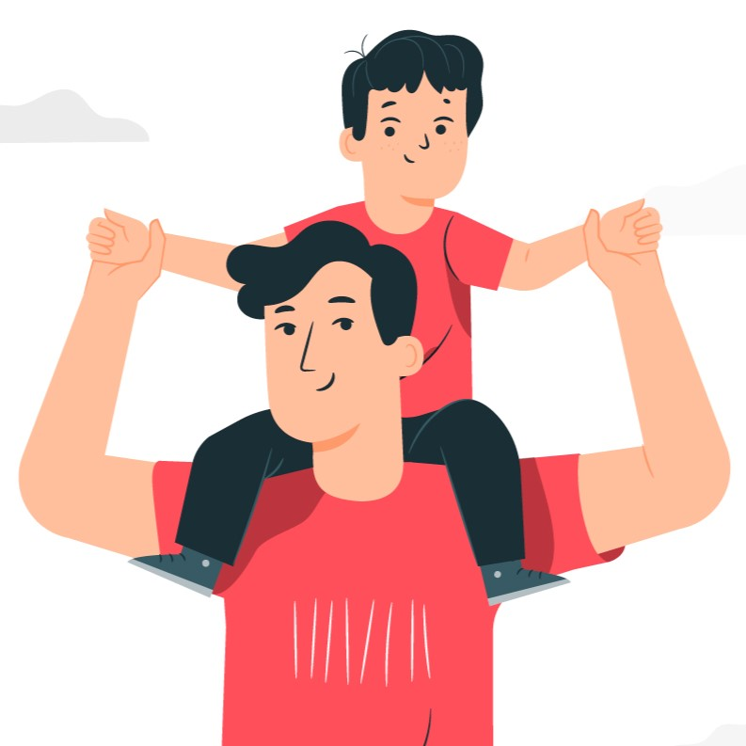

Match the definitions to the correct words.
1. to shine | 2. curious | 3. confident | 4. certain
feel or show you’re sure of yourself
want to learn or know about something
know something for sure or without doubt
to make or reflect bright light
Notes:
2A. Vocabulary
1. Say the word a few times, as you indicate the picture. For example, say, ”shine, shine, shine.” Have your students then repeat the word after you a few times.
2. Ask students to match the word to the correct definition and say the answer as a sentence. For example, “To shine is to make or reflect bright light.”
3. Check students’ comprehension further by asking direct questions. For example, “What does a star do?” “What are you when you know you have the right answer?” “If a student asks lots of questions what are they?” “What is a bus driver feeling when he drives the same route every day?”
Answers
D
C
B
A
Star image: <ahref="https://www.freepik.com/free-vector/hand-drawn-sparkling-star-collection_15479380.htm#query=storyset%20shine%20star%20green&position=46&from_view=search&track=ais">Freepik</a>
Curious image:
<ahref="https://www.freepik.com/free-vector/curiosity-child-concept-illustration_36242183.htm#query=curious%20magnifying%20glass&position=0&from_view=search&track=ais"> Image by storyset</a> on Freepik
Father Image: <ahref="https://www.freepik.com/free-vector/fatherhood-concept-illustration_7140757.htm#query=confident%20dad&position=9&from_view=search&track=ais"> Image by storyset</a> on Freepik
Self-certain Image:
<ahref="https://www.freepik.com/free-vector/self-confidence-concept-illustration_15635888.htm#page=3&query=certain%20correct%20confident&position=41&from_view=search&track=ais"> Image by storyset</a> on Freepik

Slide 6
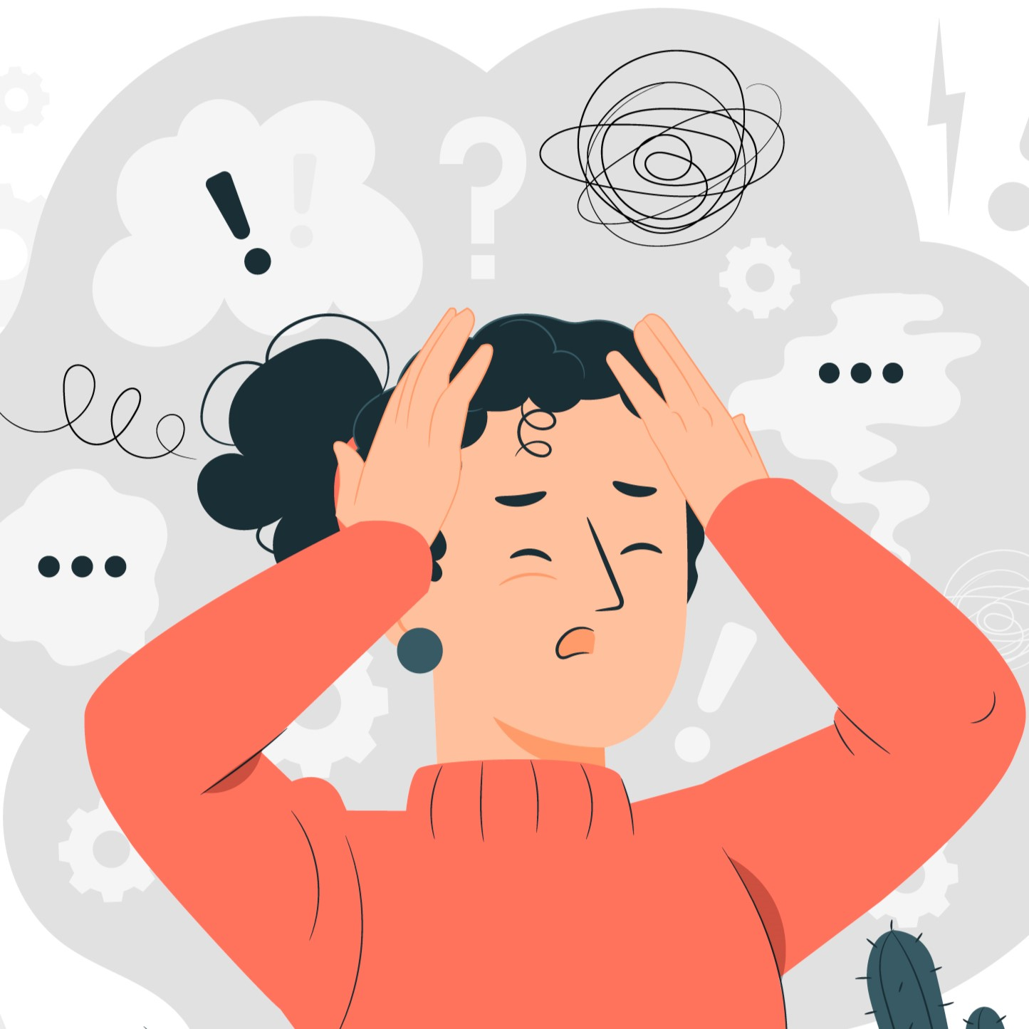
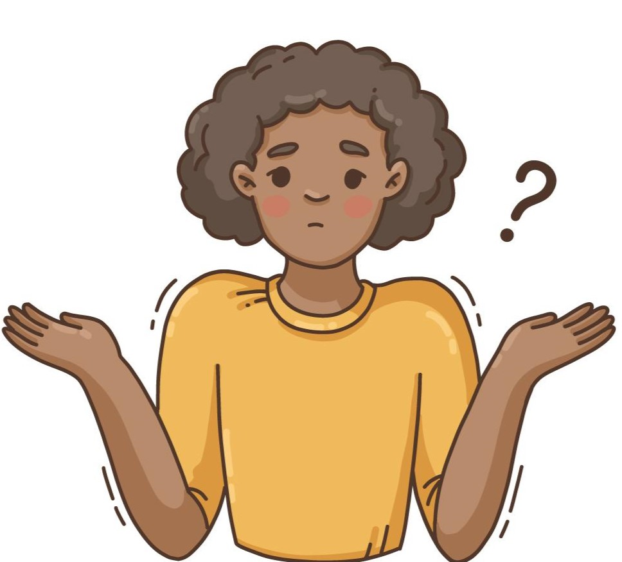
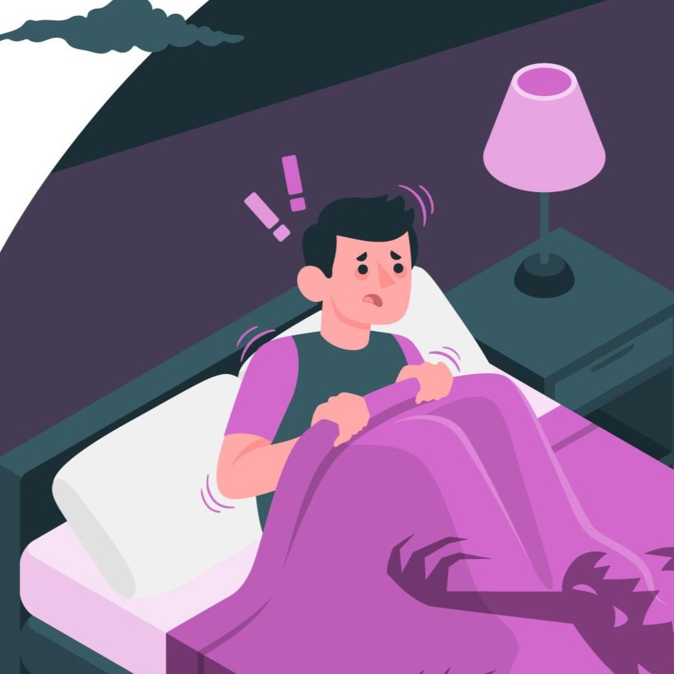
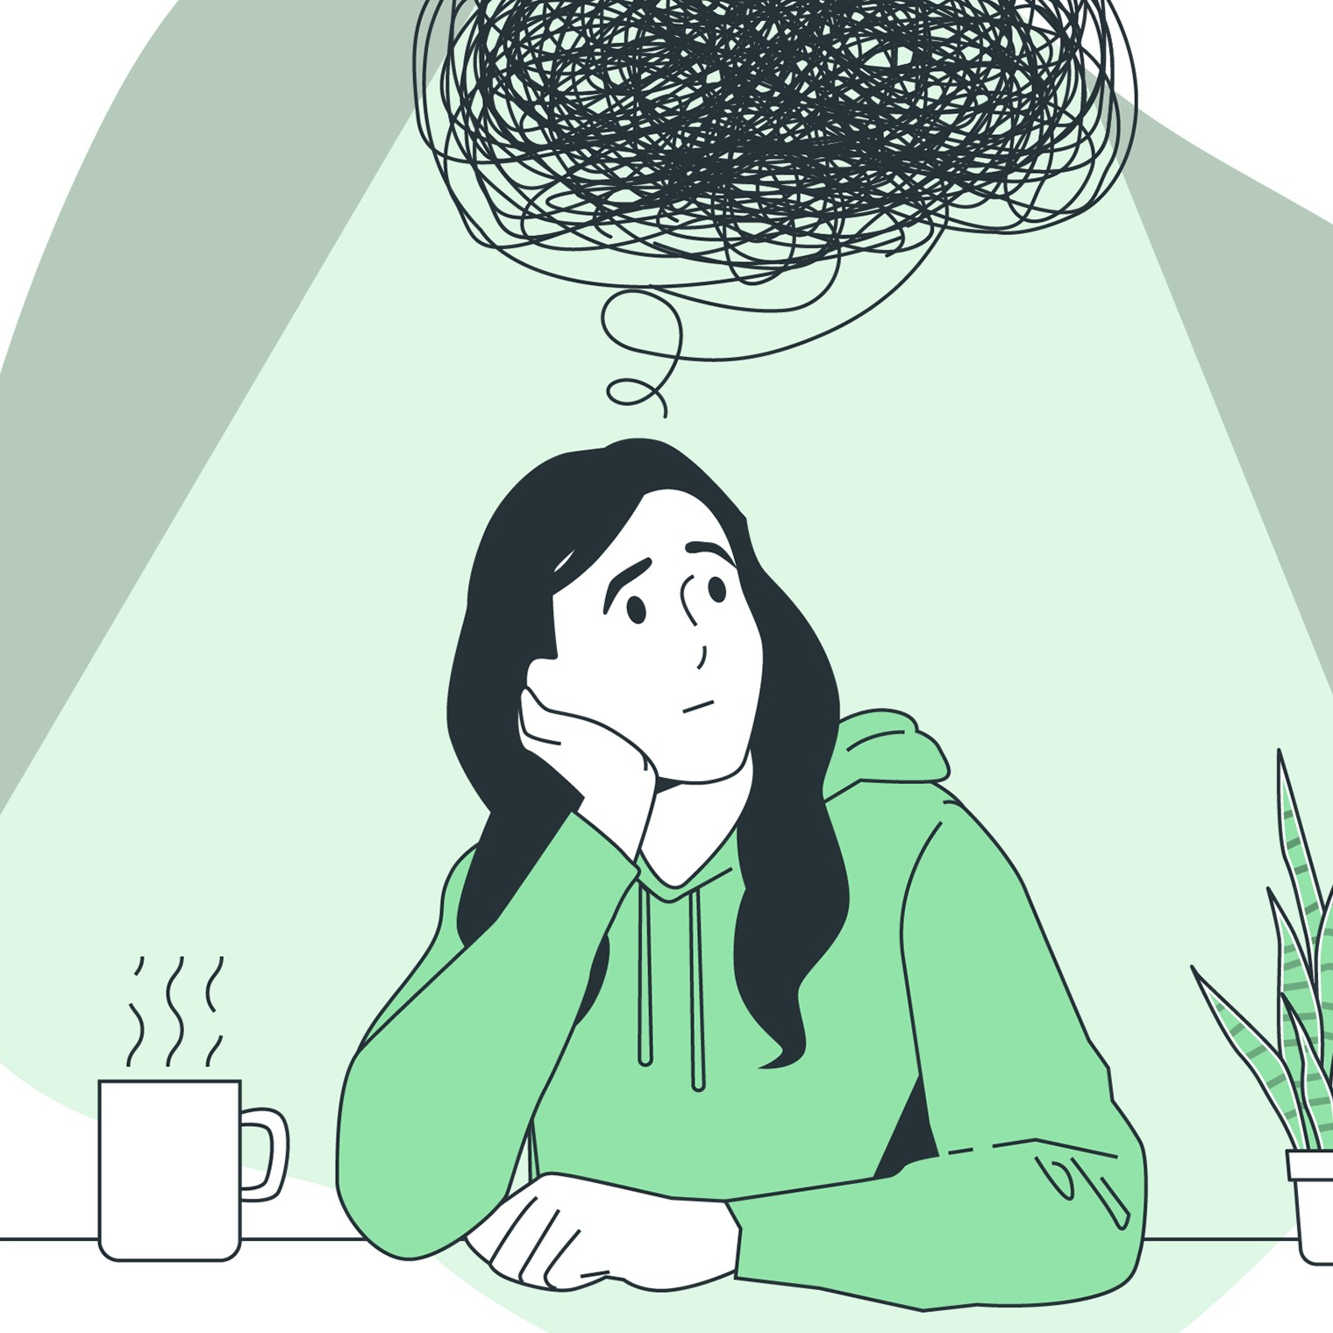
Match the definitions to the correct words.
1. anxiety | 2. to doubt | 3. to fear | 4. to regret
to feel sad or wish to change your past actions
to feel an unpleasant emotion caused by threat of danger
to feel uncertainty or lack of conviction
A feeling of worry because of something unsure in the future
Notes:
2A. Vocabulary
1. Say the word a few times, as you indicate the picture. For example, say, ”anxiety, anxiety, anxiety” Have your students then repeat the word after you a few times.
2. Ask students to match the word to the correct definition and say the answer as a sentence. For example, “Anxiety is a feeling of worry because of something in the future.”
3. Check students’ comprehension further by asking direct questions. For example, “What would you feel if you thought a tornado was coming toward your house?” “When you have a performance coming up what could you be feeling?” “What would you feel is you made a mistake that hurt other people when you were younger?” “What would you feel if you thought something you believed wasn’t true any longer?”
Answers
1. B
2. D
3. A
4. C
Anxiety Image:
<a href="https://www.freepik.com/free-vector/anxiety-concept-illustration_21118463.htm"> Image by storyset</a> on Freepik
Doubt Image:
Image by <ahref="https://www.freepik.com/free-vector/hand-drawn-people-asking-questions-illustration_13233934.htm#query=hang%20drawn%20people%20asking%20questions%20pack&position=2&from_view=search&track=ais"> Freepik</a>
Fear Image:
<ahref="https://www.freepik.com/free-vector/scared-concept-illustration_10388488.htm#query=fear%20bed&position=0&from_view=search&track=ais"> Image by storyset</a> on Freepik
Regret Image: <ahref="https://www.freepik.com/free-vector/overthinking-concept-illustration_37452331.htm#query=overthinking%20concept&position=1&from_view=search&track=ais"> Image by storyset</a> on Freepik

Slide 7
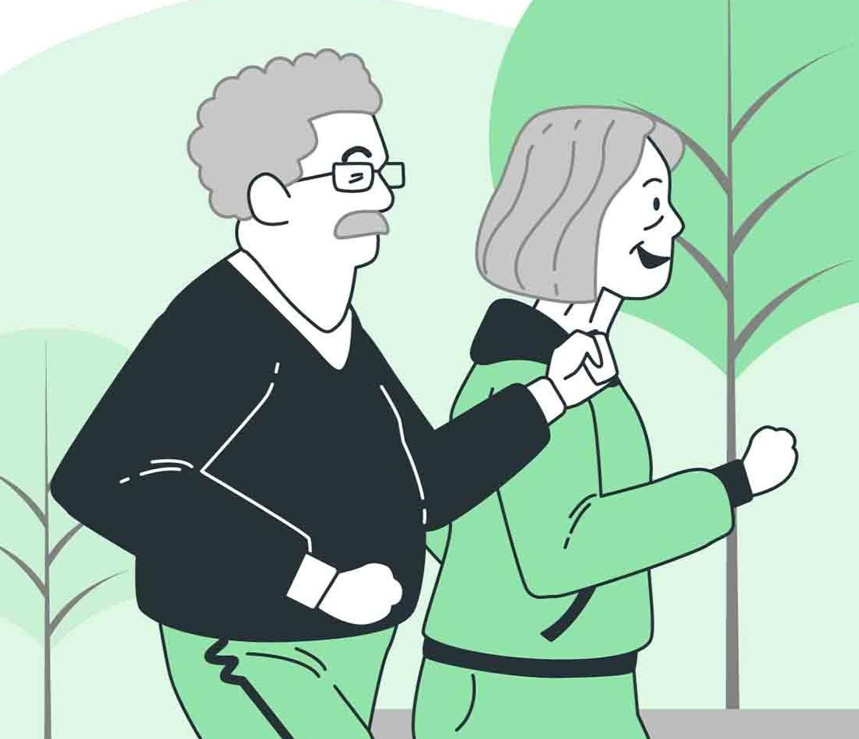
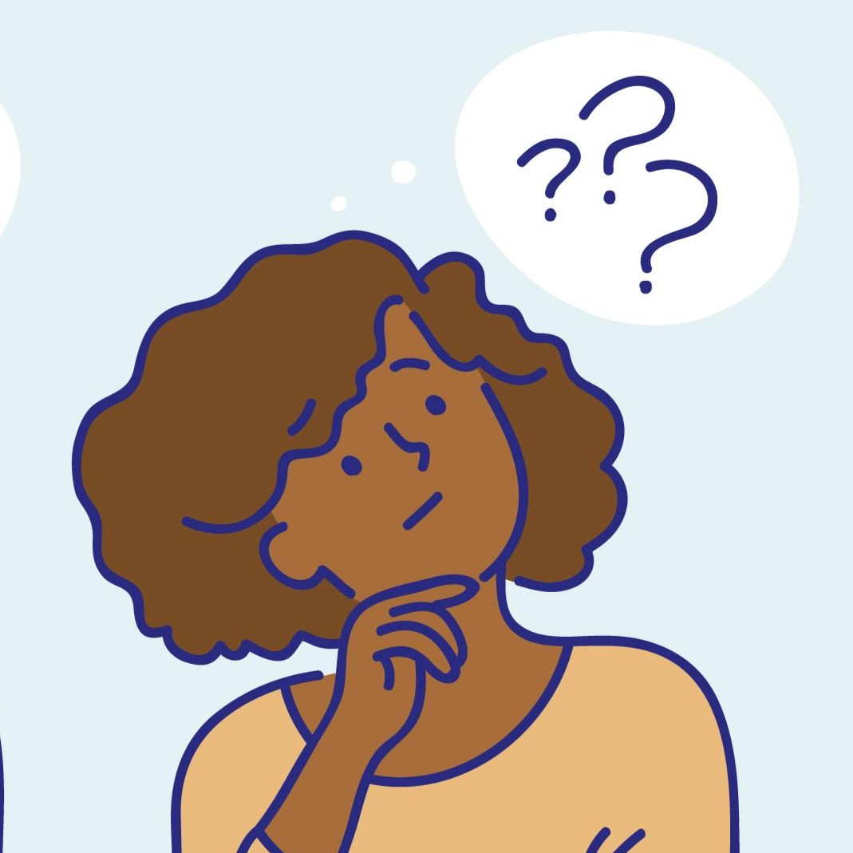
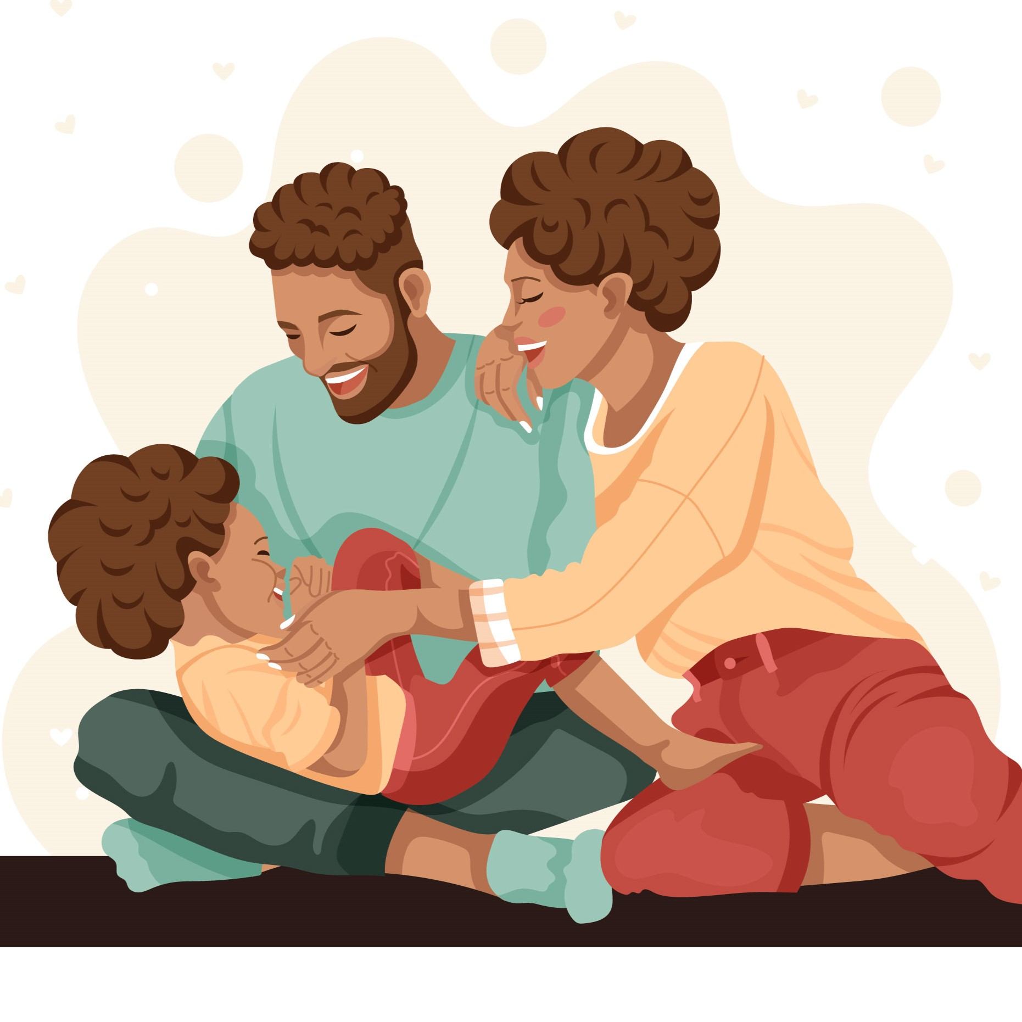
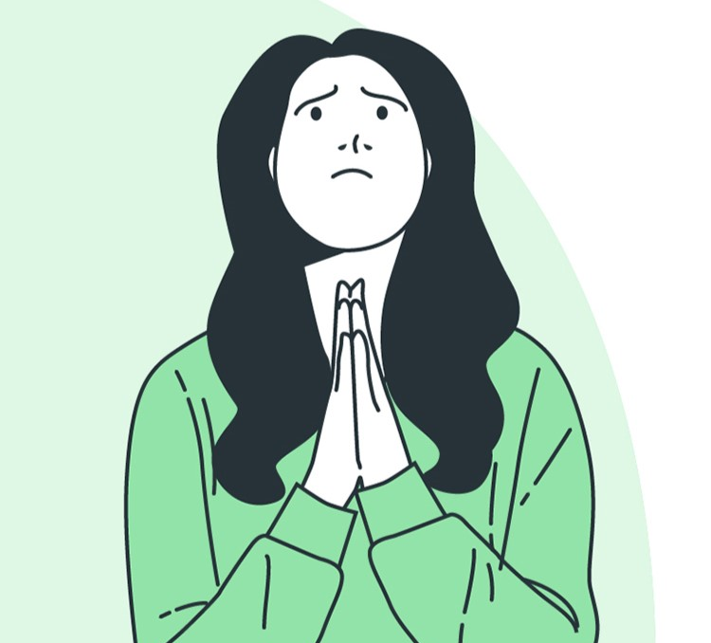
Match the beginning and end of each sentence.
1. They continue
2. She wonders
3. They are grateful
4. She believes
A. why that happened.
B. for their love and joy of being together as a family
C. walking in the park even as they get older.
D. that God is real.
Notes:
2B. Vocabulary
1. Say the beginning of the sentence a few times, as you indicate the picture. For example, say, ”They continue, they continue.” Have your students then repeat the phrase after you a few times.
2. Ask students to match the beginning and end of each sentence and say the complete sentence. For example, “They continue walking in the park even as they get older.”
3. Check students’ comprehension further by asking direct questions. For example, “What do you continue to do?” “What makes you wonder?” “What are you grateful for?” “
Answers
1. C
2. A
3. B
Walking Image: <ahref="https://www.freepik.com/free-vector/active-elderly-people-concept-illustration_9930887.htm#query=elderly%20continue&position=1&from_view=search&track=ais"> Image by storyset</a> on Freepik
Sunrise Image:
Image by <ahref="https://www.freepik.com/free-vector/hand-drawn-people-asking-questions-illustration_13379595.htm#query=wonder&position=5&from_view=search&track=sph"> Freepik</a>
Family Image: Image by <ahref="https://www.freepik.com/free-vector/hand-drawn-black-family-illustration_28203272.htm#query=grateful%20family%20hug&position=7&from_view=search&track=ais"> Freepik</a>

Slide 8
Present Continuous Categories
 | Type | Subject | am/is/are | verb-ing | ending | time.
1 | Current Unfinished Actions | I | am | preparing | for the performance | right now.
2 | Temporary Situations | You | are | living | in an apartment | this month.
3 | Temporary Habits | She | ____ | _______ | junk food | when she’s stressed.
4 | Changing Situations | We | are | ________ | in our speaking skills | _________.
5 | Future Plans | They | ____ | _______ | to Europe | ________.
Notes:
2D. Grammar – Present Continuous Tense
Use this slide to introduce present continuous verbs to your students. The following slides will be used for practice by plugging them into positive statements, negative statements and questions.
Formula: Subject>to be>verb-ing>ending>time.
We will refer to the categories on slides 10-11 by the words in bold: Actions, Situations, Habits, Changing, and Plans.
Model, Repeat, and Solo rows 1-2. Then ask students to complete the sentence for rows 3-5.
Answers may include:
3. She is eating junk food when she’s stressed.
4. We are improving in our speaking skills every day.
5. They are traveling to Europe in the summer.

Slide 9
Present Continuous Cue Words
 | Type | Cue Words
1 | Current Unfinished Actions | now, right now
2 | Temporary Situations | currently, at the moment, today, this week, this month, this year
3 | Temporary Habits | temporarily, these days, when _______
4 | Changing Situations | constantly, every day, every week, every month, every year
5 | Future Plans | soon, tomorrow, next week, next month, next year, in the summer
Notes:
2D. Grammar – Present Continuous Tense
Use this slide to introduce present continuous verbs with their cue words to your students.

Slide 10
Present Continuous Tense “+ & -”
 | Type | Subject | am/is/are(not) | verb-ing | ending | time
1 | Situations | The sun | is | shining | brightly | today
2 | Plans | They | are not | continuing | on the trip | this week.
3 | Situations | The students | are | _______ | curious about the animals | _________.
4 | Actions | The teachers | ____ ____ | feeling | certain about the lessons | _________.
Notes:
2D. Grammar – Present Continuous Tense
Note: Present continuous tense verbs are used for a present action that is currently continuing. It can be used to state a positive reality or a negative reality.
Formula [+]: Subject>to be>verb-ing>ending>time.
Formula [-]: Subject>to be>not>verb-ing>ending>time.
Model, Repeat, and Solo rows 1-2. Then ask students to complete the sentence for rows 3-4, especially using correct cue words for the time.
Possible answers:
3. The students are acting curious about the animals constantly.
4. The teachers are not feeling certain about their lesson right now.

Slide 11
Present Continuous Tense “?’s”
 | Type | Is/Are | subject | verb-ing | ending | time?
5 | ? Changing | Are | you | wondering | if your grades will improve | this month?
6 | ? Habits | Is | she | feeling anxiety | about rehearsals | these days?
7 | ? Actions | Are | they | ________ | the conversation | ________?
8 | ? Habits | Is | he | ________ | his decisions | ________?
Notes:
2D. Grammar – Present Continuous Tense
Note: Present continuous tense verbs are used for a present action that is currently continuing. It can be used to ask a question.
Formula [?]:To be>subject>verb-ing>ending>time?
Model, Repeat, and Solo rows 5-6. Then ask students to complete the sentences for rows 7-8.
Possible Answers:
7. Are they regretting the conversation now?
8. Is he doubting his decision when he stops to think?

Slide 12
Conjunctions: So, then, plus, but, finally
Conjunction |  | Use | Examples
1 | So | Introduces a result or decision | It rained, so we got wet. I was hungry, so I ate.
2 | Then | Show progression to the next action | She will read, ____ she will answer.
3 | Plus | Adds something to the beginning | We like walking, ____ we get exercise.
4 | But | Contrasts the previous point | They wish they could visit, ____they can’t.
5 | Finally | Concludes the thought | We waited for hours, ______we went inside.
Notes:
2E. Grammar: Conjunctions - So, then, plus, but, finally
Conjunctions connect two parts of a sentence.
Model, Repeat, and Solo row number 1. Then ask students to fill in the blanks for rows 2-5.
Answers:
2. She will read, then she will answer.
3. We like walking, plus we get exercise.
4. They wish they could visit, but they can’t.
5. We waited for hours, finally we went inside.

Slide 13
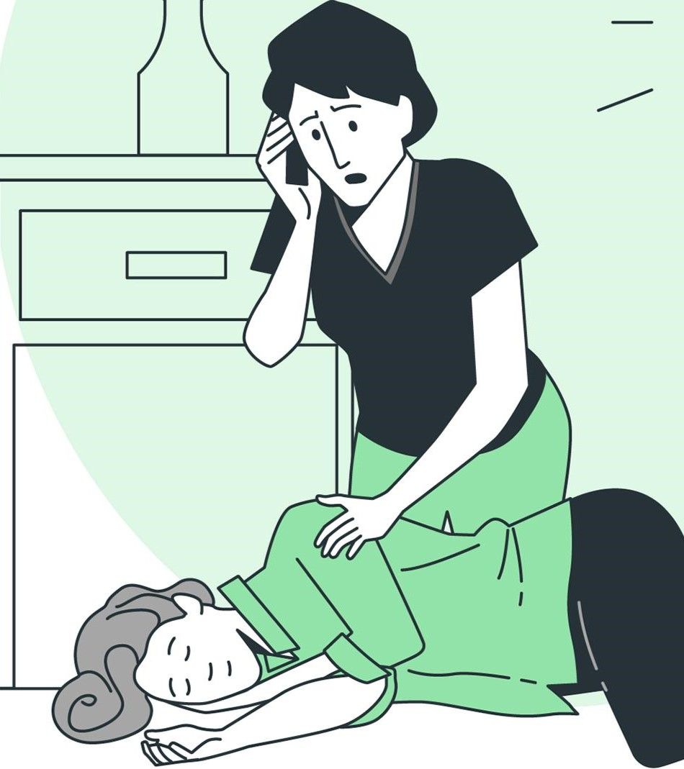
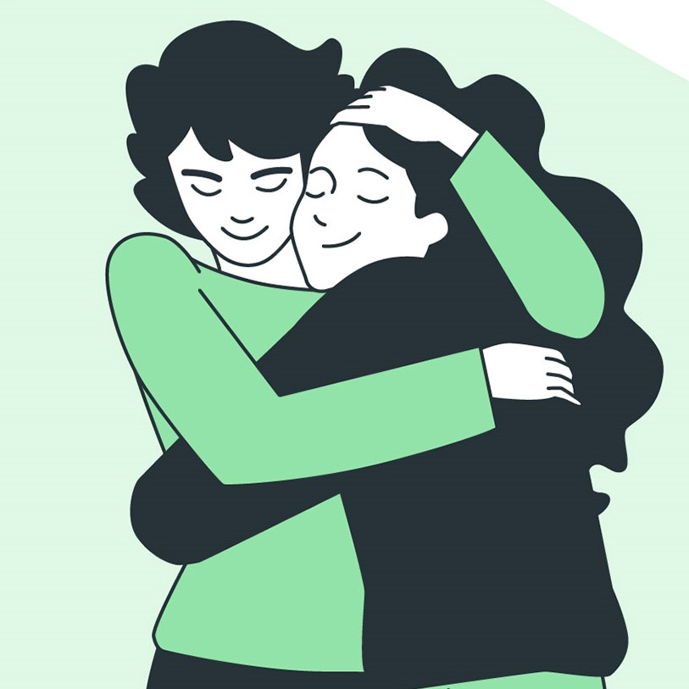
Listen and repeat.
A: You seem _____. What are you thinking about?
B: I _______________________.
A: Wow, that’s ___________ What happened?
B: _________ because _____ so ____________.
A: How do you feel?
B: I felt _______ at first, but now I’m feeling _____.
A: I’m so glad you told me.
Notes:
3. Conversation
1. Ask the students to brainstorm to fill in blanks of the conversation according to the pictures.
2. Model: Role-play the parts with a student to convey the meaning of the conversation.
3. Solo: You begin the conversation and call on individual students to respond. Then reverse the roles (students are A, you are B).
4. Once students can do both parts, encourage free conversation (students substitute their own words for the blanks).
Answers may include:
A: You seem upset. What are you thinking about?
B: I am remembering when my sister was really sick.
A: Wow, that’s scary. What happened?
B: She was sick because she ate food she was allergic to so she had to go to the hospital.
A: How do you feel?
B: I felt anxious and doubtful at first, but now I’m feeling grateful she’s ok.
A: I’m so glad you told me.
Emergency Image:
Imageby<ahref="https://www.freepik.com/free-vector/organic-flat-doctors-nurses-illustration_13233885.htm#query=doctor&position=17&from_view=search&track=sph">Freepik</a>
Hug Image: <ahref="https://www.freepik.com/free-vector/hug-concept-illustration_65672674.htm#query=storyset%20sister%20hug%20green&position=8&from_view=search&track=ais"> Image by storyset</a> on Freepik

Slide 14










Practice the /a/ and /o/ sounds. Then listen to the sentences and circle the word you hear.
 |  | /a/ | /o/
1 |  | hat | hot
2 |  | black | block
3 |  | rat | rot
4 |  | map | mop
5 |  | stamp | stomp
Notes:
4A. Pronunciation – Minimal Pairs
In this section we will practice distinguishing between the /a/ and /o/ sounds.
1. Model: Read each row several times and point to the words while students listen. For example, ”Number 1, hat, hot, hat, hot, hat, hot.” Then ask students to repeat the words.
2. Read the sentences below and ask students to circle the word that they hear.
How do you say hat in your language?
How do you spell block again?
Did you see the rat on that tree?
Can you please bring me a mop?
I don’t know if we need to stamp it.
Minimal Pairs: https://pronuncian.com/podcasts/episode211#:~:text=Minimal%20pairs%20are%20words%20that,'
Rat icon:
<ahref="https://www.freepik.com/icon/rat_8876626#fromView=search&term=greay+rat+black+outline+small&page=1&position=34&track=ais"> Icon by Aranagraphics</a>
Hat icon:
<ahref="https://www.freepik.com/icon/hat_864727#fromView=search&term=black+hat&page=1&position=23&track=ais"> Icon by Good Ware</a>
Paintbrush icon: <ahref="https://www.freepik.com/icon/brush-with-fresh-painting_46557#fromView=search&term=black+paint&page=1&position=11&track=ais"> Icon by Freepik</a>
Tea Kettle icon: <a href="https://www.freepik.com/icon/hot-food-open-bowl_45546#fromView=search&term=black+pot+with+fire&page=1&position=9&track=ais"> Icon by Freepik</a>
Blocks icon: <ahref="https://www.freepik.com/icon/abc-block_9193075#fromView=search&term=black+kids+blocks&page=1&position=3&track=ais"> Icon by Vectorslab</a>
Apple Core Icon:<ahref="https://www.freepik.com/icon/apple_5587962#fromView=search&term=black+rotten+fruit&page=1&position=70&track=ais"> Icon by maswan</a>
Map icon: <a href="https://www.freepik.com/icon/apple_5587962#fromView=search&term=black+rotten+fruit&page=1&position=70&track=ais"> Icon by maswan</a>
Rubber Stamp from NounProject
Shoe icon:
<ahref="https://www.freepik.com/icon/running_10068590#fromView=search&term=black+shoe+stomping+move&page=1&position=7&track=ais"> Icon by Vectorslab</a>

Slide 15
Most two-syllable verbs are stressed
on the 2nd syllable
 | - ▔ Common |  | B. - ▔ Common |  | C.- ▔ Common |  | D. ▔ - Exception
1 | agree | 6 | discuss | 11 | pretend | 16 | wonder
2 | believe | 7 | enjoy | 12 | provide | 17 | finish
3 | complain | 8 | explain | 13 | regret | 18 | borrow
4 | convince | 9 | impress | 14 | submit | 19 | carry
5 | decide | 10 | invent | 15 | unlock | 20 | empty
Notes:
4B. Pronunciation - Hum and clap the stress.
Most English two-syllable verbs are stressed on the second syllable because the prefix is in the first syllable. There are some exceptions, usually because either they don’t have an affix at all, or they have a suffix instead. For example: to wonder, to finish, to borrow.
Begin by humming the stress of Column A. Hum lower, shorter and quieter for the small dashes, and higher, longer, and louder for big dashes. You may also use hand gestures or clapping to indicate that the stressed syllable is higher in pitch, longer in duration, and louder. Invite your students to join in humming, gesturing or clapping the rhythm.
1. Model: Hum and then say each word in the columns A-C several times. Students listen. Then introduce the expectation column and hum and say each pair of words in column D. Students listen.
2. Repeat: Students repeat words after you in unison for columns A-C, then clarify switching to expectations and students repeat words after you in unison for column D.
3. Solo: Call on individuals to read a column with the correct stress.
4. Listen: Read the following sentences and have students circle the word they hear and indicate if it’s stress is on first syllable or second syllable by writing “1” (1st syllable) or “2” (2nd syllable) next to it. Answers are shown in parenthesis.
1. They agree with the choice you made. (agree “1”)
2. Can you unlock the door for me? (unlock “1”)
3. I wonder when the store closes today? (wonder “2”)
4. She wants to invent something new. (invent “1”)
5. Let’s discuss what we should do next. (discuss “1”)
6. He needs to borrow your shoes quickly. (borrow, “2”)
7. Someone please explain why sirens are going off. (explain “1”)
8. The parents will decide what to make for dinner. (decide “1”)
9. Please finish your homework soon (finish “2”)
10. We want our artwork impress you. (impress “1”)
Verbs on Chart: https://purlandtraining.com/hw1/180-common-2-syllable-verbs-with-prefixes-forcing-stress-on-the-second-syllable.pdf

Slide 16
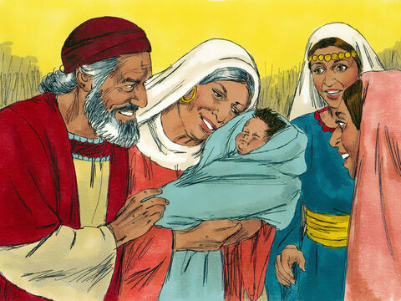
Luke 1:57-80 ERV
The Birth of John
⁵⁷ When it was time for Elizabeth to give birth, she had a boy. ⁵⁸ Her neighbors and relatives heard that the Lord was very good to her, and they were happy.
⁵⁹ When the baby was eight days old, they came to circumcise him. They wanted to name him Zechariah because this was his father’s name. ⁶⁰ But his mother said, “No, he will be named John.” ⁶¹ The people said to Elizabeth, “But no one in your family has that name.” ⁶² Then they made signs to his father, “What would you like to name him?” ⁶³ Zechariah asked for
Notes:
5A. Bible Reading
Students should have already read this story in their first language (L1) as part of their homework, so it will be familiar even if they do not know all the vocabulary yet. However, if they have not yet read it in their L1, be sure they do so now before reading it in English. The hyperlinks of the Bible verses connect to https://live.bible.is/ so students can read and hear the scripture in their own languages. You may also watch videos of the passage at the website.
A. Read the story out loud to the class.
B. If students ask about words, give simple definitions.
C. Encourage students to read aloud verses from the story and act out the scene.
D. Ask if there are any questions or comments about the story.
E. Ask the story questions and discuss as a group.
F. Optional - You may hide the words and ask students to tell the story again in their own words, using the pictures to help them.

Slide 17
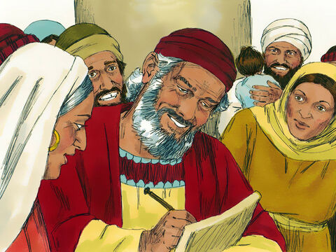
something to write on. Then he wrote, “His name is John.” Everyone was surprised. ⁶⁴ Then Zechariah could talk again, and he began praising God. ⁶⁵ And all their neighbors were afraid. In all the hill country of Judea, people continued talking about these
⁶⁶ Everyone who heard about these things wondered about them. They thought, “What will this child be?” They could see that the Lord was with him.
Zechariah Praises God
⁶⁷ Then Zechariah, John’s father, was filled with the Holy Spirit and told the people a message from God
Notes:
5B. Bible Reading
A. Read the story out loud to the class.
B. If students ask about words, give simple definitions.
C. Encourage students to read aloud paragraphs from the story and act out the scene.

Slide 18
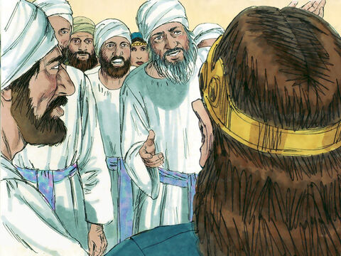
⁶⁸ “Praise to the Lord God of Israel.
He has come to help his people
and has given them freedom.
⁶⁹ He has given us a powerful Savior
from the family of his servant David.
⁷⁰ This is what he promised through his
holy prophets long ago.
⁷¹ He will save us from our enemies
and from the power of all those who hate us.
⁷² God said he would show mercy to our fathers,
and he remembered his holy agreement.
©2020-2024 Bible League International
Notes:
5C. Bible Reading
A. Read the story out loud to the class.
B. If students ask about words, give simple definitions.
C. Encourage students to read aloud paragraphs from the story and act out the scene.

Slide 19
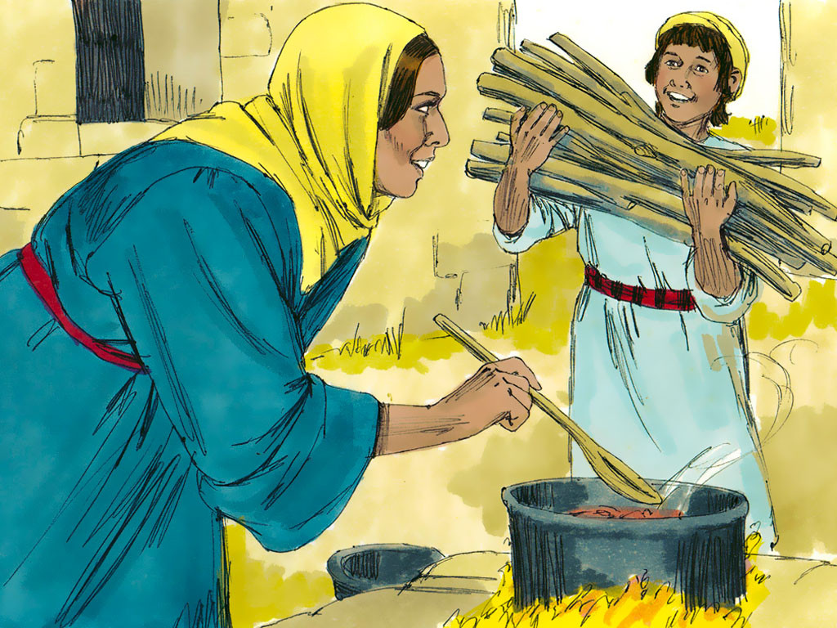
⁷³ This was the promise he made to
our father Abraham,
⁷⁴a promise to free us from the power
of our enemies,
so that we could serve him without
fear
⁷⁵in a way that is holy and right for as
long as we live.
⁷⁶ “Now you, little boy, will be called a prophet of the Most High God.
You will go first before the Lord to prepare the way for him.
Notes:
5D. Bible Reading
A. Read the story out loud to the class.
B. If students ask about words, give simple definitions.
C. Encourage students to read aloud paragraphs from the story and act out the scene.

Slide 20
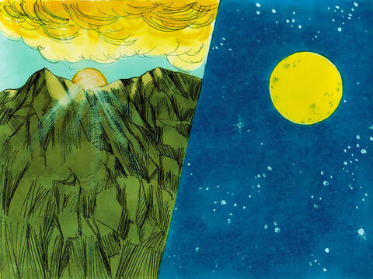
⁷⁷ You will make his people
understand that they will be saved by having their sins forgiven.
⁷⁸ “With the loving mercy of our God,
a new day^{[b]} from heaven will shine on us.
⁷⁹ It will bring light to those who live in darkness, in the fear of
death.
It will guide us into the way that brings peace.”
b: Luke 1:78 new day Literally, “dawn,” used here as a symbol, probably meaning the Lord’s Messiah
Notes:
5E. Bible Reading
A. Read the story out loud to the class.
B. If students ask about words, give simple definitions.
C. Encourage students to read aloud paragraphs from the story and act out the scene.

Slide 21
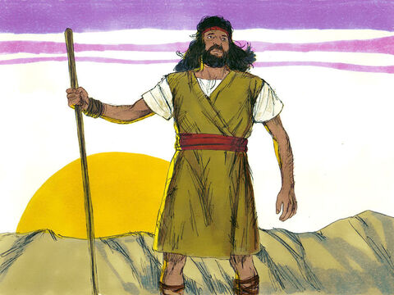
⁸⁰ And so the little boy John grew up and became stronger in spirit. Then he lived in areas away from other people until the time when he came out to tell God’s message to the people of Israel.
Notes:
5F. Bible Reading
A. Read the story out loud to the class.
B. If students ask about words, give simple definitions.
C. Encourage students to read aloud paragraphs from the story and act out the scene.

Slide 22
Answer the questions.
1. How did Elizabeth’s neighbors and relatives feel when they heard about the baby and why did they feel that way?
2. When is a time your neighbors or relatives celebrated with you?
3. How did Zechariah confirm the name of the baby was John?
4. What happened to Zechariah after they named the baby?
5. What would John do and help people understand?
6. Where did John live and what was he waiting for?
7. What do you hope in for the future?
Notes:
5G. Bible Reading Questions
Ask the questions and discuss as a group.
Potential Answers:
1. They felt happy because the Lord had been good to her (verse 58).
2. Answers will vary.
3. He wrote it on something and showed it to them (verse 63).
4. Zechariah started talking and praising the Lord (verse 64).
5. John would prepare a way for the Lord and help the people understand they would be saved by having their sins forgiven
(verses 76-77).
6. John lived in areas away from other people and waited until the time to share God’s message with the people of Israel
(verse 80).
7. Answers will vary.

Slide 23
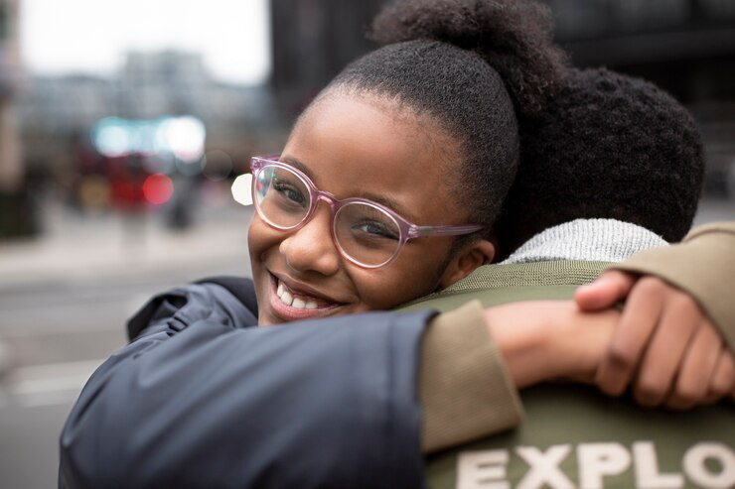
Listen and complete the sentences.
1. Her father always wears his _____ to work.
2. Her mother always lets her _____ the envelopes.
3. Every summer the city gets really _____ and the _____ streets
shimmer in the heat.
4. They are riding their bikes around the _______.
5. Sometimes ____ run by them and they _____ their feet.
6. She is looking at the _____ of their neighborhood.
7.Her job is to ________ the kitchen.
Notes:
6A. Activities – Listening to pronunciation words with /a/ and /o/ sounds.
Read the script below at least twice as students listen and answer the questions. The students should NOT look at the script.
“My family and I are living in a city. My father always wears his hat when he works. My mother sends letters to her sister who lives far away, and she always lets me stamp the envelopes. Every summer the city gets really hot and the black streets shimmer in the heat. My siblings and I ride our bikes around the block and sometimes, especially at night, rats run by us to tear into bags of rotten food. When I look at the map of our neighborhood, I realize we really know the ins and outs of everything and feel like we own the spaces we always visit. Finally, at night, our Mom always had us do our chores. After a long day of stomping dirt about, my job is to mop the kitchen, because for my Mom, no dirt marks are allowed. Then we all say our prayers and settle into our beds, another night, safe together in our home.”
Answers: 1. hat 2. stamp 3. hot, black 4. block 5. rats, stomp 6. map 7. mop

Slide 24
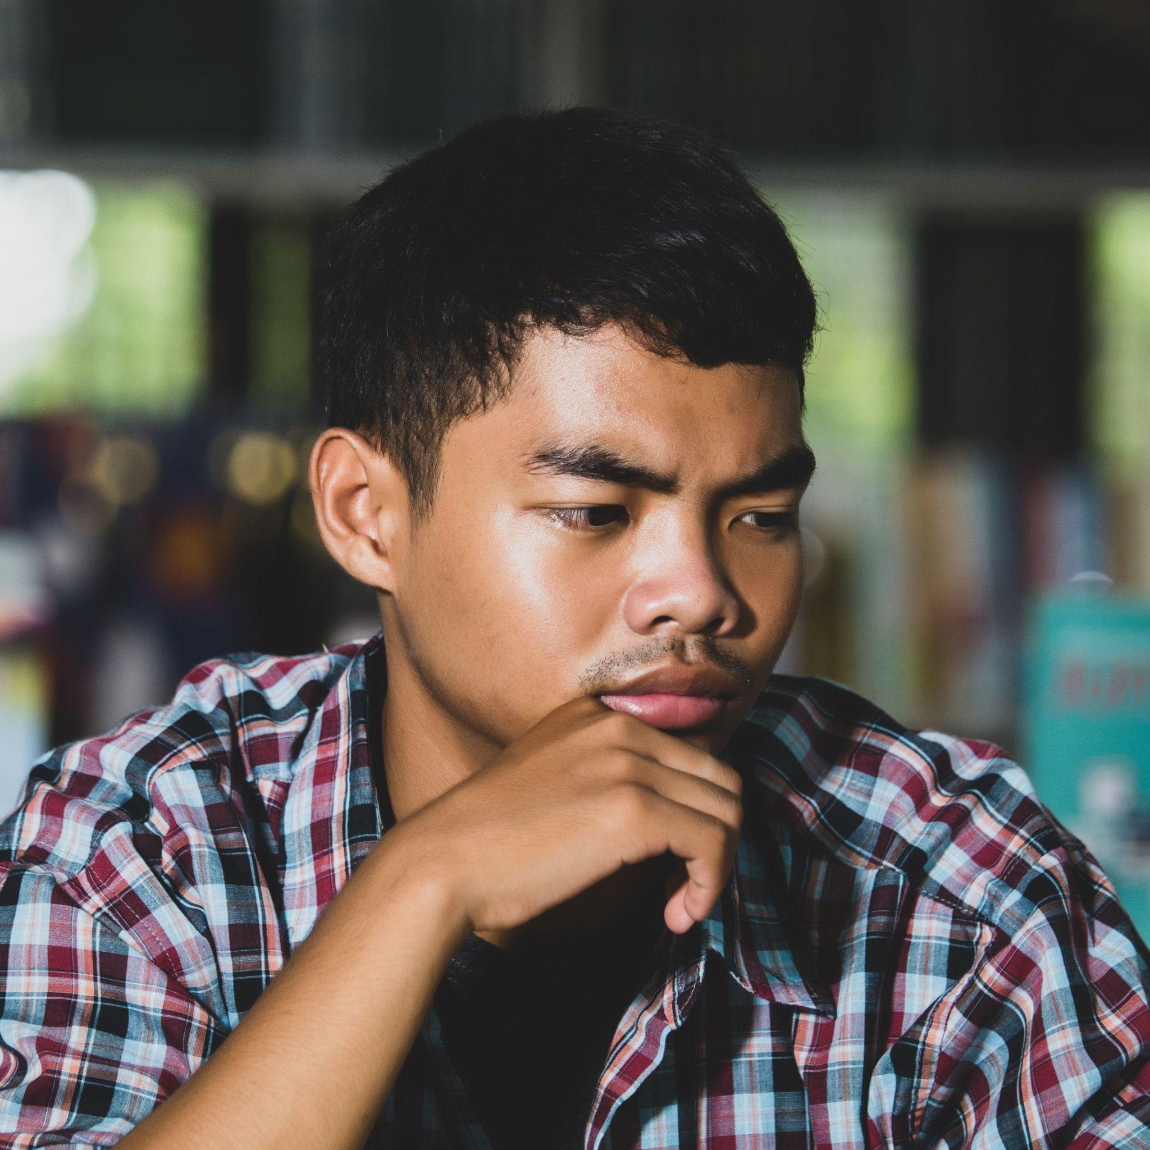
A. Role-Play – Exam Preparation
You are talking to your a friend who is preparing for
a big school exam. You took this exam last year.
You want to make sure your friend is supported and prepared by asking how they are doing and giving
advice for preparation.
First, what have you been hearing about this exam?
Next, how does this exam impact your future?
How do you usually prepare for exams?
Then, how are you preparing this time?
What are you feeling good about?
But, what are you feeling nervous about?
Who are you studying with and when can they study?
Finally, how can I support you while you study?
Notes:
6B. Activities – Pair Work Partner A
Role-Play between a friend and a student taking an exam.
Partner A will play the part of a friend talking to a student taking an exam. Partner A will ask questions from this slide and write Partner B’s answers.
Check answers for correct grammar and punctuation. Answers will vary.
Photo <ahref="https://www.freepik.com/free-photo/educational-conept-tired-student-library_5473619.htm#page=5&query=exam%20study%20teen%20bored%20thinking&position=31&from_view=search&track=ais&uuid=f380f025-1c3d-43f7-9493-f140b64c7ca4"> Image by jcomp</a> on Freepik

Slide 25
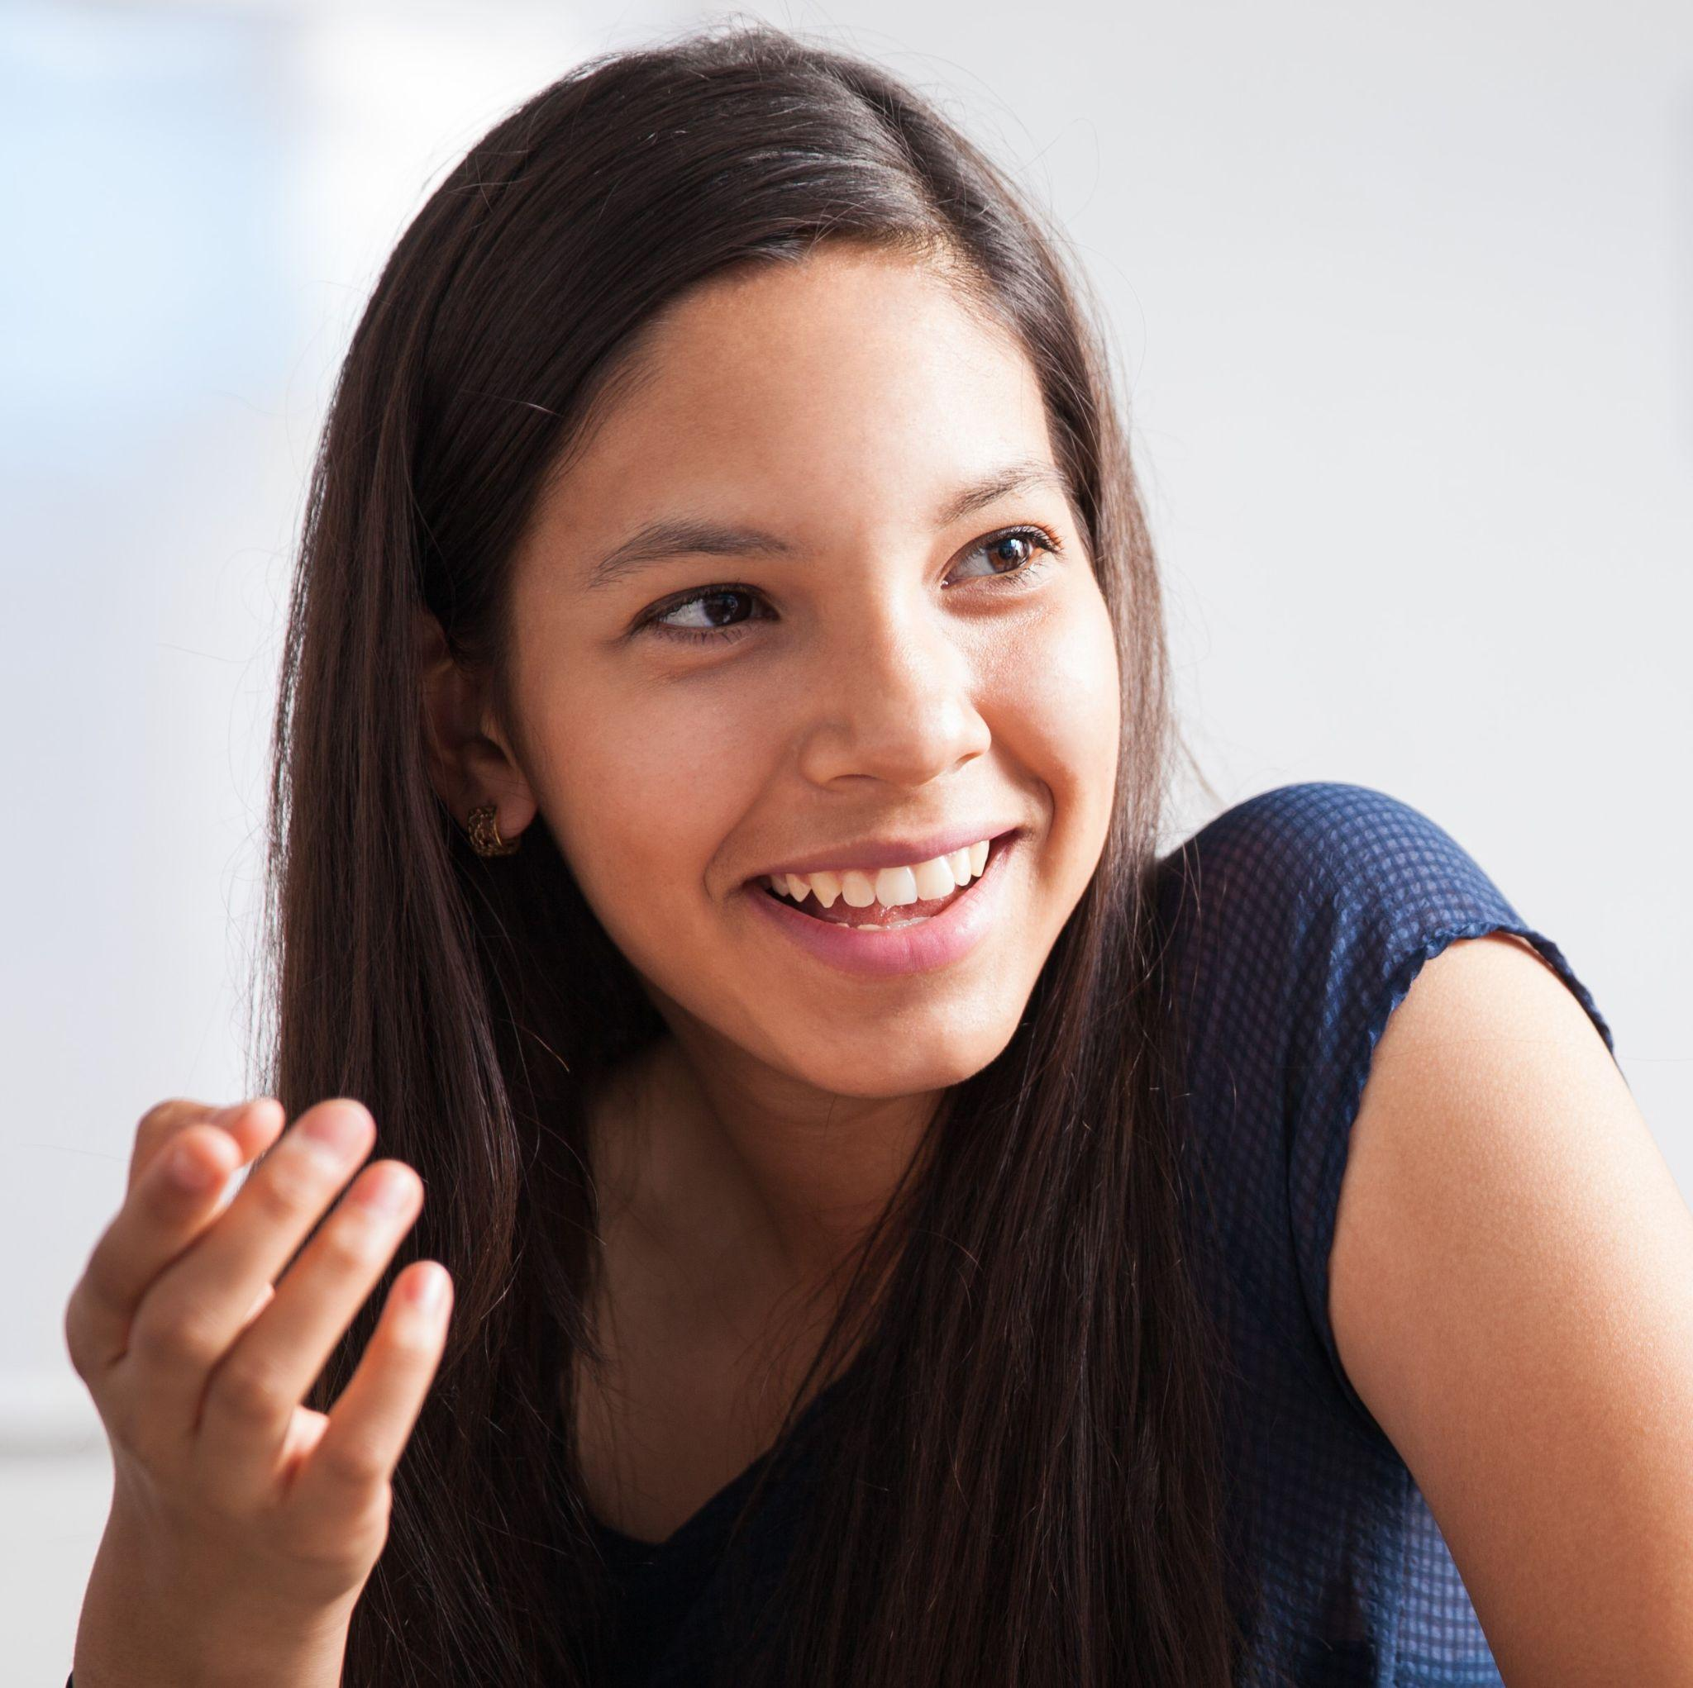
B. Role Play – Exam Preparation
You are a student about to take a big exam. You want to be as prepared as possible and you trust your friend’s advice. You have been studying but not as much as you could and you are nervous you’re not ready. Ask your friend these questions.
What was the exam like for you? How hard was it?
What do you think of how I’m preparing?
What else should I do to prepare?
What do I do if I get a low score or even fail it?
How do I respond to feeling nervous and doubtful?
What do I do if my classmates and I fight about our scores?
What was the best part about taking the exam?
What other advice or encouragement you have?
Notes:
6C. Activities – Pair Work Partner B
Role-Play between a friend and a student taking an exam.
Partner B will play the part of a student taking the exam. Partner B will ask questions from this slide and write Partner A’s answers.
Check answers for correct grammar and punctuation. Answers will vary.
Photo
<ahref="https://www.freepik.com/free-photo/cute-hispanic-teen-friends-talking-hving-fun-classroom_27999221.htm#query=teen%20give%20advice&position=2&from_view=search&track=ais&uuid=946b88bf-6584-4c7a-946c-1e24d2d80ce6"> Image by tonodiaz</a> on Freepik

Slide 26
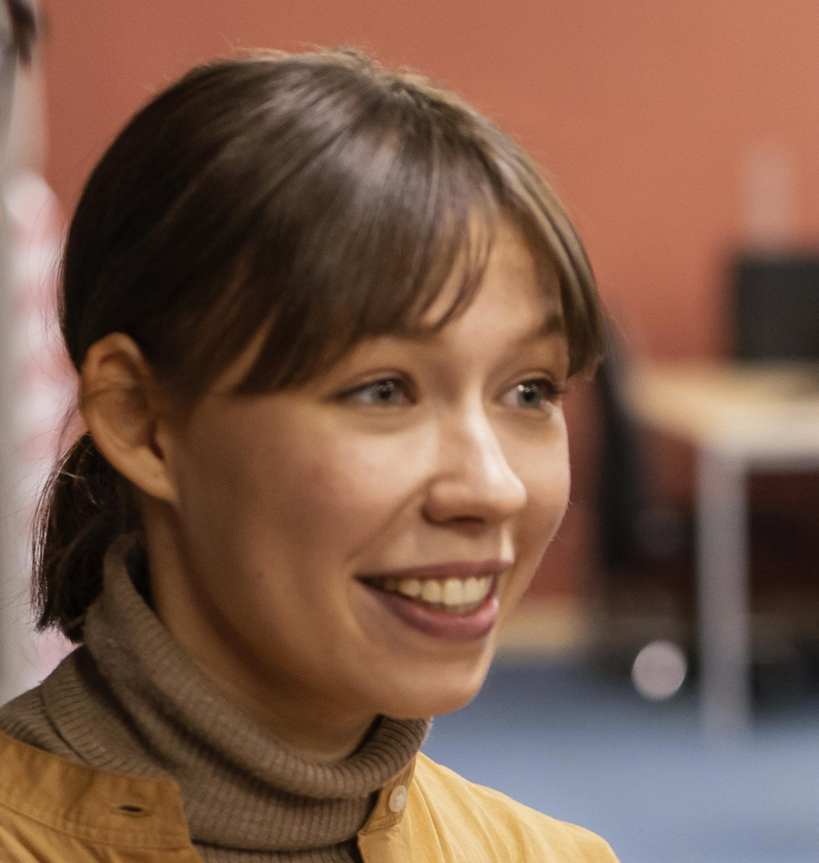
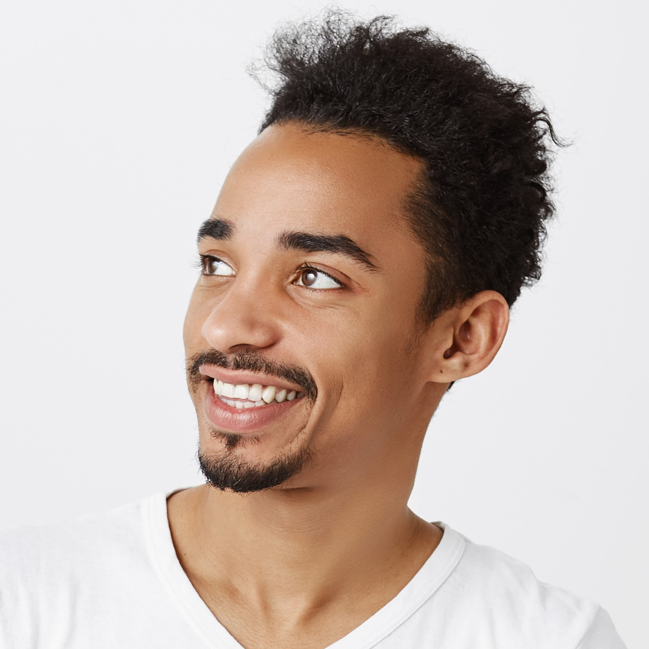
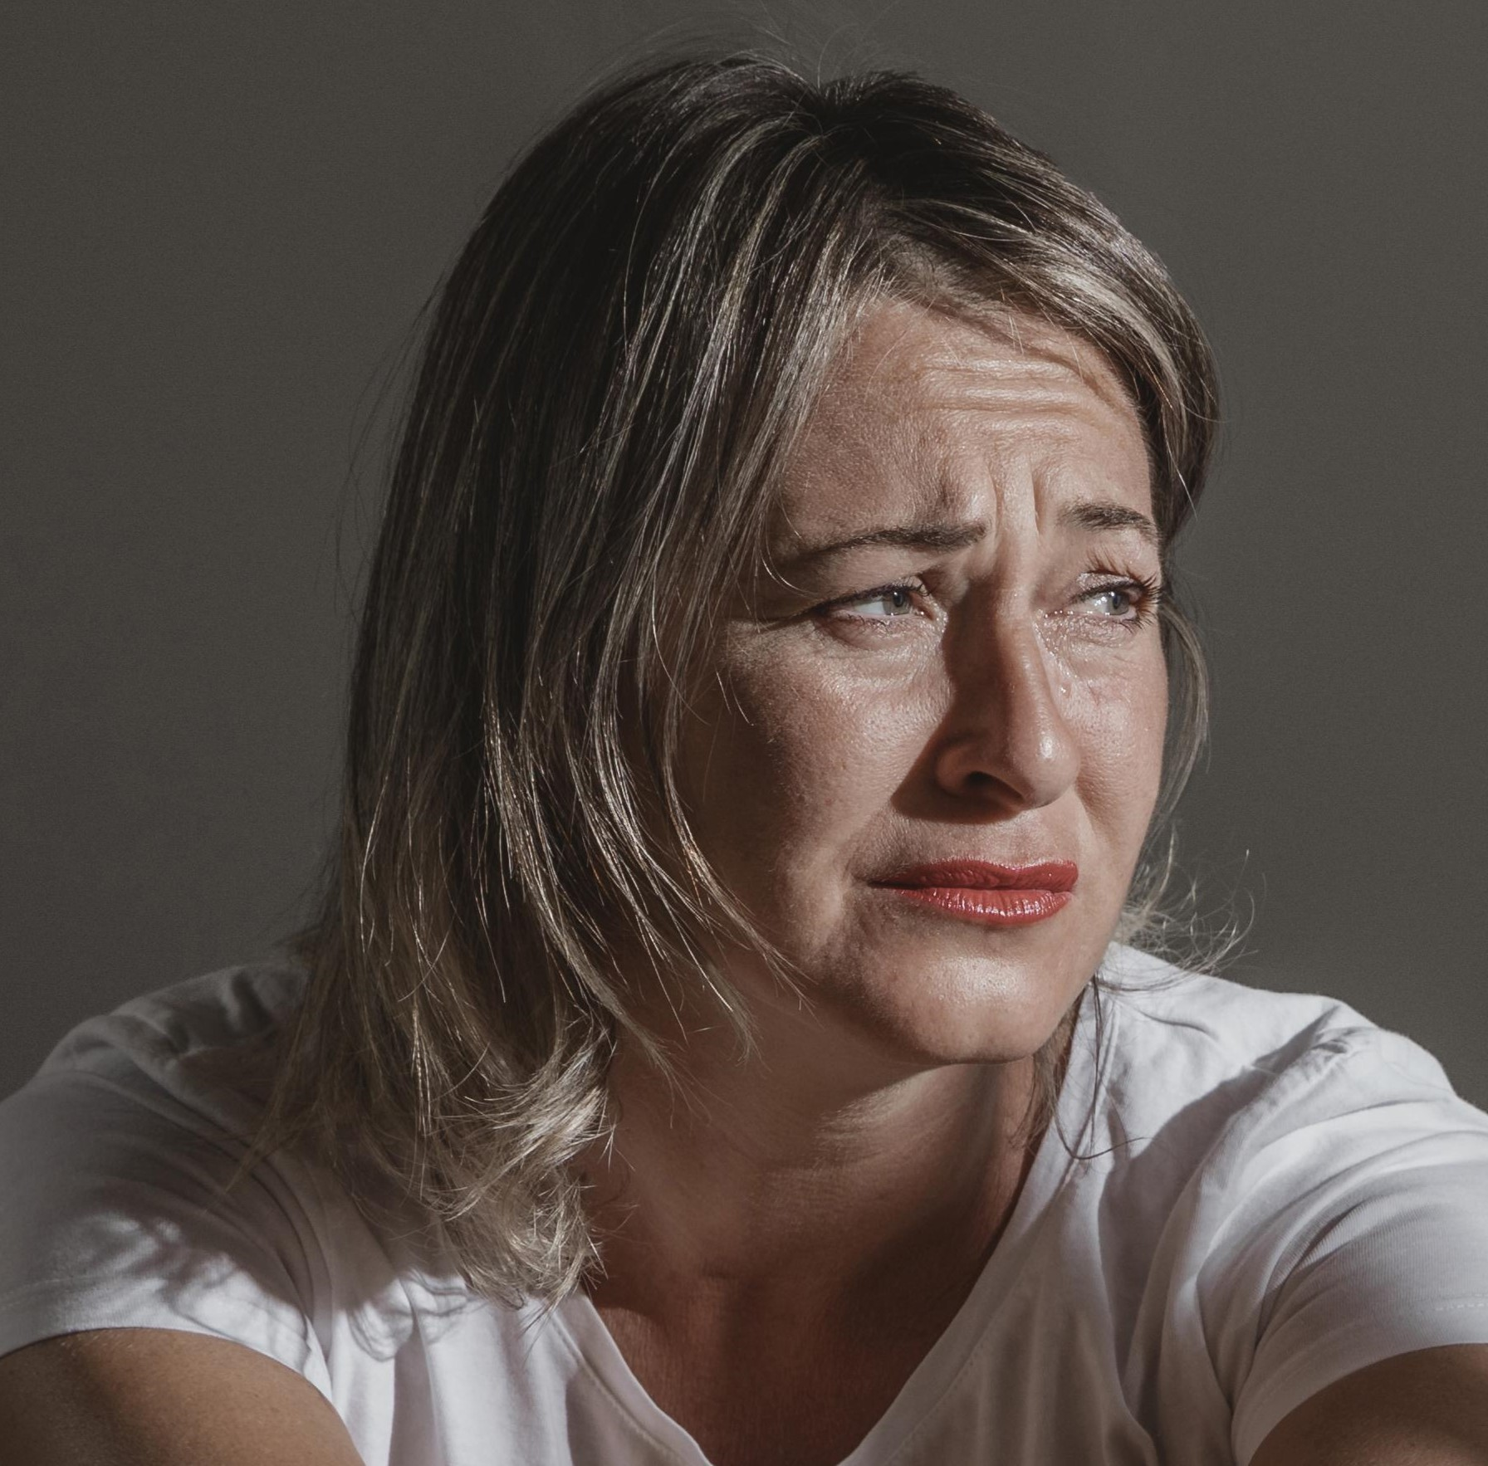
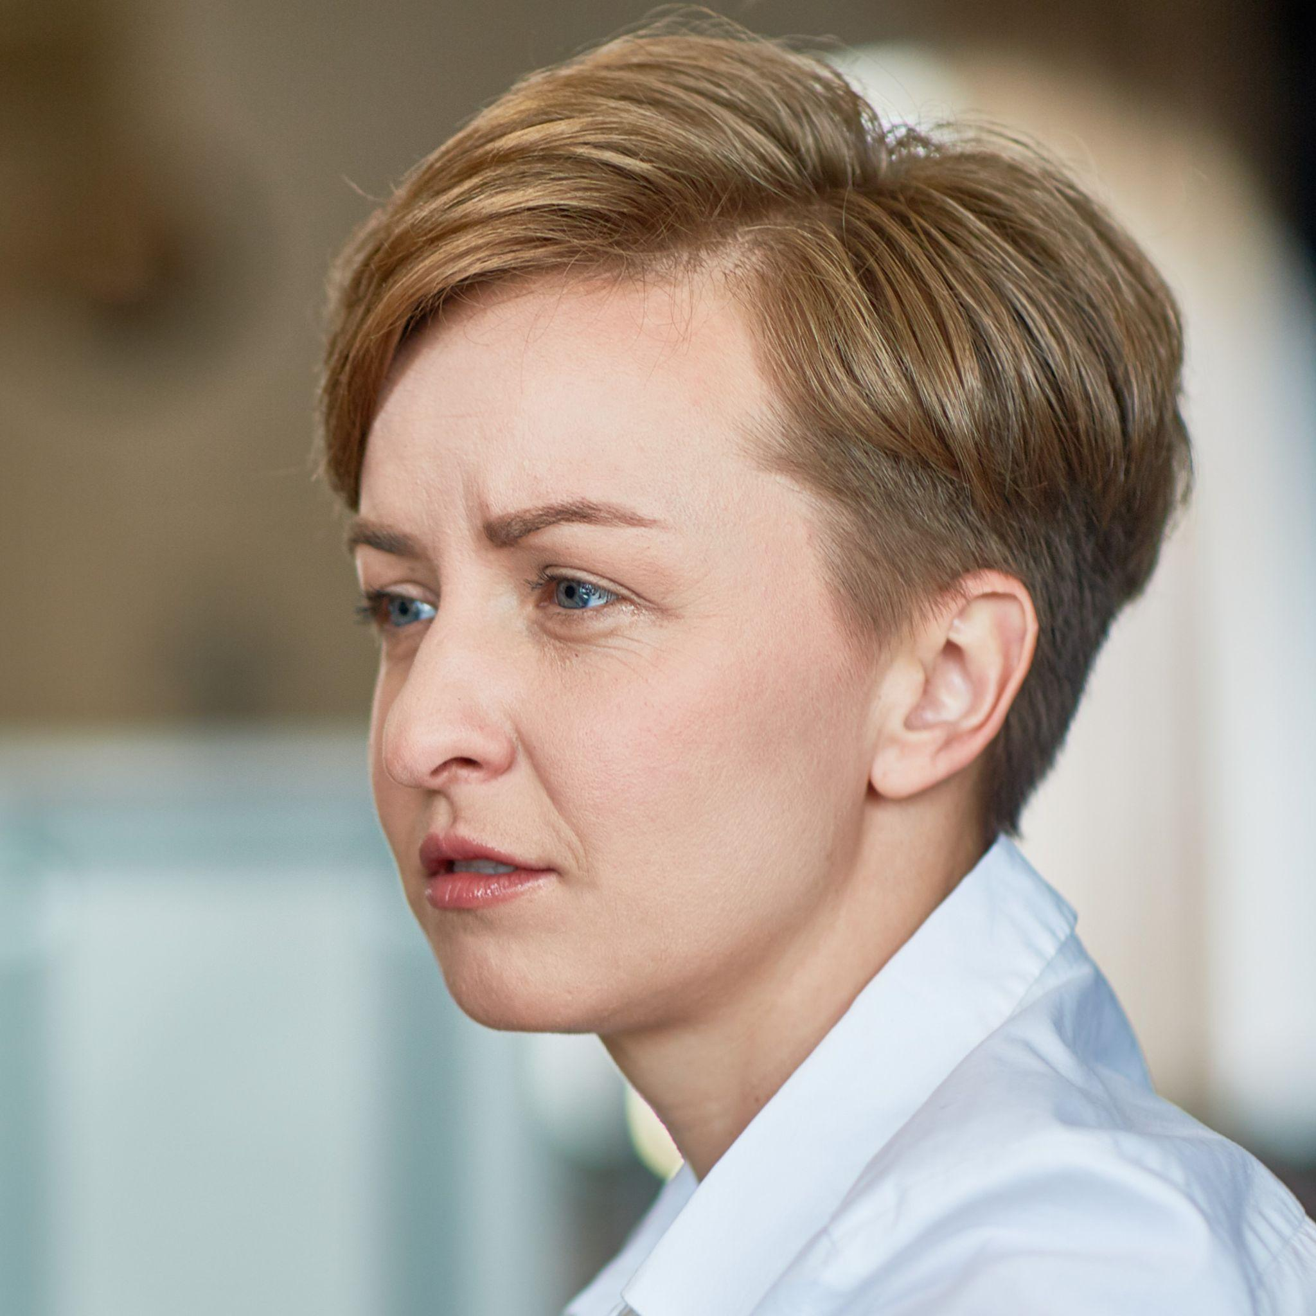
Game – Finish the Feeling!
I passed my exam today!
So I’m feeling relieved!
That’s amazing that you’re feeling relieved about passing your exam!
My grandma is in the hospital so I am feeling afraid of what will happen to her.
I’m so sorry that you’re feeling afraid of what will happen to your grandmother.
Notes:
7. Game – Finish the Feeling
Students form pairs.
Within their pairs students take turns describing their emotional response to events using:
“_____ so I’m feeling ______.”
Their partner has to choose an applicable form of affirmation and repeat back what they shared using:
“[Affirmation] that you’re feeling ______ about ______.”
Pairs get one point for each complete sentence with a good emotional response or affirmation and repetition.
Provide the students with the following list of scenarios, make your own, or allow students to choose their own scenarios.
Topics may include:
Passing an exam.
Grandma is in the hospital.
Enjoying a visit with a friend.
Falling and hurting your ankle.
Accidentally sleeping through your class.
Friends giving you a sweet surprise party.
Finding out your friend’s dog died.
Cleaning up after a big event.
Affirmations may include:
Congratulations…
I’m so sorry…
That’s amazing…
Wow, tell me more…
That sounds hard…
I’m happy for you…
The object of the game is to give as many meaningful responses as possible in five minutes.
Young woman photo: Image by <ahref="https://www.freepik.com/free-photo/university-colleagues-talking-library_12296584.htm#query=student&position=0&from_view=search&track=sph&uuid=4228f264-4486-4ff6-a15a-7f88ff672e3f">Freepik</a>
Young man photo: <ahref="https://www.freepik.com/free-photo/satisfied-african-american-guy-pointing-upper-left-corner-with-confident-smile_10293030.htm#page=4&query=guy%20look%20left&position=8&from_view=search&track=ais&uuid=7646af28-385e-45f0-9e43-3c9a1a2ae1b1"> Image by cookie_studio</a> on Freepik
Woman grieving photo: Image by <ahref="https://www.freepik.com/free-photo/adult-woman-stressing-out-home_11198885.htm#query=sad&position=41&from_view=search&track=sph&uuid=c17a5b99-959f-45bf-87db-d9395c5a1741"> Freepik</a>
Woman compassion photo: <ahref="https://www.freepik.com/free-photo/support-friend_5401236.htm#query=compassion&position=20&from_view=search&track=sph&uuid=ba1313b3-f8cf-4967-883c-3d0cdd2ecd75"> Image by pressfoto</a> on Freepik

Slide 27
1A. Homework – Write questions about the pictures in present continuous.
1 | Why is she curious about that plant? Why is she feeling happy? What is she thinking about? | 2
3 |  | 4
Notes:
Homework 1A. - Write sentences using the pictured vocabulary words.
Model. Go over each of the homework assignments to be sure the student understands what to do.
Repeat. Encourage students to practice speaking and reading the completed homework assignments with a friend. They may use a bilingual dictionary.
Solo. Students will share their homework when they are finished. After they have shared their homework, be sure to check it for correctness, including spelling. Explain mistakes, while providing praise and encouragement.
Number one is an example. Have the students use the corresponding vocabulary word for each picture in at least one sentence.
Answers may vary, and can be 1-3 sentences. They will start with a capital letter, have a question mark at the end, use the present continuous tense, and use the following words in at least one sentence:
2. certain
3. continue
4. wonder

Slide 28
1B. Homework – Write positive or negative sentences about the pictures in present continuous.
1 | The stars are not shining tonight, so the sky is dark. | 2
3 |  | 4
-
+
+
-
Notes:
Homework 1B. - Write sentences using the pictured vocabulary words.
Model. Go over each of the homework assignments to be sure the student understands what to do.
Repeat. Encourage students to practice speaking and reading the completed homework assignments with a friend. They may use a bilingual dictionary.
Solo. Students will share their homework when they are finished. After they have shared their homework, be sure to check it for correctness, including spelling. Explain mistakes, while providing praise and encouragement.
Number one is an example.
Answers may vary, but will start with a capital letter, have a punctuation mark at the end, use the present continuous tense, and use the following words:
2. confident
3. doubt
4. fear

Slide 29

1C. Homework: Write about emotional response in your culture.
1. What do people mean when they say “anxiety” in your culture and how do they respond to it?
2. What do people mean when they say “regret” in your culture and how do they respond to it?
4. What is an example of something people wonder about in your culture and why do you think they wonder about it?
5. What is an example of something people generally believe in your culture and why do you think they believe this?
Notes:
Homework 1C. - Write about the vocabulary words.
Students will write answers to the questions.
Answers will vary.

Slide 30
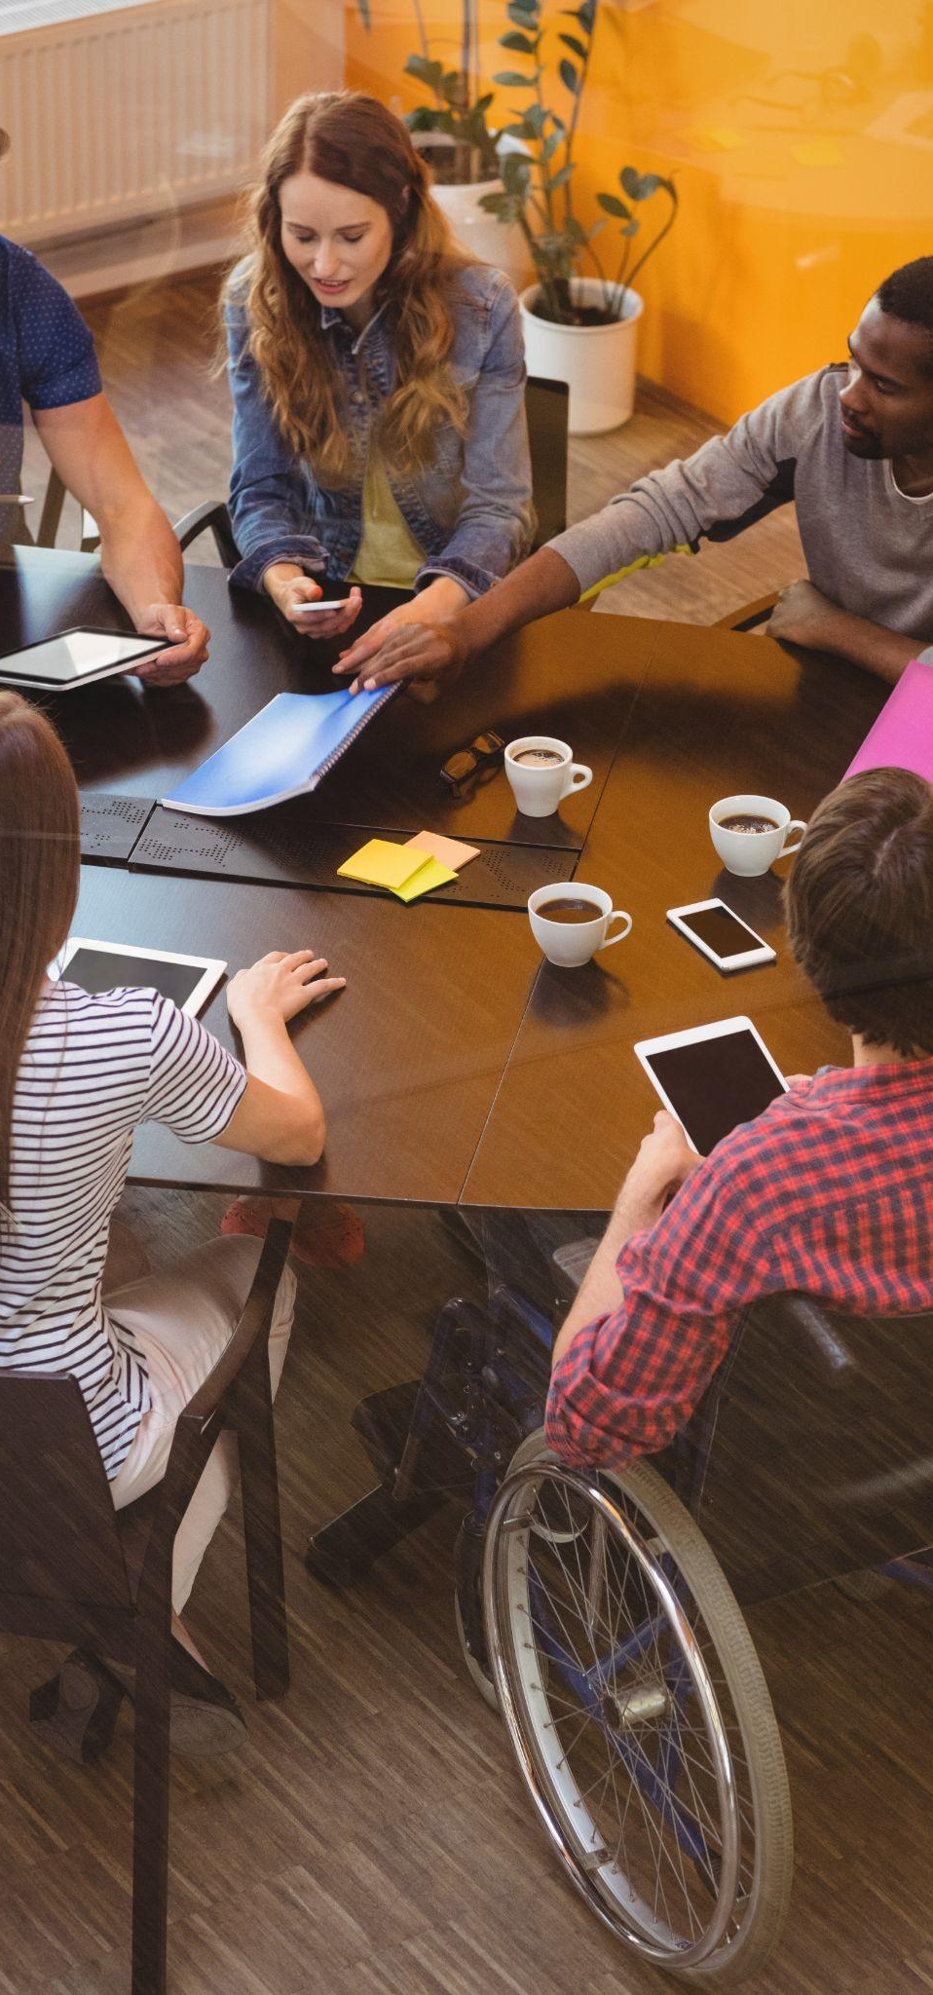
2A. Use the verbs in the present continuous tense.
I (feel)______now because _____.
I am feeling better now because I drank some water.
She (work) ______ today because ______.
You (answer) ____ at the moment because ____.
They (ask) ______ constantly because _______.
He (call) ______ every day because _______.
We (plan) ______ soon because ______.
Notes:
Homework 2A. – Grammar and Vocabulary Review
Students will complete the sentences with correct verb forms (from of “be” & “verb-ing”) and reasons. Number 1 is an example.
Answers will vary but must be in present continuous tense and include a reason for the action.
Image: <ahref="https://www.freepik.com/free-photo/business-executives-interacting-with-each-other_1005845.htm#query=conversation&position=1&from_view=search&track=sph&uuid=fbeb557f-ff49-4f6a-b319-0cf69f992bb4"> Image by peoplecreations</a> on Freepik

Slide 31
2B. Use conjunctions to connect the phrases and complete the sentences.
So, then, plus, but, finally
I am worrying ___________________________.
I am worrying about my mother so I will call her to ask how she is doing.
She is walking ___________________________.
You are thinking __________________________.
They are grieving _________________________.
He is screaming __________________________.
We are celebrating ________________________.
Notes:
Homework 2B. – Grammar and Vocabulary Review
Students will complete the sentences with correct use of conjunctions. Number 1 is an example. They should you each conjunction at least once.
Answers will vary but sentences must use conjunctions correctly.
Image: <ahref="https://www.freepik.com/free-photo/business-executives-interacting-with-each-other_1005845.htm#query=conversation&position=1&from_view=search&track=sph&uuid=fbeb557f-ff49-4f6a-b319-0cf69f992bb4"> Image by peoplecreations</a> on Freepik

Slide 32
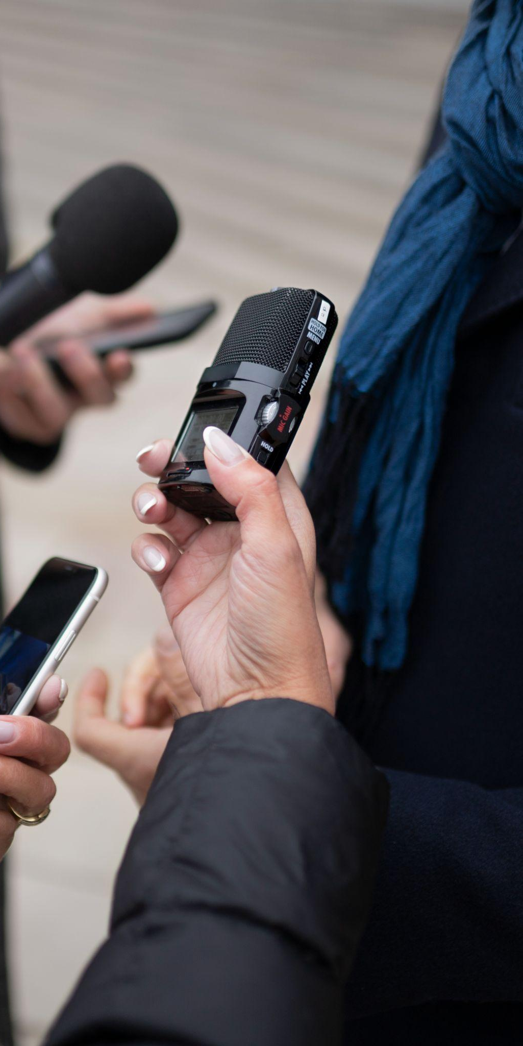
3. With a partner, discuss a current event in the world.
Where is this happening?
What is a quick summary of the circumstances?
Who is part of this situation? Who do you know personally that is part of this?
When did this start? How long might it continue?
Why do you think this is happening? What do you hope will change?
How are people feeling now? How are you feeling?
Notes:
Homework 3. – Conversations - Pair work
Students interview a partner and write their partner’s answers. They will also create two of their own follow-up questions for numbers 7 and 8. Check answers for correct grammar and punctuation.
Questions and answers will vary
Image: Image by
<ahref="https://www.freepik.com/free-photo/close-up-reporter-taking-interview_20507356.htm#query=news&position=0&from_view=search&track=sph&uuid=477639da-89b7-4f1b-b400-281dc9da4908"> Freepik</a>

Slide 33
4. Say and write the words in the correct columns.
Words
confident | family
answer | cost
loss | sad
exam | solid
happening | offer
optimistic | plan
shot | happy
grandma | offer
/a/ | B. /o/
answer | confident
Notes:
Homework 4. – Pronunciation
Students will go through the list and say each word. Then they will write words in the correct columns for the corresponding pronunciation.
Answers:
A: answer, exam, happening, grandma, family, sad, plan, happy
B: confident, loss, optimistic, shot, cost, job, solid, offer

Slide 34
4. Say and write the words in the correct columns.
invite | conclude
repeat | confide
argue | regret
review | impact
recite | express
support | follow
contact | wonder
begin | believe
listen | prepare
-▔ | B. -▔ | C. ▔-
invite |  | argue
Notes:
Homework 4. – Pronunciation
Students will go through the list and say each word. Then they will write words in the correct columns for each stress pattern.
Answers:
A: invite, repeat, review, recite, support, begin
B: conclude, confide, regret, express, believe, prepare
C: argue, contact, listen, impact, follow, wonder
Verbs: https://purlandtraining.com/hw1/180-common-2-syllable-verbs-with-prefixes-forcing-stress-on-the-second-syllable.pdf

Slide 35
5. Write about Luke 1:57-80 in your own words. Use so, then, plus, but, and finally.
©2021-2024 Literacy International
Notes:
Homework 5. – Bible Reading Review
Students will write a short summary of the Bible reading using the words so, then, plus, but and finally.
Answers will vary. Possible answers may include:
Elizabeth had a baby so her relatives and neighbors were happy. Zechariah wrote that the baby’s name should be John, then he could speak again! Plus, Zechariah spoke a long message of praise to God. Finally, John grew up and was strong in spirit. But, he waited until the time for him to share God’s message.

Slide 36
6A. Choose 1 verse to memorize and write it here. Then read the next verses in your language.
Read the next lesson’s Bible verses: Luke 2:1-21
in your language.
Notes:
Homework 6A. – Memorize a verse and read the next lesson’s verses in your native language.
Learners get to choose one verse from the lesson’s reading to memorize. Please notice that the memory work is not long. Everyone, regardless of skill level, should be able to do it. Students will also read the next lesson’s Bible passage in their native language. Students will always read the Bible lesson in their first language before reading it in English the following lesson. Help them get a Bible in their own language if they don’t have one. They may also use https://live.bible.is/ or other Bible translation resources. The hyperlinks of the Bible verses connect to https://live.bible.is/ so students can read, hear and watch videos of the scripture in their own languages.
1. Model. Recite a verse from memory.
2. Repeat. Encourage students to find someone with whom to practice conversing and reading the completed homework assignment.
3. Solo. Students will recite the verse from memory at the next class.

Slide 37

7A. Read this invitation: known as the oldest written party invitation.
Claudia Severa to her Lepidina, greetings. On 11 September, sister, for the day of the celebration of my birthday, I give you a warm invitation to make sure that you come to us, to make the day more enjoyable for me by your arrival, if you are present. Give my greetings to your Cerialis. My Aelius and my little son send him their greetings. I shall expect you, sister. Farewell, sister, my dearest soul, as I hope to prosper and hail. To Sulpicia Lepidina, wife of Cerialis, from Severa.
Notes:
Homework 7A. – Everyday Reading and Writing
Students will read the historical invitation and answer the questions.
Invitation: https://odacreative.com/blog/2018/12/24/celebrating-famous-invitations-from-ancient-to-modern-times/
Artifact: https://www.archaeology.org/issues/106-1309/artifact/1171-writing-tablet-roman-fort-northumberland

Slide 38
7B. Study this invitation: known as the oldest written party invitation.
1.Claudia Severa to her Lepidina, 2.greetings. On 3.11 September, sister, for the day of the 4.celebration of my birthday, I give you a warm invitation to make sure that you come to us, to make the day more enjoyable for me by your arrival, if you are present. Give my greetings to your Cerialis. My Aelius and my little son send him their greetings. I shall expect you, sister. 5.Farewell, sister, my dearest soul, as I hope to prosper and hail. To 6.Sulpicia Lepidina, wife of Cerialis, from Severa.
Notes:
Homework 7A. – Everyday Reading and Writing
Prompt students to guess what the six parts of the invitation are. Each number corresponds to one part.
For the teacher:
Sender
Greeting
Time
Reason
Closing
Receiver
Invitation: https://odacreative.com/blog/2018/12/24/celebrating-famous-invitations-from-ancient-to-modern-times/
Artifact: https://www.archaeology.org/issues/106-1309/artifact/1171-writing-tablet-roman-fort-northumberland

Slide 39
7C. Study this invitation: known as the oldest written party invitation.
1.Claudia Severa to her Lepidina, 2.greetings. On 3.11 September, sister, for the day of the 4.celebration of my birthday, I give you a warm invitation to make sure that you come to us, to make the day more enjoyable for me by your arrival, if you are present. Give my greetings to your Cerialis. My Aelius and my little son send him their greetings. I shall expect you, sister. 5.Farewell, sister, my dearest soul, as I hope to prosper and hail. To 6.Sulpicia Lepidina, wife of Cerialis, from Severa.
Sender
Greeting
Time
Reason
Emotion
Closing
Receiver
Notes:
Homework 7A. – Everyday Reading and Writing
Discuss the 6 parts of the invitation with students and why each of them are important. Mention that you can change the order of the 6 parts and add other details or feelings, as long as all 6 parts are included.
Sender: You, the person sending the invitation.
Greeting: Your introduction. Examples: Hello, I hope you’re doing well, Greetings, Good evening, etc.
Time: Date, day of week, time, etc.
Reason: What the event is and any important details about the event they should know.
Closing: Final words. Examples: Thank you, Goodbye, Sincerely, See you soon, etc.
Receiver: Who you’re sending the invitation to. It may be a single person or a group.
Invitation: https://odacreative.com/blog/2018/12/24/celebrating-famous-invitations-from-ancient-to-modern-times/
Artifact: https://www.archaeology.org/issues/106-1309/artifact/1171-writing-tablet-roman-fort-northumberland
Image: Image by <a href="https://www.freepik.com/free-photo/assortment-pirate-artifacts-bounty_81411643.htm#page=2&query=old%20papyrus%20edges&position=15&from_view=search&track=ais&uuid=fb480282-b7ce-43a5-bdc0-533d800129d6"> Freepik</a>

Slide 40
7D. Explain each part of an invitation and why
it’s important.
Part | Reason it’s important
Sender | The sender is me, the person sending the invitation. It is important so the people I am inviting know who is inviting them so they can decide if they want to come.
Greeting
Time
Emotion
Reason
Closing
Receiver
Notes:
Homework 7C.– Everyday Reading and Writing
Students will answer why each part of an invitation is important. “A. Sender” is an example.
Answers will vary. Examples are below:
A. This is my introduction, where I say hello. It’s important so the note is polite and the person I’m inviting feels important.
B. This is when the part is happening. It’s important so the person I’m inviting knows when to come.
C. This is what the event is. It’s important so the people I’m inviting know what it is and any important things about it so they can be ready when they come.
D. This is how I finish the invitation and say goodbye. It’s important so they know that’s the end and so it ends politely.
E. This is who I’m sending the invitation to. It’s important so it gets delivered to them and not someone else.

Slide 41
8. Write your own invitation for an event you would like to host with people you care about.
Notes:
Homework 8 – Writing
Model. To my friend: Hello! I hope you’re having a good day. It would be great if you can come over next week on Thursday evening to have dinner with me and a group of friends. We will meet at 6pm at my apartment. We will be having our first book discussion. I will introduce the book and then we will begin reading it together and engaging with it. I hope you can join us! See you soon. From your friend.
Answers will vary.

Slide 42
9. Now I Can…
I can express various emotions in conversations, including the use of the 12 vocabulary words.
I can actively listen to someone sharing about a a personal experience with me.
I can use the present continuous tense to talk about ongoing actions.
I can recognize and use the 5 learned conjunctions.
I can understand the background of John the Baptist and that God was worthy to be praised by Zechariah.
Notes:
Homework 9. – I can statements
The student must be able to achieve all of these skills before the next lesson. If not, the lesson can be repeated or additional practice materials can be used.
Review all of the skills at the beginning of the next lesson. Be sure to give lots of praise and encouragement!

Slide 43
Closing Prayer
Notes:
Pray
You may want to ask for any special prayer requests, then pray for your students and bless them. Prayers may also be written on this slide.

Slide 44

Help us share the Light of the World!
Thank you for using our materials. If these lessons are a blessing to you, please consider giving to help others learn English through the Bible.
For more information, visit LiteracyInternational.net

Slide 45

Appendix
How to Use Lessons: bit.ly/UsingLOTW
Irregular Verb List: bit.ly/IrregVerb
Lesson Downloads: bit.ly/DownloadLOTW
Order Books: bit.ly/3PlPuRg
Share Your Feedback: bit.ly/FeedbackLOTW
Table of Contents: bit.ly/ContentsLOTW
Video Channel: youtube.com/c/LiteracyInternational
Videos A2 Lessons: bit.ly/A2LessonVideos
Vocabulary List: bit.ly/VocabLOTW
Website: LiteracyInternational.net

