Slide 1
Unit B1-05
©2020-2024 Literacy International
Notes:
Teacher’s Notes:
Bible Reading: The Birth of Jesus.
Theme: Describing Things
Pronunciation: /u/ and /o/
Grammar: Present simple vs Present continuous
Preparation:
Pray.
Read the Bible passages.
Preview slides and game.
Optional: Bring a nativity set and objects made of wood, metal, fur, cloth, leather, plastic, etc.

Slide 2
Pray, Review, and Preview
Bible Reading: The Birth of Jesus Luke 2:1-21
Theme: Describing Things
Pronunciation: /u/ and /o/
Grammar: Present Simple vs. Present Continuous
Notes:
Pray
Pray for the class. You may want to thank the Lord for the gift of His Son.
Check homework and review.
Ask students to read aloud or recite their homework from the last class. Check written work.
Review the main points of the previous lesson and ask if there are any questions.
Be sure they have read the Bible passage in their native languages in preparation for the lesson.

Slide 3
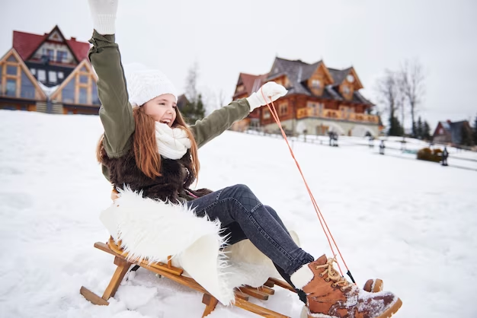
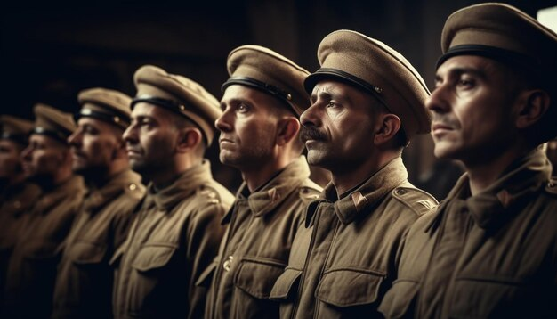
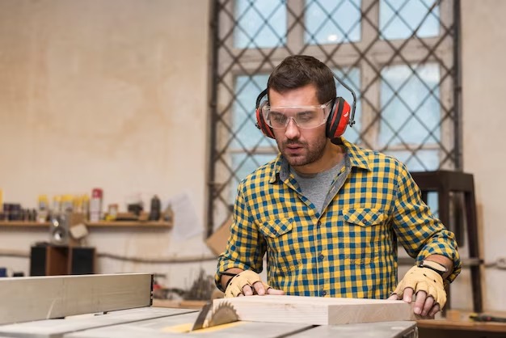
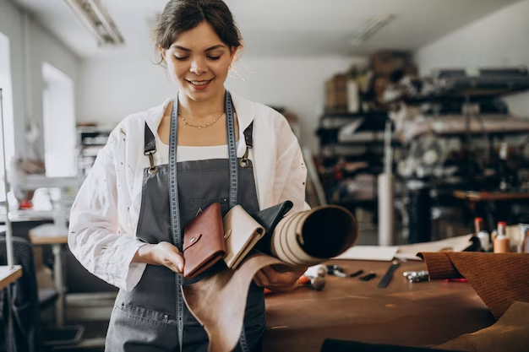
What are they doing?
Notes:
1A. Discuss Theme Picture
Ask “What do you see?” and “What are they doing?” to elicit vocabulary students already know.
Repeat and write their words or show the words on the next slide.
Answers may include:A girl is lying on a fur blanket. A man is laying down a piece of wood. Men in the army are lining up. A man is trying to cut wood. A woman is working with leather.

Slide 4
Susan loves to go sledding on her warm fur blanket, but there is nothing she loves more than her hardworking family. Although Susan doesn’t get to see her brother who registered in the army, she tries to spend time with her family when they aren’t working. Susan’s Dad works with wood as a carpenter, and her Mom makes wallets and purses with leather. When her parents appear in the front door after work, Susan loves to run up to them and give them a big hug.
Discuss with a partner
What kind of jobs does your family have?
What materials do you see around you at this moment?
Notes:
1B. Read about the theme picture and discuss with a partner
Please read the description of the theme picture to the students and point to the pictured vocabulary. If students ask about words, give simple definitions.
Then ask students to work in pairs and discuss the questions.

Slide 5
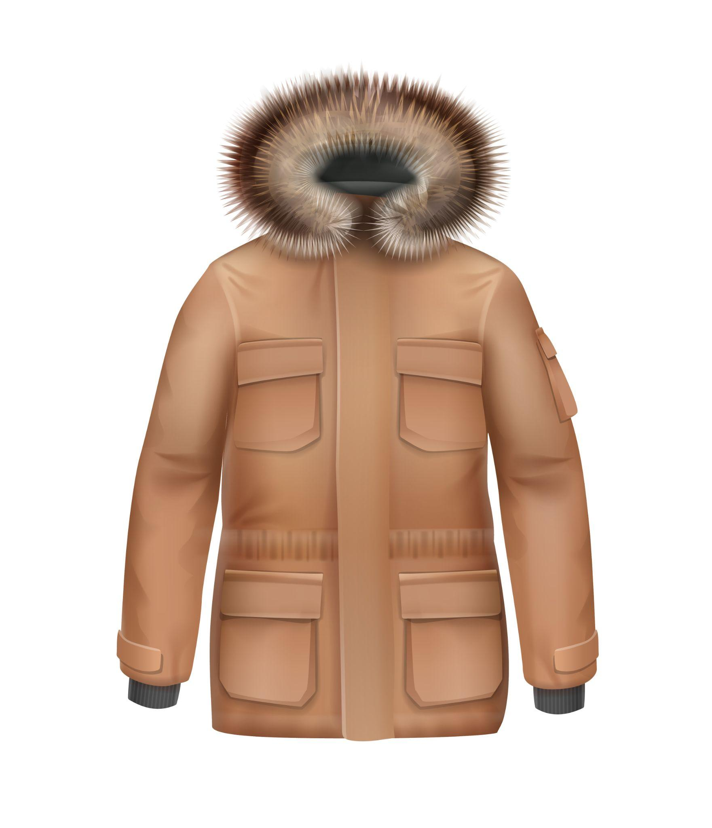
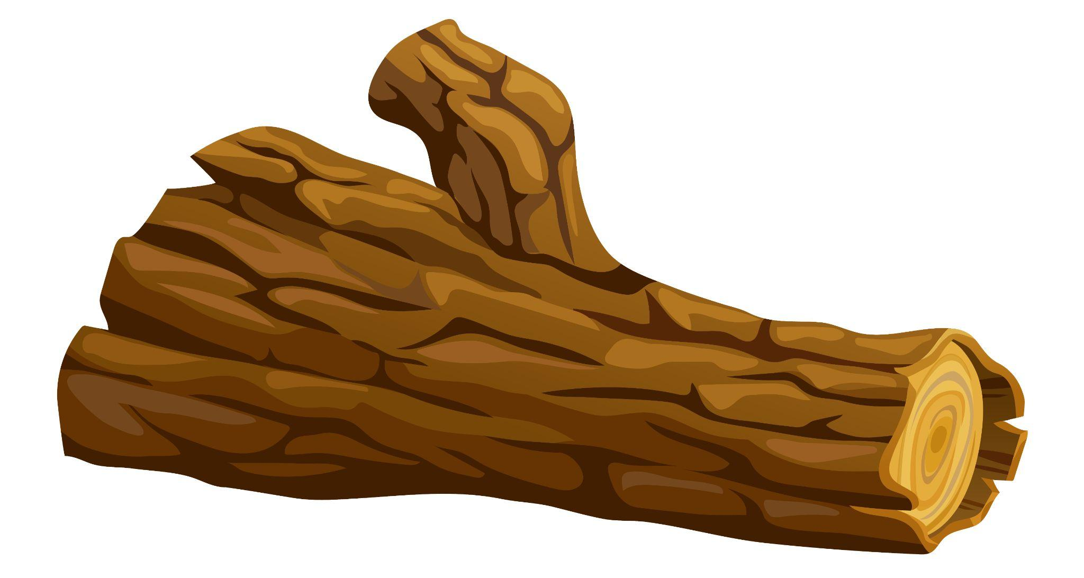
Match the definitions to the correct words.
1. wood | 2. fur | 3. metal | 4. plastic
used to make bottles and bags
used for making swords and hammers
used from trees to build homes
used from animals to make coats
Notes:
2A. Vocabulary
1. Say the word a few times, as you indicate the picture. For example, say, ”wood, wood, wood.” Have your students then repeat the word after you a few times.
2. Ask students to match the word to the correct definition and say the answer as a sentence. For example, “Wood is used from trees to build homes.”
3. Check students’ comprehension further by asking direct questions. For example, “Where do you find wood?”, “What keeps a bear warm?”, “What is made of plastic?”
Answers
1. C
2. D
3. B
4. A

Slide 6
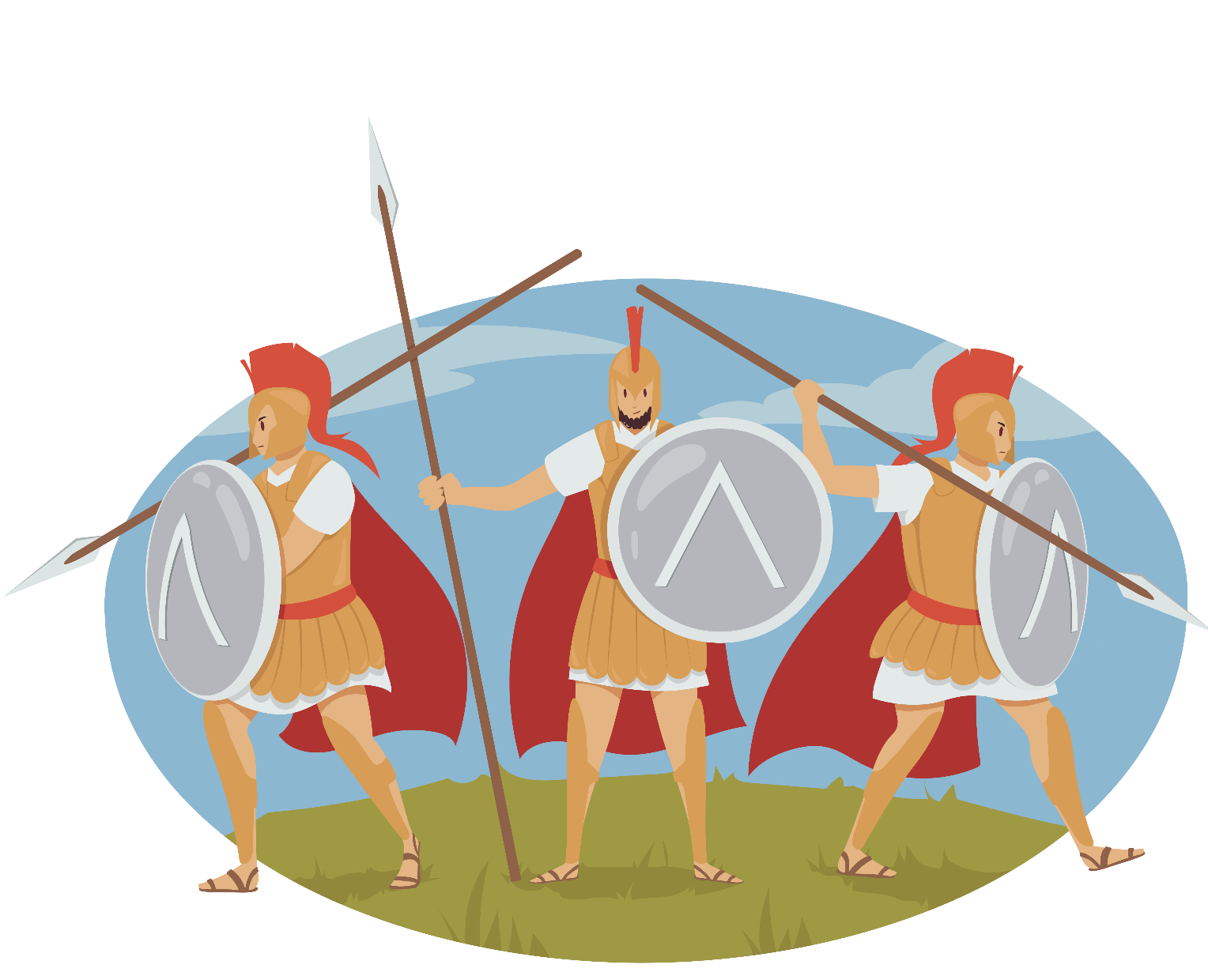
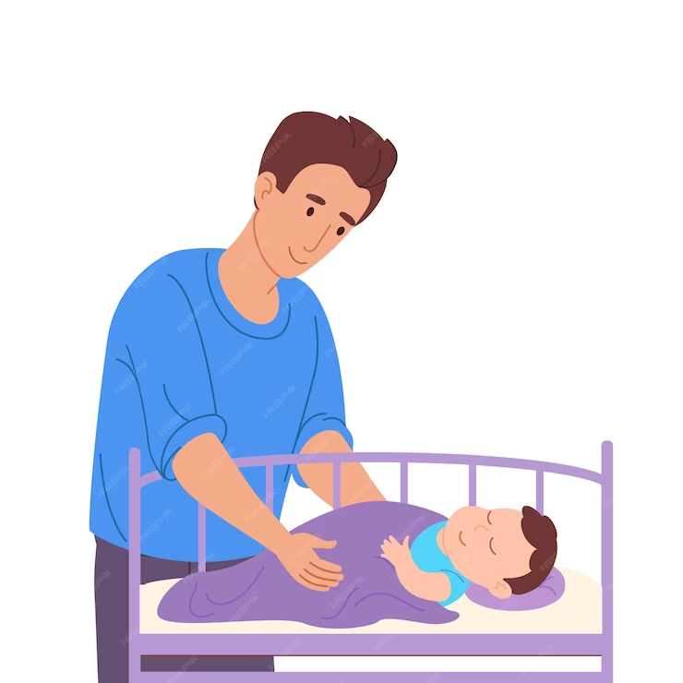
Match the definitions to the correct words.
1. an army | 2. heaven | 3. to lie | 4. to lay
group of people fighting in a war
what you do when you go to sleep
place where God and His angels are
to put something down
Notes:
2B. Vocabulary
1. Say the word a few times, as you indicate the picture. For example, say, ”army, army, army.” Have your students then repeat the word after you a few times.
2. Ask students to match the word to the correct definition and say the answer as a sentence. For example, “The army is a group of people who fight in a war.”
3. Check students’ comprehension further by asking direct questions. For example, “Where do you lie when you go to sleep?”, “What do you lay on the table before you eat?”, “Who is in heaven?”
Answers
1. A
2. C
3. B
4. D

Slide 7
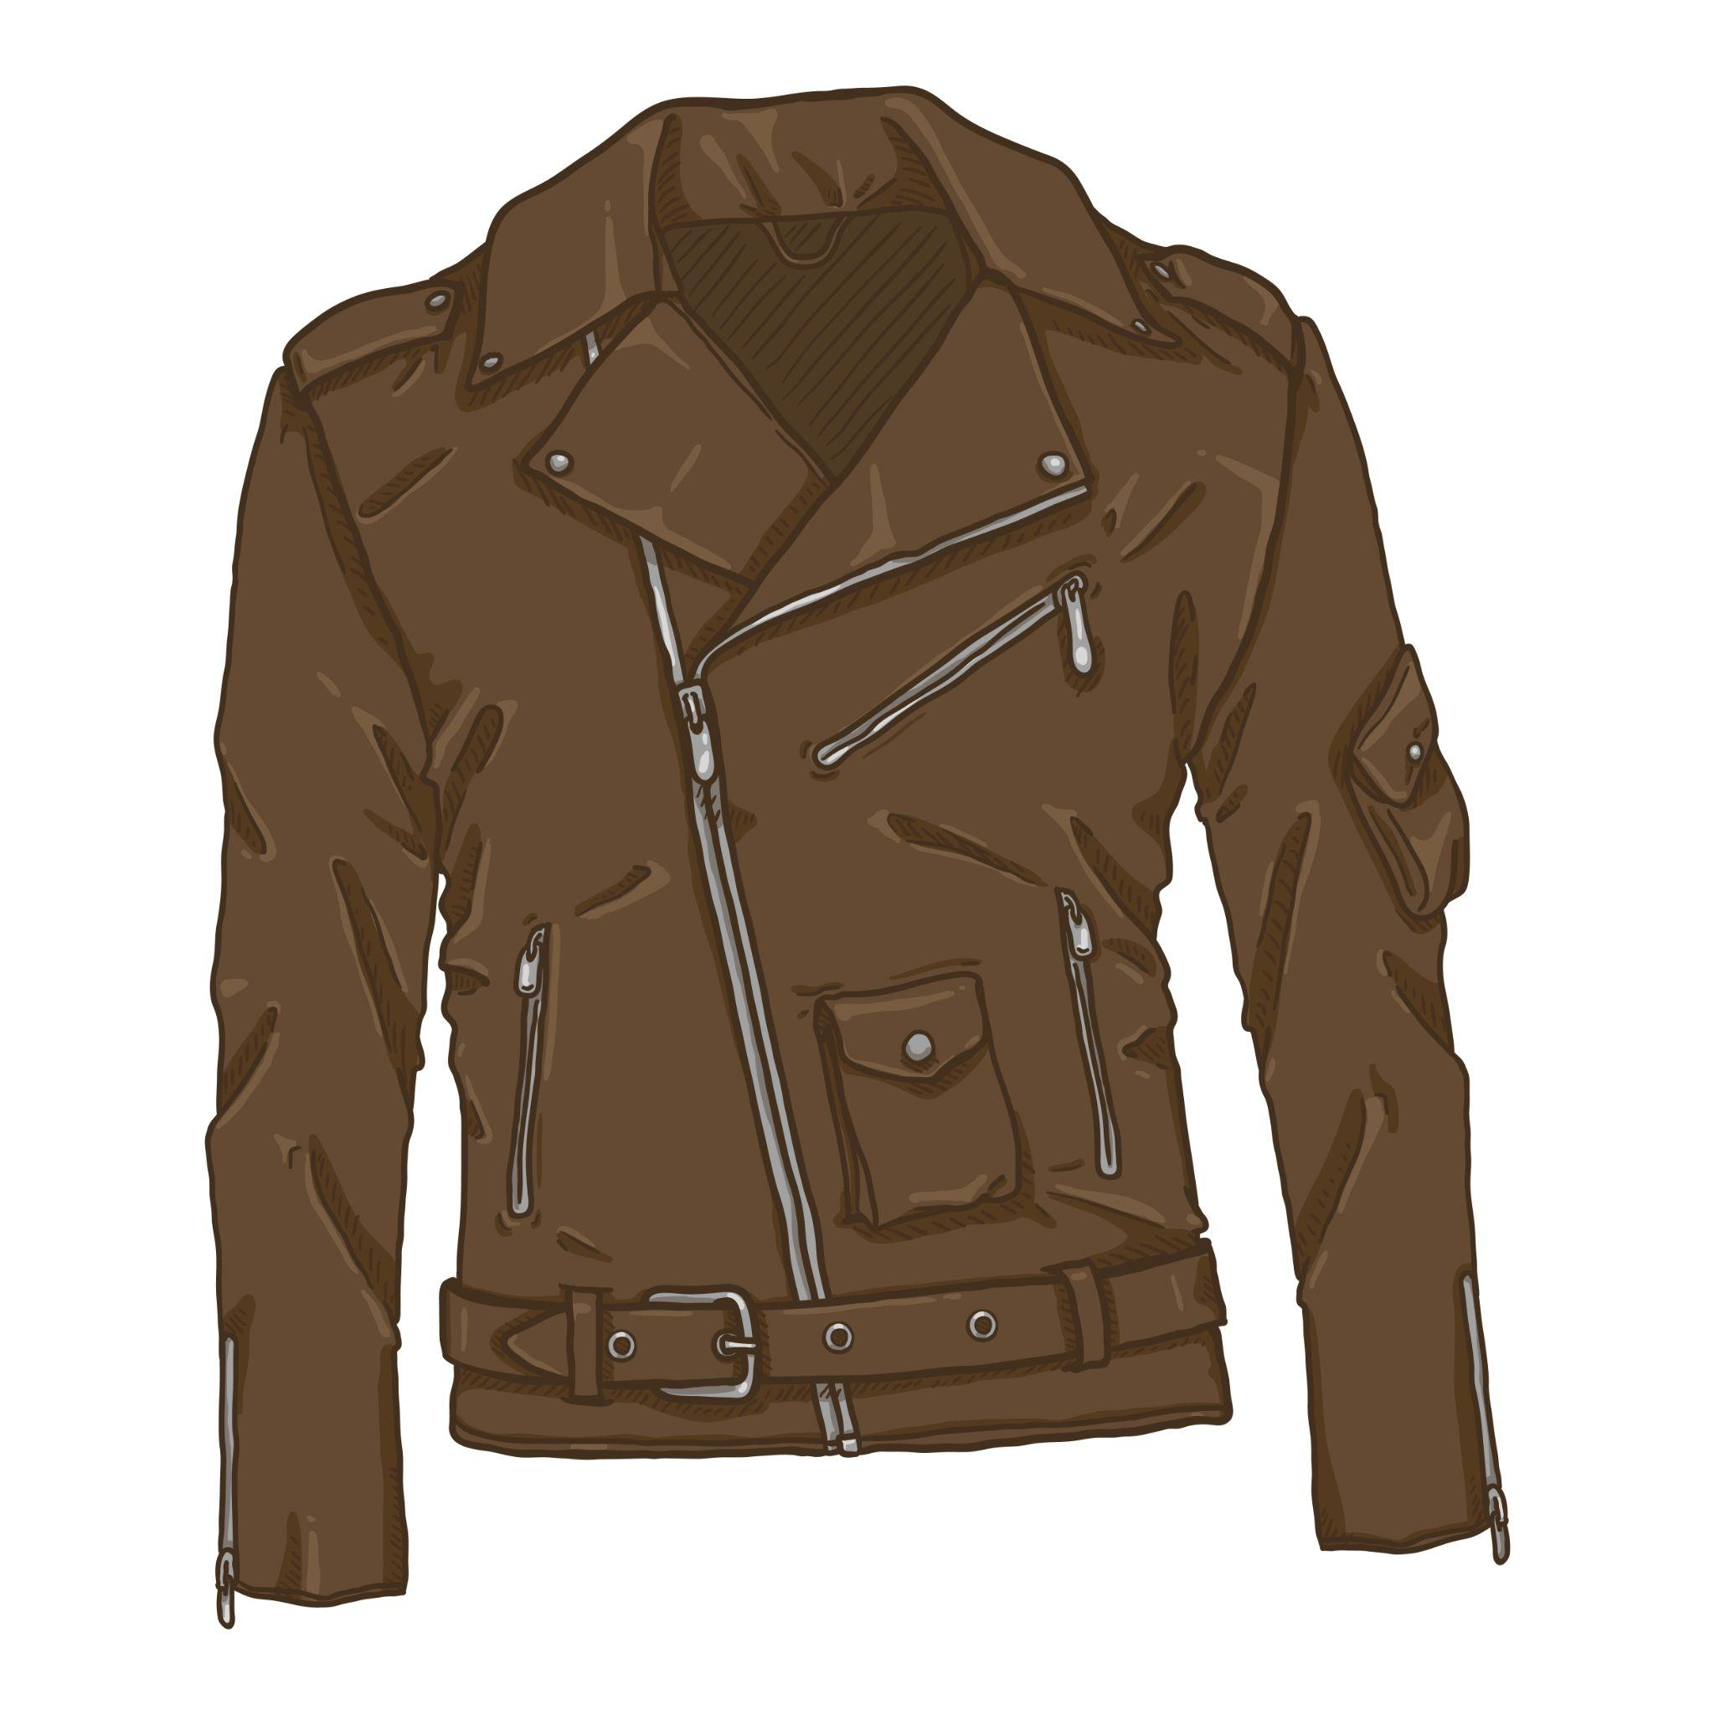
Match the definitions to the correct words.
1. to appear | 2. to try | 3. to register | 4. leather
skin from an animal made into clothing
to make something suddenly seen
to put effort into something
to enter or write something onto a list
Notes:
2C. Vocabulary
1. Say the word a few times, as you indicate the picture. For example, say, “appear, appear, appear.” Have your students then repeat the word after you a few times.
2. Ask students to match the word to the correct definition and say the answer as a sentence. For example, “The magician made the rabbit appear from the hat!”
3. Check students’ comprehension further by asking direct questions. For example, “Do you own a leather jacket?”,“Did you try to learn English before this class?”, “Did you register to join this class?”
Answers
1. B
2. C
3. D
4. A

Slide 8
 | Present simple usage | Examples & Signal Words
1 | Facts | The hot sun always rises at dawn.
2 | Habits | She usually drinks out of a cup.
3 | Permanent Situations | The road always has ruts in it.
4 | With Stative Verbs | Are you okay? You rarely look glad.
Notes:
2D. Grammar – Present simple vs Present continuous
Note: The present simple is just the subject + verb in the present tense, while the present continuous is the subject + “to be” verb + verb + -ing in the present tense to show that the verb is being continued. “Am”, “are”, and “is” are the only “to be” verbs that will be used in this exercise. The bold words in slides 8 and 9 are signal words which can indicate whether a sentence is in the present simple or present continuous. Make sure to point out these signal words to the students since it will help them with the charts on slides 10 and 11. Teacher explains the four different present simple usages and shows students the examples along with the signal words.

Slide 9
 | Present continuous usage | Examples & Signal Words
1 | Actions in progress now | He is locking up the store now.
2 | Actions in progress around now | He is trying to be a cop these days.
Notes:
2E. Grammar – Present simple vs Present continuous
Note: The present simple is just the subject + verb in the present tense, while the present continuous is the subject + “to be” verb + verb + -ing in the present tense to show that the verb is being continued. “Am”, “are”, and “is” are the only “to be” verbs that will be used in this exercise. The bold words in slides 8 and 9 are signal words which can indicate whether a sentence is in the present simple or present continuous. Make sure to point out these signal words to the students since it will help them with the charts on slides 10 and 11. Teacher explains the two different present continuous usages and shows students the examples along with the signal words.

Slide 10
 | Present simple subject + verb | Present continuous subject + to be + verb + -ing
1 | She always lies down before she goes to sleep. | At this moment, she is lying down before she goes to sleep.
2 | The man normally runs to the gates of heaven. | __________________
3 | The army often attacks the enemy with anger. | __________________
4 | ______________ | He is laying down his weapon in surrender tonight.
Notes:
2F. Grammar – Present simple vs Present continuous
Note: The present simple is just the subject + verb in the present tense, while the present continuous is the subject + “to be” verb + verb + -ing in the present tense to show that the verb is being continued. “Am”, “are”, and “is” are the only “to be” verbs that will be used in this exercise.
Model, Repeat, and Solo row number 1. Then ask students to complete the sentences for rows 2-4.
Answers:
2. The man is currently running to the gates of heaven.
3. The army is attacking the enemy with anger now.
4. He usually lays down his weapon when surrendering.

Slide 11
 | Present simple subject + verb | Present continuous subject + to be + verb + -ing
5 | ______________ | I am trying to drink juice tomorrow morning.
6 | The rabbit often appears suddenly from the hat! | __________________
7 | They usually register for basketball every season. | __________________
8 | ______________ | He is putting on his new leather jacket today.
Notes:
2G. Grammar – Present simple vs Present continuous
Note: The present simple is just the subject + verb in the present tense, while the present continuous is the subject + “to be” verb + verb + -ing in the present tense to show that the verb is being continued. “Am”, “are”, and “is” are the only “to be” verbs that will be used in this exercise.
Answers:
5. I try to drink juice every morning.
6. The rabbit is now appearing suddenly from the hat!
7. They are registering for basketball next season.
8. He rarely puts on his new leather jacket.

Slide 12
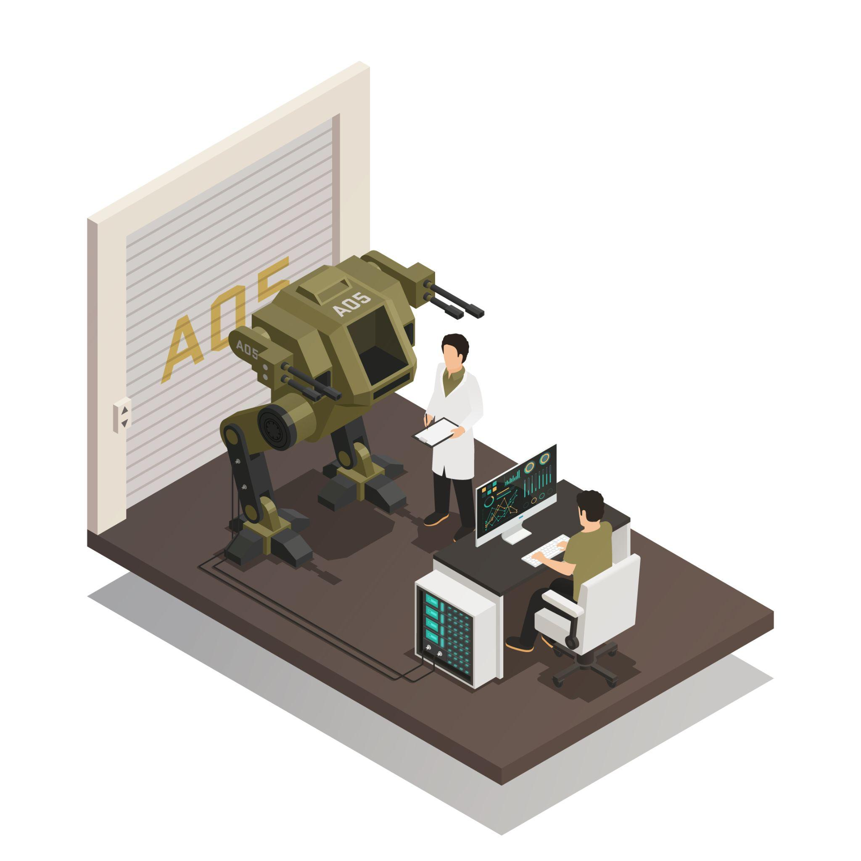
Listen and repeat.
A: What are you doing now?
B: I am laying metal down so I can make it into a _____.
A: Wow! Maybe you could use that in the army for _____. What do you usually do?
B: I usually make ______ out of wood.
A: I see, but don’t you worry your family might _____ it when it appears.
B: They ______ everyday, so probably not.
Notes:
3. Conversation
1. Ask the students to brainstorm to fill in blanks of the conversation according to the pictures.
2. Model: Role-play the parts with a student to convey the meaning of the conversation.
3. Solo: You begin the conversation and call on individual students to respond. Then reverse the roles (students are A, you are B).
4. Once students can do both parts, encourage free conversation (students substitute their own words for the blanks).

Slide 13
Practice the /u/ and /o/ sounds. Then listen to the sentences and circle the word you hear.
 |  | /u/ | /o/
1 |  | luck | lock
2 |  | hut | hot
3 |  | cup | cop
4 |  | rut | rot
5 |  | shut | shot
Notes:
4A. Pronunciation – Minimal Pairs
In this section we will practice distinguishing between the /u/ and /o/ sounds.
1. Model: Read each row several times and point to the words while students listen. For example, ”Number 1, luck, lock, luck, lock, luck, lock.” Then ask students to repeat the words
2. Read the sentences below and ask students to circle the word that they hear.
How do you spell lock?
What part of speech is “hot”?
We need another cup.
How do you pronounce “rot”?
You shut it very well.

Slide 14
Unstressed syllables are often pronounced /u/. This is also called the schwa sound /ə/.
A. ▔ _ | B. _▔ | C. _▔_
heaven | appear | Messiah
metal | believe | apparent
shepherds | convince | aroma
Joseph | afraid | banana
people | surprise | abundant
Notes:
4B. Pronunciation - Hum and clap the stress.
Note that the /u/ sound is the most common vowel sound in English. /u/ can be spelled with any unstressed vowel: ago, witness, animal, kingdom, upon; as well as with the stressed letter u: under, hum.
Begin by humming the stress of a column of words. Hum higher, longer, and louder for big dashes and lower, shorter, and quieter for small dashes.
You may use hand gestures to indicate that the stressed syllable is higher in pitch, longer in duration, and louder. Invite your students to join in humming the rhythm. Once the class is humming the rhythm in unison, you can begin saying the words. You may also wish to clap the syllables while you say the words.
1. Model: Hum and then say each word in the column several times. Students listen.
2. Repeat: Students repeat words after you in unison.
3. Solo: Call on individuals to read the entire column of words.

Slide 15
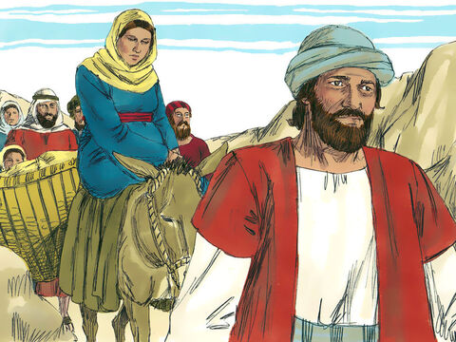
Luke 2:1-21 ERV
The Birth of Jesus Christ
¹ It was about that same time that Augustus Caesar sent out an order to all
people in the countries that were under Roman rule. The order said that
everyone’s name must be put on a list. ² This was the first counting of all the people while Quirinius was governor of Syria. ³ Everyone traveled to their own hometowns to have their name put on the list.
Notes:
5A. Bible Reading
Students should have already read this story in their first language (L1) as part of their homework, so it will be familiar even if they do not know all the vocabulary yet. However, if they have not yet read it in their L1, be sure they do so now before reading it in English. The hyperlinks of the Bible verses connect to https://live.bible.is/ so students can read and hear the scripture in their own languages. You may also watch videos of the passage at the website.
A. Read the story out loud to the class.
B. If students ask about words, give simple definitions.
C. Encourage students to read aloud verses from the story and act out the scene.
D. Ask if there are any questions or comments about the story.
E. Ask the story questions and discuss as a group.
F. Optional - You may hide the words and ask students to tell the story again in their own words, using the pictures to help them.

Slide 16
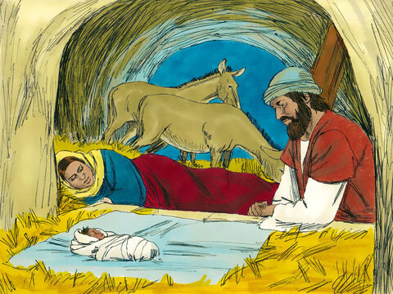
⁴ So Joseph left Nazareth, a town in Galilee, and went to the town of Bethlehem in Judea. It was known as the town of David. Joseph went there because he was from the family of David. ⁵ Joseph registered with Mary
because she was engaged to marry him. (She was now pregnant.) ⁶ While Joseph and Mary were in Bethlehem, the time came for her to have the baby. ⁷ She gave birth to her first son. She wrapped him up well and laid him in a box where cattle are fed. She put him there because the guest room was full.
Notes:
5B. Bible Reading
A. Read the story out loud to the class.
B. If students ask about words, give simple definitions.
C. Encourage students to read aloud paragraphs from the story and act out the scene.

Slide 17
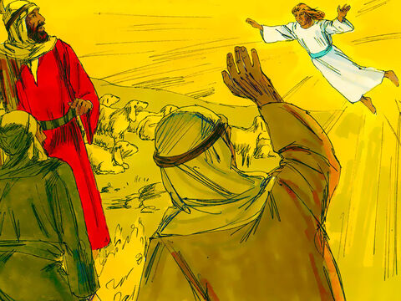
Some Shepherds Hear About Jesus
⁸ That night, some shepherds were out in the fields near Bethlehem watching their sheep. ⁹ An angel of the Lord appeared to them, and the glory of the Lord was shining around them. The shepherds were very afraid. ¹⁰ The
angel said to them, “Don’t be afraid. I have some very good news for you—news that will make everyone happy. ¹¹ Today your Savior was born in David’s town. He is the Messiah, the Lord. ¹² This is how you will know him: You will find a baby wrapped in pieces of cloth and lying in a feeding box.”
©2020-2024 Bible League International
Notes:
5C. Bible Reading
A. Read the story out loud to the class.
B. If students ask about words, give simple definitions.
C. Encourage students to read aloud paragraphs from the story and act out the scene.

Slide 18
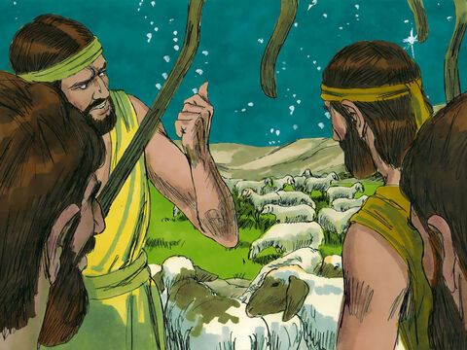
¹³ Then a huge army of angels from heaven joined the first angel, and they were all praising God, saying,
¹⁴ “Praise God in heaven,
and on earth let there be peace to the people who please him.”
¹⁵ The angels left the shepherds and went back to heaven. The shepherds said to each other, “Let’s go to Bethlehem and see this great event the Lord has told us about.”
Notes:
5D. Bible Reading
A. Read the story out loud to the class.
B. If students ask about words, give simple definitions.
C. Encourage students to read aloud paragraphs from the story and act out the scene.

Slide 19
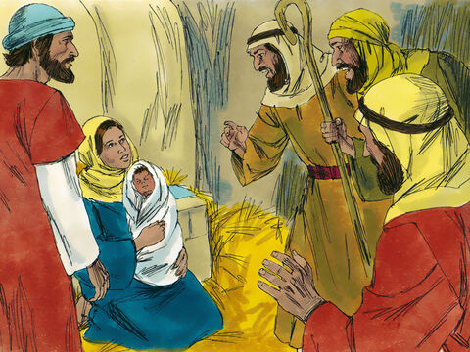
¹⁶ So they went running and found Mary and Joseph. And there was the baby, lying in the feeding box. ¹⁷ When they saw the baby, they told what the angels said about this child. ¹⁸ Everyone was surprised when they
heard what the shepherds told them. ¹⁹ Mary continued to think about these things, trying to understand them. ²⁰ The shepherds went back to their sheep, praising God and thanking him for everything they had seen and heard. It was just as the angel had told them.
Notes:
5E. Bible Reading
A. Read the story out loud to the class.
B. If students ask about words, give simple definitions.
C. Encourage students to read aloud paragraphs from the story and act out the scene.

Slide 20
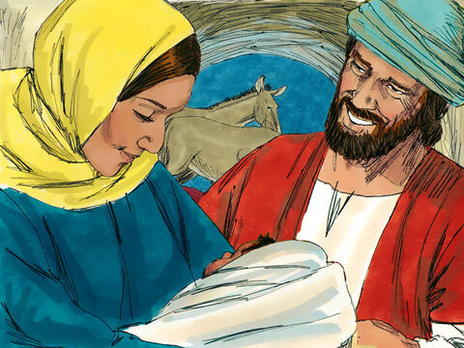
²¹ When the baby was eight days old, he was circumcised, and he was named Jesus. This name was given by the angel before the baby began to grow inside Mary.
Notes:
5F. Bible Reading
A. Read the story out loud to the class.
B. If students ask about words, give simple definitions.
C. Encourage students to read aloud paragraphs from the story and act out the scene.

Slide 21
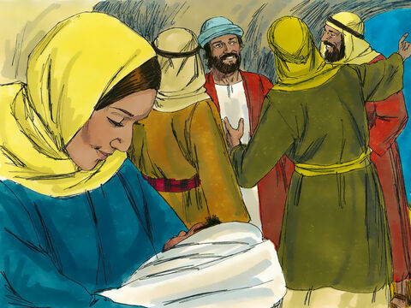
Answer the questions.
1. Where was Jesus born?
2. What did Mary lay the baby in?
3. Who has brought joy to your life?
4. Why do you think the army of angels call Jesus the “Savior”?
5. How do you think Mary and Joseph felt during this time?
6. When is the last time you celebrated someone’s birth?
Notes:
5G. Bible Reading Questions
Ask the questions and discuss as a group.
Answers:
1. Jesus was born in the town of Bethlehem .
2. Mary laid the baby in a box where cattle are fed.
Answers will vary for 3-6.

Slide 22
Listen and complete the sentences.
1. ____ cocoa always _____ us up.
2. I love to go visit my _________ and _______ for ______.
3. My family brought furry _______ and wooden _______ bats.
4. We always try our ______ at guessing what is in our _____.
5. Last Christmas I got a _______ full of basketball _____.
6. We ____ dinner _____ the _______ lights.
Notes:
6A. Activities – Listening to pronunciation words with /u/ and /o/ sounds.
Read the script below at least twice as students listen and answer the questions. The students should NOT look at the script.
“I always love when I get to go see my uncle and aunt in Chicago! Every Christmas my family and I drive hours to go spend time them. We don’t see them often, but when we do we bring plenty of presents! This Christmas we are bringing furry socks and two brand new wooden bats for my cousins who love to play baseball. Before we even shut the front door to their house, they bring us hot cocoa which always warms us up. This year is a special one because it is the first year we get to celebrate Christmas with my newly born sister. My parents named her “Mary”, because she was born just a couple weeks before Christmas and we know God has a special plan for her life. When we come together as a family, we eat dinner together under the Christmas lights hanged up around the house and try our luck at guessing what our wrapped presents in the living room are. I don’t know what I’ll get this year, but last year my uncle got me a cup filled with five tickets to go to a Chicago Bulls basketball game!”
Answers 1. Hot, warms 2. uncle, aunt, Christmas 3. socks, baseball 4. luck, presents 5. cup, tickets 6. ate, under, Christmas

Slide 23
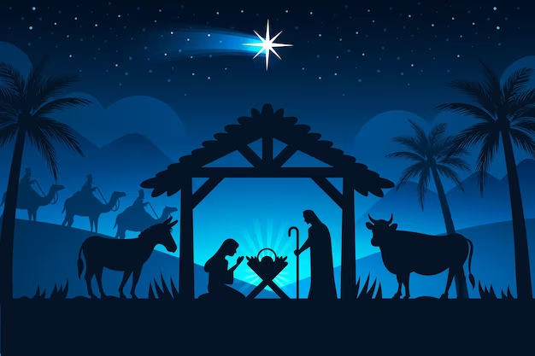
A. Role-Play – Detective
You are a detective that is trying to figure out who stole the manger from the front of the church lawn. You want to make sure that you get as many details as possible. You have to ask the witness to describe what they saw by asking the following questions.
Where were you when the manger was stolen?
What was the thief wearing?
Was it dark outside at the time of the robbery?
How quickly did the thief flee the scene?
How many people were with the thief?
Can you describe the car they were using?
Which way did they flee with the items stolen?
Can you describe the height and weight of the thief?
Notes:
6B. Activities – Pair Work Partner A
Role-Play between a detective and a witness.
Partner A will play the part of a detective talking to a witness. Partner A will ask questions from this slide and write Partner B’s answers.
Check answers for correct grammar and punctuation. Answers will vary.

Slide 24
B. Role Play – Witness
You are a witness who saw the manger get stolen from the church lawn. You want to make sure that the detective is qualified to help you find the thief. Ask the detective these questions.
How long have you been a detective?
How many cases have you solved?
Can you describe the last robbery you were able to solve?
What will you do when you find the thief?
Why do you want to help us?
How can we best solve this case?
What is the name of the department you work for?
How many people will be working with you to solve this case?
Notes:
6C. Activities – Pair Work Partner B
Role-Play between a detective and a witness.
Partner B will play the part of a witness. Partner B will ask questions from this slide and write Partner A’s answers.
Check answers for correct grammar and punctuation. Answers will vary.

Slide 25
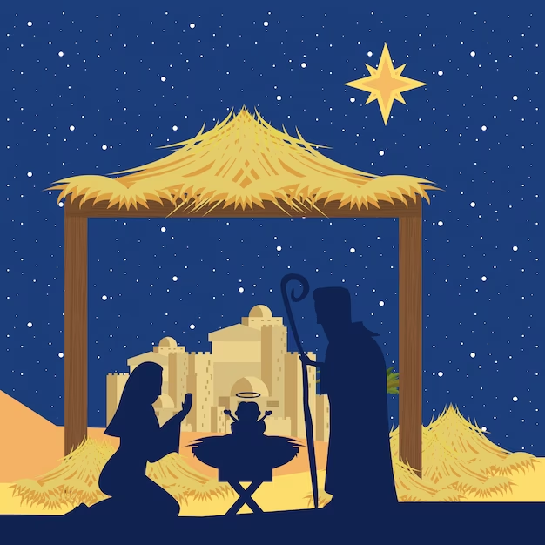
Song – Away In A Manger
Away in a manger
No crib for a bed
The little Lord Jesus
Lay down His sweet head
The stars in the sky
Look down where He lay
The little Lord Jesus
Asleep on the hay
Bless all the dear children
In Thy tender care
And take us to heaven
To live with Thee there
Notes:
7. Song
Learners will learn the new song for the lesson with the accompanying actions.
1. Model: Read the song lyrics out loud to the class. Point to the people or things in the image that correspond with the words in the song where possible. For example, point to Jesus on the hay when you read the lyrics “Asleep on the hay”. Ask if there are any questions. Write words that learners ask about on the board and give simple definitions. Then sing it two or three times, while they just listen. Point to parts of the image that correspond with the lyrics and ask students to do the same. Optional: You may bring in a manger for students to point at during the song instead of this image in the slide.
2. Repeat: Sing the selection again, a line or sentence at a time, as learners repeat after you. Then play the recording and sing the song together while pointing at things and people in the image when possible.
3. Solo: The learner sings solo (or if shy, can just read the words aloud) with the accompanying actions.

Slide 26
Homework — Write about the vocabulary.
1. What items do you own that are made of leather?
2. Where do you like to lie down when you are tired?
3. What is a goal you are going to try to accomplish this year? Why?
4. Where do you usually lay your jacket when you come home?
5. Have you ever had to register yourself for something? What was it?
6. How would you feel if an angel suddenly appeared before you?
Notes:
Homework 1A. - Write about the vocabulary words.
Model. Go over each of the homework assignments to be sure the student understands what to do.
Repeat. Encourage students to practice speaking and reading the completed homework assignments with a friend. They may use a bilingual dictionary.
Solo. Students will share their homework when they are finished. After they have shared their homework, be sure to check it for correctness, including spelling. Explain mistakes, while providing praise and encouragement.
Students will write answers to the questions.
Answers will vary.

Slide 27
Homework-Match the vocabulary word with its description.
 | Vocabulary Word |  | Descriptions of vocabulary words.
1 | plastic | A | man-made material
2 | wood | B | the military, soldiers
3 | metal | C | paradise
4 | fur | D | iron, mineral
5 | heaven | E | lumber, timber
6 | army | F | wool, fleece, hair
Notes:
Homework 1B. - Match the vocabulary words with their descriptions.
Have students match the vocabulary word with its description. The descriptions are mismatched with the vocabulary words, so students will have to put the descriptions in the correct order with their corresponding vocabulary word. Number one is an example.
Answers:
1. A
2. E
3. D
4. F
5. C
6. B

Slide 28
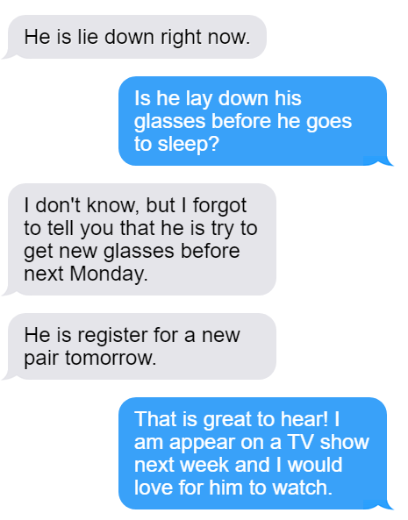
Change the verbs to the correct forms in each message.
lying
_____
_____
_____
_____
Notes:
Homework 2A. – Grammar and Vocabulary Review
Students will circle the errors and write the correct verbs. Number one is an example.
Answers:
2. lie lying
3. lay laying
4. try trying
5. register registering
6. appear appearing

Slide 29
Write sentences about the pictures in the present simple tense.
1 | The carpenter always finds wood to make furniture out of. | 4
2 |  | 5
3 |  | 6
Notes:
Homework 2B. - Grammar and Vocabulary Review.
Have students write sentences about the pictures in the present simple tense. Number one is an example.
Answers may vary, but will start with a capital letter, have a punctuation mark at the end, use the present simple tense, and use the following words:
2. metal
3. fur
4. plastic
5. heaven
6. army

Slide 30
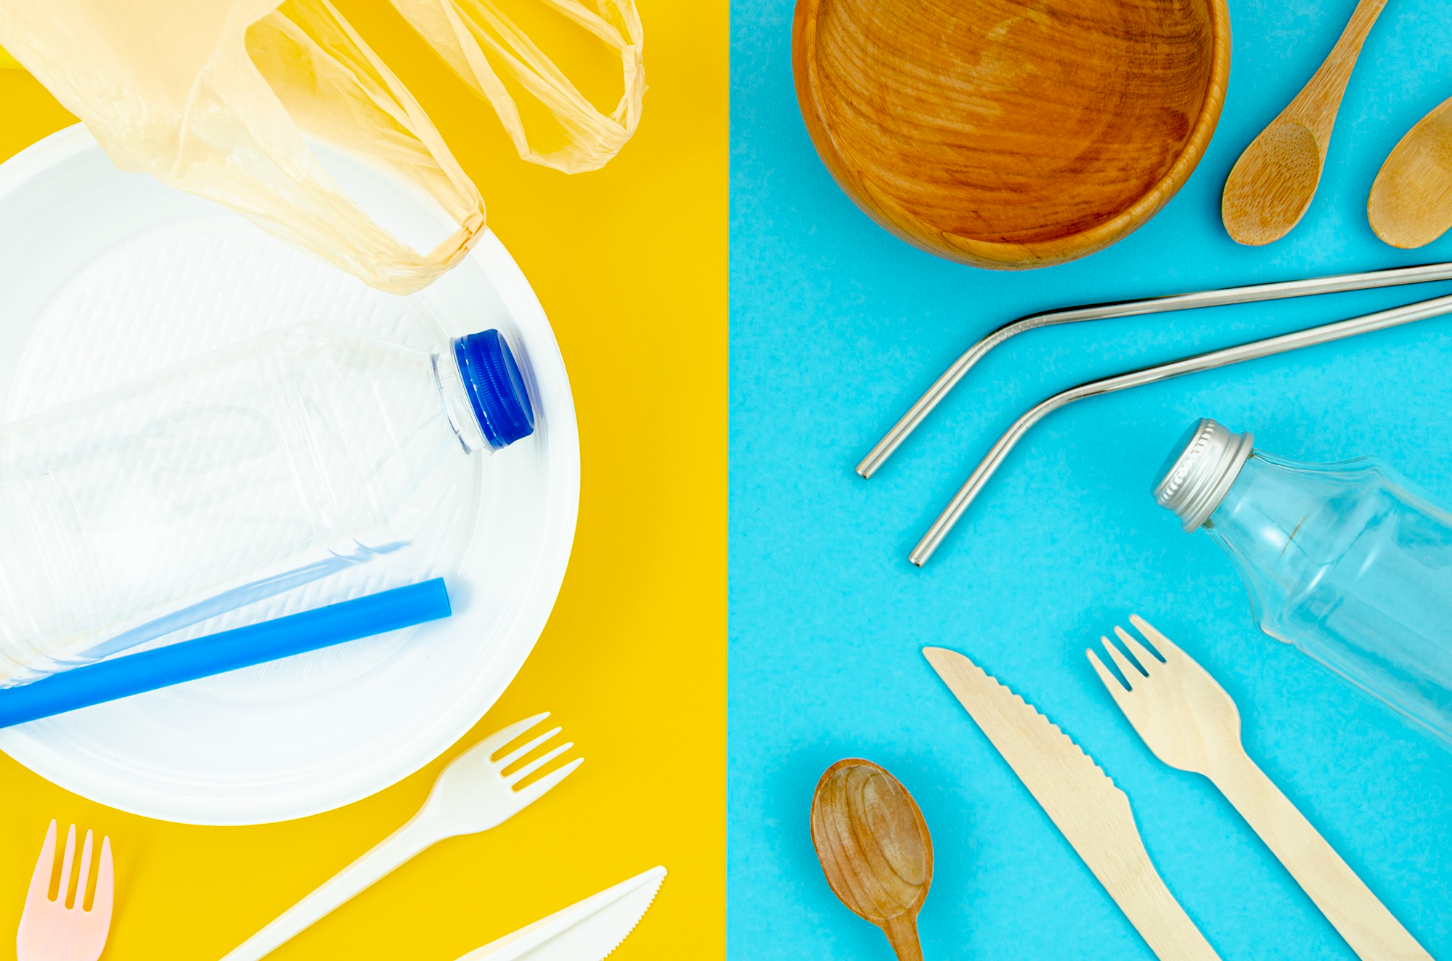
Write about the picture.
Utensils are lying on the table.
Notes:
Homework 2C. - Grammar and Vocabulary Review.
Have students write sentences about the pictures in the present simple tense. Number one is an example.
Answers may vary, but will start with a capital letter, have a punctuation mark at the end, use the present simple tense, and use the following words:

Slide 31
3. With a partner, describe items or people that you associate with.
How many items in your house are made of leather?
Are you going to show us what your house looks like?
Are you interested in me describing what my house looks like?
What is the color of your favorite clothing?
Can you start describing your favorite meal to me?
What is your family like?
What would be your family’s favorite thing about you?
Notes:
Homework 3. – Conversations - Pair work
Students interview a partner and write their partner’s answers. They will also create two of their own follow-up questions for numbers 8 and 9. Check answers for correct grammar and punctuation.
Questions and answers will vary

Slide 32
4. Say and write the words in the correct columns.
/u/ | /o/ | /ō/
love
God | box | of
ox | own | love
chose | touch | lot
above | on | Joseph
so | go | hug
must | not | old
Notes:
Homework 4. – Pronunciation
This homework practices pronouncing the /u/ and /o/ sounds.
Students will go through the list and sound out each word. Then they will write words in the correct columns for each vowel sound.
Answers:
/u/: love, of, hug, above, touch, must
/o/: God, box, ox, on, lot, not
/ō/: own, chose, so, Joseph, go, old

Slide 33
5. Write about Luke 2:1-21 in your own words. Use at least five of the vocabulary words.
©2021-2024 Literacy International
Notes:
Homework 5. – Bible Reading Review
Students will write a short summary of the Bible reading using at least five of the twelve vocabulary words from the lesson.
Answers will vary. Possible answers must include five of these vocabulary words: Army, fur, plastic, wood, heaven, metal, appear, try, register, leather, lie, lay.

Slide 34
6. Choose 1 verse to memorize and write it here. Then read the next verses in your language.
Read the next lesson’s Bible verses: Luke 2:22-38 in your language.
Notes:
Homework 6. – Memorize a verse and read the next lesson’s verses in your native language.
Learners get to choose one verse from the lesson’s reading to memorize. Please notice that the memory work is not long. Everyone, regardless of skill level, should be able to do it. Students will also read the next lesson’s Bible passage in their native language. Students will always read the Bible lesson in their first language before reading it in English the following lesson. Help them get a Bible in their own language if they don’t have one. They may also use https://live.bible.is/ or other Bible translation resources. The hyperlinks of the Bible verses connect to https://live.bible.is/ so students can read, hear and watch videos of the scripture in their own languages.
1. Model. Recite a verse from memory.
2. Repeat. Encourage students to find someone with whom to practice conversing and reading the completed homework assignment.
3. Solo. Students will recite the verse from memory at the next class.

Slide 35
7A. Read the personal narrative of someone describing a time they wish they could go back to.
Are there moments you want to relive? We usually focus on the present, but we are focusing now on a time we would like to go back to. I often hope I can relive the time I spent with my family, but at this moment, I am hoping I can specifically reimagine my first Christmas. Let me tell you about this time in my past I wish to always remember.
I usually think every Christmas is special, but I am thinking now about my favorite one. My favorite Christmas was my first. We would gather around the table and eat a delicious turkey along with a sweet apple pie. After we were filled with food, we went and opened presents together that we bought for each other weeks in advance. This was fun, but my best memory was what we did after presents.
Notes:
Homework 7A. – Everyday Reading and Writing
Students will read the personal narrative of someone describing a time they wish they could go back to and answer the questions.

Slide 36
7B. Continue the personal narrative.
After we opened up presents, we sat and listened to my Grandpa read about Christ’s birth in Luke. We learned how a God, who was Creator of all things, came as a humble baby born in a feeding box. It always made me feel good to hear how God was able to send His Son for my salvation.
Notes:
Homework 7B. – Everyday Reading and Writing
Students will read the personal narrative and answer the questions on the next slide.

Slide 37
7C. Answer the questions about the personal narrative.
A. What time did the person speaking want to go back to?
B. How did the speaker describe the food?
C. What did the family do after they opened presents?
D. Which part of Christmas did the speaker like the most?
E. Have you ever celebrated Christmas?
F. Do you give presents to your family often?
Notes:
Homework 7C.– Everyday Reading and Writing
Students will answer the questions about the personal narrative.
Answers:
A. The speaker wanted to go back to his/her first Christmas memory with the family.
B. The speaker described the food as delicious and sweet.
C. The family read about Christ’s birth in Luke.
D. The speaker’s best memory was of the reading of Christ’s birth in Luke.
Answers will vary for E and F.

Slide 38
8. Write a 200-word personal narrative describing a time you wish you could go back to.
Notes:
Homework 8 – Writing
Model. Write an example introduction such as: I used to live in Asia before I came to the U.S. and started learning English. My family lived in a beautiful wooden house that had many decorations in it. Although I love living in the U.S., I have so many good memories of living back in my hometown. Here are just a few of the wonderful things I had and did back in my home country!
Answers will vary.

Slide 39
9. Now I Can…
I can describe materials used for making things.
I can understand, say, read, and write the 12 vocabulary words.
I can use the present simple tense to talk about an action that is happening right now or happens regularly.
I can use the present continuous tense to talk about an action that is happening now or in the future.
I can understand how Jesus came into the world.
Notes:
Homework 9. – I can statements
The student must be able to achieve all of these skills before the next lesson. If not, the lesson can be repeated or additional practice materials can be used.
Review all of the skills at the beginning of the next lesson. Be sure to give lots of praise and encouragement!

Slide 40
Closing Prayer
Notes:
Pray
You may want to ask for any special prayer requests, then pray for your students and bless them. Prayers may also be written on this slide.

Slide 41
Help us share the Light of the World!
Thank you for using our materials. If these lessons are a blessing to you, please consider giving to help others learn English through the Bible.
For more information, visit LiteracyInternational.net

Slide 42
Appendix
How to Use Lessons: bit.ly/UsingLOTW
Irregular Verb List: bit.ly/IrregVerb
Lesson Downloads: bit.ly/DownloadLOTW
Order Books: bit.ly/3PlPuRg
Share Your Feedback: bit.ly/FeedbackLOTW
Table of Contents: bit.ly/ContentsLOTW
Video Channel: youtube.com/c/LiteracyInternational
Videos A2 Lessons: bit.ly/A2LessonVideos
Vocabulary List: bit.ly/VocabLOTW
Website: LiteracyInternational.net

