Slide 1
Unit B1-06
©2020-2024 Literacy International
Notes:
Teacher’s Notes:
Bible Reading: Baby Jesus presented at the Temple, stories of Simeon and Anna
Theme: Personalities
Pronunciation: /e/ & /i/
Grammar: have/have got; 5 inseparable phrasal verbs
Preparation:
Pray.
Read the Bible passages.
Preview slides and game.
Optional: Bring in letters of recommendation, help wanted ads, and resumes.

Slide 2
Pray, Review, and Preview
Bible Reading: Baby Jesus presented at the Temple, Stories of Simeon and Anna Luke 2:22-38
Theme: Personalities
Pronunciation: /e/ & /i/
Grammar: have/have got; 5 inseparable phrasal verbs
Notes:
Pray
Pray for the class. You may want to thank the Lord for coming as a baby.
Check homework and review.
Ask students to read aloud or recite their homework from the last class. Check written work.
Review the main points of the previous lesson and ask if there are any questions.
Be sure they have read the Bible passage in their native languages in preparation for the lesson.

Slide 3
What are they doing?
Notes:
1A. Discuss Theme Picture
Ask “What are they doing?” and “What do you think will happen next?” to elicit vocabulary students already know.
Repeat and write their words or show the words on the next slide. Ask students to describe the pictures and the people in the pictures. Ask them what is happening, who is talking, what are they talking about.
Answers may include: They are talking. They are asking questions. They are trying to get a job. She is talking.

Slide 4
In a job interview, the employer usually looks for someone who is trustworthy, reliable, and honest. They also look for someone who is experienced. Sometimes the employer says that the person they are interviewing must have a background in the position they are interviewing for so that the employer does not have to put up with an employee who does not know what to do. The employer and the person they are interviewing will usually go over the resume of the person applying and go over the job description. They will talk over any questions the person applying might have.
Questions:
Why would an employer want to hire someone who is trustworthy?
Is it better for an employer to hire someone who is experienced or someone who is reliable? Why?
Notes:
1B. Read about the theme picture and discuss with a partner
Please read the description of the theme picture to the students and point to the pictured vocabulary. If students ask about words, give simple definitions.
Then ask students to work in pairs and discuss the questions.

Slide 5
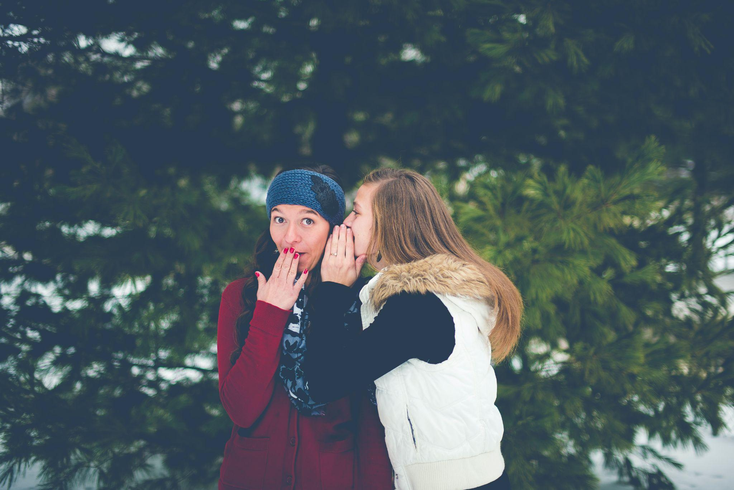
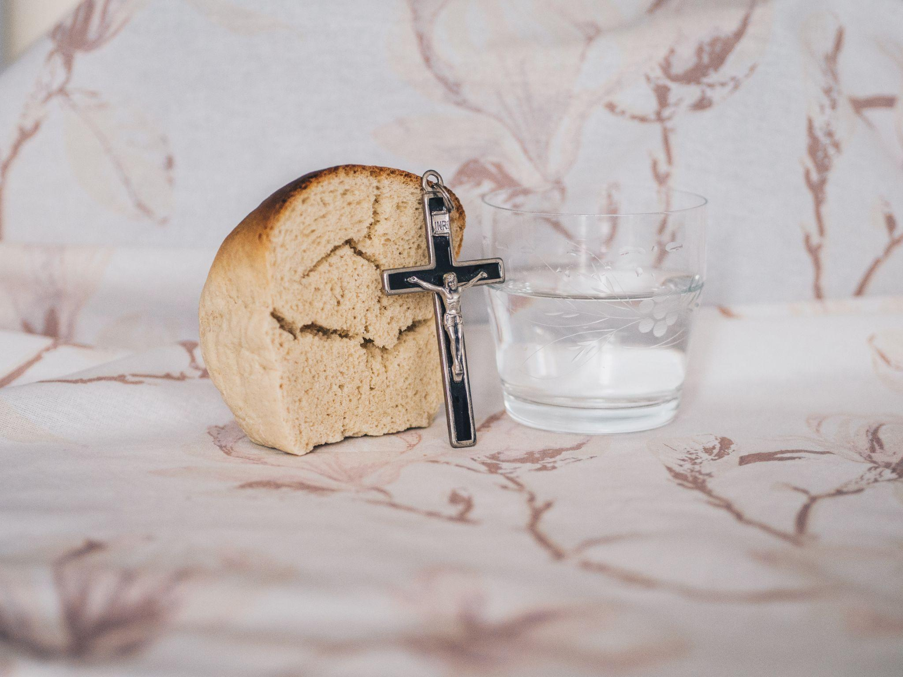
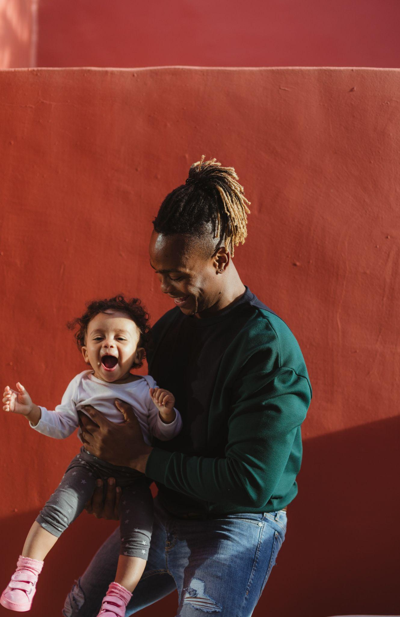
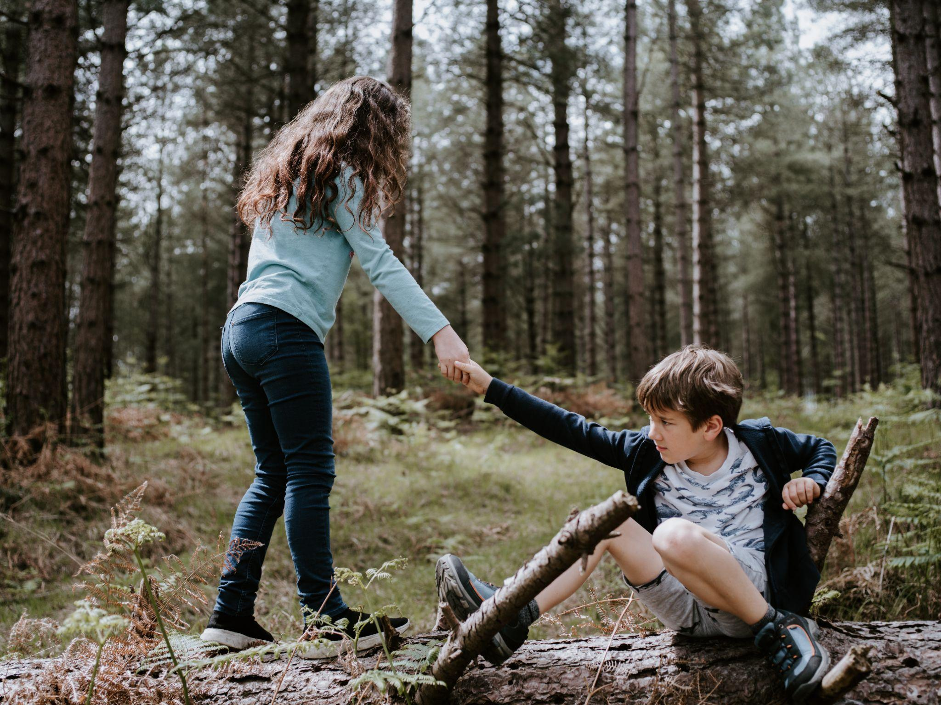
Match the beginning and end of each sentence.
1. I told my friend a secret
2. I fast
3. He is a devoted father;
4. I know you are kind
A. from eating meat because it is Lent.
B. that she can’t tell anyone.
C. because you always help people.
D. he loves spending time with his daughter.
Notes:
2A. Vocabulary
1. Say the beginning of the sentence a few times, as you indicate the picture. For example, say, ”I told my friend a secret, I told my friend a secret.” Have your students then repeat the phrase after you a few times.
2. Ask students to match the beginning and end of each sentence and say the complete sentence. For example, “I told my friend a secret that she can’t tell anyone.”
3. Check students’ comprehension further by asking direct questions. For example, “Who is a kind person you know?”
Answers
1. B
2. A
3. D
4. C

Slide 6
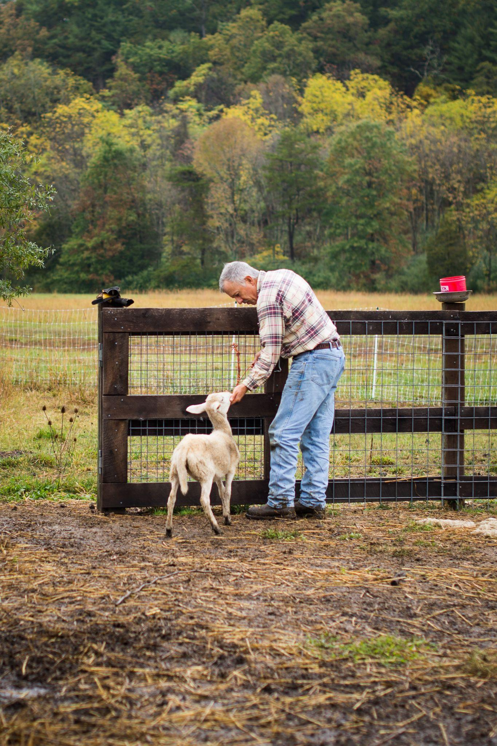
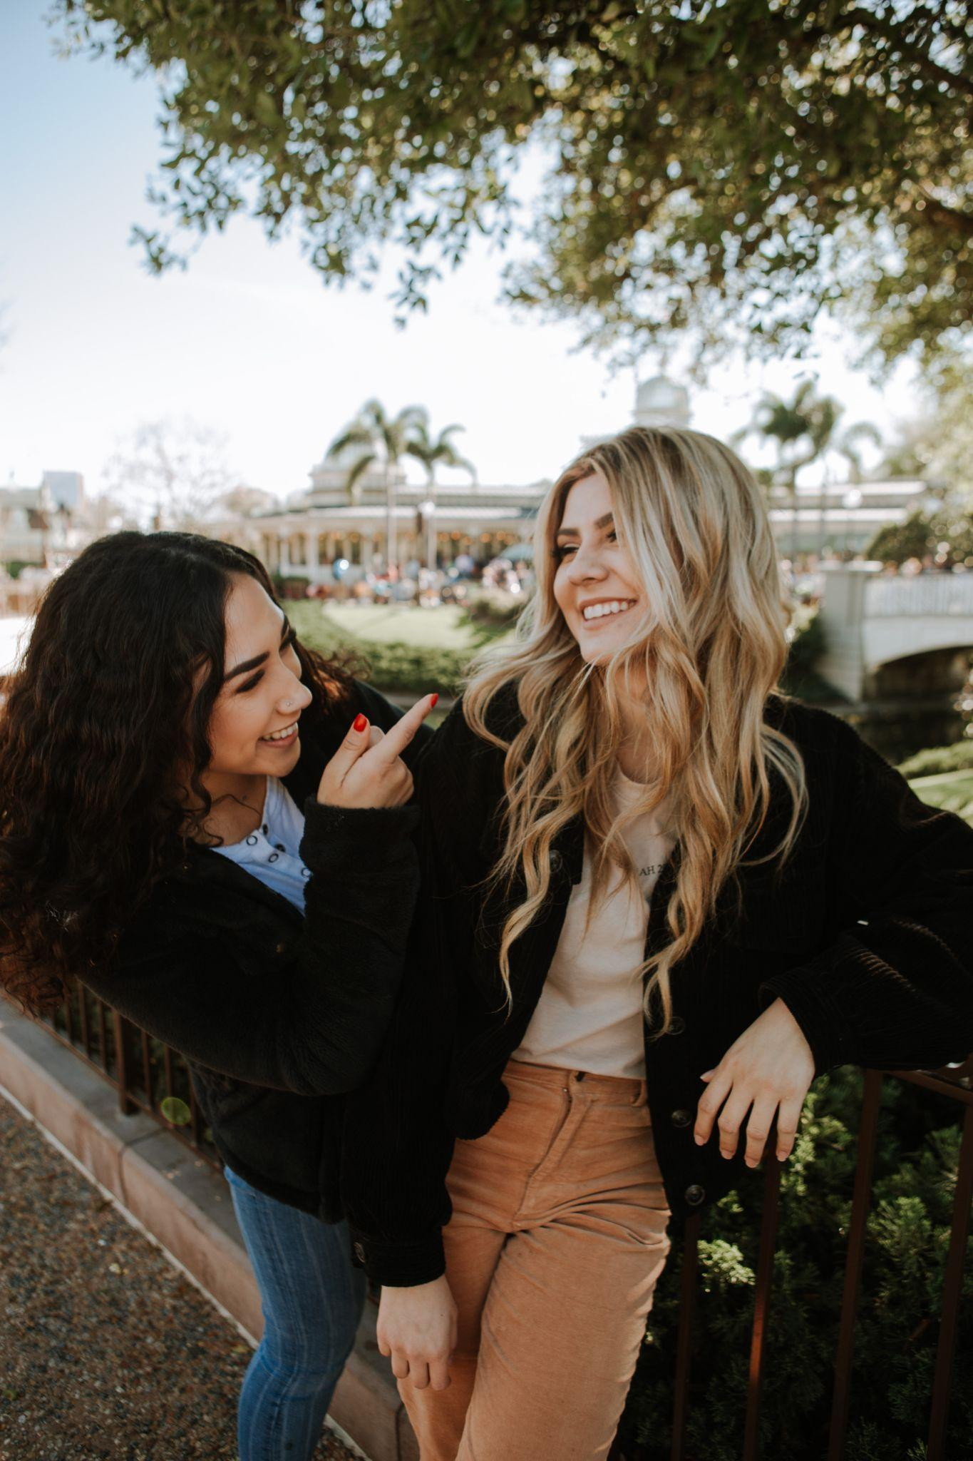
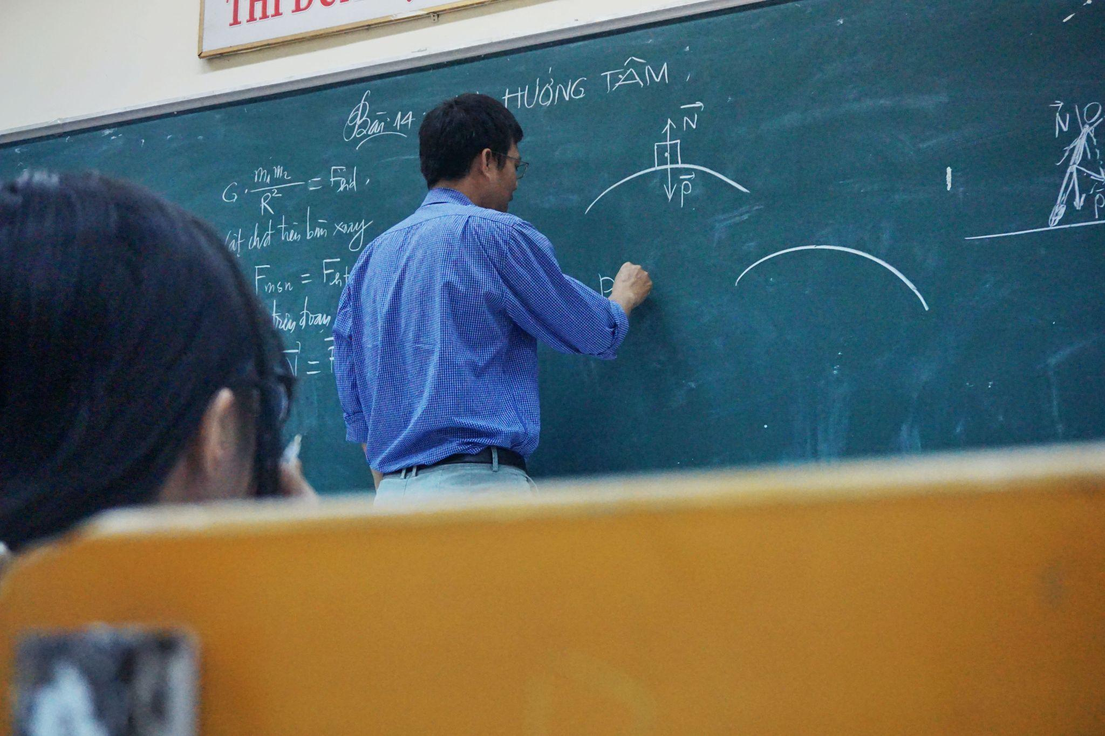
Match the beginning and end of each sentence.
1. He is honest
2. I trust you
3. He has a background in education;
4. Adults should
A. accept responsibility.
B. he has taught at 5 different schools.
C. because you always tell the truth.
D. and humble.
Notes:
2B. Vocabulary
1. Say the beginning of the sentence a few times, as you indicate the picture. For example, say, ”He is honest, he is honest.” Have your students then repeat the phrase after you a few times.
2. Ask students to match the beginning and end of each sentence and say the complete sentence. For example, “He is honest and humble.”
3. Check students’ comprehension further by asking direct questions. For example, “Who is a reliable person?”
Answers
1. D
2. C
3. B
4. A

Slide 7
Match the beginning and end of each sentence.
1. You are special
2. She is an experienced teacher
3. He is a good man
4. A reliable person
A. is someone you can count on.
B. because he has a pure heart.
C. because she has taught for twenty years.
D. because God loves you.
Notes:
2C. Vocabulary
1. Say the beginning of the sentence a few times, as you indicate the picture. For example, say, ”You are special, you are special.” Have your students then repeat the phrase after you a few times.
2. Ask students to match the beginning and end of each sentence and say the complete sentence. For example, “You are special because God loves you.”
3. Check students’ comprehension further by asking direct questions. For example, “Who is a reliable person?”
Answers
1. D
2. C
3. B
4. A

Slide 8
Have/Have got
Verb | Question | Answer
1. have got (present) | Have you got a pen? | Yes, I have a pen.
2. have (present) | Do you have a pen? | Yes, I have a pen.
3. have (past) | Did you have any toys? | No, I didn’t have any toys.
4. have (future) | Will you have any kids? | Yes, I will have kids.
5. _____ ______ _____ a dog? Yes, I’ve ____ a dog.
(have got)
6. _____ _____ _____ a cookie? Yes, I will have a cookie.
(have)
Notes:
2D. Grammar – Have/Have got
Teacher explains: “Have and have got mean the same thing, but it is more common to say ‘do you have a car’ than it is to say ‘have you got a car’. When people answer ‘Have you got ___?’ they never answer with ‘Yes, I have got ___.’ They often use a contraction, saying ‘I’ve got.’ Or, they might say, ‘Yes, I have __.’ ‘Have got’ is only used in the present tense, but ‘have’ can be used in the past present or future. If you don’t know if you could say ‘have got,’ then just say ‘have.’”
Teacher explains have/have got, then reads the sentences (model). Teacher reads the sentences and students repeat (repeat). Students say the sentences and fill in the blanks for the last section (solo).
Answer:
1. Have you got a dog? Yes, I’ve got a dog.
2. Will you have a cookie? Yes, I will have a cookie.
Have/have got summary taken from Penston, T. (2005, 2009). A concise grammar for English language teachers. TP Publications.

Slide 9
Inseparable Phrasal Verbs: Verbs that must always be followed by their preposition to know what they mean
1. She got away with stealing his car.
2. Let’s go over the last lesson.
3. I look up to my grandmother; she is a good woman.
4. I put up with my brother’s loud singing.
5. Let’s talk over what we will teach tomorrow.
Notes:
2E. Grammar: Phrasal Verbs
Teacher explains phrasal verbs, “Phrasal verbs are verbs that must be followed by their preposition. If you change the preposition or say the verb without the preposition it means something different. For example, ‘go out’ can mean to go on a date, but ‘go’ without the preposition means to leave or to move locations.”
Teacher reads each sentence to the class. Students are shown slide 10 and, in pairs, match what they think the definitions are. Then the teacher goes through the answers to the matching activity.
Phrasal verbs taken from list at https://owl.purdue.edu/owl/general_writing/mechanics/two_part_phrasal_verbs_idioms/inseparable_phrasal_verbs.html

Slide 10
Match the phrasal verbs and definitions.
Phrasal Verb | Definition
1. get away with | A. admire or respect someone, want to be like them
2. go over | B. discuss something, talk about something
3. look up to | C. ignore something annoying
4. put up with | D. when someone is not punished for something
5. talk over | E. review something
Notes:
2F. Grammar: Phrasal Verbs
Teacher pairs students and they write a list of their guesses of the matches. Teacher then goes through the correct matches.
Answers:
1.D.
2.E.
3.A.
4.C.
5.B.
Phrasal verbs taken from list at https://owl.purdue.edu/owl/general_writing/mechanics/two_part_phrasal_verbs_idioms/inseparable_phrasal_verbs.html

Slide 11
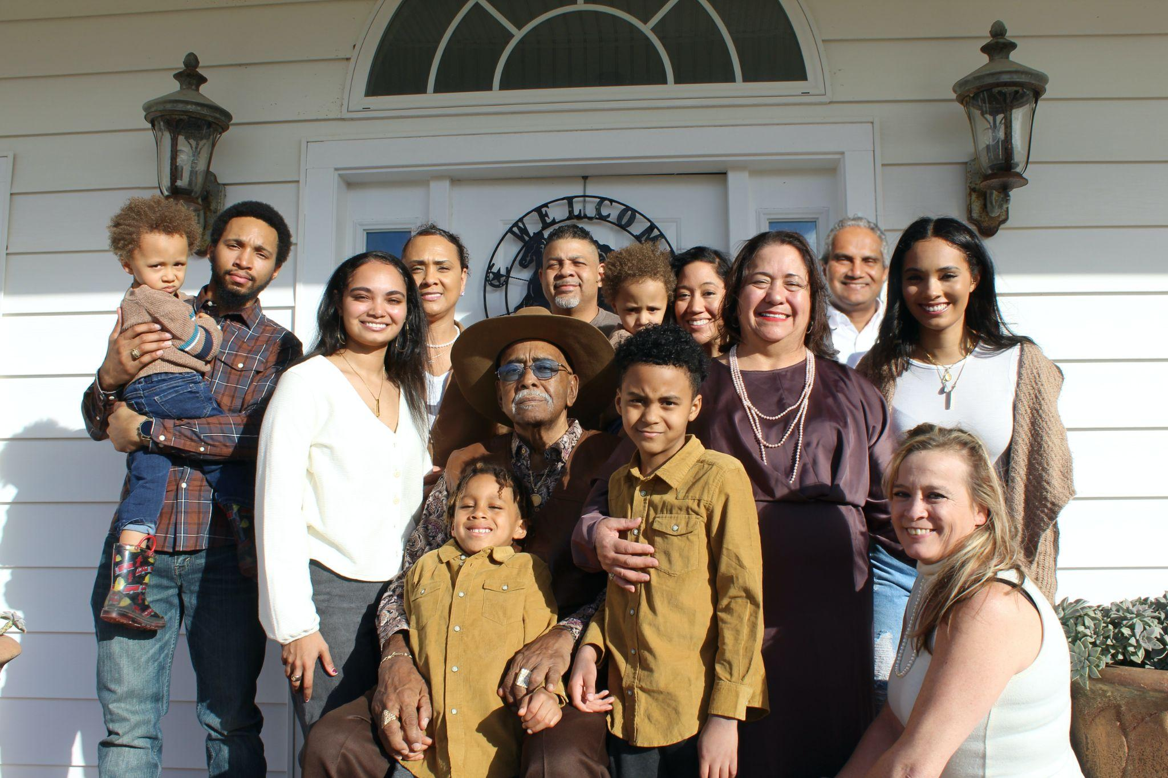
Listen and repeat.
A: Tell me about your family, what are they like?
B: This is my _____. He/she is very _____.
A: My _____ is the same way. She/he is _____.
B: Cool! I also really look up to _____.
A: That’s really special. I don’t have any _____. But I really admire my _____.
B: I am glad you can look up to your _____.
Notes:
3. Conversation
Ask the students to brainstorm to fill in blanks of the conversation according to the pictures.
Model: Role-play the parts with a student to convey the meaning of the conversation.
Solo: You begin the conversation and call on individual students to respond. Then reverse the roles (students are A, you are B).
Once students can do both parts, encourage free conversation (students substitute their own words for the blanks).

Slide 12
Practice the /e/ and /i/ sounds. Then listen to the sentences and circle the word you hear.
 |  | /e/ | /i/
1 |  | pet | pit
2 |  | met | mitt
3 |  | check | chick
4 |  | desk | disk
5 |  | fell | fill
Notes:
4A. Pronunciation – Minimal Pairs
In this section we will practice distinguishing between the /e/ and /i/ sounds.
1. Model: Read each row several times and point to the words while students listen. For example, ”Number 1, pet, pit, pet, pit, pet, pit.” Then ask students to repeat the words
2. Read the sentences below and ask students to circle the word that they hear.
Give me your pit.
The teacher wrote “met” on the board.
How do you spell “chick”?
I have a new disk.
I forgot how to say “fell” in Spanish.
Some minimal pair examples taken from https://www.englishclub.com/pronunciation/minimal-pairs-e-i.php

Slide 13
Practice the teen and -ty stress. Then listen to the sentences and circle the word you hear.
 | A. ▔ - 30-90 | B. - ▔ 13-19 | C. ▔ - 13-19
1 | thirty | thirteen | thirteen
2 | fourty | fourteen | fourteen
3 | fifty | fifteen | fifteen
4 | sixty | sixteen | sixteen
5 | seventy | seventeen | seventeen
6 | eighty | eighteen | eighteen
7 | ninety | nineteen | nineteen
Notes:
4B. Pronunciation - Hum and clap the stress.
In English “teen” and “-ty” numbers are often misheard, e.g. “thirteen” being misheard as “thirty”. When people are clarifying they often will emphasize the “teen” and de-emphasize the “ty”, saying “seventy” and “seventeen.” In a normal conversation, when people are not clarifying the number they said, people tend to emphasize the first syllable on both, e.g. “seventy” and “seventeen.”
Begin by humming the stress of Column A. Hum higher, longer, and louder for big dashes and lower, shorter, and quieter for small dashes. You may also use hand gestures to indicate that the stressed syllable is higher in pitch, longer in duration, and louder. Invite your students to join in humming or clapping the rhythm.
1. Model: Hum and then say each word in the columns A-C several times. Students listen. Then hum and say each pair of words in rows 1-7.
2. Repeat: Students repeat words after you in unison.
3. Solo: Call on individuals to read the columns and pairs of words with the correct stress.
4. Listen: Read the following sentences and have students circle the word they hear.
1. There are thirty days until my birthday. 2. They will move in thirteen days. 3. I will graduate in sixty days. 4. She is eighteen years old. 5. We have been married for fifteen years. 6. She is ninety years old. 7. They are fourteen years old.
Information about stress pattern taken from https://pronunciationcoach.blog/2023/06/11/pronouncing-english-numbers-the-13-vs-30-myth/

Slide 14
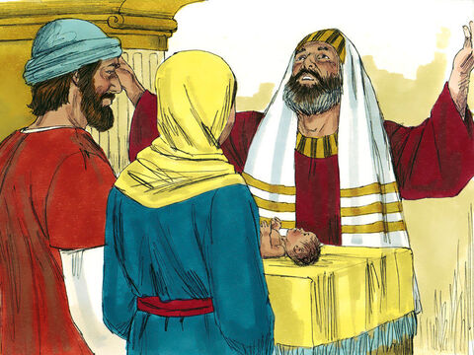
Luke 2:22-38 ERV
Jesus Presented at the Temple
²² The time came for Mary and Joseph to do the things the Law of Moses taught about being made pure.^{[a]} They brought Jesus to Jerusalem so that they could present him to the Lord.
⁴⁰ The little boy Jesus was developing int
²³ It is written in the law of the Lord: “When a mother’s first baby is a boy, he shall be called ‘special for the Lord.’”^{[b]}
a:Luke 2:22 pure The Law of Moses said that 40 days after a Jewish woman gave birth to a baby, she must be made ritually clean by a ceremony at the Temple. See Lev. 12:2-8.
b:Luke 2:23 “When … ‘special for the Lord’” See Ex. 13:2, 12.
.
Notes:
5A. Bible Reading
Students should have already read this story in their first language (L1) as part of their homework, so it will be familiar even if they do not know all the vocabulary yet. However, if they have not yet read it in their L1, be sure they do so now before reading it in English. The hyperlinks of the Bible verses connect to https://live.bible.is/ so students can read and hear the scripture in their own languages. You may also watch videos of the passage at the website.
A. Read the story out loud to the class.
B. If students ask about words, give simple definitions.
C. Encourage students to read aloud verses from the story and act out the scene.
D. Ask if there are any questions or comments about the story.
E. Ask the story questions and discuss as a group.
F. Optional - You may hide the words and ask students to tell the story again in their own words, using the pictures to help them.

Slide 15
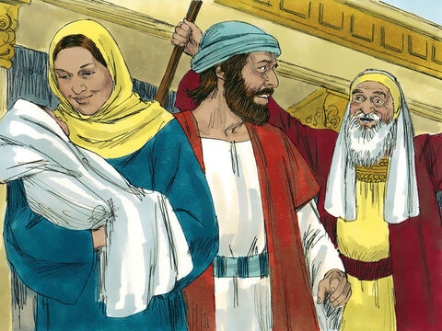
²⁴ The law of the Lord also says that people must give a sacrifice: “You must sacrifice two doves or two young pigeons.”^{[c]} So Joseph and Mary went to Jerusalem to do this. ²⁵ A man named Simeon lived in Jerusalem. He
was a good man who was devoted to God. He was waiting for the time when God would come to help Israel. The Holy Spirit was with him. ²⁶ The Holy Spirit told him that he would not die before he saw the Messiah from the Lord.
c:Luke 2:24 Quote from Lev. 12:8.
Notes:
5B. Bible Reading
A. Read the story out loud to the class.
B. If students ask about words, give simple definitions.
C. Encourage students to read aloud paragraphs from the story and act out the scene.

Slide 16
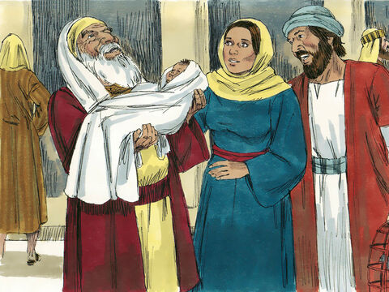
²⁷ The Spirit led Simeon to the Temple. So he was there when Mary and Joseph brought the baby Jesus to do what the Jewish law said they must do.
²⁸ Simeon took the baby in his arms and thanked God:
²⁹ “Now, Lord, you can let me, your servant, die in peace as you said.
³⁰ I have seen with my own eyes how you will save your people.
³¹ Now all people can see your plan.
³² He is a light to show your way to the other nations.
And he will bring honor to your people Israel.”
©2020-2024 Bible League International
Notes:
5C. Bible Reading
A. Read the story out loud to the class.
B. If students ask about words, give simple definitions.
C. Encourage students to read aloud paragraphs from the story and act out the scene.

Slide 17
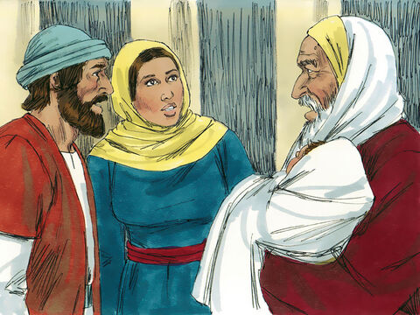
³³ Jesus’ father and mother were amazed at what Simeon said about him. ³⁴ Then Simeon blessed them and said to Mary, “Many Jews will fall and many will rise because of this boy. He will be a sign from God that some will not accept. ³⁵ So the secret thoughts
of many will be made known. And the things that happen will be painful for you—like a sword cutting through your heart.”
Notes:
5D. Bible Reading
A. Read the story out loud to the class.
B. If students ask about words, give simple definitions.
C. Encourage students to read aloud paragraphs from the story and act out the scene.

Slide 18
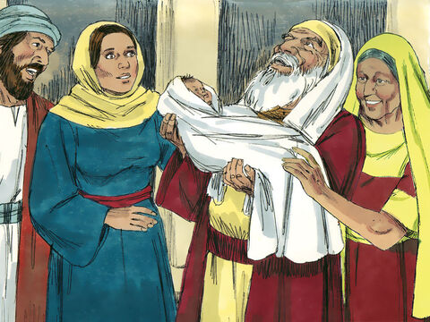
³⁶ Anna, a prophetess, was there at the Temple. She was from the family of Phanuel in the tribe of Asher. She was now very old. She had lived with her husband seven years ³⁷ before he died and left her alone. She was now 84 years old. Anna was always at the
Temple; she never left. She worshiped God by fasting and praying day and night. ³⁸ Anna was there when Joseph and Mary came to the Temple. She praised God and talked about Jesus to all those who were waiting for God to free Jerusalem.
Notes:
5E. Bible Reading
A. Read the story out loud to the class.
B. If students ask about words, give simple definitions.
C. Encourage students to read aloud paragraphs from the story and act out the scene.

Slide 19
1. Where did Joseph and Mary take Jesus?
2. What did Simeon do when he saw baby Jesus?
3. How do you think Mary and Joseph felt when they heard Simeon’s words?
4. Why did Simeon thank God when he saw the baby Jesus?
5. What questions do you have about Simeon and Anna’s words about Jesus?
6. What do you thank God for?
Answer the questions.
Notes:
5F. Bible Reading Questions
Ask the questions and discuss as a group.
Answers:
They took Jesus to the temple in Jerusalem.
He thanked God.
They might have felt thankful, or confused, or joyful, or worried.
He thanked God because God kept His promise to give people a savior.
Answers will vary for 5-6.

Slide 20
Listen and complete the sentences.
1. I sat at a _____ for my job interview.
2. The interviewer asked me if I was _____.
3. The interviewer said he would _____ with my previous job because he wanted to know if I was a good employee.
4. I am _____, _____, and _____.
5. I was _____ why they were hiring.
6. The interviewer said he wanted to hire someone the company could _____.
Notes:
6A. Activities – Listening to pronunciation words with /e/ and /i/ sounds.
Read the script below at least twice as students listen and answer the questions. The students should NOT look at the script.
“Yesterday I went to an office for a job interview. When I arrived they told me to sit at the desk and wait for my interviewer. When I met the interviewer he asked me some questions. He asked me if I was experienced. I told him yes, and that I have a background in this job. He asked me to describe myself. I told him I am honest, reliable, and kind. He told me he would check with my previous job to ask if I was a good employee. He asked if I had any questions, and I told him I was curious about why they were hiring. He said they were hiring because the last person did not behave in an honest manner at work, and the company wanted to hire someone they could trust. At the end of the interview he told me he wanted to hire me. I accepted the job. I start work tomorrow.”
Answers 1. desk 2. experienced 3. check 4. honest, reliable, and kind 5. curious 6. trust

Slide 21
<a href="https://www.freepik.com/free-photo/happy-male-candidate-greeting-member-human-resource-team-job-interview-office_26346676.htm#query=job%20interview&position=4&from_view=search&track=ais">Image by Drazen Zigic</a> on Freepik
A. Role-Play – Job Interview
You are going to interview a new employee for an opening at your job. You will interview your partner by asking the following questions. Then switch roles and your partner will interview you.
What is your job experience?
How would you describe yourself?
Is it important for an employee to be reliable? Why or why not?
How can an employee show they are reliable and honest?
Describe a good employee. What are they like?
Why would you be a good person to hire for this job?
Notes:
6B. Activities – Pair Work Partner A
Role-Play between a job interviewer and potential employee.
Partner A will play the part of an employer interviewing a potential candidate. Partner A will ask questions from this slide and write Partner B’s answers.
Check answers for correct grammar and punctuation. Answers will vary.
Photo attribution: <a href="https://www.freepik.com/free-photo/happy-male-candidate-greeting-member-human-resource-team-job-interview-office_26346676.htm#query=job%20interview&position=4&from_view=search&track=ais">Image by Drazen Zigic</a> on Freepik

Slide 22
<a href="https://www.freepik.com/free-photo/businesswomen-office_1192177.htm#query=job%20interview&position=16&from_view=search&track=ais">Image by prostooleh</a> on Freepik
B. Role Play – Job Interview
You are at an interview for a job you really want. It is your turn to ask the interviewer any questions you have about the job.
What kinds of experience are helpful for this job?
How do you expect reliable employees to behave?
Can we go over the benefits for this position?
Is there anything that you think I might find hard to put up with at this job?
Do you have any other questions for me?
Notes:
6C. Activities – Pair Work Partner B
Role-Play job interview
Partner B will play the part of a person being interviewed for a job. They will ask their potential employer any questions they have. Partner A will play the part of the employer answering questions.

Slide 23
Game – Pictionary
Draw pictures from the Bible story/previous Bible stories and take turns guessing!
Notes:
7. Game – Pictionary
One person picks a scene from the Bible story for the lesson or a previous lesson’s Bible story. One person draws the scene while the other person guesses the scene. If they don’t guess the scene in under 1 minute the player drawing gets the point. If they guess the scene before the minute is up the person guessing gets the point. If there are only two players, then points go to the individual, but if there are more than two players then divide the class into two teams. Play game for about 10-15 minutes (or however long teacher decides).
Possible scene suggestions:
Luke writing the book of Luke
Announcement of Jesus’s birth
Pregnant Mary visits pregnant Elizabeth
Baby Jesus in the stable
John the baptist’s birth is announced
Joseph and pregnant Mary travel to Bethlehem
Angels announce Jesus’s birth to the shepherds
Jesus dedicated in the temple
Simeon and Anna prophesying about Jesus and praising God
Anna tells people about Jesus

Slide 24
1A. Homework - Write a sentence about the picture
1. She is telling her friend a secret. ,; ,
2.
3.
4.
Notes:
Homework 1A. - Write sentences using the pictured vocabulary words.
Model. Go over each of the homework assignments to be sure the student understands what to do.
Repeat. Encourage students to practice speaking and reading the completed homework assignments with a friend. They may use a bilingual dictionary.
Solo. Students will share their homework when they are finished. After they have shared their homework, be sure to check it for correctness, including spelling. Explain mistakes, while providing praise and encouragement.
Number one is an example.
Answers may vary, but will start with a capital letter, have a punctuation mark at the end, use the simple past tense, and use at least one of the following words:
2. fast/special
3. devoted/reliable/honest
4. kind/honest/reliable

Slide 25
Homework 1B - Define the Word.
1. Honest
2. Trust
3. Background
4. Accept
A. Honest means telling the truth; not lying.
B.
C.
D.
Notes:
Homework 1B. - Write sentences describing the highlighted vocabulary words.
Model. Go over each of the homework assignments to be sure the students understand what to do.
Repeat. Encourage students to practice speaking and reading the completed homework assignments with a friend. They may use a bilingual dictionary.
Solo. Students will share their homework when they are finished. After they have shared their homework, be sure to check it for correctness, including spelling. Explain mistakes, while providing praise and encouragement.
Number one is an example.
Students will write a short definition of the word.
Answers will vary.

Slide 26
2A. Use Phrasal Verbs in a Sentence
(get away with)... You are so smart you could get away with anything.
(go over)...
(look up to)...
(put up with)...
(talk over)...
Notes:
Homework 2A. – Grammar and Vocabulary Review
Students will complete the sentences with the phrasal verbs. Number 1 is an example.
Answers will vary but must include the phrasal verb listed next to the number.

Slide 27
2B: Have/have got
Tense | Question/Statement | Sentence
1. Present - have got | Question | Have you got any wood?
2. Present - have | Statement
3. Past - have | Question
4. Past - have | Statement
5. Future - have | Question
6. Future - have | Statement
Notes:
Homework 2B. – Grammar and Vocabulary Review
Students will write sentences that use have/have got. The sentence will be either a question or a statement.
1 is an example.
Answers will vary but may include/resemble the following:
2. I have a book.
3. Did you have any help?
4. I will have a party tomorrow.

Slide 28
3. With a partner, discuss the questions
Who is someone you look up to?
Why do you admire him/her?
What’s he/she like?
Is he/she reliable? Why or why not?
Do you trust him/her? Why or why not?
What is something he/she does that you put up with?
How would you describe him/her?
Notes:
Homework 3. – Conversations - Pair work
Students interview a partner and write their partner’s answers. They will also create two of their own follow-up questions for numbers 8 and 9. Check answers for correct grammar and punctuation.
Questions and answers will vary

Slide 29
4. Say and write the words in the correct columns.
head | says
what | quick
regret | loves
death | friends
guilty | enough
hymn | practice
reliable | plastic
heaven | because
various | busy
/e/ | /i/ | /u/
Notes:
Homework 4. – Pronunciation
This homework practices pronouncing the /e/, /i/ and /u/ sounds.
Students will go through the list and sound out each word. Then they will write words in the correct columns for each vowel sound.
Answers:
/e/: head, says, regret, death, friends, heaven
/i/: promise, quick, guilty, busy, hymn, plastic
/u/: what, loves, enough, reliable, because, various

Slide 30
5. Reflection Questions
Who worshiped Jesus at the temple?
Why did they worship Jesus?
Why should we worship Jesus?
How can we worship Jesus?
What should we thank God for?
©2021-2024 Literacy International
Notes:
Homework 5. – Bible Reading Review
Students will fill in the blanks for the statements.
Answers: A. Simeon and Anna B. Because Jesus is the Messiah who God promised
Answers vary for C., D., and E.

Slide 31
6A. Choose 1 verse to memorize and write it here. Then read the next verses in your language.
Read the next lesson’s Bible verses: Luke 2:39-52 in your language.
Notes:
Homework 6A. – Memorize a verse and read the next lesson’s verses in your native language.
Learners get to choose one verse from the lesson’s reading to memorize. Please notice that the memory work is not long. Everyone, regardless of skill level, should be able to do it. Students will also read the next lesson’s Bible passage in their native language. Students will always read the Bible lesson in their first language before reading it in English the following lesson. Help them get a Bible in their own language if they don’t have one. They may also use https://live.bible.is/ or other Bible translation resources. The hyperlinks of the Bible verses connect to https://live.bible.is/ so students can read, hear and watch videos of the scripture in their own languages.
1. Model. Recite a verse from memory.
2. Repeat. Encourage students to find someone with whom to practice conversing and reading the completed homework assignment.
3. Solo. Students will recite the verse from memory at the next class.

Slide 32
7A. Read the sample letter of recommendation.
To whom it may concern,
I highly recommend my coworker Anna for the position of English teacher. I recommend you hire her because she is kind, honest, and reliable. Since she is kind she will help the students to feel comfortable and relax in the classroom which will help them to learn more easily. Since she is honest students and fellow teachers will trust her and learn from her. Since she is reliable you will never have to worry about her arriving to work late or arriving with no plan for her class. In addition, she is someone the students can look up to since she is an amazing person inside and outside the classroom. You will have a better school if you hire Anna as one of your teachers. Anna loves her students and is a devoted teacher. She accepts responsibility for her teaching and is good at planning lessons. Anna has a background in English teaching and has plenty of experience teaching children.
Notes:
Homework 7A. – Everyday Reading and Writing
Students will read the sample letter of recommendation and answer the questions.

Slide 33
7B. Continue the sample letter of recommendation.
I have worked with Anna for five years and she has been a very kind and excellent coworker that whole time. Because of Anna’s previous experience working as an English teacher she is prepared to teach and will be a good teacher for her students to learn from. In addition to being a good teacher, she will be a good person for her students to look up to and admire. Since she is so kind, honest, and reliable, she will be a good addition to the staff at your school. If you hire Anna, she will help your students learn English well and become better students and better people.
Sincerely,
Janet Jones
Notes:
Homework 7B. – Everyday Reading and Writing
Students will read the sample letter and answer the questions on the next slide.

Slide 34
7C. Answer the questions about the letter.
A. What job is Anna applying for?
B. Why would Anna be a good candidate for the job?
C. Why would students relax and feel comfortable around Anna?
D. Why should coworkers trust Anna?
E. Why should the students look up to Anna?
F. What qualities do you think a good teacher needs?
Notes:
Homework 7C.– Everyday Reading and Writing
Students will answer the questions about the recommendation letter.
Answers:
A. Anna is applying to be an English teacher.
B. She is a good candidate for the job because she is kind, honest, and reliable.
C. They would feel comfortable around Anna because she is a kind person.
D. Practice, do exercises, look in a mirror, listen to how others say words, and ask a teacher for help.
E. Because she is a good person and a good role model.
Answers will vary for F.

Slide 35
8. Write a 200-word letter of recommendation for a friend or family member
Notes:
Homework 8 – Writing
Model. Write an example introduction such as: I recommend my friend, _______, for this job because…
Answers will vary.

Slide 36
9. Now I Can…
I can talk about personalities.
I can understand, say, read, and write the 12 vocabulary words.
I can use have/have got and 5 phrasal verbs.
I can pronounce /e/ and /i/ and pronounce the difference between -teen and -ty.
I can understand how Jesus was presented in the temple as a boy.
Notes:
Homework 9. – I can statements
The student must be able to achieve all of these skills before the next lesson. If not, the lesson can be repeated or additional practice materials can be used.
Review all of the skills at the beginning of the next lesson. Be sure to give lots of praise and encouragement!

Slide 37
Closing Prayer
Notes:
Pray
You may want to ask for any special prayer requests, then pray for your students and bless them. Prayers may also be written on this slide.

Slide 38
Help us share the Light of the World!
Thank you for using our materials. If these lessons are a blessing to you, please consider giving to help others learn English through the Bible.
For more information, visit LiteracyInternational.net

Slide 39
Appendix
How to Use Lessons: bit.ly/UsingLOTW
Irregular Verb List: bit.ly/IrregVerb
Lesson Downloads: bit.ly/DownloadLOTW
Order Books: bit.ly/3PlPuRg
Share Your Feedback: bit.ly/FeedbackLOTW
Table of Contents: bit.ly/ContentsLOTW
Video Channel: youtube.com/c/LiteracyInternational
Videos A2 Lessons: bit.ly/A2LessonVideos
Vocabulary List: bit.ly/VocabLOTW
Website: LiteracyInternational.net

