Slide 1
Unit B1-09
©2020-2024 Light of the World Learning
Notes:
Teacher’s Notes:
Bible Readings: Luke 3:1-20, Psalm 119:25-32
Theme: Education
Pronunciation: /E/ & /i/ sheep/ship; cheap/chip
Grammar: The past continuous, positive and negative form. Differences in usage between past continuous and past simple. Using the past continuous and simple past together
Preparation:
Pray.
Read the Bible passages.
Preview slides and game.
Optional: Bring a textbook, academic degree, and assessment for vocabulary demonstration of the lesson’s theme.

Slide 2
Pray, Review, and Preview
Bible Readings: Luke 3:1-20, Psalm 119:25-32
Theme: Education
Pronunciation: /E/ & /i/ sheep/ship; cheap/chip
Grammar: The past continuous, positive and negative form. Differences in usage between past continuous and past simple. Using the past continuous and simple past together
Notes:
Pray
Pray for the class. You may want to thank the Lord for giving us the opportunity to learn and study together.
Check homework and review.
Ask learners to read aloud or recite their homework from the last class. Check written work.
Review the main points of the previous lesson and ask if there are any questions.
Be sure they have read the Bible passage in their native languages in preparation for the lesson.

Slide 3
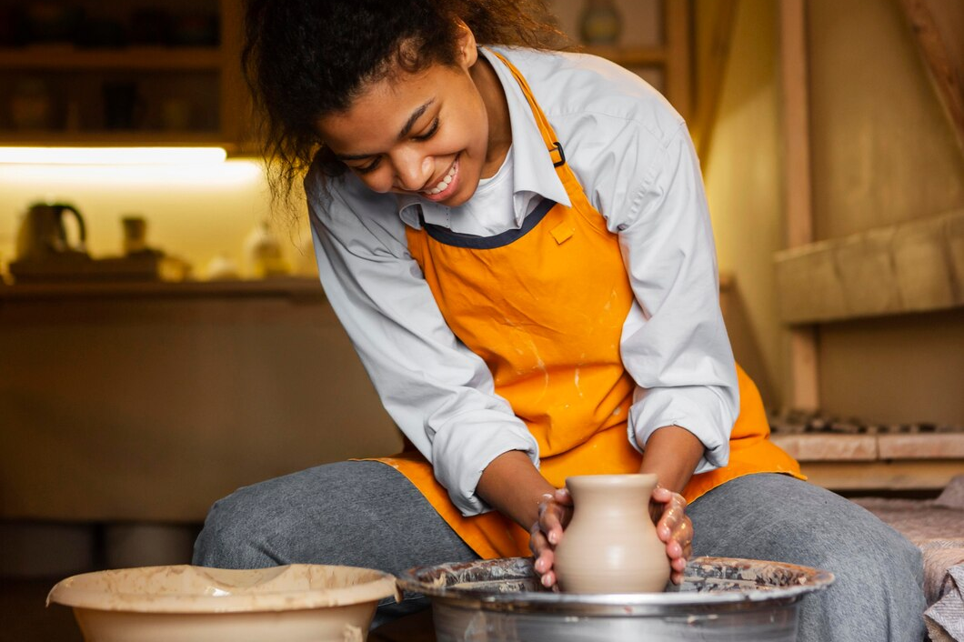
What are they working on?
Notes:
1A. Discuss Theme Picture
Ask “What are they doing?” and “What do you think they are reading?” to elicit vocabulary learners already know.
Repeat and write their words or show the words on the next slide.
Answers may include: The students are reading/studying together. They are looking at a book. She is making pottery. She is working on a potter’s wheel.
https://www.freepik.com/free-photo/group-cheerful-students-sitting-lecture-hall-before-lesson_9441518.htm#from_view=detail_alsolike
https://www.freepik.com/free-photo/smiley-artist-doing-pottery_13757752.htm

Slide 4
A crowd of college students are sitting together and looking at a textbook. They are preparing for an assessment next week in their literature class. A few of the students were absent from class this week, so they need to review lessons and notes they received from their classmates.
Katie sits at the pottery wheel gently shaping the clay until it is smooth. Soon she will separate the vase from the wheel and leave it on a shelf to dry. A few days ago, Katie received a message from her art professor, praising her work and encouraging her to continue working hard. Katie is almost finished with her art degree.
Discuss with a partner:
Do you like to study with a group or by yourself?
Why do you think it is important to work hard?
Notes:
1B. Read about the theme picture and discuss with a partner
Please read the description of the theme picture to the learners. If learners ask about the bolded words, give simple definitions.
Then ask learners to work in pairs and discuss the questions.

Slide 5
Match the definitions to the correct words.
1. crooked | 2. smooth | 3. real | 4. absent
completely flat or even, without any rough areas
not present in something; not in a place
bent or twisted; not in a straight line
actually existing or happening; not imagined
Notes:
2A. Vocabulary
1. Say the word a few times, as you indicate the picture. For example, say, ”crooked, crooked, crooked.” Have your learners then repeat the word after you a few times.
2. Ask learners to match the word to the correct definition and say the answer as a sentence. For example, “Crooked means something is bent or twisted. It is not in a straight line.”
3. Check learners’ comprehension further by asking direct questions. For example, “Can you think of an object or surface that is smooth?” “Have you ever been absent from somewhere?”
Answers
1. C
2. A
3. D
4. B
https://www.freepik.com/free-photo/double-bend-road-arrow-sign-outdoors_6984576.htm#fromView=search&page=1&position=0&uuid=fe21df18-c78b-4189-a6e9-54d087178eca
https://www.freepik.com/free-vector/melting-ice-cubes-with-flat-design_2533633.htm#fromView=search&page=1&position=19&uuid=1b0d0c2b-1f34-4211-8193-81d53efe5aaf
https://www.freepik.com/free-vector/myths-facts-comparison-rubber-stamp-white-background_197580041.htm#fromView=search&page=1&position=11&uuid=4e6c23ce-2c57-4b96-b689-2000899eb4d5
https://www.freepik.com/free-vector/vacancy-concept-illustration_133782182.htm#fromView=search&page=2&position=4&uuid=73eeedf5-de38-4b9e-bd37-38cd5e216c7b

Slide 6
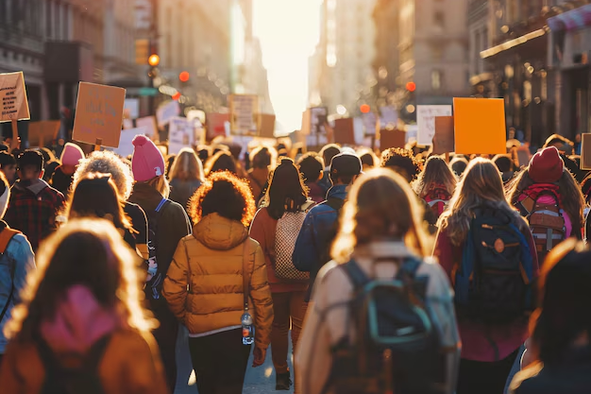
Match the definitions to the correct words.
1. literature | 2. crowd | 3. degree | 4. message
a qualification earned by students who graduated
a large group of people
a piece of information that you send to someone
a piece of writing like a novel, play, or poem
Notes:
2A. Vocabulary
1. Say the word a few times, as you indicate the picture. For example, say, ”literature, literature, literature.” Have your learners then repeat the word after you a few times.
2. Ask learners to match the word to the correct definition and say the answer as a sentence. For example, “Literature is a piece of writing like a novel, play, and poem.”
3. Check learners’ comprehension further by asking direct questions. For example, “Do you have a favorite piece of literature?” “Do you like to be in a crowd or on you own?”
Answers
1. D
2. B
3. A
4. C
https://www.freepik.com/free-photo/opened-books-library-table_1925586.htm#fromView=search&page=1&position=40&uuid=5189d92a-f71c-4571-87a5-edb235a10ff0
https://www.freepik.com/free-ai-image/individual-expressing-concern-about-rising-cost-living_272719412.htm#fromView=search&page=2&position=1&uuid=65a67c54-e0e7-4203-a7d9-9e1f76145e27
https://www.freepik.com/free-photo/front-view-girl-smiling-holding-her-certificate_5070529.htm#fromView=search&page=1&position=46&uuid=9c569458-f081-48f3-bd25-f091a0603766
https://www.freepik.com/free-photo/woman-chatting-her-smartphone_11303317.htm#fromView=search&page=1&position=17&uuid=5be1533a-cfb3-4727-b363-484f715a8ef9

Slide 7
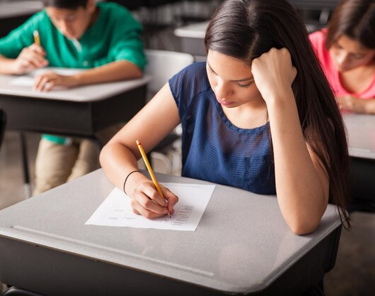
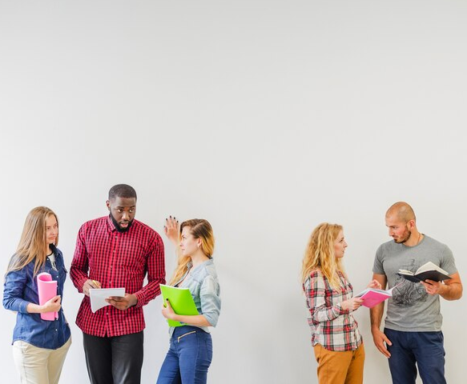
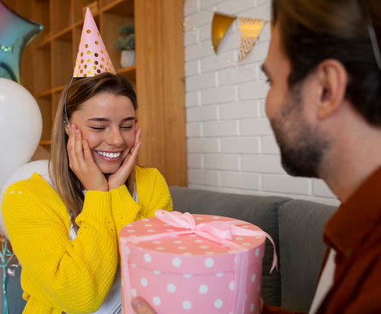
Match the photo and sentence.
A
1. Our teacher asked us to separate into two groups for an activity.
2. I received a gift from my friend for my birthday.
3. The school gave the students new textbooks this year.
4. Teachers use assessments to see how much students have learned.
B
C
D
Notes:
2C. Vocabulary
1. Say the sentences so learners can hear the pronunciation. If learners ask about words, give simple definitions (see answers below for definitions).
2. Ask learners to match the pictures and sentences and then say the complete sentence.
3. Check learners’ comprehension further by asking direct questions. For example, “What kinds of gifts do you like to receive from others?” “How often do you think teachers should use assessments in their classes?”
Answers
C. separate- to divide into parts or to make something into different groups
D. receive- to get something that someone has given or sent you
A. textbook- a book about a specific subject, written for students
B. assessment- the process of testing students and making a judgement about their knowledge
https://www.freepik.com/free-photo/smiley-people-holding-bunch-books-donate-them_10301467.htm#fromView=search&page=1&position=48&uuid=8e07c844-bfb9-4393-ba64-f60fef537bcd
https://www.freepik.com/free-photo/group-high-school-students-taking-test-classroom_27999198.htm#fromView=search&page=1&position=0&uuid=e6156fe4-1525-42b9-be7e-e24a110923dd
https://www.freepik.com/free-photo/groups-students-white_1313890.htm#fromView=serie&position=33
https://www.freepik.com/free-photo/side-view-couple-celebrating-birthday_40133189.htm#fromView=search&page=2&position=48&uuid=17b50c75-596d-4b08-9109-f7fd158d0bdd

Slide 8
Simple Past vs. Past Continuous
Simple Past | Past Continuous
Actions completed in the past | Actions in progress at a specific time in the past
Example: I rode my bike yesterday. | Example: I was riding my bike yesterday.
Simple Past & Past Continuous Together:
Ongoing actions in the past are interrupted by something
I was taking a literature class, but I dropped out because I got sick.
While he was praying, the heavens opened.
Notes:
2D. Grammar – Simple past tense verbs with Past Continuous
Note: Past simple tense verbs are used for a completed action in the past. For example, the sentence, “I rode my bike” means that I completed the action of riding my bike already in the past. The past continuous is used describe an action that was in progress at a specific time in the past. So the sentence, “I was riding my bike yesterday,” emphasizes that you were in the process of riding your bike.
The simple past and past continuous can be used together in the same sentence. For example: “I was taking a literature course, but I dropped out because I got sick.” The past continuous used in this sentence (was taking) means that I was in the process of taking a course, but the use of the simple past (dropped out) shows that the action was completed.

Slide 9
Past Continuous Words end with -ing
 | Question ? | Positive + | Negative -
1 | Was she taking a literature class when she got sick? | Yes, she was taking a literature class. | No, she was not taking a literature class.
2 | Was the teacher separating the students as they entered? | Yes, she was separating the students. | _______________
3 | __________the message when you got home? | Yes, she was reading the message. | No, she was not reading the message.
4 | When he arrived, were they standing in the crowd? | ______________ | No, they were not standing in the crowd.
Notes:
2D. Grammar – Simple past tense verbs
Note:To make a question using the past continuous, start with either “was” (for he/she/it) or “were”(you, they) and then continuous spelling of the verb.
Model, Repeat, and Solo row number 1. Then ask learners to complete the sentences for rows 2-4.
Answers:
2. No, she was not separating the students.
3. Was she reading the message?
4. Yes, they were standing in the crowd.

Slide 10
Complete the sentences with simple past or past continuous verbs.
When we (walk) on the ice, we (fall) through.
She (wear) a new dress when I (see) her.
My phone (ring) while I (carry) my groceries.
They (hear) the news when they (have) dinner.
The baby (cry) when his mother finally (come) back.
Notes:
2E. Grammar: Simple past tense verbs with Past Continuous
Answers:
When we were walking on the ice, we fell through.
She was wearing a new dress when I saw her.
My phone rang while I was carrying my groceries.
They heard the news when they were having dinner.
The baby was crying when his mother finally came back.

Slide 11
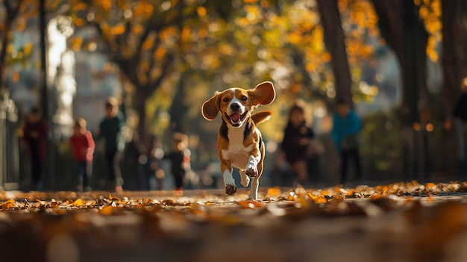
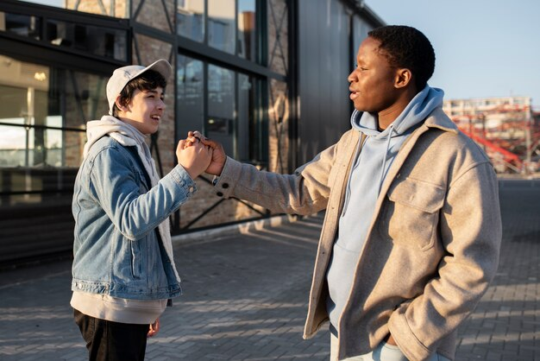
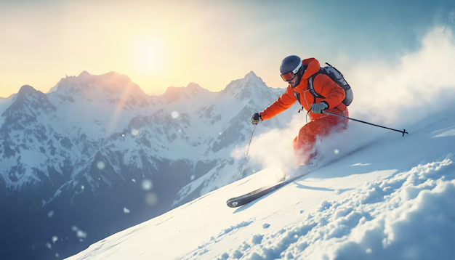
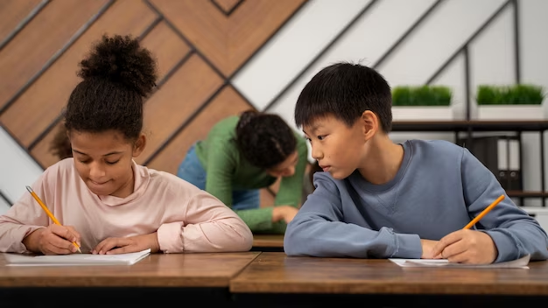
Simple Past & Past Continuous Together
Run & Found
2. Meet & Go
3. Ski & Break
4. Cheat & Take
Notes:
2E. Grammar: Simple past tense verbs with Past Continuous
Students will look at pictures and make their own sentence using the simple past and past continuous verbs together.
Example for number 1: The dog was running through the park when the kids found it.
Possible student answers:
2. When he was skiing, he broke his leg.
3. I met an old friend while I was going to work.
4. He cheated while they were taking an assessment
https://www.freepik.com/free-ai-image/portrait-adorable-beagle-nature_311013622.htm#fromView=search&page=1&position=40&uuid=f7b3f543-bb17-4df9-b22b-3620dd9aaeeb
https://www.freepik.com/free-ai-image/close-up-person-skiing_356740685.htm#fromView=search&page=1&position=12&uuid=0a474236-8f44-4811-a372-87d43c2edf94
https://www.freepik.com/free-photo/friends-spending-time-together_23440706.htm#fromView=search&page=1&position=11&uuid=829c7acd-1a70-4387-8b2a-866753050a38
https://www.freepik.com/free-photo/medium-shot-kid-cheating-school-test_37127439.htm#fromView=search&page=2&position=12&uuid=2c1d9502-f6f2-4a23-b64a-87a9da239484

Slide 12
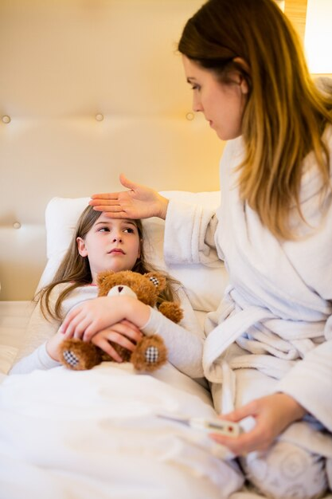
Listen and repeat.
A: Hi ____, what ______ you _____ last night when
I called you?
B: I ____________________________________.
A: ___________ my email about _______________
for next week?
B: Yes, I ___________________this morning.
A: Good! I noticed you ____________ from class on
__________. Is_____________?
B: Yes, I ________, so I ________. I ________now.
Notes:
3. Conversation
Ask the learners to brainstorm to fill in blanks of the conversation according to the pictures.
Model: Role-play the parts with a student to convey the meaning of the conversation.
3. Solo: You begin the conversation and call on individual learners to respond. Then reverse the roles (learners are A, you are B).
4. Once learners can do both parts, encourage free conversation (learners substitute their own words for the blanks).
Possible answer:
A: Sarah, what were you doing last night when I called you?
B: I was reading the literature book for my class.
A: Did you receive my email about the assessment
for next week?
B: Yes, I received it this morning.
A: Good! I noticed you were absent from class on
Tuesday. Is everything okay?
B: Yes, I was sick, so I could not attend. I am better now.
A: Great! I’ll send the homework you missed.
https://www.freepik.com/free-photo/here-are-your-test-results-you-got_26605817.htm#from_view=detail_alsolike
https://www.freepik.com/free-photo/mother-checking-fever-her-daughter-bedroom_1009035.htm#fromView=search&page=2&position=7&uuid=9a41750a-3187-4330-8c75-87418c8b9ea0
https://www.freepik.com/free-photo/front-view-cute-little-girl-reading-stories_6071486.htm#fromView=search&page=1&position=2&uuid=ac0e3f59-fbdb-4a7e-94ff-c1c72bd34753

Slide 13
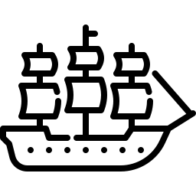
Practice the /i/ and /E/ sounds. Then listen to the sentences and circle the word you hear.
 |  | /i/ | /E/
1 |  | ship | sheep
2 |  | whip | weep
3 |  | lip | leap
4 |  | rip | reap
5 |  | fit | feet
Notes:
4A. Pronunciation – Minimal Pairs
In this section we will practice distinguishing between the /i/ and /E/ sounds.
1. Model: Read each row several times and point to the words while learners listen. For example, ”Number 1, ship, sheep, ship, sheep, ship, sheep.” Then ask learners to repeat the words
2. Read the sentences below and ask learners to circle the word that they hear.
The sheep was very fast.
There is no need to weep.
Please look up the word lip in your dictionary.
How do you spell reap?
They did not know what the word fit meant.
https://www.freepik.com/icon/sailing-ship_17664892#fromView=search&page=1&position=78&uuid=34eda8a5-0a9e-44c6-901c-fb978653481e
https://www.freepik.com/icon/whip_3791497#fromView=search&page=1&position=50&uuid=746dd942-96ca-4b62-b26f-b067e6675eb9
https://www.freepik.com/icon/lips_8429900#fromView=search&page=1&position=87&uuid=f1b57276-4699-401a-af9f-03080ca09cef
https://www.freepik.com/icon/tear_2911106#fromView=search&page=1&position=3&uuid=3e063ad0-1343-4d0c-ad9f-1a5881d2d854
https://www.freepik.com/icon/muscle_780103#fromView=search&page=1&position=54&uuid=de55e4e3-4e4e-4476-b24a-821874aec9a0
https://www.freepik.com/icon/sheep_4987758#fromView=search&page=1&position=61&uuid=2cc32d58-d35d-42af-815c-07cfc52af0c2
https://www.freepik.com/icon/sheep_4987758#fromView=search&page=1&position=61&uuid=2cc32d58-d35d-42af-815c-07cfc52af0c2
https://www.freepik.com/icon/game_16467712#fromView=search&page=1&position=8&uuid=720b630c-5309-4cea-b5db-01e0c3509be8
https://www.freepik.com/icon/crate_7216287#fromView=search&page=1&position=27&uuid=5252a3ed-4c64-4afa-8783-644c73940a04
https://www.freepik.com/icon/feet_10437650#fromView=search&page=1&position=6&uuid=7b1284bd-86c5-4242-9342-1e1fa6b13167

Slide 14
Compound nouns have stress on the first word
 | Noun + Noun = Compound noun | Stress on the first word
1 | class + room = | classroom
2 | home + work = | homework
3 | text + book = | textbook
4 | white + board = | whiteboard
5 | class + mate= | classmate
Notes:
4B. Pronunciation - Hum and clap the stress.
Many English words are made by combined two nouns together to form one word called a compound noun. When this happens, the stress is placed on the first word in the compound noun.
Begin by humming the stress of the second column. Hum higher, longer, and louder for bolded word and lower, shorter, and quieter for unbolded word. You may also use hand gestures to indicate that the stressed syllable is higher in pitch, longer in duration, and louder. Invite your learners to join in humming or clapping the rhythm.
1. Model: Hum and then say each word in the rows 1-5 several times. Students listen.
2. Repeat: Students repeat words after you in unison.
3. Solo: Call on individuals to read different words with the correct stress.

Slide 15
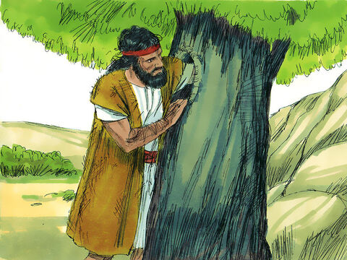
Luke 3:1-20 ERV
John Prepares the Way for Jesus
¹ It was the 15th year of the rule of Tiberius Caesar. These men were under Caesar:
Pontius Pilate, the governor of Judea;
Herod, the ruler of Galilee;
Philip, Herod’s brother, the ruler of Iturea and Trachonitis;
Lysanias, the ruler of Abilene.
² Annas and Caiaphas were the high priests. During this time, John, the son of Zechariah, was living in the desert, and he received a message from God.
Notes:
5A. First Bible Reading
Learners should have already read this passage in their first language (L1) as part of their homework, so it will be familiar even if they do not know all the vocabulary yet. However, if they have not yet read it in their L1, be sure they do so now before reading it in English. The hyperlinks of the Bible verses connect to https://live.bible.is/ so learners can read and hear the scripture in their own languages. You may also watch videos of the passage at the website.
A. Read the verses out loud to the class.
B. If learners ask about words, give simple definitions.
C. Encourage learners to read aloud verses.
D. Ask if there are any questions or comments about the verses.
E. Ask the questions and discuss as a group.
F. Optional - You may hide the words and ask learners to tell the story again in their own words, using the pictures to help them.
https://media.freebibleimages.org/stories/FB_JohnBaptist_Jesus/overview-thumbnails/01_FB_JohnBaptist_Jesus_Thumbnail.jpg?1635949785

Slide 16
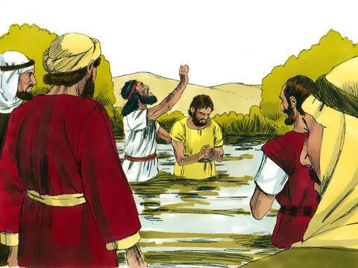
³ So he went through the whole area around the Jordan River and told the people God’s message. He told them to be baptized to show that they wanted to change their lives, and then their sins would be forgiven.⁴ This is like the words
written in the book of Isaiah the prophet:
“There is someone shouting in the desert:
‘Prepare the way for the Lord.
Make the road straight for him.
⁵ Every valley will be filled,
Notes:
5B. Bible Reading
A. Read the story out loud to the class.
B. If learners ask about words, give simple definitions.
C. Encourage learners to read aloud paragraphs from the story and act out the scene.
https://media.freebibleimages.org/stories/FB_JohnBaptist_Jesus/overview-thumbnails/03_FB_JohnBaptist_Jesus_Thumbnail.jpg?1635949785

Slide 17
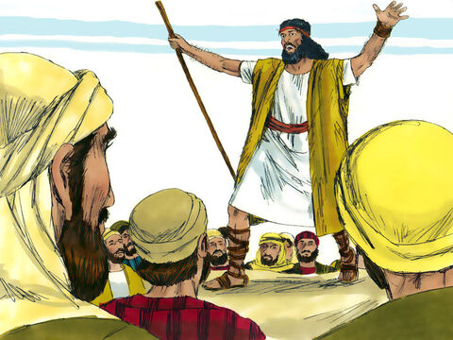
and every mountain and hill will be
made flat.
Crooked roads will be made straight,
and rough roads will be made smooth.
⁶ Then everyone will see
how God will save his people!’”
⁷ Crowds of people came to be baptized by John. But he said to them, “You are all snakes! Who warned you to run from God’s judgement that is coming? ⁸ Change your hearts! And show by your lives that you have changed. I know what you are about to say- ‘but Abraham is our father!’ That means nothing. I tell you that God can make children for Abraham from these rocks!
©2020-2024 Bible League International
Notes:
5C. Bible Reading
A. Read the story out loud to the class.
B. If learners ask about words, give simple definitions.
C. Encourage learners to read aloud paragraphs from the story and act out the scene.
https://media.freebibleimages.org/stories/FB_JohnBaptist_Jesus/overview-thumbnails/02_FB_JohnBaptist_Jesus_Thumbnail.jpg?1635949785

Slide 18
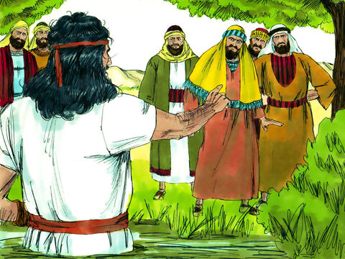
⁹ The ax is now ready to cut down the trees.^{[a]} Every tree that does not produce good fruit will be cut down and thrown into the fire.”
¹⁰ The people asked John, “What should we do?”
¹¹ He answered, “If you have two shirts, share with someone who does not have one. If you have food, share that too.”
¹² Even the tax collectors came to John. They wanted to be baptized. They said to him, “Teacher, what should we do?"
Luke 3:9 trees Meaning the people who don’t obey God. They are like “trees” that will be cut down.
Notes:
5D. Bible Reading
A. Read the story out loud to the class.
B. If learners ask about words, give simple definitions.
C. Encourage learners to read aloud paragraphs from the story and act out the scene.
https://media.freebibleimages.org/stories/FB_JohnBaptist_Jesus/overview-thumbnails/04_FB_JohnBaptist_Jesus_Thumbnail.jpg?1635949785

Slide 19
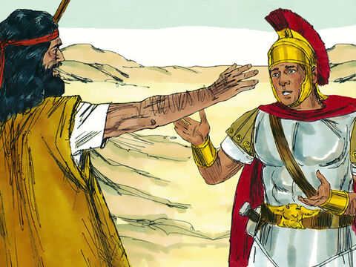
¹³ He told them, “Don’t take more taxes from people than you have been ordered to collect.”
¹⁴ The soldiers asked him, “What about us? What should we do?”
He said to them, “Don’t use force or lies to make people give you money. Be happy with the pay you get.”
¹⁵ Everyone was hoping for the Messiah to come, and they wondered about John. They thought, “Maybe he is the Messiah.”
Notes:
5E. Bible Reading
A. Read the story out loud to the class.
B. If learners ask about words, give simple definitions.
C. Encourage learners to read aloud paragraphs from the story and act out the scene.
https://media.freebibleimages.org/stories/FB_JohnBaptist_Jesus/overview-thumbnails/06_FB_JohnBaptist_Jesus_Thumbnail.jpg?1635949785

Slide 20
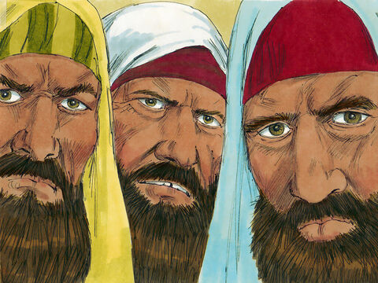
¹⁶ John’s answer to this was, “I baptize you in water, but there is someone coming later who is able to do more than I can. I am not good enough to be the slave who unties his sandals. He will baptize you with the Holy Spirit and with
fire.¹⁷ He will come ready to clean the grain. He will separate the good grain from the straw, and he will put the good part into his barn. Then he will burn the useless part with a fire that cannot be stopped.” ¹⁸ John said many other things like this to encourage the people to change, and he told them the Good News.
Notes:
5F. Bible Reading
A. Read the story out loud to the class.
B. If learners ask about words, give simple definitions.
C. Encourage learners to read aloud paragraphs from the story and act out the scene.
https://media.freebibleimages.org/stories/FB_JohnBaptist_Jesus/overview-thumbnails/05_FB_JohnBaptist_Jesus_Thumbnail.jpg?1635949785

Slide 21
How John’s Work Later Ended
¹⁹ John criticized Herod the ruler for what he had done with Herodias, the wife of Herod’s brother, as well as for all the other bad things he had done. ²⁰ So Herod added another bad thing to all his other wrongs: He put John in jail.
Notes:
5G. Bible Reading
A. Read the story out loud to the class.
B. If learners ask about words, give simple definitions.
C. Encourage learners to read aloud paragraphs from the story and act out the scene.

Slide 22
Answer the questions.
1. Why do you think John lived in the desert?
2. Who were the different people that John spoke to?
3. What was John’s message from God?
4. Who do you think is the person John says is coming after him?
5. What do you think John meant when he said, “Change your hearts”?
6. What questions would you have if you could meet John?
Notes:
5H. Bible Reading Questions
Ask the questions and discuss as a group.
Answers:
(Answers will vary.)
He spoke to crowds of people, tax collectors, and soldiers.
John’s message was for the people to be baptized and to change their hearts and actions.
(Answers will vary. After discussion, explain to students that Jesus is the person John says is coming after him.)
(Answers will vary.)
(Answers will vary.)
https://media.freebibleimages.org/stories/FB_JohnBaptist_Jesus/overview-thumbnails/02_FB_JohnBaptist_Jesus_Thumbnail.jpg?1635949785

Slide 23
Psalm 119:25-32 ERV
Daleth
²⁵ I lie here like a dying man.
Say the word, and I will live again. ^{[b]}
²⁶ I told you about my life, and you answered me.
Now, teach me you laws.
²⁷ Help me understand your instructions,
and I will think about your wonderful teachings. ^{[c]}
²⁸ I am sad and tired.
Say the word, and make me strong again.
b. Psalm 119:25 Say … again Or “Give me life as you promised.”
c. Psalm 119:27 teachings Or “deeds.”
Notes:
5I. Second Bible Reading
Daleth meaning: Daleth is the 4th letter in the Hebrew alphabet, so it is used in this Psalm to mark the 4th section.
Learners should have already read this passage in their first language (L1) as part of their homework, so it will be familiar even if they do not know all the vocabulary yet. However, if they have not yet read it in their L1, be sure they do so now before reading it in English. The hyperlinks of the Bible verses connect to https://live.bible.is/ so learners can read and hear the scripture in their own languages. You may also watch videos of the passage at the website.
A. Read the verses out loud to the class.
B. If learners ask about words, give simple definitions.
C. Encourage learners to read aloud verses.
D. Ask if there are any questions or comments about the verses.
E. Ask the questions and discuss as a group.
F. Optional - You ask learners to tell the psalm in their own words, or listen to a musical recording of the psalm.

Slide 24
²⁹ Don’t let me live a lie.
Guide me with your teachings.
³⁰ I have chosen to be loyal to you.
I respect your laws.
³¹ I follow your rules closely, LORD.
Don’t let me be put to shame.
³² I do my best to follow your commands,
because you are the one who gives me the desire.
Notes:
5J. Bible Reading
Learners should have already read this passage in their first language (L1) as part of their homework, so it will be familiar even if they do not know all the vocabulary yet. However, if they have not yet read it in their L1, be sure they do so now before reading it in English. The hyperlinks of the Bible verses connect to https://live.bible.is/ so learners can read and hear the scripture in their own languages. You may also watch videos of the passage at the website.
A. Read the verses out loud to the class.
B. If learners ask about words, give simple definitions.
C. Encourage learners to read aloud verses.
D. Ask if there are any questions or comments about the verses.

Slide 25
Answer the questions.
1. How does the writer of this Psalm feel?
2. Who does the writer ask for help?
3. What choices does the writer make in this Psalm?
4. Why does the writer want to follow God’s commands?
5. What is a rule or instruction that’s hard to follow?
6. Do you think it is important to follow God’s commands?
Notes:
5K. Bible Reading Questions
Ask the questions and discuss as a group. You may also ask learners to tell the psalm in their own words, or listen to a musical recording of the psalm.
Answers:
1. (Answers will vary.)
2. The writer asks God for help to understand His instructions and to be strong again.
3. The writer chooses to be loyal to God, to respect God’s laws, and to try to follow God’s commands.
4. The writer wants to follow God’s commands because God has given the writer a desire to follow Him.
5. (Answers will vary.)
6. (Answers will vary.)

Slide 26
Listen and complete the sentences.
1. She had ______, “Write a_______about a ______.”
2. In ____ story, there was a ____ ship sailing across the____.
3. The _____was strong like a ____, making the sails ____ apart.
4. Tom_____ the captain giving _____ with a stern look on his __.
5. The crew ______to save the _____ and _____ a big reward.
Notes:
6A. Activities – Listening to pronunciation words with /E/ and /i/ sounds and compound nouns.
Read the script below at least twice as learners listen and answer the questions. The learners should NOT look at the script.
In Mrs. Brown's classroom, the students were busy with their homework. On the whiteboard, she had written, "Write a story about a ship." The classroom was filled with the sound of pencils scratching on paper. Tom looked at his textbook for ideas, but he felt stuck. His classmate, Drew, was sitting next to him. He leaned over and whispered, “Think of something exciting, like pirates!” Tom smiled. He liked that idea, so he began to write. In Tom’s story, there was a big ship sailing across the sea. The ship was carrying a flock of sheep to a new country. Suddenly, a storm hit. The wind was strong like a whip, making the sails rip apart. The crew had to act quickly to save the ship. Tom imagined the captain giving orders with a stern look on his lip. The sailors leaped into action, working hard with their bare feet on the wet deck. They had to fit everything back in place or else the ship would sink. At the end of Tom’s story, the storm calmed, and the crew managed to save the sheep and reap a big reward. Just then the bell rang, as Tom finished his story. He was proud of his work and couldn’t wait tell it to his friends.
Answers:
had, written, story, ship
Tom’s, story, big, ship, across, sea
wind, strong, whip, sails, rip
imagined, orders, look, lip
managed, sheep, reap, big

Slide 27
A. Partner Debate: Which class is better?
Answer the following questions on your own about your favorite class. Then compare answers with a partner and debate which class is better.
What is your favorite class？
Which lessons from this class have you learned the most from?
What do you like about how the teacher taught the class?
Did you feel challenged by this class?
What was the most surprising thing you learned from this class?
What was your favorite project or assignment from this class?
Notes:
6B. Activities – Pair Work Partner A
Partner Debate: Which class is better?
Students will work on their own answering the set of questions. After answering the questions, they will work with a partner comparing answers and debating which class is better. Answers will vary.

Slide 28
B. Partner Debate: Which class is better?
Answer the following questions on your own about your favorite class. Then compare answers with a partner and debate which class is better.
What makes this class for enjoyable than other classes？
What projects from the class have you learned the most from?
What is the learning environment like in this class?
How does this class prepare you for your future classes or job?
Has this class made a difference in your academic interests?
What is one way this class has challenged you?
Notes:
6C. Activities – Pair Work Partner B
Partner Debate: Which class is better?
Students will work on their own answering the set of questions. After answering the questions, they will work with a partner comparing answers and debating which class is better. Answers will vary.

Slide 29
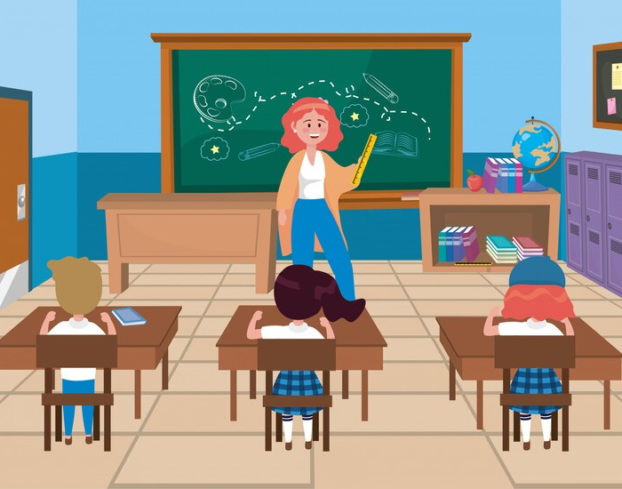
Song – Learning Together
(Verse 1) In a classroom full of dreams, We were learning many things, Textbooks open, notes to write, Study hard each day and night. Crooked paths and smooth roads too, We were learning, pushing through.
(Verse 2) Final tests are drawing near, Let’s stay focused, never fear.
Something comes to ease my mind, My friend’s words are real and kind. With our books, we all agree, We will earn that sweet degree.
Notes:
7. Song
Learners will learn the new song for the lesson with the accompanying actions. This song is sung to the tune of “Twinkle Twinkle Little Star”.
1. Model: Read the song lyrics out loud to the class. Ask if there are any questions. Write words that learners ask about on the board and give simple definitions. Then sing it two or three times, while they just listen.
2. Repeat: Sing the selection again, a line or sentence at a time, as learners repeat after you.
3. Solo: The learner sings solo (or if shy, can just read the words aloud).
https://www.freepik.com/free-vector/woman-teacher-with-girls-boy-students-with-books_4772660.htm#from_view=detail_alsolike

Slide 30
1A. Homework – Write a sentence with each vocab word using the past continuous tense.
Ex. Yesterday, we were skating on the lake because the ice was so smooth
1. smooth
3. absent
2. crooked
4. real
Notes:
Homework 1A. - Write a sentence with each vocab word using the past continuous tense.
Model. Go over each of the homework assignments to be sure the student understands what to do.
Repeat. Encourage learners to practice speaking and reading the completed homework assignments with a friend. They may use a bilingual dictionary.
Solo. Students will share their homework when they are finished. After they have shared their homework, be sure to check it for correctness, including spelling. Explain mistakes, while providing praise and encouragement.
Number one is an example.
Answers may vary, but will start with a capital letter, have a punctuation mark at the end, use the past continuous tense, and use the following words:
2. crooked
3. absent
4. real
https://www.freepik.com/free-photo/double-bend-road-arrow-sign-outdoors_6984576.htm#fromView=search&page=1&position=0&uuid=fe21df18-c78b-4189-a6e9-54d087178eca
https://www.freepik.com/free-vector/melting-ice-cubes-with-flat-design_2533633.htm#fromView=search&page=1&position=19&uuid=1b0d0c2b-1f34-4211-8193-81d53efe5aaf
https://www.freepik.com/free-vector/myths-facts-comparison-rubber-stamp-white-background_197580041.htm#fromView=search&page=1&position=11&uuid=4e6c23ce-2c57-4b96-b689-2000899eb4d5
https://www.freepik.com/free-vector/vacancy-concept-illustration_133782182.htm#fromView=search&page=2&position=4&uuid=73eeedf5-de38-4b9e-bd37-38cd5e216c7b

Slide 31
1B. Homework – Write a sentence with each vocab word using the past continuous tense.
1. literature
3. crowd
2. degree
4. message
Notes:
Homework 1B. - Write a sentence with each vocab word using the past continuous tense.
Model. Go over each of the homework assignments to be sure the student understands what to do.
Repeat. Encourage learners to practice speaking and reading the completed homework assignments with a friend. They may use a bilingual dictionary.
Solo. Students will share their homework when they are finished. After they have shared their homework, be sure to check it for correctness, including spelling. Explain mistakes, while providing praise and encouragement.
Answers may vary, but will start with a capital letter, have a punctuation mark at the end, use the past continuous tense, and use the following words:
literature
degree
crowd
message
https://www.freepik.com/free-photo/opened-books-library-table_1925586.htm#fromView=search&page=1&position=40&uuid=5189d92a-f71c-4571-87a5-edb235a10ff0
https://www.freepik.com/free-ai-image/individual-expressing-concern-about-rising-cost-living_272719412.htm#fromView=search&page=2&position=1&uuid=65a67c54-e0e7-4203-a7d9-9e1f76145e27
https://www.freepik.com/free-photo/front-view-girl-smiling-holding-her-certificate_5070529.htm#fromView=search&page=1&position=46&uuid=9c569458-f081-48f3-bd25-f091a0603766
https://www.freepik.com/free-photo/woman-chatting-her-smartphone_11303317.htm#fromView=search&page=1&position=17&uuid=5be1533a-cfb3-4727-b363-484f715a8ef9

Slide 32
1C. Write about the lesson vocabulary words.
1. What are two things you think would be hard to separate?
2. What is the best present you have ever received?
4. What kind of assessments do you think are the hardest?
3. Do you prefer to read a textbook or listen to a lesson? Why?
Notes:
Homework 1C. - Write about the lesson vocabulary words.
Students will write answers to the questions.
Answers will vary.

Slide 33
2A. Write the question for each of the sentences.
We were walking on the ice, when we fell through.
Example: When you fell through, were you walking on the ice?
She was wearing a new dress when they saw her.
His phone rang while he was carrying the groceries.
They heard the news when they were having dinner.
The baby was crying when his mother finally came back.
Notes:
Homework 2A. – Grammar and Vocabulary Review
Students will complete the sentences with the correct verb forms. Number 1 is an example.
Answers will vary but must include:
2. When they saw her, was she wearing a new dress？
3. Did his phone ring while he was carrying the groceries?
4. Did they hear the news when they were having dinner?
5. Was the baby crying when his mother finally came back?

Slide 34
2B: Write a sentence using the simple past and past continuous together.
baptize/river/ask
John was baptizing the man in the river when the soldiers asked him a question.
crowd/receive/night?
straw/separate/tell
desert/shout/message
Notes:
Homework 2B. – Grammar and Vocabulary Review
Students will complete the sentences using each of the words in the group.
Number one is an example.
Answers will vary.
https://www.freepik.com/free-vector/landscape-park-scene-icon_5825528.htm#fromView=search&page=1&position=15&uuid=a0f1b7d7-12e5-4f39-b8b0-9a149e079432

Slide 35
3. With a partner, discuss what you were doing last year.
What classes were you taking last year？
Where were you living?
Who were you spending time with?
How were you feeling about English class?
What places were you going?
What were you learning?
Notes:
Homework 3. – Conversations - Pair work
Students interview a partner and write their partner’s answers. They will also create two of their own follow-up questions for numbers 7 and 8. Check answers for correct grammar and punctuation.
Questions and answers will vary.
https://www.freepik.com/free-vector/landscape-park-scene-icon_5825528.htm#fromView=search&page=1&position=19&uuid=f4f19f54-0f4c-42ca-b8b9-768ff4dd32ee

Slide 36
4. Match the words with the pictures and write the words in the correct columns.
sheep
reap
fit
weep
lip
whip
leap
ship
rip
feet
/E/ | /i/
1
6
2
7
3
8
4
9
5
10
Notes:
Homework 4. – Pronunciation
This homework practices pronouncing the /E/and /i/ sounds.
Students will go through the list and sound out each word. Then they will write words by the correct picture and in the correct columns for each vowel sound.
Answers:
feet
weep
lip
rip
fit
leap
reap
ship
whip
sheep
/E/: sheep, reap, weep, leap, feet
/i/: fit, lip, whip, ship, rip
https://www.freepik.com/icon/sailing-ship_17664892#fromView=search&page=1&position=78&uuid=34eda8a5-0a9e-44c6-901c-fb978653481e
https://www.freepik.com/icon/whip_3791497#fromView=search&page=1&position=50&uuid=746dd942-96ca-4b62-b26f-b067e6675eb9
https://www.freepik.com/icon/lips_8429900#fromView=search&page=1&position=87&uuid=f1b57276-4699-401a-af9f-03080ca09cef
https://www.freepik.com/icon/tear_2911106#fromView=search&page=1&position=3&uuid=3e063ad0-1343-4d0c-ad9f-1a5881d2d854
https://www.freepik.com/icon/muscle_780103#fromView=search&page=1&position=54&uuid=de55e4e3-4e4e-4476-b24a-821874aec9a0
https://www.freepik.com/icon/sheep_4987758#fromView=search&page=1&position=61&uuid=2cc32d58-d35d-42af-815c-07cfc52af0c2
https://www.freepik.com/icon/sheep_4987758#fromView=search&page=1&position=61&uuid=2cc32d58-d35d-42af-815c-07cfc52af0c2
https://www.freepik.com/icon/game_16467712#fromView=search&page=1&position=8&uuid=720b630c-5309-4cea-b5db-01e0c3509be8
https://www.freepik.com/icon/crate_7216287#fromView=search&page=1&position=27&uuid=5252a3ed-4c64-4afa-8783-644c73940a04
https://www.freepik.com/icon/feet_10437650#fromView=search&page=1&position=6&uuid=7b1284bd-86c5-4242-9342-1e1fa6b13167

Slide 37
5. Fill in the blanks from Luke 3:1-20.
John, the son of _______, was living in the ______.
John told the people _____ message, to be ______ and then their sins would be _______.
John said, “I baptize you in _____, but there is someone coming _____ who is able to do ____ that I can.”
He will _____ the good grain from the ____, and he will put the _____ part into his barn.
©2021-2024 Light of the World Learning
Notes:
Homework 5. – Bible Reading Review
Students will fill in the blanks with the correct words from the Bible reading passage of Luke 3:1-20.
Answers:
Zechariah, desert
God’s, baptized, forgiven
water, later, more,
separate, straw, good

Slide 38
6. Choose 1 verse to memorize and write it here. Then read the next verses in your language.
Read the next lesson’s Bible verses: Luke 3:21-38 and PS 104:10-15, 27-30 in your language.
Notes:
Homework 6. – Memorize a verse and read the next lesson’s verses in your native language.
Learners get to choose one verse from the lesson’s reading to memorize. Please notice that the memory work is not long. Everyone, regardless of skill level, should be able to do it. Students will also read the next lesson’s Bible passage in their native language. Students will always read the Bible lesson in their first language before reading it in English the following lesson. Help them get a Bible in their own language if they don’t have one. They may also use https://live.bible.is/ or other Bible translation resources. The hyperlinks of the Bible verses connect to https://live.bible.is/ so learners can read, hear and watch videos of the scripture in their own languages.
1. Model. Recite a verse from memory.
2. Repeat. Encourage learners to find someone with whom to practice conversing and reading the completed homework assignment.
3. Solo. Students will recite the verse from memory at the next class.

Slide 39
7A. Read the Article on The Story of the Bible.
In the Bible, you can find many different kinds of people and stories. There are conquests and battles, parables and poetry, and even prophecies. Some books like Psalms and Proverbs are poetry, and they express emotion and give wisdom. Other books, called narratives, tell the story of what happened to God’s people, Israel.
The books like Mark and Luke are narratives that tell the story of Jesus’ life, while other narratives such as Exodus and 1 & 2 Samuel contain stories about important Biblical figures including Moses, Jacob, Joshua, Samuel, and King David.
Notes:
Homework 7A. – Everyday Reading and Writing
Students will read the article about on the story of the Bible and answer the questions.

Slide 40
7B. Continue the Article on The Story of the Bible.
It might seem strange that the Bible can contain such a large variety of genres and stories. However, all of these different books in the Bible come together to tell the most important story of all. This is the story of God’s special plan to save mankind through his son, Jesus.
When you read the Bible, try to find the ways the text is pointing to God’s special plan. It will take some practice at first, but after some time, you will begin to see how the different characters and stories in the Bible point to Jesus. Stories and prophecies in the Old Testament tell about the coming Savior, and in the New Testament, Jesus comes and changes everyone’s lives.
Notes:
Homework 7B. – Everyday Reading and Writing
Students will read the article and answer the questions on the next slide.

Slide 41
7C. Answer the questions about Bible reading.
What books of the Bible have you read so far?
Which one was your favorite, and why?
What is challenging about reading the Bible?
What lessons have you learned from reading Psalms?
What book in the Bible would you like to read next?
Do you have any questions about reading the Bible?
Notes:
Homework 7C.– Everyday Reading and Writing
Students will answer the questions about the article.
Answers:
(Answers will vary, though students should say at least Psalms and Luke so far.)
(Answers will vary.)
(Answers will vary.)
(Answers will vary.)
(Answers will vary.)
(Answers will vary.)

Slide 42
8. Write a 200-word article about your education.
Tell about your favorite classes, lesson, or teachers.
Notes:
Homework 8 – Writing
Model. Write an example introduction such as: I am in 10th grade, and I attend an international school in Taiwan. Art has always been my favorite class, and when I was in 8th grade, my art teacher, Mrs. Adams, inspired me to become a better artist. She also taught me a lot about life through her art lessons.
Answers will vary.

Slide 43
9. Now I Can…
I can understand, say, read, and write the 12 vocabulary words.
I can use the simple past and past continuous to talk about actions that were interrupted in the past.
I can pronounce and spell verbs in past continuous tense.
I can pronounce compound words with the right stress.
I can understand John’s message he received from God.
Notes:
Homework 9. – I can statements
The student must be able to achieve all of these skills before the next lesson. If not, the lesson can be repeated or additional practice materials can be used.
Review all of the skills at the beginning of the next lesson. Be sure to give lots of praise and encouragement!

Slide 44
Closing Prayer
Notes:
Pray
You may want to ask for any special prayer requests, then pray for your learners and bless them. Prayers may also be written on this slide.

Slide 45
Help us share the Light of the World!
Thank you for using our materials. If these lessons are a blessing to you, please consider giving to help others learn English through the Bible.
For more information, visit LiteracyInternational.net

Slide 46
Appendix
How to Use Lessons: bit.ly/UsingLOTW
Irregular Verb List: bit.ly/IrregVerb
Lesson Downloads: bit.ly/DownloadLOTW
Order Books: bit.ly/3PlPuRg
Share Your Feedback: bit.ly/FeedbackLOTW
Table of Contents: bit.ly/ContentsLOTW
Video Channel: youtube.com/c/LiteracyInternational
Videos A2 Lessons: bit.ly/A2LessonVideos
Vocabulary List: bit.ly/VocabLOTW
Website: LiteracyInternational.net

