Slide 1
Unit B1-10
©2020-2024 Light of the World Learning
Notes:
Teacher’s Notes:
Bible Readings: Lk 3:21-38; PS 104:10-15, 27-30
Theme: Food and drinks
Pronunciation: /e/ & /A/ pen/pain
Grammar: Past simple & past continuous review; Negative affixes (un- in- mis- non- dis- -less -free)
Preparation:
Pray.
Read the Bible passages.
Preview slides and game.

Slide 2
Pray, Review, and Preview
Bible Readings: Lk 3:21-38; PS 104:10-15, 27-30
Theme: Food and drinks
Pronunciation: /e/ & /A/
Grammar: Past simple & past continuous review; Negative affixes (un- in- mis- non- dis- - free -less)
Notes:
Pray for the class. You may want to thank the Lord for giving us the ability taste, the ability to work with our hands, and for our families.
Check homework and review.
Ask learners to read aloud or recite their homework from the last class. Check written work.
Review the main points of the previous lesson and ask if there are any questions.
Be sure they have read the Bible passage in their native languages in preparation for the lesson.

Slide 3
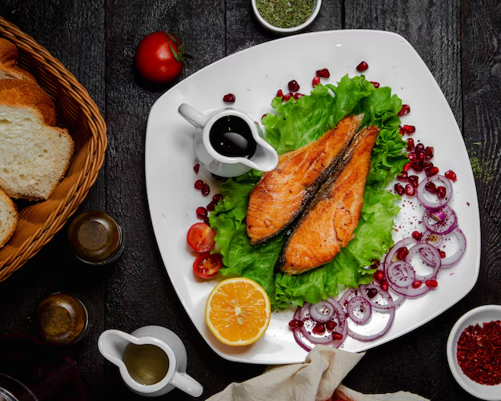
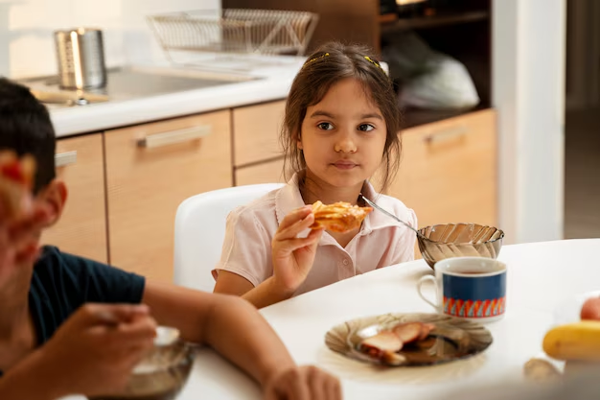
Theme Picture
freepik link
freepik link
Notes:
1A. Discuss Theme Picture
Ask “What is she doing?” and “What is in the picture?” to elicit vocabulary learners already know.
Repeat and write their words or show the words on the next slide.
Answers may include: A girl is eating the food her mother prepared. A girl is eating. There is food on the plate.

Slide 4
Maya likes many types of foods. Normally, she likes to eat Indian food, which is vegetarian. Her mom cooks Indian food from scratch using raw ingredients. However, it depends on what she has to cook at the time. Sometimes she likes to fry food, sometimes she bakes food. Often times times she makes extra food to freeze for later.
Today she is making something Maya is frightened to try! Her mom is making fried fish, battered in egg and flour. The fish will be served with arugula, a fresh crop from their garden, and two types of tea for refreshments.
What are some foods you are frightened to try?
What are foods you like to cook? How do you cook them?
Notes:
1B. Read about the theme picture and discuss with a partner
Please read the description of the theme picture to the learners. If learners ask about words, give simple definitions.
Then ask learners to work in pairs and discuss the questions.

Slide 5
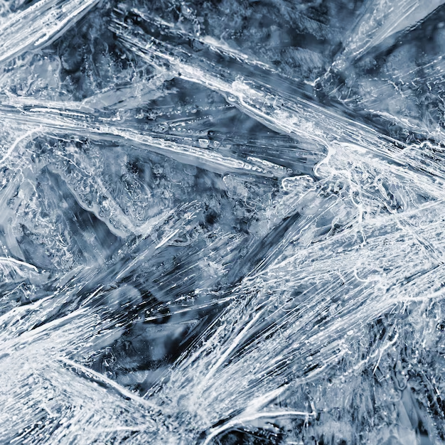
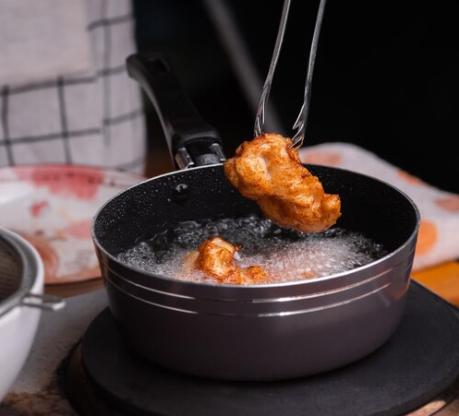
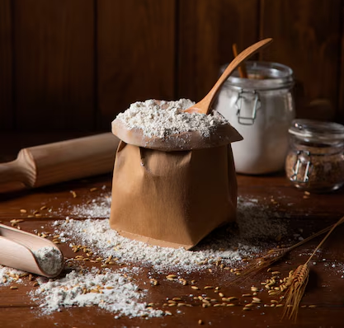
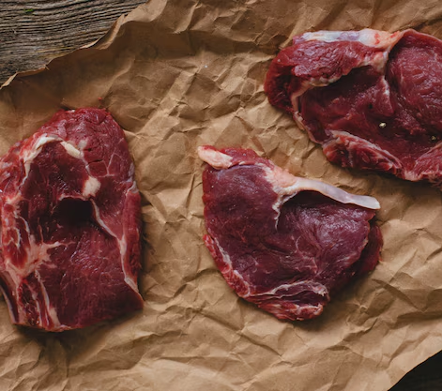
Match the definitions to the correct words.
1. freeze | 2. fry | 3. flour | 4. raw
freeze
\fry
flour
raw
To cook food in very hot fat or oil
Uncooked food
To be turned into ice by extreme cold
A power made by grinding grain
Notes:
2A. Vocabulary
1. Read our vocabulary words out loud again.
2. Go through each number and ask students to write down which ones they think it is.
3. Check learners’ comprehension further by asking direct questions. For example, “What happen when we freeze water?”, “What types of food contain flour?”, “Do you like to eat any foods raw?”
Answers:
C.
B.
D.
B.

Slide 6
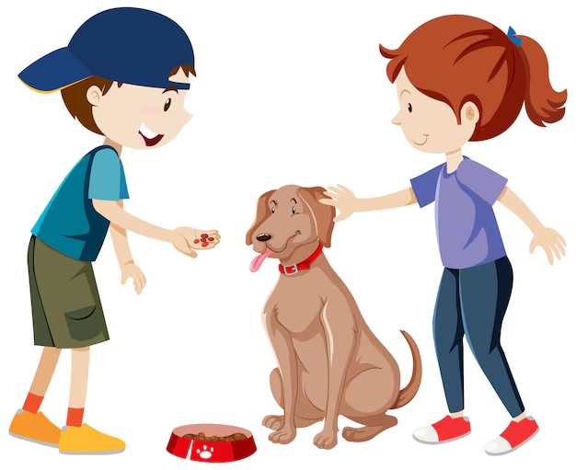
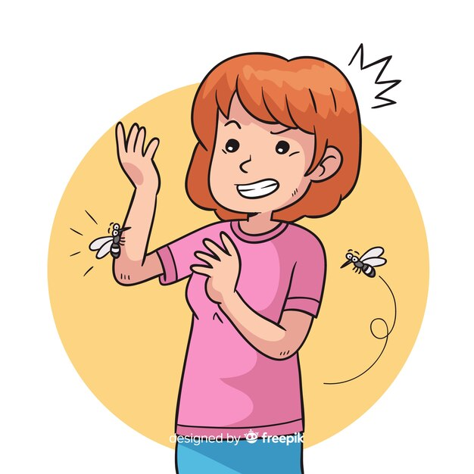
Match the beginning and end of each sentence.
1. She is frightened
2. My friend is a vegetarian,
3. My dog depends
4. The farmer’s crop
is harvested every fall.
on me to feed him!
which means he doesn’t eat meat.
of getting stung by a bee!
dog
bee
Notes:
2B. Vocabulary
1. Say the beginning of the sentence a few times, as you indicate the picture. For example, say,
2. Ask learners to match the beginning and end of each sentence and say the complete sentence.
3. Check learners’ comprehension further by asking direct questions. For example: “What food do vegetarians eat?”, “What are some common crops?”, “Are you frightened of anything?”, “Who is someone you depend on?”
Answers
1. D
2. C
3. B
4. A

Slide 7
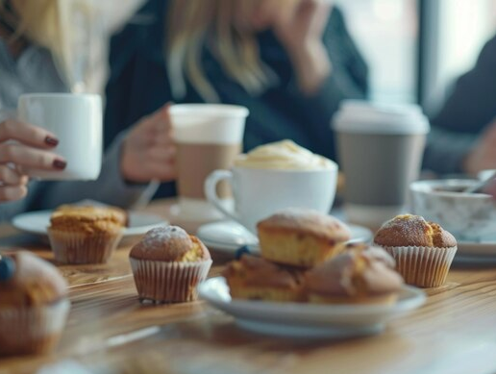
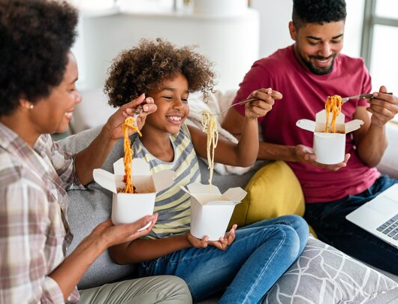
Match the photo and sentence.
1. At the company meeting they served many refreshments including coffee, and muffins.
2. The recipe she is cooking requires many ingredients, including flour, sugar, and butter. 3. The guests at the wedding drank alcoholic beverages. 4. My family sometimes orders takeout on Sunday night.
a
b
C picture
D picture
A
B
C
D
Notes:
2C. Vocabulary
1. Say the sentences so learners can hear the pronunciation. If learners ask about words, give simple definitions (see answers below for definitions).
2. Ask learners to match the pictures and sentences and then say the complete sentence.
3. Check learners’ comprehension further by asking direct questions. For example, “What refreshments do you enjoy having?”, “What sort of ingredients could be used in making in bread?”, “Where is takeout food usually eaten?”
Answers
B. Refreshments is a noun that refers to light snacks or drinks served at a public event. For example, “The birthday party had many different refreshments.”
A. Ingredients is a noun that refers to any foods that are used in cooking to make dishes. For example, “I was missing an ingredient to make pizza.”
D. Alcoholic is a adjective that is used to describe any drinks which contain alcohol in them. For example, “Wine is an alcoholic drink.”
C. Takeout is a noun or adjective which refers to or describes food that is specifically taken from a restaurant to be eaten elsewhere. For example, “I had takeout from my favorite Indian restaurant for dinner.”

Slide 8
Past Simple & Past Continuous Forms
 | Past simple |  | Past Continuous
1 | Did Maya eat raw fish? | Yes, she ate it. | Was Maya eating raw fish? | Yes, she was eating it.
2 | Did your mom cook dinner? | My mom cooked dinner. | _____________________? | No, she was not cooking dinner
3 | Did he freeze the chicken? | Yes, he froze the chicken. | Was he freezing it? | Yes,______________________.
4 | Did Jesus walk on water? | Yes,__________________. | Was he walking? | Yes, he was walking.
Notes:
2D. Grammar – Simple past & past continuous verbs
Review the past and continuous forms. Model, Repeat, and Solo row number 1. Then ask learners to complete the sentences for rows 2-4.
Answers:
2. Was your mom cooking dinner?
3. Yes, he was freezing it.
4. Yes, Jesus walked on water.

Slide 9
Past Simple & Past Continuous Review
We can use the past continuous to show a longer past action which is interrupted by a shorter past simple action.
 | When and While show these two actions happening together.
1. | John was baptizing people when Jesus came to be baptized.
2. | While Jesus was praying, the sky opened.
3. | When Jesus began to preach, he was sitting on the mountain side.
4. | I burned my hand when I was frying chicken.
5. | While I was cooking, I used many ingredients.
Notes:
2E. Grammar – Simple past & past continuous verbs
Read and explain the reviewed grammar by reading the descriptions out loud.
Go through each example, highlighting “when” and “while” as well as the verb to show past simple and continuous.
Ask students to give other examples. You may prompt them with questions such as, “What happened when you were walking to class?” or “What did you do while you were living in Zambia?”

Slide 10
When we add a negative affix to a word, the new word means the opposite.
Negative Prefixes - before the word |  | Negative Suffixes - after the word
in- non- mis- un- dis- |  | -less -free
Examples: |  | Examples:
1 | I misunderstood the test question. | Flourless means without flour.
2 | The unknown sound frightened me. | Gluten-free bread has no wheat.
3 | The man was very disagreeable. | Little kids are often carefree.
4 | The drinks were nonalcoholic. | Sugarless means without sugar.
5 | My test answer was incorrect. | Vegetarians eat meatless meals.
Notes:
2F. Grammar: Using negative prefixes and suffixes
Negative affixes are placed at the beginning or end of a word to change the meaning to the opposite, meaning “not” or “without”. Prefixes are placed at the beginning and suffixes are placed at the end of the word.
Give some examples and ask students to guess the meaning of the word.
Examples:
Mindless - Without thinking
Misunderstand - Not understand
Unappealing - Not appealing
Noninvasive - Not invasive
Incomprehensible - Not comprehensible
Restless - Without rest

Slide 11
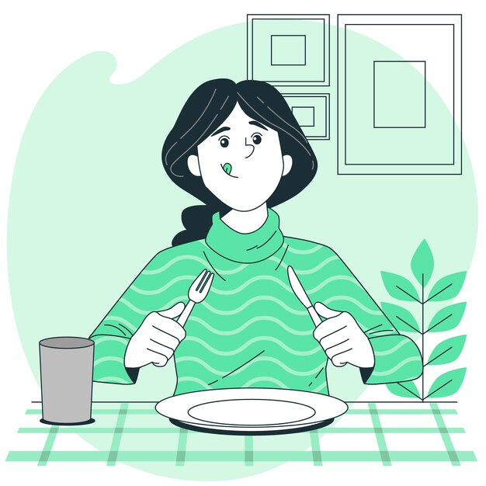
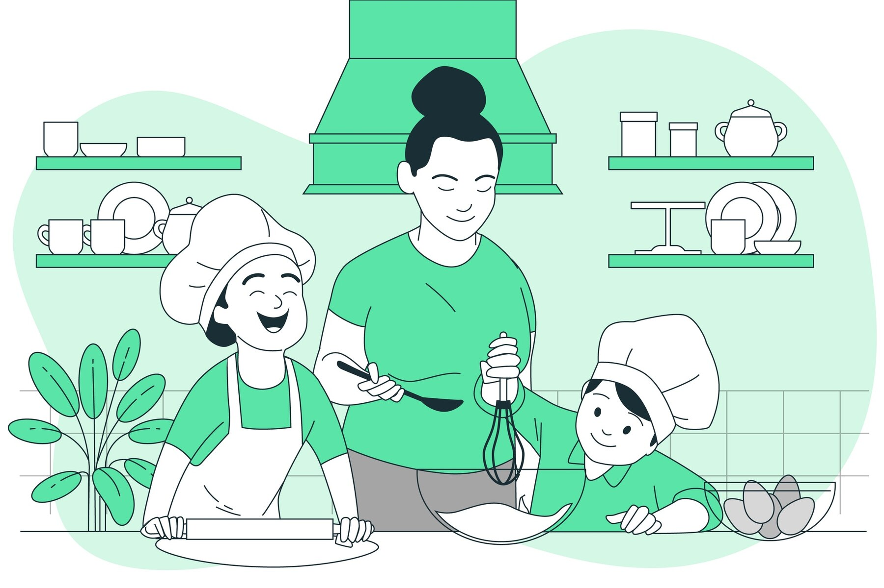
Listen and repeat.
A: What were you eating?
B: I was eating _________ and _____________.
A: That sound delicious.
B: It was! I like to cook with fresh ingredients, like _______, __________, and __________. Do you cook?
A: I have cooked before, but I am frightened I will burn my food! However, I want to learn to _______.
pic 1
pic 2
learn pic 3
Notes:
3. Conversation
Ask the learners to brainstorm to fill in blanks of the conversation according to the pictures.
Model: Role-play the parts with a student to convey the meaning of the conversation.
3. Solo: You begin the conversation and call on individual learners to respond. Then reverse the roles (learners are A, you are B).
4. Once learners can do both parts, encourage free conversation (learners substitute their own words for the blanks).

Slide 12
Practice the /e/ and /A/ sounds. Then listen to the sentences and circle the word you hear.
 |  | /e/ | /A/
1 |  | wren | rain | rain
2 | men | men | mane | mane
3 | pen | pen | pain | pain
4 | age | age | edge | edge
5 | waste | waste | west | west
wren
Notes:
4A. Pronunciation – Minimal Pairs
In this section we will practice distinguishing between the /e/ and /A/ sounds.
1. Model: Read each row several times and point to the words while learners listen. For example, ”Number 1, wren, rain, wren, rain.” Then ask learners to repeat the words
2. Read the sentences below and ask learners to circle the word that they hear.
I can see the wren outside!
How do you spell mane?
I have a pain in my hand.
You can see the age of the knife easily.
Look at the waste!

Slide 13
Words with affixes (un- in- mis- non- dis- -less -free) are usually stressed on the base word.
 | A. - ▔ | B. - ▔ - | C. ▔ -
1 | misread | non-dairy | homeless
2 | dislike | unhealthy | fearless
3 | unfair | infrequent | tasteless
4 | mistake | indecent | handsfree
5 | unkempt | nontoxic | carefree
6 | undo | distasteful | restless
Notes:
4B. Pronunciation - Hum and clap the stress.
The stress is on the base word, not the affix: un-HAP-py, USE-less.
Except when contrasting: Are you happy? No, I'm UN-happy.
For our lesson, we have words with prefixes and with suffix.
Begin by humming the stress of Column A. Hum higher, longer, and louder for big dashes and lower, shorter, and quieter for small dashes. You may also use hand gestures to indicate that the stressed syllable is higher in pitch, longer in duration, and louder. Invite your learners to join in humming or clapping the rhythm.
1. Model: Hum and then say each word in the columns A-C several times. Students listen.
2. Repeat: Students repeat words after you in unison.
3. Solo: Call on individuals to read the columns and pairs of words with the correct stress.

Slide 14
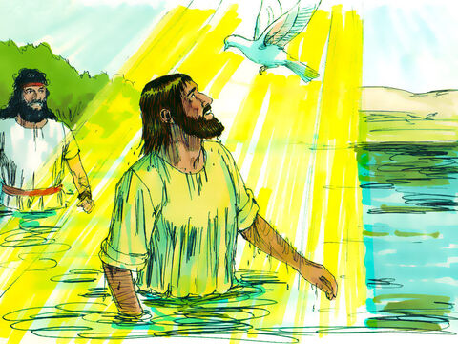
image
Luke 3:21-38 ERV
Jesus Is Baptized by John
²¹ When all the people were being baptized, Jesus came and was baptized too. And while he was praying, the sky opened,
²² and the Holy Spirit came down on him. The Spirit looked like a real dove. Then a voice came from heaven and said, “You are my Son, the one I love. I am very pleased with you.”
Notes:
5A. First Bible Reading
Learners should have already read this passage in their first language (L1) as part of their homework, so it will be familiar even if they do not know all the vocabulary yet. However, if they have not yet read it in their L1, be sure they do so now before reading it in English. The hyperlinks of the Bible verses connect to https://live.bible.is/ so learners can read and hear the scripture in their own languages. You may also watch videos of the passage at the website.
A. Read the verses out loud to the class.
B. If learners ask about words, give simple definitions.
C. Encourage learners to read aloud verses.
D. Ask if there are any questions or comments about the verses.
E. Ask the questions and discuss as a group.
F. Optional - You may hide the words and ask learners to tell the story again in their own words, using the pictures to help them.

Slide 15
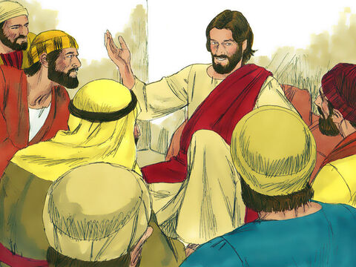
The Family History of Joseph
²³ When Jesus began to teach, he was about 30 years old. People thought that Jesus was Joseph’s son.
Joseph was the son of Eli.
²⁴ Eli was the son of Matthat.
Matthat was the son of Levi.
Levi was the son of Melchi.
Melchi was the son of Jannai.
Jannai was the son of Joseph.
image
Notes:
5B. Bible Reading
A. Read the story out loud to the class.
B. If learners ask about words, give simple definitions.
C. Encourage learners to read aloud paragraphs from the story and act out the scene.

Slide 16
²⁵ Joseph was the son of Mattathias.
Mattathias was the son of Amos.
Amos was the son of Nahum.
Nahum was the son of Esli.
Esli was the son of Naggai.
²⁶ Naggai was the son of Maath.
Maath was the son of Mattathias.
Mattathias was the son of Semein.
Semein was the son of Josech.
Josech was the son of Joda.
²⁷ Joda was the son of Joanan.
Joanan was the son of Rhesa.
Rhesa was the son of Zerubbabel.
Zerubbabel was the son of Shealtiel.
Shealtiel was the son of Neri.
²⁸ Neri was the son of Melchi.
Melchi was the son of Addi.
Addi was the son of Cosam.
Cosam was the son of Elmadam.
Elmadam was the son of Er.
©2020-2024 Bible League International
Notes:
5C. Bible Reading
A. Read the story out loud to the class.
B. If learners ask about words, give simple definitions.
C. Encourage learners to read aloud paragraphs from the story and act out the scene.

Slide 17
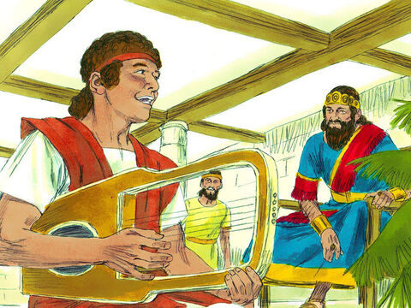
²⁹ Er was the son of Joshua.
Joshua was the son of Eliezer.
Eliezer was the son of Jorim.
Jorim was the son of Matthat.
Matthat was the son of Levi.
³⁰ Levi was the son of Simeon.
Simeon was the son of Judah.
Judah was the son of Joseph.
Joseph was the son of Jonam.
Jonam was the son of Eliakim.
³¹ Eliakim was the son of Melea.
Melea was the son of Menna.
Menna was the son of Mattatha.
Mattatha was the son of Nathan.
Nathan was the son of David.
king david
Notes:
5D. Bible Reading
A. Read the story out loud to the class.
B. If learners ask about words, give simple definitions.
C. Encourage learners to read aloud paragraphs from the story and act out the scene.

Slide 18
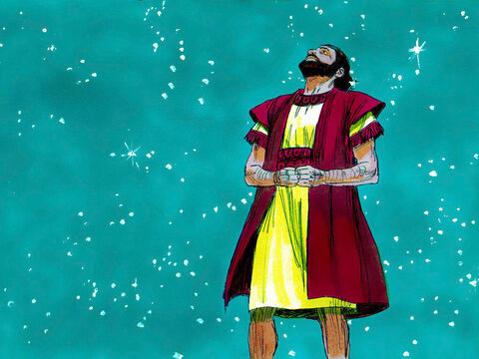
³² David was the son of Jesse.
Jesse was the son of Obed.
Obed was the son of Boaz.
Boaz was the son of Salmon.
Salmon was the son of Nahshon.
³³ Nahshon was the son of Amminadab.
Amminadab was the son of Admin.
Admin was the son of Arni.
Arni was the son of Hezron.
Hezron was the son of Perez.
Perez was the son of Judah.
³⁴ Judah was the son of Jacob.
Jacob was the son of Isaac.
Isaac was the son of Abraham.
Abraham was the son of Terah.
Terah was the son of Nahor.
³⁵ Nahor was the son of Serug.
Serug was the son of Reu.
Reu was the son of Peleg.
Peleg was the son of Eber.
Eber was the son of Shelah.
Notes:
5E. Bible Reading
A. Read the story out loud to the class.
B. If learners ask about words, give simple definitions.
C. Encourage learners to read aloud paragraphs from the story and act out the scene.

Slide 19
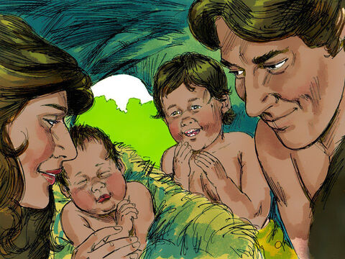
³⁶ Shelah was the son of Cainan.
Cainan was the son of Arphaxad.
Arphaxad was the son of Shem.
Shem was the son of Noah.
Noah was the son of Lamech.
³⁷ Lamech was the son of Methuselah. Methuselah was the son of Enoch. Enoch was the son of Jared. Jared was the son of Mahalaleel. Mahalaleel was the son of Cainan.
³⁸ Cainan was the son of Enos.
Enos was the son of Seth.
Seth was the son of Adam.
Adam was the son of God.
adam and eve, cain and abel
Notes:
5F. Bible Reading
A. Read the story out loud to the class.
B. If learners ask about words, give simple definitions.
C. Encourage learners to read aloud paragraphs from the story and act out the scene.

Slide 20
Answer the questions.
1. What happened when Jesus was praying?
2. How old was Jesus when he began to teach?
3. Who was Adam the son of?
4. Why do you think John baptized Jesus?
5. Why are these people being listed?
6. What can you learn from reading Jesus’s genealogy?
7. How can you see God providing for you in your life?
Notes:
5G. Bible Reading Questions
Ask the questions and discuss as a group.
Answers:
The sky opened and the Holy Spirit came down.
He was 30 years old.
Adam was the son of God.
Answers will vary for 4-6.

Slide 21
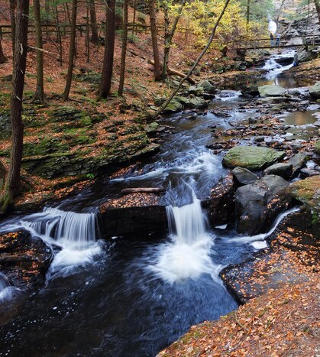
PS 104:10-15, 27-30 ERV
¹⁰ Lord, you cause water to flow from springs into the streams
that flow down between the mountains.
¹¹ The streams provide water for all the wild animals.
Even the wild donkeys come there to drink.
¹² Wild birds come to live by the pools;
they sing in the branches of nearby trees.
river pic
Notes:
5H. Second Bible Reading
Note: A gittith is a Hebrew musical term which may refer to a type of musical instrument.
Learners should have already read this passage in their first language (L1) as part of their homework, so it will be familiar even if they do not know all the vocabulary yet. However, if they have not yet read it in their L1, be sure they do so now before reading it in English. The hyperlinks of the Bible verses connect to https://live.bible.is/ so learners can read and hear the scripture in their own languages. You may also watch videos of the passage at the website.
A. Read the verses out loud to the class.
B. If learners ask about words, give simple definitions.
C. Encourage learners to read aloud verses.
D. Ask if there are any questions or comments about the verses.
E. Ask the questions and discuss as a group.
F. Optional - You ask learners to tell the psalm in their own words, or listen to a musical recording of the psalm.

Slide 22
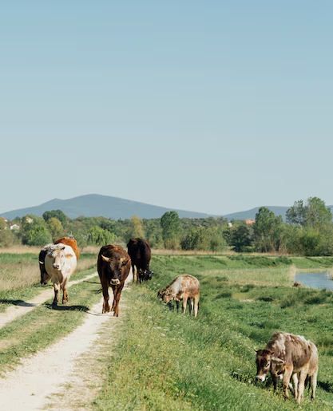
¹³ You send rain down on the mountains.
The earth gets everything it needs from what you have made.
¹⁴ You make the grass grow to feed the animals.
You provide plants for the crops we grow—
the plants that give us food from the earth.
¹⁵ You give us the wine that makes us happy,
the oil that makes our skin soft,
and the food that makes us strong.
animals grazing pic
Notes:
5I. Bible Reading
Learners should have already read this passage in their first language (L1) as part of their homework, so it will be familiar even if they do not know all the vocabulary yet. However, if they have not yet read it in their L1, be sure they do so now before reading it in English. The hyperlinks of the Bible verses connect to https://live.bible.is/ so learners can read and hear the scripture in their own languages. You may also watch videos of the passage at the website.
A. Read the verses out loud to the class.
B. If learners ask about words, give simple definitions.
C. Encourage learners to read aloud verses.
D. Ask if there are any questions or comments about the verses.
.

Slide 23
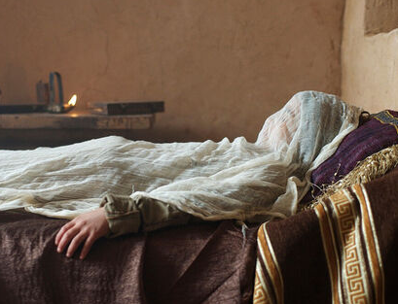
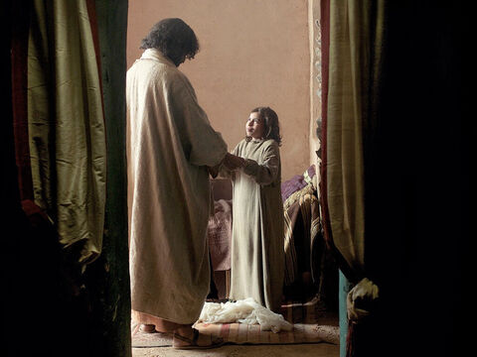
²⁷
Lord, all living things depend on you.
You give them food at the right time.
²⁸
You give it, and they eat it.
They are filled with good food from your open hands.
²⁹
When you turn away from them,
they become frightened.
When you take away their breath,
they die, and their bodies return to the dust.
³⁰
But when you send out your life-giving breath,
things come alive, and the world is like new again!
pic 1
pic 2
Notes:
5J. Bible Reading
Learners should have already read this passage in their first language (L1) as part of their homework, so it will be familiar even if they do not know all the vocabulary yet. However, if they have not yet read it in their L1, be sure they do so now before reading it in English. The hyperlinks of the Bible verses connect to https://live.bible.is/ so learners can read and hear the scripture in their own languages. You may also watch videos of the passage at the website.
A. Read the verses out loud to the class.
B. If learners ask about words, give simple definitions.
C. Encourage learners to read aloud verses.
D. Ask if there are any questions or comments about the verses.
.

Slide 24
Answer the questions.
Who gives water to animals and people?
What does God give us that makes us strong?
What things does the Lord provide for us?
Do you think God is in control of every animal?
Why would the Lord bring life to dead things?
How can you thank God in your life for all he has provided?
What is one example of the Lord taking care of the earth?
Notes:
5K. Bible Reading Questions
Ask the questions and discuss as a group. You may also ask learners to tell the psalm in their own words, or listen to a musical recording of the psalm.
Answers:
1. The Lord provides water.
2. God provides food which makes us strong.
3. He provides plants for the crops we grow.
Answers will vary for 3-6.

Slide 25
Listen and complete the sentences.
1. What kind of restaurant does Mary own?
2. The food they serve is made with fresh ____________.
3. Is the food Mary serves good?
4. How is the fried onion made?
5. Where was the food eaten at?
6. Was everything that was ordered eaten?
Notes:
6A. Activities – Listening to pronunciation words with /e/ and /A/ sounds.
Read the script below at least twice as learners listen and answer the questions. The learners should NOT look at the script.
Listening Script:
“My friend Mary owns a restaurant, which has recently gotten popular! Her restaurant is a vegetarian one that doesn’t serve any meat. The food they serve is made with fresh ingredients, using local farmers crops in many ways. It depend on what you like, but I think all of the food she serves is amazing! Even things I would normally be frightened to try are delicious!
Yesterday I went there and ordered the fried onion, which is made by taking raw onion, coating it in flour and letting it fry in hot oil. I also ordered a few refreshments, including a locally made alcoholic beverage. I took the food as takeout, going home before eating. The food was so good and filling, I had to freeze the leftovers for another day since I could not finish it all.”
Answers
A vegetarian restaurant.
Ingredients.
The food she serves is amazing.
By taking a raw onion, coating it in flour, and letting it fry in hot oil.
The food was taken home to be eaten.
No, they had to freeze the leftovers because they could not finish it all.

Slide 26
A. Role-Play – Private Chef
You are a private chef discussing with your client the food they would like you to prepare for the week. Talk through the questions to figure out a meal plan.
What foods are you unable to eat?
What kind of things do you like to eat?
How many meals a day do you want me to make?
Are there foods that are unappealing to you?
How many portion sizes should I make for your family?
What is most important for you to have in your diet?
Where do you want me to buy ingredients from?
Are there certain cooking methods you don’t want me to use?
Notes:
6B. Activities – Pair Work Partner A
Role-Play between a private chef and a client.
Partner A will play the part of a private chef talking to a client. Partner A will ask questions from this slide and write Partner B’s answers.
Check answers for correct grammar and punctuation. Answers will vary.

Slide 27
B. Role Play – Client
You are the customer who is hiring the private chef.
How many hours a week can you work for me?
What types of tools do you use to cook?
Can you make flourless foods?
How many people can you cook for at once?
Can you cook fried foods?
Are you able to prepare foods to freeze?
How much will each weeks ingredients cost?
What types of cuisines do you specialize in making?
Notes:
6C. Activities – Pair Work Partner B
Role-Play between a chef and a client.
Partner B will play the part of the client. Partner B will ask questions from this slide and write Partner A’s answers.
Check answers for correct grammar and punctuation. Answers will vary.

Slide 28
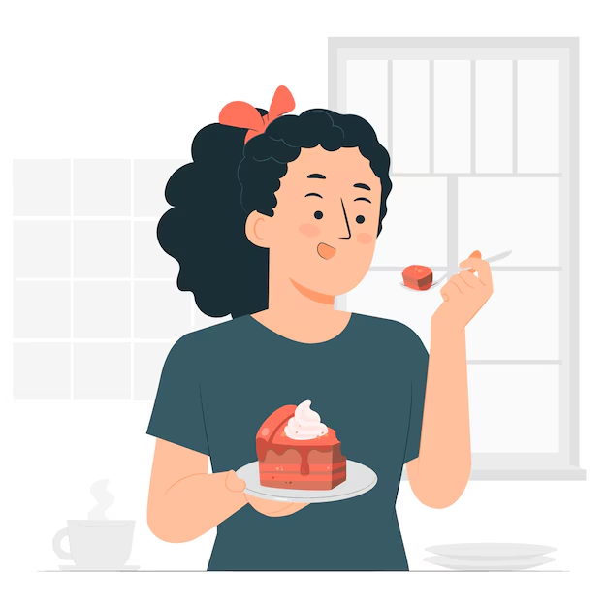
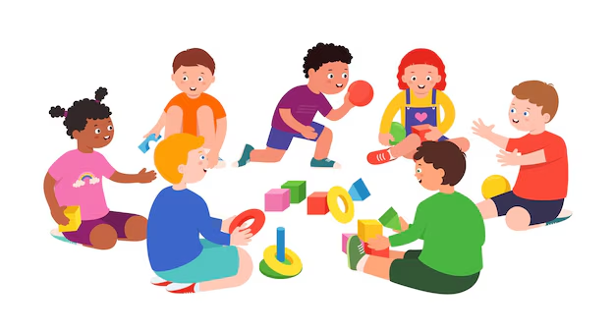
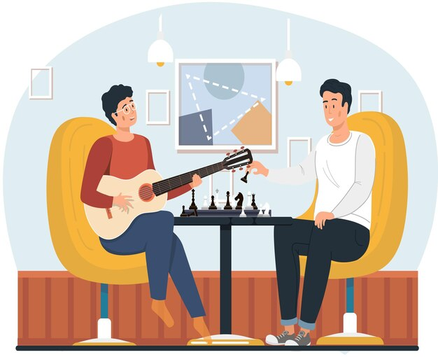
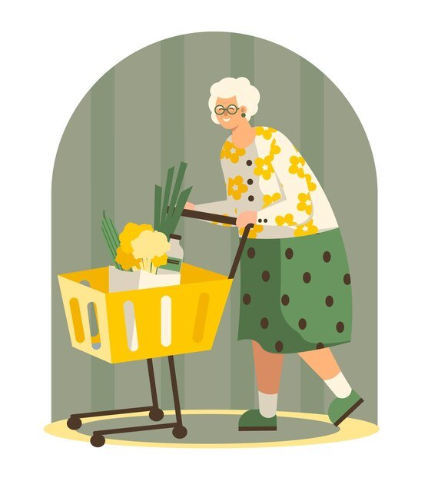
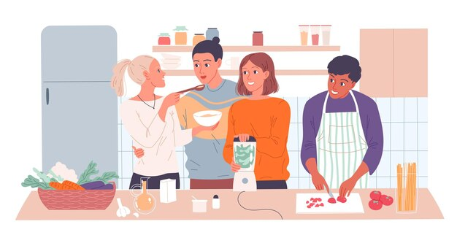
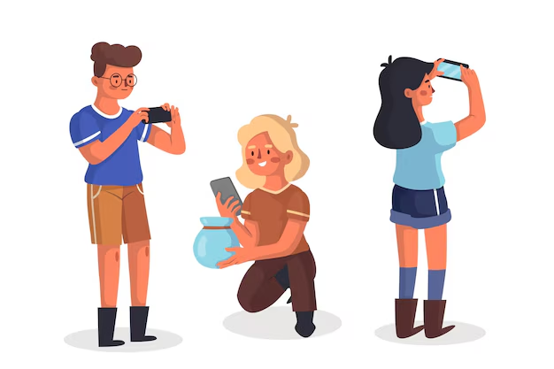
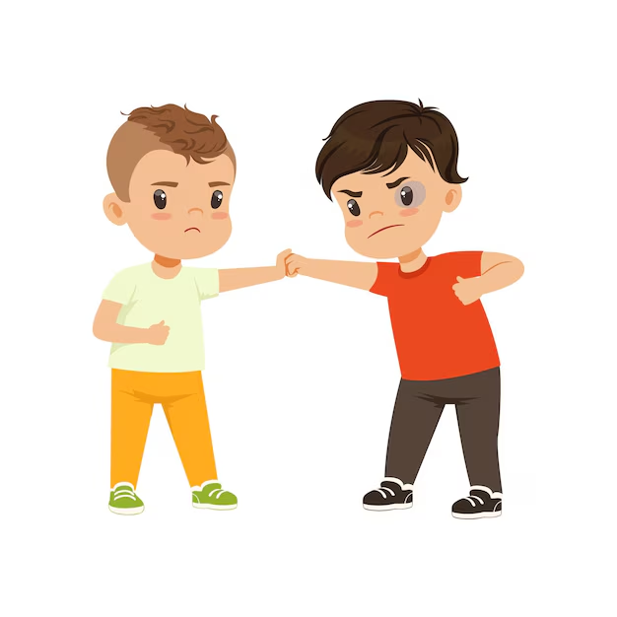
Memory Game
Study the pictures below for one minute. Then hide them and write about them in the past continuous.
run
eat
men playing
old lady
photo
cooking
kids
Notes:
7. Game – Memory
This game can be played by teams or individuals. Ask students to study the pictures for one minute. After the time is up, hide the pictures. Then ask students to write as many past continuous sentences as they can about the pictures in two minutes.
The student or team with the most correct answers wins.

Slide 29
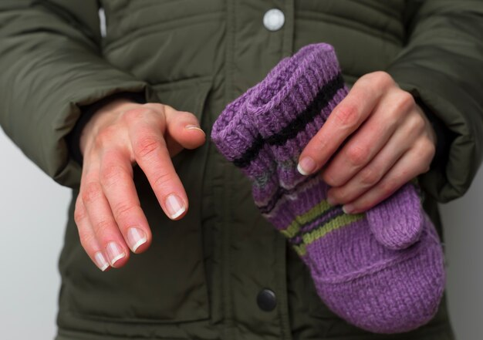
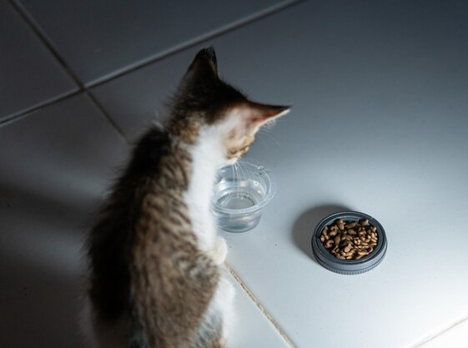
1A. Homework - Write about the pictures in the past or past continuous tense.
freeze
depends
1 | She cooked with many ingredients. | 4 | _____________________.
2 | _______________________. | 5 | _____________________.
3 | _______________________. | 6 | _____________________.
Notes:
Homework 1A. - Write sentences using the pictured vocabulary words.
Model. Go over each of the homework assignments to be sure the student understands what to do.
Repeat. Encourage learners to practice speaking and reading the completed homework assignments with a friend. They may use a bilingual dictionary.
Solo. Students will share their homework when they are finished. After they have shared their homework, be sure to check it for correctness, including spelling. Explain mistakes, while providing praise and encouragement.
Number one is an example.
Answers may vary, but will start with a capital letter, have a punctuation mark at the end, use the simple past or past continuous tense, and use the following words:
ingredients
fry
alcoholic
takeout
freeze
depends

Slide 30
1B. Write about the vocabulary.
1. Who is someone that depends on you?
2. How is flour made from wheat?
3. What kinds of foods do people like to eat raw?
4. What is something you were frightened of as a child?
5. What is a vegetarian food you have eaten before?
6. Write down some examples of refreshments.
Notes:
Homework 1B. - Write about the vocabulary words.
Students will write answers to the questions.
Answers will vary.

Slide 31
2A. Fill in the blank - past simple & continuous
1 | She (eat) was eating takeout when she (hear) heard a frightening noise.
2 | While he (walk)___________, he (see)__________ fresh crops growing.
3 | He (depend) ________on God for food when he (live) _________alone.
4 | While I (cook) _________, I (taste) ________ the food.
5 | When she (play)___________ soccer, she (feel)________ tired.
Notes:
Homework 2A. – Grammar and Vocabulary Review
Students will complete the sentences with the correct verb forms. Number 1 is an example.
Answers will vary but must include:
She was eating takeout when she heard a frightening noise.
While he was walking he saw fresh crops growing.
He was depending on God for food when he lived alone.
While I was cooking, I tasted the food.
When she was playing soccer, she felt tired.

Slide 32
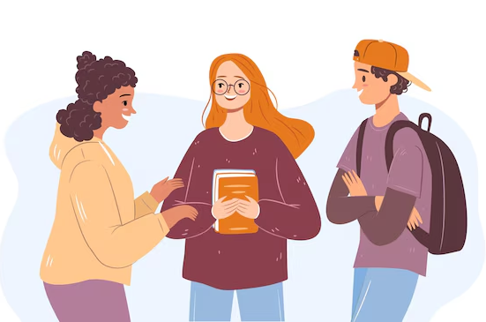
2B: Past tense review – peer interview
Questions:
What food did you dislike growing up?
What foods did you cook yesterday?
What food have you been frightened to try?
Answers:
1. ______________________________
2. ______________________________
3. ______________________________
students
Notes:
Homework 2B. – Grammar and Vocabulary Review
Students will interview one other person in the class and ask and answer each question by writing in the past tense. Answers may vary.

Slide 33
2C. Match the negative affix word to the definition.
1. Safe to eat = non-toxic
2. Wrong =
3. Dangerous =
4. To lose something =
5. Wheat-free =
6. Not enjoy =
non-toxic
flourless
incorrect
dislike
unsafe
misplace
Notes:
Homework 2C. – Grammar and Vocabulary Review
Students will match the correct negative suffix or prefix to the corresponding word. Number 1 is an example.
Answers:
Safe to eat = non-toxic
Wrong = incorrect
Dangerous = unsafe
To lose something = misplace
Wheat-free = flourless
Not enjoy = dislike

Slide 34
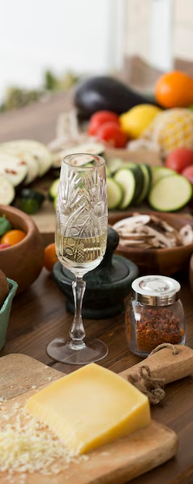
3. Talk about food with a partner
What were some of your favorite meals growing up?
Has your taste in food changed over time?
What types of flavors do you like in your drinks?
What is the perfect food and drink combo?
food
____________________________________
1.
2.
3.
4.
____________________________________
____________________________________
____________________________________
Notes:
Homework 3. – Conversations - Pair work
Students interview a partner and write their partner’s answers. They will also create two of their own follow-up questions for numbers 8 and 9. Check answers for correct grammar and punctuation.
Questions and answers will vary

Slide 35
4. Say and write the words in the correct columns.
taste | test
sane | seen
pain | pen
teen | ten
pent | paint
leg | league
wren | rain
reek | rake
leek | lake
/e/ | /A/ | /E/
Notes:
Homework 4. – Pronunciation
This homework practices pronouncing the /A/, /e/ and /E/ sounds.
Students will go through the list and sound out each word. Then they will write words in the correct columns for each vowel sound.
Answers:
/A/: taste, pain, paint, rake, lake, sane
/e/: test, pen, ten, pent, leg, men
/E/: seen, teen, league, reek, leek, mean

Slide 36
5. Write about Luke 3:21-22 in your own words. Use past simple and past continuous tense to describe the story of Jesus’ baptism.
©2021-2024 Light of the World Learning
Notes:
Homework 5. – Bible Reading Review
Students will write a short summary of the Bible reading using the past simple and past continuous tense.
Answers will vary. Possible answers may include:
“Jesus was baptised at the river. When he was being baptised, the Holy Spirit came down on him in the from of a dove.”
“When Jesus was praying, the Holy Spirit spoke to him.”
“When Jesus was baptised, he was praying to God.”

Slide 37
6. Choose 1 verse to memorize and write it here. Then read the next verses in your language.
Read the next lesson’s Bible verses: Luke 4:1-30 and Ps 71:1-6 in your language.
Notes:
Homework 6. – Memorize a verse and read the next lesson’s verses in your native language.
Learners get to choose one verse from the lesson’s reading to memorize. Please notice that the memory work is not long. Everyone, regardless of skill level, should be able to do it. Students will also read the next lesson’s Bible passage in their native language. Students will always read the Bible lesson in their first language before reading it in English the following lesson. Help them get a Bible in their own language if they don’t have one. They may also use https://live.bible.is/ or other Bible translation resources. The hyperlinks of the Bible verses connect to https://live.bible.is/ so learners can read, hear and watch videos of the scripture in their own languages.
1. Model. Recite a verse from memory.
2. Repeat. Encourage learners to find someone with whom to practice conversing and reading the completed homework assignment.
3. Solo. Students will recite the verse from memory at the next class.

Slide 38
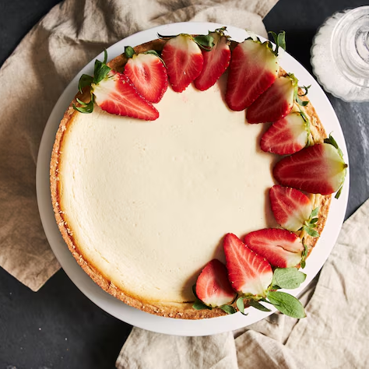
7A. Read the recipe description.
Strawberry cheesecake is a classic dessert that is good for many occasions. However, many people have food allergies and are unable to eat common ingredients including eggs and gluten.
Though most recipes include food allergens, this recipe was designed specifically for people who need gluten-free or egg-free diets. It is a safe option for making a cheesecake that doesn’t include these foods, but is still delicious and easy to make!
cake
gluten
egg
Notes:
Homework 7A. – Everyday Reading and Writing
Students will read the recipe description about the recipe for this cheesecake.

Slide 39
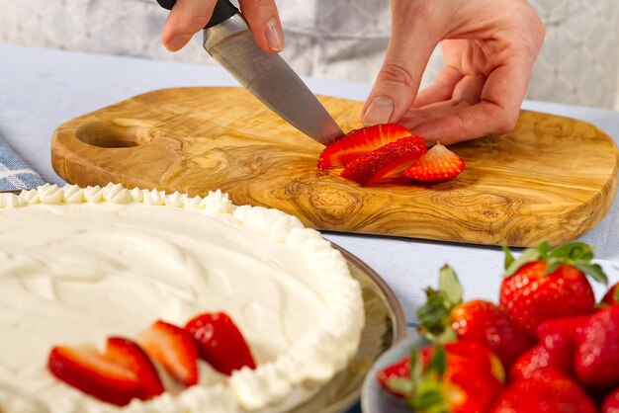
7B. Read the recipe.
Recipe for gluten-free and eggless strawberry cheesecake.
Ingredients:
2 cups or 400g gluten-free graham cracker crumbs
½ cup or 100g of butter, melted
3 cups or 600g of cream cheese
1 cup or 200g of white sugar
2 tbsp or 25g of lemon juice
1 cup or 200g sweetened condensed milk
2 tbsp or 25g of cornstarch
¼ cup or 50g of powdered sugar
1 ½ cup or 300g fresh strawberries, sliced
picture
Notes:
Homework 7B. – Everyday Reading and Writing
Students will read the recipe about making a cheesecake.

Slide 40
7C. Continue the recipe.
Instructions:
3. Add sweetened condensed milk to mixture. Beat on high for 5 minutes until fluffy.
4. Pour into round 9” or 22 cm pan. Bake on 325 F or 165 C for 25-30 mins, or until golden and firm.
5. Top with fresh strawberries and powdered sugar. Serve chilled.
Mix together melted butter and graham cracker crumbs. Press into a round 9 in or 22 cm pan. Bake at 350 F or 176 C for 10 minutes.
Cream the cream cheese and sugar together. Add in lemon juice slowly, do not let the juice curdle the cheese.
Notes:
Homework 7C. – Everyday Reading and Writing
Students will read the instructions and answer the questions on the next slide.

Slide 41
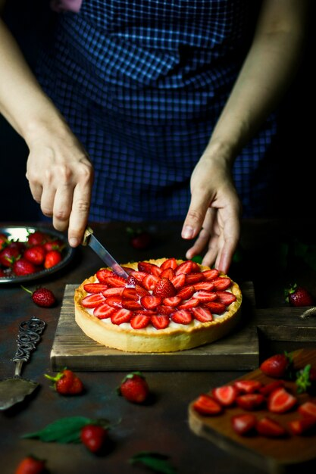
7D. Answer the questions about the recipe.
What does this recipe not contain in it?
How is the crust of the cheesecake made?
What is the cake mostly made up of?
What method of cooking is being used for this recipe?
What type for pan is used for this cake?
How do you know when the cheesecake is ready?
How is the cake finished off at the end?
picture
Notes:
Homework 7D.– Everyday Reading and Writing
Students will answer the questions about the recipe.
Answers may vary, but should include:
A. This recipe is eggless and gluten-free, so it does not contain eggs or flour.
B. The crust is made by baking butter and gluten-free graham cracker crumbs in a pan.
C. The cake is made up mostly of cream cheese (2 cups or 400g) and sugar (1 cup or 200g white sugar, 1 cup or 200g sweetened condensed milk).
D. This recipe uses baking the cake in an oven to cook.
E. A 9 inch or 22 cm round pan.
F. The cheesecake is ready when it is golden brown on top, after about 25-30 minutes at 325 F or 165 C.
G. The cake is finished off by adding the strawberries and powdered sugar on top, then serving chilled.

Slide 42
8. Write a 200-word instruction for a recipe of a food you know how to cook.
Notes:
Homework 8 – Writing
Model. Write an example recipe such as: A recipe for homemade macaroni and cheese. This recipe is one my mother taught me how to cook. This recipe calls for the ingredients listed: 2 cup3 or 400g cheddar cheese, 1 cup or 200g whole milk, 3 cups or 600g of cooked macaroni pasta, etc.
Answers will vary.

Slide 43
9. Now I Can…
Write about different ways to cook and prepare food.
Use new vocabulary in sentences and in conversations.
Recognize words that use negative affixes.
Understand the meaning and content of Luke. 3:21-38 and Psalms 104:10-15, 27-30.
Notes:
Homework 9. – I can statements
The student must be able to achieve all of these skills before the next lesson. If not, the lesson can be repeated or additional practice materials can be used.
Review all of the skills at the beginning of the next lesson. Be sure to give lots of praise and encouragement!

Slide 44
Closing Prayer
Notes:
Pray
You may want to ask for any special prayer requests, then pray for your learners and bless them. Prayers may also be written on this slide.

Slide 45
Help us share the Light of the World!
Thank you for using our materials. If these lessons are a blessing to you, please consider giving to help others learn English through the Bible.
For more information, visit LiteracyInternational.net

Slide 46
Appendix
How to Use Lessons: bit.ly/UsingLOTW
Irregular Verb List: bit.ly/IrregVerb
Lesson Downloads: bit.ly/DownloadLOTW
Order Books: bit.ly/3PlPuRg
Share Your Feedback: bit.ly/FeedbackLOTW
Table of Contents: bit.ly/ContentsLOTW
Video Channel: youtube.com/c/LiteracyInternational
Videos A2 Lessons: bit.ly/A2LessonVideos
Vocabulary List: bit.ly/VocabLOTW
Website: LiteracyInternational.net

