Slide 1


Unit A2-37
©2020-2025 Light of the World Learning
Notes:
Teacher’s Notes:
Thank you for using our materials. For more resources and teacher training visit LightOfTheWorldLearning.org or contact Info@LOTWL.org
Preparation:
Pray.
Read the Bible passages.
Preview slides and game.
Optional: Bring samples of natural objects – rocks, grain, grass, sand, soil, thorns, roots, etc.

Slide 2
Pray, Review, and Preview
Bible Readings: Jesus Teaches with Stories – Mark 4:1-20,
Matthew 13:31-46, Luke 13:18-21, Luke 18:9-14
Theme: Natural World
Pronunciation: /O/ spelled with o in an open syllable and /z/ spelled z
Grammar: Similes with “like" and "as...as"
Notes:
Pray
Pray for the class. You may want to thank the Lord for what he has created, the sand, rocks, grass, the sky.
Check Homework and Review
Ask students to read aloud or recite their homework from the last class. Check written work. Be sure they have read Mark 4:1-20, Matthew 13:31-46, Luke 13:18-21, 18:9-14 in their native languages in preparation for the lesson.
Review the main points of the previous lesson and ask if there are any questions.

Slide 3
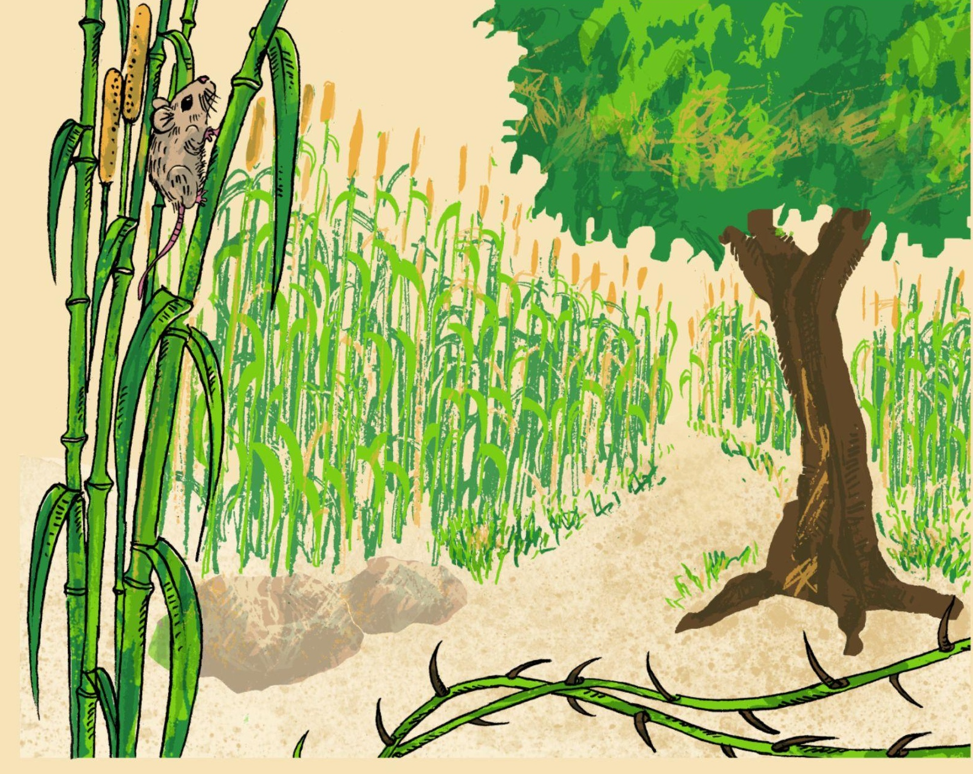
What do you see?
Notes:
1A. Discuss Theme Picture
Ask “What do you see in this picture?” and “What else?” to elicit vocabulary they already know.
Repeat and write their words or show the words on the next slide.
Answers may include path, grass, mouse, grain, roots, thorns, soil, etc.
More advanced students can be encouraged to make complete sentences:
There is a path through a beautiful island. The grain is growing. There are rocks and thorns on the ground.

Slide 4

The Natural World
Papa Ato and his daughter Aba walk slowly through their farm. They are both carefully watching the ground because of the rocks and thorns along the path. Aba looks up and spots a mouse eating the maize.
“Look, Papa!” she exclaims. “Mice are pests. They eat the grain or dig up the roots in the soil and destroy the plant.”
“Don’t worry,” Papa Ato said. “The Lord provides plenty of grain for the mice, the birds, and all of us.”
Notes:
1B. Show Description of Theme Picture
Please read the description of the theme picture to the students and point to the pictured vocabulary.
These words can be studied for homework.
Practice of vocabulary begins with the following slide.

Slide 5




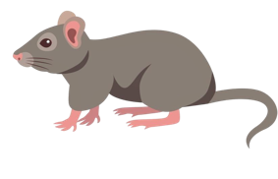
Match the beginning and end of each sentence.
1. A path is like
An island is land surrounded
3. Cows and sheep like to
A mouse is a small animal, but it can cause
A. eat grass.
B. a small road for walking.
a lot of damage. The plural form of the word is mice.
D. by water on all sides.
©2020-2025 Light of the World Learning
5
Notes:
2A. Vocabulary
1. Say the beginning of the sentence a few times, as you indicate the picture. For example, say, ”An island, an island.” Have your students then repeat the phrase after you a few times.
2. Ask students to match the beginning and end of each sentence and say the complete sentence. For example, ”An island is land surrounded by water on all sides.”
3. Check students’ comprehension further by asking direct questions. For example, “Have you ever been on an island?”
Answers
B
D
A
C
5
©2020-2025 Light of the World Learning

Slide 6

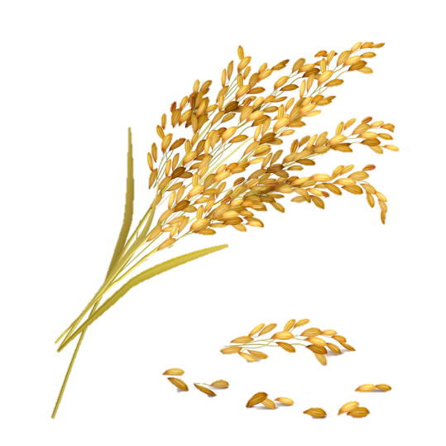
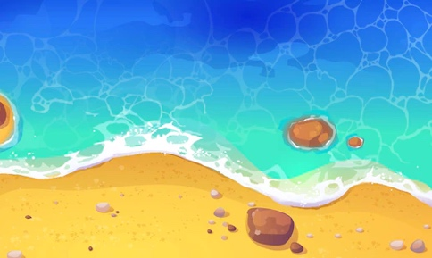
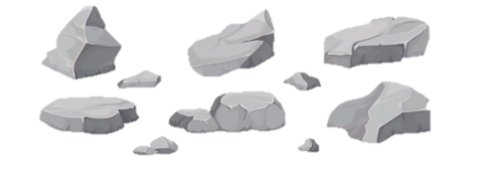
Match the beginning and end of each sentence.
5. The shore is the land
6. Rice, oats, and wheat
7. The tree has
8. Mountains and cliffs
are made of hard rock.
deep roots that grow underground.
are kinds of grain.
next to water.
©2020-2025 Light of the World Learning
6
Notes:
2B. Vocabulary
1. Say the beginning of the sentence a few times, as you indicate the picture. For example, say, ”The tree has, the tree has” Have your students then repeat the phrase after you a few times.
2. Ask students to match the beginning and end of each sentence and say the complete sentence. For example, ”The tree has deep roots that grow underground.”
3. Check students’ comprehension further by asking direct questions. For example, “Have you seen mountains made of rock?”
Answers
5. H
6. G
7. F
8. E
6

Slide 7



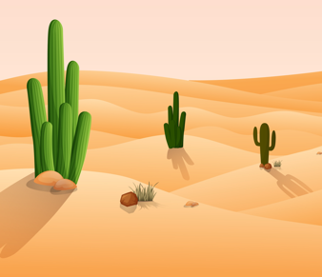
Match the beginning and end of each sentence.
9. We plant seeds
10. Roses are flowers with
11. Sand covers the ground
12. The smoke from the car
I. sharp thorns.
in the soil.
K. pollutes the air.
in the desert.
©2020-2025 Light of the World Learning
7
Notes:
2C. Vocabulary
1. Say the beginning of the sentence a few times, as you indicate the picture. For example, say, ”We plant seeds, we plant seeds” Have your students then repeat the phrase after you a few times.
2. Ask students to match the beginning and end of each sentence and say the complete sentence. For example, ”We plant seeds in the soil.”
3. Check students’ comprehension further by asking direct questions. For example, “Have you planted seeds?”
Answers
9. J
10. I
11. L
12. K
©2020-2025 Light of the World Learning
7

Slide 8
Similes with “as…as”
 | Subject + Verb | + As + Adjective + As | Noun
1 | He sounds | as quiet as | a mouse.
2 | You are | as gentle as | doves.
3 | It feels | as light as | a feather.
4 | He is | as wise as | King Solomon.
5
6
7
Notes:
2D. Grammar – Similes with “as…as”
Note: We use similes to compare two things that have a similar trait. This figurative language helps people understand and use their senses to communicate.
We use “as…as” similes to compare two things that have a similar trait.
Model, Repeat, and Solo the pronunciation of 1-4. Then ask students to create their own similes for 5-7. Answers will vary.

Slide 9
Similes with “like”
 | Subject + Verb | + Like | Noun
1 | The kingdom of heaven is | like | a mustard seed.
2 | The kingdom of heaven is | like | a treasure.
3 | Pleasant words are | like | a honeycomb.
4 | He roars | like | a lion.
5
6
7
Notes:
2E. Grammar – Similes with Like
Note: We use “like” similes to compare two things that have a similar trait. These techniques are also useful for language learners to describe unknown words. This helps us communicate effectively.
Model, Repeat, and Solo the pronunciation of 1-4. Then ask students to create their own similes for 5-7. Answers will vary.

Slide 10
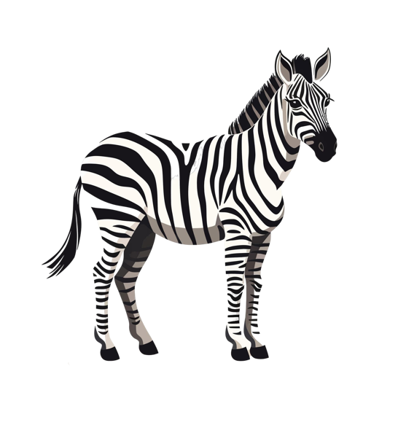
Use similes to explain unknown words.
 | Question | Simile
1 | What is a giraffe? | It’s like a camel with a long neck and spots.
2 | What’s a tortilla? | It’s like bread that’s as thin as paper.
3 | What’s a zebra?
4 | What’s a mouse?
5
6
7
Notes:
2F. Grammar – Similes to explain unknown words.
Note: We use similes to compare two things that have a similar trait. These techniques are also useful for language learners to describe unknown words. This helps us communicate effectively.
Model, Repeat, and Solo the pronunciation of 1-4. Then ask students to create their own similes for 3-4 and questions and similes for 5-7. Answers will vary.
Possible Answers:
3. It’s like a horse with black and white stripes.
4. It’s like a small rat.

Slide 11
Underline the similes in these verses:
Isaiah 40:31 NIRV – But those who trust in the Lord will receive new strength. They will fly as high as eagles.
Psalm 1:3 NIRV – That kind of person is like a tree that is planted near a stream of water. It always bears its fruit at the right time.
Matthew 10:16 NIRV – I am sending you out like sheep among wolves. So be as wise as snakes and as harmless as doves.
Matthew 28:3 ERV - The angel was shining as bright as lightning. His clothes were as white as snow.
1 Peter 1:24 NIRV - It is written, “All people are like grass. All their glory is like the flowers in the field. The grass dries up. The flowers fall to the ground.
Notes:
2G. Grammar – Similes with Like and As…As
Encourage the students to read or listen to the verses in their own language. Then Model, Repeat, and Solo the pronunciation of the verses. Then ask students to look for the words like and as and underline the similes in each verse. The first verse is underlined as an example.
You may also ask questions to check comprehension. For example, Who will fly as high as eagles? What color were the angel’s clothes? Who is like grass?
Answers:
Psalm 1:3 NIRV – That kind of person is like a tree that is planted near a stream of water.
Matthew 10:16 NIRV – I am sending you out like sheep among wolves. So be as wise as snakes and as harmless as doves.
Matthew 28:3 ERV - The angel was shining as bright as lightning. His clothes were as white as snow.
1 Peter 1:24 NIRV - It is written, “All people are like grass. All their glory is like the flowers in the field. The grass dries up. The flowers fall to the ground.

Slide 12
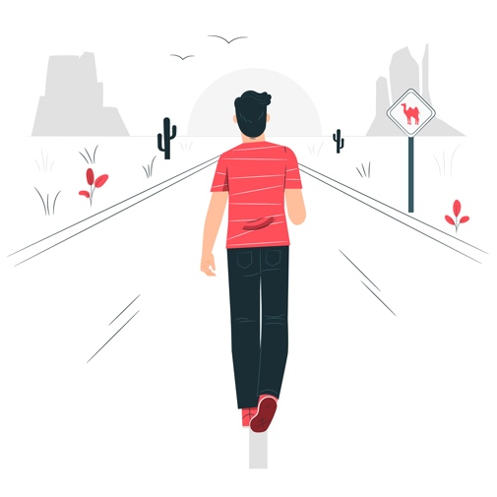
Listen and repeat.
Where are you going this weekend?
B. I’m going to an island to do some walking.
What is the island like?
It has paths with grass near the shore. What are you doing?
A. I’m going to get my hands in the soil and plant roses.
B. What are your roses like?
The thorns are sharp but the roses smell as sweet as perfume.
Notes:
3. Conversation:
1. Model: Say both parts of the conversation several times. Use A and B cards, stick figures, or change your physical position to indicate the dual parts. Role-play the parts to convey the meaning of the conversation. Students are to watch and listen.
2. Repeat: Say one line at a time and have students repeat until they can be understood.
3. Solo: You begin the conversation and call on individual students to respond. Then reverse the roles (students are A, you are B).
4. Once students can do both parts, encourage free conversation (students substitute their own words for the blue words).

Slide 13
Listen and repeat.
1. /O/ | 2. /z/ | 3. Challenge
open | zero
over | lazy
ago | zoo
solo | quiz
no | Zambia
also | zebra
4. I am flying solo over to Zambia.
5. I received a zero on the quiz a week ago.
Notes:
4A. Pronunciation - Sound and Spelling
Note: The long /O/ sound can be spelled with the letter o in an open syllable. An open syllable ends with a vowel sound that is spelled with a single vowel letter. The letter z is always pronounced /z/.
1. Model: Say the sound several times while pointing to it. For example, point to the /O/ and say “/O/ /O/ /O/.” Then say the sound and quickly read the entire list, pointing to each item as you read it (open, over, ago, solo, no, also). Students just watch and listen.
2. Repeat: Say the sound and each word several times, having students repeat each time after you in unison. Be sure to use your normal voice and rate of speed. Do one column at a time, top to bottom. Then read the sentences.
3. Solo: Call on individuals to say a sound and its word group. Give lots of praise. Then ask students to read the sentences.
4. Challenge: Choose another sound from the lesson that is challenging for your particular students to pronounce. Use words from this lesson and from previous lessons to make a group of 3-5 words. You may repeat the same challenging sounds in several lessons. Students need a lot of practice on sounds that do not exist in their first language.

Slide 14
Listen and repeat.
A. _ | B. _ ₋ | C. ₋ _
mice | teaching | pollute
grain | farmer | receive
sand | island | confused
roots | over | vaccine
Notes:
4B. Pronunciation - Hum and clap the stress.
Begin by humming the stress of a column of words. Hum higher, longer, and louder for big dashes and lower, shorter, and quieter for small dashes.
You may use hand gestures to indicate that the stressed syllable is higher in pitch, longer in duration, and louder. Invite your students to join in humming the rhythm. Once the class is humming the rhythm in unison, you can begin saying the words. You may also wish to clap the syllables while you say the words.
1. Model: Hum and then say each word in the column several times. Students listen.
2. Repeat: Students repeat words after you in unison.
3. Solo: Call on individuals to read the entire column of words.

Slide 15
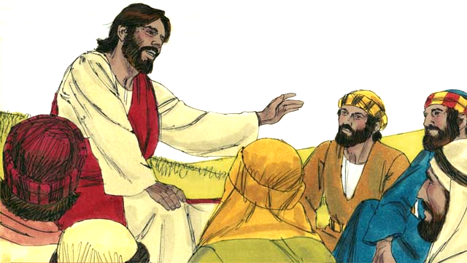
Read Matthew 13:31-46; Mark 4:26-34; Luke 13:18-21; 18:9-14 in your language. Then read Jesus Teaches with Stories.
One day, Jesus was near the shore of the lake.
He was teaching a very large crowd of people. So many people came to hear him that Jesus did not have enough room to speak to them all. So, he got into a boat on the water. There he sat and taught the people.
Notes:
5A. Bible Reading
Students should have already read this story in their first language (L1) as part of their homework, so it will be familiar even if they do not know all the vocabulary yet. However, if they have not yet read it in their L1, be sure they do so now before reading it in English. The hyperlinks of the Bible verses connect to https://live.bible.is/ so students can read and hear the scripture in their own languages.
A. Read the story out loud to the class.
B. If students ask about words, give simple definitions.
C. Encourage students to read aloud paragraphs from the story.
D. Ask if there are any questions or comments about the story.
E. Ask the story questions and discuss as a group.
F. Optional - You may hide the words and ask students to tell the story again in their own words, using the pictures to help them.

Slide 16
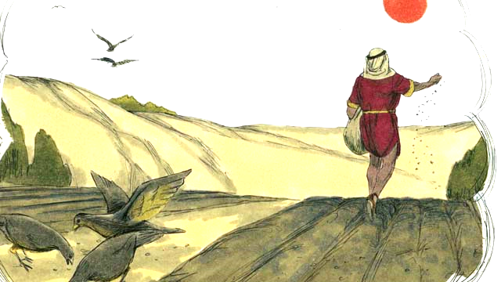
Jesus told this story. “A farmer went out to plant some seed. As he was spreading the seed by hand, some of the seed fell on the path. But birds came and ate all of that seed.”
“Other seed fell on rock, where there was very little soil. The seed on the rocky ground sprouted quickly, but its roots were not able to go deep into the soil. When the sun came up and it got hot, the plants dried out and died.”
Notes:
5B. Bible Reading
A. Read the story out loud to the class.
B. If students ask about words, give simple definitions.
C. Encourage students to read aloud paragraphs from the story.

Slide 17
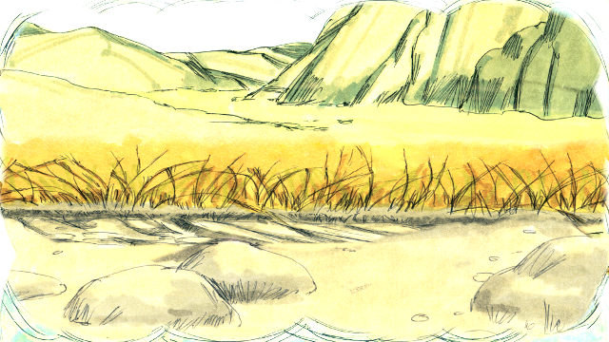
“Still other seed fell among thorn bushes. This seed began to grow, but the thorns choked it out. So, the plants that grew from the seed in the thorny ground did not produce any grain.”
“Other seed fell into good soil. This seed grew up and produced 30, 60, or even 100 times as much grain as the seed that had been planted. Whoever wants to follow God, let him pay attention to what I am saying!”
Notes:
5C. Bible Reading
A. Read the story out loud to the class.
B. If students ask about words, give simple definitions.
C. Encourage students to read aloud paragraphs from the story.

Slide 18
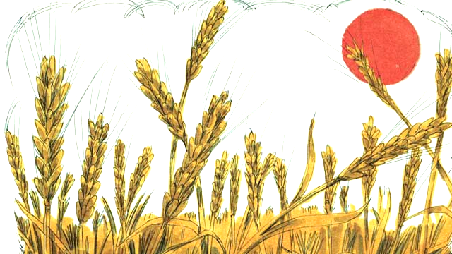
This story confused the disciples. So, Jesus explained, “The seed is the word of God. The path is a person who hears God’s word but does not understand it. Then the devil takes the word away from
him. That is, the devil keeps him from understanding it.”
“The rocky ground is a person who hears God’s word and accepts it with joy. But when he suffers hardships, or when other people make him suffer, he falls away from God. That is, he stops trusting in God.”
Notes:
5D. Bible Reading
A. Read the story out loud to the class.
B. If students ask about words, give simple definitions.
C. Encourage students to read aloud paragraphs from the story.

Slide 19
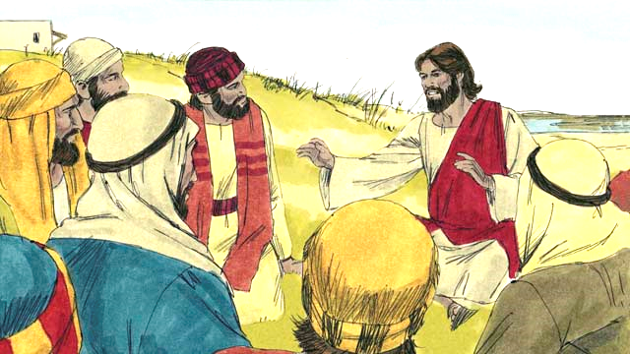
“The thorny ground is like a person who hears God’s word. But he begins to worry about many things, and he tries to make a lot of money, and he tries to get many things. After some time, he is not able to love God any longer.
So, what he learned from God’s word does not make him able to please God. He is like wheat stalks that do not produce any grain.”
“But the seed in the good soil is a person who hears the word of God, believes it, and produces fruit.”
Notes:
5E. Bible Reading
A. Read the story out loud to the class.
B. If students ask about words, give simple definitions.
C. Encourage students to read aloud paragraphs from the story.
©2020-2025 Light of the World Learning

Slide 20
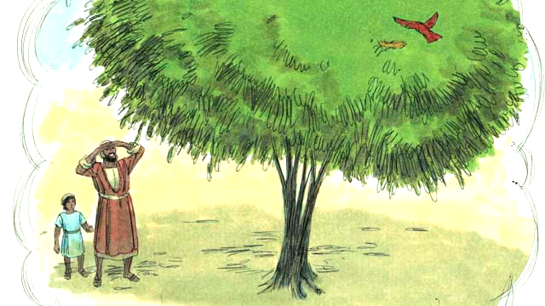
Jesus told many other stories about the kingdom of God. For example, he said, “The kingdom of God is like a mustard seed that someone planted in his field.”
“You know that the mustard seed is the smallest seed of all. But when the mustard seed grows, it becomes the largest of all the garden plants, big enough that even the birds come and rest in its branches.”
Notes:
5F. Bible Reading
A. Read the story out loud to the class.
B. If students ask about words, give simple definitions.
C. Encourage students to read aloud paragraphs from the story.
©2020-2025 Light of the World Learning

Slide 21
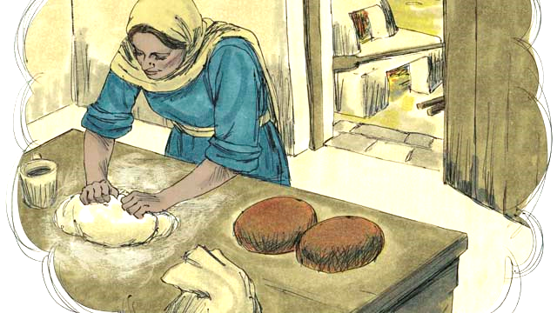
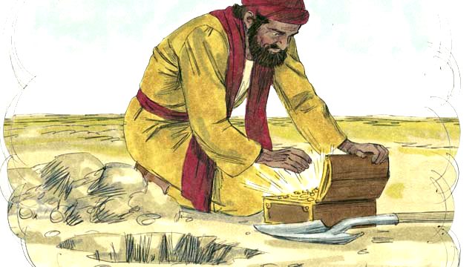
Telling another story, Jesus said, “The kingdom of God is like yeast that a woman mixes into some bread dough until it spreads throughout the dough.”
“The kingdom of God is also like treasure that someone hid in a field. When a man found the treasure he wanted it very much. So, he buried it again. He was so filled with joy that he went and sold everything he had so he could buy that field where the treasure was.”
Notes:
5G. Bible Reading
A. Read the story out loud to the class.
B. If students ask about words, give simple definitions.
C. Encourage students to read aloud paragraphs from the story.
©2020-2025 Light of the World Learning

Slide 22
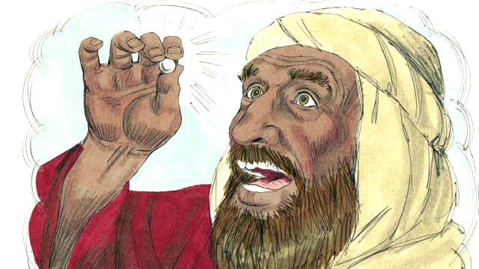
“The kingdom of God is also like a merchant looking for fine pearls. When he found a perfect pearl of great value he sold everything he had, so he could buy it.”
Notes:
5H. Bible Reading
A. Read the story out loud to the class.
B. If students ask about words, give simple definitions.
C. Encourage students to read aloud paragraphs from the story.
©2020-2025 Light of the World Learning

Slide 23
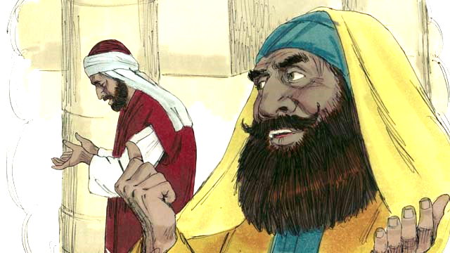
“There were some people who thought they were very good. They thought God would accept them because they did good things. These people hated others who did not do those good things.”
“One day a religious leader and a tax collector went to the Temple to pray. The religious leader prayed, ‘Thank you, God, that I am not a sinner like other men—such as robbers, adulterers, or even like that tax collector over there. For example, I fast two times every week and I give you ten percent of all the money that I receive.’”
Notes:
5I. Bible Reading
A. Read the story out loud to the class.
B. If students ask about words, give simple definitions.
C. Encourage students to read aloud paragraphs from the story.
©2020-2025 Light of the World Learning

Slide 24
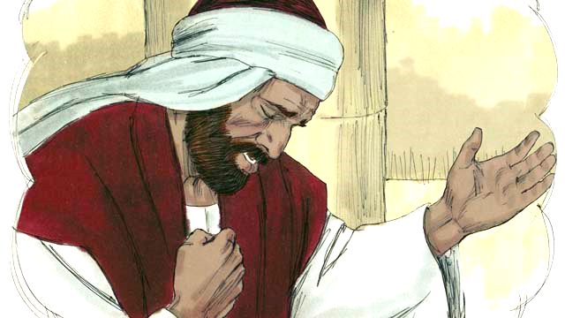
“But the tax collector stood far away from the religious leader. He did not even look up to heaven. Instead, he pounded on his chest with his fist and prayed, ‘God, please have mercy on me because I am a sinner.’”
Then Jesus said, “I tell you. God heard the tax collector’s prayer and made him right with God, rather than the religious leader. God will dishonor everyone who is proud, but he will honor whoever humbles himself.”
Notes:
5J. Bible Reading
A. Read the story out loud to the class.
B. If students ask about words, give simple definitions.
C. Encourage students to read aloud paragraphs from the story.
©2020-2025 Light of the World Learning

Slide 25
Answer the questions.
1. What are the 4 kinds of ground the seeds fell on?
2. Why did Jesus have to explain the story to the disciples?
3. What did Jesus say the seeds were like?
4. Why is the kingdom of God like a mustard seed?
5. Why were the tax collector’s prayers right and the religious
man’s prayers not right?
6. How does God want us to pray?
Notes:
5K. Bible Reading Questions
Ask the questions and discuss as a group. For questions 1, 2, and 3 you may go back to the story to help students find the answer.
Answers:
1. The seeds fell on the path, rocky ground, among thorns, and good ground .
2. They were confused.
3. The seeds were like the word of God.
4. Answers may vary. It seems small but grows and is a shelter to many.
5. Answers may vary. Because the tax collector was humble and the religious man was proud.
6. Answers may vary. God wants us to be humble.

Slide 26
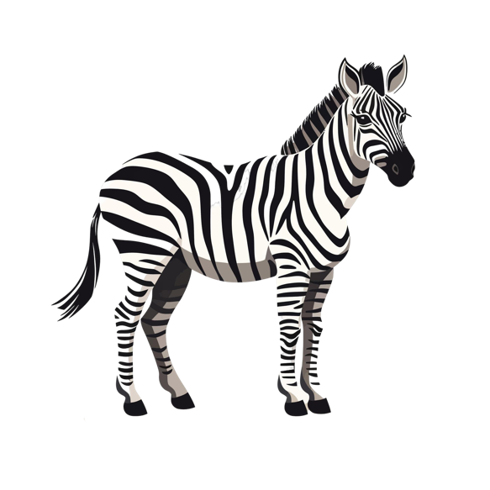
Listen and answer the questions.
What will happen at 3:00?
Who can enter the zoo before 3:00?
Are zebras lazy?
Where do zebras live?
How long can zebras live?
Where do most people see zebras?
©2020-2025 Light of the World Learning
Notes:
6A. Activities – Listening with sound/spelling words /O/ and /z/
Read the following script at least twice as students listen and write their answers to the questions. Students may NOT look at the script.
Hello everyone and welcome to the Brookfield Zoo. For today only, the zoo will open at three o’clock. Usually, it opens at ten. It is opening late today because a special zebra is coming over from Zambia. No one can enter the zoo until the new animal arrives. Here is a quick quiz for you: Do you think zebras are lazy? No, they can go from zero to forty miles per hour in seconds. They live in open grasslands, moving in herds of 20 to 100 zebras. They love to graze on green grass. They protect one another and look out for the old and the weak. They can live for over 20 years. The stripes of each zebra are unique. No two zebras are exactly the same. Also, they are very smart. They can find water in very dry places. Not long ago, some zebras were endangered, but now they are protected by environmentalists. Some people go to Zambia to see zebras in wildlife parks, but most of us can only see zebras in a zoo.
Answers:
The zoo will open at 3:00.
No one can enter before 3:00.
Zebras are not lazy. They can go from zero to 40 mph in seconds.
Zebras live in open grasslands.
5. Zebras can live for over 20 years.
6. Most people see zebras in a zoo.

Slide 27
Role Play A - Customer
A: Hello, how much do you charge to work in a garden?
B: It depends on the type of work. Do you need branches cut?
Garden Work Needed |  | Cost
A | Weeds pulled - about 3 hours
B | 100 square foot path repaved
C | Roots removed - about 2 hours
D | Soil tilled - about 1 hour
E | Grass mowed - about 1 hour
F | Six 20-pound rocks removed
Total Cost |  | $
Notes:
6B. Activities - Role Play
Pair work. Partner B is a gardener. Partner A is a customer who wants to know the cost of garden work. Partner A will look at this slide and fill in the information. Partner B will look at the following slide. They may NOT look at each other’s slides.
Student B must ask about the type of work needed.
Student A must answer the questions and discuss the price.

Slide 28
Role Play B – Garden Worker
A: Hello, how much do you charge to work in a garden?
B: It depends on the type of work. Do you need branches cut?
Work | Price | Work | Price
Branches cut | $5 per branch | Fruit picked | $20 per hour
Seeds planted | $23 per hour | Weeds pulled | $20 per hour
Rocks removed | $2 per pound | Path repaved | $10 per square foot
Leaves raked | $21 per hour | Tree roots removed | $30 per hour
Bushes trimmed | $22 per hour | Soil tilled | $25 per hour
Grass cut | $25 per hour | Plants watered | $15 per hour
Notes:
6C. Activities - Role Play
Pair work. Student B is a gardener. Student A is a customer who wants to know the cost of garden work. Partner A will look at the previous slide and fill in the information. Partner B will look at is slide. They may NOT look at each other’s slides.
Student B must ask about the type of work needed.
Student A must answer the questions and discuss the price.

Slide 29

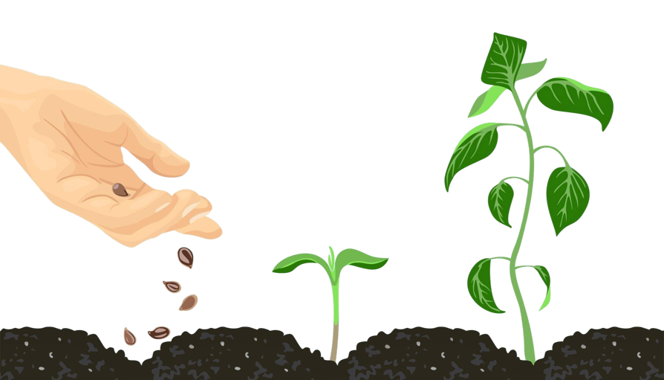
Chorus
The seed is the word of God that’s sown
On hearts like the fertile soil or hardened like stone
But when we hear his words of love
Receive the truth sown from above
The seed will take root, and God’s fruit will grow
Song: God’s Fruit Will Grow ©2024 by Tim Lewis
The farmer goes out to plant his seed,
He scatters it all around.
It falls on the path, in the rocks and the weeds,
On four different types of ground.
Some seeds will fall upon the path
Where the birds come devour every one
On the rocky soil the seeds begin to grow,
But they wither in the heat of the sun
Some seeds will fall among the thorns
Where they’re choked so the fruit will never come
But where the seeds fall upon the fertile soil
A harvest of new grain has begun
And when we hear his words of love
Receive the truth sown from above
The seed will take root – and God’s fruit will grow
The seed will take root – and God’s fruit will grow
Notes:
7. Songs
Students will learn the new song for the lesson and may also request to sing favorite songs from previous lessons, if time permits. For this song, you will sing the chorus after each verse.
1. Model: Read the song lyrics out loud to the class. Ask if there are any questions. Highlight words that students ask about and give simple definitions. Then sing the song two or three times, as the students just listen.
2. Repeat: Sing the selection again, a line or sentence at a time, as students repeat after you. Then play the recording and sing the song together as a class in unison.
3. Solo: The student sings solo (or if shy, can just read the words aloud).

Slide 30



1A. Write about the pictures using As…As similes.
1 | The path was as curvy as a winding river. | 4
2 |  | 5
3 |  | 6
Notes:
Homework 1A. - Write sentences using the pictured vocabulary words.
Model. Go over each of the homework assignments to be sure the student understands what to do.
Repeat. Encourage students to practice speaking and reading the completed homework assignments with a friend. They may use a bilingual dictionary.
Solo. Students will share their homework when they are finished. After they have shared their homework, be sure to check it for correctness, including spelling. Explain mistakes, while providing praise and encouragement.
Number one is an example.
Answers may vary, but will start with a capital letter, have a punctuation mark at the end, and use the following words:
path
roots
island
grain
thorn
soil
©2020-2025 Light of the World Learning

Slide 31
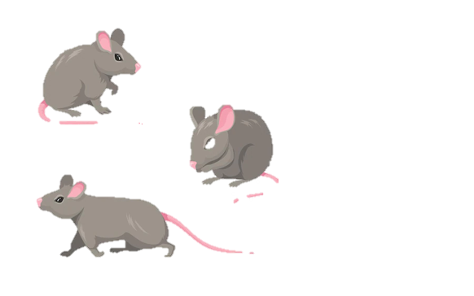
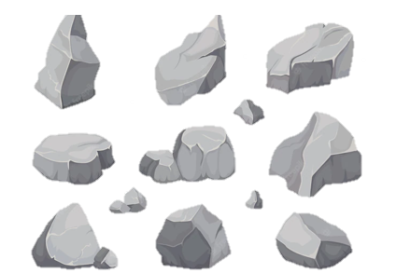
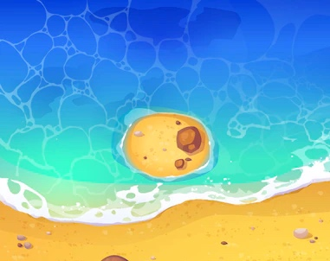

1B. Write about the pictures using Like similes.
7 |  | 10
8 |  | 11
9 |  | 12
Notes:
Homework 1B. - Write sentences using the pictured vocabulary words.
Students will write a sentence for each picture to practice the lesson’s vocabulary words.
Answers may vary, but will start with a capital letter, have a punctuation mark at the end, and use the following words:
7. mice
8. pollute
9. shore
10. sand
11. rocks
12. grass
©2020-2025 Light of the World Learning

Slide 32
2. Complete the charts with your own similes using like and as…as.
My heart is like | a drum.
Our class is like
My life feels like
My faith is like
 | the sea.
We run | as slow as | turtles.
 | as cold as
 | as smart as
 | as light as
 | as sweet as
I feel
 |  | the moon.
Notes:
Homework 2. Grammar Review - Similes
Learners will fill in the blanks to create their own similes. The first rows give examples.
Answers will vary but must include the correct simile forms.

Slide 33
3. Write questions and ask your partner.
Questions | Answers
1. Where are Zambia and Zimbabwe? | They are in Africa.
2. Do you like mustard on _____________
3. Do you like to work _______________
4. Which grain do you ________________
5. What plants do you ________________
6. What kind of pollution ______________
7. What color is the soil in _____________
Notes:
Homework 3. – Conversations - Pair work
First, ask students to complete writing the questions with their own words. Be sure they put a question mark at the end. Number 1 is an example.
Questions and answers will vary, but may include:
2. Do you like mustard on your hot dog?
3. Do you like to work in the garden?
4. Which grain do you grow in your area?
5. What plants do you grow in your garden?
6. What kind of pollution bothers you?
7. What color is the soil in your country?
Then ask each student to interview a partner and write their partner’s answers. Then they will switch roles and answer their partner’s questions.
Check answers for correct grammar and punctuation.
©2020-2025 Light of the World Learning

Slide 34
4. Match the words and say the sentences with the /O/ and /z/ sounds.
over graze Zambia a zebra a zoo solo
buzz open Brazil an ocean photo polite
A. | Solo | means alone.
B. |  | is a country in South America.
C. |  | is a country in southern Africa.
D. |  | is like a big sea.
E. |  | is the opposite of closed.
F. |  | is like a horse with stripes.
Notes:
Homework 4. – Write and say sentences with the new sounds.
This homework practices writing, spelling, and pronouncing the /O/ and /z/ sounds.
Answers:
Solo
Brazil
Zambia
An ocean
Open
A zebra

Slide 35
5. Answer the questions about the Bible reading.
1. What things did Jesus use to describe God’s kingdom?
2. What did Jesus say about the rocky soil?
3. Why was the tax collector’s prayer better than the rich
ruler’s prayer?
What is something you want so much that you would sell everything to get it?
Notes:
Homework 5. – Bible Reading Review
Students may look back at the story to answer the questions.
Answers:
The kingdom of God is like a mustard seed, a treasure, a merchant, yeast.
The seed in the rocky soil sprouted quickly, but its roots were not able to go deep into the soil.
3. Because he admitted his sin and asked for forgiveness.
4. Answers will vary.

Slide 36
6A. Choose one verse to memorize.
“But God has blessed you. You understand what you see with your eyes. And you understand what you hear with your ears.” Matthew 13:16 ERV
“And what about the seed that fell on the good ground? That is like the people who hear God’s teaching with a good, honest heart. They obey it and patiently produce a
good crop.” Luke 8:15 ERV
A
B
Notes:
Homework 6A. – Memorize a Verse
Learners get to choose A, B, or C (on the next slide) to memorize. Please notice that the memory work is not long. Everyone, regardless of skill level, should be able to do it.
1. Model. Recite a verse from memory.
2. Repeat. Encourage students to find someone with whom to practice conversing and reading the completed homework assignment.
3. Solo. Students will recite the verse from memory at the next class.

Slide 37
6B. Choose one verse to memorize and
read the next verses.
“God’s kingdom is like the seed of the mustard plant. Someone plants this seed in their garden. The seed grows and becomes a tree, and the birds build nests on its branches.”
Luke 13:19 ERV
Read the next lesson’s Bible verses in your language.
Luke 15:1-32
C
Notes:
Homework 6B. – Memorize a verse and read the next lesson’s verses.
Learners get to choose A, B, (from the previous slide) or C to memorize.
Students will always read the Bible lesson in their first language (L1) before reading it in English the following lesson. Help them get a Bible in their own language if they don’t have one. They may also use Bible.IS or other Bible translation resources.

Slide 38
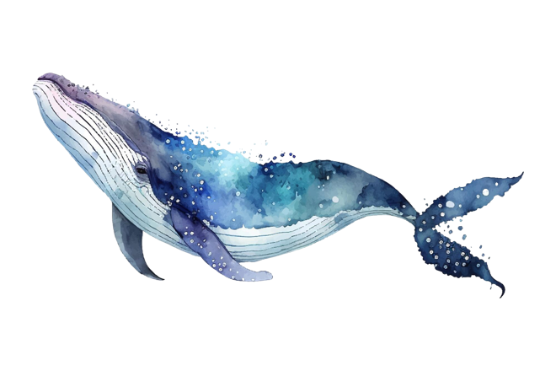
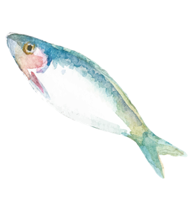
7A. Read and answer the questions.
Whales and Fish
Whales and fish both live in water. There are other ways that they are similar, but there are big differences, too.
Most whales live only in ocean water, but fish live in both freshwater and saltwater. Whales are among the largest animals on Earth, and some fish are among the smallest. You will not find many fish that are as big as whales, or even close.
One way that fish are like whales is that both have fins and a tail. This helps them to swim and stay upright. The sei whale can swim up to thirty-four miles per hour, but gray whales are not as fast. Their top speed is about six miles per hour.
Notes:
Homework 7A. – Everyday Reading and Writing
The learners will read the article and answer the questions on the last slide.

Slide 39

7B(cont.). Read and answer the questions on
the next slide.
Swordfish are the fastest fish. They can swim at sixty miles per hour. In contrast, herrings swim at only three miles per hour.
Whales are mammals, which means that they are warm-blooded like humans. Fish, on the other hand, are usually cold-blooded like snakes. That means that their body temperature changes to match the surrounding water.
Fish and whales are both created for living in the water. They are interesting creatures and fun to watch. If you live near the water, try to find time to look for them.
Notes:
Homework 7B (cont.). – Everyday Reading and Writing
The learners will read the article and answer the questions on the last slide.
©2020-2025 Light of the World Learning

Slide 40
7C. Answer the questions about the article.
What kind of water do whales and fish live in?
How do fins and a tail help whales and fish?
How fast can sei whales swim?
What kind of fish do you like to eat?
Would you like to live near the shore of a river, lake, or sea? Why?
Notes:
Homework 7C. – Everyday Reading and Writing
Answers:
Most whales live only in ocean water, but fish live in both fresh water and salt water.
Fins and a tail help whales and fish to swim and stay upright.
Sei whales can swim up to thirty-four miles per hour.
Answers will vary.
Answers will vary.

Slide 41
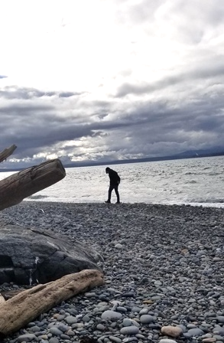
8. Writing
Draw or take a photo of your favorite place to walk. Write Write a paragraph to describe it.
Notes:
Homework 8. – Writing
Model. Show your own picture to the students and write a paragraph about it. Example: This is a photo of my favorite beach. It has lots of rocks near the shore.
Answers will vary.

Slide 42
9. Now I Can…
I can talk about things in the world of nature.
I can understand, say, read, and write _____, _____, _____, _____, _____, _____, _____, _____, _____, _____, _____, and _____.
I can use “like” and “as…as” to compare different things.
I can understand Jesus’ parable about a farmer.
I can understand how God’s word is like a seed.
Notes:
Homework 9. – “I can” statements
The student must be able to achieve all these skills before the next lesson. If not, the lesson can be repeated, or additional practice materials can be used.
Review all the skills at the beginning of the next lesson. Be sure to give lots of praise and encouragement!
©2020-2025 Light of the World Learning

Slide 43
Reflections and Closing Prayer
©2020-2025 Light of the World Learning
46
Notes:
Reflections and Closing Prayer
You may want to thank the Lord for what we have learned, ask for special prayer requests, then pray for your students and bless them. Students may write reflections and their prayers here.

Slide 44

Help us share the Light of the World!
Thank you for using our materials. If these lessons are a blessing to you, please give or volunteer to help others learn English through the Bible.
For more information, visit LightOfTheWorldLearning.org or contact Info@LOTWL.org

Slide 45

Appendix
Visit LOTWL.org to access our training, resources, community, and more.
Lesson Downloads: LightOfTheWorldLearning.org
Order Books: bit.ly/BooksLOTW
Teaching Guide: LightOfTheWorldLearning.org/training
Video Channel: youtube.com/@LightOfTheWorldLearning

Slide 46
Acknowledgements
We would like to thank the entire Light of the World volunteer team for their hard work and creativity in making this project possible. For all those around the world who prayed, wrote, edited, narrated, illustrated, sang, tested, and gave generously for this curriculum, we appreciate you sharing the love of Jesus through the gift of English. Our team members include:
Anonymous | Emily Cox | Jill Gramzow | Martha Lane
Jean Ato | Marilyn Dano | Tanya Griffin | Audrey Larsen
Bradley Baurain | Hephzi Davidson | Rachel Grijincu | Aden Lewis
Ana Biederman | Susanna Diallo | Lauren Haines | Bruce Lewis
Bob Biederman | Alyssa Dokolas | Carol Hale | Elena Lewis
Joshua Blake | EasyReadEnglish.com | Emily Hamilton | James Lewis
Rachael Braggs | Don Edic | Patty Hickman | Micah Beth Lewis
Hannah Brendel | Peggy Fergus | Juliette Hyer | Tim Lewis
Larry Buell | MaryBeth Gahan | Lyudmila Ivanyuk | Ward Lewis
Cindy Campbell | Melina Gallo | Debbie Johnson | Cosette Lindsay
Christian Cha | Alicia Gentile | Carey Jo Johnston | Johnny Lukashevich
Olivia Cheney | Prakash Chandra Giri | Nancy Kingdon | Gail MacMillan
Hannah Clark | Ellenor Gopal | Dorothy Konadu | Ivan Mader
Nancy Cobb | Henrietta Grajcar | Macy Lake | Amy Martin
(continued on the next slide)
©2020-2025 Light of the World Learning
49
Notes:
49

Slide 47
Acknowledgements - Continued
Diana Martz | Martha Ort | Macie Stuckman | Graham Whitmore
Hannah McMahan | Barb Park | Jia Le Su | Cheri Wilke
Shelli McNutt | Deb Payne | Carole Svensson | Mackenzie Williams
Christy McPherson | Linda Petrie | Ellie Talalight | Allison Wright
Tracy Meddaugh | Joan Phelps | Peter Talalight | Tiffany Yeh
Barbara Newsome | Megan Rahn | Weston Talalight | Muchun Yin
Brenda Nielsen | Sara Scazzero | Rachel Tamang | Ted York
Danielle Nowe | Hannah Schmokel | Lorna Tatomir | Tai Lee Young
Deborah O’Donnell | Ashlyn Shrimplin | Darrell Turner | Abigail Zawisza
Evelyn Ocasio | Leah Sprague | Leigha Wachter | Anita Zeifert
Georg Ort | Noah Staal | Joseph Waite
Bible story and pictures on slides 15-24 adapted from the original work by unfoldingWord available from https://openbiblestories.org
Bible Verses on slides 36-37 Taken from the HOLY BIBLE: EASY-TO-READ VERSION ©2014 by Bible League International. Used by permission.
©2020-2025 Light of the World Learning
50
Notes:
50

