Slide 1

Unit B1-01
©2020-2025 Light of the World Learning
Notes:
Teacher’s Notes:
Thank you for using our materials. For more resources visit LightOfTheWorldLearning.org or contact Info@LOTWL.org
Preparation:
Pray.
Read the Bible passages.
Preview slides and game.
Optional: Bring pictures of yourself as a child and growing up.

Slide 2

Pray, Review, and Preview
Bible Reading: Introduction and Luke 1:1-4; Psalm 24
Theme: Writing reports
Pronunciation: /oo/ and /U/
Grammar: Review using present simple, present continuous, past simple, present perfect, and future verb forms
Notes:
Pray
Pray for the class. You may want to ask God to help us tell his message well so that others can know the truth.
Check homework and review.
Ask learners to read aloud or recite their homework from the last class. Check written work.
Review the main points of the previous lesson and ask if there are any questions.
Be sure they have read the Bible passage in their native languages in preparation for the lesson.

Slide 3
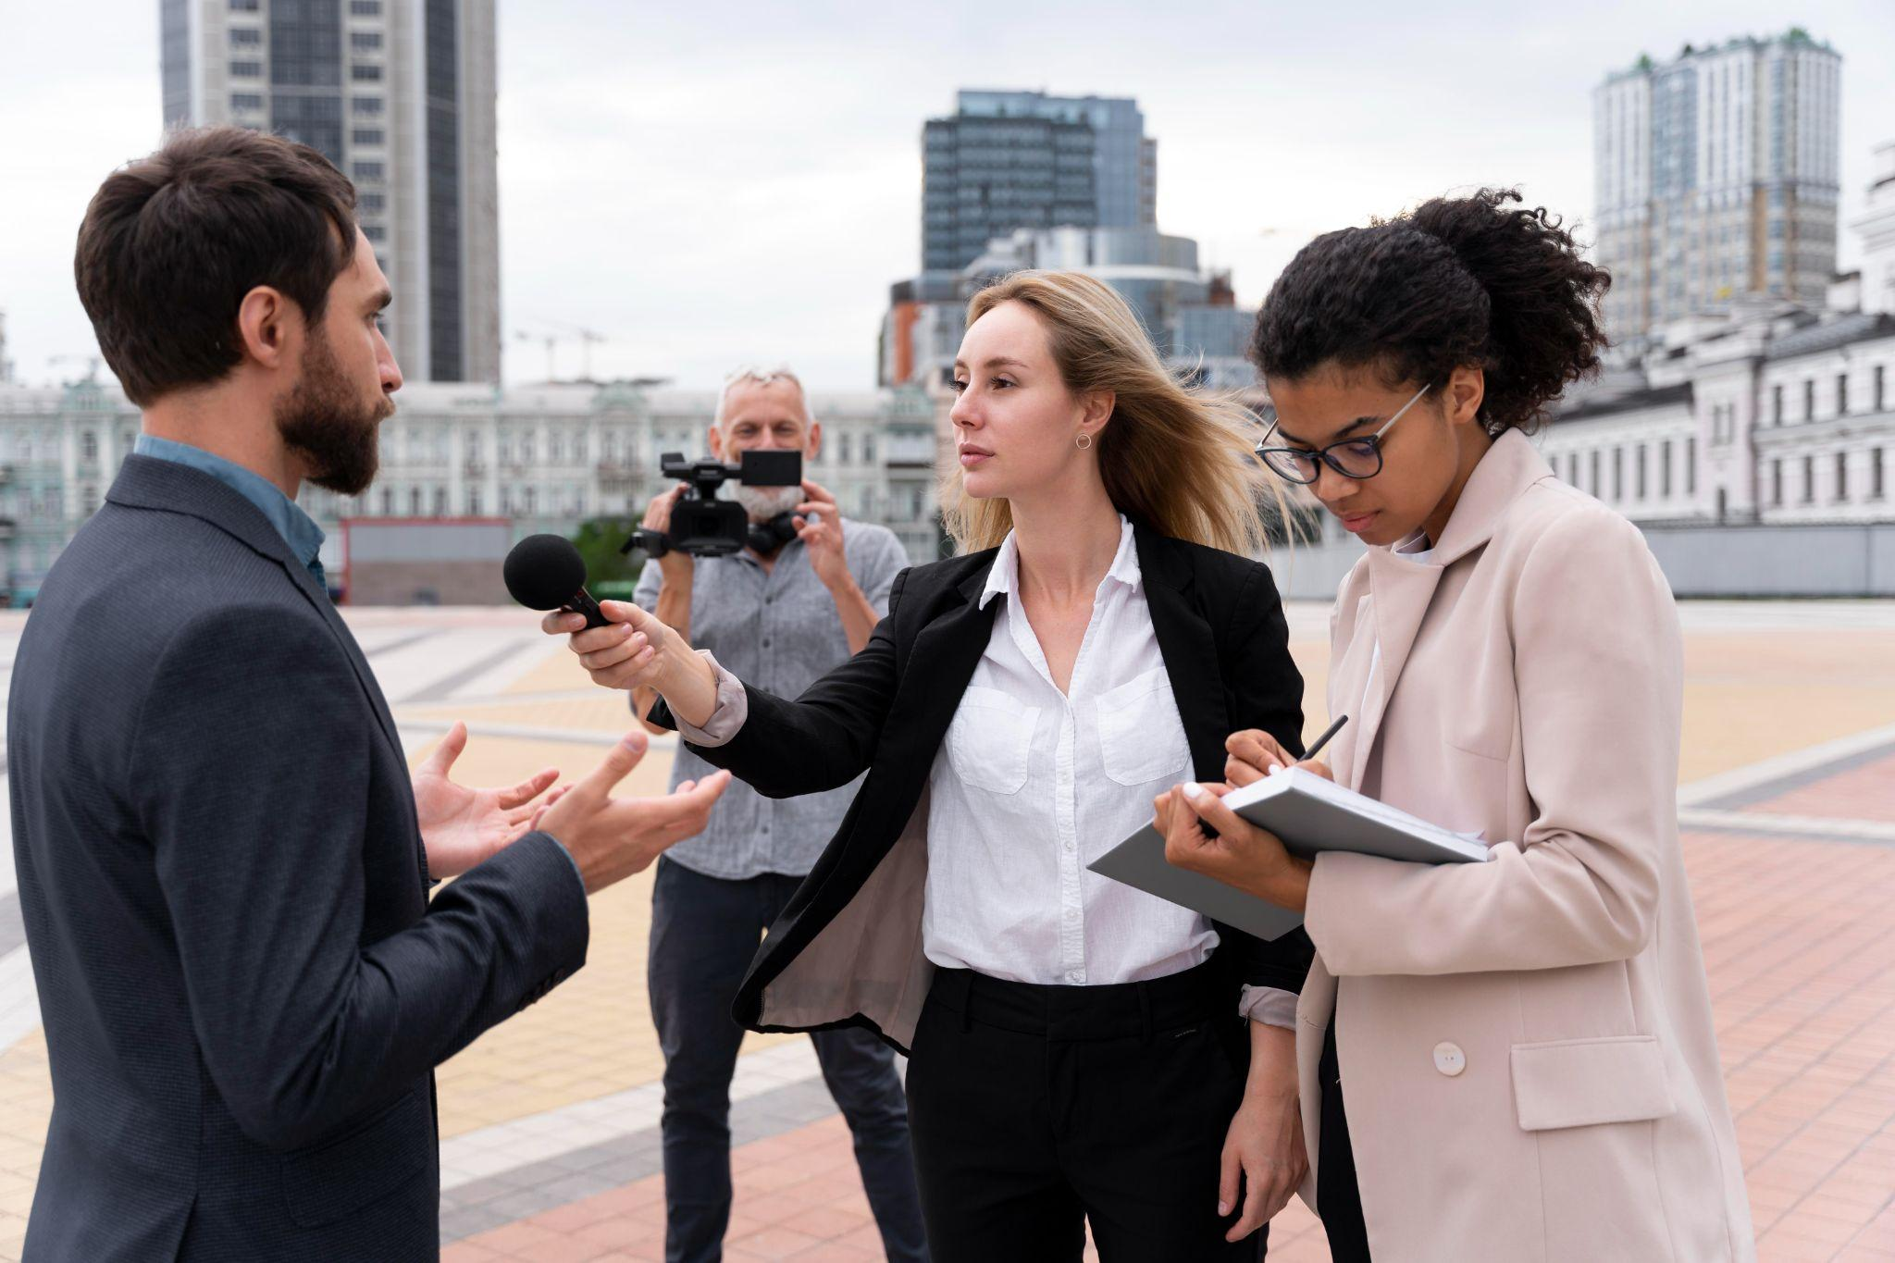
What are they doing?
Notes:
1A. Discuss Theme Picture
Ask “What are they doing?” and “What do you think will happen next?” to elicit vocabulary learners already know.
Repeat and write their words or show the words on the next slide.
Answers may include: A man is talking. A man is being interviewed. A reporter is holding a microphone. A woman is writing what the man is saying. A man is taking pictures. The women are asking the man questions. She is taking notes.

Slide 4
June and Lucy are reporters. Each day, they gather information about events happening in their city. Today, they decide to begin their day by interviewing a politician about a new law. June is holding the microphone and asking questions, and Lucy is taking notes in her notebook.
Later, Lucy will organize her notes into a report for the newspaper. She is a very good writer and wants to be sure that she writes her message clearly. Tonight, the whole city will watch this interview on television and read about it in the newspaper.
Discuss with a partner:
What kind of news do you like to read about?
Would you rather read about that news or write about it? Why?
Notes:
1B. Read about the theme picture and discuss with a partner
Please read the description of the theme picture to the learners. If learners ask about words, give simple definitions.
Then ask learners to work in pairs and discuss the questions.

Slide 5
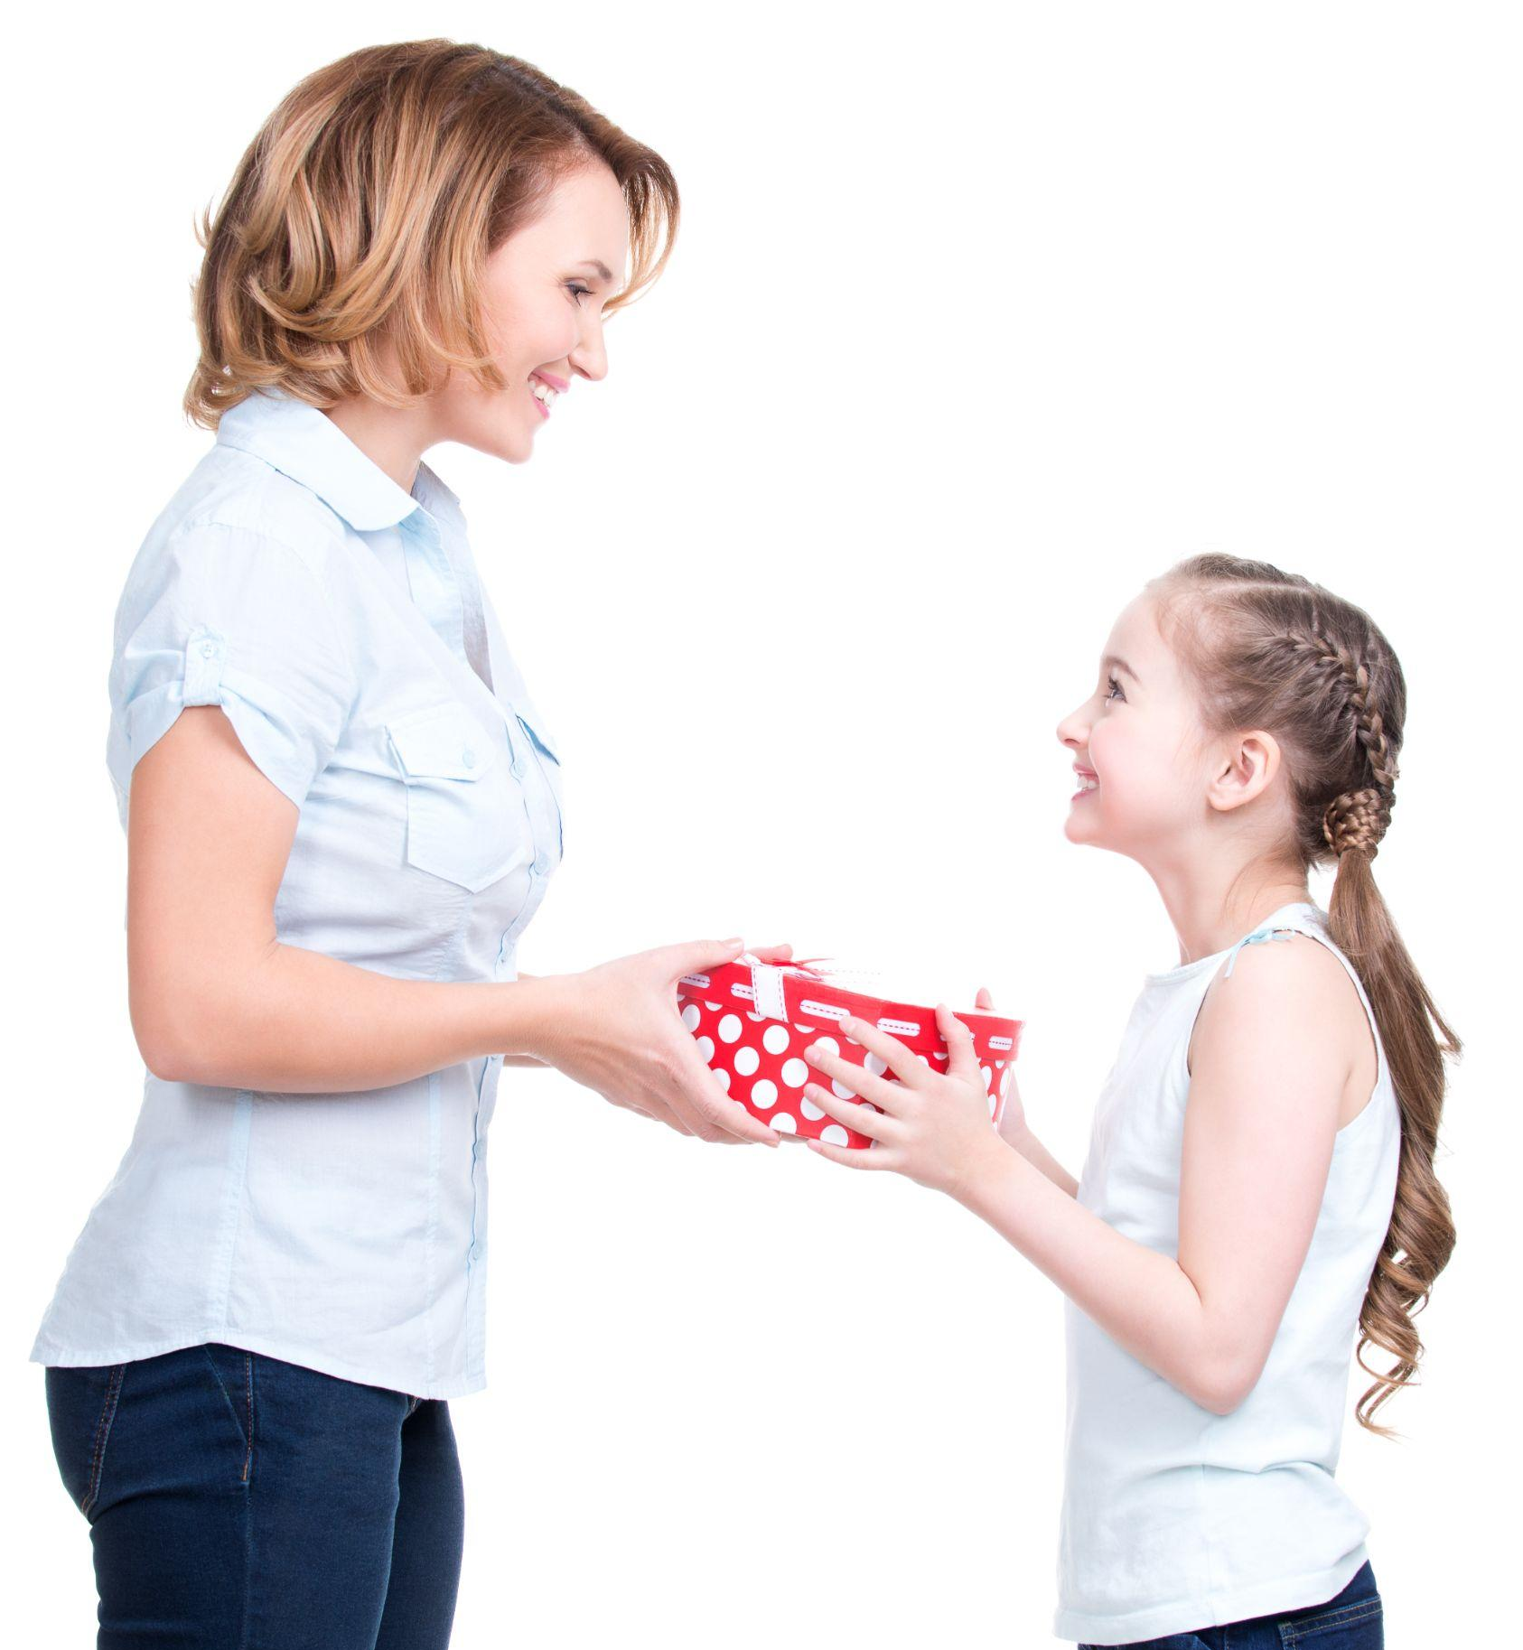

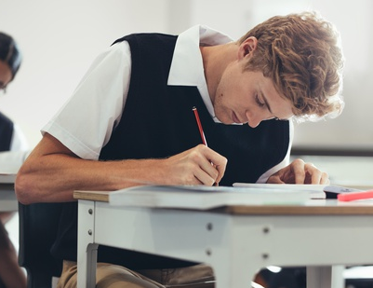
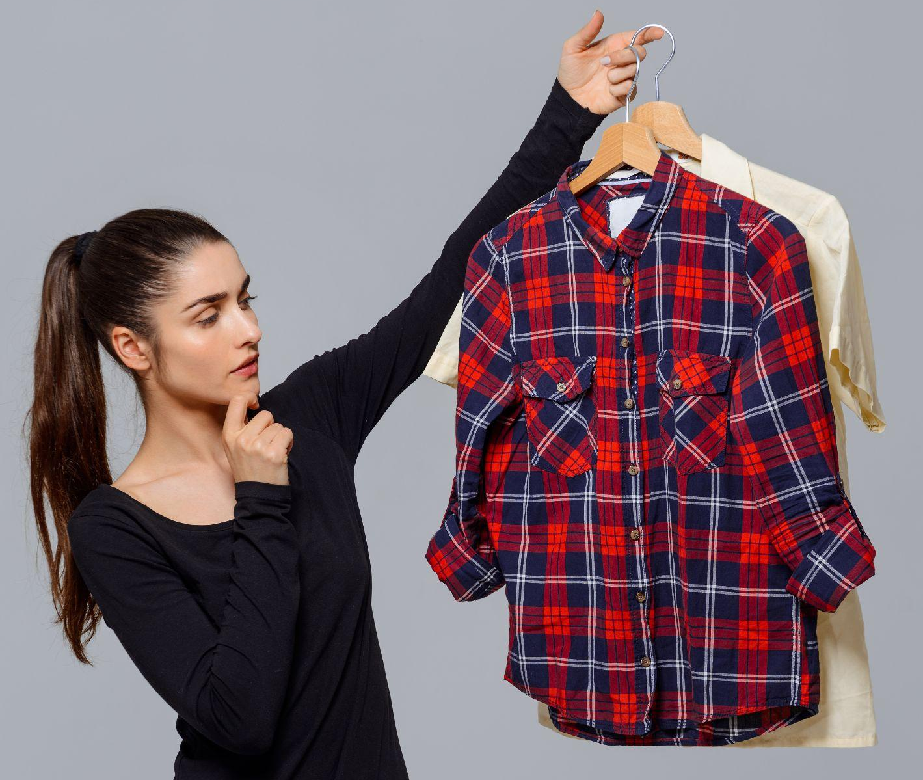
Match the beginning and end of each sentence.
1. She honored
2. I am sure
3. The learners will begin
4. She could not decide
their exam now.
her mother by giving her a gift.
that he likes coffee.
which shirt to wear.
Notes:
2A. Vocabulary
1. Say the beginning of the sentence a few times, as you indicate the picture. For example, say, ”She honored, she honored.” Have your learners then repeat the phrase after you a few times.
2. Ask learners to match the beginning and end of each sentence and say the complete sentence. For example, “She honored her mother by giving her a gift.”
3. Check learners’ comprehension further by asking direct questions. For example, “How do you honor your parents? Who else do you honor?”
Answers
1. B
2. C
3. A
4. D

Slide 6



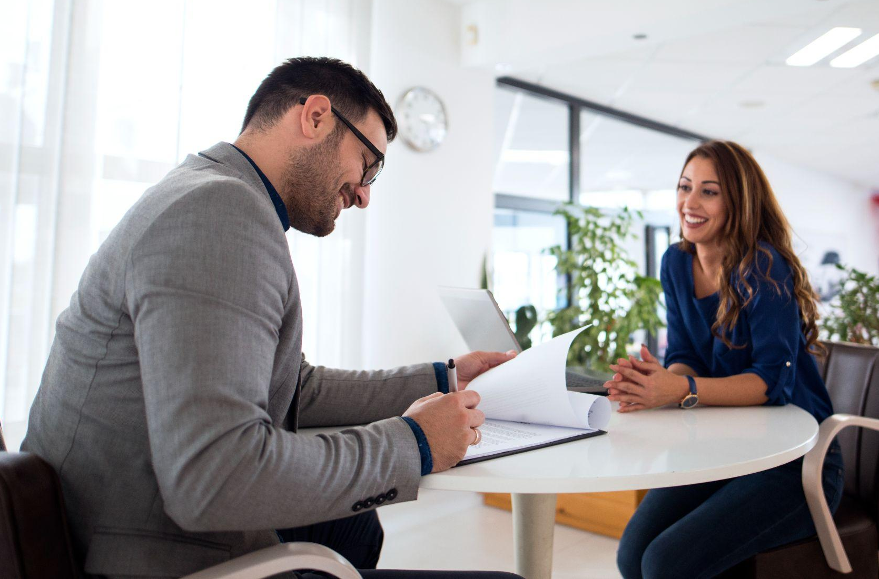
Match the beginning and end of each sentence.
1. He is writing a report
2. There are many events
3. I wrote the information
4. I gathered the news
by interviewing many people.
about crime in the city.
in my city every month.
in my notebook. 6
Notes:
2B. Vocabulary
1. Say the beginning of the sentence a few times, as you indicate the picture. For example, say, ”He is writing a report, he is writing a report.” Have your learners then repeat the phrase after you a few times.
2. Ask learners to match the beginning and end of each sentence and say the complete sentence. For example, “He is writing a report about crime in the city.”
3. Check learners’ comprehension further by asking direct questions. For example, “What would you write a report on? Do you have crime in your city?”
Answers
1. B
2. C
3. D
4. A

Slide 7




Match the beginning and end of each sentence.
1. She organizes
2. Her outline
3. The introduction
4. The conclusion
shows all the important parts of her report.
begins the report to say what it is about.
ends the report to emphasize the main point.
her notes so that they are in order.
Notes:
2C. Vocabulary
1. Say the beginning of the sentence a few times, as you indicate the picture. For example, say, ”She organizes, she organizes.” Have your learners then repeat the phrase after you a few times.
2. Ask learners to match the beginning and end of each sentence and say the complete sentence. For example, “She organizes her notes so that they are in order.”
3. Check learners’ comprehension further by asking direct questions. For example, “Do you like to organize? Are you an organized person? What do you organize?”
Answers
1. D
2. A
3. B
4. C

Slide 8

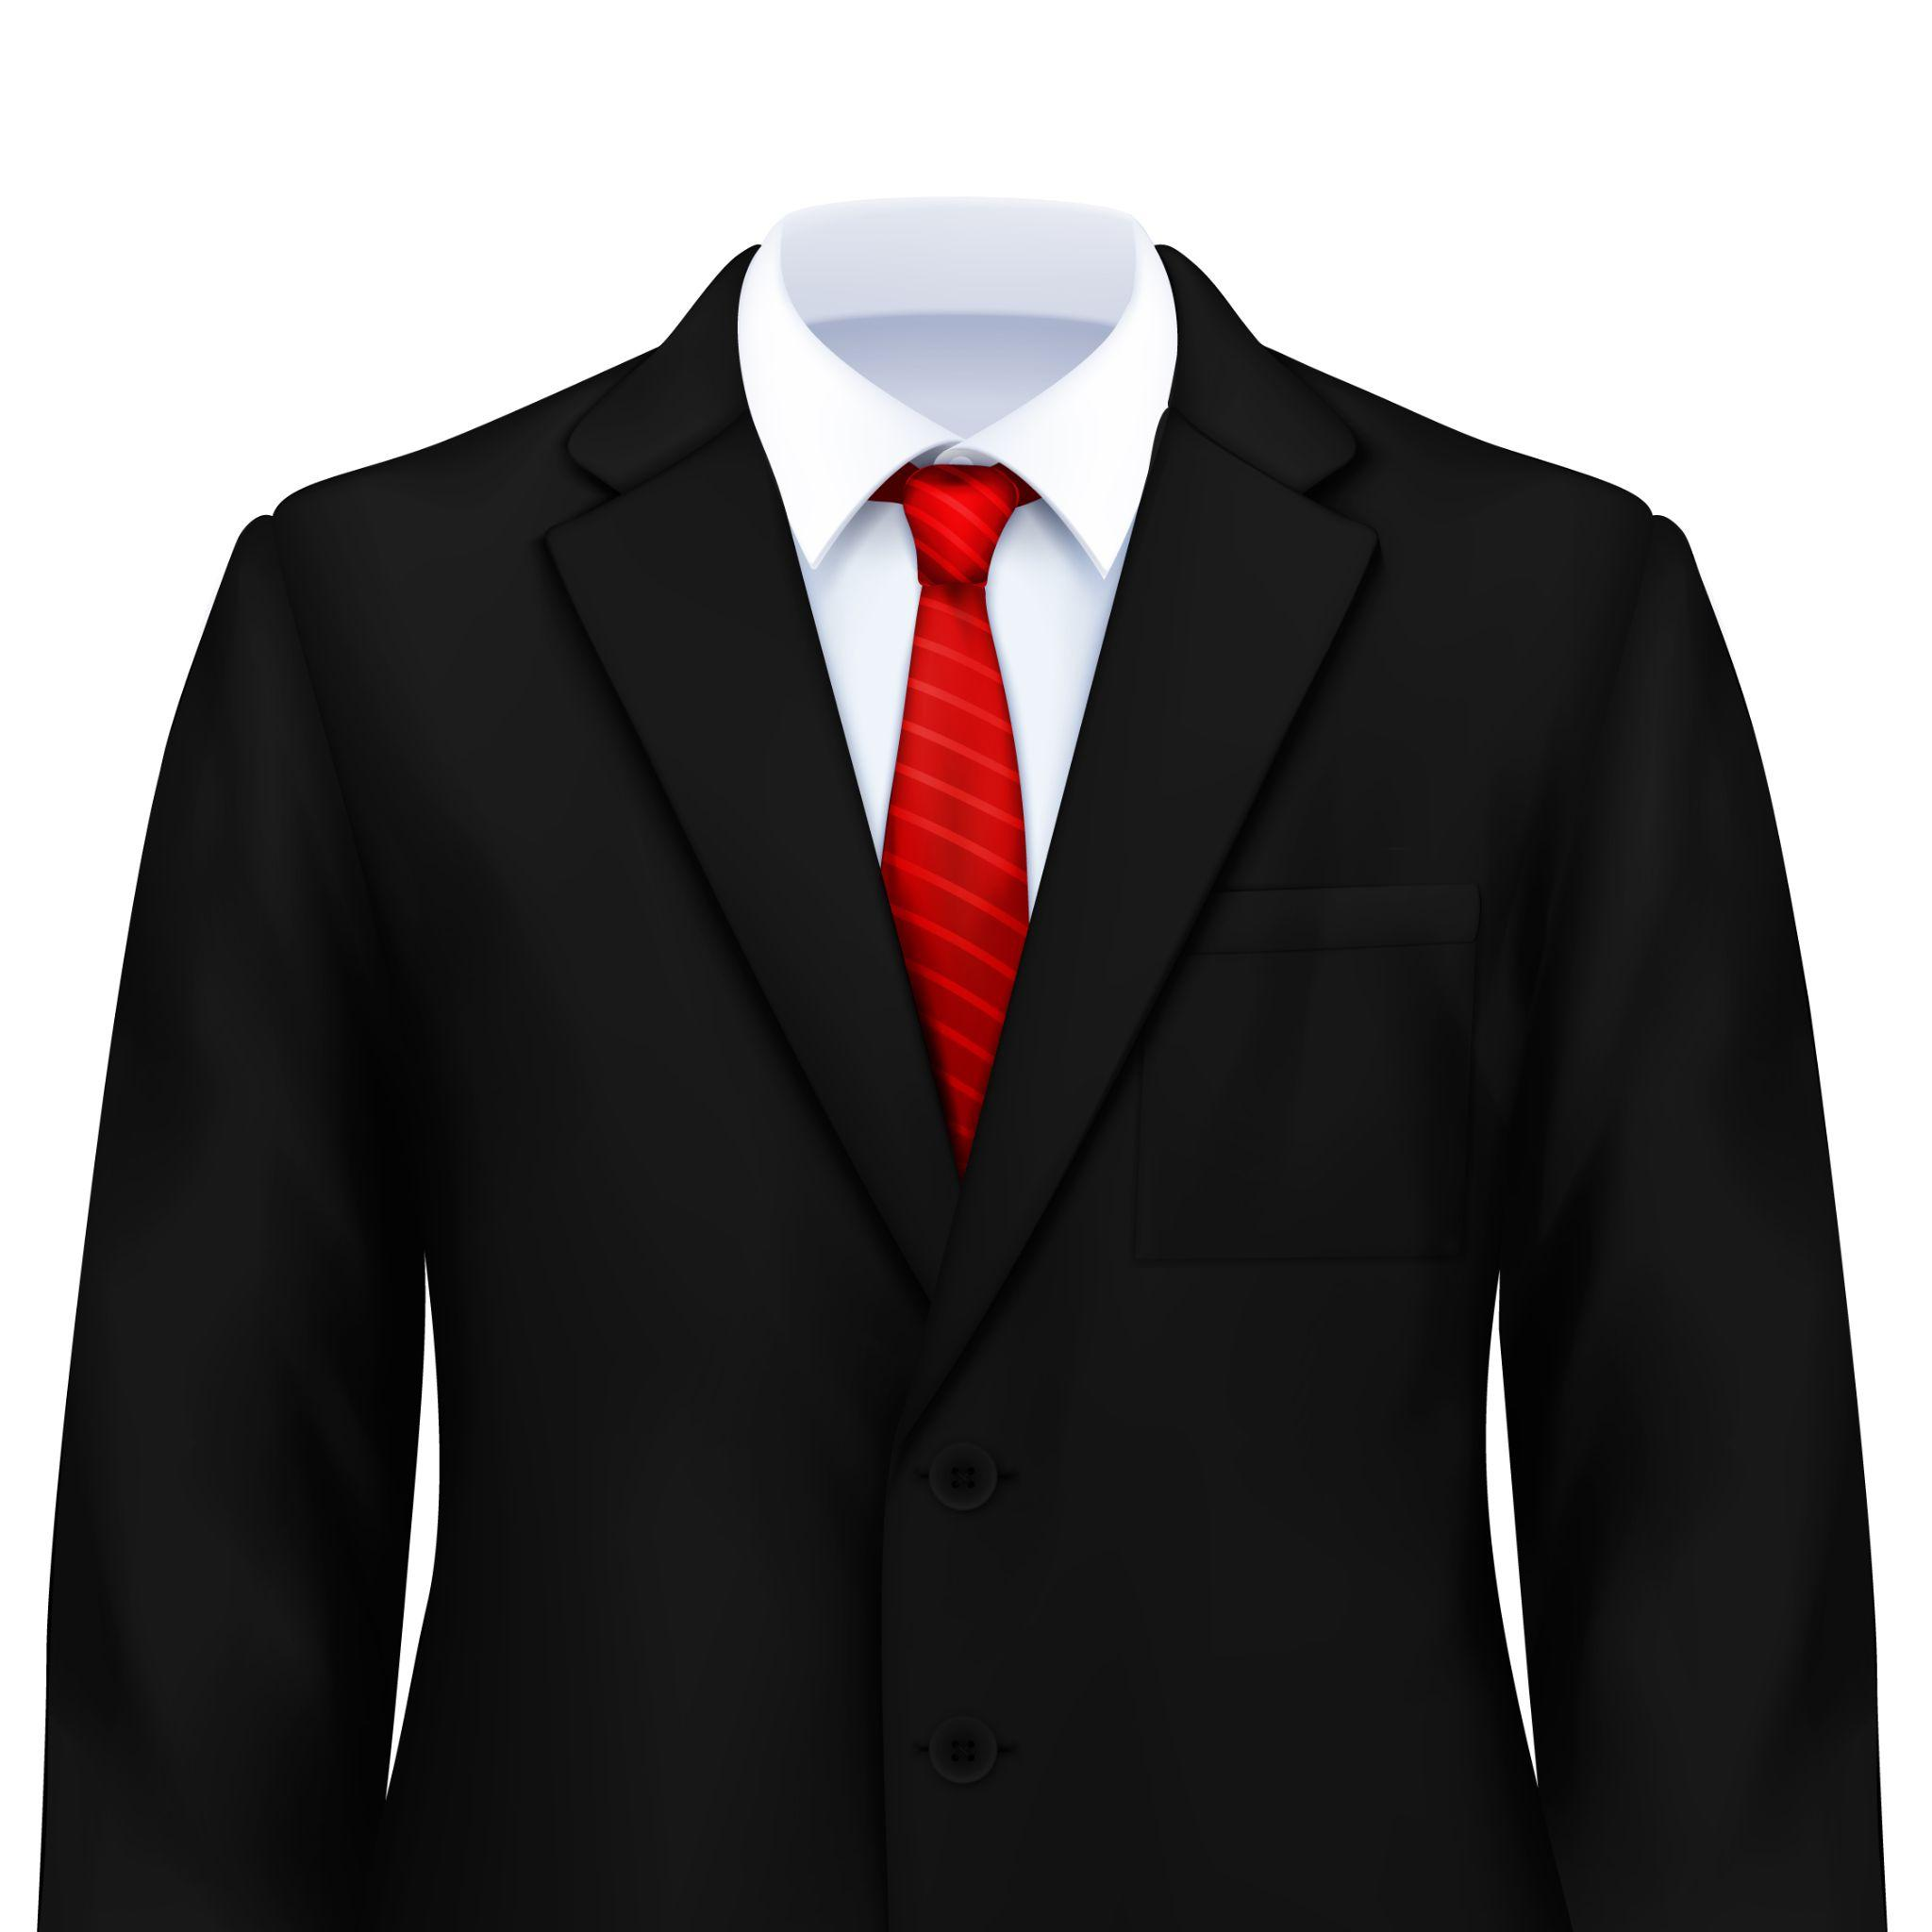

Reviewing Verb Tenses
Past Simple
Usage | Example
Describes an action already completed. | I pulled the door open.
Present Simple
Usage | Example
Describes habits or general truth. | He always wears a suit.
Present Perfect
Usage | Example
Describe a past action with an unfinished time | I have gone in the pool.
Notes:
2D. Grammar: Reviewing Verb Tenses
Read the usage and example sentence for each of the five verb forms before completing the practice on the next two slides.
Past simple describes an action already completed.
Example: I pulled the door open.
Present simple describes habits or general truth.
Example: He wears a suit.
Present perfect describes a past action with an unfinished time.
Example: I have gone in the pool.

Slide 9


Reviewing Verb Tenses
Present Continuous
Usage | Example
Describe something happening right now. | They are looking at me.
Future Simple
Usage | Example
Describe something which has not happened yet. | She will write a report. She is going to write a report.
Notes:
2E. Grammar: Reviewing Verb Tenses
Read the usage and example sentence for each of the five verb forms before completing the practice on the next two slides.
Present continuous describes something happening right now.
Example: They are looking at me.
Future simple describes something which has not happened yet. There are two main ways that we write the past tense.
Example: She will write a report.
Example: She is going to write a report.

Slide 10
Present Simple, Past Simple, and Future Tenses
 | Present Simple | Past Simple | Future Simple
1 | He always walks to the store. | He walked to the store last night. | He’ll walk to the store at 3:00. He’s going to walk to the store.
2 | I honor my parents every day. | ______________. | I will honor my parents. ___________________.
3 | She studies her vocabulary. | She studied her vocabulary in May. | ___________________. ___________________.
4 | They usually smile at the baby. | ______________. | ___________________. They’re going to smile at the baby when they visit.
Notes:
2F. Grammar – Reviewing present simple, past simple, and future tenses
Simple past tense is used for a past action that is finished.
Regular simple past verbs end in –ed. Irregular verbs do not end in -ed. They can be found on the list in the appendix.
The past tense verb form is the same in all persons.
Future tense is used for an action that will happen in the future, and it is communicated in two main ways.
The first way is with the word “will” plus the base form of the verb (example: He will walk).
The second way is with a conjugated form of “be” plus “going to” plus the base form of the verb (example: He is going to walk). This second way often sounds less formal, since it is easier to make a contraction (example: he’s, I’m, she’s, they’re).
Model, Repeat, and Solo row number 1. Then ask learners to complete the sentences for rows 2-4.
Answers:
2. I honored my parents. I am going to plan my schedule.
3. She will study her new vocabulary. She is going to study her new vocabulary.
4. They smiled at the baby. They will smile at the baby.

Slide 11
Present Simple, Present Continuous, and Present Perfect Tenses
 | Present Simple | Present Continuous | Present Perfect
1 | I rarely wrap presents. | I am wrapping presents right now. | I have wrapped presents before.
2 | She gathers information. | She is gathering information today. | _______________.
3 | You honor your father. | _____________. | You have honored your father.
4 | We organize the closet. | _____________. | _______________.
Notes:
2G. Grammar: Reviewing present simple, present continuous, and present perfect tenses
Present continuous tense is used for an action that is happening right now and has not finished yet.
We make the present continuous form by adding a conjugated form of “be,” then the base verb with an -ing ending (example: I am wrapping).
Present perfect tense is used for unfinished actions that happened in the past but have not necessarily ended.
We make the present perfect form by adding a conjugated form of “have” and the past participle form of the verb (example: I have wrapped). For most verbs, the past participle is the same as the simple past tense.
Model, Repeat, and Solo row number 1. Then ask learners to fill in the blanks for rows 2-4.
Answers:
2. She has gathered information.
3. You are honoring your father.
4. We are organizing the closet. We have organized the closet.

Slide 12


Listen and repeat.
A: What are you doing?
B: I’m writing a report about _____ for my class.
A: Wow, how did you gather all your information?
B: Well, first I _____. Then, I _____. Right now, I am working on _____.
A: I’ve never _____ before. I hope one day I will _____.
B: I’m sure you will one day!
Notes:
3. Conversation
Ask the learners to brainstorm to fill in blanks of the conversation according to the pictures.
Model: Role-play the parts with a learner and call on individual learners to respond. Then reverse the roles learners are A, you are B).
Once learners can do both parts, encourage free conversation (learners substitute their own words for the blanks).

Slide 13

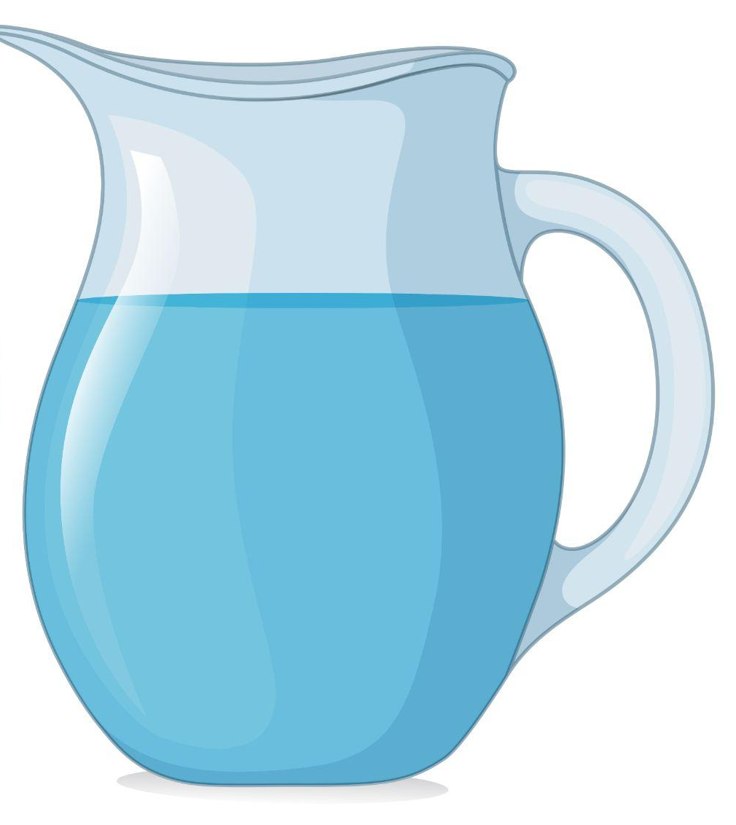




Practice the /oo/ and /U/ sounds. Then listen to the sentences and circle the word you hear.
 |  | /oo/ | /U/
1 |  | look | Luke
2 |  | full | fool
3 |  | pull | pool
4 |  | soot | suit
5 |  | could | cooed
Notes:
4A. Pronunciation – Minimal Pairs
In this section we will practice distinguishing between the /oo/ and /U/ sounds.
1. Model: Read each row several times and point to the words while learners listen. For example, ”Number 1, look, Luke, look, Luke, look, Luke.” Then ask learners to repeat the words. You may want to explain that there are multiple ways to write the /oo/ sound, as shown in the examples.
2. Read the sentences below and ask learners to circle the word that they hear.
How do you spell Luke?
I am looking for the definition of full.
She just learned the word pool.
Where is the soot?
I heard that she could.

Slide 14
Syllables and Stress
Dictionaries will often write a word by separating its syllables and making the stressed syllable bold.
1 | The•o•phi•lus | 6 | em•pha•size
2 | in•for•ma•tion | 7 | de•cide
3 | in•ter•view | 8 | or•ga•nize
4 | ga•ther | 9 | in•tro•duc•tion
Notes:
4B. Pronunciation - Hum and clap the stress.
Dictionaries will often write a word by separating its syllables with dashes or dots like the words shown on the slide. The stressed syllable is often shown in bold. This is how your learners can figure out the pronunciation of a word from a dictionary entry.
Begin by clapping the syllables of each word so that learners can hear how many syllables each word has. Invite learners to clap along with you.
Then show learners how the syllable in bold is the one to be stressed. Stress will make the syllable longer or louder than the rest. Clap or hum each word again and have learners listen for the stress.
Now, say each of the words. Learners will repeat the words after you in unison with the correct stress.

Slide 15
Listen to the pattern and repeat.
A. ▔ - | B. - ▔ | C. ▔ -- | D. -- ▔-
ho•nor | be•gin | em•pha•size | in•for•ma•tion
mes•sage | re•port | care•ful•ly | po•li•ti•tion
out•line | e•vent | in•ter•view | in•tro•duc•tion
note•book | com•plete | or•ga•nize | ex•cla•ma•tion
Notes:
4C. Pronunciation - Hum and clap the stress.
Begin by humming the stress of Column A. Hum higher, longer, and louder for big dashes and lower, shorter, and quieter for small dashes. You may also use hand gestures to indicate that the stressed syllable is higher in pitch, longer in duration, and louder. Invite your learners to join in humming or clapping the rhythm.
1. Model: Hum and then say each word several times. Students listen.
2. Repeat: Hum and say each word again. This time, learners repeat the words after you in unison.
3. Solo: Call on individuals to read one column of words with the correct stress.

Slide 16
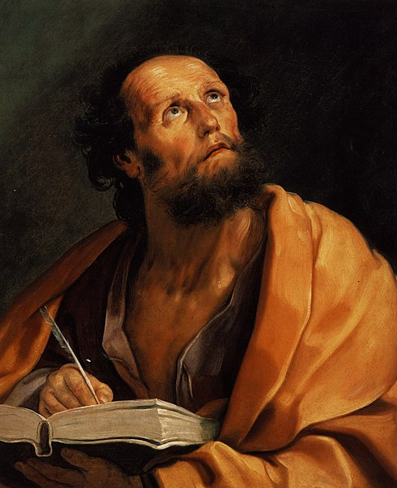
Introduction to Luke
There are four books about the life of Jesus Christ found in the Bible: Matthew, Mark, Luke and John. These books are known as the gospels because they share the good news of Jesus’ life and our hope of salvation. Each gospel has a slightly different perspective as each writer noticed different parts of Jesus’ life.
The Gospel According to Luke is a book of the Bible written around the year 90 AD by a man named Luke.
Notes:
5A. Bible Reading Introduction
A. Read the story out loud to the class.
B. If learners ask about words, give simple definitions.
C. Encourage learners to read aloud verses from the story and act
out the scene.
D. Ask if there are any questions or comments about the story.
E. Ask the story questions and discuss as a group.
F. Optional - You may hide the words and ask learners to tell the
story again in their own words, using the pictures to help them.

Slide 17
Luke was believed to be a medical doctor and a co-worker with the apostle Paul. He was a Gentile (not Jewish), and was the only Gentile to write parts of the New Testament. Luke also wrote the New Testament book of Acts. He wrote this history of the life of Jesus for Theophilus. The name Theophilus means one who loves God.
The gospel of Luke reflects Luke’s own interest in medicine with many descriptions of healings performed by Jesus. It also reflects his compassion for people who were, like himself, outside the religious elite.
Notes:
5B. Bible Reading Introduction
A. Read the story out loud to the class.
B. If learners ask about words, give simple definitions.
C. Encourage learners to read aloud verses from the story and act
out the scene.
D. Ask if there are any questions or comments about the story.
E. Ask the story questions and discuss as a group.
F. Optional - You may hide the words and ask learners to tell the
story again in their own words, using the pictures to help them.

Slide 18
These outsiders -- the poor, the sick, women, foreigners and sinners -- were warmly welcomed by Jesus. We hope that you will enjoy reading the good news found in the book of Luke in this series of lessons.
Notes:
5C. Bible Reading Introduction
A. Read the story out loud to the class.
B. If learners ask about words, give simple definitions.
C. Encourage learners to read aloud verses from the story and act
out the scene.
D. Ask if there are any questions or comments about the story.
E. Ask the story questions and discuss as a group.
F. Optional - You may hide the words and ask learners to tell the
story again in their own words, using the pictures to help them.

Slide 19
Please read Luke 1:1-4 in your language. Then read Luke Writes About the Life of Jesus
¹ Most Honorable Theophilus:
Many others have tried to give a report of the things that happened among us to complete God’s plan. ² What they have written agrees with what we learned from the people who saw those events from the beginning. They also served God by telling people his message. ³ I studied it all carefully from the beginning. Then I decided to write it down for you in an organized way. ⁴ I did this so that you can be sure that what you have been taught is true.
Notes:
5D. First Bible Reading
A. Read the story out loud to the class.
B. If learners ask about words, give simple definitions.
C. Encourage learners to read aloud paragraphs from the story and
act out the scene.

Slide 20
Answer the questions.
1. What are the 4 books Matthew, Mark, Luke, and John known as?
2. Who did Luke write his report for?
3. Why is Luke writing this report?
4. What do you think Luke means by God’s “message”?
5. Why do you think Luke had to study carefully?
6. How do you find out what is true?
7. Why is it important to know what is true?
Notes:
5E. Bible Reading Questions
Ask the questions and discuss as a group.
Answers:
They are known as “the gospels.”
Theophilus, whose name means “one who loves God.”
Luke is writing this report so that Theophilus can be sure that what he was taught is true.
Possible answers: The gospel; the story of Jesus; the story of salvation; good news; the healings of Jesus.
Answers will vary for 5-7.

Slide 21
Psalm 24 NLT - A Psalm of David
¹ The earth is the Lord’s, and everything in it.
The world and all its people belong to him.
² For he laid the earth’s foundation on the seas
and built it on the ocean depths.
³ Who may climb the mountain of the Lord?
Who may stand in his holy place?
⁴ Only those whose hands and hearts are pure,
who do not worship idols
and never tell lies.
⁵ They will receive the Lord’s blessing
and have a right relationship with God their savior.
⁶ Such people may seek you
and worship in your presence, O God of Jacob. Interlude
Notes:
5F. Second Bible Reading
Learners should read this passage in their first language so it will be familiar before reading it in English. The hyperlinks of the Bible verses connect to https://live.bible.is/ so learners can read and hear the scripture in their own languages.
A. Read the verses out loud to the class.
B. If learners ask about words, give simple definitions.
C. Encourage learners to read aloud verses.
D. Ask if there are any questions or comments about the verses.
E. Ask the questions and discuss as a group.
F. Optional – Ask learners to tell the psalm in their own words, or listen to a musical recording of the psalm.

Slide 22
Psalm 24 NLT - A Psalm of David
⁷ Open up, ancient gates!
Open up, ancient doors,
and let the King of glory enter.
⁸ Who is the King of glory?
The Lord, strong and mighty;
the Lord, invincible in battle.
⁹ Open up, ancient gates!
Open up, ancient doors,
and let the King of glory enter.
¹⁰ Who is the King of glory?
The Lord of Heaven’s Armies—
he is the King of glory.
Notes:
5G. Bible Reading
Learners should read this passage in their first language so it will be familiar before reading it in English. The hyperlinks of the Bible verses connect to https://live.bible.is/ so learners can read and hear the scripture in their own languages.
A. Read the verses out loud to the class.
B. If learners ask about words, give simple definitions.
C. Encourage learners to read aloud verses.
D. Ask if there are any questions or comments about the verses.
E. Ask the questions and discuss as a group.
F. Optional – Ask learners to tell the psalm in their own words, or listen to a musical recording of the psalm.

Slide 23
Answer the questions.
Why do all people, the world, and everything in the world belong to God?
Who is the King of glory?
What are some qualities of this King?
How can someone have pure hands and a pure heart?
How can you have a right relationship with God the Savior?
What are some things you can do to honor God today?
Notes:
5H. Bible Reading Questions
Ask the questions and discuss as a group. You may also ask learners to tell the psalm in their own words, or listen to a musical recording of the psalm.
Answers:
All people, the world and everything in it belong to God, because He made them.
The King of glory is the LORD of Heaven’s Armies.
This King is strong, mighty, invincible in battle, the Lord of Heaven’s Armies.
To have pure hands and heart, we should not worship idols and never tell lies.
Answers will vary for 4-6.

Slide 24
Listen and complete the sentences.
1. Each day, _______ has to close the gate.
2. Cookie and Bruce ran past a man in a _______.
3. The woman _______ the stroller out of the way.
4. Cookie was covered in black _______.
5. Bruce _______ up to see Cookie standing next to a swimming _______ _______ of water!
6. “Don’t jump, _______! Don’t be a _______!” shouted Bruce.
Notes:
6A. Activities – Listening to pronunciation words with /oo/ and /U/ sounds.
Read the script below at least twice as learners listen and answer the questions. The learners should NOT look at the script.
Each day when Bruce leaves for school, he has to close the gate behind him so that his pet dog, Cookie, doesn’t run away. Yesterday, Bruce was late to school and left the gate open! Before he could stop her, Cookie raced out the gate and down the street! “Cookie, come back!” shouted Bruce. He dropped his bag on the ground and ran after the dog. They ran past a man in a suit, and then past a woman pushing a baby in a stroller. The woman pulled the stroller out of the way when Cookie and Bruce ran past her, and the baby cooed with delight. In front of them was a man on a ladder, cleaning soot out of his chimney. “Don’t hit the ladder, Cookie!” warned Bruce, but Cookie didn’t listen. The dog ran straight into the ladder, which began to sway back and forth. “Whoa, whoa!” yelled the man as the ladder began to fall. With a big cloud of smoke and soot, the man and the ladder both fell on top of Cookie! Bruce rushed over to help the man stand up, but as he arrived, Cookie jumped up. The dog was covered in black soot, but he just kept running down the street. “What will you do next, Cookie?” Bruce shouted. Now Bruce was beginning to get tired from chasing Cookie. Ahead of him, Cookie turned around a corner and disappeared under a bush. Dropping to his hands and knees, Bruce crawled under the bush, too. Covered in dirt, he looked up to see Cookie standing next to a swimming pool full of water! “Don’t jump, Cookie! Don’t be a fool!” shouted Bruce. But it was too late. With a big splash, Cookie took a flying leap and landed right in the middle of the pool! Bruce wanted to be angry, but then he smiled. “At least you’re clean again, Cookie!”
Answers: 1. Bruce 2. suit 3. pulled 4. soot 5. looked, pool, full 6. Cookie, fool

Slide 25
A. Role-Play – Reporter
You are a reporter who must write about an important soccer game for the newspaper. The game just ended, and you can now interview a famous player on the winning team to gather information for your report! These are the questions you will ask the soccer player. Write down your partner’s responses.
What events happened in today’s game?
How do you feel right now?
How will your team celebrate tonight?
Who decides what your team should do?
How does your team stay organized?
When did you begin playing soccer?
Have you always loved playing soccer?
Notes:
6B. Activities – Pair Work Partner A
Role-Play between a soccer coach and a player.
Partner A will play the part of a reporter talking to a soccer player. Partner A will ask questions from this slide and write down Partner B’s answers.
After completing the activity, Partners A and B should switch roles so that they each get a chance to write down answers.
Check answers for correct grammar and punctuation. Answers will vary.

Slide 26
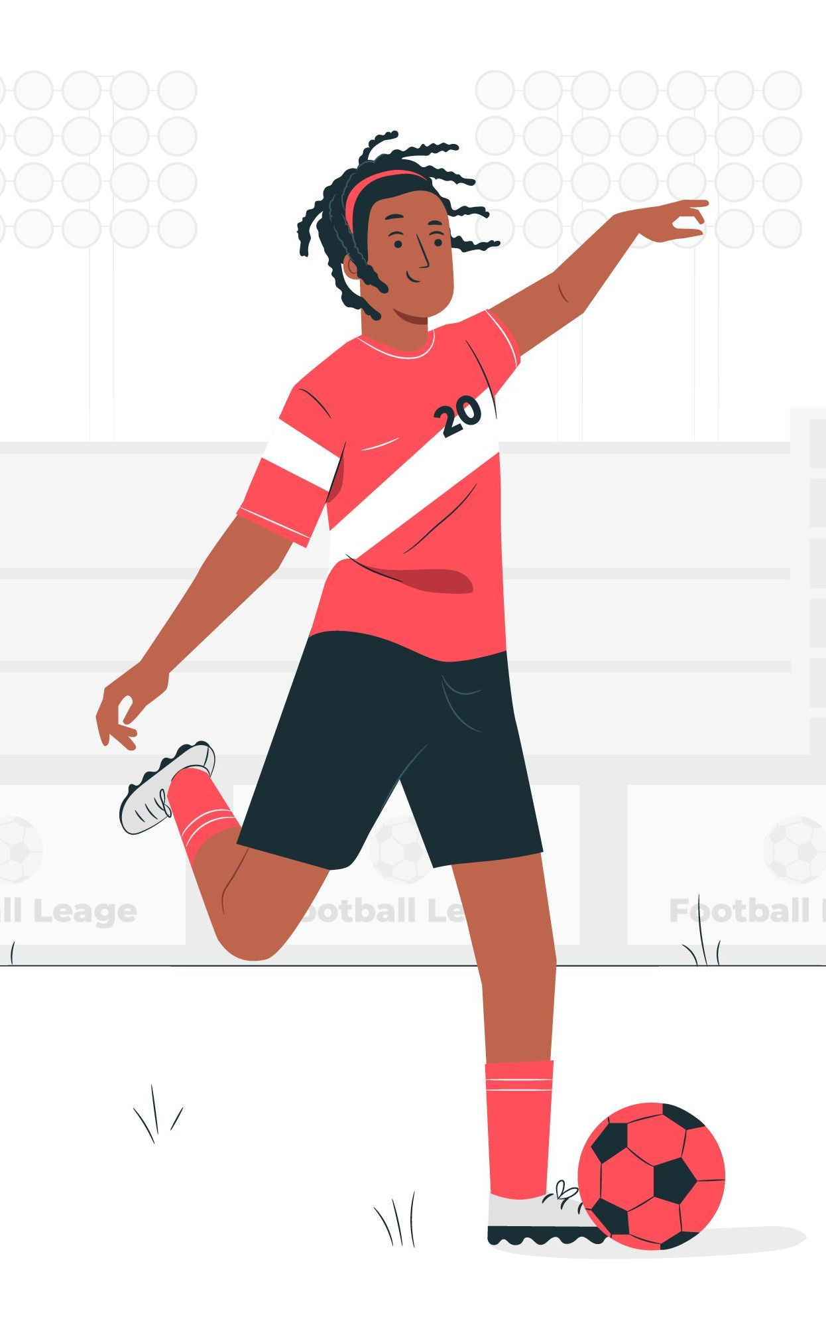
B. Role Play – Soccer Player
You are a famous soccer player whose team just won a game! As soon as the game ended, a reporter came over to ask you some questions. Answer the reporter’s questions using the information below. You can make up more details if you want to.
In today’s game, the scores were even the whole time. Then, in the last minute, you scored a goal and your team won. You feel so proud of all your hard work. After this, the team will get some good food and have a party. The coach decides how the team should play and which players should be on the field. He keeps the team organized by taking notes on what they can improve for the next game. You began playing soccer when you were four years old. You have not always loved playing soccer - when you first began, you were not sure that you wanted to play.
Notes:
6C. Activities – Pair Work Partner B
Role-Play between a soccer coach and a player.
Partner B will play the part of a soccer player being interviewed by the reporter. Partner B will answer Partner A’s questions using the information on this slide and turning it into first-person point of view. Partner A will write down Partner B’s answers.
After completing the activity, Partners A and B should switch roles so that they each get a chance to write down answers.
Check answers for correct grammar and punctuation. Answers will vary.

Slide 27

Song – I Love to Tell the Story
I love to tell the story
Of unseen things above
Of God’s plan and His glory
Of Jesus and His love
I love to write the story,
Because I know it’s true
The message of salvation
That every day is new
I love to tell the story
It’ll be my theme in glory
To tell the honored story
Of Jesus and His love
Notes:
7. Song adapted from original I Love to Tell the Story by Arabella Katherine Hankey (1866)
Learners will learn the new song for the lesson.
1. Model: Read the song lyrics out loud to the class. Ask if there are any questions. Write words that learners ask about on the board and give simple definitions. Then sing it or play the recording two or three times, while they just listen.
2. Repeat: Sing the selection again, a line or sentence at a time, as learners repeat after you. Then play the recording and sing the song together as a class in unison.
3. Solo: The learner sings solo (or if shy, can just read the words aloud).

Slide 28
1A. Homework – Write a sentence about each picture using the vocabulary word and the correct verb tense.
1. Future simple | He will gather information by asking her questions. | 4. Future simple
2. Past simple |  | 5. Present simple
3. Present continuous |  | 6. Present perfect
Notes:
Homework 1A. - Write sentences using the pictured vocabulary words.
Model. Go over each of the homework assignments to be sure the learner understands what to do.
Repeat. Encourage learners to practice speaking and reading the completed homework assignments with a friend. They may use a bilingual dictionary.
Solo. Learners will share their homework when they are finished. After they have shared their homework, be sure to check it for correctness, including spelling. Explain mistakes, while providing praise and encouragement.
Number one is an example.
Answers may vary, but will start with a capital letter, have a punctuation mark at the end, use the tense stated above the picture, and use a form of the following words:
2. begin (past simple)
3. decide (present continuous)
4. event (future simple)
5. sure (present simple)
6. report (present perfect)

Slide 29

1B. Answer these questions about the vocabulary.
1. In your language, what is the word for “honor”? Who do you honor?
2. Which part of a report is at the beginning?
3. Which part of a report is at the end?
4. How can you become a more organized person?
5. Why is it helpful to write an outline for a report?
6. What do you do if you need information about something?
Notes:
Homework 1B. - Write about the vocabulary words.
Learners will write answers to the questions.
Answers:
Answers will vary.
The introduction
The conclusion
Answers will vary.
Answers will vary.
Answers will vary.

Slide 30

2A. Write two sentences with each verb, one in the present perfect tense and one in the present continuous tense.
I (decide) to…
  I have decided to eat breakfast.
  I am deciding to stay here.
2. He (gather)…
  b.
3. You (honor)...
a.
b.
4. They (begin)...
a.
b.
Notes:
Homework 2A. – Grammar and Vocabulary Review
Learners will complete the sentences with the correct verb forms. Number 1 is an example.
Answers will vary but must include:
2a. has gathered
2b. is gathering
3a. have honored
3b. are honoring
4a. have begun
4b. are beginning

Slide 31

2B: Add the correct tense of the verb based on the clues in the rest of the sentence.
  Today I am too busy, but tomorrow I will organize the closet. (organize)
  She _________ me with her presence at the party yesterday. (honor)
  Every day, I _________ my day with a cup of coffee. (begin)
  Before I leave work, I always _________ my hat, my coat, and my bag. (gather)
  Tonight when she gets home, my sister _________ for her missing earring. (look)
Notes:
Homework 2B. – Grammar and Vocabulary Review
Learners will complete fill in the blank with the correct tense of the verb based off the clues in the rest of the sentence.
1 is an example.
Answers:
2. honored
3. begin
4. gather
5. will look

Slide 32

3. With a partner, discuss the questions and write your own.
What has happened in your city recently?
What did you learn about it from reading articles or reports?
How do you gather information when you want to know about something?
What kind of reports have you written?
Which is easier: speaking or writing in English? Why?
Why do people write about events that have happened?
Notes:
Homework 3. – Conversations - Pair work
Learners interview a partner and write their partner’s answers. They will also create two of their own follow-up questions for numbers 7 and 8. Check answers for correct grammar and punctuation.
Questions and answers will vary.

Slide 33
4. Say and write the words in the correct columns.
look | cooed
suit | pull
tub | school
shut | book
full | cup
pool | luck
news | cookie
could | won
love | too
/U/ | /u/ | /oo/
Notes:
Homework 4. – Pronunciation
This homework practices pronouncing the /U/, /u/, and /oo/ sounds.
Students will go through the list and sound out each word. Then they will write words in the correct columns for each vowel sound.
Answers:
/U/: cooed, suit, school, pool, news, too
/u/: tub, shut, cup, luck, won, love
/oo/: look, pull, book, full, cookie, could

Slide 34
5. Fill in the blanks.
Matthew, Mark, Luke, and John are known as the _________.
Luke was believed to be a medical _________.
Luke also wrote the New Testament book of _________.
Luke addresses his book to “Most _________ Theophilus.”
Luke _________ to write it down for Theophilus.
He did this so that Theophilus could be _________ that what he was taught was true.
©2020-2025 Light of the World Learning
Notes:
Homework 5. – Bible Reading Review
Learners will write a short summary of the Bible reading using the words first, then, next and finally.
Answers:
gospels
doctor
Acts
Honorable
decided
sure

Slide 35
6A. Choose 1 verse to memorize and write it here. Then read the next verses in your language.
Read the next lesson’s Bible verses: Luke 1:5-25 in your language.
Notes:
Homework 6A. – Memorize a verse and read the next lesson’s verses in your native language.
Learners get to choose one verse from the lesson’s reading to memorize. Please notice that the memory work is not long. Everyone, regardless of skill level, should be able to do it. Learners will also read the next lesson’s Bible passage in their native language. Learners will always read the Bible lesson in their first language before reading it in English the following lesson. Help them get a Bible in their own language if they don’t have one. They may also use https://live.bible.is/ or other Bible translation resources. The hyperlinks of the Bible verses connect to https://live.bible.is/ so learners can read, hear and watch videos of the scripture in their own languages.
1. Model. Recite a verse from memory.
2. Repeat. Encourage learners to find someone with whom to practice conversing and reading the completed homework assignment.
3. Solo. Learners will recite the verse from memory at the next class.

Slide 36
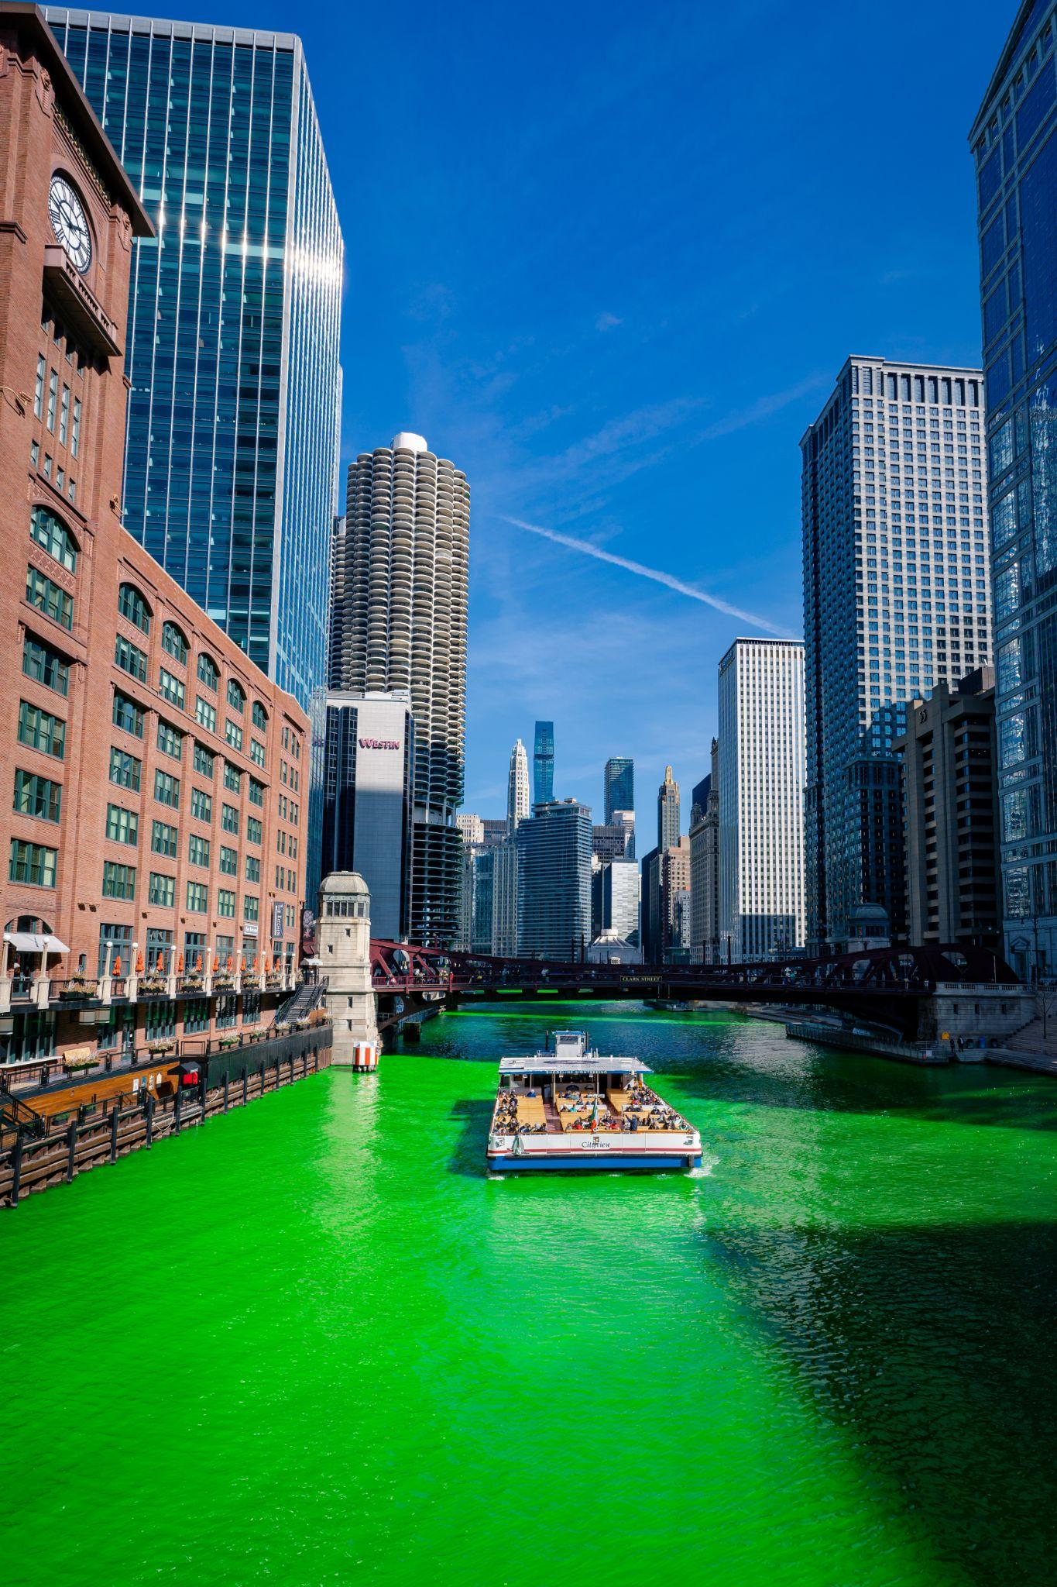
7A. Read the report.
Did you know a river can change colors? Well, in the city of Chicago in the United States, the big Chicago River turns a bright green color in March of every year. It’s not a natural event – it’s a celebration of a treasured holiday!
Every March brings Saint Patrick’s Day, which honors a Christian missionary named Patrick, who is credited with bringing Christianity to Ireland. Today, many people in the United States don’t remember the history, but use this holiday as a chance to celebrate all things Irish. This includes having parties, wearing green clothes, and eating Irish food like corned beef and cabbage.
Notes:
Homework 7A. – Everyday Reading and Writing
Learners will read the report about a city event and note the introduction and conclusion paragraphs. Then, learners will answer the questions that follow.

Slide 37
7B. Continue reading the report.
Since 1962, the city of Chicago has chosen to celebrate Saint Patrick’s Day by putting bright green dye into the river. The dye used today is an environmentally safe powder, and the recipe for this powder dye is a closely guarded secret, known only by city officials.
Each year, thousands of tourists gather in Chicago to celebrate Saint Patrick’s Day by watching the dyeing of the river. June Hook, a Chicago resident, says, “As soon as I see all the crowds, I know it’s Saint Patrick’s Day! I always feel so joyful watching this city tradition with so many people.”
The city is already preparing for next March – and so can you! Will you decide to come to Chicago?
Notes:
Homework 7B. – Everyday Reading and Writing
Learners will read the report about a city event and note the introduction and conclusion paragraphs. Then, learners will answer the questions that follow.

Slide 38
7C. Answer the questions about the report.
In which month does the Chicago River turn green?
What is the history behind Saint Patrick’s Day?
How do many people in the United States celebrate the holiday today?
What kind of dye does the city use?
Why do you think the reporter interviewed a Chicago resident?
Which paragraph was the introduction? What do you think was its purpose?
Which paragraph was the conclusion? What do you think was its purpose?
Notes:
Homework 7C.– Everyday Reading and Writing
Learners will answer the questions about the report.
Answers:
The river turns green in March.
Answers may vary. Possible answers: Saint Patrick’s Day celebrates a Christian missionary named Patrick; Saint Patrick’s Day celebrates all things Irish; Patrick brought Christianity to Ireland.
Answers may vary. Possible answers: They celebrate all things Irish; They have parties; They wear green clothes; They wish for good luck.
The city uses an environmentally safe powder dye. The recipe for the dye is a closely guarded secret.
Answers may vary.
The introduction was the first paragraph. Further answers may vary.
The conclusion was the last paragraph. Further answers may vary.

Slide 39
8. Write a 200-word report about a recent event in your area. Include an introduction, a conclusion, and a short quote from an interview with someone at the event.
Notes:
Homework 8 – Writing
Make sure learners understand the instructions. Show learners that the sample report in 7A-7B also has an introduction, a conclusion, and a quote from an interview with someone at the event.
Answers will vary.

Slide 40
9. Now I Can…
I can talk about the process of writing a report.
I can use the new words:
_________________________________________
_________________________________________
I can use five tenses: past simple, present simple, future simple, present perfect, and present continuous.
I can understand the background and setting of the book of Luke.
Notes:
Homework 9. – “I Can” statements
The learner must be able to achieve all of these skills before the next lesson. If not, the lesson can be repeated or additional practice materials can be used.
Review all of the skills at the beginning of the next lesson. Be sure to give lots of praise and encouragement!

Slide 41
Closing Prayer
Notes:
Pray
You may want to ask for any special prayer requests, then pray for your learners and bless them. Prayers may also be written on this slide.

Slide 42
Scripture quotations marked NLT are taken from the Holy Bible, New Living Translation, copyright © 1996, 2004, 2015 by Tyndale House Foundation. Used by permission of Tyndale House Publishers, Inc., Carol Stream, Illinois 60188. All rights reserved.

