Slide 1


Unit A2-39
Unit A2-39
©2020-2025 Light of the World Learning
Notes:
Teacher’s Notes:
Bible Reading: The Transfiguration – Matthew 17:1-9
Theme: Comparing and Contrasting
Pronunciation: /est/ and /un/
Grammar: Comparatives/superlatives
Preparation:
Pray.
Read the Bible passages.
Preview slides and game.
Optional: Bring objects that you can compare and contrast.

Slide 2
Pray, Review, and Preview
Bible Reading: The Transfiguration - Matthew 17:1-9
Theme: Comparing and Contrasting
Pronunciation: /est/ and /un/
Grammar: Comparatives and Superlatives
Notes:
Pray
Pray for the class. You may want to thank the Lord for loving us and dying on the cross.
Check Homework and Review
Ask learners to read aloud or recite their homework from the last class. Check written work.
Review the main points of the previous lesson and ask if there are any questions.

Slide 3
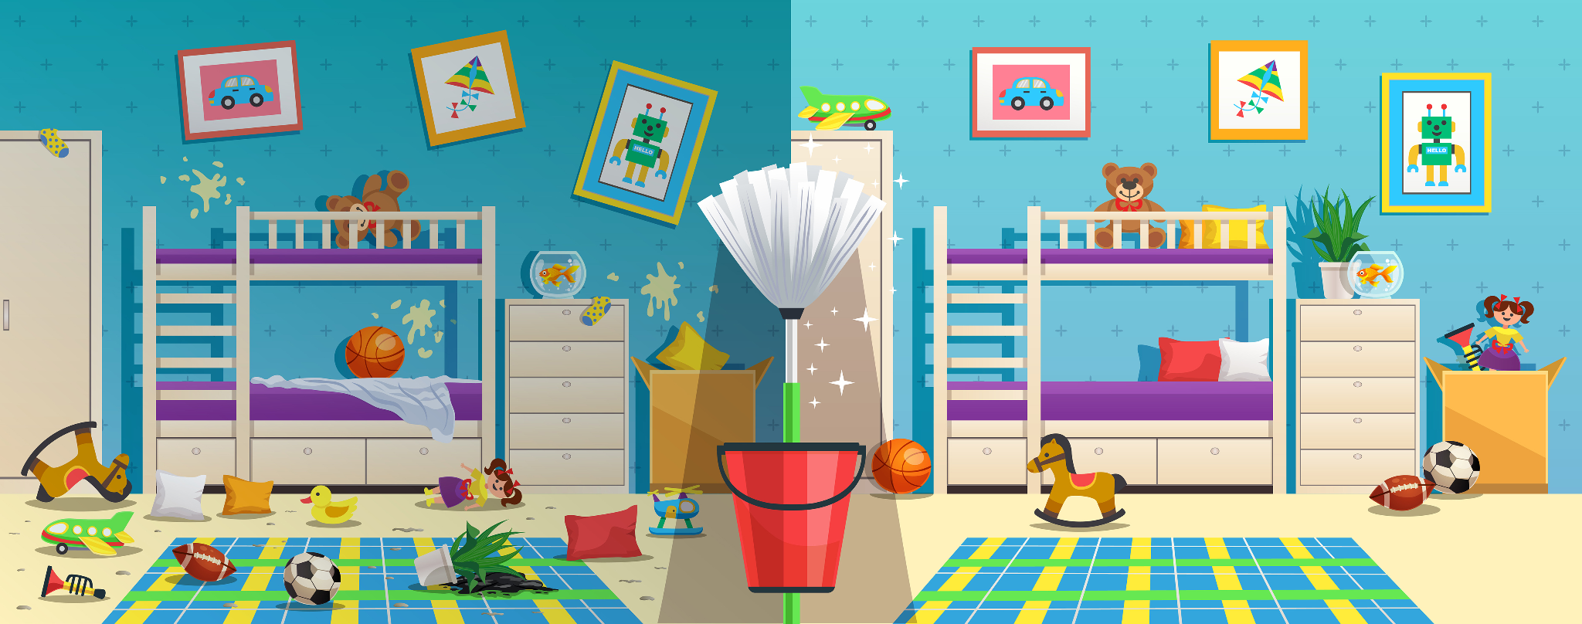
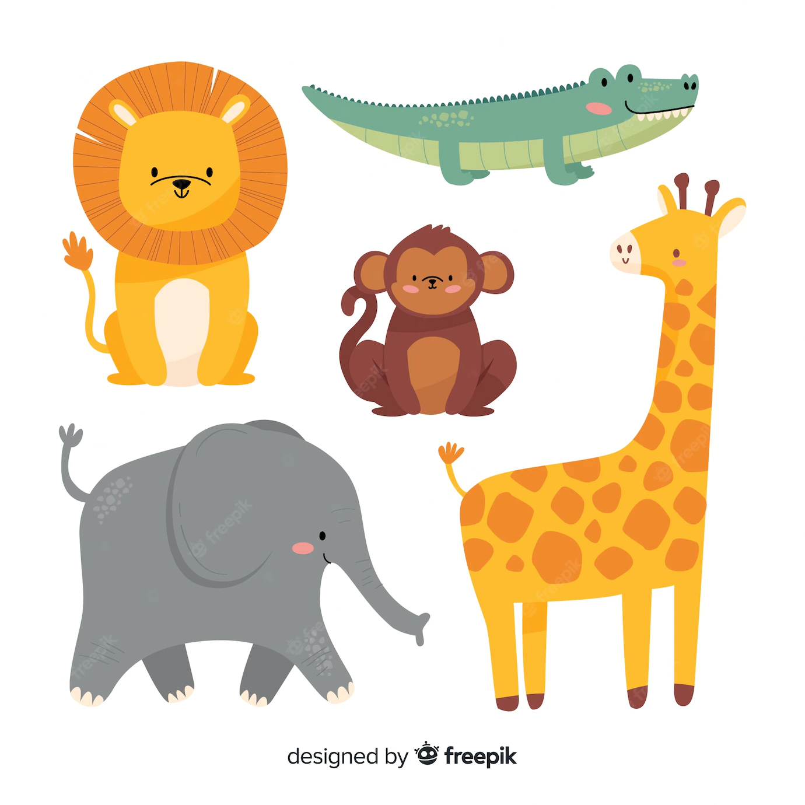
What do you see?
Notes:
1A. Discuss Theme Picture
Ask “What do you see in this picture?” and “What else?” to elicit vocabulary they already know.
Repeat and write their words or show the words on the next slide.
Answers may include: messy, clean, fresh, cheap, expensive, tame, bed, etc.
More advanced students can be encouraged to make complete sentences:
One side is messy. One side is neat. The toys are cheap. The mop is fresh.

Slide 4
1. messy
2. neat
4. fresh
7. wild
3. tame
6. expensive
5. cheap
Notes:
1B. Show Words for Theme Picture
Please show the names of the theme picture items to the students briefly.
These words can be studied for homework.
Practice of vocabulary begins with the following slide.

Slide 5
Today is Saturday and we are all going to take part in cleaning the house. Eva finds it easier to clean up the mess in the children’s room. She thinks cleaning the bathroom is too difficult. She usually works well and makes the room neat by arranging their closet and putting the toys away. Dinah thinks Eva has a false impression about cleaning the bathroom. She likes to mop up the bathroom and the corridors. When she is done, all the stale smell in the house vanishes and the whole place smells fresh. Interestingly, she prefers the cheap, sharp detergents. She thinks the expensive ones do not work well.
As for me, I will just supervise.
Notes:
1C. Show Description of Theme Picture
Please read the description of the theme picture to the students and point to the pictured vocabulary.
These words can be studied for homework.
Practice of vocabulary begins with the following slide.
5

Slide 6


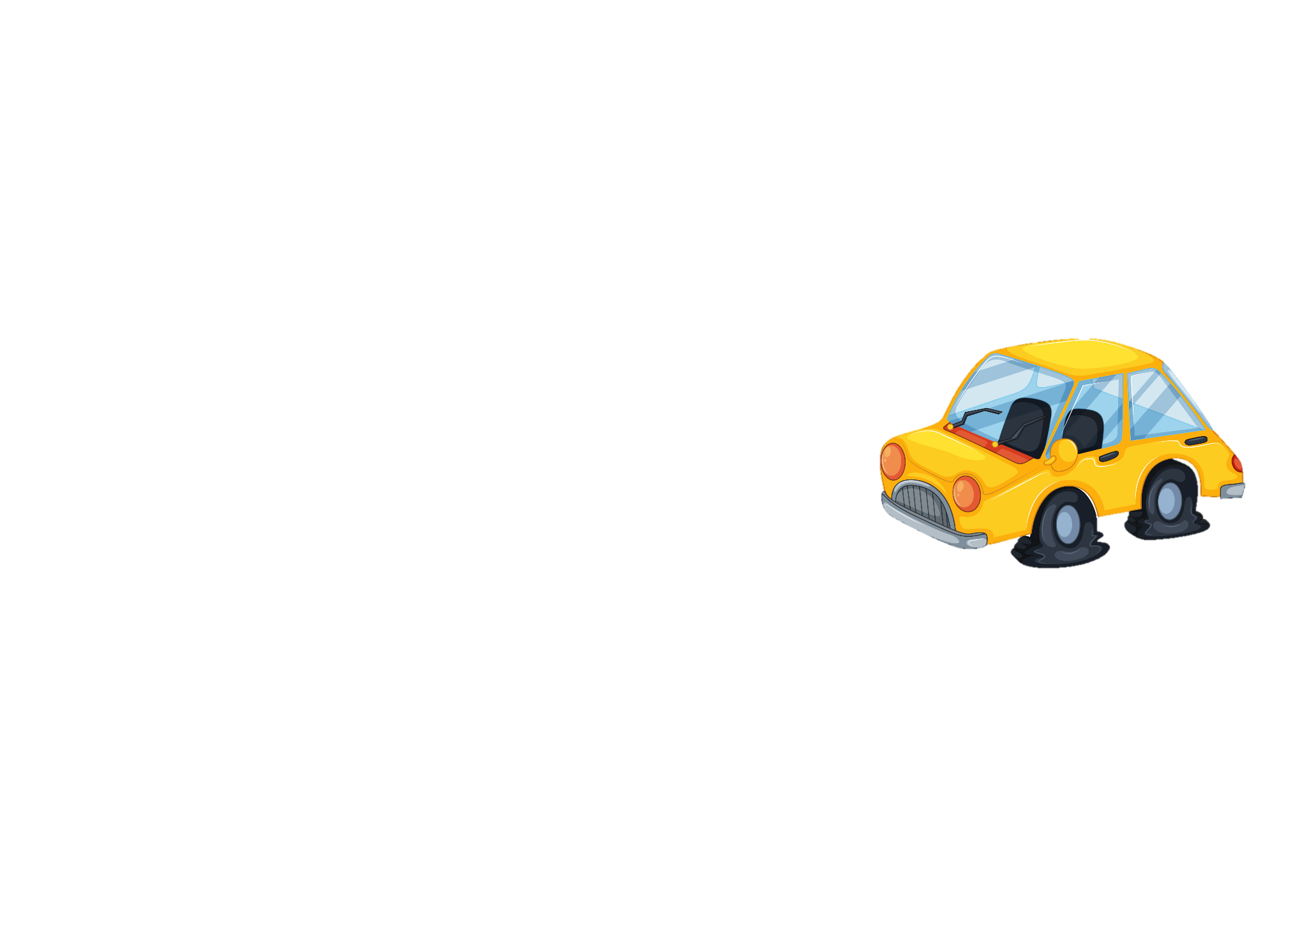
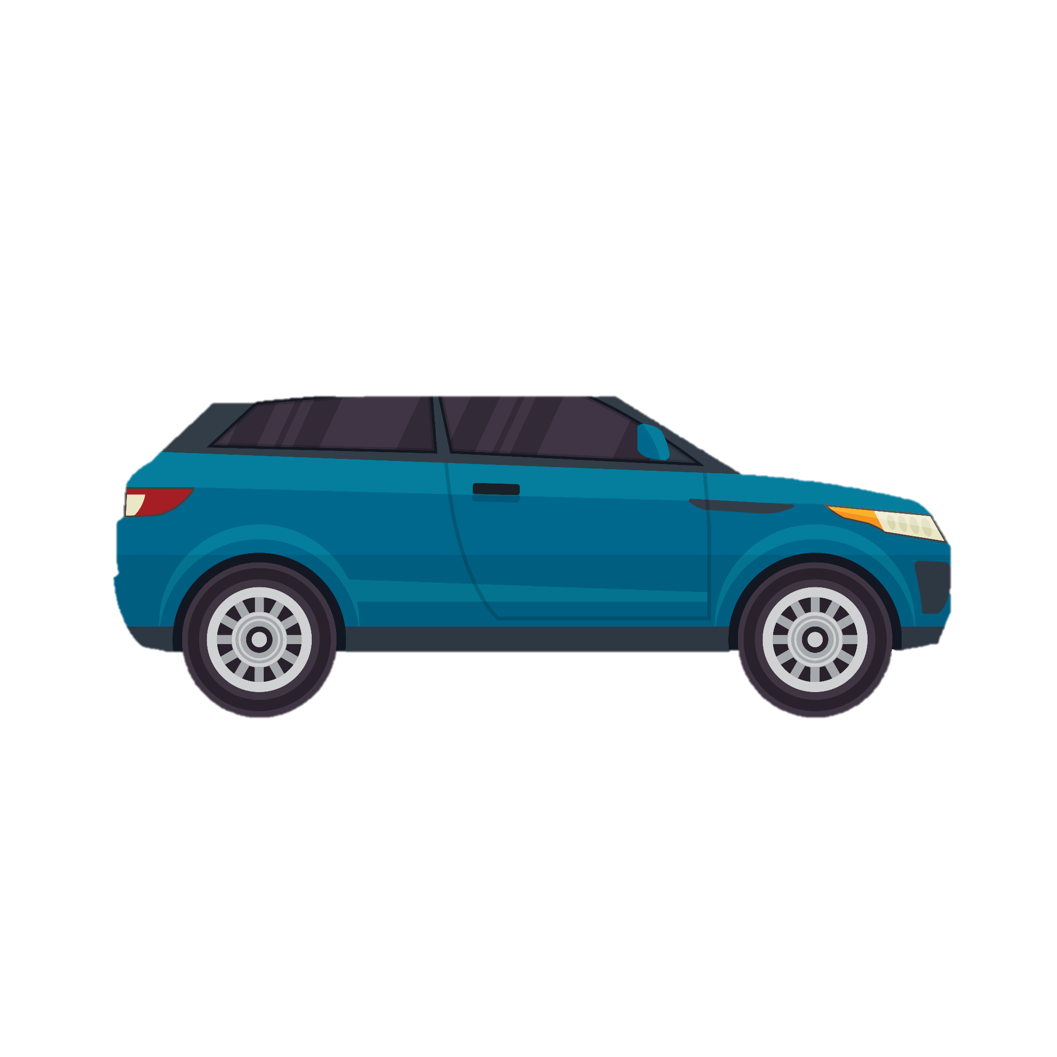
Match the beginning and end of each sentence.
The big box is
2. The smaller box is
3. The car was cheap
4. I had to save my money,
A. difficult to carry alone.
B. because the car is so expensive.
C. easy to carry.
D. so I bought it.
Notes:
2A. Vocabulary
1. Say the beginning of the sentence a few times, as you indicate the picture. For example, say, ”The smaller box is, the smaller box is.” Have your students then repeat the phrase after you a few times.
2. Ask students to match the beginning and end of each sentence and say the complete sentence. For example, ”The smaller box is easy to carry.”
3. Check students’ comprehension further by asking direct questions. For example, “Could you carry that big box?”
Answers
A
C
D
B

Slide 7

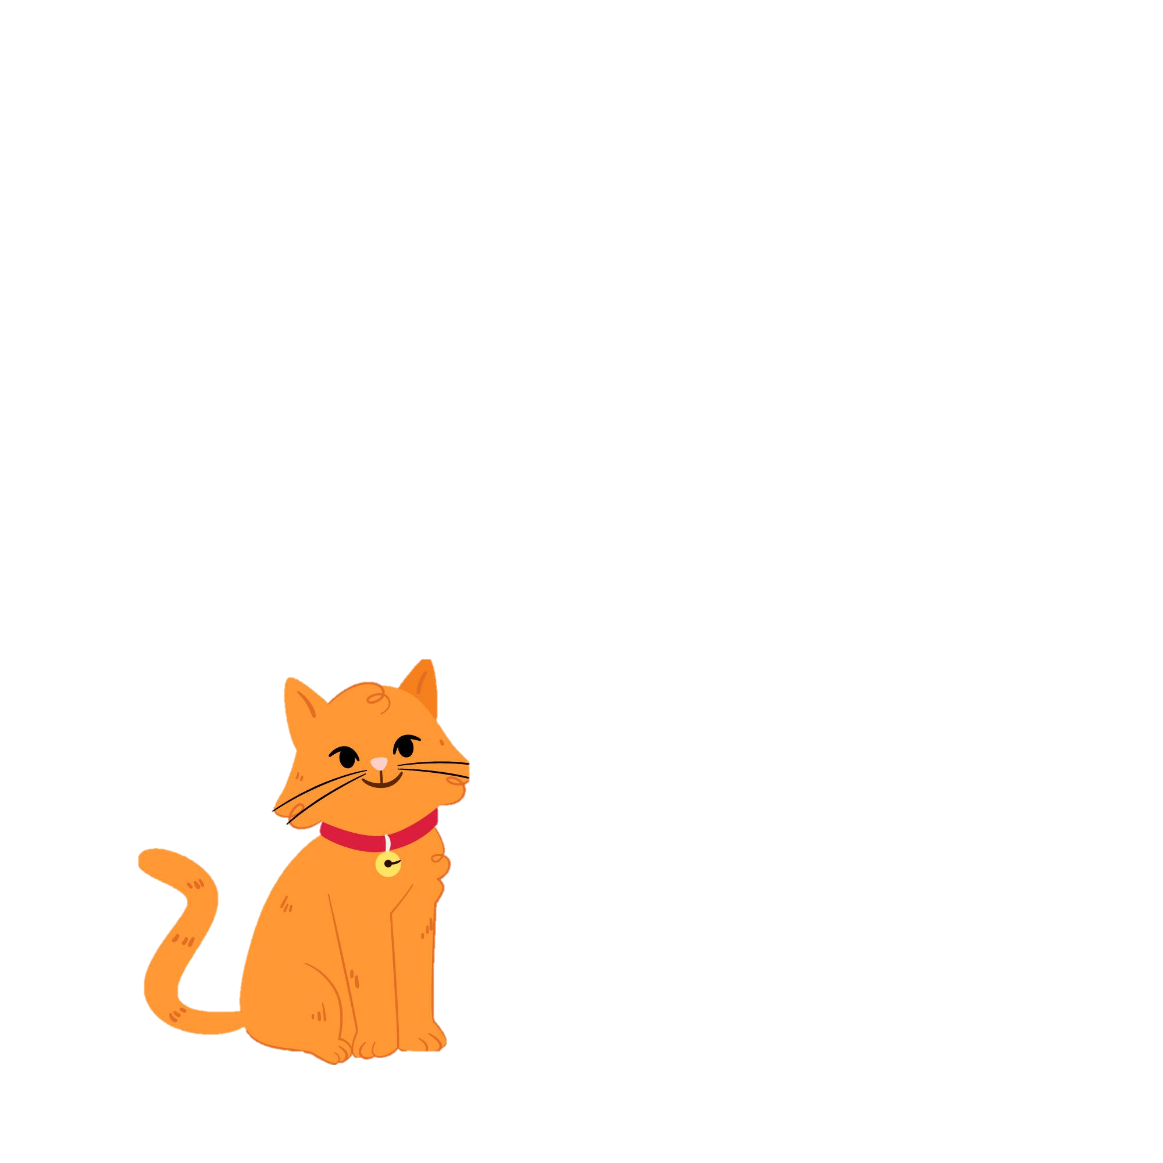


Match the beginning and end of each sentence.
5. The movie was
6. Marc brushed his
7. Lions are
8. Pets are
E. wild animals.
F. tame animals.
G. based on a true story.
H. false teeth.
Notes:
2B. Vocabulary
1. Say the beginning of the sentence a few times, as you indicate the picture. For example, say, ”Lions are, lions are,” Have your students then repeat the phrase after you a few times.
2. Ask students to match the beginning and end of each sentence and say the complete sentence. For example, ”Lions are wild animals.”
3. Check students’ comprehension further by asking direct questions. For example, “Have you ever seen a lion?”
Answers
5. G
6. H
7. E
8. F

Slide 8
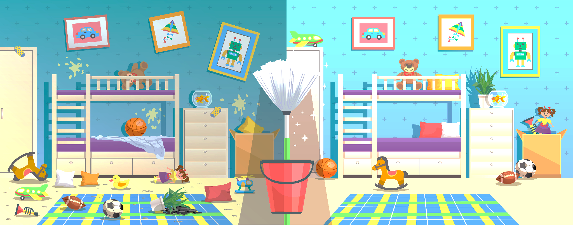
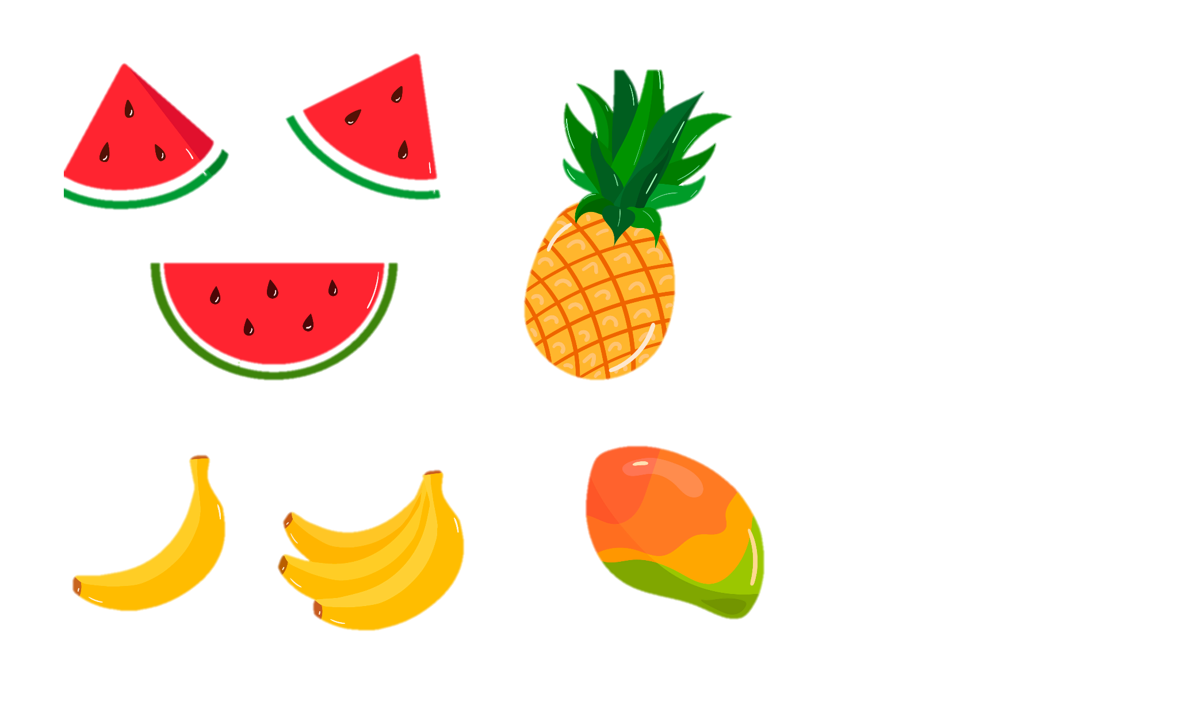
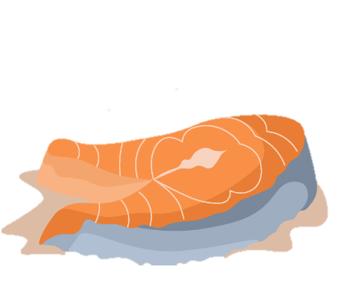
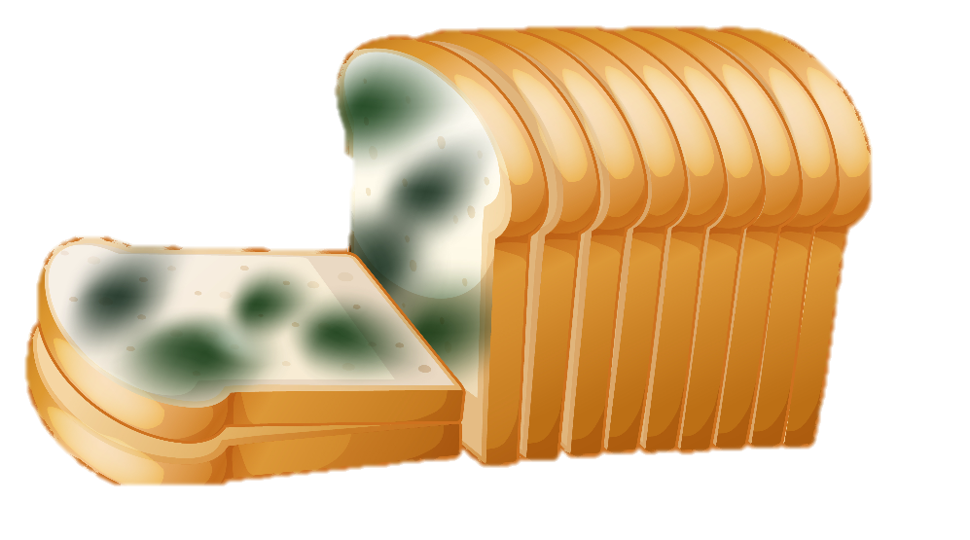
Match the beginning and end of each sentence.
9. I cleaned,
10. The bedroom is messy
11. The juice is made
12. Stale food is old
I. because of the kids.
and tastes bad.
from fresh fruit.
so I have a neat bedroom.
Notes:
2C. Vocabulary
1. Say the beginning of the sentence a few times, as you indicate the picture. For example, say, ”The juice is made, the juice is made.” Have your students then repeat the phrase after you a few times.
2. Ask students to match the beginning and end of each sentence and say the complete sentence. For example, ”The juice is made from fresh fruit.”
3. Check students’ comprehension further by asking direct questions. For example, “Do you like fresh fruit?”
Answers
9. L
10. I
11. K
12. J

Slide 9
Comparatives; compare two nouns
One syllable
1. | Cheap | cheaper than | The bus is cheaper than the train.
Two or more syllables
2. | Expensive | more expensive than | The train is more expensive than the bus.
Two syllables that end in -y
3. | Messy | messier than | The bathroom is messier than the bedroom.
Notes:
2C. Grammar – Comparatives
Comparatives are adjectives used to compare two nouns.
One Syllable: Add -er or -r + ‘than’
Two or more syllables: Add ‘more’ + adjective + ‘than’
Two syllables that end in -y: Change -y to -i and add -er + ‘than’
Model, Repeat, and Solo the pronunciation of all forms shown on the chart.

Slide 10
Comparatives
End with a single vowel then a consonant
4. | big | bigger than | Earth is bigger than the moon.
Irregular
5. | good | better than | Chocolate is better than vanilla.
6. | bad | worse than | The weather today is worse than yesterday.
7. | far | farther than | The store is farther than the mall.
Notes:
2D. Grammar – Comparatives
End with single vowel then a consonant: double last consonant + -er + ‘than’
Model, Repeat, and Solo the pronunciation of all forms shown on the chart.

Slide 11
Superlatives; compare more than two nouns
One syllable
8. | cheap | the cheapest | The bus is the cheapest way to travel.
Two or more syllables
9. | expensive | the most expensive | Airplanes are the most expensive way to travel.
Two syllables that end in -y
10. | messy | the messiest | The bathroom is the messiest room in the house.
Notes:
2E. Grammar – Superlatives
Superlatives are adjectives used to compare more than two nouns.
One Syllable: Add ‘the___ -est’
Two or more syllables: Add ‘the most’
Two syllables that end in -y: Change -y to -i and add -est
Model, Repeat, and Solo the pronunciation of all forms shown on the chart.

Slide 12
Superlatives
End with a single vowel then a consonant
11. | big | the biggest | Jupiter is the biggest planet.
Irregular
12. | good | the best | Chocolate is the best candy.
13. | bad | the worst | Rainy weather is the worst.
14. | far | the farthest | The store is the farthest building from my car.
Notes:
2F. Grammar – Superlatives
End with single vowel then a consonant: double last consonant + ‘than’
Model, Repeat, and Solo the pronunciation of all forms shown on the chart.

Slide 13
Listen and repeat.
A: I plan to invite my family to a special dinner at my house.
B: What day are they coming?
A: Either Wednesday or Thursday.
B: Who will come to the dinner?
A: My sister, who is the oldest, and my brother, who is the youngest. Their families will come, too.
B: Will it be difficult to feed so many?
A: No. I plan an easy meal with a spicy bean soup and fresh bread. I will get chocolate ice cream for dessert, if it is not too expensive.
B: That dinner sounds better than a meal at a restaurant!
Notes:
3. Conversation:
1. Model: Say both parts of the conversation several times. Use A and B cards, stick figures, or change your physical position to indicate the dual parts. Role-play the parts to convey the meaning of the conversation. Students are to watch and listen.
2. Repeat: Say one line at a time and have students repeat until they can be understood.
3. Solo: You begin the conversation and call on individual students to respond. Then reverse the roles (students are A, you are B).
4. Once students can do both parts, encourage free conversation (students substitute their own words for the blue words).

Slide 14
-Est means “the most”. Un- means “not”
1. /est/ | 2. /un/ | 3. Challenge
the biggest | unhappy
the longest | uncomfortable
the highest | untrue
the strongest | unemployed
the brightest | unable
Can I have the biggest slice of cake?
A rainy day makes me unhappy.
Notes:
4A. Pronunciation - Sound and Spelling
Note: The suffix “-est” at the end of an adjective or adverb turns it into a superlative and means “the most”. The prefix “un-” at the beginning of the word means “not.”
1. Model: Say the sound several times while pointing to it. (For example, point to the /est/ and say /est/ /est/ /est/. Then say the sound and quickly read the entire list, pointing to each item as you read it (the biggest, the longest, the highest, the strongest, the brightest). Students just watch and listen.
2. Repeat: Say the sound and each word several times, having students repeat each time after you in unison. Be sure to use your normal voice and rate of speed. Do one column at a time, top to bottom. Then read the sentences.
3. Solo: Call on individuals to say a sound and its word group. Give lots of praise. Then ask students to read the sentences.
4. Challenge: Choose another sound from the lesson that is challenging for your particular students to pronounce. Use words from Parts 1 and 2 of the lesson, and from previous lessons to make a group of 3-5 words. You may repeat the same challenging sounds in several lessons. Students need a lot of practice on sounds that do not exist in their first language.

Slide 15
Listen and repeat.
A. _ ₋₋ | B. _ ₋ | C. ₋_ ₋
difficult | easy | expensive
medicine | messy | disciples
flammable | Matthew | deliver
ambulance | compass | directions
poisonous | helmet | museum
Notes:
4B. Hum and clap the stress.
Begin by humming the stress of a column of words. Hum higher, longer, and louder for big dashes and lower, shorter, and quieter for small dashes.
You may use hand gestures to indicate that the stressed syllable is higher in pitch, longer in duration, and louder. Invite your students to join in humming the rhythm. Once the class is humming the rhythm in unison, you can begin saying the words. You may also wish to clap the syllables while you say the words.
1. Model: Hum and then say each word in the column several times. Students listen.
2. Repeat: Students repeat words after you in unison.
3. Solo: Call on individuals to read the entire column of words.

Slide 16
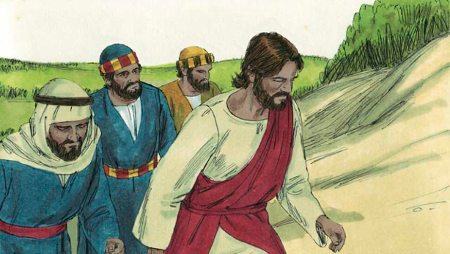
Read Matthew 17:1-9 in your language. Then read the story of The Transfiguration.
One day, Jesus took three of his
disciples, Peter, James, and John,
with him. (The disciple named John
was not the same person who baptized Jesus.)
They went up on a high mountain by themselves to pray. They were all alone. As Jesus was praying, his face became as bright as the sun. His clothes became as white as light, whiter than anyone on earth could make them.
Notes:
5A. Bible Reading
Be sure students read this story in their first language before reading it in English. The hyperlinks of the Bible verses connect to https://live.bible.is/ so students can read and hear the scripture in their own languages.
A. Read the story out loud to the class.
B. If students ask about words, give simple definitions.
C. Encourage students to read aloud paragraphs from the story. Encourage students to act out the story.
D. Ask if there are any questions or comments about the story.
E. Ask the story questions and discuss as a group.
F. Optional - You may hide the words and ask students to tell the story again in their own words, using the pictures to help them.

Slide 17
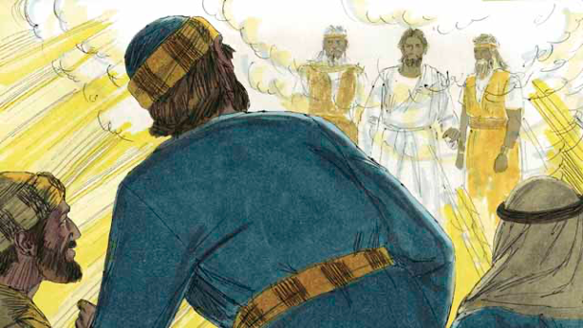
Then Moses and the prophet Elijah appeared. These men had lived on the earth hundreds of years before this. They talked with Jesus about his death, because he would soon die in Jerusalem.
As Moses and Elijah were talking with Jesus, Peter said to Jesus, “It is good for us to be here. Let us make three shelters, one for you, one for Moses, and one for Elijah.” But Peter did not know what he was saying.
Notes:
5B. Bible Reading
A. Read the story out loud to the class.
B. If students ask about words, give simple definitions.
C. Encourage students to read aloud paragraphs from the story.

Slide 18
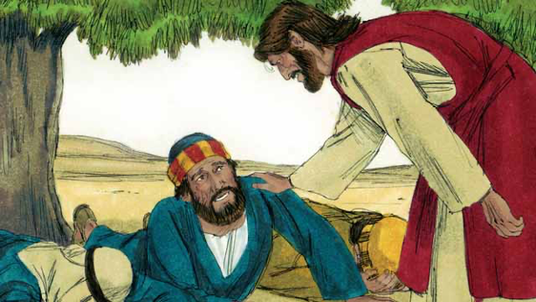
As Peter was talking, a bright cloud came down and surrounded them. Then they heard a voice coming from the cloud. It said, “This is my Son whom I love. I am pleased with
him. Listen to him.” The three disciples were terrified and fell on the ground. Then Jesus touched them and said, “Do not be afraid. Get up.” When they looked around, the only one still there was Jesus.
Notes:
5C. Bible Reading
A. Read the story out loud to the class.
B. If students ask about words, give simple definitions.
C. Encourage students to read aloud paragraphs from the story.

Slide 19
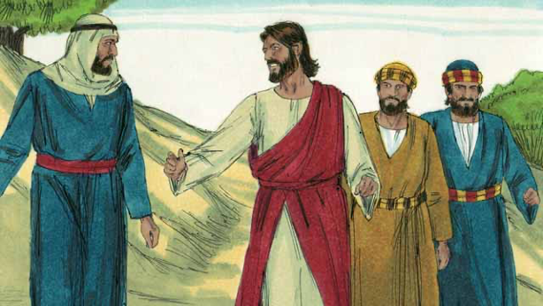
As Jesus and the three disciples were coming down from the top of the mountain, Jesus said to them, “Do not tell anyone yet about what you saw on the mountain. I will soon die and then come back to life. After that, you may tell people about what you saw.”
Notes:
5D. Bible Reading
A. Read the story out loud to the class.
B. If students ask about words, give simple definitions.
C. Encourage students to read aloud paragraphs from the story.

Slide 20
Answer the questions.
1. What happened when Jesus was praying?
2. Who appeared with Jesus?
3. What did they talk about?
4. What did Jesus say to the terrified disciples?
5. When have you been afraid?
6. How has God helped you overcome fear? When?
Notes:
5E. Bible Reading Questions
Ask the questions and discuss as a group. For questions 1-4 you may go back to the story to help students find the answer.
Answers:
1. The face of Jesus became as bright as the sun.
2. Moses and the prophet Elijah appeared with Jesus.
3. They talked about Jesus’ death.
4. Jesus told the disciples, “Do not be afraid.”
5. and 6. Answers will vary.

Slide 21
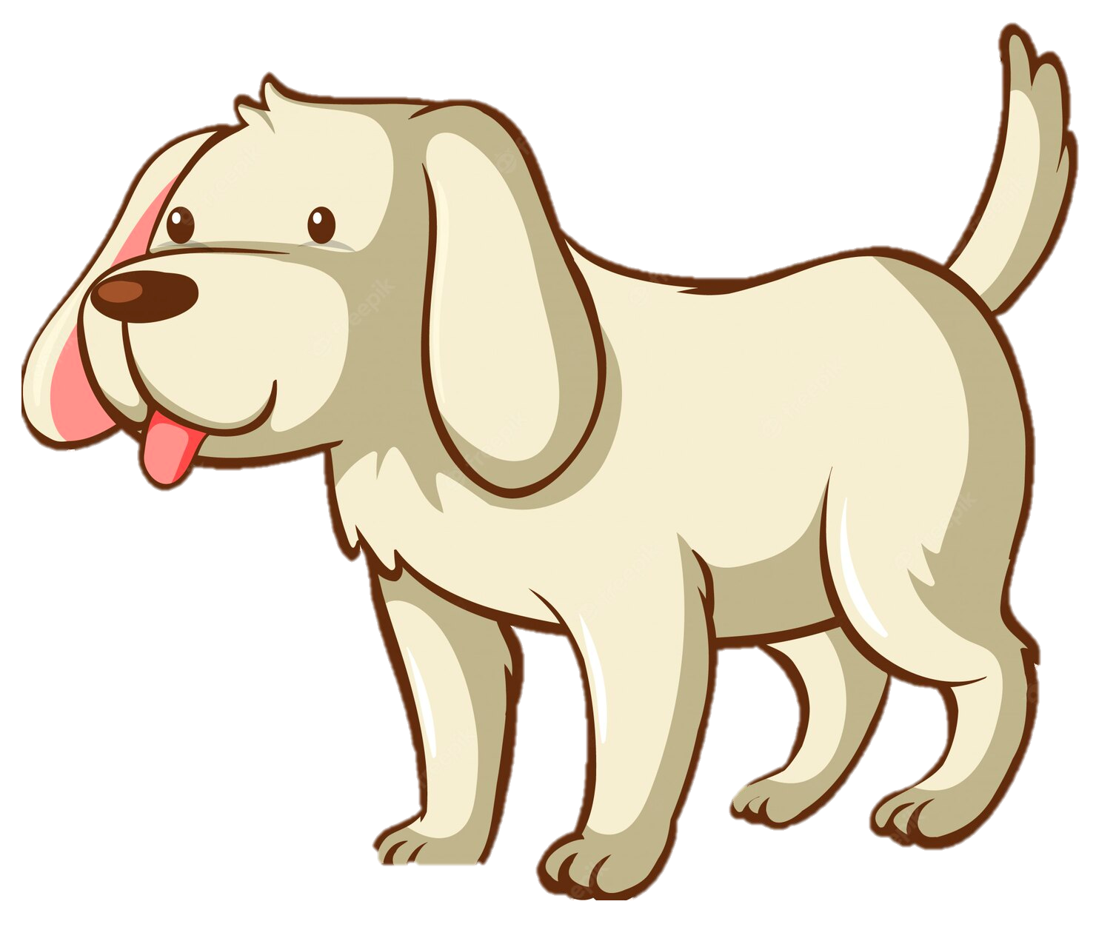
Listen and answer the questions.
How are the dogs that are competing described?
What are the categories for competing?
Describe the poodle, Dolly.
What is Oscar’s weakness?
What are Oscar’s strengths?
Which dog won the show?
Notes:
6A. Activities – Listening with sound/spelling words /est/ and /un/
Read the following script at least twice as students listen and write their answers to the questions. Students may NOT look at the script.
Ladies and gentlemen, welcome to the Twentieth Annual Summer Dog Show! This is where the brightest and the best dogs compete in several categories: grooming, obedience, ability, and friendliness. Our first contestant is a poodle named Dolly, and she looks like a winner! She has the curliest fur and best haircut, with the cutest bow on her collar. She is by far the best groomed dog here today. The judges gave her seventy-five points. Our next contestant is a golden retriever named Oscar. He is the tallest dog on the field, but he looks unhappy with his trainer and uncomfortable in his new collar. Oscar can run the farthest and jump the highest of any dog at the show. He got only seventy points, though, because he is difficult to control. Our final contestant is a dalmatian named Spot. He is the biggest and strongest dog here! Spot scored well in every category and ended with the final score of ninety points. Spot is this year's Twentieth Annual Summer Dog Show winner! Make sure to join us for next year’s show!
Answers:
1. The dogs are the brightest and the best.
2. The categories for competing are grooming, obedience, and friendliest as a pet.
3. Dolly has the curliest fur, best haircut and cutest bow.
4. Oscar is uncomfortable in his new collar/he looks unhappy with his trainer/he is difficult to control.
5. Oscar can run the farthest and jump the highest.
6. Spot won the show.

Slide 22
Role Play – Favorite Season
Questions | Answers
1. What weather do you like best?
2. What season is the most uncomfortable?
3. How do you enjoy the fresh air?
4. What is the highest mountain you have seen?
5. What is a cheap way to relax?
6. What activities are the most fun for you?
7. Which season has the longest days?
Notes:
6B. Activities – Pair work
Partner A will ask questions from this slide and write Partner B’s answers.
Check answers for correct grammar and punctuation.

Slide 23
Role Play – Enjoying the Outdoors
Questions | Answers
1. What is your favorite water activity?
2. When you have a picnic, do you leave the area messy?
3. Where is the best park you ever went to?
4. What do people say about swimming that is true?
5. What is the biggest fish you ever caught?
6. Where do you see the brightest beauty?
7. How do you know rain is coming?
Notes:
6C. Activities – Pair work
Partner B will ask questions from this slide and write Partner A’s answers.
Check answers for correct grammar and punctuation.

Slide 24
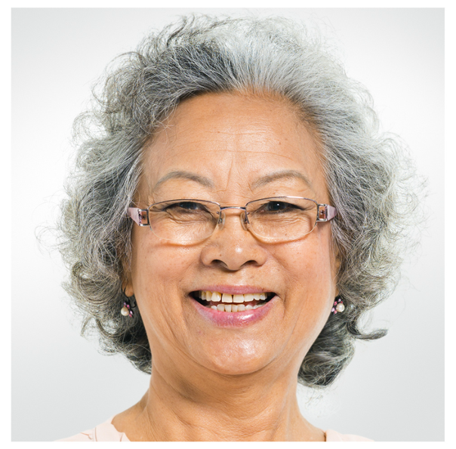
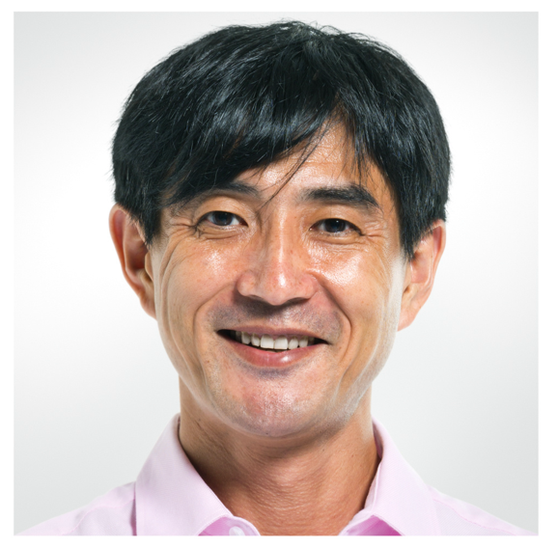
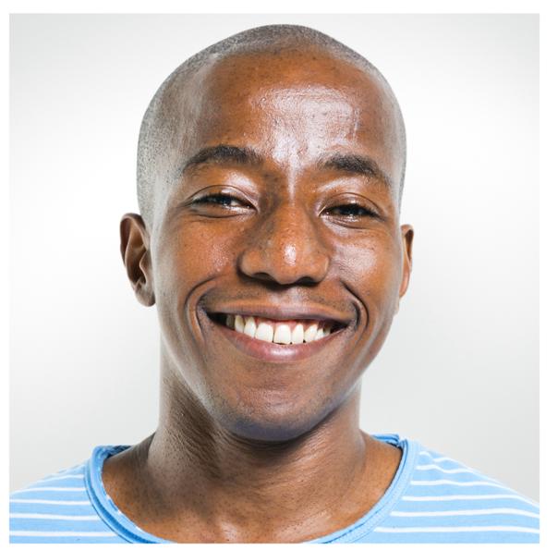
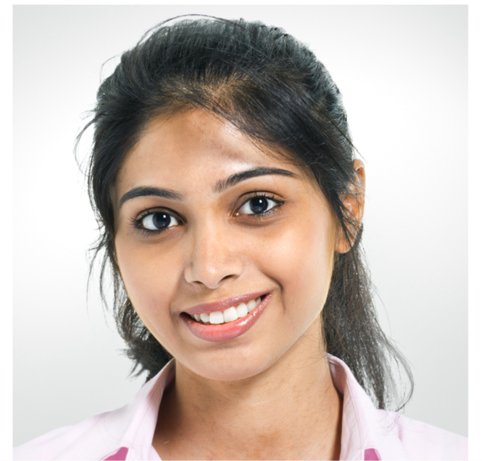
Game – Superlative & Comparative Reasons!
I Use “smart” as a superlative.
I think bees are the smartest insects because they work together.
Use “bad” as a comparative.
I think English is worse than Hindi because it is hard to write.
Notes:
7. Game – Agree or Disagree
Players take turns giving base adjectives for their partner to use in the comparative or superlative form. The first partner says, “Use ____ as a superlative.” or “Use _____ as a comparative.”
The second partner must then give their opinion using “I think____because____“ with the correct form of the adjective and a reason.
You may give learners a list of base adjectives, or to make it more challenging, they can brainstorm their own list of adjectives before they start to play.
Adjectives may include: easy, good, spicy, bad, old, bright, high, low, beautiful, dangerous, happy, intelligent, healthy, strong, weak, comfortable, fun, long, messy, etc.
Players get 1 point for each complete sentence with a correct form and a good reason. The object of the game is to give as many opinions as possible in five minutes.

Slide 25
1A. Homework: Write a sentence about the pictures using comparatives C and superlatives S.
1. C | This box is more difficult to carry without someone to help me. | 4. C
2. C |  | 5. S
3. S |  | 6. S
Notes:
Homework 1A. - Write sentences using the pictured vocabulary words.
Model. Go over each of the homework assignments to be sure the student understands what to do.
Repeat. Encourage students to practice speaking and reading the completed homework assignments with a friend. They may use a bilingual dictionary.
Solo. Students will share their homework when they are finished. After they have shared their homework, be sure to check it for correctness, including spelling. Explain mistakes, while providing praise and encouragement. Answers will vary.
Number one is an example.
Answers may vary, but will start with a capital letter, have the correct verb form and punctuation mark, and use the following words:
2. easier
3. the cheapest
4. more expensive
5. the truest
6. the falsest

Slide 26
1B. Write a sentence about the pictures using comparatives C and superlatives S.
7. S |  | 10. S
8. C |  | 11. C
9. C |  | 12. S
Notes:
Homework 1B. - Write sentences using the pictured vocabulary words.
Students will write a sentence for each picture to practice the lesson’s vocabulary words.
Answers may vary, but will start with a capital letter, have a punctuation mark at the end, and use the following words:
7. the wildest
8. tamer
9. neater
10. the messiest
11. fresher
12. the stalest

Slide 27
2A. Fill in the blanks with the correct comparative
or superlative.
difficult
cheap
true
easy
expensive
false
Dancing is __________ than walking.
Steak is _____________ than chicken.
Cleaning the floor is ______ with a vacuum.
Advertisements are ________ than the product.
Water is the _________ drink.
The mirror is the _________ picture.
Notes:
Homework 2A. – Grammar and Vocabulary Review
Learners must use the correct comparative or superlative with the correct vocabulary word to complete the sentences.
Answers
Dancing is more difficult than walking.
Steak is more expensive than chicken.
Cleaning the floor is easier/easiest with a vacuum.
Advertisements are more false than the product.
Water is the cheapest drink.
The mirror is the most true picture.

Slide 28
2B. Fill in the blanks with a comparative or superlative.
far
wild
neat
fresh
cheap
tame
messy
stale
Lions are _________ than house cats.
Oranges taste ________ when eaten right off of a tree.
Children have the ________ rooms in the house.
Bread gets __________ when left out of the bag.
Cats are usually _________ than dogs.
Lines are _________ when drawn with a ruler.
Notes:
Homework 2B. – Grammar and Vocabulary Review
Learners must use the correct comparative or superlative with the correct vocabulary word to complete the sentences.
Answers
Lions are wilder than house cats.
Oranges taste freshest when eaten right off of a tree.
Children have the messiest rooms in the house.
Bread gets staler when left out of the bag.
Cats are usually tamer than dogs.
Lines are neatest when drawn with a ruler.

Slide 29
3. Write questions and ask a partner.
Questions | Answers
1. Is running or walking more difficult to learn first? | Running is more difficult to learn before walking.
2. _______ freshest _______
3. _______ cheapest _______
4. _______ neatest _______
5. _______ truer _______
6. _______ wildest _______
7. _______ easiest _______
Notes:
Homework 3. – Conversations - Pair work
First, students complete writing the questions with their own words. Then ask students to interview a partner, and write their partner’s answers. Then they will switch roles and answer their partner’s questions.
Check answers for correct grammar and punctuation.
Number 1 is an example.
Questions and answers will vary, but may include:
2. Which fruit makes the freshest juice?
3. Where do you go shopping for the cheapest clothes?
4. What is the neatest way to keep the house clean?
5. What is something that is truer than the sky is blue?
6. What is the wildest dream you have had?
7. When is it easiest to run errands?

Slide 30

4. Answer and say the sentences. Mark the /est/ and /un/ sounds.
A. Are you the tallest student? | No, I am not the tallest.
B. What are you unable to do?
C. When are you unhappy?
D. What is the longest you’ve lived somewhere?
E. What is your biggest fear?
F. What did you not understand in class today?
Notes:
Homework 4. – Write and say sentences with the new sounds.
This homework practices writing, spelling, and pronouncing the /est/ and /un/ sounds.
Answers will vary. Learners should mark the following sounds:
A. Are you the tallest student?
B. What are you unable to do?
C. When are you unhappy?
D. What is the longest you’ve lived somewhere?
E. What is your biggest fear?
F. What did you not understand in class today?

Slide 31
5. Summarize the Bible lesson using your own words.
Jesus was praying with his disciples up on a mountain.
Then appeared ____________________________________
They talked _______________________________________
Then came _______________________________________
The disciples ______________________________________ Then ____________________________________________
Notes:
Homework 5. – Bible Reading Review
Students may look back at the story to write their answers.
Answers will vary but may include:
Jesus was praying with his disciples up on a mountain. Then appeared Moses and the prophet Elijah. They talked with Jesus about his death. Then came God in a bright cloud. The disciples were afraid and fell on the ground. Then Jesus told them to not be afraid and they climbed down the mountain.

Slide 32
6A. Homework – Choose 1 verse to memorize.
A
While Peter was talking, a bright cloud came over them. A voice came from the cloud and said, “This is my Son, the one I love. I am very pleased with him. Obey him!” Matthew 17:5 ERV
Jesus answered, “You were not able to make the demon go out because your faith is too small.”
Matthew 17:20 ERV
B
Notes:
Homework 6A. – Memorize a Verse
Learners get to choose A, B, or C (on the next slide) to memorize. Please notice that the memory work is not long. Everyone, regardless of skill level, should be able to do it.
1. Model. Recite a verse from memory.
2. Repeat. Encourage students to find someone with whom to practice conversing and reading the completed homework assignment.
3. Solo. Students will recite the verse from memory at the next class.

Slide 33
6B. Homework – Choose 1 verse to memorize and read the next verses.
The Lord said, “If your faith is as big as a mustard seed, you can say to this mulberry tree, `Dig yourself up and plant yourself in the ocean! And the tree will obey you.” Luke 17:6 ERV
          Read the next lesson’s Bible verses: John 11:1-46
C
Notes:
Homework 6B. – Memorize a verse and read the next lesson’s verses.
Learners get to choose A, B, or C to memorize.
Students will always read the Bible lesson in their first language (L1) before reading it in English the following lesson. Help them get a Bible in their own language if they don’t have one. They may also use Bible.IS or other Bible translation resources.

Slide 34
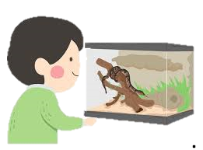
7A. Read the letter and answer the questions.
Warning! Loose Snake!
Dear Resident,
We have received a report from residents about a wild snake loose in our apartment building. Be aware; we have an expensive pest control service trying their best to fix this difficult problem. There is no need to panic. It is not the most dangerous snake in the world, but we understand that this situation makes everyone unhappy and uncomfortable. What should you do? If you see the snake, please notify the office and keep an eye on the snake. If the worst happens, and you are bitten by the snake, go to the hospital before the bite mark gets messier from infection than when you first got it. Be careful! Snakes can be faster than you, so stay safe.
Notes:
Homework 7A. – Everyday Reading and Writing
The learners will read a residential letter and answer the questions on the next slide.

Slide 35
7A. Read the letter and answer the questions.
Warning! Loose Snake! (Continued)
This unpleasant situation happened because a resident had a pet snake that escaped in the building. As you know, animals of any kind are forbidden here. Many residents have allergies to cats and dogs. Some birds, such as parrots, can be louder than dogs. Our apartments are safer, cleaner, and quieter without animals. Help us to keep our building the most beautiful, most comfortable, and safest place in town.
Thank you,
Mr. Saul Riley
Awesome Apartments Manager
Notes:
Homework 7A. – Everyday Reading and Writing
The learners will read a residential letter and answer the questions on the next slide.

Slide 36
7B. Answer the questions
A. Where is the snake loose?
B. How dangerous is the snake?
C. How can residents help?
D. What happens if someone gets bitten?
E. Is the person or the snake faster? How do you know?
F. How do you know the residents are safe?
Notes:
Homework – Everyday Reading and Writing
The learners will read the residential letter and answer the questions.
Answers:
A. The snake is loose in an apartment building.
B. The snake is not the most dangerous snake in the world.
C. Keep an eye out for the snake, and notify the office if you see it.
D. If bitten they should go to the hospital.
E. The snake is faster than any person.
F. The residents are safe because the apartments have hired a pest control service.

Slide 37
8. Writing
Using comparatives and superlatives, write a paragraph about your favorite and least favorite season, chore, or book.
_________________________________________________
_________________________________________________
_________________________________________________
_________________________________________________
_________________________________________________
_________________________________________________
_________________________________________________
Notes:
Homework 8. – Writing
Model. Write something about your favorite season. For example: I love the summer time. It has the hottest weather, and playing in the water is the most refreshing thing to do. The sun is the brightest, and the days are the longest.
Answers will vary.

Slide 38
9. Homework – Now I Can….
I can use words that compare and contrast and apply them.
I can use the new words including _____, _____, _____, _____, _____, _____, _____, _____, _____, _____, _____, and _____.
I can use comparatives and superlatives and apply them.
I can understand what Jesus told the disciples about his
death and resurrection.
Notes:
Homework 9. – I can statements
The student must be able to achieve all of these skills before the next lesson. If not, the lesson can be repeated or additional practice materials can be used.
Review all of the skills at the beginning of the next lesson. Be sure to give lots of praise and encouragement!

Slide 39
Reflections and Closing Prayer
Notes:
Reflections and Closing Prayer
You may want to thank the Lord for what we have learned, ask for special prayer requests, then pray for your students and bless them. Students may write reflections and their prayers here.

Slide 40

Help us share the Light of the World!
Thank you for using our materials. If these lessons are a blessing to you, please give or volunteer to help others learn English through the Bible.
For more information, visit LightOfTheWorldLearning.org

Slide 41
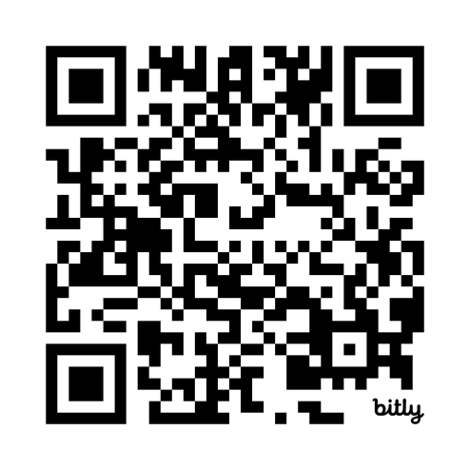
Appendix
How to Use Lessons: bit.ly/UseLOTW
Irregular Verb List: bit.ly/ListVerbs
Lesson Downloads: LightOfTheWorldLearning.org
Order Books: bit.ly/BooksLOTW
Share Your Feedback: bit.ly/FeedbackLOTW
Table of Contents: bit.ly/TocLOTW
Video Channel: youtube.com/@LightOfTheWorldLearning
Vocabulary List: bit.ly/VocabUS
Website: LightOfTheWorldLearning.org

Slide 42
Acknowledgements
We would like to thank the entire Light of the World volunteer team for their hard work and creativity in making this project possible. For all those around the world who prayed, wrote, edited, narrated, illustrated, sang, tested, and gave generously for this curriculum, we appreciate you sharing the love of Jesus through the gift of English. Our team members include:
Anonymous | Emily Cox | Jill Gramzow | Martha Lane
Jean Ato | Marilyn Dano | Tanya Griffin | Audrey Larsen
Bradley Baurain | Hephzi Davidson | Rachel Grijincu | Aden Lewis
Ana Biederman | Susanna Diallo | Lauren Haines | Bruce Lewis
Bob Biederman | Alyssa Dokolas | Carol Hale | Elena Lewis
Joshua Blake | EasyReadEnglish.com | Emily Hamilton | James Lewis
Rachael Braggs | Don Edic | Patty Hickman | Micah Beth Lewis
Hannah Brendel | Peggy Fergus | Juliette Hyer | Tim Lewis
Larry Buell | MaryBeth Gahan | Lyudmila Ivanyuk | Ward Lewis
Cindy Campbell | Melina Gallo | Debbie Johnson | Cosette Lindsay
Christian Cha | Alicia Gentile | Carey Jo Johnston | Johnny Lukashevich
Olivia Cheney | Prakash Chandra Giri | Nancy Kingdon | Gail MacMillan
Hannah Clark | Ellenor Gopal | Dorothy Konadu | Ivan Mader
Nancy Cobb | Henrietta Grajcar | Macy Lake | Amy Martin
(continued on the next slide)

Slide 43
Acknowledgements - Continued
Diana Martz | Joan Phelps | Lorna Tatomir
Hannah McMahan | Megan Rahn | Darrell Turner
Christy McPherson | Sara Scazzero | Leigha Wachter
Tracy Meddaugh | Hannah Schmokel | Joseph Waite
Barbara Newsome | Ashlyn Shrimplin | Graham Whitmore
Brenda Nielsen | Leah Sprague | Cheri Wilke
Danielle Nowe | Noah Staal | Mackenzie Williams
Deborah O’Donnell | Macie Stuckman | Allison Wright
Evelyn Ocasio | Jia Le Su | Tiffany Yeh
Georg Ort | Carole Svensson | Muchun Yin
Martha Ort | Ellie Talalight | Ted York
Barb Park | Peter Talalight | Tai Lee Young
Deb Payne | Weston Talalight | Abigail Zawisza
Linda Petrie | Rachel Tamang | Anita Zeifert
Bible story and pictures on slides 15-20 adapted from the original work by unfoldingWord available from https://openbiblestories.org
Bible Verses on slides 32-33 Taken from the HOLY BIBLE: EASY-TO-READ VERSION ©2014 by Bible League International. Used by permission.

