Slide 1


Unit A2-29
© 2022-2025 Light of the World Learning
Notes:
Teacher’s Notes:
Bible Reading: Jesus is tempted in the wilderness
Matthew 4:1-11; Mark 1:12-13; Luke 4:1-13
Theme: Parts of the body
Pronunciation: /t/, /d/ and /id/ spelled -ed
Grammar: Past simple tense verbs, Positive and Negative “Did” Questions
Preparation:
Pray.
Read the Bible passages.
Preview slides and game.
Optional: Bring a razor, dolls to show body parts, objects to taste, see, touch, smell (flowers, food, etc.)

Slide 2

Pray, Review, and Preview
Bible Reading: Jesus Is Tempted in the Desert – Matthew 4:1-11; Luke 4:1-13
Theme: Parts of the body and senses
Pronunciation: /t/, /d/ and /id/ spelled -ed
Grammar: Simple past regular verbs
Notes:
Pray
Pray for the class. You may want to thank the Lord for having a healthy body or pray for health concerns.
Check Homework and Review
Ask students to read aloud or recite their homework from the last class. Check written work.
Be sure they have read Matthew 4:1-11; and Luke 4:1-13 in their native languages in preparation for the lesson.
Review the main points of the previous lesson and ask if there are any questions.

Slide 3
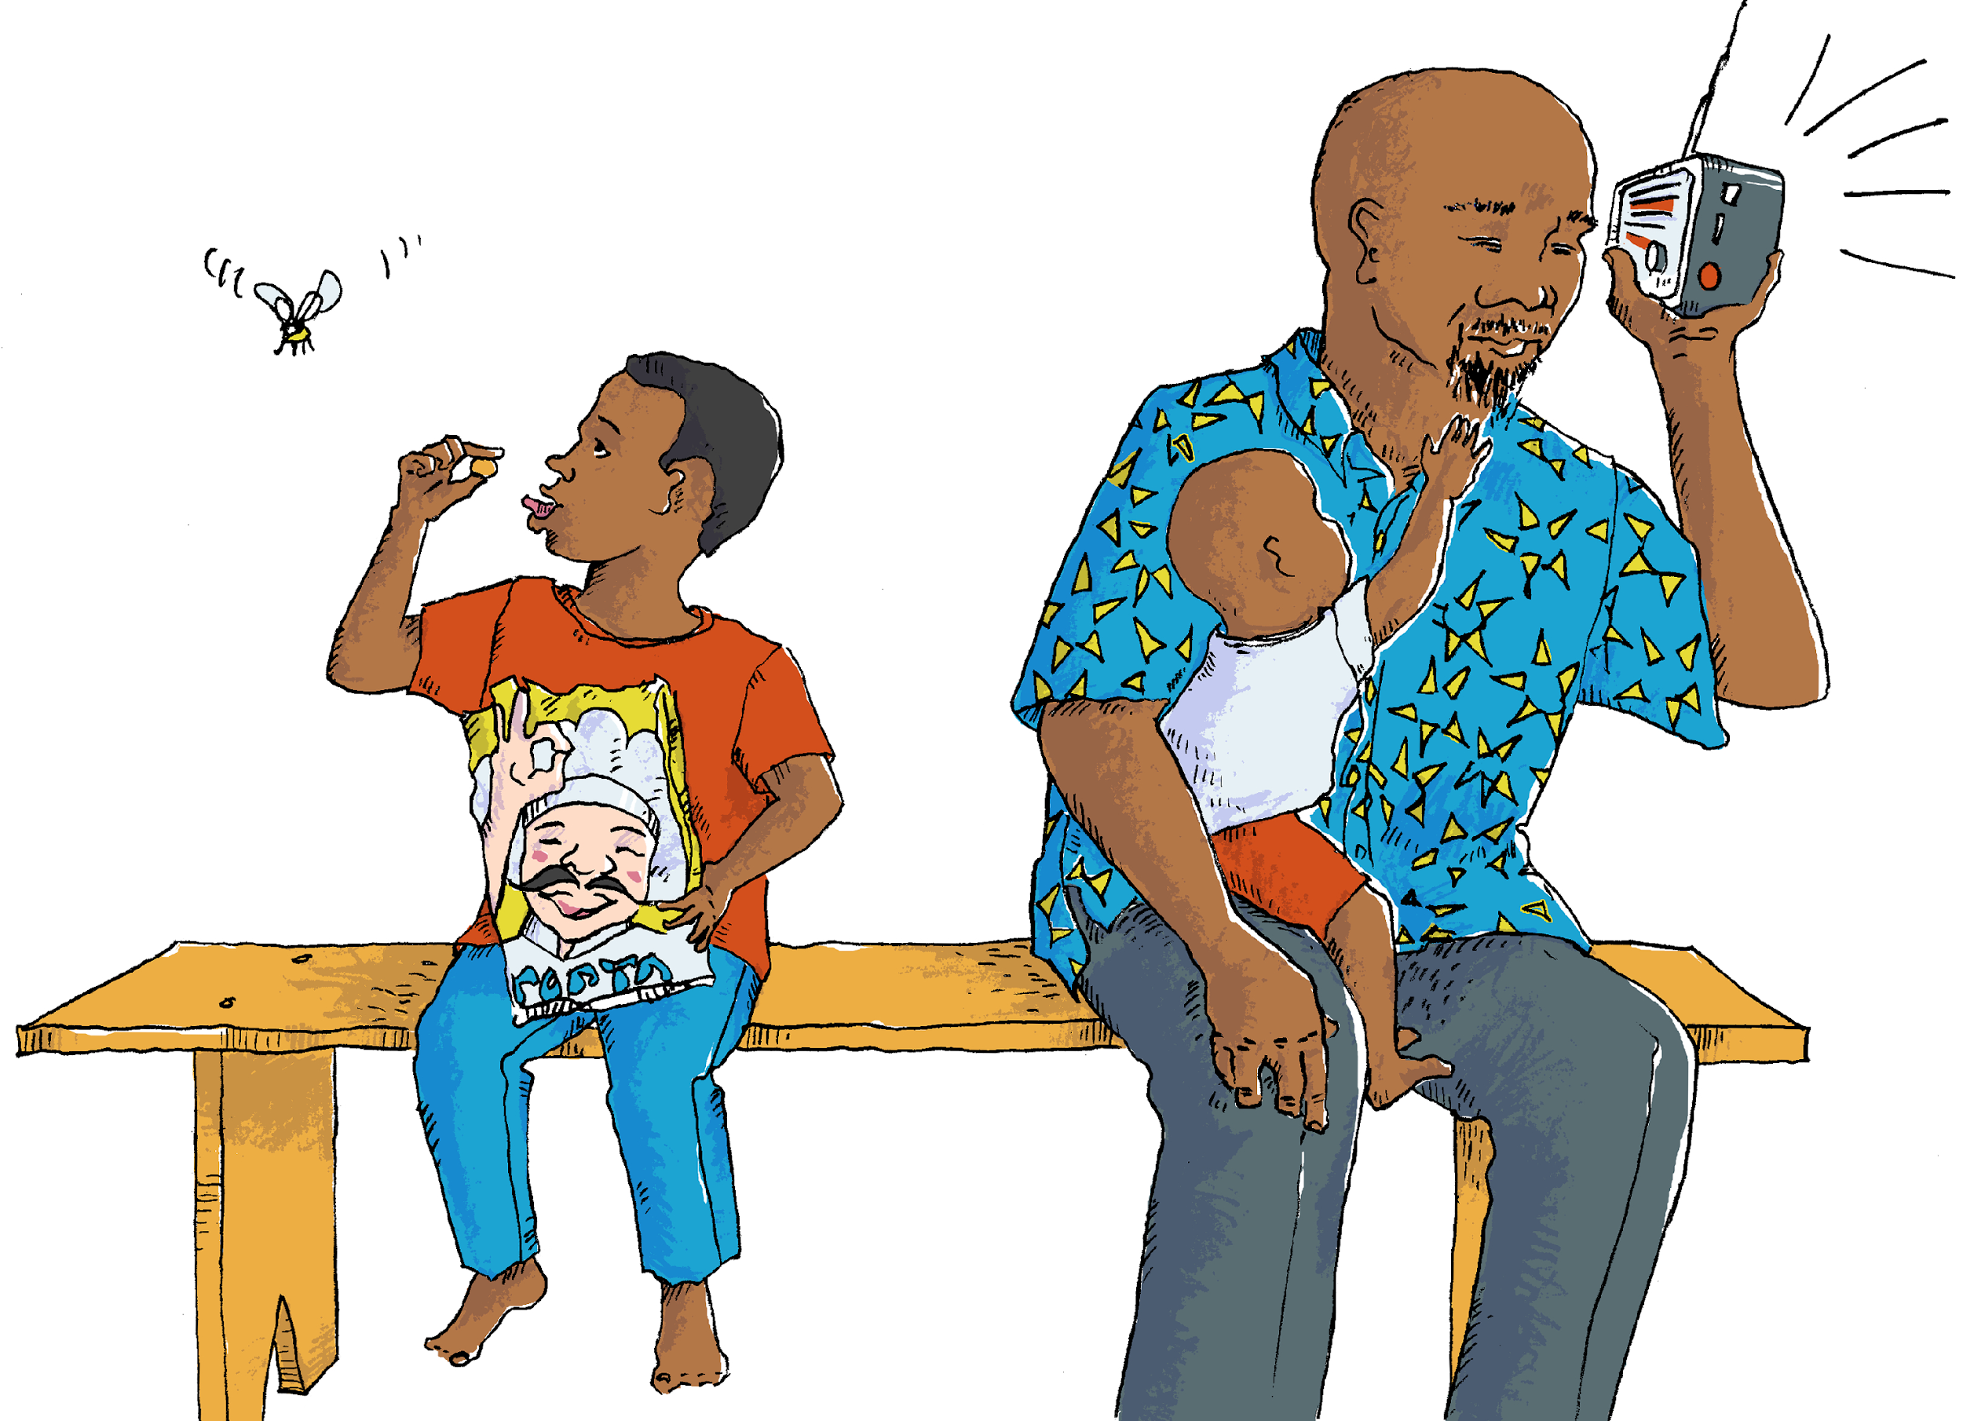
What do you see?
Notes:
1A. Discuss Theme Picture
Ask “What do you see in this picture?” and “What else?” to elicit vocabulary they already know.
Repeat and write their words or show the words on the next slide.
Answers may include: face, neck, fingers, mustache, thumb, lips, beard etc.
More advanced students can be encouraged to make complete sentences:
The baby wants to touch his father’s beard. The boy holds a snack between his thumb and finger.

Slide 4

A father and his two sons sat on a park bench. The father listened to the radio as the toddler reached for his face and tried to touch his dad’s beard and mustache.
Relaxing in the Park
The older son slowly ate some cheesy snacks from a bag. He held each snack between his finger and thumb for a moment before he popped it into his mouth. They tasted good, and his lips and tongue started to turn orange from eating so many.
Suddenly, he heard an insect buzzing and turned his neck to see it. It was a large bee! He waved it away and then shared his snacks with his brother.
Notes:
1B. Show Description of Theme Picture
Please read the description of the theme picture to the students and point to the pictured vocabulary.
These words can be studied for homework.
Practice of vocabulary begins with the following slide.

Slide 5



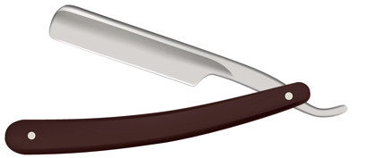

Match the definitions to the correct words.
1. a neck | 2. a beard | 3. a moustache | 4. a razor
hair between a man’s mouth and nose
a body part between the head and shoulders
a sharp tool used to shave hair
hair below a man’s mouth
Notes:
2A. Vocabulary
This vocabulary section is in a different format than previous lessons. As students’ skills improve, they need more challenges.
1. Say the word a few times, as you indicate the picture. For example, say, ”a neck, a neck, a neck.” Have your students then repeat the word after you a few times.
2. Ask students to match the word to the correct definition and say the answer as a sentence. For example, “A neck is a body part between the head and shoulders.”
3. Check students’ comprehension further by asking direct questions. For example, “Where is your neck?” “Do I have a beard?” “Does your father use a razor?”
Answers
1. B
2. D
3. A
4. C

Slide 6



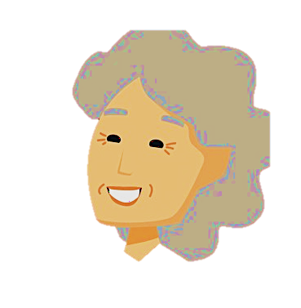
Match the beginning and end of each sentence.
5. Put your thumbs up
6. I have 5 fingers
7. I move my lips
8. Her face always
E. when I talk and smile.
on each hand, and 5 toes on each foot.
G. shows her feelings.
H. to express something good.
Notes:
2B. Vocabulary
Note: A thumb is one of the fingers. The other fingers are called index finger, middle finger, ring finger and pinky (or little) finger.
1. Say the beginning of the sentence a few times, as you indicate the picture. For example, say, ”Put your thumbs up, put your thumbs up.” Have your students then repeat the phrase after you a few times.
2. Ask students to match the beginning and end of each sentence and say the complete sentence. For example, “Put your thumbs up to express something good.”
3. Check students’ comprehension further by asking direct questions. For example, “Where are your thumbs?”
Answers
5. H
6. F
7. E
8. G

Slide 7


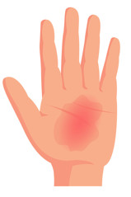
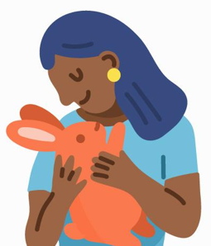
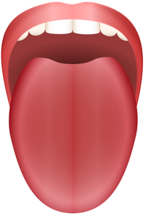
Match the beginning and end of each sentence.
9. She tasted
10. I burned
11. She touched
12. My tongue
the palm of my hand on the hot pan.
J. the fruit but didn’t like it.
helps me to talk and taste food and drinks.
the soft animal with her hands.
Notes:
2C. Vocabulary
1. Say the beginning of the sentence a few times, as you indicate the picture. For example, say, ”She tasted, she tasted.” Have your students then repeat the phrase after you a few times.
2. Ask students to match the beginning and end of each sentence and say the complete sentence. For example, “She tasted the fruit but didn’t like it.”
3. Check students’ comprehension further by asking direct questions. For example, “What do you like to taste?”
Answers
9. J
10. I
11. L
12. K

Slide 8
Simple past regular verbs end in -ED.
 | Question ? | Positive + | Negative -
1 | Did she smell the flower? | Yes, she smelled it. | No, she didn’t smell it.
2 | Did you burn the food? | Yes, I burned it. | __________________
3 | __________the paint? | Yes, I touched it. | No, I did not touch it.
4 | Did you yawn a lot? | ______________ | No, I didn’t yawn.
Notes:
2D. Grammar – Simple past tense verbs
Note: Past simple tense verbs are used for a past action that is finished. The form is the same in all persons
Regular simple past verbs end in –ed. Irregular verbs do not end in -ed. They can be found on the list in the appendix.
The -ed ending is used in the positive form but not in the question or negative form.
To spell many simple past regular verbs we just add the letters –ed to the end of the word. However, the next slide shows 3 rules where this pattern is different.
Model, Repeat, and Solo row number 1. Then ask students to complete the sentences for rows 2-4.
Answers:
2. No, I didn’t (did not) burn it.
3. Did you touch the paint?
4. Yes, I yawned (a lot).

Slide 9
Spelling Rules for Simple Past Regular Verbs
 | Base Verb | Simple Past | Spelling Rule
1 2 3 | taste shave translate | tasted __________ __________ | If the word ends in E, just add D.
4 5 6 | carry study marry | carried __________ __________ | If the word ends in a consonant + Y, change the Y to I and add ED
7 8 9 | wrap stop plan | wrapped __________ __________ | If the word ends in 1 vowel and 1 consonant, double the last consonant and add ED.
Notes:
2E. Grammar: The spelling rules of regular verbs
If the word already ends in silent E, just add D.
If the word ends in a consonant + Y, change the Y to I and add ED.
If the verb has one syllable and ends in one vowel and one consonant (-vc) the final consonant is doubled: stopped, planned. However, do not double w, x, y (sowed, boxed, played).
Model, Repeat, and Solo row number 1. Then ask students to complete the sentences for rows 2-9.
Answers:
2. shaved
3. translated
5. studied
6. married
8. stopped
9. planned

Slide 10
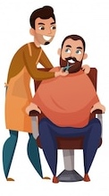

Listen and repeat.
A: What do you do?
B: I’m a barber. I cut hair and use a razor to shave men’s faces. I also trim their beards and mustaches with scissors. What do you do?
A: That sounds interesting! I work as a chef. I like to cook and taste all the good food. But yesterday I burned my tongue on a piece of hot pizza. Now I can’t taste anything.
B: Ouch! That’s too bad! I hope your sense of taste improves soon.
Notes:
3. Conversation
1. Model: Say both parts of the conversation several times. Use A and B cards, stick figures, or change your physical position to indicate the dual parts. Role-play the parts to convey the meaning of the conversation. Students just watch and listen.
2. Repeat: Say one line at a time and have students repeat until they can be understood.
3. Solo: You begin the conversation and call on individual students to respond. Then reverse the roles (students are A, you are B).
4. Once students can do both parts, encourage free conversation (students substitute their own words for the blue words).

Slide 11
Three Ways to Pronounce –ED Endings.
1. /id/ | 2. /t/ | 3. /d/
Pronounce –ed as an extra syllable, /id/, only after /t/ or /d/. | Pronounce –ed as /t/ after unvoiced sounds: /p/, /k/, /ch/, /f/, /s/, /sh/, /th/ | Pronounce –ed as /d/ after all other voiced sounds.
painted waited needed handed | talked stopped washed watched | stayed loved burned buzzed
Notes:
4A. Pronunciation
Explain that there are three ways to pronounce -ed at the end of words. The pronunciation changes based on the sound before the -ed.
You may demonstrate voiced and unvoiced sounds by asking students to put their hand on their throat while saying the sound.
/s/ is unvoiced. Air comes from your mouth but your throat does not vibrate: /sssssss/ like the sound a snake makes.
/z/ is voiced. You can feel your throat vibrate when you say the sound: /zzzzzz/ like the sound a bee makes.
If the final sound is /t/ or /d/, the -ed is pronounced with an extra syllable: /id/.
If the sound before is unvoiced the -ed is pronounced /t/.
If the sound before the -ed is voiced, the -ed is pronounced /d/.
Go over the pronunciation and rules with the students.

Slide 12
Three Ways to Pronounce –ED Endings.
1. /id/ | 2. /d/ | 3. /t/ | 4. Challenge
waited | stayed | talked
needed | loved | stopped
painted | cleaned | touched
handed | used | looked
tasted | hugged | danced
5. I waited after class and talked to my teacher.
6. We stayed outside last night and painted the fence.
Notes:
4B. Pronunciation - Sound and Spelling
1. Model: Say the sound several times while pointing to it. (For example, point to /id/ and say /id/ /id/ /id/. Then say the sound and read the entire list, pointing to each item as you read it (/id/, waited, needed, painted, handed, tasted). Students just watch and listen.
2. Repeat: Say the sound and each word several times, having students repeat each time after you in unison. Be sure to use your normal voice and rate of speed. Do one column at a time, top to bottom. Then read the sentences.
3. Solo: Call on individuals to say a sound and its word group. Give lots of praise. Then ask students to read the sentences.
4. Challenge: Choose another sound from the lesson that is challenging for your particular students to pronounce. Use words from this lesson and from previous lessons to make a group of 3-5 words. You may repeat the same challenging sounds in several lessons. Students need a lot of practice on sounds that do not exist in their first language.

Slide 13
Listen and repeat.
A. ▔ | B. ▔-- | C. ▔-
thumbs | visited | desert
tongues | teenager | faces
beard | elderly | finger
burned | mustaches | razor
touched | serious | tasted
Notes:
4C. Pronunciation - Hum and clap the stress.
Begin by humming the stress of a column of words. Hum higher, longer, and louder for big dashes and lower, shorter, and quieter for small dashes.
You may use hand gestures to indicate that the stressed syllable is higher in pitch, longer in duration, and louder. Invite your students to join in humming the rhythm. Once the class is humming the rhythm in unison, you can begin saying the words. You may also wish to clap the syllables while you say the words.
1. Model: Hum and then say each word in the column several times. Students listen.
2. Repeat: Students repeat words after you in unison.
3. Solo: Call on individuals to read the entire column of words.

Slide 14
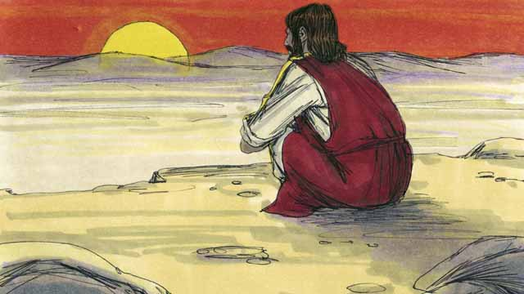
Jesus Is Tempted in the Desert Matthew 4:1-11; Luke 4:1-13
Immediately after Jesus was baptized, the Holy Spirit led him out into the
desert. Jesus ate nothing for 40 days and 40 nights and when it was finished, he was very hungry.
The devil came to Jesus and tempted him to sin.
First, he said to Jesus, “If you are the Son of God, tell this rock to become bread so you can eat!”
Notes:
5A. Bible Reading
Students should have already read this story in their first language (L1) as part of their homework, so it will be familiar even if they do not know all the vocabulary yet. However, if they have not yet read it in their L1, be sure they do so now before reading it in English. The hyperlinks of the Bible verses connect to https://live.bible.is/ so students can read and hear the scripture in their own languages.
A. Read the story out loud to the class.
B. If students ask about words, give simple definitions.
C. Encourage students to read aloud paragraphs from the story and act out the scene.
D. Ask if there are any questions or comments about the story.
E. Ask the story questions and discuss as a group.
F. Optional - You may hide the words and ask students to tell the story again in their own words, using the pictures to help them.

Slide 15
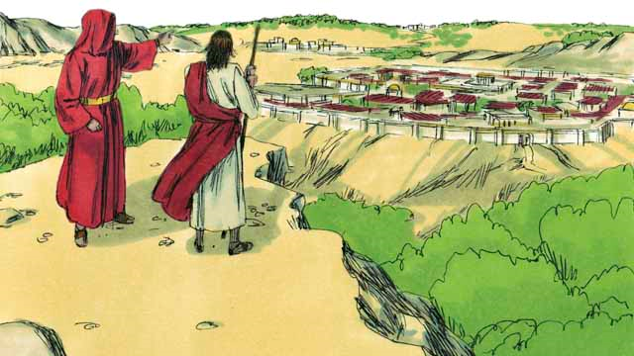
Jesus answered him, “It is written in God’s word, ‘People do not only need bread in order to live, but they need everything that God tells them!’”
Then the devil took Jesus and in a
moment of time showed him all the kingdoms of the world and all the wonderful things in them. The devil said to him, “I will make you king over all these places. You will have power over them, and you will get all the glory. It has all been given to me. I can give it to anyone I want. I will give it all to you, if you will only bow down and worship me”
Notes:
5B. Bible Reading
A. Read the story out loud to the class.
B. If students ask about words, give simple definitions.
C. Encourage students to read aloud paragraphs from the story and act out the scene.

Slide 16
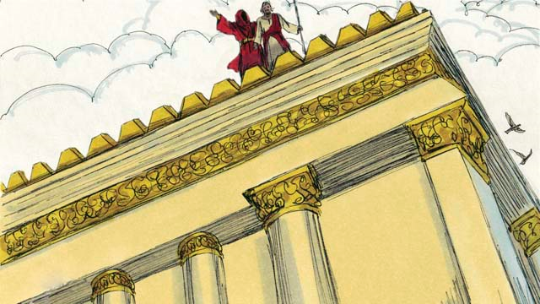
Jesus answered, “The Scriptures say, ‘You must worship the Lord your God. Serve only him!’”
Then the devil led Jesus to Jerusalem and put him on a high
place at the edge of the Temple area. He said to him,
“If you are the Son of God, jump off to the ground, because the Scriptures say, ‘God will command his angels to take care of you.’ It is also written, ‘Their hands will catch you, so that you will not hit your foot on a rock.’”
Notes:
5C. Bible Reading
A. Read the story out loud to the class.
B. If students ask about words, give simple definitions.
C. Encourage students to read aloud paragraphs from the story and act out the scene.

Slide 17
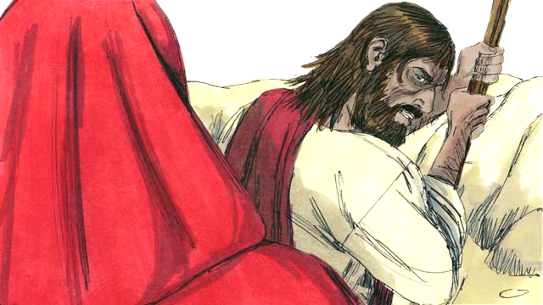
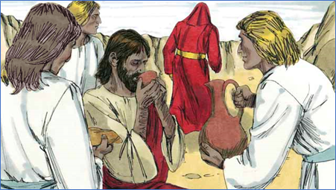
Jesus answered, “Get away from me Satan! The Scriptures say, ‘You must not test the Lord your God.’”
The devil finished tempting Jesus in every way and went away to wait until a better time.
Then angels came and took care of Jesus.
Notes:
5D. Bible Reading
A. Read the story out loud to the class.
B. If students ask about words, give simple definitions.
C. Encourage students to read aloud paragraphs from the story and act out the scene.

Slide 18
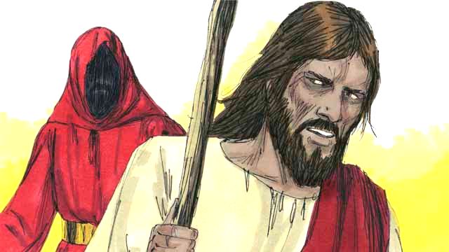
Answer the questions.
1. Who led Jesus into the desert?
2. How long did Jesus go without food?
3. What was the first thing the devil tempted Jesus to do?
4. Why do you think the devil tempted Jesus?
5. What happened after the devil left Jesus?
6. How did Jesus answer each of the temptations?
7. What can you do when you are tempted?
Notes:
5E. Bible Reading Questions
Ask the questions and discuss as a group.
Answers:
1. The Holy Spirit.
2. 40 days and 40 nights
3. To tell the rock to become bread.
4. Answers will vary but may include, to try make Jesus worship him.
5. Angels came to take care of Jesus.
6. He used the Word of God, the Scriptures.
7. Answers may vary but may include, pray, quote scripture, etc.

Slide 19

Listen and write the correct verbs.
1. Ana _________ a cake for her grandmother.
2. Her brothers _________ the yard and _______ the tables.
3. The lemon cake _______ great and _______ beautiful.
4. Ana ______ _______ to forget anything.
5. The family _______ and kissed when they __________.
6. Grandma asked, “How _____ you _______ I like yellow?”
Notes:
6A. Activities – Listening to sound/spelling words
Read the script below at least twice as students listen and answer the questions. The students should NOT look at the script.
“My family was so excited to plan a big party for my grandma’s birthday yesterday. I didn’t want to forget anything, so I made a list of all the things we needed to do. Everyone knows yellow is Grandma’s favorite color. She always wears yellow and she even painted the walls in her room yellow. That morning, I baked a lemon cake because Grandma loves the taste of lemon. I placed it in the oven and set the timer so I didn’t burn it. Next I decorated it with yellow icing and candles so that it looked beautiful and smelled great My brothers cleaned the backyard and washed the tables and chairs. My sisters bought her a pretty necklace and wrapped it in yellow paper. They also picked yellow flowers for her. Everyone was invited to the party. I was excited to see my aunts, uncles, and cousins who traveled a long way to come see Grandma. We all hugged and kissed when they arrived. Grandma tasted the cake and held up both thumbs. “Great job, baking the cake, Ana!” she said. Her face lit up with excitement and she smiled as my sister placed the necklace around her neck. “This is the best birthday party!” she told us. “How did you know I like yellow?”’
Answers 1. baked 2. cleaned and washed 3. tasted and looked 4. didn’t want 5. hugged and arrived 6. did and know

Slide 20
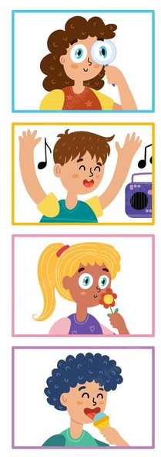

Partner A: Ask questions to complete the chart.
 | Name | Verb | Object | Body Part | Time
 | Sue |  | insect |  | yesterday
 | Tim | listen |  | ears
 | Sara |  | flower |  | last week
 | Joe | taste |  | tongue
 | Mary | touch |  | thumb
What did Sue do with the insect yesterday?
She looked at the insect with her eyes.
Notes:
6B. Activities – Pair work Partner A
Student A looks at this slide and student B looks at the next slide. Each slide has different information and they may not look at each others’ slides.
Student A will look at their chart and ask questions to fill in the blanks such as “What did Sue do with the insect yesterday?” and student B will use their chart to answer: “She looked at the insect with her eyes.”
For the next picture they will switch roles, with student B asking a question: ex. “What did Tim do with the music at 8:00?” and student A answering based on their chart will answer: ex. “He listened to the music with his ears.”

Slide 21

Partner B: Ask questions to complete the chart.
 | Name | Verb | Object | Body Part | Time
 | Sue | look |  | eyes
 | Tim |  | music |  | 8:00
 | Sara | smell |  | nose
 | Joe |  | ice cream |  | Friday
 | Mary |  | her neck |  | noon
What did Sue do with the insect yesterday?
She looked at the insect with her eyes.
Notes:
6C. Activities – Pair work Partner B
Student B looks at this slide and student A looks at the previous slide. Each slide has different information and they may not look at each others’ slides.
Student B will look at their chart and ask questions to fill in the blanks such as “What did Tim do with the music at 8:00?” and student A answering based on their chart will answer: ex. “He listened to the music with his ears.”
For the next picture they will switch roles, with student A asking a question: ex. “What did Sue do with the insect yesterday?” and student B will use their chart to answer: “She looked at the insect with her eyes.”

Slide 22
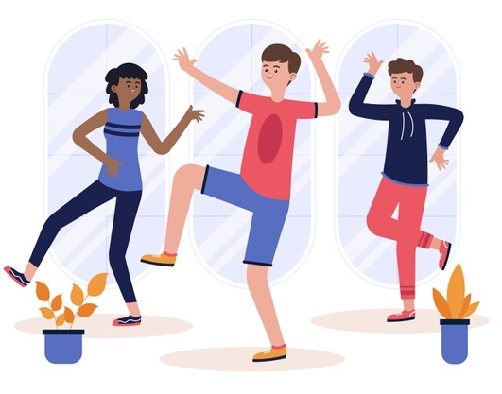
Song – Head and Shoulders
Head and shoulders, knees and toes
Knees and toes
Head and shoulders, knees and toes
Knees and toes
Eyes and ears and mouth and nose
Head and shoulders, knees and toes
Knees and toes!
Ankles, waist and neck and lips
Neck and lips
Ankles, waist and neck and lips
Neck and lips
Forehead, back and thumbs and hips
Ankles, waist and neck and lips
Neck and lips!
Notes:
7 Song
Learners will learn the new song for the lesson with the accompanying actions.
1. Model: Read the song lyrics out loud to the class. Point to your own body parts as you say each word. Ask if there are any questions. Write words that learners ask about on the board and give simple definitions. Then sing it two or three times, while they just listen. Point to your body parts as you sing the song and ask students to point to their own body parts.
2. Repeat: Sing the selection again, a line or sentence at a time, as learners repeat after you. Then play the recording and sing the song together with motions as a class in unison.
3. Solo: The learner sings solo (or if shy, can just read the words aloud) with the accompanying actions.

Slide 23


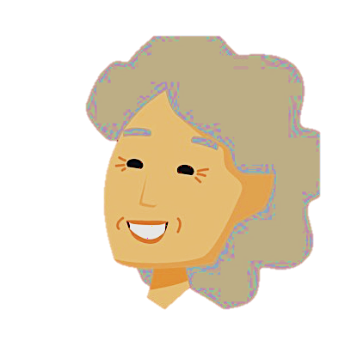



1A. Homework – Write positive or negative sentences about the pictures in the simple past.
-
1 | Her lips moved quickly as she talked about her work. | 4
2 |  | 5
3 |  | 6
+
-
+
+
-
Notes:
Homework 1A. - Write sentences using the pictured vocabulary words.
Model. Go over each of the homework assignments to be sure the student understands what to do.
Repeat. Encourage students to practice speaking and reading the completed homework assignments with a friend. They may use a bilingual dictionary.
Solo. Students will share their homework when they are finished. After they have shared their homework, be sure to check it for correctness, including spelling. Explain mistakes, while providing praise and encouragement.
Number one is an example.
Answers may vary, but will start with a capital letter, have a punctuation mark at the end, use the simple past tense, and use the following words:
2. face
3. neck
4. finger
5. taste
6. razor

Slide 24






1B. Write questions about the pictures in the simple past.
?
?
7 |  | 10
8 |  | 11
9 |  | 12
?
?
?
?
Notes:
Homework 1B. - Write sentences using the pictured vocabulary words.
Students will write a sentence for each picture to practice the lesson’s vocabulary words.
Answers may vary, but will start with a capital letter, have a punctuation mark at the end, use the simple past tense question form and use the following words:
7. mustache
8. beard
9. thumb
10. touch
11. tongue
12. burn

Slide 25
2A. Fill in the blanks with the correct verb form.
(text) She sometimes texts with her thumbs, but yesterday she texted a message with her index fingers.
(shave) He usually _________ his face in the morning, but yesterday he didn’t __________ because he wants to grow a beard.
(touches) She rarely _______ the hot stove, but earlier today she ________ it accidentally.
(burn) Last Sunday we ______ two candles, but we normally don’t _______ candles when we pray.
(care) Angels came and __________ for Jesus after he was tempted. God is our Father and he always __________ for us.
Notes:
Homework 2A. – Grammar and Vocabulary Review
Students will fill in the blanks with the correct forms of the verbs in parenthesis to complete the sentences.
Letter A is an example.
B. He usually shaves his face in the morning, but yesterday he didn’t shave because he wants to grow a beard.
C. She rarely touches the hot stove, but earlier today she touched it accidentally.
D. Last Sunday we burned two candles, but we normally don’t burn candles when we pray.
E. Angels came and cared for Jesus after he was tempted. God is our Father and he always cares for us.

Slide 26
2B. Spell and say the simple past verbs.
 | Base Verb | Simple Past |  | Base Verb | Simple Past
1 | smile | smiled | 9 | wave
2 | worship |  | 10 | cry
3 | translate |  | 11 | repeat
4 | jump |  | 12 | confess
5 | play |  | 13 | donate
6 | hurry |  | 14 | wrap
7 | stop |  | 15 | plan
8 | carry |  | 16 | study
Notes:
Homework 2A. – Grammar and Vocabulary Review
Students will spell and say the simple past regular verbs. Number one is an example.
Answers:
2. worshipped 3. translated 4. jumped 5. played 6. hurried 7. stopped 8. carried 9. waved 10. cried 11. repeated 12. confessed 13. donated 14. wrapped 15. planned 16. studied

Slide 27

2C. Match the names of the body parts.
5
A. index finger 1
B. thumb __
C. ring finger __
D. middle finger __
E. palm __
F. wrist __
G. pinky / little finger __
1
2
6
3
7
4
Notes:
Homework 2C. – Grammar and Vocabulary Review
Match the names of the body parts. Letter A is an example.
Answers:
B. 5
C. 3
D. 2
E. 6
F. 7
G. 4

Slide 28
3. Write questions and ask your partner.
Questions | Answers
1. How long was Jesus tempted? | For 40 days.
2. What did _________________
3. ________ taste ____________
4. ______ moustache _________
5. __________ burn __________
6. Why didn’t ________________
7. When did _________________
Notes:
Homework 3. – Conversations - Pair work
First, students complete writing the questions with their own words. Then students interview a partner and write their partner’s answers. Check answers for correct grammar and punctuation.
Number 1 is an example.
Questions and answers will vary, but may include:
2. What did you feel when the doctor pressed your stomach?
3. What do you like to taste or smell?
4. Who has a moustache in your family?
5. When did you burn something?
6. Why didn’t you take this medicine?
7. When did you last taste chocolate?

Slide 29
4. Write the past tense verbs in the correct columns.
taste | help
stay | use
love | stop
look | wash
need | hug
decide | wait
move | tempt
fast | talk
shop | touch
/t/ | /d/ | /id/
 |  | tasted
Notes:
Homework 4. – Pronunciation
This homework practices pronouncing the /t/, /d/ and /id/ sounds and spelling the regular past tense verbs.
Students will go through the list and sound out each word. Then they will write the verbs in the past tense in the correct ending sound columns.
Answers:
/t/: looked, helped, stopped, shopped, talked, touched
/d/: moved, used, stayed, loved, washed, hugged
/id/: needed, decided, waited, tasted, tempted, fasted

Slide 30
5. Write your Bible reading summary here. Use first, then, next, and finally.
© 2022-2025 Light of the World Learning
Notes:
Homework 5. – Bible Reading Review
Students will write a short summary of the Bible story using the words first, then, next and finally.
Answers will vary. Possible answers may include:
The Holy Spirit led Jesus into the desert. He fasted for 40 days and the devil tempted him. First the devil told him to turn a stone into bread. Then the devil told him to worship him. Next the devil told him to jump off a high place. Every time the devil spoke, Jesus answered him with scripture. Finally the devil went away and angels took care of Jesus.

Slide 31
6A. Choose 1 verse to memorize.
A
Jesus said to him, “Get away from me, Satan! The Scriptures say, ‘You must worship the Lord your God. Serve only him!’”
Matthew 4:10 ERV
Jesus answered him, “The Scriptures say, ‘It is not just bread that keeps people alive. Their lives depend on what God says.’”
Matthew 4:4 ERV
B
Notes:
Homework 6A. – Memorize a Verse
Learners get to choose A, B, or C (on the next slide) to memorize. Please notice that the memory work is not long. Everyone, regardless of skill level, should be able to do it.
1. Model. Recite a verse from memory.
2. Repeat. Encourage students to find someone with whom to practice conversing and reading the completed homework assignment.
3. Solo. Students will recite the verse from memory at the next class.

Slide 32
6B. Choose 1 verse to memorize and read the next verses.
"Remember, I commanded you to be strong and brave. Don’t be afraid, because the Lord your God will be with you wherever you go."
Joshua 1:9 ERV
          Read the next lesson’s Bible verses: Matthew 4:12-25 and Luke 4 in your language.
C
Notes:
Homework 6B. – Memorize a verse and read the next lesson’s verses.
Learners get to choose A, B, (from the previous slide) or C to memorize.
Students will always read the Bible lesson in their first language before reading it in English the following lesson. Help them get a Bible in their own language if they don’t have one. They may also use Bible.IS or other Bible translation resources.

Slide 33


7A. Read the pronunciation article.
Learning to pronounce words correctly is quite important in English. There are certain things you need to know about your tongue, lips, and teeth to make the right sounds.
Let's start with the tongue. It's a special muscle in your mouth that can move in different ways to make different sounds. For example, when you say words like "think" or "three," your tongue goes between your top and bottom front teeth. It's also important to know that when you say the letter “L” or “T” your tongue touches the roof of your mouth.
Next, are the lips. They help us make sounds like /p/, /b/, and /m/. When you say the /p/ sound, your lips press together and then open to let out a little burst of air. For the /b/ sound, your lips are in the same position, but your voice also makes a sound. And when you say the /m/ sound, your lips stay closed, and the sound comes out of your nose!
Notes:
Homework 7A. – Everyday Reading and Writing
The learners will read the article and answer the questions.

Slide 34

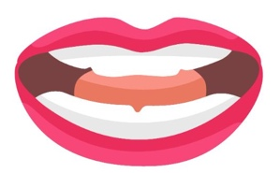
7B. Read the pronunciation article.
Lastly, your teeth can affect some sounds too. Your top front teeth touch your bottom lip when you make the /f/ and /v/ sounds. And the /s/ and /z/ sounds are made when air goes through the little gap between your teeth while your tongue is near the roof of your mouth.
To get better at pronouncing words, it's good to practice the positions of your tongue, lips, and teeth. You can do exercises, look in a mirror, listen to how others say words, and ask your teacher for help.
In summary, knowing how your tongue, lips, and teeth work can help you pronounce English words correctly. By practicing and learning from others, we can get better at speaking clearly and being understood by everyone.
Notes:
Homework 7A. – Everyday Reading and Writing
The learners will read the article and answer the questions on the next slide.

Slide 35
7C. Answer the questions about pronunciation.
A. What parts of our mouths do we use to speak?
B. Which sounds do we make with our lips pressed together?
C. How do we make the /f/ sound?
D. How can we get better at pronunciation?
E. Which words are the most difficult for you to pronounce?
F. How do you practice pronouncing English?
Notes:
Homework 7C.– Everyday Reading and Writing
The learners will answer the questions about the pronunciation article.
Answers:
A. We use our tongues, lips and teeth.
B. We make the /p/, /b/ and /m/ sounds with our lips pressed together.
C. Our top front teeth touch our bottom lip.
D. Practice, do exercises, look in a mirror, listen to how others say words, and ask a teacher for help.
Answers will vary for E and F.

Slide 36
8. Write at least five sentences about things you saw, heard, tasted, touched, and smelled yesterday.
Notes:
Homework 8 – Writing
Model. Write an example such as, I love to see and smell the flowers in the park. I like to taste chocolate and I enjoy touching the cool water of the river with my feet.
Answers will vary.

Slide 37
9. Now I Can…
I can talk about different body parts and senses.
I can understand, say, read, and write the 12 vocabulary words.
I can use the simple past tense to talk about past actions that are finished.
I can pronounce and spell regular past tense verbs.
I can understand how Jesus was tempted.
Notes:
Homework 9. – I can statements
The student must be able to achieve all of these skills before the next lesson. If not, the lesson can be repeated or additional practice materials can be used.
Review all of the skills at the beginning of the next lesson. Be sure to give lots of praise and encouragement!

Slide 38
Closing Prayer
Notes:
Pray
You may want to ask for any special prayer requests, then pray for your students and bless them.

Slide 39

Help us share the Light of the World!
Thank you for using our materials. If these lessons are a blessing to you, please give or volunteer to help others learn English through the Bible.
Contact us at: LightOfTheWorldLearning.org or Info@LOTWL.org

Slide 40
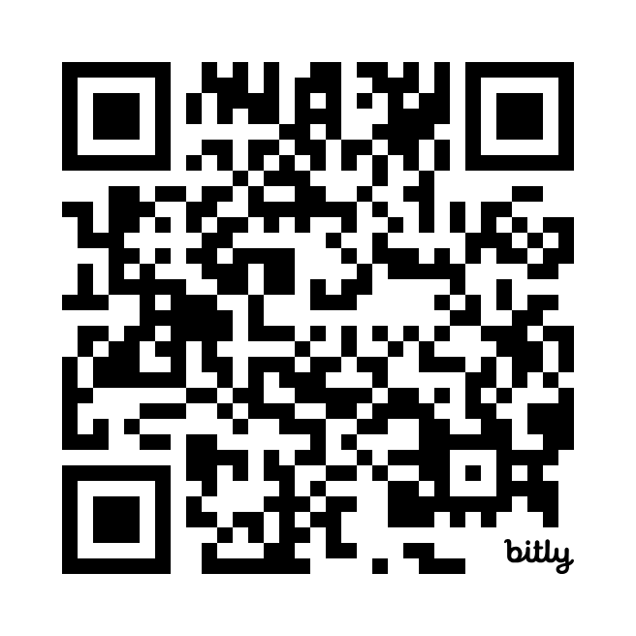
Appendix
How to Use Lessons: bit.ly/UseLOTW
Irregular Verb List: bit.ly/ListVerbs
Lesson Downloads: LightOfTheWorldLearning.org
Order Books: bit.ly/BooksLOTW
Share Your Feedback: bit.ly/FeedbackLOTW
Table of Contents: bit.ly/TocLOTW
Video Channel: youtube.com/@LightOfTheWorldLearning
Vocabulary List: bit.ly/VocabUS
Website: LightOfTheWorldLearning.org

Slide 41
Acknowledgements
We would like to thank the entire Light of the World volunteer team for their hard work and creativity in making this project possible. For all those around the world who prayed, wrote, edited, narrated, illustrated, sang, tested, and gave generously for this curriculum, we appreciate you sharing the love of Jesus through the gift of English. Our team members include:
Ashlyn Shrimplin
Leah Sprague
Macie Stuckman
Carole Svensson
Ellie Talalight
Peter Talalight
Weston Talalight
Rachel Tamang
Darrell Turner
Graham Whitmore
Cheri Wilke
Mackenzie Williams
Muchun Yin
Ted York
Anita Zeifert
Anonymous
Jean Ato
Bradley Baurain
Joshua Blake
Rachael Braggs
Larry Buell
Cindy Campbell
Christian Cha
Olivia Cheney
Hannah Clark
Nancy Cobb
Emily Cox
Marilyn Dano
Susanna Diallo
Alyssa Dokolas
Hephzi Davidson
EasyReadEnglish.com
Don Edic
Peggy Fergus
MaryBeth Gahan
Melina Gallo
Alicia Gentile
Prakash Chandra Giri
Ellenor Gopal
Jill Gramzow
Rachel Grijincu
Carol Hale
Emily Hamilton
Patty Hickman
Lyudmila Ivanyuk
Debbie Johnson
Carey Jo Johnston
Nancy Kingdon
Dorothy Konadu
Macy Lake
Martha Lane
Audrey Larsen
Tai Young Lee
Aden Lewis
Bruce Lewis
Elena Lewis
James Lewis
Micah Beth Lewis
Tim Lewis
Ward Lewis
Johnny Lukashevich
Gail MacMillan
Ivan Mader
Amy Martin
Diana Martz
Christy McPherson
Tracy Meddaugh
Barbara Newsome
Brenda Nielsen
Danielle Nowe
Deborah O’Donnell
Georg Ort
Martha Ort
Deb Payne
Linda Petrie
Joan Phelps
Sara Scazzero
Hannah Schmokel
Bible story and pictures on slides 14-18 adapted from the original work by unfoldingWord available from https://openbiblestories.org
© 2022-2025 Light of the World Learning

