Slide 1


Unit A2-38
Unit A2-38
©2020-2025 Light of the World Learning
Notes:
Teacher’s Notes:
Thank you for using our materials. For more resources and teacher training visit LightOfTheWorldLearning.org
Preparation:
Pray.
Read the Bible passages.
Preview slides and song.
Optional: Bring a compass, maps, signs, or other objects related to the lesson.

Slide 2
Pray, Review, and Preview
Bible Reading: The Compassionate Father – Luke 15
Theme: Giving Directions and Following Instructions
Pronunciation: /z/ /s/ and /iz/ spelled with final s
Grammar: Prepositions of Motion, Sequencing Directions
Notes:
Pray
Pray for the class and any needs they have. You may want to thank God for forgiving us when we have sinned against him.
Check Homework and Review
Ask students to read aloud or recite their homework from the last class. Check written work. Be sure they have read Luke 15 in their native languages in preparation for the lesson.
Review the main points of the previous lesson and ask if there are any questions.

Slide 3
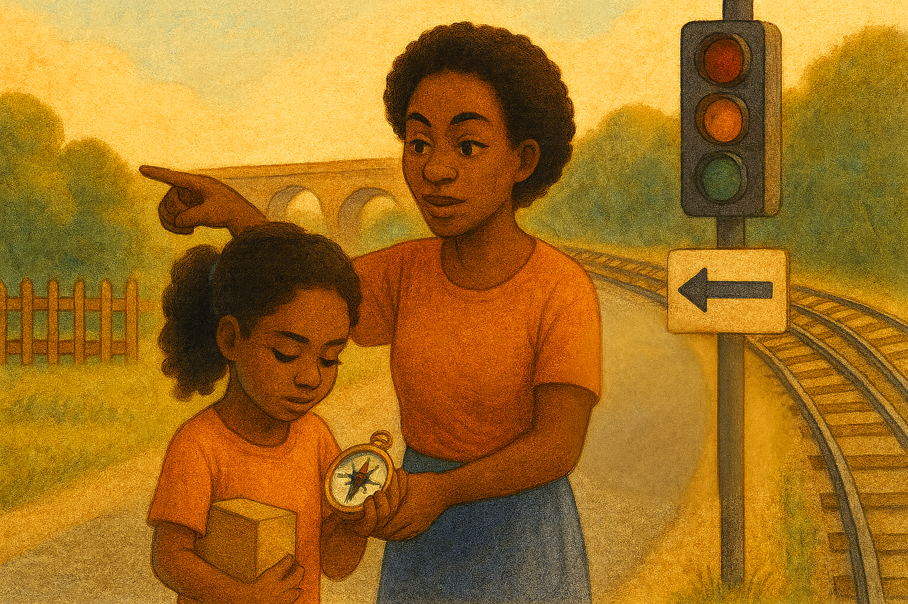
What do you see?
Notes:
1A. Discuss Theme Picture
Ask “What do you see on the street?” and “What else is close to it?” to elicit vocabulary they already know.
Repeat and write their words or show the words on the next slide.
Answers may include: sign, yard, bridge, traffic light, point, compass, directions, etc.
More advanced students can be encouraged to make complete sentences like:
I see train tracks, a traffic light, and a sign. The woman is pointing and the girl is holding a compass.

Slide 4
Little Gina needed to deliver an important package to a friend. She ran down the street following the directions on her compass. First, she went north across a bridge towards her destination. Her friend lived near the train station, so she then followed the train tracks until she got to the traffic light.
Then Gina got lost. She thought she should turn right but she noticed a sign with an arrow pointing left. So she asked a woman on the corner if she knew where the Glass family lived. The woman nodded and pointed to a cottage in a green yard. Finally, Gina ran to the house, knocked on the door, and showed the package to her friend. "Thank you for bringing me this Bible!" her friend said. “I love it!”
Gina was happy. She had followed the right directions and finished her delivery. Now, it was time to race home before dinner!
Notes:
1B. Show Description of Theme Picture
Please read the description of the theme picture to the students and point to the pictured vocabulary.
These words can be studied for homework.
Practice of vocabulary begins with the following slide.

Slide 5

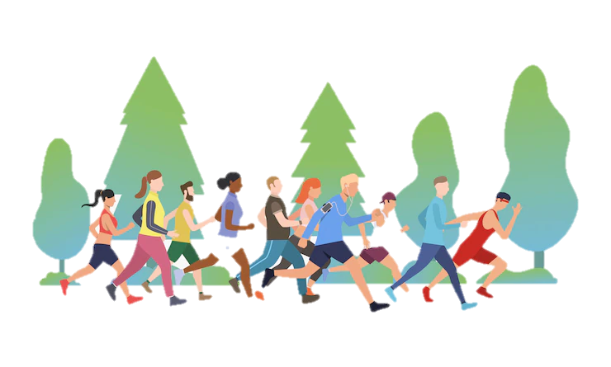
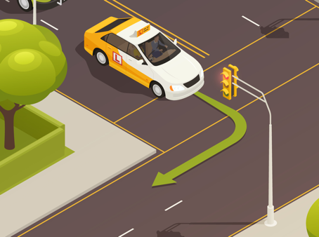
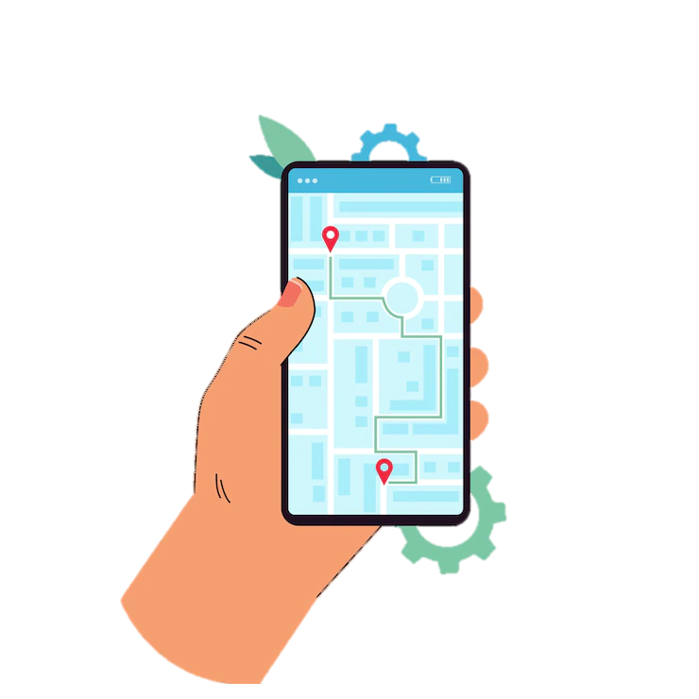
Match the beginning and end of each sentence.
The traffic light
2. The directions tell me
3. The taxi turns
4. A race is a game to see who is
A. the fastest.
B. at the corner.
C. how to get to the store.
D. shows us when to stop and when to go.
©2020-2025 Light of the World Learning
6
Notes:
2A. Vocabulary
1. Say the beginning of the sentence a few times, as you indicate the picture. For example, say, ”The traffic light, the traffic light.” Have your students then repeat the phrase after you a few times.
2. Ask students to match the beginning and end of each sentence and say the complete sentence. For example, ”The traffic light shows us when to stop and when to go.”
3. Check students’ comprehension further by asking direct questions. For example, “Did you ever compete in a race?”
Answers
D
C
B
A
6

Slide 6

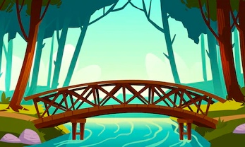

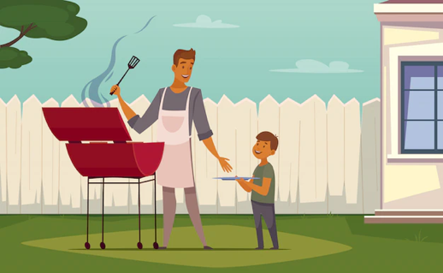
Match the beginning and end of each sentence.
5. A bridge
6. A father and son are
7. The stop sign
8. A compass
E. is red.
F. goes over the river.
G. shows the direction: north, south, east, or west.
H. in the yard.
©2020-2025 Light of the World Learning
7
Notes:
2B. Vocabulary
1. Say the beginning of the sentence a few times, as you indicate the picture. For example, say, ”A bridge, a bridge.” Have your students then repeat the phrase after you a few times.
2. Ask students to match the beginning and end of each sentence and say the complete sentence. For example, ”A bridge goes over the river.”
3. Check students’ comprehension further by asking direct questions. For example, “Have you used a compass?”
Answers
5. F
6. H
7. E
8. G

Slide 7
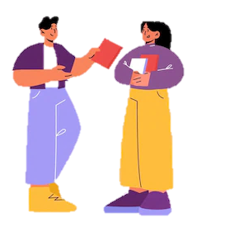
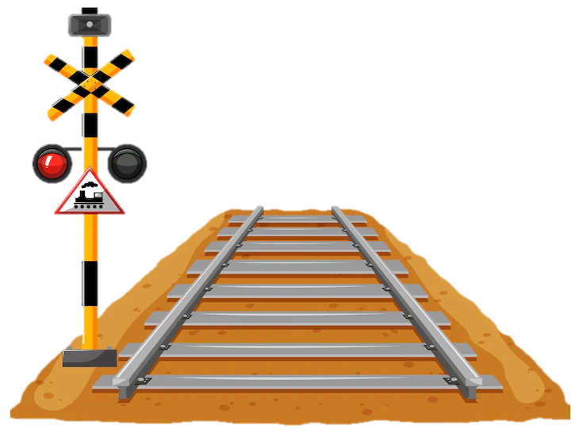
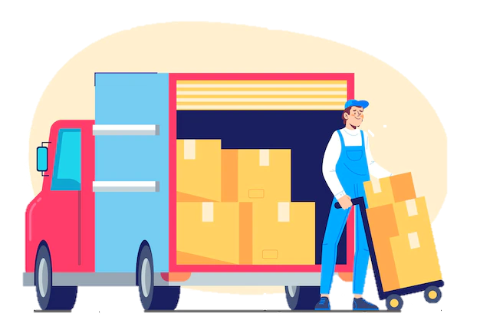
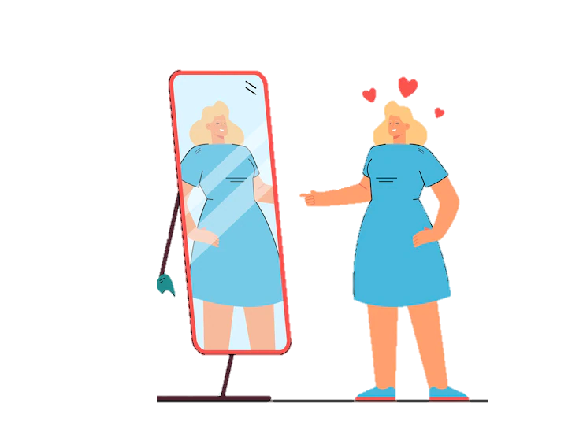
Match the beginning and end of each sentence.
9. Train tracks carry trains
10. He is showing
11. She is pointing
12. He is delivering
I. the book to her.
for many miles.
the boxes.
at the mirror.
©2020-2025 Light of the World Learning
8
Notes:
2C. Vocabulary
1. Say the beginning of the sentence a few times, as you indicate the picture. For example, say, ”She is pointing, she is pointing.” Have your students then repeat the phrase after you a few times.
2. Ask students to match the beginning and end of each sentence and say the complete sentence. For example, ”She is pointing at the mirror.”
3. Check students’ comprehension further by asking direct questions. For example, “Have you ever ridden on a train?”
Answers
J
I
11. L
12. K

Slide 8
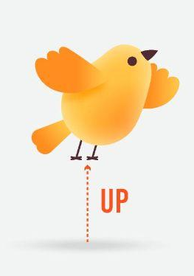


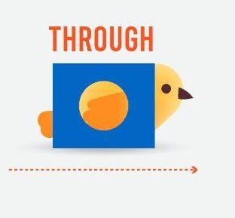
 | First | Next | Then | Finally
1 | First, I go over the bridge. | Next, I go around the corner. | Then, I turn right at the stop sign. | Finally, I arrive at Grandma’s yard.
2 | First, the bird flies up. | Next, it flies down. | Then, it flies over the box. | Finally, it goes through the box.
3 | First, I | Next, I | Then, I | Finally, I
Notes:
2D. Grammar – Prepositions of Movement.
Note: Next and Then can be used multiple times, but First and Finally can only be used once.
Model, Repeat, and Solo sentences 1-2. Ask students to complete 3 to describe how they go to school or work.

Slide 9
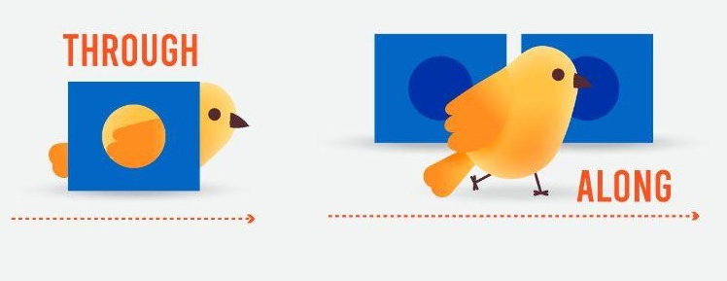
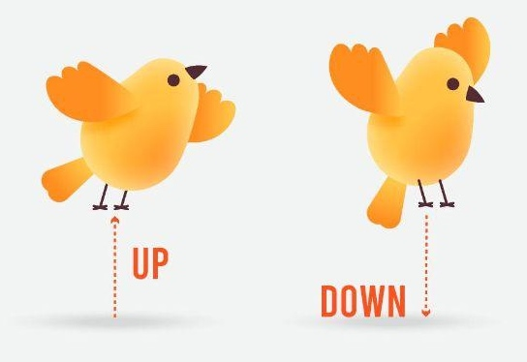
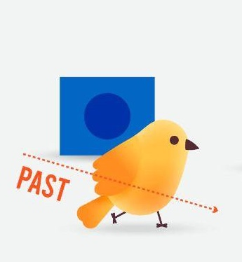
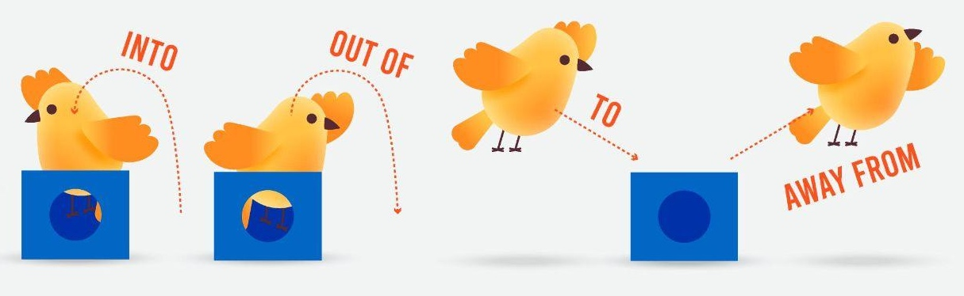

Talk about the bird. Use First, Next, Then, Finally.
A
B
Notes:
2E. Grammar – Prepositions of Movement.
Working in pairs, learners will talk about the bird’s journey using First, Next, Then, and Finally. One learner will describe row A, the other will describe row B.
Answers
First the bird flies over the box. Next, it goes through the box. Then, it walks along the boxes. Then, it flies up. Finally, it flies down.
First, the bird walks past the box, Next, it goes into the box. Then, it flies out of the box. Then, it flies to the box. Finally, it flies from the box.

Slide 10




 | Preposition of motion | Example |  | Preposition of motion | Example
1 | across | Walk across the street. | 7 | out of | Get _____the car.
2 | along | Go along the train tracks. | 8 | over | Go _____ the bridge.
3 | around | Go around the corner. | 9 | past | Go _____ the cafe.
4 | down | Walk down the stairs. | 10 | through | Drive ____ the tunnel.
5 | from | Run from home to school. | 11 | to | Run from home _____ school.
6 | into | Go _____ the house. | 12 | up | Go _____the stairs.
Notes:
2F. Grammar – Prepositions of Motion.
Model, Repeat, and Solo sentences 1-5. Ask students to complete 6-12.
Answers
6. into
7. out of
8. over
9. past
10. through
11. to
12. up

Slide 11
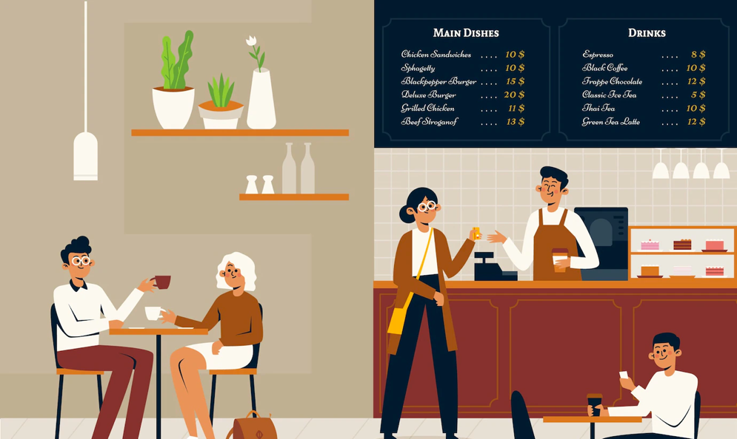

Listen and repeat.
A: Hey, Maria! Do you want to meet at
Cafe Espresso? I can give you
directions.
B: Yes, Francis. I am on the corner of Elm
Street Bridge and Oak Street.
A: First, walk along the train tracks towards the next traffic light. At the traffic light, turn right.
B: Okay, then where do I go?
A: Cafe Espresso is past the library. You will see the sign for the cafe along the street.
Notes:
3. Conversation
1. Model: Say both parts of the conversation several times. Use A and B cards, stick figures, or change your physical position to indicate the dual parts. Role-play the parts to convey the meaning of the conversation. Students are to watch and listen.
2. Repeat: Say one line at a time and have students repeat until they can be understood.
3. Solo: You begin the conversation and call on individual students to respond. Then reverse the roles (students are A, you are B).
4. Once students can do both parts, encourage free conversation (students substitute their own words for the blue words).

Slide 12
Final S after a voiced sound is /z/.
Final S after an unvoiced sound is /s/.
Final ES after a hissing sound is /iz/.
1. /z/ | 2. /s/ | 3. /iz/ | 4. Challenge
delivers | points | churches
shows | Jack’s | compasses
directions | lights | washes
corners | tracks | races
She delivers the boxes to the churches.
The compass points us in the right directions.
Notes:
4A. Pronunciation - Sounds and Spelling
Note: When a word ends in a voiced sound (most vowels and consonants) + s, the s is pronounced /z/.
When a word ends with an unvoiced sound (/p/, /t/, /k/, or /f/) + s, the s is pronounced /s/.
Final es after a hissing sound like /s/, /z/, /sh/, /ch/, or /zh/ is pronounced /iz/.
1. Model: Say the sound several times while pointing to it. For example, point to the /z/ and say /z/ /z/ /z/. Then say the sound and quickly read the entire list, pointing to each item as you read it (/z/, delivers, shows, directions). Students just watch and listen.
2. Repeat: Say the sound and each word several times, having students repeat each time after you in unison. Be sure to use your normal voice and rate of speed. Do one column at a time, top to bottom. Then read the sentences.
3. Solo: Call on individuals to say a sound and its word group. Give lots of praise. Then ask students to read the sentences.
4. Challenge: Choose another sound from the lesson that is challenging for your particular students to pronounce. Use words from Parts 1 and 2 of the lesson, and from previous lessons to make a group of 3-5 words. You may repeat the same challenging sounds in several lessons. Students need a lot of practice on sounds that do not exist in their first language.

Slide 13
Listen and repeat.
A. | B. | C.
traffic lights | along | corners
finally | around | show me
over it | across | train tracks
compasses | repeat | bridges
Notes:
4B. Pronunciation - Hum and clap the stress.
Begin by humming the stress of a column of words. Hum higher, longer, and louder for big dashes and lower, shorter, and quieter for small dashes.
You may use hand gestures to indicate that the stressed syllable is higher in pitch, longer in duration, and louder. Invite your students to join in humming the rhythm. Once the class is humming the rhythm in unison, you can begin saying the words. You may also wish to clap the syllables while you say the words.
1. Model: Hum and then say each word in the column several times. Students listen.
2. Repeat: Students repeat words after you in unison.
3. Solo: Call on individuals to read the entire column of words.

Slide 14
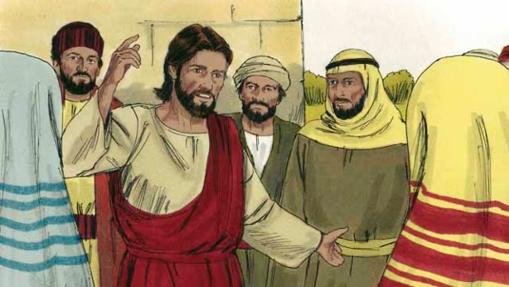
Read Luke 15 in your language. Then read
The Story of the Compassionate Father.
One day, Jesus was teaching many people who had gathered to
hear him. These people were tax collectors and also other people who did not try to obey the Law of Moses.
Some religious leaders saw Jesus talking to these people as friends. So they began to tell each other that he was doing wrong. Jesus heard them talk, so he told them this story.
Notes:
5A. Bible Reading
Be sure students read this story in their first language before reading it in English. The hyperlinks of the Bible verses connect to https://live.bible.is/ so students can read and hear the scripture in their own languages.
A. Read the story out loud to the class.
B. If students ask about words, give simple definitions.
C. Encourage students to read aloud paragraphs from the story. Encourage students to act out the story.
D. Ask if there are any questions or comments about the story.
E. Ask the story questions and discuss as a group.
F. Optional - You may hide the words and ask students to tell the story again in their own words, using the pictures to help them.

Slide 15
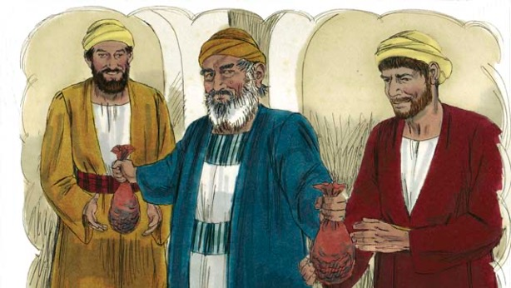
“There was a man who had two sons. The younger son told his father, ‘Father, I want my inheritance now! Give me now the part of your property that I am supposed receive one day.’
So the father divided his property between his two sons.”
“Soon after that the younger son gathered all that he had and went far away to another country and wasted his money in sinful living. After that, a severe famine occurred in the land where the younger son was, and he had no money to buy food.”
Notes:
5B. Bible Reading
A. Read the story out loud to the class.
B. If students ask about words, give simple definitions.
C. Encourage students to read aloud paragraphs from the story.

Slide 16
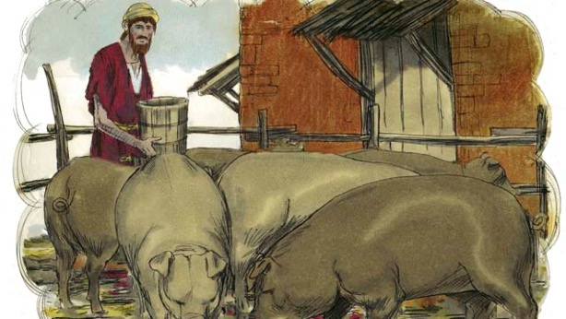
“He was hungry and needed money. So he took the only job he could find, feeding pigs. He was so miserable and so hungry that he wanted to eat the food pigs were eating.”
“Finally, the younger son said to himself, ‘What am I doing? All my father’s servants have plenty to eat, and yet here I am starving. I am almost dead because I have nothing to eat. I will go back to my father and ask him to let me be like one of his servants.’”
Notes:
5C. Bible Reading
A. Read the story out loud to the class.
B. If students ask about words, give simple definitions.
C. Encourage students to read aloud paragraphs from the story.

Slide 17
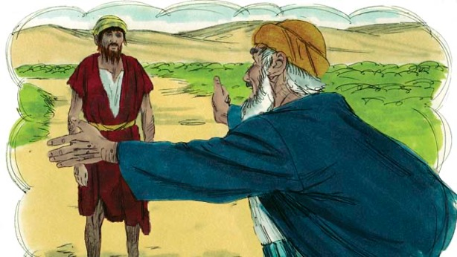
“So the younger son started back towards his father’s home. When he was still far away, his father saw him coming and felt compassion for him. He ran to his son and hugged him and kissed him.”
“The son said, ‘Father, I have sinned against God and against you. I am no longer worthy to be your son.’”
“But his father told one of his servants, ‘Go quickly and bring the best clothes and put them on my son!’”
Notes:
5D. Bible Reading
A. Read the story out loud to the class.
B. If students ask about words, give simple definitions.
C. Encourage students to read aloud paragraphs from the story.

Slide 18
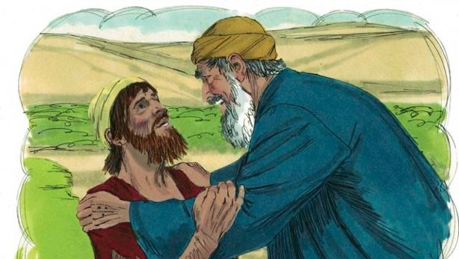
“‘Put a ring on his finger and put good sandals on his feet. Then kill the best calf so we can have a feast and celebrate, because my son was dead, but now he is alive again! He was lost, but now we have found him!’”
“So the people began to celebrate. Before long, the older son came home. He had been out working in the field. When he came near the house, he heard the sound of music and dancing. He wondered what was happening.”
Notes:
5E. Bible Reading
A. Read the story out loud to the class.
B. If students ask about words, give simple definitions.
C. Encourage students to read aloud paragraphs from the story.

Slide 19
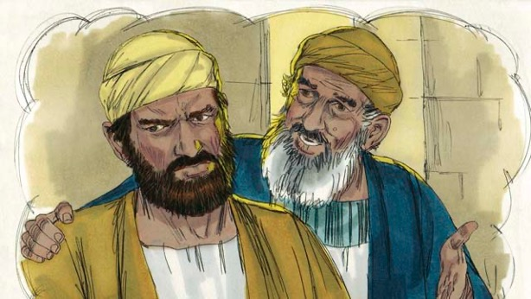
“When the older son found out that they were celebrating because his brother had come home, he was very angry and would not go into
the house. His father came out and
begged him to come and celebrate with them, but he refused.”
“The older son said to his father, ‘All these years I have worked faithfully for you! I never disobeyed you, and still you did not give me even one small goat so I could celebrate with my friends.’”
Notes:
5F. Bible Reading
A. Read the story out loud to the class.
B. If students ask about words, give simple definitions.
C. Encourage students to read aloud paragraphs from the story.

Slide 20
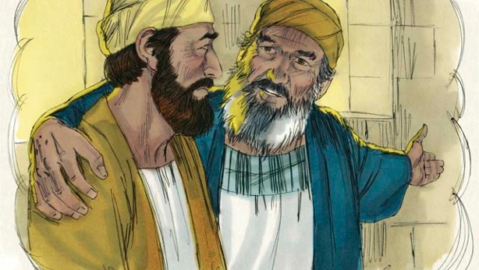
“‘But this son of yours has wasted your money doing sinful things. When he came home, you killed the best calf to celebrate!’” “The father answered, ‘My son, you are always with me, and everything I
have is yours. But this was a day to be happy and celebrate. Your brother was dead, but now is alive. He was lost, and now we have found him!’”
Notes:
5G. Bible Reading
A. Read the story out loud to the class.
B. If students ask about words, give simple definitions.
C. Encourage students to read aloud paragraphs from the story.

Slide 21
Answer the questions.
Why did Jesus tell the religious leaders this story?
What made the younger son return to his father?
How did the father react to the younger son’s return?
Why did the older son refuse to celebrate his brother’s return?
How does the father’s love for his sons in this story remind you of God’s love for you?
Do you identify more with the older son or the younger son? Why?
Notes:
5I. Bible Reading Questions
Ask the questions and discuss as a group. For questions 1-6 you may go back to the story to help students find the answer.
Answers:
Jesus told it to them because he heard them talking about how he was doing something wrong.
He returned because he was ready to ask for forgiveness.
The father felt compassion for him and ran to him and kissed him.
He was angry because his father threw his brother a feast and was overjoyed to see him despite him wasting his inheritance.
Answers will vary.
6. Answers will vary.

Slide 22
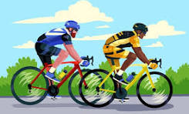
Listen and answer the questions.
What was the name of the race that Noor
watched?
2. What city is the race going through next?
3. What kinds of things does the race pass?
4. What happened during the race?
5. Why was there an accident during the race?
6. What needs to happen to make the routes safer for future races?
Notes:
6A. Activities – Dictation of sound/spelling words /s/, /z/, /iz/
Read script below at least twice as students listen and answer the questions. They may write long or short answers.
Hello Fadia,
It’s Noor. Did you see the Tour de France race yesterday? They went through so many cities. Today, the next city they go though is Caen in northern France. They are traveling over bridges, through tunnels, and along some beautiful rivers. I loved seeing all the old churches the race goes past. Did you see the accident during the race? There were tree branches lying across the road, and the cyclists came around the corner too fast and ended up in a pile. They had to take some of the cyclists to the hospital. I hope that they are all okay. They need to make sure that the routes for future races are clear and safe. I plan to do some biking trips with friends this summer and want to ask you to join us. I look forward to talking to you soon!
Love, Noor
Answers:
1. The race is named the Tour de France which goes through many cities in France.
2. The next city the race will go through is Caen.
3. The race passes churches and rivers.
4. Some cyclists were in an accident.
5. There was an accident because there were tree branches lying across the road.
6. The routes need to be clear of any branches.

Slide 23
Partner A – Ask for Locations
Questions | Answers
1. Where is the train? | The train is over the park, on top of the bridge.
2. Where is the traffic light?
3. Where is the female cyclist riding her bike?
4. Where is the woman walking her dog?
5. How many people are walking across the street?
6. Where is the red car going?
Notes:
6B. Activities – Pair work
Partner A will ask questions about where various items are located. Partner B will use prepositions to describe where the items are. Partner A should not look at Partner B’s slide that has the picture of the items.
Answers
Note: Answers may vary slightly. The instructor should make sure students use prepositions of movement.
2. The traffic light is on the corner.
3. She is riding it along the sidewalk.
4. She is walking her dog across the street/crosswalk.
5. There are two people walking across the street (the third one is bicycling).
6. The red car is going into the city.

Slide 24
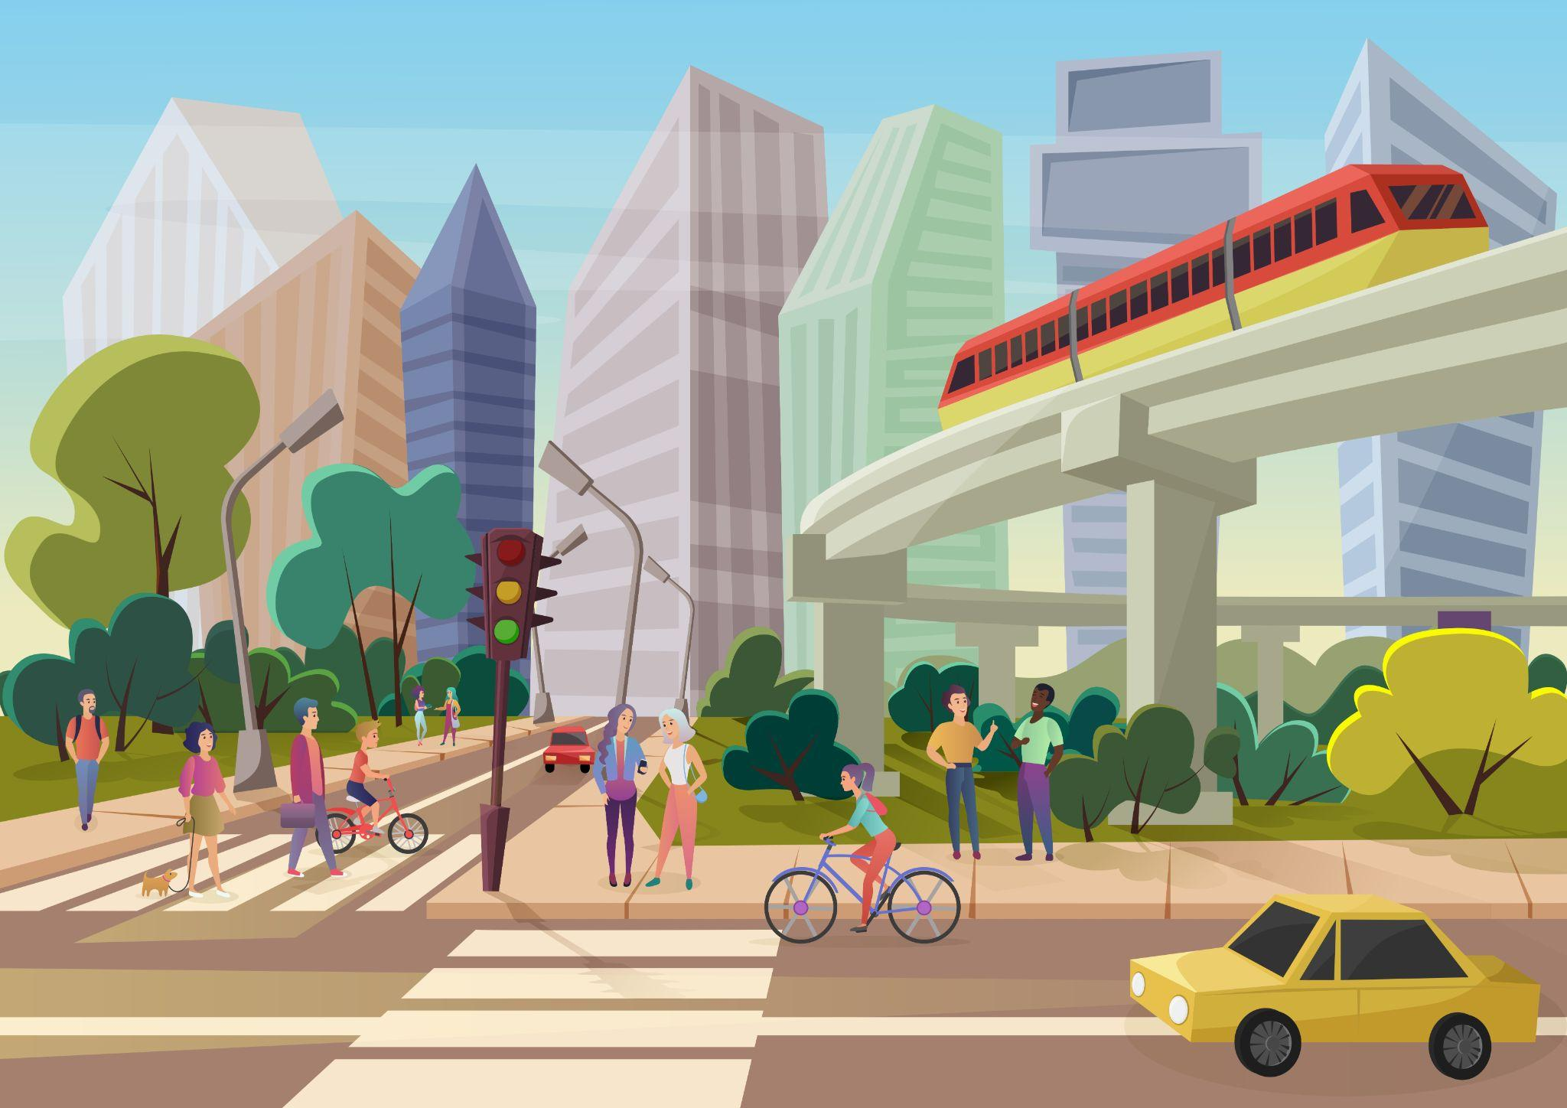
Partner B: City Street Locations
Notes:
6C. Activities – Pair work
Partner A will ask questions about where various items are located.
Partner B will use prepositions to describe where the items are. Partner A should not look at Partner B’s slide that has the picture of the items.

Slide 25

Game: Simon Says, “Please.”
Notes:
7. Game
The teacher gives commands for the students to act out, but only if the teacher says “please.” The teacher and each student will need two small objects (pencil, pen, book, bag, cup, etc.). The teacher will begin by saying, “Does everyone have a pencil and a book? Okay! Now please do what I say, but only if I say the word ‘please’.”
1. Please put the pencil on the book.
2. Please move the pencil up over your head.
3. Please move the pencil down below the book.
4. Please put the pencil into the book and close it.
5. Open the book. (I didn’t say please!)
6. Please take the pencil out of the book.
7. Please move the pencil around the book.
8. Please move the pencil across the book.
9. Move the pencil to your other hand. (I didn’t say please!)
10. Please point to the floor.
11. Please show me your teeth.
For #12-20, the teacher will hold up the objects in different positions and students must say the answer.
12. Please tell me, where is the book?
13. Please tell me, where is the pencil?
14. Tell me, where is the pencil? (I didn’t say please!)
15. Please tell me, where is the pencil?
16. Please tell me, where is the book?
17. Please tell me, where is the pencil?
18. Tell me, where is the pencil? (I didn’t say please!)
19. Please tell me, where is the pencil?
20. Please tell me, where is the book?

Slide 26

1A. Homework – Write about the pictures with prepositions of motion.
1 | My phone gives me directions to the store. | 4
2 |  | 5
3 |  | 6
Notes:
Homework 1A. - Write sentences using the pictured vocabulary words.
Model. Go over each of the homework assignments to be sure the student understands what to do.
Repeat. Encourage students to practice speaking and reading the completed homework assignments with a friend. They may use a bilingual dictionary.
Solo. Students will share their homework when they are finished. After they have shared their homework, be sure to check it for correctness, including spelling. Explain mistakes, while providing praise and encouragement. Answers will vary.
Number one is an example.
Answers may vary, but will start with a capital letter, have a punctuation mark at the end, and may use the following words:
2. compass
3. bridge
4. to point
5. to deliver
6. yard

Slide 27
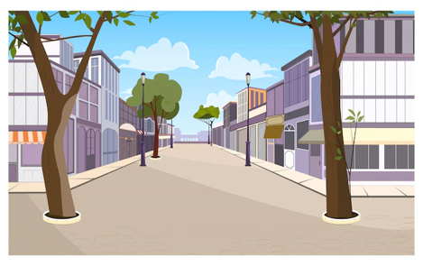


1B. Write about the pictures with prepositions of motion.
7 |  | 10
8 |  | 11
9 |  | 12
Notes:
Homework 1B. - Write sentences using the pictured vocabulary words.
Students will write a sentence for each picture to practice the lesson’s vocabulary words.
Answers may vary, but will start with a capital letter, have a punctuation mark at the end, and use the following words:
7. train tracks
8. race
9. sign
10. to show
11. corner
12. traffic light

Slide 28
2A. Fill in the blanks
corner
around
over
on
yard
sign
across
through
deliver
out of
He walks ____ the street.
The stop ____ is ____ the corner.
Drive ____ the tunnel.
The bridge goes _____ the river.
The _____ is _____ the house.
He takes the boxes _____ the truck to _____ them.
Notes:
Homework 2A: Grammar and Vocabulary Review
Use the words provided to fill in the blanks.
Answers:
A. He walks across the street.
B. The stop sign is on the corner.
C. Drive through the tunnel.
D. The bridge goes over the river.
E. The yard is around the house.
F. He takes the boxes out of the truck to deliver them.

Slide 29
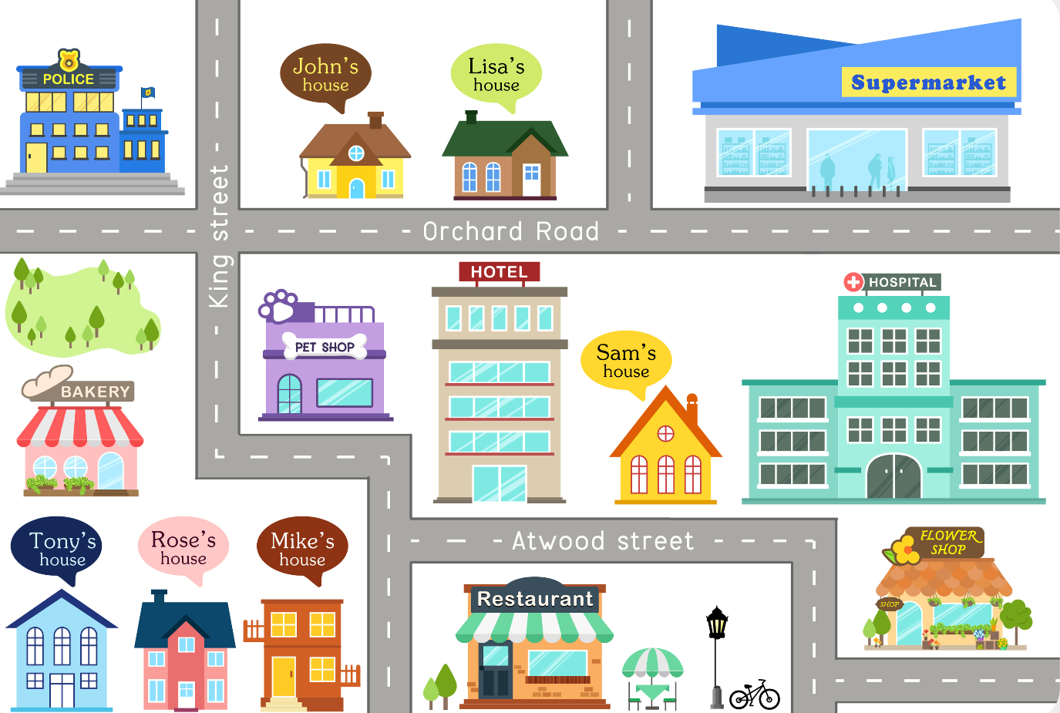
2B. Write directions to drive from Mike’s house to the supermarket.
Notes:
Homework 2B. – Grammar and Vocabulary Review
Answers
First drive toward the pet shop. Next turn left toward the bakery. Then turn right on King Street. Then at the intersection, turn right on Orchard road. Go past Lisa’s house and finally you will see the supermarket on your left.

Slide 30
3. Write questions and ask your partner.
Questions | Answers
1. Do you use a compass? | No, I use a GPS.
2. Do you live down the street from _______
3. What are the directions to _______
4. Are there any bridges ______
5. How can I get to _______
6. Where is the _______
Notes:
Homework 3. – Conversations - Pair work
First, students complete writing the questions with their own words. Then ask students to interview a partner, and write their partner’s answers.
Check answers for correct grammar and punctuation.
Number 1 is an example.
Questions and answers will vary, but may include:
2. Do you live down the street from the train tracks?
3. What are the directions to the supermarket?
4. Are there any bridges in your town?
5. How can I get to the police station?
6. Where is the bathroom?

Slide 31
4. Say and write the words in the correct columns.
churches | brothers
compass | boxes
sons | caps
buses | hugs
servants | washes
father’s | was
kiss | bridges
blesses | backs
lights | yours
/s/ | /z/ | /iz/
Notes:
Homework 4. – Pronunciation
This homework practices pronouncing the final S sounds: /s/, /z/, and /iz/.
Students will go through the list and sound out each word. Then they will write words in the correct columns for each vowel sound.
Answers:
/s/: compass, servants, kiss, lights, caps, backs
/z/: sons, father’s, hugs, brothers, was, yours
/iz/: churches, buses, blesses, boxes, washes, bridges

Slide 32
5. Answer the questions.
Why did Jesus tell the story to the leaders?
Why did the father give his younger son his inheritance early?
Why did the younger son return to his father?
How did the older son respond to his brother’s return?
Why did the father say they should celebrate the younger son’s return?
Notes:
Homework 5. – Bible Reading Review
Students may look back at the story to answer the questions.
Answers:
1. Jesus told the leaders this story because they thought he was doing something bad by treating tax collectors and others as friends.
2. The father gave his younger son his inheritance early because he asked for it.
3. The younger son returned because he needed food and knew he could work as a servant in his father’s house and be fed./ He knew he could count on his father’s love for forgiveness.
4. The older son was angry and refused to celebrate his return.
5. The father said this because his son was as good as dead while he was away and also he had no certainty about seeing him again.

Slide 33
6A. Choose one verse to memorize.
A
But this was a day to be happy and celebrate. Your brother was dead, but now he is alive. He was lost, but now he is found.
Luke 15:32 ERV
Trust the Lord completely, and don’t depend on your own knowledge. With every step you take, think about what he wants, and he will help you go the right way.
Proverbs 3:5-6 ERV
B
Notes:
Homework 6A. – Memorize a Verse
Learners get to choose A, B, or C (on the next slide) to memorize. Please notice that the memory work is not long. Everyone, regardless of skill level, should be able to do it.
1. Model. Recite a verse from memory.
2. Repeat. Encourage students to find someone with whom to practice conversing and reading the completed homework assignment.
3. Solo. Students will recite the verse from memory at the next class.

Slide 34
6B. Choose one verse to memorize and read the next verses.
You will teach me the right way to live. Just being with you will bring complete happiness. Being at your right side will make me happy forever.
Psalm 16:11 ERV
Read the next lesson’s Bible verses: Matthew 17:1-9, Mark 9:2-8, and Luke 9:28-36 in your language.
C
Notes:
Homework 6B. – Memorize a verse and read the next lesson’s verses.
Learners get to choose A, B, (from the previous slide) or C to memorize.
Students must always read or listen to the Bible lesson in their first language before reading it in English. Help them get a Bible in their own language if they don’t have one. They may also use Bible.IS or other Bible translation resources.

Slide 35
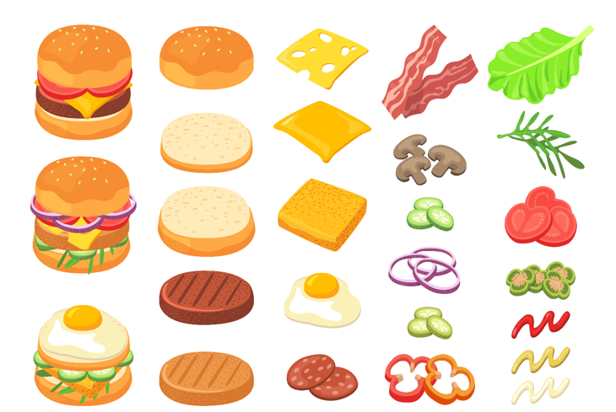
7A. Cooking a Hamburger
Have you ever wanted to cook a meal for yourself, but you did not know how? You might begin by cooking a hamburger. It is not very
difficult if you follow these steps. Before you start, you will need to collect the following supplies: one hamburger patty, cooking oil or butter, salt and pepper, a frying pan, and a metal hamburger flipper.
First, place the patty on a plate and shake salt and pepper on it. Next, place the frying pan on a stove burner, and turn the heat to high. Immediately place a pat of butter or a drop of oil into the pan.
Notes:
Homework 7A. – Everyday Reading and Writing
The learners will finish reading the article on 7B and then answer the questions on the slide 7C.

Slide 36
7B. Cooking a Hamburger (Continued)
When the butter or oil begins to sizzle, put the hamburger into the pan, and watch it carefully. When the bottom of the hamburger begins to
turn brown, flip the hamburger. Continue frying the hamburger until it reaches the stage you prefer—rare, medium, or well done. Then put it back on the plate and serve it.
Now you have a tasty meal to enjoy on your own or with friends. If you like, you can add to the taste of the hamburger with ketchup, mustard, onions, or pickles—or some of each!
Notes:
Homework 7B. – Everyday Reading and Writing
The learners will read the article and answer the questions on the next slide.

Slide 37
7C. Answer the following questions.
What supplies do you need to cook a hamburger?
What is the first thing to do?
What setting should be used for the heat?
When should you flip the hamburger?
What are the three stages of a finished hamburger?
What can you add to the hamburger?
Do you eat hamburgers? What do you like to eat?
What food can you cook?
Notes:
Homework 7C. – Answers to the Questions
A hamburger patty, cooking oil or butter, salt and pepper, a frying pan, and a metal hamburger flipper at the supplies.
First, place the patty on a plate and shake salt and pepper on it.
The heat should be set on high.
The hamburger should be flipped when the bottom begins to turn brown.
The three stages of a finished hamburger are rare, medium, and well done.
Ketchup, mustard, onions, and pickles can add to the taste of the hamburger.
Answers will vary for 7 and 8.

Slide 38
8. Write out the instructions to your favorite dinner recipe. Use sequencing words like first, next, then, finally.
___________________________________________________
___________________________________________________
___________________________________________________
___________________________________________________
___________________________________________________
___________________________________________________
___________________________________________________
Notes:
Homework 8. – Writing
Model.
Write out the instructions to your favorite dinner recipe. For example: First, cut the chicken in to bite-sized pieces. Next, season the chicken with cumin and chili powder. Then, heat olive oil in a pan on the stove. When the pan is hot, put the chicken in the pan. Cook the chicken for three minutes. Then, turn the chicken over and cook for 2-3 more minutes. Next, take the pan off the stove. Finally, cut the chicken and make sure it is not pink in the middle. Serve with rice or pasta.
Answers will vary.

Slide 39
9. Now I Can…
I can give directions and follow instructions.
I can use the new words including _____, _____, _____, _____, _____, _____, _____, _____, _____, _____, _____, and _____.
I can pronounce and spell /z/, /s/, and /iz/ sounds.
I can use prepositions of motion and sequence directions.
I understand that God is a compassionate father who loves every person, even sinners.
Notes:
Homework 9. – I can statements
The student must be able to achieve all of these skills before the next lesson. If not, the lesson can be repeated or additional practice materials can be used.
Review all of the skills at the beginning of the next lesson. Be sure to give lots of praise and encouragement!

Slide 40
Reflections and Closing Prayer
Notes:
Reflections and Closing Prayer
You may want to thank the Lord for what we have learned, ask for special prayer requests, then pray for your students and bless them. Students may write reflections and their prayers here.

Slide 41

Help us share the Light of the World!
Thank you for using our materials. If these lessons are a blessing to you, you may give or volunteer at LightOfTheWorldLearning.org to help others learn English through the Bible.
Contact us at: Info@LOTWL.org
We would love to hear from you!

Slide 42
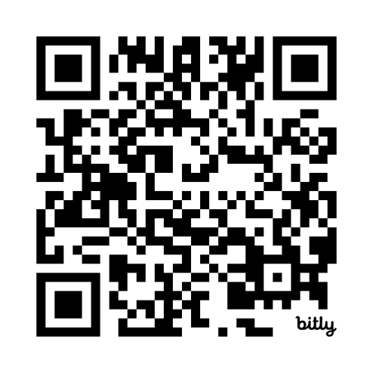
Appendix
How to Use Lessons: bit.ly/UseLOTW
Irregular Verb List: bit.ly/ListVerbs
Lesson Downloads: LightOfTheWorldLearning.org
Order Books: bit.ly/BooksLOTW
Share Your Feedback: bit.ly/FeedbackLOTW
Table of Contents: bit.ly/TocLOTW
Video Channel: youtube.com/@LightOfTheWorldLearning
Vocabulary List: bit.ly/VocabUS
Website: LightOfTheWorldLearning.org

Slide 43
Acknowledgements
We would like to thank the entire Light of the World volunteer team for their hard work and creativity in making this project possible. For all those around the world who prayed, wrote, edited, narrated, illustrated, sang, tested, and gave generously for this curriculum, we appreciate you sharing the love of Jesus through the gift of English. Our team members include:
Anonymous | Emily Cox | Jill Gramzow | Martha Lane
Jean Ato | Marilyn Dano | Tanya Griffin | Audrey Larsen
Bradley Baurain | Hephzi Davidson | Rachel Grijincu | Aden Lewis
Ana Biederman | Susanna Diallo | Lauren Haines | Bruce Lewis
Bob Biederman | Alyssa Dokolas | Carol Hale | Elena Lewis
Joshua Blake | EasyReadEnglish.com | Emily Hamilton | James Lewis
Rachael Braggs | Don Edic | Patty Hickman | Micah Beth Lewis
Hannah Brendel | Peggy Fergus | Juliette Hyer | Tim Lewis
Larry Buell | MaryBeth Gahan | Lyudmila Ivanyuk | Ward Lewis
Cindy Campbell | Melina Gallo | Debbie Johnson | Cosette Lindsay
Christian Cha | Alicia Gentile | Carey Jo Johnston | Johnny Lukashevich
Olivia Cheney | Prakash Chandra Giri | Nancy Kingdon | Gail MacMillan
Hannah Clark | Ellenor Gopal | Dorothy Konadu | Ivan Mader
Nancy Cobb | Henrietta Grajcar | Macy Lake | Amy Martin
(continued on the next slide)

Slide 44
Acknowledgements - Continued
Diana Martz | Joan Phelps | Lorna Tatomir
Hannah McMahan | Megan Rahn | Darrell Turner
Christy McPherson | Sara Scazzero | Leigha Wachter
Tracy Meddaugh | Hannah Schmokel | Joseph Waite
Barbara Newsome | Ashlyn Shrimplin | Graham Whitmore
Brenda Nielsen | Leah Sprague | Cheri Wilke
Danielle Nowe | Noah Staal | Mackenzie Williams
Deborah O’Donnell | Macie Stuckman | Allison Wright
Evelyn Ocasio | Jia Le Su | Tiffany Yeh
Georg Ort | Carole Svensson | Muchun Yin
Martha Ort | Ellie Talalight | Ted York
Barb Park | Peter Talalight | Tai Lee Young
Deb Payne | Weston Talalight | Abigail Zawisza
Linda Petrie | Rachel Tamang | Anita Zeifert
Bible story and pictures on slides 15-20 adapted from the original work by unfoldingWord available from https://openbiblestories.org
Bible Verses on slides 32-33 Taken from the HOLY BIBLE: EASY-TO-READ VERSION ©2014 by Bible League International. Used by permission.

