Slide 1


Unit A2-39
Unit A2-40
©2020-2025 Light of the World Learning
Notes:
Teacher’s Notes:
Thank you for using our materials. For more resources and teacher training visit LightOfTheWorldLearning.org.
Preparation:
Pray.
Read the Bible passages.
Preview slides and game.
Optional: Bring documents and proofread papers to show paragraphs, punctuation, corrections and comments.

Slide 2
Pray, Review, and Preview
Bible Reading: Jesus Raises Lazarus from the Dead - John 11:1-46
Theme: Writing
Pronunciation: /mis/ and /ex/
Grammar: Present continuous and spelling verb + ing; present simple vs. present continuous
Notes:
Pray
Pray for the class. You may want to thank the Lord for giving us the ability to communicate. This can be one of the most crucial parts of the lesson, inviting the Holy Spirit into today's lesson. Take however long is needed to pray, dedicate today's lesson to the Lord and for the students minds and hearts.
Check Homework and Review
Ask each student to read aloud or recite their homework from the last class. Check written work.
Review the main points of the previous lesson and ask if there are any questions.

Slide 3

What do you see?
X
.
?
!
3
Notes:
1A. Discuss Theme Picture
Ask “What do you see in this picture?” and “What else?” to elicit vocabulary they already know.
Repeat and write their words or show the words on the next slide.
Answers may include: check, proofread, sentence, exclamation mark, question mark, period, etc.
More advanced students can be encouraged to make complete sentence. For example:
Proofread your document to check for mistakes.
Have you read over each sentence?
Check each sentence for correct use of periods, exclamation marks, and question marks.

Slide 4

X
4. a mistake
1. a sentence
.
3. a period
5. a paragraph
?
2. a question mark
6. a document
!
7. an exclamation point
Notes:
1B. Show Words for Theme Picture
Please show the names of the theme picture items to the students briefly. Then read the story on the next slide.

Slide 5
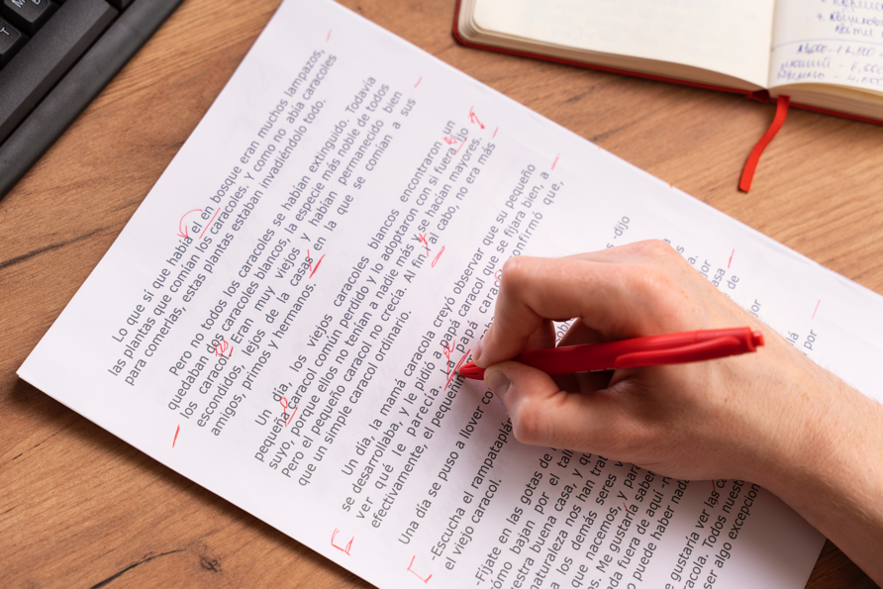
Please give me a few minutes to proofread
this document to check the spelling and the
grammar. I will show you the mistakes.
The paragraphs as well as the sentences are too long. Note that writing each new idea in a new paragraph is best. Write good sentences by using commas for short pauses and a period at the end to help the reader understand. However, if the sentence is a question, end it with a question mark instead of a period. To express a very strong feeling, use the exclamation mark.
I hope these comments will help you improve your writing.
©2020-2025 Light of the World Learning
Notes:
1C. Theme Picture Story
Please read the description of the theme picture to the students and point to the pictured vocabulary.
These words can be studied for homework.
Practice of vocabulary begins with the following slide.
©2020-2025 Light of the World Learning
5

Slide 6

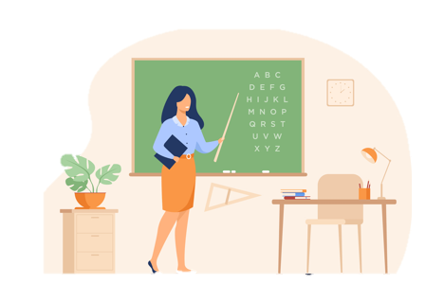
Match the beginning and end of each sentence.
1. The student will check spelling, grammar,
2. The teacher is explaining
3. Now I am writing a
4. Use an exclamation point
A. proper grammar.
B. complete sentence.
C. to show surprise.
D. and punctuation before handing in her paper.
!
Notes:
2A. Vocabulary
1. Say the beginning of the sentence a few times, as you indicate the picture. For example, say “The teacher is explaining, the teacher is explaining.” Have your students then repeat the phrase after you a few times.
2. Ask students to match the beginning and end of each sentence and say the complete sentence. For example, ”The teacher is explaining proper grammar.”
3. Check students’ comprehension further by asking direct questions. For example, “Can you write a complete sentence?”
Answers
1. D
2. A
3. B
4. C
©2020-2025 Light of the World Learning
6

Slide 7
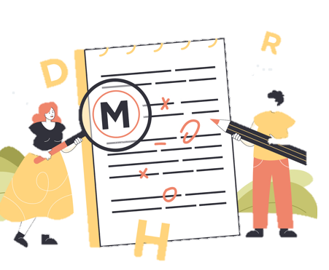


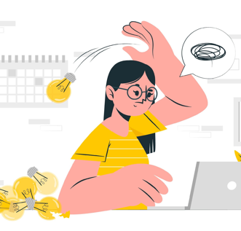


Match the beginning and end of each sentence.
5. Good students
6. Write a comma to
7. The teacher writes
8. The student was
E. separate items in a list.
F. upset that she made a mistake.
G. always proofread their work.
H. comments on the homework.
Notes:
2B. Vocabulary
1. Say the beginning of the sentence a few times, as you indicate the picture. For example, say, ”The student, the student.” Have your students then repeat the phrase after you a few times.
2. Ask students to match the beginning and end of each sentence and say the complete sentence. For example, ”The student made a mistake.”
3. Check students’ comprehension further by asking direct questions. For example, “When do you proofread your work?”
Answers
5. G
6. E
7. H
8. F
©2020-2025 Light of the World Learning
7

Slide 8


Match the beginning and end of each sentence.
A paragraph usually
10. Put a period
11. Did you remember to
12. Give the document
I. at the end of a sentence.
J. has several sentences about a single topic or theme.
K. to the teacher.
L. add a question mark?
Notes:
2C. Vocabulary
1. Say the beginning of the sentence a few times, as you indicate the picture. For example, say, ”Put a period, put a period.” Have your students then repeat the phrase after you a few times.
2. Ask students to match the beginning and end of each sentence and say the complete sentence. For example, ”Put a period at the end of a sentence.”
3. Check students’ comprehension further by asking direct questions. For example, “Can you write a paragraph?”
Answers
9. J
10. I
11. L
12. K
©2020-2025 Light of the World Learning
8

Slide 9
Present continuous verbs are for actions happening now or in the planned near future.
 | Verb + ing | Positive | Negative
1 | checking | I am checking the document. | I am not checking it.
2 | correcting | He is correcting the mistake. | He is not correcting it.
3 | reading | They
4 | writing | We
5 | making | She
Notes:
2D. Grammar – Present Continuous Verbs
The present continuous verb tense is often used for things that are done in the present moment, or planned in the near future.
Model, Repeat, and Solo the pronunciation of all forms shown on the chart. Ask students to complete the sentences with the blank spaces.
Answers will vary but may include:
3. They are reading the Bible. They are not reading the Bible.
4. We are writing an email. We are not writing an email.
5. She is making a mistake. She is not making a mistake.
©2020-2025 Light of the World Learning
9

Slide 10
Present Continuous Questions and Answers
 | Question ? | Positive + | Negative -
1. | Is he writing for class? | Yes, he is writing for class. | No, he is not writing for class.
2. | Are you checking a paper?
3. |  | Yes, they are singing a song.
4. |  |  | No, you are not making a mistake.
10
Notes:
2E. Grammar – Present Continuous Verbs
The present continuous verb tense is often used for things that are done in the present moment, or planned in the near future.
Model, Repeat, and Solo the pronunciation of all forms shown on the chart. Ask students to complete the sentences with the blank spaces.
Answers:
2. Yes, I am checking a paper. No, I am not checking a paper.
3. Are they singing a song? No, they aren’t singing a song.
4. Am I making a mistake? Yes, you are making a mistake.
©2020-2025 Light of the World Learning
10

Slide 11
Present Continuous Verb Questions
 | Question ? |  | Answer
4. | How | are they writing? | They are writing in cursive.
5. | Where | is he writing his paper?
6. |  |  | Because she is doing a class assignment.
7. |  |  | I am writing a story using present continuous verbs.
Notes:
2F. Grammar – Present Continuous Verbs
The present continuous verb tense is often used for things that are done in the present moment, something someone is actively participating in.
Model, Repeat, and Solo the pronunciation of all forms shown on the chart. Ask students to complete the sentences with the blank spaces.
Answers may vary but should use correct verb forms:
5. He is writing his paper in the library.
6. Why is she doing that?
7. What are you writing?
©2020-2025 Light of the World Learning
11

Slide 12
Listen and repeat.
A: So, Jen, tell me what document you are using for the school writing contest?
B: It’s the one about Lazarus and his sisters.
A: That sounds great. Do you need help?
B: I am just proofreading the last paragraph now. Could you check it again for any mistakes?
A: Yes. I will write down my comments for you.
B: Thank you.
Notes:
3. Conversation:
Model: Say both parts of the conversation several times. Use A and B cards, stick figures, or change your physical position to indicate the dual parts. Role-play the parts to convey the meaning of the conversation. Students are to watch and listen.
Repeat: Say one line at a time and have students repeat until they can be understood.
Solo: You begin the conversation and call on individual students to respond. Then reverse the roles (students are A, you are B).
Once students can do both parts, encourage free conversation (students substitute their own words for the blue words).
Teacher can read through the entire conversation once through.
©2020-2025 Light of the World Learning
12

Slide 13
Mis- and Ex- are Prefixes
1. /mis/ often means ”badly" | 2. /ex/ often means "former" or “out” | 3.Challenge
misspell | ex-president
mistake | exit
misuse | exile
miscount | exhale
misspoke | ex-boyfriend
4. She exhaled when her ex-boyfriend exited the room.
5. I made a mistake when I misspelled the word.
Notes:
4A. Pronunciation - Sound and Spelling
Note: The prefix mis is often added in front of a verb to mean “badly” The prefix ex- (with a dash) is often added in front of a noun to mean “former” or ex (without a dash) often means “out”.
1. Model: Say the sound several times while pointing to it. (For example, point to the /mis/ and say /mis/ /mis/ /mis/. Then say the sound and quickly read the entire list, pointing to each item as you read it. Students just watch and listen.
2. Repeat: Say the sound and each word several times, having students repeat each time after you in unison. Be sure to use your normal voice and rate of speed. Do one column at a time, top to bottom. Then read the sentences.
3. Solo: Call on individuals to say a sound and its word group. Give lots of praise. Then ask students to read the sentences.
4. Challenge: Choose another sound from the lesson that is challenging for your particular students to pronounce. Use words from Parts 1 and 2 of the lesson, and from previous lessons to make a group of 3-5 words. You may repeat the same challenging sounds in several lessons. Students need a lot of practice on sounds that do not exist in their first language.
©2020-2025 Light of the World Learning
13

Slide 14
Listen and repeat.
A. ₋_ | B. _ ₋ | C. _ ₋₋
misspell | sentence | paragraph
believes | comma | question mark
asleep | grammar | document
mistake | proofread | period
Notes:
4B. Hum and clap the stress.
Begin by humming the stress of a column of words. Hum higher, longer, and louder for big dashes and lower, shorter, and quieter for small dashes.
You may use hand gestures to indicate that the stressed syllable is higher in pitch, longer in duration, and louder. Invite your students to join in humming the rhythm. Once the class is humming the rhythm in unison, you can begin saying the words. You may also wish to clap the syllables while you say the words.
1. Model: Hum and then say each word in the column several times. Students listen.
2. Repeat: Students repeat words after you in unison.
3. Solo: Call on individuals to read the entire column of words.
©2020-2025 Light of the World Learning
14

Slide 15
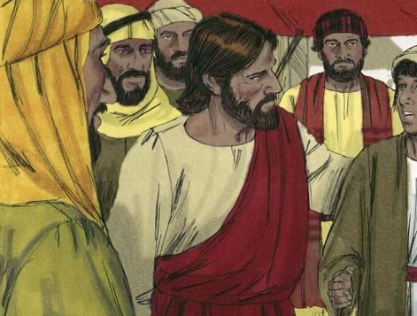
Read John 11:1-46 in your language. Then read the story
Jesus Raised Lazarus
from the Dead.
There was a man named Lazarus.
He had two sisters named Mary and
Martha. They were all close friends of Jesus. One day
someone told Jesus that Lazarus was very sick. When Jesus heard this, he said, “This sickness will not end with Lazarus dying. Instead, it will cause people to honor God.”
Jesus loved his friends, but he waited where he was for two days.
Notes:
5A. Bible Reading
Be sure students read this story in their first language before reading it in English. The hyperlinks of the Bible verses connect to https://live.bible.is/ so students can read and hear the scripture in their own languages and watch the video.
A. Read the story out loud to the class.
B. If students ask about words, give simple definitions.
C. Encourage students to read aloud paragraphs from the story. Encourage students to act out the story.
D. Ask if there are any questions or comments about the story.
E. Ask the story questions and discuss as a group.
F. Optional - You may hide the words and ask students to tell the story again in their own words, using the pictures to help them.
©2020-2025 Light of the World Learning
15

Slide 16
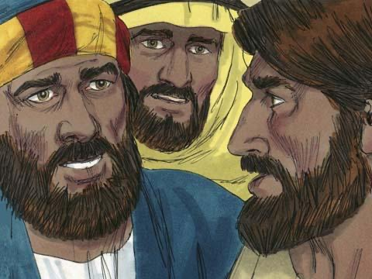
After those two days he said to his disciples, “Let’s go back to Judea.”
“But Teacher,” the disciples answered, “just a short time ago the people there wanted to kill you!” Jesus said, “Our friend Lazarus has fallen asleep, and I must wake him.”
Jesus’ disciples replied, “Master, if Lazarus is sleeping, then he will get better.” Then Jesus told them plainly, “Lazarus is dead. I am glad that I was not there, so that you may believe in me. We will go to him now.” When Jesus arrived at Lazarus’ hometown, Bethany, Lazarus had already been dead for four days.
©2020-2025 Light of the World Learning
Notes:
5B. Bible Reading
A. Read the story out loud to the class.
B. If students ask about words, give simple definitions.
C. Encourage students to read aloud paragraphs from the story.
©2020-2025 Light of the World Learning
16

Slide 17
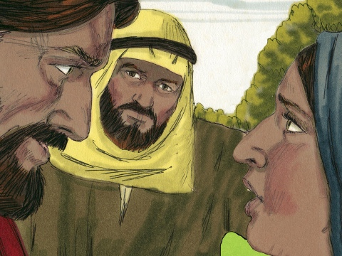
When Martha heard that Jesus was coming, she went out to meet him. She said, “Master, if only you had been here,
my brother would not have died. But I know that even now God will give you whatever you ask from him.”
Jesus replied, “I am the Resurrection
and the Life. Whoever believes in me will live, even though he dies. Martha do you believe this?” Martha answered, “Yes, Lord. I believe that you are the Messiah, the Son of God”. After saying this Martha went back to call her sister. Mary immediately left to go to Jesus. Those who were in the house comforting Mary thought she was going to the tomb to cry. So they followed her.
Notes:
5C. Bible Reading
A. Read the story out loud to the class.
B. If students ask about words, give simple definitions.
C. Encourage students to read aloud paragraphs from the story.
©2020-2025 Light of the World Learning
17

Slide 18
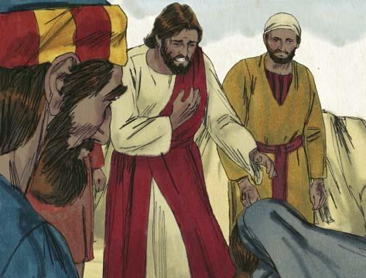
When Mary arrived at the place where
Jesus was she fell at the feet of Jesus
and said, “Master, if only you had been
here, my brother would not have
died.” Jesus asked them, “Where have
you put Lazarus?”
They told him, “In the tomb. Come and see.”
Then Jesus wept. The tomb was a cave with a large stone covering the entrance. When Jesus arrived at the tomb, he told them, “Roll the stone away.” But Martha said, “He has been dead for four days. There will be a bad smell.” Jesus answered, “Did I not tell you that you would see God’s power if you believe in me?”
Notes:
5D. Bible Reading
A. Read the story out loud to the class.
B. If students ask about words, give simple definitions.
C. Encourage students to read aloud paragraphs from the story.
©2020-2025 Light of the World Learning
18

Slide 19
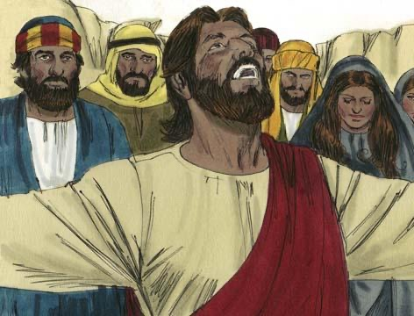
So they rolled the stone away. Then Jesus looked up to heaven and said, “Father, I think you have heard me. I know you always listen to me, but I say this in order to help all these people standing here, so that they will believe you sent me.”
Then Jesus shouted, “Lazarus, come out!” So Lazarus came out! He was still wrapped in grave clothes. Jesus told them, “Help him take off those grave clothes and release him!” Many of the Jews who had come there with Mary believed in Jesus because of this miracle. But the religious leaders of the Jews envied Jesus, so they gathered together to plan how they could kill Jesus and Lazarus.
Notes:
5E. Bible Reading
A. Read the story out loud to the class.
B. If students ask about words, give simple definitions.
C. Encourage students to read aloud paragraphs from the story.
©2020-2025 Light of the World Learning
19

Slide 20
Answer the questions.
How long did Jesus wait before he went to see Lazarus?
What did Jesus mean when he said that Lazarus was sleeping?
How long had Lazarus been dead when Jesus finally arrived at Bethany?
What title did Jesus give to himself when he spoke to Martha?
Who did Martha say that Jesus was?
Why was Martha afraid to open the tomb?
Do you trust God to answer your prayer as Jesus did?
Notes:
5F. Bible Reading Questions and Answers
Jesus waited two days at the place where he was.
Jesus meant Lazarus was dead.
Lazarus had already been dead for four days.
Jesus said, “I am the Resurrection and the Life”.
She said he was the Messiah, the Son of God.
She was afraid that the body of Lazarus would smell bad because he had been dead for four days.
Answers will vary
©2020-2025 Light of the World Learning
20

Slide 21
Listen and answer the questions.
What day of school is it?
Why did Tom have to study hard?
Who is Tom going to miss?
Who helped Tom study for his final English exam?
How must Tom prepare for his next class in the spring?
©2020-2025 Light of the World Learning
Notes:
6A. Activities – Listening with sound/spelling prefixes /mis/ and /ex/
Read the following script at least twice as students listen and write their answers to the questions. Students may NOT look at the script.
Last Day of School
Today Tom woke up feeling excited and nervous. Today he has to take his final exam of the year on the last day of school. He studied very hard for it. On his last test, he made too many spelling mistakes and got a bad grade. His parents paid one of Tom’s ex-teachers to be his tutor for the rest of the year. She helped him study the misspelled words he got wrong. If he passes this test, he will graduate into the next level of English. He will miss his ex-classmates who must return to their village and not continue in school. Tom wants to continue English classes. He is good at learning languages. He will be the first one in his family to complete English classes for more than five years. His family is very proud of him. They plan to celebrate together once he graduates from level 5. Tom is planning on continuing his English education in the spring and must not misuse his time when he needs to study.
Answers:
1. Today is the last day of school.
2. He made too many mistakes on his last test.
3. He will miss his ex-classmates who must return to their village.
4. One of Tom’s ex-teachers helped him study.
5. He must not misuse his time when he needs to study.
©2020-2025 Light of the World Learning
21

Slide 22
Questionnaire – School - Classmates
Questions | Answers
1. What classes have you signed up for?
2. What was your favorite subject?
3. Do you like writing sentences?
4. How do you check your homework?
5. How do you best study?
6. What is your biggest challenge in school?
7. What is your biggest accomplishment in school?
Notes:
6B. Activities – Pair work
Partner A will play the part of a boss interviewing a job applicant. Partner A will ask questions from this slide and write Partner B’s answers.
Check answers for correct grammar and punctuation.
These answers will vary, must be checked by teacher.
©2020-2025 Light of the World Learning
22

Slide 23
Game: Find and Correct the Errors
their were a men names Lazarus who was sick? he lived in the town of Bethany where mary and her sister martha Lived. Mary’s brother was lazarus the man who was now sick, So Mary and Martha sents someone to tell Jesus, “Lord, you’re dear friend Lazarus is sick When Jesus heard this he said The end of this sickness will not be death. No this sickness is for the glory of God. This has happened to bring glory to the Sun of God.” Jesus loved martha and her sister and lazarus. Sew! when he heard that Lazarus was sick, he stayed where he was two more days and then said Two his followers, “We should go back to judea
Notes:
7. Game
Present these paragraphs from the Bible with errors in grammar, spelling, and punctuation. Each student has to try to find and correct all the errors within five minutes. Whoever corrects the most errors wins!
Go over the correct answers and explain the corrections.
Answers with corrections in bold print:
There was a man named Lazarus who was sick. He lived in the town of Bethany, where Mary and her sister Martha lived. Mary’s brother was Lazarus, the man who was now sick. So Mary and Martha sent someone to tell Jesus, “Lord, your dear friend Lazarus is sick.”
When Jesus heard this he said, “The end of this sickness will not be death. No, this sickness is for the glory of God. This has happened to bring glory to the Son of God.” Jesus loved Martha and her sister and Lazarus. So when he heard that Lazarus was sick, he stayed where he was two more days and then said to his followers, “We should go back to Judea.”

Slide 24

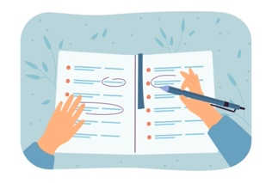



1A. Homework: Write sentences about the pictures using the present continuous with questions ? positives + or negatives - .
1. ! | I’m still writing my paper and it’s due in only 10 minutes! | 4.?
2. - |  | 5. +
3. - |  | 6.?
Notes:
Homework 1A. - Write sentences using the pictured vocabulary words.
Model. Go over each of the homework assignments to be sure the student understands what to do.
Repeat. Encourage students to practice speaking and reading the completed homework assignments with a friend. They may use a bilingual dictionary.
Solo. Students will share their homework when they are finished. After they have shared their homework, be sure to check it for correctness, including spelling. Explain mistakes, while providing praise and encouragement. Answers will vary.
Number one is an example.
Answers may vary, but will start with a capital letter, have the correct verb form and punctuation mark, and use the following words:
Vocab words: Example sentences:
Writing 1. I am writing my paper for class tomorrow!
Commas 2. I don’t know how to use commas.
Check 3. The teacher isn’t checking the homework.
Comments 4. What comments do you have?
Proofread 5. I am proofreading my paper.
Paragraph 6. How do I write a paragraph?
©2020-2025 Light of the World Learning
24

Slide 25


1B. Write about the pictures using the present continuous with questions ? positives + or negatives -.
7. - |  | 10. -
8.+ |  | 11. -
9.+ |  | 12.? .
Notes:
Homework 1B. - Write sentences using the pictured vocabulary words.
Students will write a sentence for each picture to practice the lesson’s vocabulary words.
Answers may vary, but will start with a capital letter, have a punctuation mark at the end, and use the following words:
7. Paragraph
8. Exclamation mark
9. Question mark
10. Documents
11. Grammar
12. Period
©2020-2025 Light of the World Learning
25

Slide 26
2. Fill in the blanks with the words.
grammar
check
comma
sentence
mistakes
document
edit
exclamation point
Be sure to ________ that your ________ is correct for your final paper.
Always proofread your paper to eliminate __________.
An __________ at the end of the sentence shows strong emotion.
A __________ is a complete thought.
Write a 3-page __________ for your research project.
Put a ________ in between items in a list.
Notes:
Homework 2. – Grammar and Vocabulary Review
Learners must use the correct continuous present form of the verbs with to complete the sentences.
Answers may vary but can include:
Be sure to check that your grammar is correct for your final paper.
Always proofread your paper to eliminate mistakes.
An exclamation point at the end of the sentence show strong emotion.
A sentences is a complete thought.
Write a 3-page document for your research project.
Put a comma in between items in a list.
©2020-2025 Light of the World Learning
26

Slide 27
3. Write questions and ask a partner.
Questions | Answers
1. When do you need to use a period? | I use a period at the end of a sentence.
2. _______ sentence _________
3. _______ proofread _________
4. _______ paragraphs ________
5. ________ mistakes _________
6. _________ write __________
7. __________ put __________
Notes:
Homework 3. – Conversations - Pair work
First, students complete writing the questions with their own words. Then ask students to interview a partner, and write their partner’s answers. Then they will switch roles and answer their partner’s questions.
Check answers for correct grammar and punctuation.
Number 1 is an example.
Questions and answers will vary but may include:
2. Does your sentence end with a question mark?
3. Who will proofread your document?
4. How many paragraphs did you write?
5. What mistakes did you find in your paper?
6. What do you like to write about?
7. Where do I put an exclamation point?
©2020-2025 Light of the World Learning
27

Slide 28
4. Write and say sentences using the words in the box.
misspoke misunderstand misheard exile ex-member explode ex-president
A. How do you know if you misspoke? People look confused.
B.
C.
D.
E.
F.
G.
Notes:
Homework 4. – Write and say sentences with the new sounds.
This homework practices writing, spelling, and pronouncing the /mis/ and /ex/ sounds.
Answers will vary but should include the following words and be used and pronounced correctly.
B. I misheard his comment.
C. What is the ex-president’s name?
D. What can you do if you misunderstand?
E. Why did the ex-member leave?
F. Where do exiles go to live?
G. I heard the bomb explode.
©2020-2025 Light of the World Learning
28

Slide 29
5A. Discuss the Bible story with your partner.
What was your favorite part of the Bible story?
Which person did you relate to in the story and why?
What was confusing about the story?
What did you learn from the story?
How do you think it applies to your life?
How can you show that Jesus is your friend?
Notes:
Homework 5. – Bible Reading Review
Ask the students to tell the Bible story to a partner and then interview the partner, and write their partner’s answers. Then they will switch roles and answer their partner’s questions.
Check answers for correct grammar and punctuation.
Answers will vary.
©2020-2025 Light of the World Learning
29

Slide 30
5B. Write a summary of Lazarus’ story here.
Use at least two paragraphs and proofread your work.
©2020-2025 Light of the World Learning
Notes:
Homework 5. – Bible Reading Review
Learners will write a summary of the Bible story with at least two paragraphs.
Answers will vary.
©2020-2025 Light of the World Learning
30

Slide 31
6A. Homework – Choose one Verse to memorize.
A
Jesus said to her, “I am the resurrection. I am life. Everyone who believes in me will have life, even if they die. And everyone who lives and believes in me will never really die. Martha, do you believe this?” John 11:25-26 ERV
Jesus said to them, “Come, follow me, and I will make you a different kind of fishermen. You will bring in people, not fish.” Matthew 4:19 ERV
B
Notes:
Homework 6A. – Memorize a Verse
Learners get to choose A, B, or C (on the next slide) to memorize. Please notice that the memory work is not long. Everyone, regardless of skill level, should be able to do it.
1. Model. Recite a verse from memory.
2. Repeat. Encourage students to find someone with whom to practice conversing and reading the completed homework assignment.
3. Solo. Students will recite the verse from memory at the next class.
©2020-2025 Light of the World Learning
31

Slide 32
6B. Homework – Choose one verse to memorize and read the next verses.
C
Jesus answered, “I am the way, the truth, and the life. The only way to the Father is through me.” John 14:6 ERV
Read the next lesson’s Bible verses: John 18:1-11 ERV
Notes:
Homework 6B. – Memorize a verse and read the next lesson’s verses.
Learners get to choose A, B, or C to memorize.
Students will always read the Bible lesson in their first language (L1) before reading it in English the following lesson. Help them get a Bible in their own language if they don’t have one. They may also use Bible.IS or other Bible translation resources.
©2020-2025 Light of the World Learning
32

Slide 33
7A. Read and answer the questions
An email from a classmate
Hi Samia,
I am writing to email you about our project coming up next week. I know you were out sick, so our teacher said I could update you on what you missed. We are partners and need to write a one-paragraph summary about our journey of learning English. For this summary we have to make sure all our grammar is correct. That means checking that every sentence ends with either a period, an exclamation mark, or a question mark. I think if we proofread each other’s summaries we can also check for any missing commas.
Notes:
Homework 7A. – Everyday Reading and Writing
The learners will read the article and answer the questions on the last slide.
©2020-2025 Light of the World Learning
33

Slide 34
7B. Read and answer the questions
An email from a classmate (continued)
I find it is very difficult to proofread my own work. I don’t always notice the mistakes. Writing on the computer is helpful because it checks the spelling and grammar for me. However, the computer doesn’t catch other errors such as making sure I am staying on topic. Let me know how you are feeling and when we can meet to go over our summaries.
Feel better,
Ryan
Notes:
Homework 7A. – Everyday Reading and Writing
The learners will read the article and answer the questions on the next slide.
©2020-2025 Light of the World Learning
34

Slide 35
7C. Homework – Answer the questions
A. What is difficult for Ryan?
B. What did they plan on doing together?
C. What were the directions for the assignment?
D. How were they going to help each other?
E. What did Ryan ask Samia?
F. Why did Samia miss class?
Notes:
Homework 7C. – Everyday Reading and Writing
Answers will vary but may include:
A. Proofreading his own work is difficult.
B. They planned to proofread each other’s summaries for class.
C. They had to to write a summary paragraph about their journey of learning English.
D. They were going to help each other by checking for grammar mistakes.
E. Ryan asked Samia when they could meet.
F. Samia was sick.
©2020-2025 Light of the World Learning
35

Slide 36
8. Writing - Write a letter using present continuous and simple present tenses. Use commas, exclamation points, question marks, and periods.
Notes:
Homework 8. – Writing
Model. Write something about the story of Lazarus. For example: Jesus raised Lazarus from the dead. Answers will vary.
©2020-2025 Light of the World Learning
36

Slide 37
9. Homework – Now I Can….
I can talk about schoolwork and describe documents and writing.
I can use the new words including _____, _____, _____, _____, _____, _____, _____, _____, _____, _____, _____, and _____.
I can use the present and present continuous tenses.
I can understand that Jesus is God.
I can understand that sometimes Jesus wants me to wait for him to act, and to trust him in all ways.
Notes:
Homework 9. – I can statements
The student must be able to achieve all of these skills before the next lesson. If not, the lesson can be repeated or additional practice materials can be used.
Review all of the skills at the beginning of the next lesson. Be sure to give lots of praise and encouragement!
©2020-2025 Light of the World Learning
37

Slide 38
Reflections and Closing Prayer
Notes:
Reflections and Closing Prayer
You may want to thank the Lord for what we have learned, ask for special prayer requests, then pray for your students and bless them. Students may write reflections and their prayers here.
©2020-2025 Light of the World Learning
38

Slide 39

Help us share the Light of the World!
Thank you for using our materials. If these lessons are a blessing to you, please give or volunteer to help others learn English through the Bible.
For more information, visit LightOfTheWorldLearning.org
Notes:
©2020-2025 Light of the World Learning
39

Slide 40
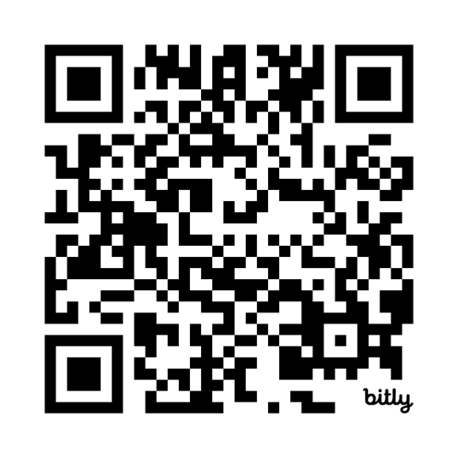
Appendix
Irregular Verb List: bit.ly/ListVerbs
Lesson Downloads: LightOfTheWorldLearning.org
Order Books: bit.ly/BooksLOTW
Share Your Feedback: bit.ly/FeedbackLOTW
Table of Contents: bit.ly/TocLOTW
Videos: bit.ly/A2videos
Vocabulary List: bit.ly/VocabUS
Website: LightOfTheWorldLearning.org
Notes:
©2020-2025 Light of the World Learning
40

Slide 41
Acknowledgements
We would like to thank the entire Light of the World volunteer team for their hard work and creativity in making this project possible. For all those around the world who prayed, wrote, edited, narrated, illustrated, sang, tested, and gave generously for this curriculum, we appreciate you sharing the love of Jesus through the gift of English. Our team members include:
Anonymous | Emily Cox | Jill Gramzow | Martha Lane
Jean Ato | Marilyn Dano | Tanya Griffin | Audrey Larsen
Bradley Baurain | Hephzi Davidson | Rachel Grijincu | Aden Lewis
Ana Biederman | Susanna Diallo | Lauren Haines | Bruce Lewis
Bob Biederman | Alyssa Dokolas | Carol Hale | Elena Lewis
Joshua Blake | EasyReadEnglish.com | Emily Hamilton | James Lewis
Rachael Braggs | Don Edic | Patty Hickman | Micah Beth Lewis
Hannah Brendel | Peggy Fergus | Juliette Hyer | Tim Lewis
Larry Buell | MaryBeth Gahan | Lyudmila Ivanyuk | Ward Lewis
Cindy Campbell | Melina Gallo | Debbie Johnson | Cosette Lindsay
Christian Cha | Alicia Gentile | Carey Jo Johnston | Johnny Lukashevich
Olivia Cheney | Prakash Chandra Giri | Nancy Kingdon | Gail MacMillan
Hannah Clark | Ellenor Gopal | Dorothy Konadu | Ivan Mader
Nancy Cobb | Henrietta Grajcar | Macy Lake | Amy Martin
(continued on the next slide)
Notes:
©2020-2025 Light of the World Learning
41

Slide 42
Acknowledgements - Continued
Diana Martz | Joan Phelps | Lorna Tatomir
Hannah McMahan | Megan Rahn | Darrell Turner
Christy McPherson | Sara Scazzero | Leigha Wachter
Tracy Meddaugh | Hannah Schmokel | Joseph Waite
Barbara Newsome | Ashlyn Shrimplin | Graham Whitmore
Brenda Nielsen | Leah Sprague | Cheri Wilke
Danielle Nowe | Noah Staal | Mackenzie Williams
Deborah O’Donnell | Macie Stuckman | Allison Wright
Evelyn Ocasio | Jia Le Su | Tiffany Yeh
Georg Ort | Carole Svensson | Muchun Yin
Martha Ort | Ellie Talalight | Ted York
Barb Park | Peter Talalight | Tai Lee Young
Deb Payne | Weston Talalight | Abigail Zawisza
Linda Petrie | Rachel Tamang | Anita Zeifert
Bible story and pictures on slides 15-20 adapted from the original work by unfoldingWord available from https://openbiblestories.org
Bible Verses on slides 31-32 Taken from the HOLY BIBLE: EASY-TO-READ VERSION ©2014 by Bible League International. Used by permission.
Notes:
©2020-2025 Light of the World Learning
42

