Slide 1


Unit A2-41
Unit A2-41
©2020-2025 Light of the World Learning
Notes:
Teacher’s Notes:
Thank you for using our materials. For more resources and teacher training visit LightOfTheWorldLearning.org
Preparation:
Pray.
Read the Bible passages.
Preview slides and song.
Optional: Bring silverware, menus, restaurant reviews, and other items related to restaurants.
1

Slide 2
Pray, Review, and Preview
Bible Reading: Jesus is Betrayed - Matthew 26:14-56
Theme: Restaurant
Pronunciation: /rE/ “again” prefix and /dis/ negative prefix
Grammar: Giving and Taking Advice; Following Rules; Should, Must, and Have to
Notes:
Pray
Pray for the class. You may want to thank the Lord for giving us freedom and the ability to work.
Check Homework and Review
Ask each student to read aloud or recite their homework from the last class. Check written work. Be sure they have read Matthew 26: 14-56 in their native languages in preparation for the lesson.
Review the main points of the previous lesson and ask if there are any questions.
2

Slide 3
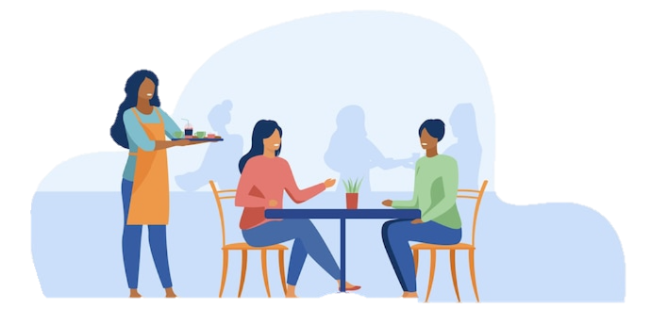



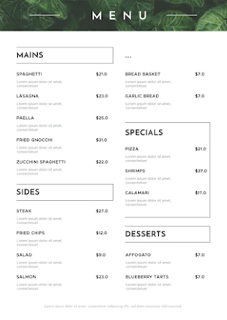

What do you see?
Oops, I’m sorry.
It’s no problem. Thanks for serving us!
Notes:
1A. Discuss Theme Picture
Ask “What do you see in this picture?” and “What else?” to elicit vocabulary they already know.
Repeat and write their words or show the words on the next slide.
Answers may include: restaurant, server, waitress, customers, apron, food, table, chair, drop, silverware, menu, etc.
More advanced students can be encouraged to make complete sentences:
The customers are talking. The waitress drops the silverware. The customers sit at the chairs.
3

Slide 4
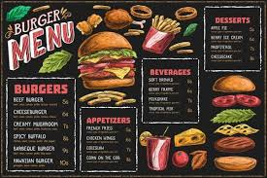
At the restaurant today, Mary and I chose the most popular item on the menu, cheeseburgers. The waitress repeated our order and returned quickly with our food. In her haste she dropped the silverware.
“Oops, I’m sorry,” the server apologized. She went off to bring a second set while I passed the food to Mary.
The manager came by and asked how our meal was.
“The waitress was distracted and dropped our silverware, but she was polite. The food is delicious, so we are not disappointed,” I said. After eating, I wrote a good score on the review card and I left a good tip for the waitress, too.
Notes:
1B. Read about the Theme Picture
Please read the description of the theme picture to the students and point to the pictured vocabulary. If students ask about words, give simple definitions.
Practice of vocabulary begins with the following slide.
4

Slide 5
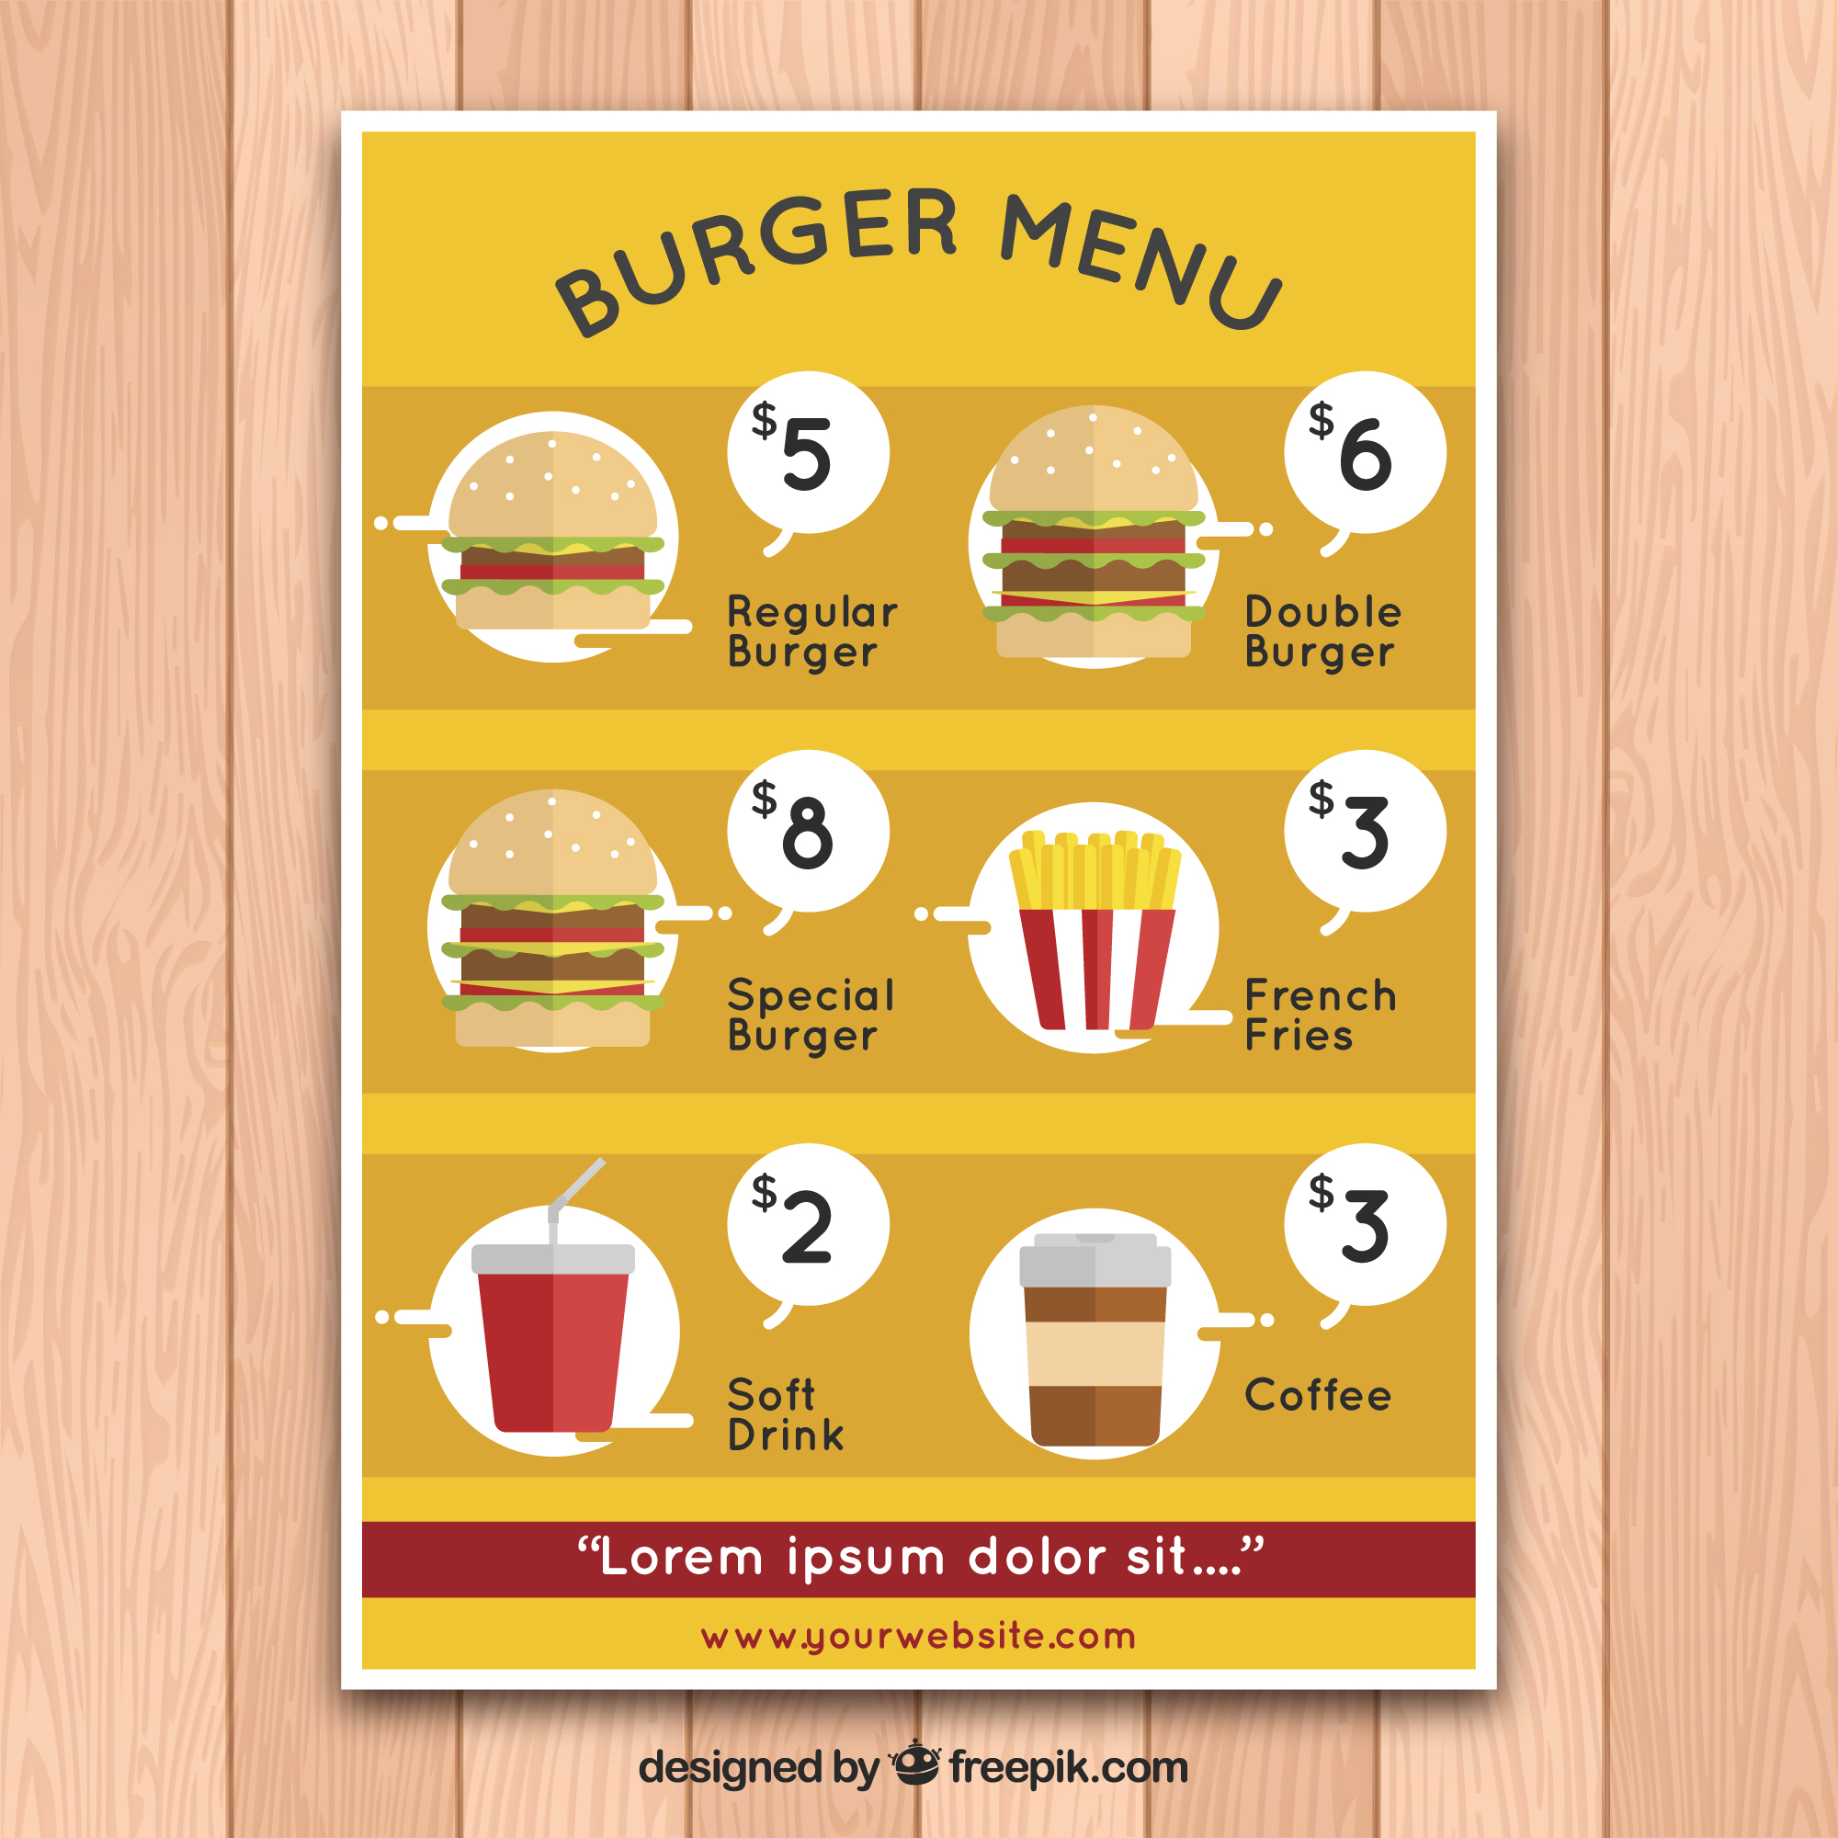



Match the beginning and end of each sentence.
A menu tells you
2. The manager
3. We leave a tip
4. One minute has
A. scheduled a meeting.
B. what is available to eat.
C. sixty seconds.
D. when we get good service.
Notes:
2A. Vocabulary
1. Say the beginning of the sentence a few times, as you indicate the picture. For example, say, ”A menu tells you, A menu tells you,” Have your students then repeat the phrase after you a few times.
2. Ask students to match the beginning and end of each sentence and say the complete sentence. For example, ”A menu tells you what is available to eat.”
3. Check students’ comprehension further by asking direct questions. For example, “Can you hold your breath for sixty seconds?”
Answers
B
A
D
C
5

Slide 6
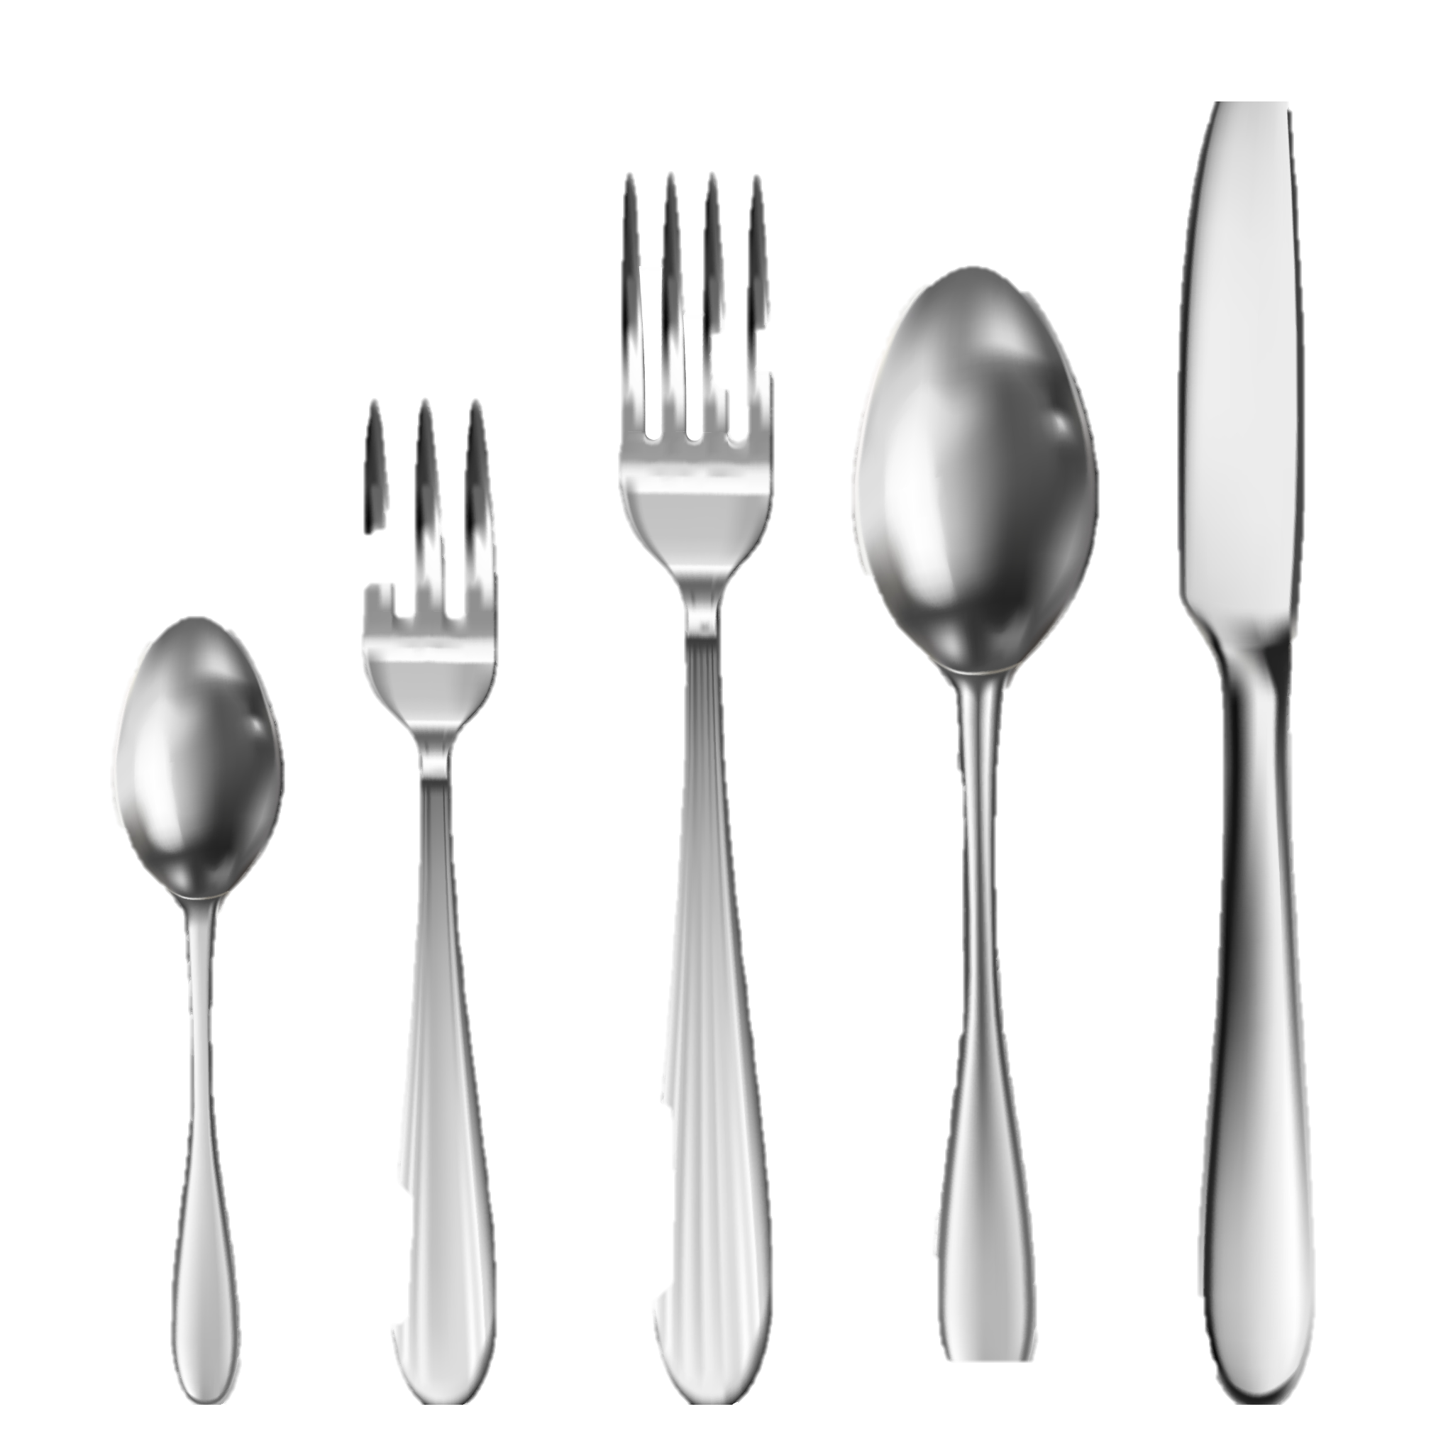

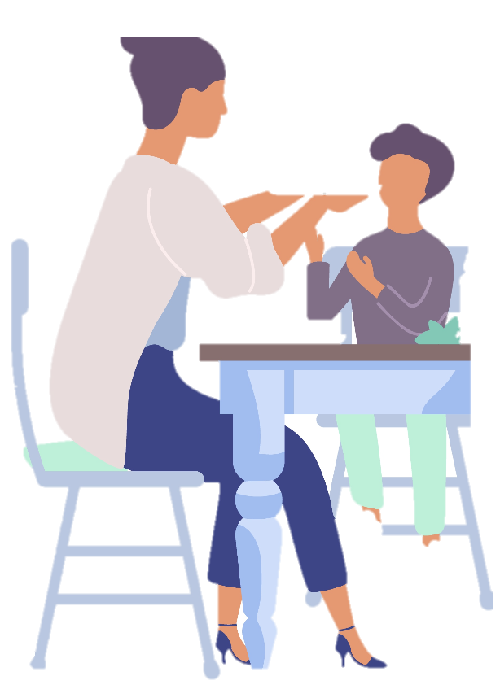
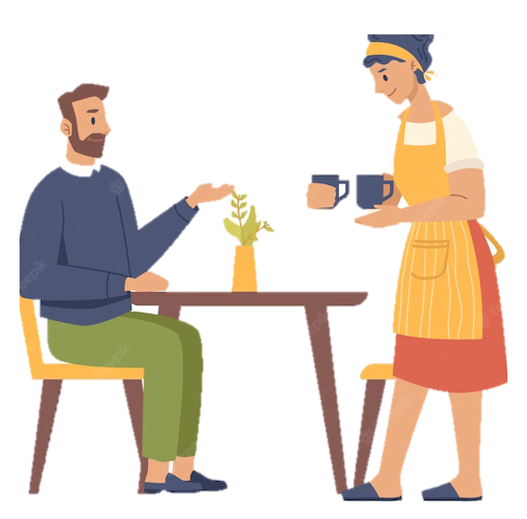
Match the beginning and end of each sentence.
5. I wrote a 5-star review
6. We use silverware
7. The server brings him
8. Please pass the
E. when we eat.
F. meat to me.
G. of the fine restaurant.
H. his coffee.
Notes:
2B. Vocabulary
1. Say the beginning of the sentence a few times, as you indicate the picture. For example, say, ”The server brings him, The server brings him.” Have your students then repeat the phrase after you a few times.
2. Ask students to match the beginning and end of each sentence and say the complete sentence. For example, ”The server brings him his coffee.”
3. Check students’ comprehension further by asking direct questions. For example, “Do you eat with silverware?”
Answers
5. G
6. E
7. H
8. F
6

Slide 7
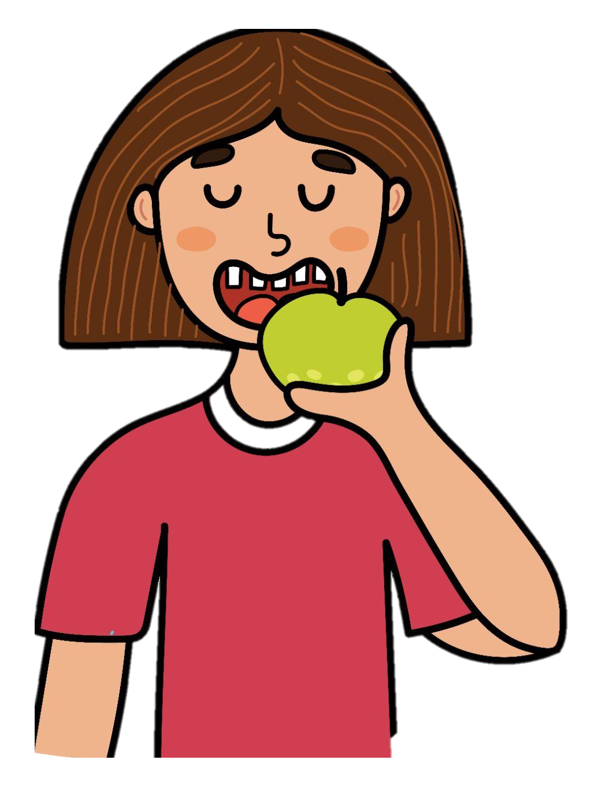
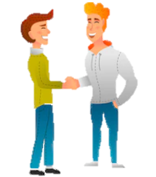
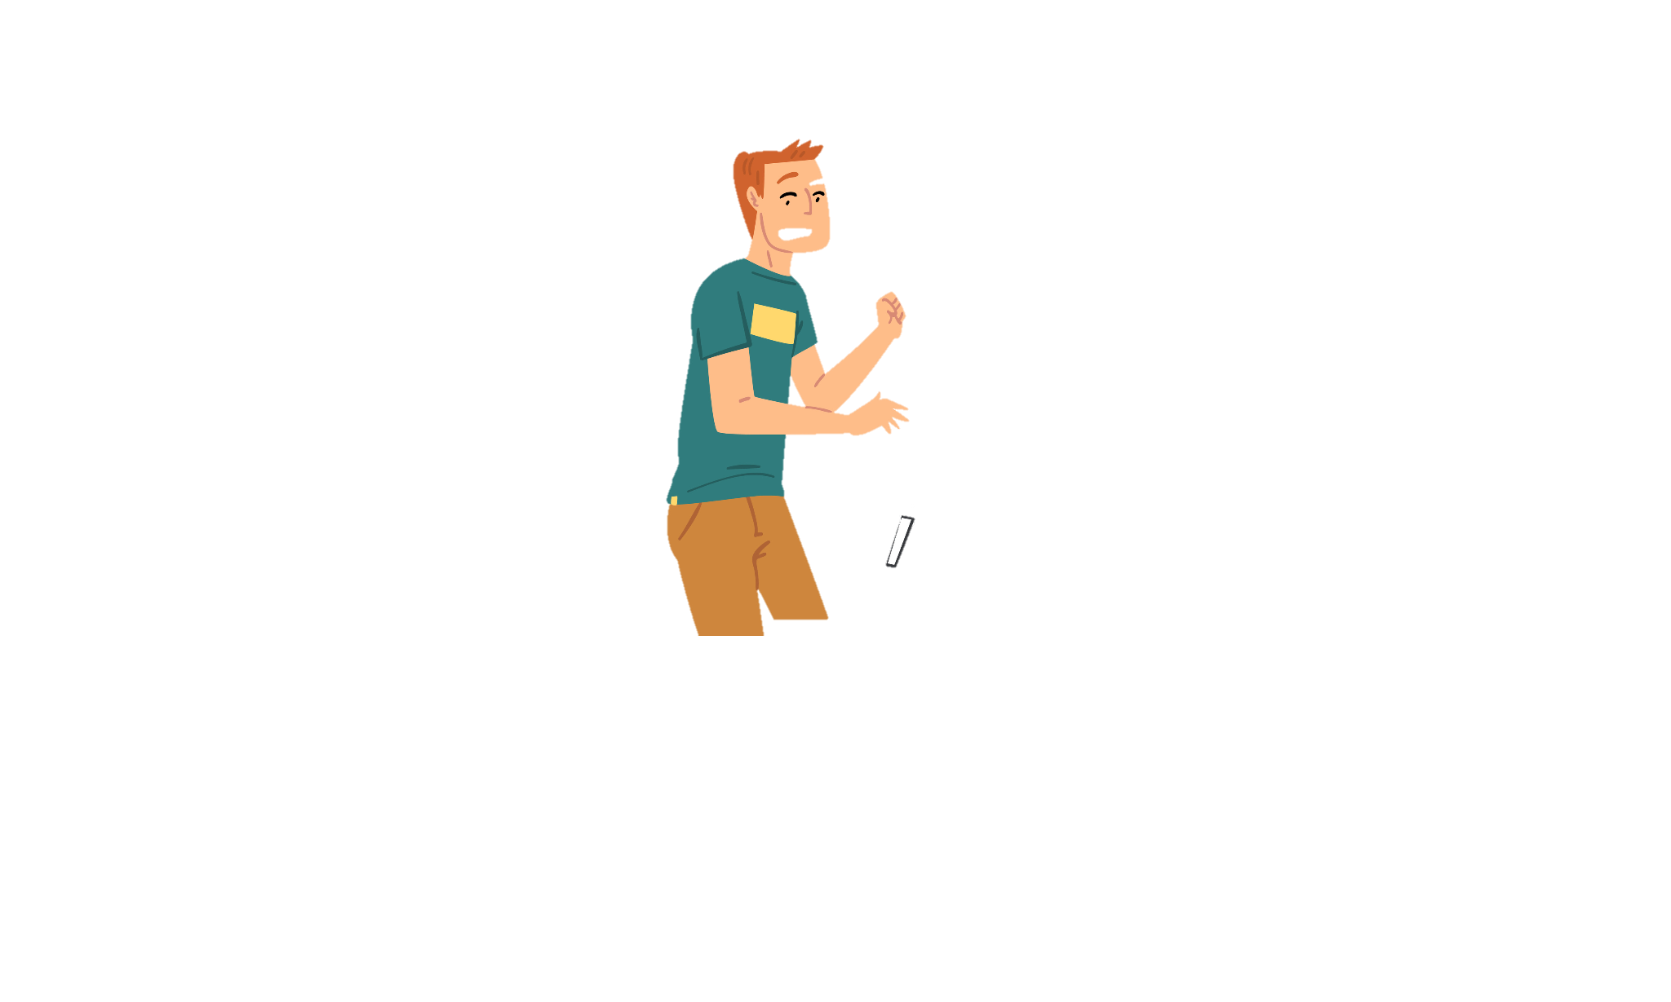
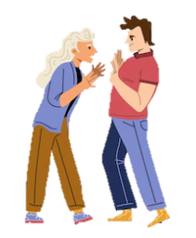
Match the beginning and end of each sentence.
He dropped
10. She takes a big bite
11. Please be polite
12. You are being t
I. out of the apple.
to the guests.
very impolite to me.
his cell phone.
Notes:
2C. Vocabulary
1. Say the beginning of the sentence a few times, as you indicate the picture. For example, say, ”He dropped, he dropped.” Have your students then repeat the phrase after you a few times.
2. Ask students to match the beginning and end of each sentence and say the complete sentence. For example, ”He dropped his cell phone.”
3. Check students’ comprehension further by asking direct questions. For example, “Are you polite to others?”
Answers
9. L
10. I
11. J
12. K
7

Slide 8
Should, Must, & Have to - for Advice and Rules
Use | Verb | Sentence
Advice | Should Should not | Should I leave a tip for the waiter? Yes, you should leave a 20% tip. He should not write a bad review today.
Formal Rule | Must Must not | Must he call the manager if he is late? Yes, he must call before 8:00. She must not be impolite to customers.
Informal Rule | Have to Don’t have to | Do we have to wash the silverware now? No, you don’t have to wash it now. Does she have to rewrite the menus? No, she doesn’t have to rewrite them.
Notes:
2D. Grammar – Should, Have To, Must
The auxiliary verb Should is used to ask for and give advice. The auxiliary verb Must is used for rules and obligations. Have to is used more commonly for rules and obligations and is less formal than must.
Should and Must are modal verbs. Modal verbs do not add -s after he/she/it in the present tense, and the main verb does not change after the modal verb. We do not need to put do/does/don’t/doesn’t in front of a modal verb.
For example: He should go. NOT: He shoulds go.
She must arrive on time. NOT: She musts arrive on time.
8

Slide 9
Should is a modal verb used for advice.
 | Question ? | Answer
1. | What should I do if my neighbor’s dog bites me? | You should talk to your neighbor.
2. |  | He should not run in the library.
3. | Should I wait ten seconds before I say something impolite?
4. |  | She should go to a doctor.
5. | Shouldn’t he finish his homework by tonight?
Notes:
2E. Grammar – Obligation Verbs
The auxiliary verb Should is used to ask for and give advice. The auxiliary verb Must is used for rules and obligations. Have to is used more commonly for rules and obligations and is less formal than must.
Modal verbs do not add -s after he/she/it, and the verb tenses do not change after the must/mustn’t. We do not need to put do/does/don’t/doesn’t in front of a modal verb.
Model, Repeat, and Solo number one. Ask students to complete the sentences for numbers 2-5.
Answers may vary but should contain the correct form of Should:
2. Should he run in the library?
3. You should wait ten seconds before you say something impolite.
4. Should she go to a doctor?
5. He should finish his homework by tonight.
9

Slide 10
Must is a modal verb used for formal rules.
 | Question ? | Answer
1. | Must he wear a helmet when he rides a motorcycle? | He must wear a helmet when he rides a motorcycle.
2. |  | They must wear seatbelts because it’s the law.
3. | Must you eat so fast?
4. |  | She mustn't drive so fast.
5. | Must he go to the hospital?
Notes:
2F. Grammar – Obligation Verbs
The auxiliary verb Should is used to ask for and give advice. The auxiliary verb Must is used for rules and obligations. Have to is used more commonly for rules and obligations and is less formal than must.
Modal verbs do not add -s after he/she/it, and the verb tenses do not change after the must/mustn’t. We do not need to put do/does/don’t/doesn’t in front of a modal verb.
Model, Repeat, and Solo number one. Ask students to complete the sentences for numbers 2-5.
Answers may vary but should contain the correct form of Must:
2. Why must they wear seatbelts?
3. I must not eat so fast.
4. Must she drive so fast?
5. He must go to the hospital.
10

Slide 11
Have to - for Informal Rules
 | Question ? | Answer
1. | Does a restaurant manager have to be friendly? | Yes, he has to be friendly.
2. |  | Yes, you have to practice every day.
3. | Do you have to eat with silverware?
4. |  | No, we don’t have to go.
5. | Does a customer have to order from the menu?
Notes:
2E. Grammar – Obligation Verbs
Have to is used more commonly for rules and obligations and is less formal than must. We use do/does/don’t/doesn’t
Model, Repeat, and Solo number one. Ask students to complete the sentences for numbers 2-5.
Answers may vary but should include the correct form of Have To:
2. Do I have to practice every day?
3. Yes, I have to eat with silverware.
4. Do we have to go to the basketball game?
5. Yes, she has to order from the menu.
11

Slide 12
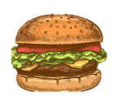
Listen and repeat.
A: I am excited to bring you to this restaurant!
B: Can you tell me what I should order from the menu?
A: Sure! You should try the soup and salad special. And we have to order the refried beans.
B: I read some reviews of this place. They said the food is fresh, the staff is polite, and the silverware is clean.
A: Yes, it’s a great place because you don’t have to spend a lot of money and the food is delicious!
Notes:
3. Conversation
1. Model: Say both parts of the conversation several times. Use A and B cards, stick figures, or change your physical position to indicate the dual parts. Role-play the parts to convey the meaning of the conversation. Students are to watch and listen.
2. Repeat: Say one line at a time and have students repeat until they can be understood.
3. Solo: You begin the conversation and call on individual students to respond. Then reverse the roles (students are A, you are B).
4. Once students can do both parts, encourage free conversation (students substitute their own words for the blue words).
12

Slide 13

The prefix re- means again, and dis- means not.
1. /rE/ ”again” | 2. /dis/ negative | 3. Challenge
repeat | dislike
redo | disappear
renew | dishonest
review | disorder
recite | discomfort
Should I repeat what you said?
I dislike cold winter days.
Notes:
4A. Pronunciation - Sound and Spelling
Note: The prefix “dis-” functions as the opposite of the original word. That is the purpose of adding “dis-”.
1. Model: Say the sound several times while pointing to it. (For example, point to the /rE/ and say /rE/ /rE/ /rE/. Then say the sound and quickly read the entire list, pointing to each item as you read it (/rE/ Repeat, Redo, Renew, Review, Recite). Students just watch and listen.
2. Repeat: Say the sound and each word several times, having students repeat each time after you in unison. Be sure to use your normal voice and rate of speed. Do one column at a time, top to bottom. Then read the sentences.
3. Solo: Call on individuals to say a sound and its word group. Give lots of praise. Then ask students to read the sentences.
4. Challenge: Choose another sound from the lesson that is challenging for your particular students to pronounce. Use words from Parts 1 and 2 of the lesson, and from previous lessons to make a group of 3-5 words. You may repeat the same challenging sounds in several lessons. Students need a lot of practice on sounds that do not exist in their first language.
13

Slide 14
Listen and repeat.
A. ₋ _ | B. _ ₋₋ | C. _ ₋
polite | restaurant | menu
dislike | generous | second
to drop | customers | order
to bring | manager | waiter
review | silverware | finish
Notes:
4B. Hum and clap the stress.
Begin by humming the stress of a column of words. Hum higher, longer, and louder for big dashes and lower, shorter, and quieter for small dashes.
You may use hand gestures to indicate that the stressed syllable is higher in pitch, longer in duration, and louder. Invite your students to join in humming the rhythm. Once the class is humming the rhythm in unison, you can begin saying the words. You may also wish to clap the syllables while you say the words.
1. Model: Hum and then say each word in the column several times. Students listen.
2. Repeat: Students repeat words after you in unison.
3. Solo: Call on individuals to read the entire column of words.
14

Slide 15
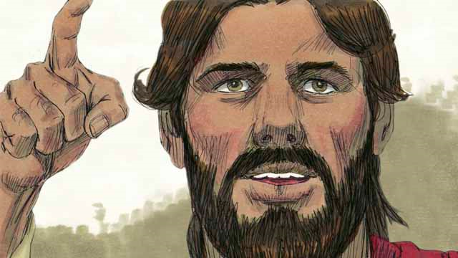
Read Matthew 26:14-56 in your own language. Then read the story of how Jesus was betrayed.
Every year, the Jews celebrated
the Passover. This was a celebration
of how God had saved their ancestors
from slavery in Egypt many centuries earlier. About three years after Jesus first began preaching and teaching publicly, Jesus told his disciples that he wanted to celebrate this Passover with them in Jerusalem, and that he would be killed there.
Notes:
5A. Bible Reading
Be sure students read this story in their first language before reading it in English. The hyperlinks of the Bible verses connect to https://live.bible.is/ so students can read and hear and watch videos of the scripture in their own languages.
A. Read the story out loud to the class.
B. If students ask about words, give simple definitions.
C. Encourage students to read aloud paragraphs from the story. Encourage students to act out the story.
D. Ask if there are any questions or comments about the story.
E. Ask the story questions and discuss as a group.
F. Optional - You may hide the words and ask students to tell the story again in their own words, using the pictures to help them.
15

Slide 16
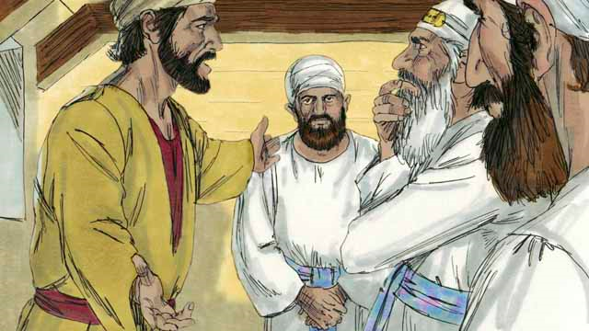
One of Jesus’ disciples was a man named Judas. Judas was in charge of the apostles’ money bag, but he often stole money out of the bag.
After Jesus and the disciples arrived in
Jerusalem, Judas went to the Jewish leaders. He offered
to betray Jesus in exchange for money. He knew that the Jewish leaders did not accept that Jesus was the Messiah. They wanted to kill him. The Jewish leaders, led by the high priest, paid Judas 30 silver coins to betray Jesus by handing him over to them. This happened just as the prophets said it would. Judas agreed, took the money, and went away. He began looking for a chance to help them arrest Jesus.
Notes:
5B. Bible Reading
A. Read the story out loud to the class.
B. If students ask about words, give simple definitions.
C. Encourage students to read aloud paragraphs from the story. Encourage them to act out the story.
16

Slide 17
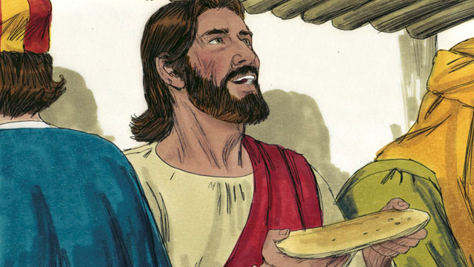
In Jerusalem, Jesus celebrated the Passover with his disciples. During the Passover meal, Jesus took some bread and broke it. He said, “Take and eat this. This is my body, which I will give for
you. Do this to remember me.”
In this way, Jesus said that he would die for them, that he would sacrifice his body for them.
Then Jesus picked up a cup of wine and said, “Drink this. It is my blood of the New Covenant that I will pour out so that God will forgive your sins. Do what I am doing now, to remember me every time you drink it.”
Notes:
5C. Bible Reading
A. Read the story out loud to the class.
B. If students ask about words, give simple definitions.
C. Encourage students to read aloud paragraphs from the story. Encourage them to act out the story.
17

Slide 18
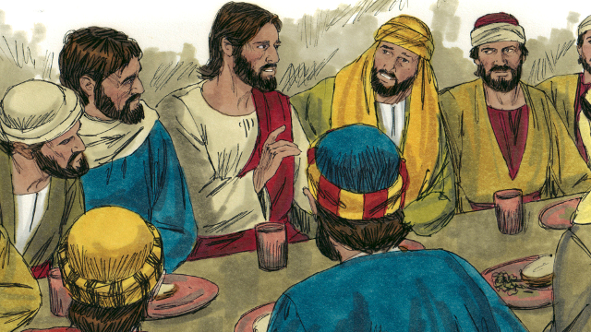
Then Jesus said to the disciples, “Believe me when I say that one of you will turn against me.” The disciples were shocked to hear this. Each one said, “Lord, surely I am not the one!”
Jesus said, “One who has dipped his bread in the same bowl with me will be the one to betray me. The Son of Man will leave this world, just as the Scriptures say.”
Then Judas said to Jesus, ”Teacher, I am not the one you are talking about, am I?”
Jesus answered, “Yes, it is you.”
Judas left and went to help the Jewish leaders arrest Jesus. It was night time.
Notes:
5D. Bible Reading
A. Read the story out loud to the class.
B. If students ask about words, give simple definitions.
C. Encourage students to read aloud paragraphs from the story. Encourage them to act out the story.
18

Slide 19
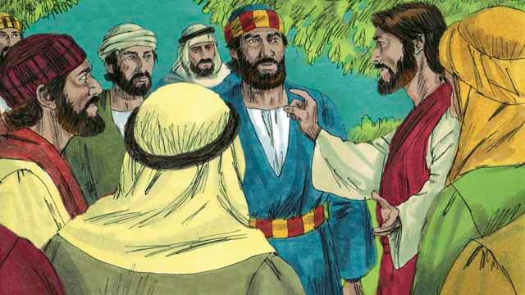
After the meal, Jesus and his disciples walked to the Mount of Olives. Jesus said, “You will all abandon me tonight. It is written, ‘I will strike the shepherd and all the sheep will be scattered.’ But
after I am killed, I will rise from death.”
Peter replied, “Even if all the others abandon you, I will not!” Then Jesus said to Peter, “Satan wants to test each of you, but I have prayed for you, Peter, that your faith will not fail completely! And when you come back to me, help your brothers to be stronger.” But Peter said to Jesus, “Lord, I am ready to go to go to jail with you. I will even die with you!”
Notes:
5E. Bible Reading
A. Read the story out loud to the class.
B. If students ask about words, give simple definitions.
C. Encourage students to read aloud paragraphs from the story. Encourage them to act out the story.
19

Slide 20
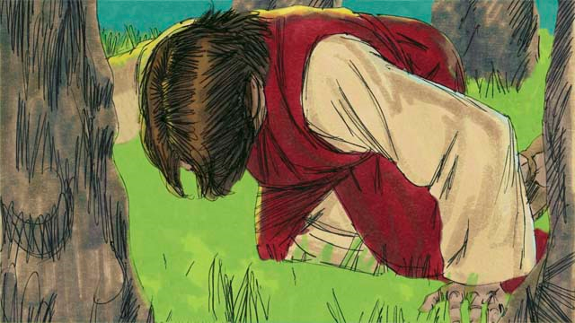
But Jesus said, “Peter, the truth is, tonight you will say you do not know me. You will deny me three times before the rooster crows.” Then Jesus went with his disciples to a place called Gethsemane.
Jesus told his disciples to pray that they would not enter into temptation. Then Jesus went to pray by himself. He prayed three times, “My Father, if it is possible, please let me not have to drink this cup of suffering. But if there is no other way for people’s sins to be forgiven, then let your will be done.” Jesus was very troubled and his sweat was like drops of blood. God sent an angel to strengthen him.
Notes:
5F. Bible Reading
A. Read the story out loud to the class.
B. If students ask about words, give simple definitions.
C. Encourage students to read aloud paragraphs from the story. Encourage them to act out the story.
20

Slide 21
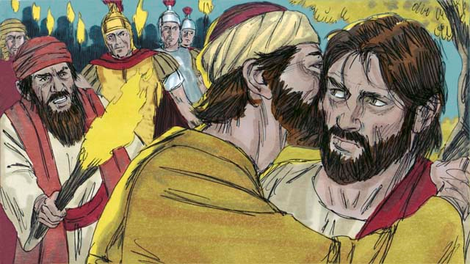
After each time of prayer, Jesus came
back to his disciples, but they were asleep. When he returned the third time, Jesus said, “The time has come for the Son of Man to be handed over to the control of sinful men. Wake up! We
must go. Here comes the one who will hand me over.”
Judas came with the Jewish leaders, soldiers, and a large crowd. They were carrying swords and clubs. Judas came to Jesus and said, “Greetings, Teacher,” and kissed him. He did this to show the Jewish leaders the man to arrest.
Then Jesus said, “Judas, are you betraying me with a kiss?”
Notes:
5G. Bible Reading
A. Read the story out loud to the class.
B. If students ask about words, give simple definitions.
C. Encourage students to read aloud paragraphs from the story. Encourage them to act out the story.
21

Slide 22
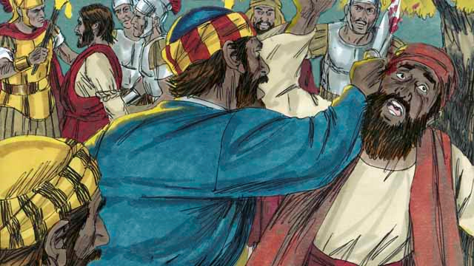
Then the men came and grabbed Jesus and arrested him. As the soldiers grabbed Jesus, Peter pulled out his sword and cut off the ear of a servant of the high priest. But Jesus said, “Put the sword away! I could
ask my Father for an army of angels to defend me, but I must obey my Father.” Jesus healed the man’s ear.
Then Jesus said to the crowd, “I sat in the Temple area teaching every day. Why didn’t you arrest me there? But all these things have happened to show the full meaning of what the prophets wrote.”
Then all the disciples left him and ran away.
Notes:
5H. Bible Reading
A. Read the story out loud to the class.
B. If students ask about words, give simple definitions.
C. Encourage students to read aloud paragraphs from the story. Encourage them to act out the story.
22

Slide 23

Answer the questions.
What is the Passover?
Who was in charge of the apostles’ money bag?
Why did Jesus give bread and wine to them?
Why did Judas betray Jesus?
How has someone betrayed you? How have you betrayed someone?
Do you believe Jesus has broken any promises to you? Why or why not?
Notes:
5I. Bible Reading Questions
Ask the questions and discuss as a group. For questions 1-4 you may go back to the story to help students find the answer.
Answers:
1. A celebration of how God saved the ancestors from the Israelites from slavery in Egypt many centuries earlier.
2. Judas was in charge of the money bag.
3. As symbols to help them remember his body and blood that he sacrificed for our sins
4. He wanted money.
5. and 6. Answers will vary.
23

Slide 24
Listen and answer the questions.
What did the directors of the school do?
What is the principal’s name?
What was the misbehavior of the students in how they treated the teachers?
How did the principal react to this?
How did the students leave the science labs?
What is the plan to correct the problem?
Notes:
6A. Activities – Listening with sound/spelling words /rE/ and /dis/
Read the following script at least twice as students listen and write their answers to the questions. Students may NOT look at the script.
Hello everyone! I am your school principal, Mr. Rework. I will be your principal again next year because the directors of the school reviewed my work and decided to renew my contract. I am excited to work with all of you to make this school a better place.
First of all, I want to explain some changes that need to be made. This past year, various incidents happened in this school that created problems. One of the common misbehaviors was students being dishonest to the teachers. I dislike the disrespect that this behavior shows. This school expects students to tell the truth. Students who break the honesty rule will stay after school. Another problem that must be addressed is proper treatment of the science labs. The science labs are school property and are not to be left in disorder when class is finished. Also, some of the equipment disappeared. We plan to revise the rules for using the labs to correct the problem. From now on, you must sign your name and put the time that you entered and left the lab and stop all lab activities five minutes early to allow for clean-up. Let’s keep this school a healthy and safe place for learning and growing as a community. Thank you.
Answers:
1. They reviewed the principal’s work and renewed his contract. 2. The principal’s name is Mr. Rework. 3. The students were dishonest. 4. He strongly disliked their behavior. 5. The science labs were left in disorder. 6. They plan to revise the rules for using the lab and make students write down their names when they enter.
24

Slide 25
Role Play – Job Interview - Boss
Questions | Answers
1. Tell me about yourself.
2. Which position are you applying for?
3. Why do you want to work here?
4. What is your educational level?
5. What should you do if you drop food on the floor?
6. Can you set up plates and silverware in 45 seconds?
7. How do you treat impolite customers?
8. Do you have any questions?
Notes:
6B. Activities – Pair work
Partner A will play the part of a boss interviewing a job applicant. Partner A will ask questions from this slide and write Partner B’s answers.
Check answers for correct grammar and punctuation.
25

Slide 26
Role Play – Job Interview - Applicant
Questions | Answers
1. What job openings are available?
2. How many hours could I work?
3. Should I wear a uniform or something else?
4. What time must I arrive at work?
5. How late must I work on weekends?
6. When should I call the manager if I have a problem?
7. How much is the pay?
Notes:
6C. Activities – Pair work
Partner B will play the part of an applicant interviewing for a job. Partner B will ask questions from this slide and write Partner A’s answers.
Check answers for correct grammar and punctuation.
26

Slide 27

Song: Beautiful Savior
1. Beautiful Savior, King of Creation, Son of God and Son of Man! Truly I love you, truly I serve you, Light of my soul, my joy, my crown.
2. Meadows are lovely, forests are lovely, dressed in the flowers that bloom in spring;
Jesus is better, Jesus is purer, Jesus can make our sad hearts sing.
3. Sunlight shines so bright, moonlight gleams at night, stars up above sparkle and they shine;
Jesus shines brighter, Jesus shines purer than all the angels in the sky.
Notes:
7. Songs
Students will learn the new song for the lesson and may also request to sing favorite songs from previous lessons, if time permits.
1. Model: Read the song lyrics out loud to the class. Note the names of Jesus: Beautiful Savior, King of Creation, Son of God, Son of Man. Ask if there are any questions. Write words that students ask about on the board and give simple definitions. Then sing it two or three times, as the students just listen.
2. Repeat: Sing the selection again, a line or sentence at a time, as students repeat after you. Then play the recording and sing the song together as a class in unison.
3. Solo: The student sings solo (or if shy, can just read the words aloud).

Slide 28
1A. Homework: Write about the pictures using ‘have to’, ‘should’, and ‘must’ with questions ? or answers A.
1. ? | Should we look at the menu before we order our food? | 4. A
2. A |  | 5. ?
3. ? |  | 6. A
Notes:
Homework 1A. - Write sentences using the pictured vocabulary words.
Model. Go over each of the homework assignments to be sure the student understands what to do.
Repeat. Encourage students to practice speaking and reading the completed homework assignments with a friend. They may use a bilingual dictionary.
Solo. Students will share their homework when they are finished. After they have shared their homework, be sure to check it for correctness, including spelling. Explain mistakes, while providing praise and encouragement. Answers will vary.
Number one is an example.
Answers may vary, but will start with a capital letter, have the correct verb form and punctuation mark, and use the following words:
2. manager 3. tip 4. second 5. review 6. silverware
28

Slide 29
1B. Write about the pictures using ‘have to’, ‘should’, and ‘must’ with questions ? or answers A.
7. A. |  | 10. ?
8. ? |  | 11. A
9. A |  | 12. ?
Notes:
Homework 1B. - Write sentences using the pictured vocabulary words.
Students will write a sentence for each picture to practice the lesson’s vocabulary words.
Answers may vary, but will start with a capital letter, have a punctuation mark at the end, and use the following words:
7. to bring
8. to pass
9. to drop
10. to bite
11. polite
12. impolite
29

Slide 30
2. Fill in the blanks with the correct verb forms.
interview
drop
bite
bring
pass
serve
order
finish
quit
ask
Did the boss have to _____ you for the new job yet?
My friend must _______ the papaya salad from the menu.
My co-worker always ______ plates on the floor.
Shouldn’t you ______ your homework before class?
I think I have to _____ my job because it is too hard.
Please ____ me the salt. The potatoes are very bland.
Must she______ the food so quickly? She might spill it.
Notes:
Homework 2. – Grammar and Vocabulary Review
Learners must use the correct form of the verbs with or without S endings to complete the sentences.
Answers may vary but should use the correct verb form.
A. Did the boss have to interview you for the new job yet?
B. My friend must order the papaya salad from the menu.
C. My co-worker always drops plates on the floor.
D. Shouldn’t you finish your homework before class?
E. I think I have to quit my job because it is too hard.
F. Please pass/bring me the salt. The potatoes are very bland.
G. Must she serve/bring/pass the food so quickly? She might spill it.
30

Slide 31
3. Write questions and ask a partner.
Questions | Answers
1. Do I have to wear nice clothes at that restaurant? | Yes, you should dress up. It is a fancy place.
2. Should I bring _____
3. _____ pass _____
4. _____ server ______
5. _____ have to _____
6. _____ reviews ______
7. _____ menu ______
Notes:
Homework 3. – Conversations - Pair work
First, students complete writing the questions with their own words. Then ask students to interview a partner, and write their partner’s answers. Then they will switch roles and answer their partner’s questions.
Check answers for correct grammar and punctuation.
Number 1 is an example.
Questions and answers will vary, but may include:
2. Should I bring that trash can to you?
3. Shouldn’t you pass the homework to the teacher?
4. Have you seen that server who does a very good job?
5. Do you have to give a tip to the waiter?
6. Should you be careful about what kind of reviews you are writing?
7. Has anyone got a menu for me?
31

Slide 32
4. Write and say sentences using the words in the box.
repeat dislike review redo disappear dishonest recite
A. Can you repeat that please? I am confused.
B.
C.
D.
E.
F.
G.
Notes:
Homework 4. – Write and say sentences with the new sounds.
This homework practices writing, spelling, and pronouncing the /rE/ and /dis/ sounds.
Answers will vary but should include the following words and be used and pronounced correctly.
B. Do you dislike the food?
C. May I see that book review?
D. Do I need to redo my homework?
E. Can soap make this spot disappear?
F. Are you being dishonest with me?
G. Could you recite this verse for me?
©2020-2025 Light of the World Learning
32

Slide 33
5A. Discuss the Bible story with your partner.
What was your favorite part of the Bible story?
Which person did you relate to in the story and why?
What was confusing about the story?
What did you learn from the story?
How do you think it applies to your life?
What are two questions you have about the story?
A.
B.
Notes:
Homework 5A. – Bible Reading Review
Ask the students to tell the Bible story to a partner and then interview the partner, and write their partner’s answers. Then they will switch roles and answer their partner’s questions.
Check answers for correct grammar and punctuation.
Answers will vary.
33

Slide 34
5B. Summarize the Bible lesson using your own words.
Jesus’ disciples ate a Passover meal with him.
But Jesus__________________________________________
So Judas ________________________________________
But Peter _________________________________________
Then Jesus ________________________________________ Then_____________________________________________
_________________________________________________
Notes:
Homework 5. – Bible Reading Review
Students may look back at the story to write their answers.
Answers will vary but may include:
Jesus’ disciples were having a Passover meal with him. But Jesus told them one of his disciples would betray him. So Judas left and helped the Jewish leaders to arrest him. But Peter told Jesus he would not abandon him. Then Jesus prayed to his father for mercy on him. Then the soldiers found Jesus and arrested him. Then all the disciples ran away.
34

Slide 35
6A. Homework – Choose one Verse to Memorize.
A
I want you to know, I will not drink this wine again until that day when we are together in my Father’s kingdom and the wine is new. Then I will drink it again with you. Matthew 26:29 ERV
Don’t worry—I am with you. Don’t be afraid—I am your God. I will make you strong and help you. I will support you with my right hand that brings victory. Isaiah 41:10 ERV
B
Notes:
Homework 6A. – Memorize a Verse
Learners get to choose A, B, or C (on the next slide) to memorize. Please notice that the memory work is not long. Everyone, regardless of skill level, should be able to do it.
1. Model. Recite a verse from memory.
2. Repeat. Encourage students to find someone with whom to practice conversing and reading the completed homework assignment.
3. Solo. Students will recite the verse from memory at the next class.
35

Slide 36
6B. Homework – Choose one verse to memorize and read the next verses.
So they grow strong, like a tree planted by a stream—a tree that produces fruit when it should and has leaves that never fall. Everything they do is successful. Psalm 1:3 ERV
Read the next lesson’s Bible verses: Matthew 26:57-27:26; Matthew 27:27-61
C
Notes:
Homework 6B. – Memorize a verse and read the next lesson’s verses.
Learners get to choose A, B, or C to memorize.
Students will always read the Bible lesson in their first language (L1) before reading it in English the following lesson. Help them get a Bible in their own language if they don’t have one. They may also use Bible.IS or other Bible translation resources.
36

Slide 37
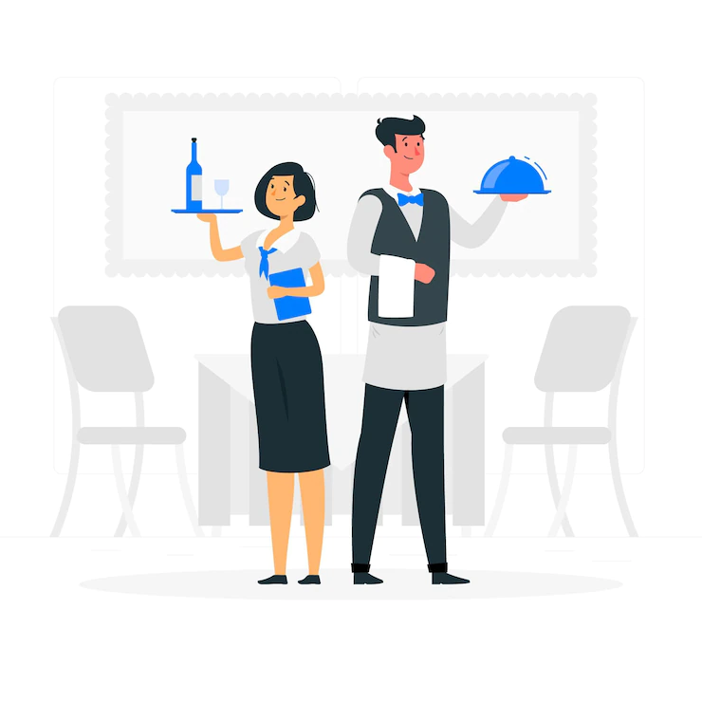
7A. Read and answer the questions
Welcome to the Pac’s Kitchen restaurant! We are so happy that you are working with us today. There are some things we want to teach you before you start. First, you must wear a uniform at all times during your shift. Our restaurant dress code is a white dress shirt and black pants. Since you will be a waiter, you must memorize all the menu items, so that you know how to take orders from customers. You should ask for advice from your manager whenever you need help or are not sure about anything in the kitchen. We cannot tolerate people who assume things without consulting us first.
Some of the basic things you should know without asking us are: Wash your hands before you work, do not yell during your shift. One last thing: you must follow the rules at all times, unless there is an emergency.
Notes:
Homework 7A. – Everyday Reading and Writing
The learners will read restaurant training procedures and answer the questions on the next slide.
37

Slide 38
7B. Answer the questions
A. What is the restaurant’s name?
B. What does the worker have to wear during shifts?
C. What is the restaurant’s dress code?
D. What should the worker do when unsure about something?
E. What are the basic things to do?
F. What rules do you find difficult to follow at work or school? Why?
Notes:
Homework 7B. – Everyday Reading and Writing
The learners will read the restaurant training procedures and answer the questions.
Answers:
A. The name of the restaurant is Pac’s Kitchen.
B. The workers must wear a uniform.
C. The dress code is a white dress shirt and black pants.
D. When you are unsure about something, you should ask for advice.
E. The basic things to do are: wash your hands, do not yell.
F. Answers may vary.
38

Slide 39
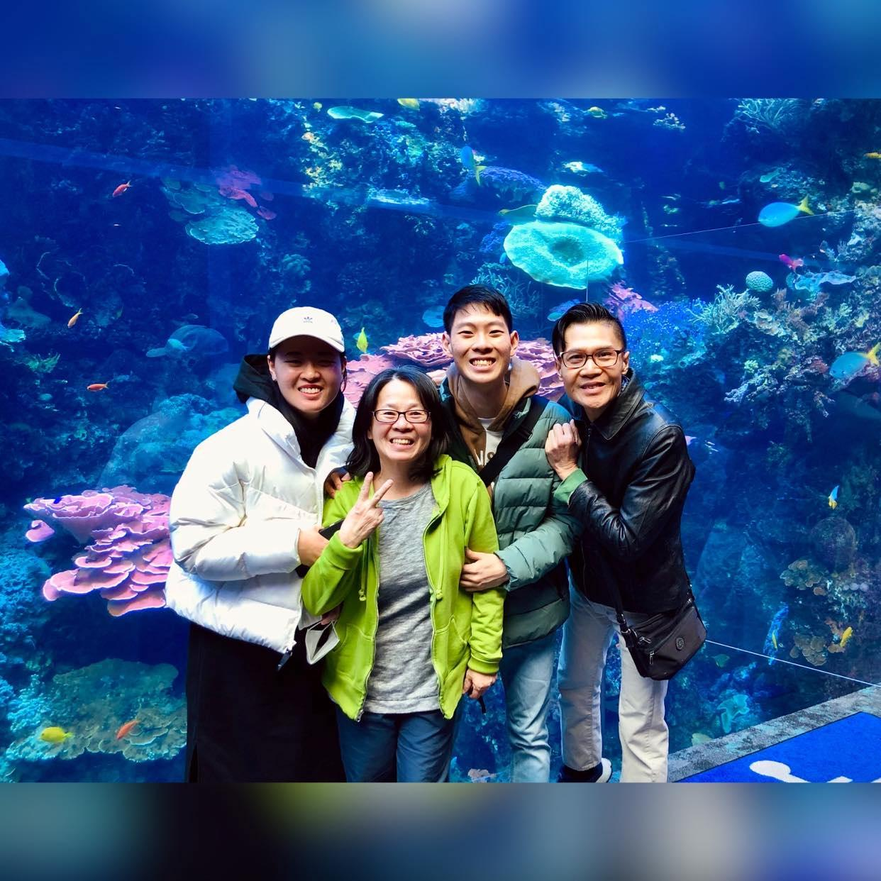
8. Writing
Write a letter asking a friend advice about what you should do and where you should go when you visit a city.
Notes:
Homework 8. – Writing
Model. Write something giving examples of asking advice. For example: Dear Sue, I will visit Chicago next month for 3 days. Should I visit the aquarium or the zoo? Do I have to bring a coat, or is the weather warm? Do you think I should see the Bean sculpture and the fountains? Where should I eat? Do we have to take expensive taxis or should we ride the bus? I appreciate your advice!
Answers will vary.
39

Slide 40
9. Homework – Now I Can….
I can talk about restaurants and serving food and have a polite conversation.
I can use the new words, including _____, _____, _____, _____, _____, _____, _____, _____, _____, _____, _____, and _____.
I can use the obligation verbs have to, should and must.
I can understand how Jesus was betrayed.
Notes:
Homework 9. – I can statements
The student must be able to achieve all of these skills before the next lesson. If not, the lesson can be repeated or additional practice materials can be used.
Review all of the skills at the beginning of the next lesson. Be sure to give lots of praise and encouragement!
40

Slide 41
Reflections and Closing Prayer
Notes:
Reflections and Closing Prayer
You may want to thank the Lord for what we have learned, ask for special prayer requests, then pray for your students and bless them. Students may write reflections and their prayers here.
41

Slide 42

Help us share the Light of the World!
Thank you for using our materials. If these lessons are a blessing to you, please give or volunteer to help others learn English through the Bible.
For more information, visit LightOfTheWorldLearning.org
Notes:
42

Slide 43
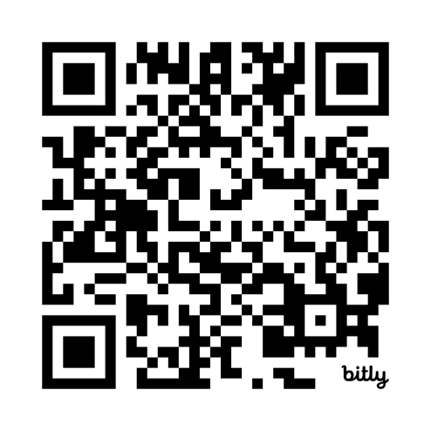
Appendix
How to Use Lessons: bit.ly/UseLOTW
Irregular Verb List: bit.ly/ListVerbs
Lesson Downloads: LightOfTheWorldLearning.org
Order Books: bit.ly/BooksLOTW
Share Your Feedback: bit.ly/FeedbackLOTW
Table of Contents: bit.ly/TocLOTW
Video Channel: youtube.com/@LightOfTheWorldLearning
Vocabulary List: bit.ly/VocabUS
Website: LightOfTheWorldLearning.org
Notes:
43

Slide 44
Acknowledgements
We would like to thank the entire Light of the World volunteer team for their hard work and creativity in making this project possible. For all those around the world who prayed, wrote, edited, narrated, illustrated, sang, tested, and gave generously for this curriculum, we appreciate you sharing the love of Jesus through the gift of English. Our team members include:
Anonymous | Emily Cox | Jill Gramzow | Martha Lane
Jean Ato | Marilyn Dano | Tanya Griffin | Audrey Larsen
Bradley Baurain | Hephzi Davidson | Rachel Grijincu | Aden Lewis
Ana Biederman | Susanna Diallo | Lauren Haines | Bruce Lewis
Bob Biederman | Alyssa Dokolas | Carol Hale | Elena Lewis
Joshua Blake | EasyReadEnglish.com | Emily Hamilton | James Lewis
Rachael Braggs | Don Edic | Patty Hickman | Micah Beth Lewis
Hannah Brendel | Peggy Fergus | Juliette Hyer | Tim Lewis
Larry Buell | MaryBeth Gahan | Lyudmila Ivanyuk | Ward Lewis
Cindy Campbell | Melina Gallo | Debbie Johnson | Cosette Lindsay
Christian Cha | Alicia Gentile | Carey Jo Johnston | Johnny Lukashevich
Olivia Cheney | Prakash Chandra Giri | Nancy Kingdon | Gail MacMillan
Hannah Clark | Ellenor Gopal | Dorothy Konadu | Ivan Mader
Nancy Cobb | Henrietta Grajcar | Macy Lake | Amy Martin
(continued on the next slide)
Notes:
44

Slide 45
Acknowledgements - Continued
Diana Martz | Joan Phelps | Lorna Tatomir
Hannah McMahan | Megan Rahn | Darrell Turner
Christy McPherson | Sara Scazzero | Leigha Wachter
Tracy Meddaugh | Hannah Schmokel | Joseph Waite
Barbara Newsome | Ashlyn Shrimplin | Graham Whitmore
Brenda Nielsen | Leah Sprague | Cheri Wilke
Danielle Nowe | Noah Staal | Mackenzie Williams
Deborah O’Donnell | Macie Stuckman | Allison Wright
Evelyn Ocasio | Jia Le Su | Tiffany Yeh
Georg Ort | Carole Svensson | Muchun Yin
Martha Ort | Ellie Talalight | Ted York
Barb Park | Peter Talalight | Tai Lee Young
Deb Payne | Weston Talalight | Abigail Zawisza
Linda Petrie | Rachel Tamang | Anita Zeifert
Bible story and pictures on slides 15-22 adapted from the original work by unfoldingWord available from https://openbiblestories.org
Bible Verses on slides 35-36 Taken from the HOLY BIBLE: EASY-TO-READ VERSION ©2014 by Bible League International. Used by permission.
Notes:
45

