Slide 1



Unit A2-42
Review Unit A2-42
©2020-2025 Light of the World Learning
Notes:
Teacher’s Notes: Review of A2 Lessons 36-41
Visit LightOfTheWorldLearning.org for more resources.
Bible Readings:
Jesus Heals a Demon-Possessed Man and a Sick Woman, Jesus Teaches with Stories, The Compassionate Father, The Transfiguration, Jesus Raises Lazarus from the Dead, Jesus is Betrayed
Themes:
Entertainment/Pastimes, Natural World, Giving Directions and Following Instructions, Comparing and Contrasting, Writing, Restaurant
Grammar:
Would like/wouldn't like; Irregular verbs; Similes with “like" and "as...as“; Prepositions of Motion, Directions; Comparatives and Superlatives; Present continuous vs. present simple; Should, Must, and Have to
Preparation:
Pray. Preview slides and game.
Optional: Bring objects and pictures related to the lessons.
©2020-2025 Light of the World Learning

Slide 2
Pray, Review, and Preview
Bible Readings:
Jesus Heals a Demon-Possessed Man and a Sick Woman
Jesus Teaches with Stories
The Compassionate Father
The Transfiguration
Jesus Raises Lazarus from the Dead
Jesus is Betrayed
Themes:
Entertainment/Pastimes
Natural World
Giving Directions and Following Instructions
Comparing and Contrasting
Writing
Restaurant
©2020-2025 Light of the World Learning
Notes:
Pray
Pray for the class. You may want to thank the Lord for the opportunity to learn.
Check Homework and Review
Ask each student to read aloud or recite their homework from the last class. Check written work.
Review the main points of the previous lesson and ask if there are any questions.
©2021-2025 Light of the World Learning

Slide 3
Preview
Pronunciation:
/E/ Spelled Open e, /I/ Spelled Open i
/O/ Spelled Open o and /z/
/z/ /s/ /iz/ Spelled Final s
/est/ and /un/
/mis/ and /ex/
/rE/ and /dis/
Grammar:
Would/Wouldn’t Like; Irregular Verbs
Similes with “Like" and ”As...As"
Prepositions of Motion, Directions
Comparatives and Superlatives
Present Continuous vs. Present Simple
Should, Must, and Have to
©2020-2025 Light of the World Learning
Notes:
These are the sounds, spellings and grammar points that will be reviewed in this lesson.
©2021-2025 Light of the World Learning

Slide 4

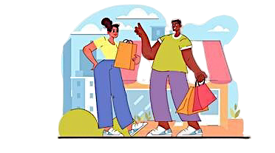
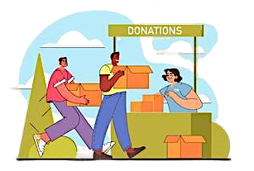
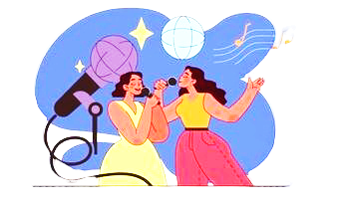
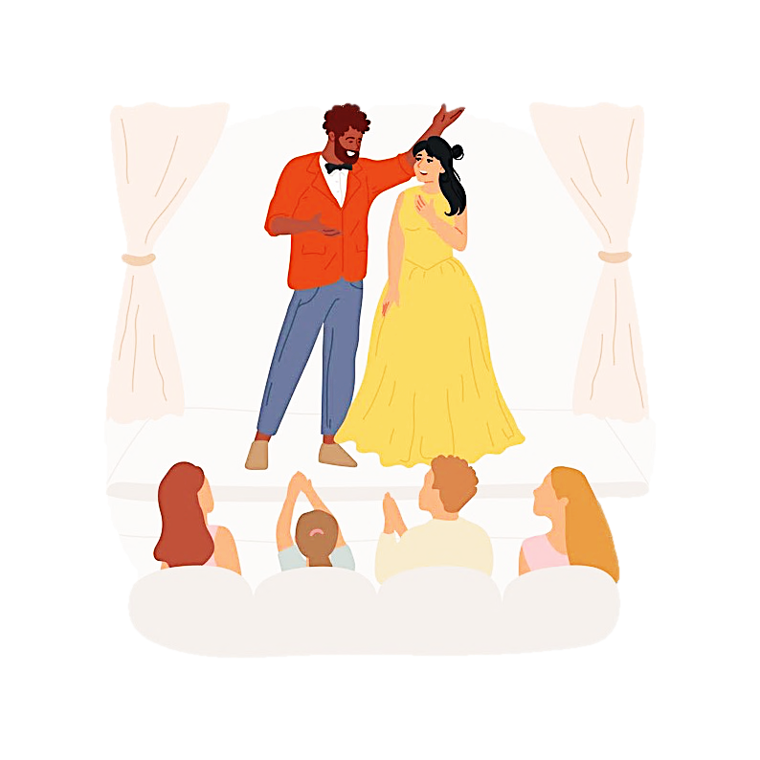
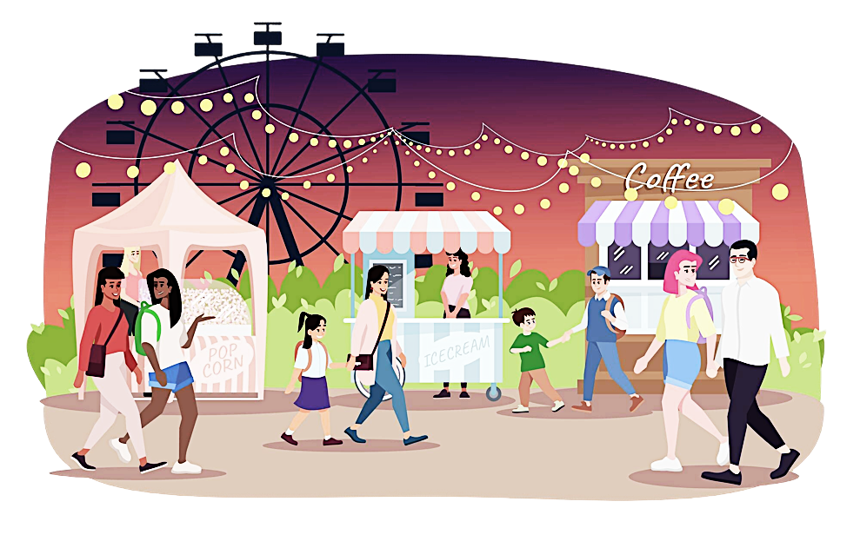
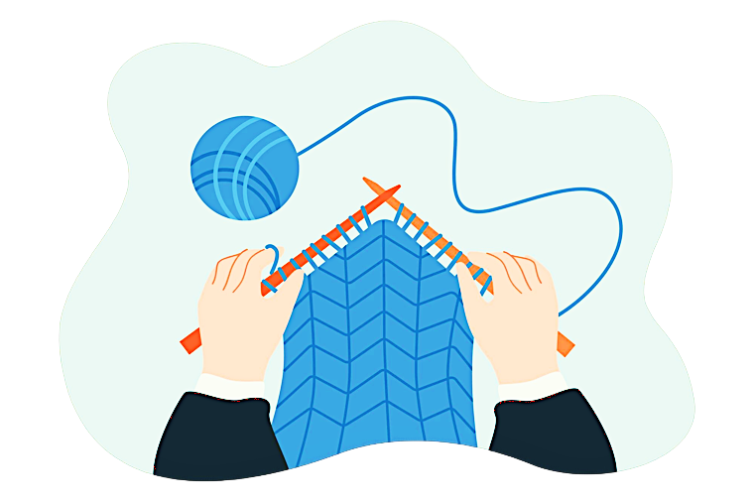
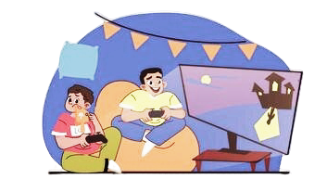
What do you see?
Notes:
1A. Discuss Theme Picture
Ask “What do you see in this picture?” and “What else?” to elicit vocabulary they already know.
Repeat and write their words or show the words on the next slide.
Answers may include: downtown, a mall, a shopping center, volunteering, a club, a concert, a play, a theater, a fair, video games, knitting.
More advanced students can be encouraged to make complete sentences:
People are enjoying entertainment and pastimes.

Slide 5
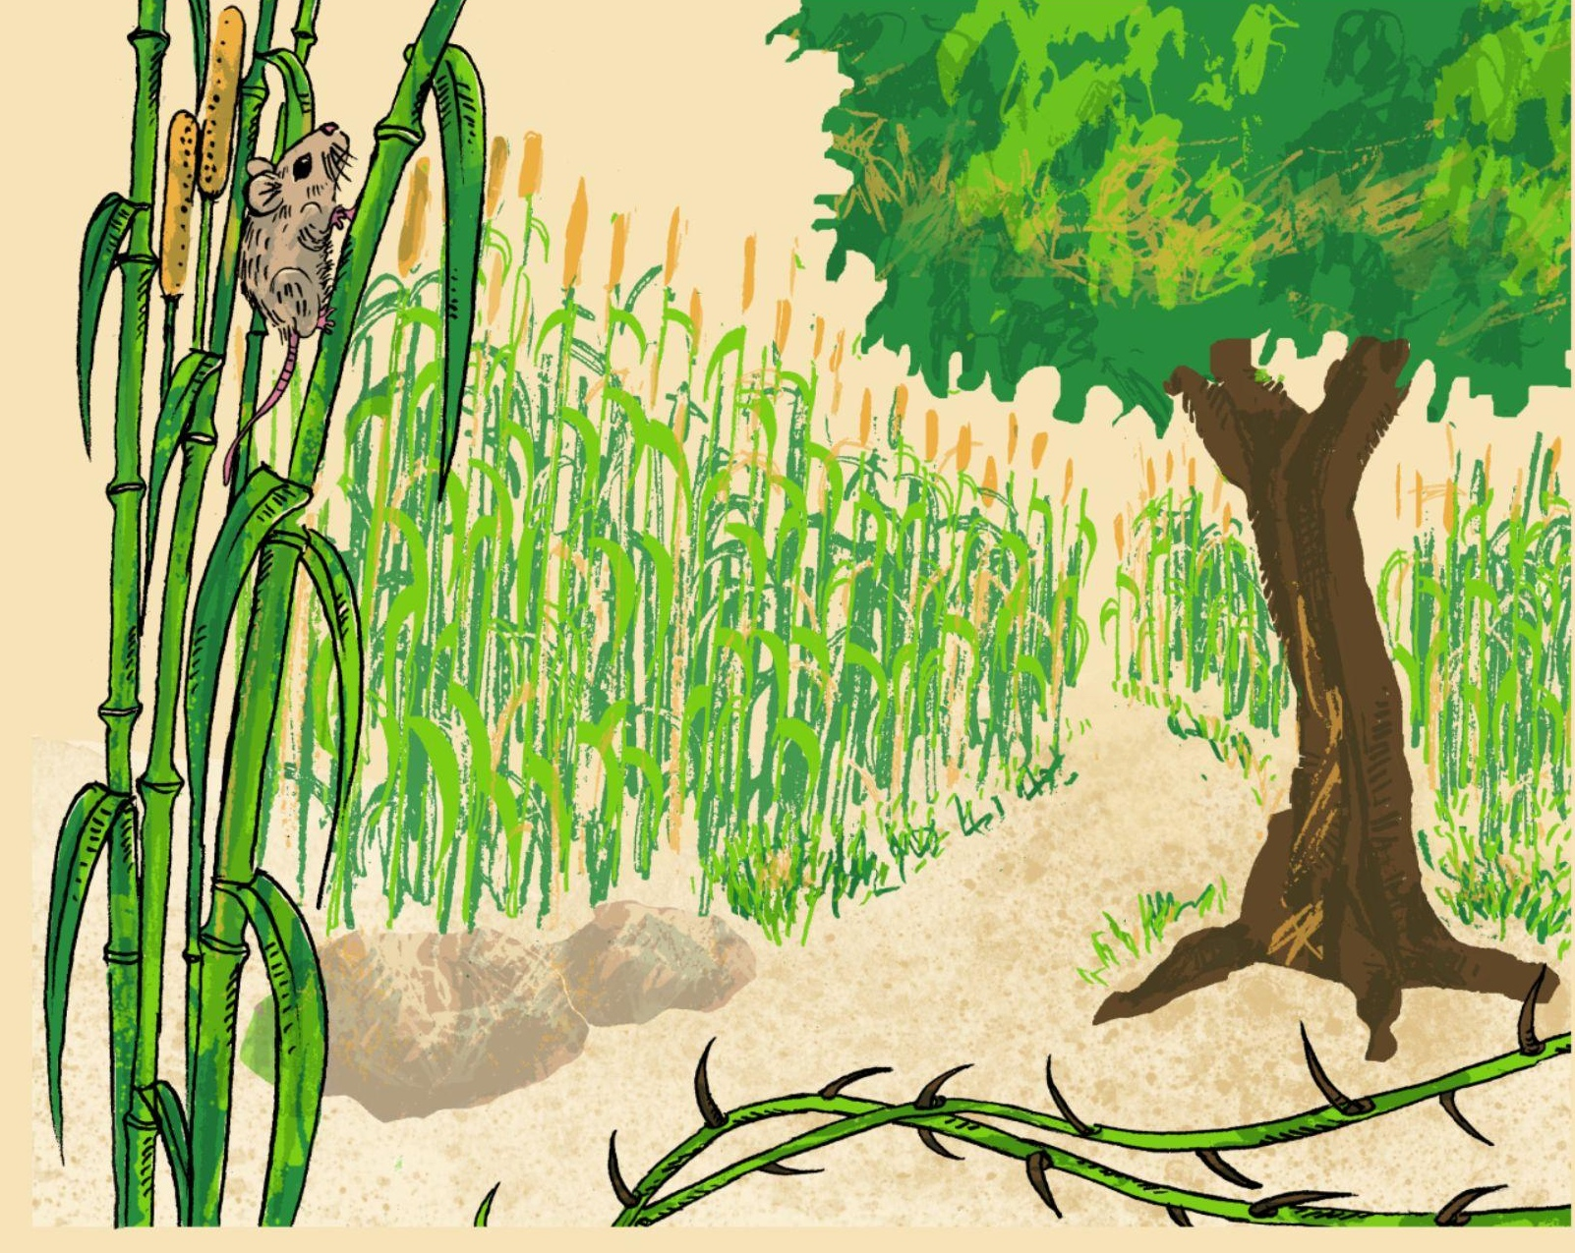
What do you see?
Notes:
1B. Discuss Theme Picture
Ask “What do you see in this picture?” and “What else?” to elicit vocabulary they already know.
Repeat and write their words or show the words on the next slide.
Answers may include path, grass, mouse, grain, roots, thorns, soil, etc.
More advanced students can be encouraged to make complete sentences:
There is a path through a beautiful island. The grain is growing. There are rocks and thorns on the ground.

Slide 6
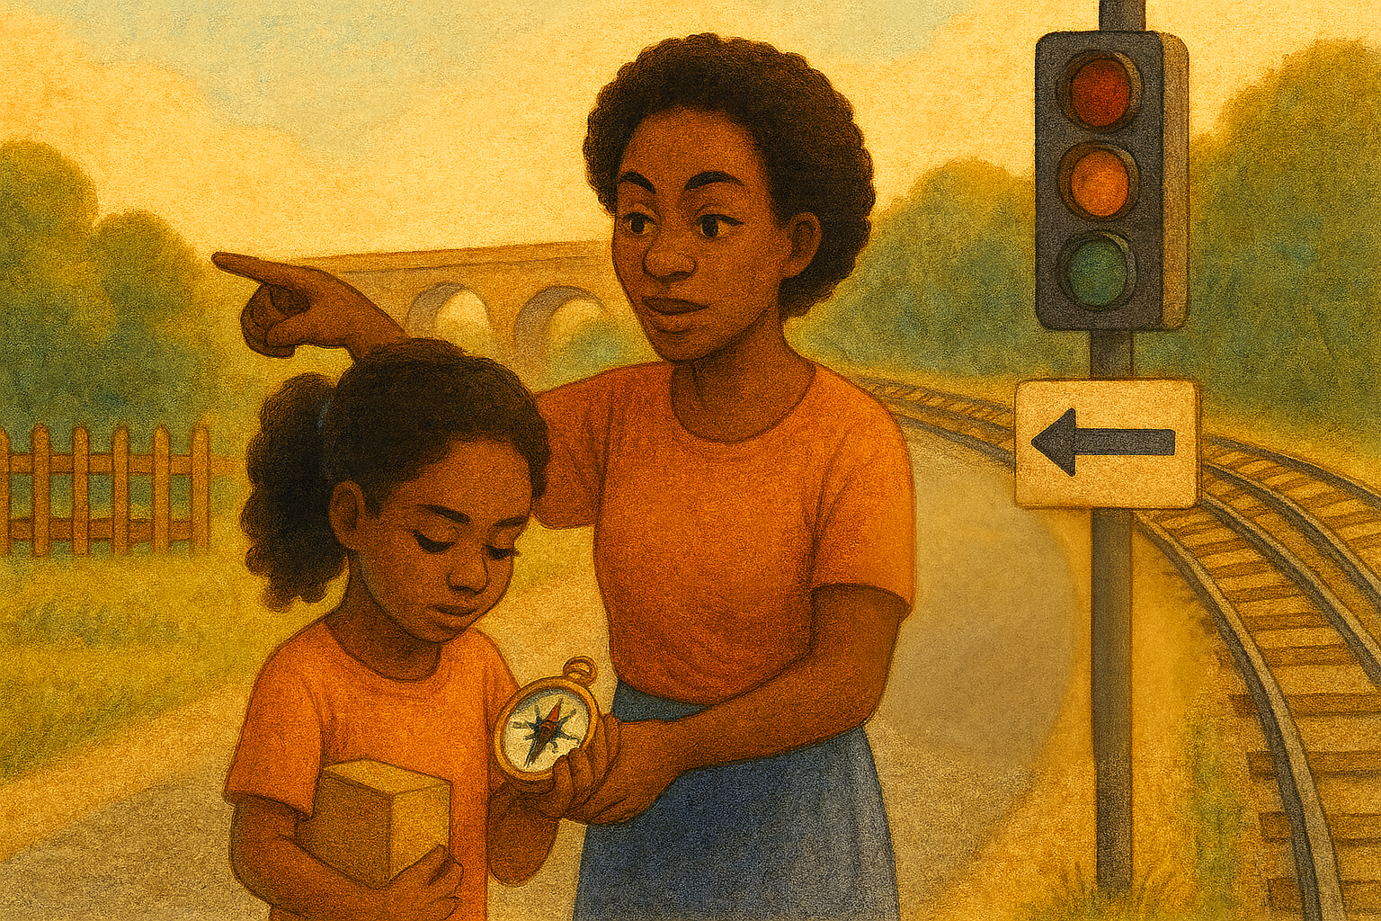
What do you see?
Notes:
1C. Discuss Theme Picture
Ask “What do you see on the street?” and “What else is close to it?” to elicit vocabulary they already know.
Repeat and write their words or show the words on the next slide.
Answers may include: sign, yard, bridge, traffic light, point, compass, directions, etc.
More advanced students can be encouraged to make complete sentences like:
I see train tracks, a traffic light, and a sign. The woman is pointing and the girl is holding a compass.

Slide 7
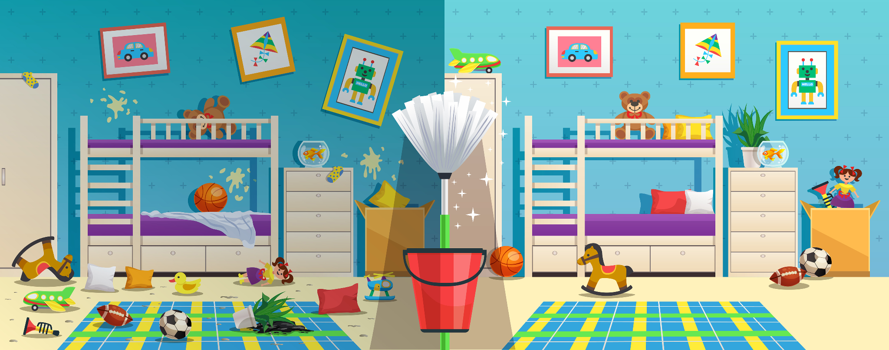

What do you see?
Notes:
1D. Discuss Theme Picture
Ask “What do you see in this picture?” and “What else?” to elicit vocabulary they already know.
Repeat and write their words or show the words on the next slide.
Answers may include: messy, clean, fresh, cheap, expensive, tame, bed, etc.
More advanced students can be encouraged to make complete sentences:
One side is messy. One side is neat. The toys are cheap. The mop is fresh.

Slide 8

What do you see?
X
.
?
!
8
Notes:
1E. Discuss Theme Picture
Ask “What do you see in this picture?” and “What else?” to elicit vocabulary they already know.
Repeat and write their words or show the words on the next slide.
Answers may include: check, proofread, sentence, exclamation mark, question mark, period, etc.
More advanced students can be encouraged to make complete sentence. For example:
Proofread your document to check for mistakes.
Have you read over each sentence?
Check each sentence for correct use of periods, exclamation marks, and question marks.

Slide 9
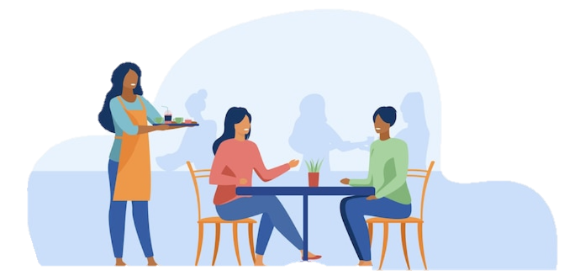






What do you see?
Oops, I’m sorry.
It’s no problem. Thanks for serving us!
Notes:
1F. Discuss Theme Picture
Ask “What do you see in this picture?” and “What else?” to elicit vocabulary they already know.
Repeat and write their words or show the words on the next slide.
Answers may include: restaurant, server, waitress, customers, apron, food, table, chair, drop, silverware, menu, etc.
More advanced students can be encouraged to make complete sentences:
The customers are talking. The waitress drops the silverware. The customers sit at the chairs.
9

Slide 10
We use would like to offer something or to tell what we want. The contractions are ’d like or wouldn’t like.
 | Question | Positive + | Negative -
1 | Would you like to learn how to knit? | Yes, I would like to learn. Please teach me! | No, I would not like to learn.
2 | Where would you like to go tomorrow?
3 |  | Yes, she’d love to write about it.
4 |  |  | No, he wouldn’t like to volunteer.
5 | What would you like to see tonight?
Notes:
2A. Grammar – Would like
Spoken English usually uses the contraction forms. Written English usually uses the full forms.
Model, Repeat and Solo the pronunciation of row 1. Then have students complete the chart by asking and answering questions with would.
Answers will vary, but may include:
2. I’d like to go to the state fair tomorrow. I wouldn’t like to go downtown.
3. Would she like to write a blog about her mission experience? No, she would not like to write about it.
4. Would Tim like to volunteer to teach English. Yes, he would.
5. We would love to see a play. We wouldn’t like to see a concert.

Slide 11
Practice Irregular Verbs
 | Base form | Simple past | Tell what you would or wouldn’t like to do next week and what you did last week.
6 | tell | told | I’d like to tell my mom “I love you” next week. I also told her last week.
7 | think | thought
8 | understand | understood
9 | wear | wore
10 | write | wrote
Notes:
2B. Grammar - Irregular simple past verbs
Note: Irregular verbs do not form the simple past tense by adding -ed to the end. There is no pattern to how to form irregular simple past tense verbs. They just need to be memorized
Model, repeat, and solo row 6, then ask students to complete 7-10 with the base and past form of the verbs provided and using forms of would and wouldn’t like.
Answers may vary but should include correct forms of would and the verbs provided.

Slide 12
Similes with “As…As”
 | Subject + Verb | + As + Adjective + As | Noun
1 | He sounds | as quiet as | a mouse.
2 | You are | as gentle as
3 | It feels |  | a feather.
4 |  | as wise as | King Solomon.
5
6
7
Notes:
2C. Grammar – Similes with “as…as”
Note: We use similes to compare two things that have a similar trait. This figurative language helps people understand and use their senses to communicate.
We use “as…as” similes to compare two things that have a similar trait.
Model, Repeat, and Solo the pronunciation of 1. Then ask students to create their own similes for 2-7. Answers will vary, but include “as…as” structure.

Slide 13
Similes with “Like”
 | Subject + Verb | + Like | Noun
1 | The kingdom of heaven is | like | a mustard seed.
2 |  | like | a treasure.
3 | Pleasant words are
4 |  |  | a lion.
5
6
7
Notes:
2D. Grammar – Similes with Like
Note: We use “like” similes to compare two things that have a similar trait. These techniques are also useful for language learners to describe unknown words. This helps us communicate effectively.
Model, Repeat, and Solo the pronunciation of 1. Then ask students to create their own similes for 2-7. Answers will vary.

Slide 14



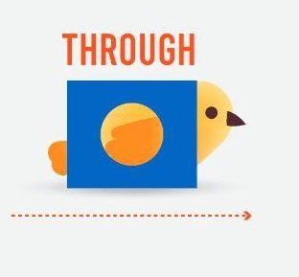
 | First | Next | Then | Finally
1 | First, I go over the bridge. | Next, I go around the corner. | Then, I turn right at the stop sign. | Finally, I arrive at Grandma’s yard.
2
3 | First, I | Next, I | Then, I | Finally, I
Notes:
2E. Grammar – Prepositions of Movement.
Note: Next and Then can be used multiple times, but First and Finally can only be used once.
Model, Repeat, and Solo sentence 1. Ask students to complete 2 to describe the bird and 3 to describe how they go to school or work.

Slide 15




 | Preposition of Motion | Example |  | Preposition of Motion | Example
1 | across | Walk across the street. | 7 | out of
2 | along | Go along the train tracks. | 8 | over
3 | around |  | 9 | past
4 | down |  | 10 | through
5 | from |  | 11 | to
6 | into |  | 12 | up
Notes:
2F. Grammar – Prepositions of Motion.
Model, Repeat, and Solo sentences 1-2. Ask learners to complete 3-12.
Answers will vary, but should be grammatically correct and use the given preposition.

Slide 16
Comparative adjectives compare two nouns.
One syllable adds –er.
1. | cheap | cheaper than | The bus is cheaper than the train.
Two or more syllables that don’t end in y, add more __.
2. | expensive | more expensive than
3. | beautiful
Two syllables ending in consonant y, drop the y and add –ier.
4. | messy | messier than
5. | busy
Notes:
2G. Grammar – Comparatives
Comparatives are adjectives used to compare two nouns.
One Syllable: Add -er or -r + ‘than’
Two or more syllables: Add ‘more’ + adjective + ‘than’
Two syllables that end in -y: Change -y to -i and add -er + ‘than’
Model, Repeat, and Solo #1. Then ask learners to create sentences for 2-5. Answers will vary but will use the correct comparative form.

Slide 17
Comparative adjectives compare two nouns.
One syllable ends with CVC, double the last consonant & add -er
6. | big | bigger than | Earth is bigger than the moon.
7. | hot
Irregular
8. | good | better than
9. | bad | worse than
10. | far | farther than
Notes:
2H. Grammar – Comparatives
If a one-syllable adjective ends with a consonant then a vowel and then another consonant (CVC), double last consonant and add –er.
Irregular comparatives have different forms that must be memorized.
Model, Repeat, and Solo #6. Then ask learners to create sentences for 7-10. Answers will vary.

Slide 18
Superlatives compare more than two nouns
One syllable adds the and -est
1. | cheap | the cheapest | Rice is the cheapest food.
2. | tame
Two or more syllables add the most
3. | expensive | the most expensive
4. | difficult
Two syllables that end in y, drop the y and add the and -iest
5. | messy | the messiest
Notes:
2I. Grammar – Superlatives
Superlatives are adjectives used to compare more than two nouns.
One Syllable: Add ‘the___ -est’
Two or more syllables: Add ‘the most’
Two syllables that end in -y: Change -y to -i and add -est
Model, Repeat, and Solo #1. Then ask learners to create sentences for 2-5. Answers will vary.

Slide 19
Superlatives
One syllable ends with CVC, double the last consonant & add -est
6. | sad | the saddest | Funerals are the saddest events.
7. | big
Irregular
8. | good | the best
9. | bad | the worst
10. | far | the farthest
Notes:
2J. Grammar – Superlatives
End with a consonant then a vowel then a consonant (CVC): double last consonant and add –est.
Irregular superlatives have different forms that must be memorized.
Model, Repeat, and Solo #6. Then ask learners to create sentences for 7-10.

Slide 20
Present continuous verbs are for actions happening now or in the planned near future.
 | Verb + ing | Positive | Negative
1 | checking | I am checking the documents right now. | I am not checking the books tomorrow.
2 | correcting
3 | reading
4 | writing
5 | making
Notes:
2K. Grammar – Present Continuous Verbs
The present continuous verb tense is often used for things that are done in the present moment, or planned in the near future. The simple present is used for habits and facts.
Model, Repeat, and Solo the pronunciation of #1. Ask learners to complete the sentences for 2-5.
Answers will vary but may include:
2. You are correcting my homework right now. I’m not correcting my essay today.
3. They are reading the Bible this afternoon. They are not reading any magazines now.
4. We are writing an email now. We are not writing a novel next week.
5. She is making a mistake today. She is not making breakfast Saturday.
©2020-2025 Light of the World Learning
20

Slide 21
Should, Must, & Have to - for Advice and Rules
Use | Verb | Sentence
1. Advice | Should Should not | Should I leave a tip for the waiter? Yes, you should leave a 20% tip. He should not write a bad review today.
2. Formal Rule | Must Must not | Must ____________________________? Yes, _____________________________. No, ______________________________.
3. Informal Rule | Have to Don’t have to | Does he have to __________________? Yes, _____________________________. Don’t ___________________________? No,______________________________.
Notes:
2L. Grammar – Should, Have To, Must
The auxiliary verb Should is used to ask for and give advice. The auxiliary verb Must is used for rules and obligations. Have to is used more commonly for rules and obligations and is less formal than must.
Should and Must are modal verbs. Modal verbs do not add -s after he/she/it in the present tense, and the main verb does not change after the modal verb. We do not need to put do/does/don’t/doesn’t in front of a modal verb.
For example: He should go. NOT: He shoulds go.
She must arrive on time. NOT: She musts arrive on time.
Model, Repeat, and Solo the pronunciation of #1. Ask learners to complete the sentences for sections 2 and 3.
Answers will vary, but may include:
2. Must he call the manager if he is late? Yes, he must call before 8:00. No, he must not call after 8:00.
3. Does he have to wash the silverware? Yes, he has to wash the silverware. Don’t we have to dry the silverware? No, we don’t have to dry the silverware.
21

Slide 22

Conversation Questions A
What would you like to do this weekend?
Where would you like to visit someday?
What kind of nature do you enjoy most? Why?
What is heaven like? What is as small as a mouse?
What is across from you? What is over you?
Tell me the directions from your home to the nearest store.
Notes:
3A. Conversation Practice – Pair work
With a partner, students will practice asking and answering the questions. Student A will ask the questions on this slide, student B will ask the questions on the following slide.
Answers will vary but may include:
1. I would like to go to a concert.
2. I would like to visit a museum.
3. I enjoy the beach and walking around an island in the sand.
4. Heaven is like a mustard seed. An eraser is as small as a mouse.
5. A computer is across from me. A light is over me.
6. Go down the block to Monroe street and turn right. Go across the street and walk past the café. You will see the store on your left.
©2020-2025 Light of the World Learning

Slide 23

Conversation Questions B
What’s the best Bible story you read? Why?
What’s worse now than last year? What’s better?
What do you look for when you are proofreading?
Which punctuation marks are hardest to use correctly?
What must we do to please God?
What should you do to improve your English?
Notes:
3B. Conversation Practice – Pair work
With a partner, students will practice asking and answering the questions. Student A will ask the questions on the previous slide; student B will ask the questions on this slide.
Answers will vary but may include:
1. The story of the prodigal son is the best. I like it because the younger son is like me.
2. The weather is worse this year than last year. My English is better.
3. I look for mistakes in grammar and spelling.
4. It is hard to use quotation marks, sometimes.
5. We must love God and our neighbors.
6. I should practice speaking everyday and listen to English music.
©2020-2025 Light of the World Learning

Slide 24
Listen and repeat.
1. /E/ spelled open e | 2. /I/ spelled open i | 3. /O/ spelled open o
be | hi | open
me | Bible | ago
4. /z/ spelled s | 5. /s/ spelled s | 6. /iz/ spelled es
thorns | points | churches
delivers | lights | washes
7. That man delivers Bibles to our churches.
8. I’m glad he opens the door and turns on the lights for me.
Notes:
4A. Pronunciation - Sound and Spelling
Note: The vowels e, i, and o are often pronounced as long sounds when they end an open syllable. An open syllable is a syllable that ends in a vowel, rather than a consonant. The first syllable of Bi-ble is an open syllable ending in i and pronounced as the long /I/ sound. In contrast, the word bib is a closed syllable, ending in the consonant b and is pronounced with the short /i/ sound.
1. Model: Say the sound several times while pointing to it. Then say the sound and quickly read the two examples. pointing to each item as you read it. Students just watch and listen.
2. Repeat: Say the sound and each word several times, having students repeat each time after you in unison. Be sure to use your normal voice and rate of speed. Then read the sentences at the bottom of the slide.
3. Solo: Call on individuals to say a sound and its word group. Provide praise and encouragement for successful attempts.

Slide 25
Listen and repeat the words with affixes.
1. /est/ can mean the most | 2. /un/ can mean not | 3. /mis/ can mean badly
biggest | unhappy | misunderstand
strongest | unable | misspell
4. /ex/ can mean former or out | 5. /rE/ can mean again | 6. /dis/ can mean not
ex-boyfriend | repeat | dislike
exit | redo | dishonest
7. The biggest mistake I made was going out with my dishonest ex-boyfriend.
8. I’m unhappy when I misspell words and have to redo them.
Notes:
4B. Pronunciation- Sound and Spelling
1. Model: Say the sound several times while pointing to it. Then say the sound and quickly read the two examples. pointing to each item as you read it. Students just watch and listen.
2. Repeat: Say the sound and each word several times, having students repeat each time after you in unison. Be sure to use your normal voice and rate of speed. Then read the sentences at the bottom of the slide.
3. Solo: Call on individuals to say a sound and its word group. Give lots of praise.
©2020-2025 Light of the World Learning

Slide 26
Say the word and the stress pattern.
A | B | C | D | E
▔ | ▔- | -▔ | ▔-- | -▔-
theater
play
island
pollute
direction
compass
7. expensive
8. easy
9. mistake
10. question mark
11. manager
12. polite
Notes:
4C. Hum the stress.
1. Model the first word: Hum the D pattern and then say “Theater, D.”
2. Repeat: students repeat words after you in unison.
3. Solo: call on individuals to say the words and pattern letters.
Answers:
theater D
play A
Island B
pollute C
direction E
compass B
expensive E
easy B
mistake C
question mark D
manager D
polite C

Slide 27
Jesus Heals a Demon-Possessed Man and a Sick Woman Mark 5:1-34
1. How did the demon-possessed man act?
2. Why did the people of Gerasene beg Jesus to leave?
3. Why did Jesus tell the healed man to go home?
4. Why did the bleeding woman touch Jesus’ robe?
5. Why did Jesus ask the woman to tell what had happened to
her?
6. What has God done for you? Who have you told?
Notes:
5A. Bible Reading Questions
Ask the questions and discuss as a group. For questions 1-5 you may go back to the story to help students find the answer.
Answers:
1. He cut himself, screamed, broke chains, and lived by the tombs.
2. They were afraid. Maybe they were mad because the pigs died.
3. So that he could tell his family and friends how God was good to him.
4. She knew he could heal people. She believed if she touched his clothes she would be healed.
5. Maybe he wanted other people to hear her story and how she was healed.
Answer to question 6 will vary

Slide 28
Jesus Teaches with Stories Matthew 13:31-46; Mark 4:26-34; Luke 13:18-21; 18:9-14
1. What are the 4 kinds of ground the seeds fell on?
2. Why did Jesus have to explain the story to the disciples?
3. What did Jesus say the seeds were like?
4. Why is the kingdom of God like a mustard seed?
5. Why were the tax collector’s prayers right and the religious
man’s prayers not right?
6. How does God want us to pray?
Notes:
5B. Bible Reading Questions
Ask the questions and discuss as a group. For questions 1, 2, and 3 you may go back to the story to help students find the answer.
Answers:
1. The seeds fell on the path, rocky ground, among thorns, and good ground .
2. They were confused.
3. The seeds were like the word of God.
4. Answers may vary. It seems small but grows and is a shelter to many.
5. Answers may vary. Because the tax collector was humble and the religious man was proud.
6. Answers may vary. God wants us to be humble.

Slide 29
The Story of the Compassionate Father.
Luke 15
Why did Jesus tell the religious leaders this story?
What made the younger son return to his father?
How did the father react to the younger son’s return?
Why did the older son refuse to celebrate his brother’s return?
How does the father’s love for his sons in this story remind you of God’s love for you?
Do you identify more with the older son or the younger son? Why?
Notes:
5C. Bible Reading Questions
Ask the questions and discuss as a group. For questions 1-6 you may go back to the story to help students find the answer.
Answers:
Jesus told it to them because he heard them talking about how he was doing something wrong.
He returned because he was ready to ask for forgiveness.
The father felt compassion for him and ran to him and kissed him.
He was angry because his father threw his brother a feast and was overjoyed to see him despite him wasting his inheritance.
Answers will vary.
6. Answers will vary.

Slide 30
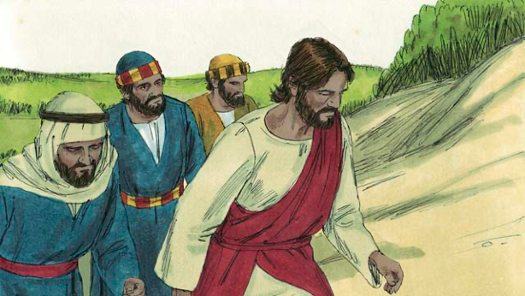
The Transfiguration
Matthew 17:1-9
1. What happened when Jesus was praying?
2. Who appeared with Jesus?
3. What did they talk about?
4. What did Jesus say to the terrified disciples?
5. When have you been afraid?
6. How has God helped you overcome fear? When?
Notes:
5D. Bible Reading Questions
Ask the questions and discuss as a group. For questions 1-4 you may go back to the story to help students find the answer.
Answers:
1. The face of Jesus became as bright as the sun.
2. Moses and the prophet Elijah appeared with Jesus.
3. They talked about Jesus’ death.
4. Jesus told the disciples, “Do not be afraid.”
5. and 6. Answers will vary.

Slide 31
Jesus Raised Lazarus from the Dead.
John 11:1-46
How long did Jesus wait before he went to see Lazarus?
What did Jesus mean when he said that Lazarus was sleeping?
How long had Lazarus been dead when Jesus finally arrived at Bethany?
What title did Jesus give to himself when he spoke to Martha?
Who did Martha say that Jesus was?
Why was Martha afraid to open the tomb?
Do you trust God to answer your prayer as Jesus did?
Notes:
5E. Bible Reading Questions and Answers
Jesus waited two days at the place where he was.
Jesus meant Lazarus was dead.
Lazarus had already been dead for four days.
Jesus said, “I am the Resurrection and the Life”.
She said he was the Messiah, the Son of God.
She was afraid that the body of Lazarus would smell bad because he had been dead for four days.
Answers will vary
©2020-2025 Light of the World Learning
31

Slide 32

How Jesus was Betrayed Matthew 26:14-56
What is the Passover?
Who was in charge of the apostles’ money bag?
Why did Jesus give bread and wine to them?
Why did Judas betray Jesus?
How has someone betrayed you? How have you betrayed someone?
Do you believe Jesus has broken any promises to you? Why or why not?
Notes:
5F. Bible Reading Questions
Ask the questions and discuss as a group. For questions 1-4 you may go back to the story to help students find the answer.
Answers:
1. A celebration of how God saved the ancestors from the Israelites from slavery in Egypt many centuries earlier.
2. Judas was in charge of the money bag.
3. As symbols to help them remember his body and blood that he sacrificed for our sins
4. He wanted money.
5. and 6. Answers will vary.
32

Slide 33
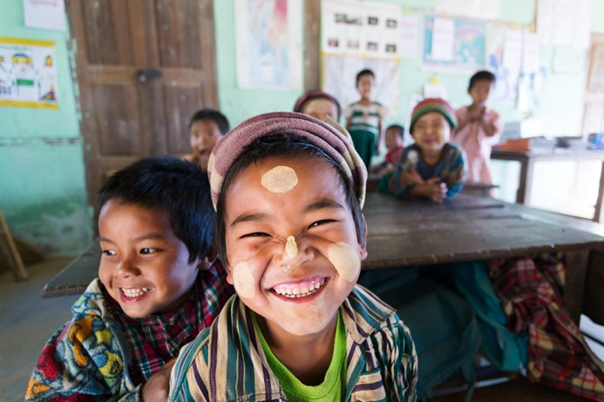

Listen and answer the questions.
How many years of school do most students complete in Myanmar?
Where does the teacher live?
What do the students learn online?
How much do the classes cost?
What do students memorize?
Notes:
6A. Activities – Dictation of sound/spelling words
Read the script at least two times as students listen and answer the questions. Students should NOT read the script.
Today close to 2 million people are displaced in the Asian country of Myanmar due to the civil war. Most students complete only 6 years of school. The best jobs require English skills, but good English education is hard to get there. So, every week, Sarah from the USA teaches online. She teaches 7 learners in Myanmar about the Bible in English. The students are currently children who come from Christian families or are being cared for by Christians. “The classes are free, and the students want to learn English. God is at work in the country of Myanmar,” Sarah said.
The Light of the World material has stories about Jesus and his teachings. Students also memorize Bible verses and share what they have learned about Jesus. “At the end of our classes, we spend time in prayer,” Sarah says. “I encourage the kids to say their prayers in Burmese. I love that they know that there are people on the other side of the world praying for them.”
Answers: 1. They complete 6 years. 2. She lives in the USA. 3. They learn about the Bible and Jesus. 4. The classes are free. 5. They memorize Bible verses.

Slide 34
Song: Irregular Verbs (Part 1 of 2)
https://bit.ly/SongsLOTW
Write, wrote, written
Hide, hid, hidden
Sing, sang, sung
Ring, rang, rung
Go, went, gone
Have, had, had
See, saw, seen
Sit, sat, sat
Know, knew, known
Grow, grew, grown
Drive, drove, driven
Give, gave, given
Think, thought, thought
Teach, taught, taught
Hit, hit, hit;
Cut, cut, cut
Hurt, hurt, hurt;
Put, put, put
Do, did, done
Win, won, won
© 2022-2025 Light of the World Learning
Notes:
7A. Song
This song teaches 40 common irregular verbs in the present, past and participle forms. The YouTube video has pictures to help learning: https://bit.ly/SongsLOTW
1. Model: Read the song lyrics out loud to the class. Ask if there are any questions. Highlight words that students ask about and give simple definitions. Then sing the song two or three times, as the students just listen.
2. Repeat: Sing the selection again, a line or sentence at a time, as students repeat after you. Then play the recording and sing the song together as a class in unison.
3. Solo: The student sings solo (or if shy, can just read the words aloud).

Slide 35
Song: Irregular Verbs (Part 2 of 2)
Take, took, taken
Shake, shook, shaken
Drink, drank, drunk
Sink, sank, sunk
Make, made, made
Sell, sold, sold
Pay, paid, paid
Tell, told, told
Fly, flew, flown
Show, showed, shown
Break, broke, broken
Speak, spoke, spoken
*Read (reed), read (red), read (red)
Say, said, said
Lose, lost, lost
Come, came, come
Stand, stood, stood
Run, ran, run
Wear, wore, worn
Tear, tore, torn
© 2022-2025 Light of the World Learning
Notes:
7B. Song
This song teaches 40 common irregular verbs in the present, past and participle forms. The YouTube video has pictures to help learning. https://bit.ly/SongsLOTW
*Note that the word “read” is pronounced differently in the present tense /rEd/ and past and participle forms /red/.
1. Model: Read the song lyrics out loud to the class. Ask if there are any questions. Highlight words that students ask about and give simple definitions. Then sing the song two or three times, as the students just listen.
2. Repeat: Sing the selection again, a line or sentence at a time, as students repeat after you. Then play the recording and sing the song together as a class in unison.
3. Solo: The student sings solo (or if shy, can just read the words aloud).

Slide 36
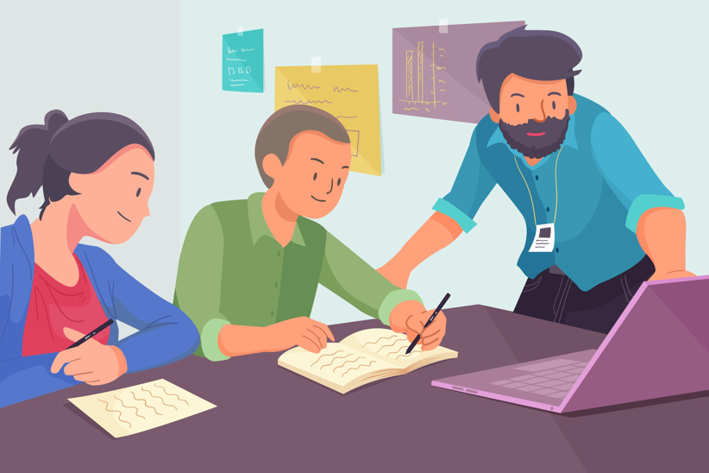
First Review Quiz
Take the listening, speaking, and writing quiz with your
teacher.
Listen to the 5 speaking questions and say your answers.
Then look at the theme picture and write 5 sentences about it. Each sentence must have at least 6 words.
Notes:
First Review Quiz – Listening, Speaking, and Writing
There are two review quizzes. The first quiz is done in class, the second may be done as homework. Use the Rubric found in the appendix to score the student’s answers. You will give the first speaking, listening and writing quiz by asking the student the following questions. Students may not look at the questions. Encourage the students to answer in a complete sentence. Answers will vary.
1. Tell me the directions from your home to the store.
2. Where would you like to visit someday? Why?
3. What is the best Bible story you read? Why?
4. What do you look for when you are proofreading?
5. What should you do to improve your English?
6. Write five sentences about one theme picture. Each sentence must have at least 6 words. (The teacher may choose any one theme picture from slides 4 to 9 for the student to use in this writing exercise). The student may write on paper or an electronic device.
The second quiz (found on the next slide) is online. You may download the quiz at LOTWL.org and print it or students can take it online with automatic scoring. Students may do the second quiz for homework.

Slide 37
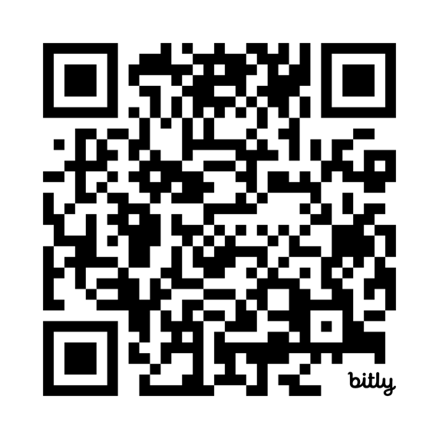
1 & 2 Homework
Read or listen to Matthew 26:57 - 27:61
in your language.
Take the 2nd review quiz at this link: bit.ly/quiza2-42 or at the QR code. Write your score here ___
If you are not happy with your score, practice more. Then take the quiz again, and write your new score here ___
Notes:
8A. Homework 1 and 2
Students must always read the Bible lesson in their first language before reading it in English the following lesson.
Students may scan the QR code or go to the quiz link to access the multiple choice online quiz. Go over how to take the quiz, to be sure the student understands what to do. Encourage students to look at their quiz results and practice areas that they missed. They may take the quiz again if needed.
©2020-2025 Light of the World Learning

Slide 38
Now I Can…
I can use like and as…as to describe things.
I can use should, must, and have to.
I can talk about what I would and wouldn’t like to do.
I can understand and give directions to different places.
I can talk about present and future actions.
I can use comparatives and superlatives to compare things.
I can understand that Jesus is God.
I can understand how God’s word is like a seed.
Notes:
Homework – I Can Statements & Closing Prayer
The student must be able to achieve all of these skills before the next lesson. If not, the lesson can be repeated or additional practice materials can be used.
Review all of the skills at the beginning of the next lesson. Be sure to give lots of praise and encouragement!
Pray
You may want to ask for any special prayer requests, then pray for your students and bless them.
©2020-2025 Light of the World Learning

Slide 39
Reflections and Closing Prayer
Notes:
Reflections and Closing Prayer
You may want to thank the Lord for what we have learned, ask for special prayer requests, then pray for your students and bless them. Students may write reflections and their prayers here.

Slide 40

Help us share the Light of the World!
Thank you for using our materials. If these lessons are a blessing to you, you may give or volunteer at LightOfTheWorldLearning.org to help others learn English through the Bible.
Contact us at: Info@LOTWL.org
We would love to hear from you!

Slide 41
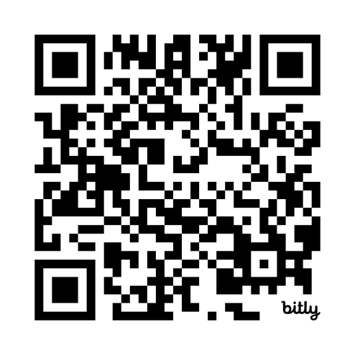
Appendix
How to Use Lessons: bit.ly/UseLOTW
Irregular Verb List: bit.ly/ListVerbs
Lesson Downloads: LightOfTheWorldLearning.org
Order Books: bit.ly/BooksLOTW
Share Your Feedback: bit.ly/FeedbackLOTW
Table of Contents: bit.ly/TocLOTW
Videos: bit.ly/A2videos
Vocabulary List: bit.ly/VocabUS
Website: LightOfTheWorldLearning.org
Notes:
41

Slide 42
Rubric for Listening, Speaking and Writing Quiz
Student Name: Date:
Score for Listening, Speaking and Writing:
Score for Multiple Choice Quiz:
Total Score:
Listening and speaking | Question | Good - 3 points Answer is correct, clear and complete. | Okay - 1 point Answer is correct, but unclear or incomplete. | Not acceptable - 0 points Answer is not correct.
Examples: | Where do you live? | I live in an apartment in Tokyo. | I live apartment.
1. Tell me the directions from your home to the store.
2. Where would you like to visit someday? Why?
3. What is the best Bible story you read? Why?
4. What do you look for when you are proofreading?
5. What should you do to improve your English?
6. Write 5 sentences about the theme picture. Each sentence must have at least 6 words. |  | Good - 3 points Answer is correct, clear and complete. Sentence begins with a capital letter has at least 6 words and ends with punctuation. | Okay - 1 point Answer is correct, but incomplete. Sentence is missing capital letters or punctuation. | Not acceptable - 0 points Answer is not correct.
Examples: | Examples: | I see a man and a woman talking. This is a very busy street. The bees make some sweet honey. | see mans womens. This is street busy they are bees
Sentence 1.
Sentence 2.
Sentence 3.
Sentence 4.
Sentence 5.
Total Points out of 30
Notes:
Please use this rubric to score students’ responses.
©2020-2025 Light of the World Learning

Slide 43
Acknowledgements
We would like to thank the entire Light of the World volunteer team for their hard work and creativity in making this project possible. For all those around the world who prayed, wrote, edited, narrated, illustrated, sang, tested, and gave generously for this curriculum, we appreciate you sharing the love of Jesus through the gift of English. Our team members include:
Anonymous | Emily Cox | Jill Gramzow | Martha Lane
Jean Ato | Marilyn Dano | Tanya Griffin | Audrey Larsen
Bradley Baurain | Hephzi Davidson | Rachel Grijincu | Aden Lewis
Ana Biederman | Susanna Diallo | Lauren Haines | Bruce Lewis
Bob Biederman | Alyssa Dokolas | Carol Hale | Elena Lewis
Joshua Blake | EasyReadEnglish.com | Emily Hamilton | James Lewis
Rachael Braggs | Don Edic | Patty Hickman | Micah Beth Lewis
Hannah Brendel | Peggy Fergus | Juliette Hyer | Tim Lewis
Larry Buell | MaryBeth Gahan | Lyudmila Ivanyuk | Ward Lewis
Cindy Campbell | Melina Gallo | Debbie Johnson | Cosette Lindsay
Christian Cha | Alicia Gentile | Carey Jo Johnston | Johnny Lukashevich
Olivia Cheney | Prakash Chandra Giri | Nancy Kingdon | Gail MacMillan
Hannah Clark | Ellenor Gopal | Dorothy Konadu | Ivan Mader
Nancy Cobb | Henrietta Grajcar | Macy Lake | Amy Martin
(continued on the next slide)
Notes:
43

Slide 44
Acknowledgements - Continued
Diana Martz | Joan Phelps | Lorna Tatomir
Hannah McMahan | Megan Rahn | Darrell Turner
Christy McPherson | Sara Scazzero | Leigha Wachter
Tracy Meddaugh | Hannah Schmokel | Joseph Waite
Barbara Newsome | Ashlyn Shrimplin | Graham Whitmore
Brenda Nielsen | Leah Sprague | Cheri Wilke
Danielle Nowe | Noah Staal | Mackenzie Williams
Deborah O’Donnell | Macie Stuckman | Allison Wright
Evelyn Ocasio | Jia Le Su | Tiffany Yeh
Georg Ort | Carole Svensson | Muchun Yin
Martha Ort | Ellie Talalight | Ted York
Barb Park | Peter Talalight | Tai Lee Young
Deb Payne | Weston Talalight | Abigail Zawisza
Linda Petrie | Rachel Tamang | Anita Zeifert
Bible story and pictures on slides 15-22 adapted from the original work by unfoldingWord available from https://openbiblestories.org
Bible Verses on slides 35-36 Taken from the HOLY BIBLE: EASY-TO-READ VERSION ©2014 by Bible League International. Used by permission.
Notes:
44

