Slide 1


FIRST CHURCH A1 ENGLISH CLASS
Graduation Ceremony
CLASS OF 2026
15 January | 10:00 AM
123 Anywhere St., Any City

Slide 2
Program
07:00
OPENING PRAYER
Lead Teacher
07:10
THANK YOU
Samira Hadid
07:20
SONGS
Class
07:30
ADDRESS
Mr. Pedro Fernandez
07:40
STUDENT TESTIMONIES
Graduates
07:50
DIPLOMA PRESENTATION
Reese Miller
08:00
SIGN UP FOR NEXT CLASS
Enroll, Invite Others, Volunteer
08:05
PRAYER & BLESSING
Pastor Bob
Congratulations!

Slide 3
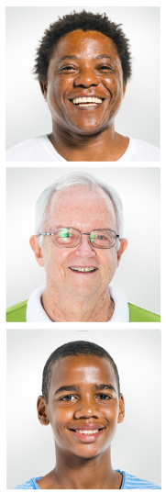
Graduates
Ernie Fisher
Perfect Attendance
Tim Peterson
Simon Neil
Congratulations!

