Slide 1


Unit A2-41
Unit A2-43
©2020-2025 Light of the World Learning
Notes:
Teacher’s Notes:
Thank you for using our materials. For more resources and teacher training visit LightOfTheWorldLearning.org
Preparation:
Pray
Read the Bible passages.
Preview slides and song.
Optional: Bring games, money, and other items related to banking.

Slide 2
Pray, Review, and Preview
Bible Reading:
Jesus is Put on Trial and Crucified: Matthew 26:57-27:61
Theme: Banking
Pronunciation: /un-der/ and /O-ver/
Grammar: Who’s vs. Whose and Possessive Pronouns: mine, yours, his, hers, its, theirs, ours
Notes:
Pray
Pray for the class. Pray that the students would be able to focus in class, and for any students’ prayer requests.
Check Homework and Review
Ask each student to read aloud or recite their homework from the last class. Check written work. Be sure they have read Matthew 26:57-27-61 in their native languages in preparation for the lesson.
Review the main points of the previous lesson and ask if there are any questions.

Slide 3
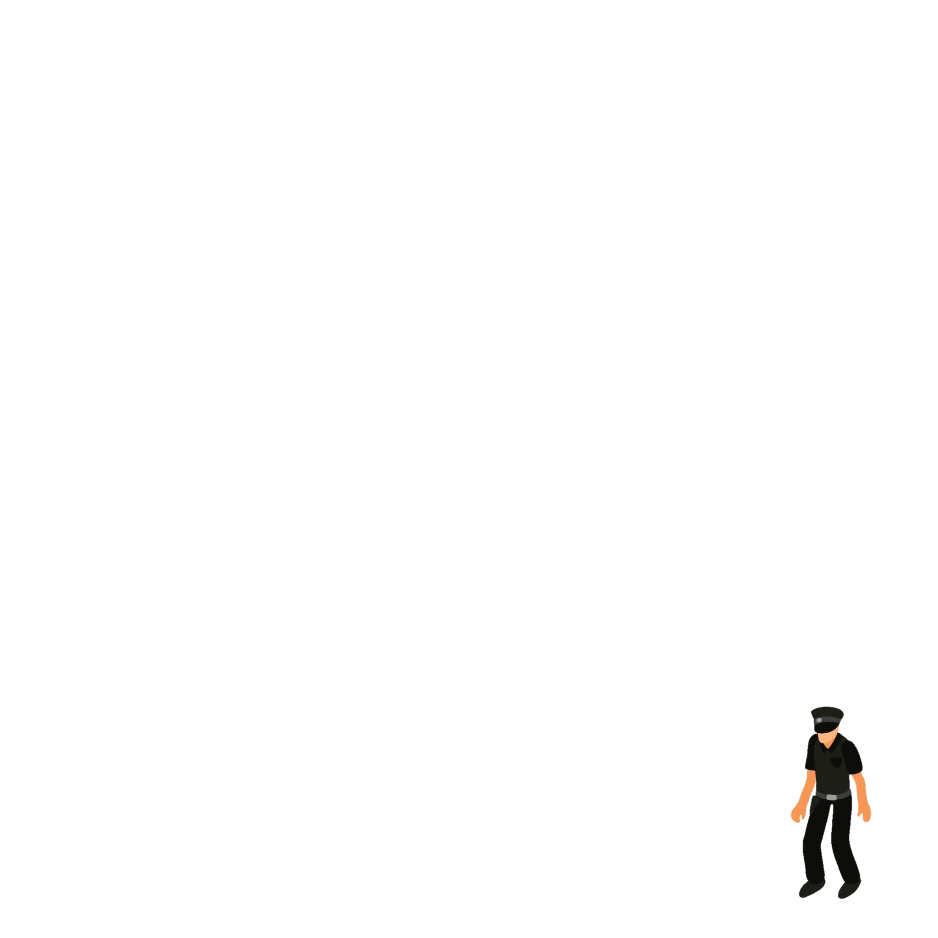
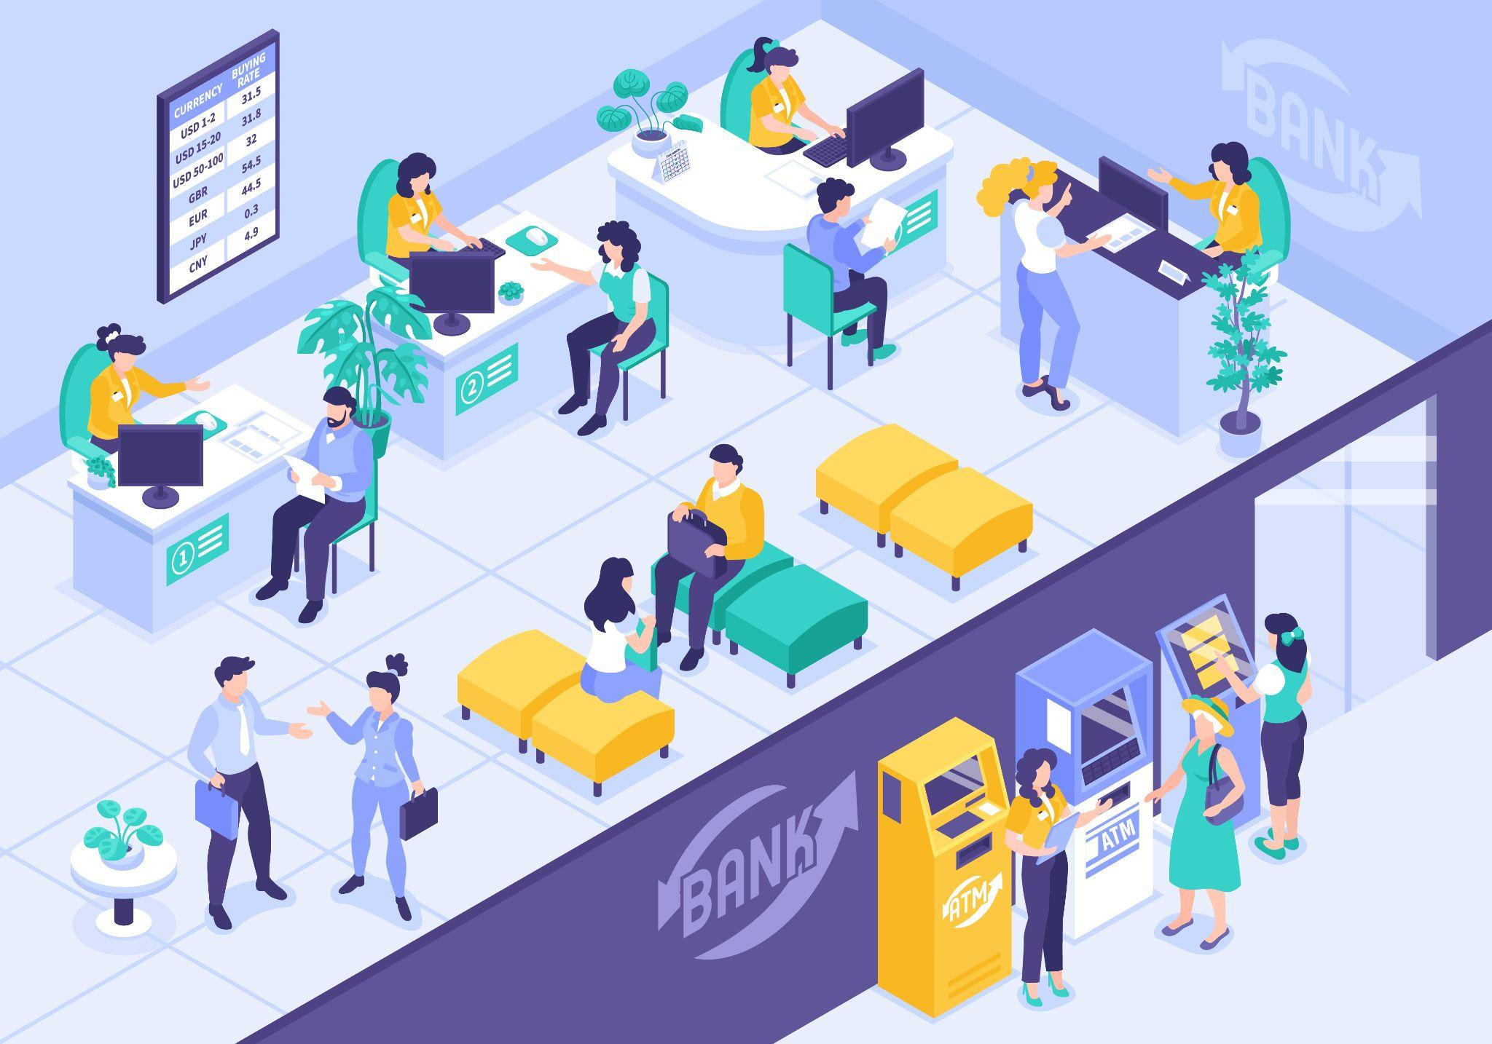


What do you see?
Notes:
1A. Discuss Theme Picture
Ask “What do you see in this picture?” and “What else?” to elicit vocabulary they already know.
Repeat and write their words or show the words on the next slide.
Answers may include: ATM, security guard, change, teller, safe, money, etc.
More advanced students can be encouraged to make complete sentences:
People are at the bank. People are getting money from an ATM. A teller is helping a customer.

Slide 4
It is very safe to save money at the bank. If you deposit cash at a bank, your money may be locked up in a safe. Also, the security guard makes sure that robbers do not go in to steal. You may withdraw this money at any time either from the teller in the bank or from the ATM outside. You may also go to the teller to exchange bills for change. When you save with the bank you can borrow money from the bank when in need. The money they lend you is only a loan and must be paid back quickly to avoid paying too much interest.
Notes:
1B. Read about the Theme Picture
Please read the description of the theme picture to the students and point to the pictured vocabulary. If students ask about words, give simple definitions.
Practice of vocabulary begins with the following slide.

Slide 5
People Are at the Bank
1.
3.
a teller
a security guard
4. a safe
2. change
5. an ATM
Notes:
1C. Show Words for Theme Picture
Please show the names of the theme picture items to the students briefly.
These words can be studied for homework.
Practice of vocabulary begins with the following slide.

Slide 6
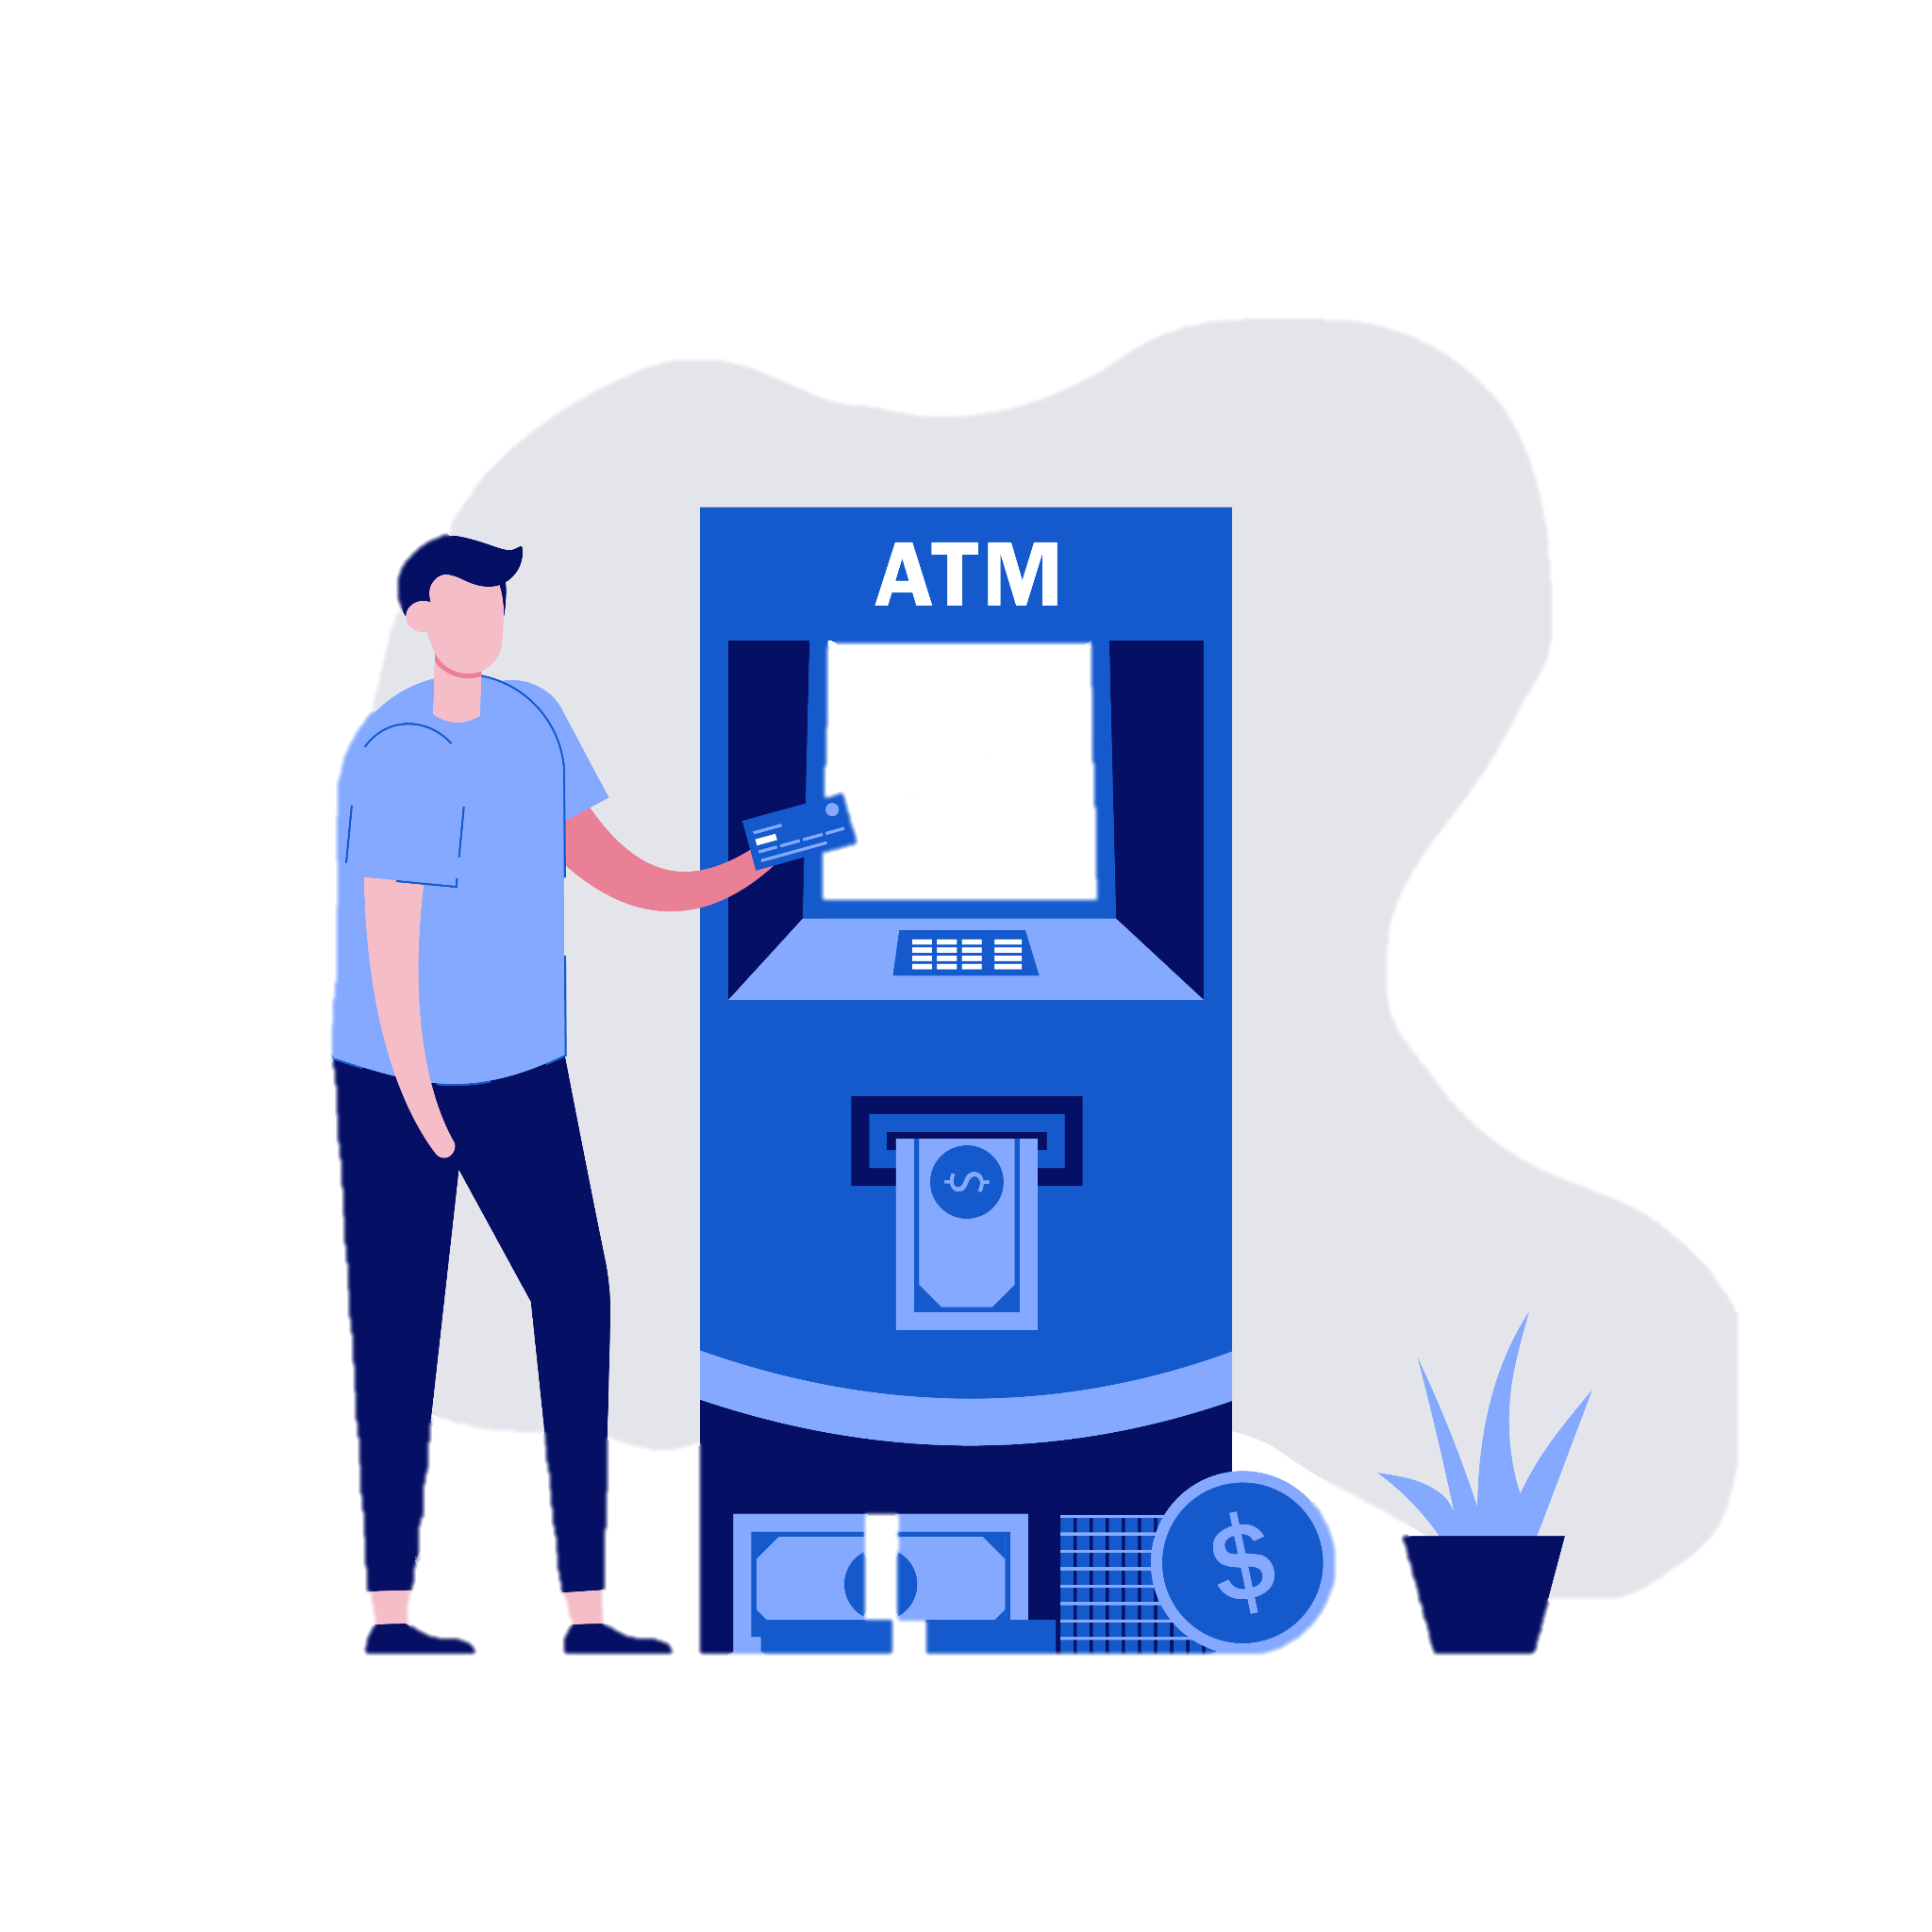
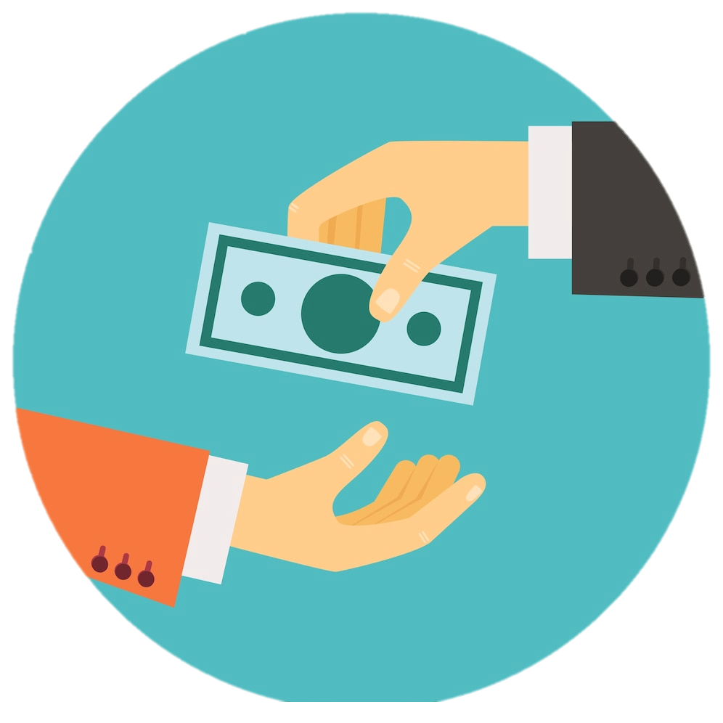
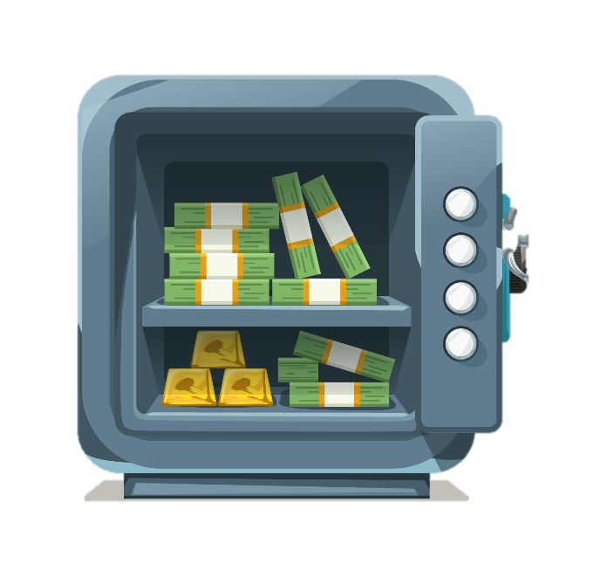

Match the beginning and end of each sentence.
He gets money
2. When you borrow money from the bank,
3. She has change in her pocket,
4. I keep money
A. it is called a loan.
B. silver and copper coins.
C. in a locked safe.
D. from the ATM (automatic teller machine).
Notes:
2A. Vocabulary
1. Say the beginning of the sentence a few times, as you indicate the picture. For example, say, ”He gets money, he gets money.” Have your students then repeat the phrase after you a few times.
2. Ask students to match the beginning and end of each sentence and say the complete sentence. For example, ”He gets money from the ATM.”
3. Check students’ comprehension further by asking direct questions. For example, “Do you have a bank account?”
Answers
D
A
B
C

Slide 7


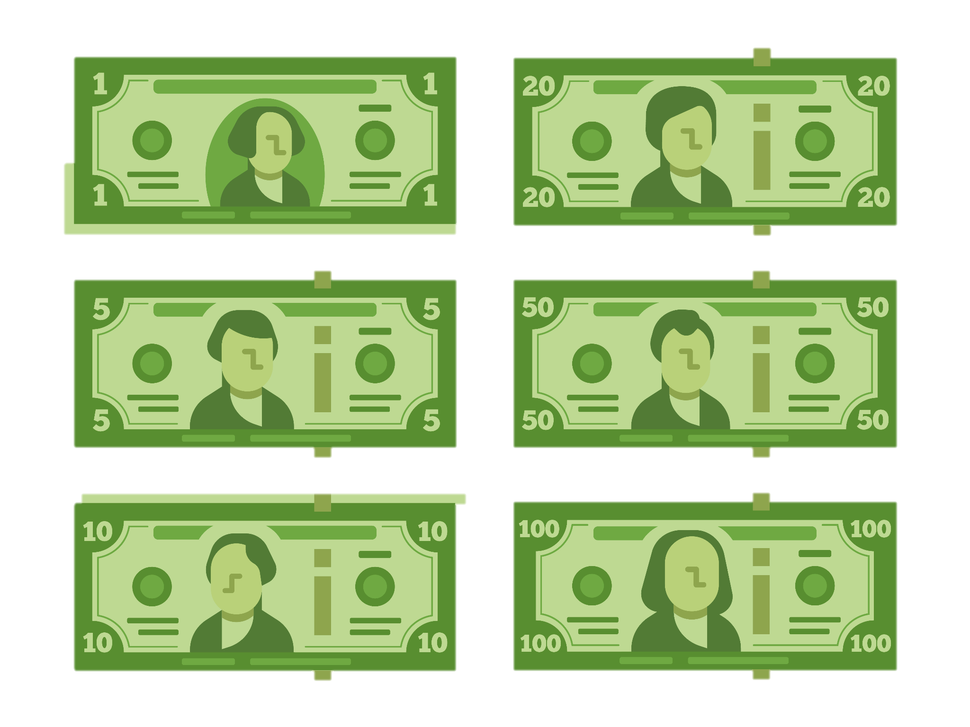
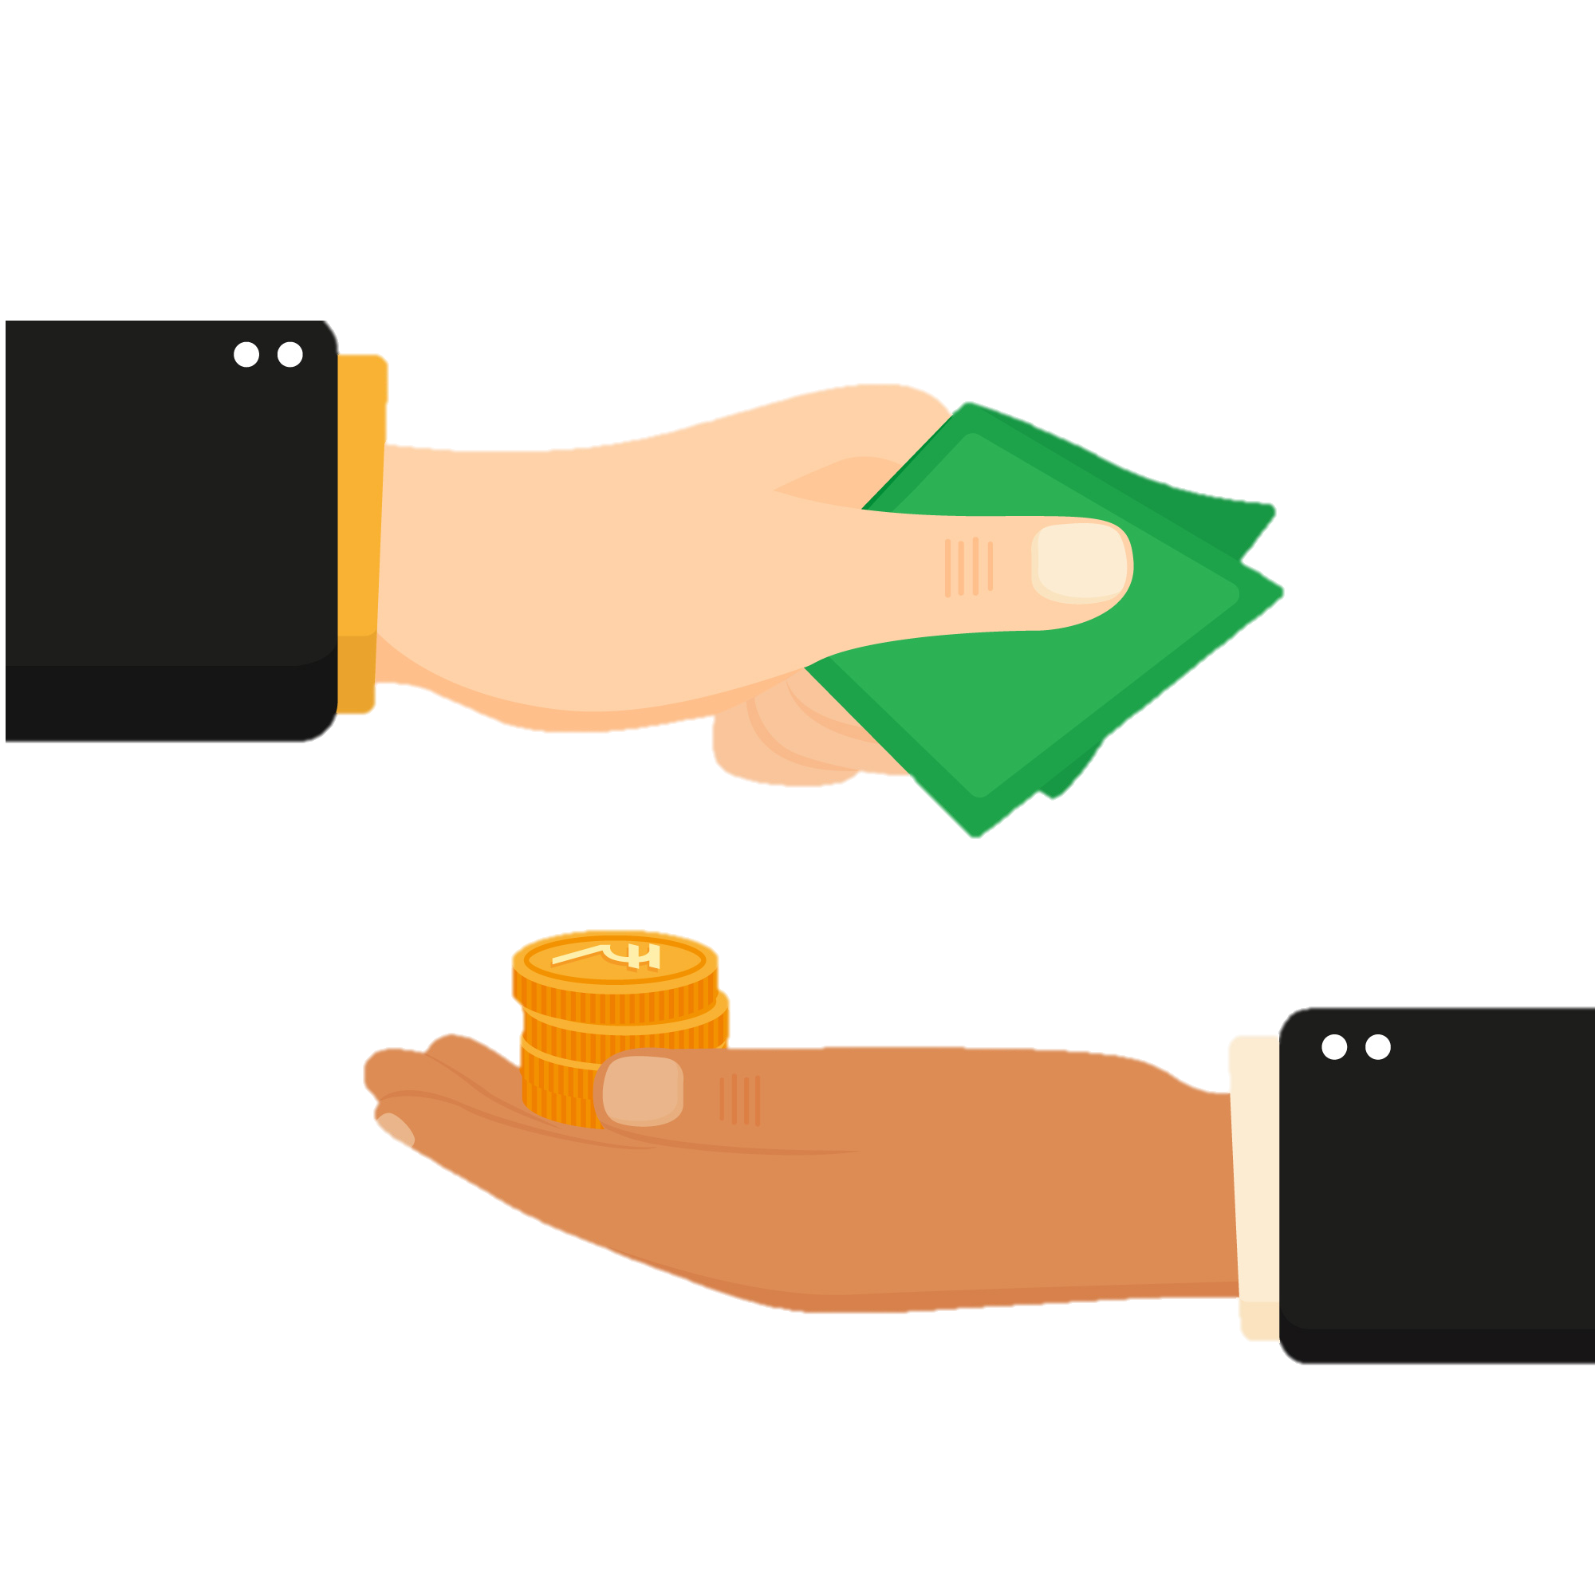
Match the beginning and end of each sentence.
5. The security guard
6. The bank teller
7. I pay with
8. I exchange dollars
E. dollar bills.
F. keeps people safe.
G. for euros.
H. helps customers with financial transactions.
Notes:
2B. Vocabulary
1. Say the beginning of the sentence a few times, as you indicate the picture. For example, ”I pay with, I pay with,” Have your students then repeat the phrase after you a few times.
2. Ask students to match the beginning and end of each sentence and say the complete sentence. For example, ”I pay with dollar bills.”
3. Check students’ comprehension further by asking direct questions. For example, “What kind of money does your country use?”
Answers
5. F
6. H
7. E
8. G

Slide 8
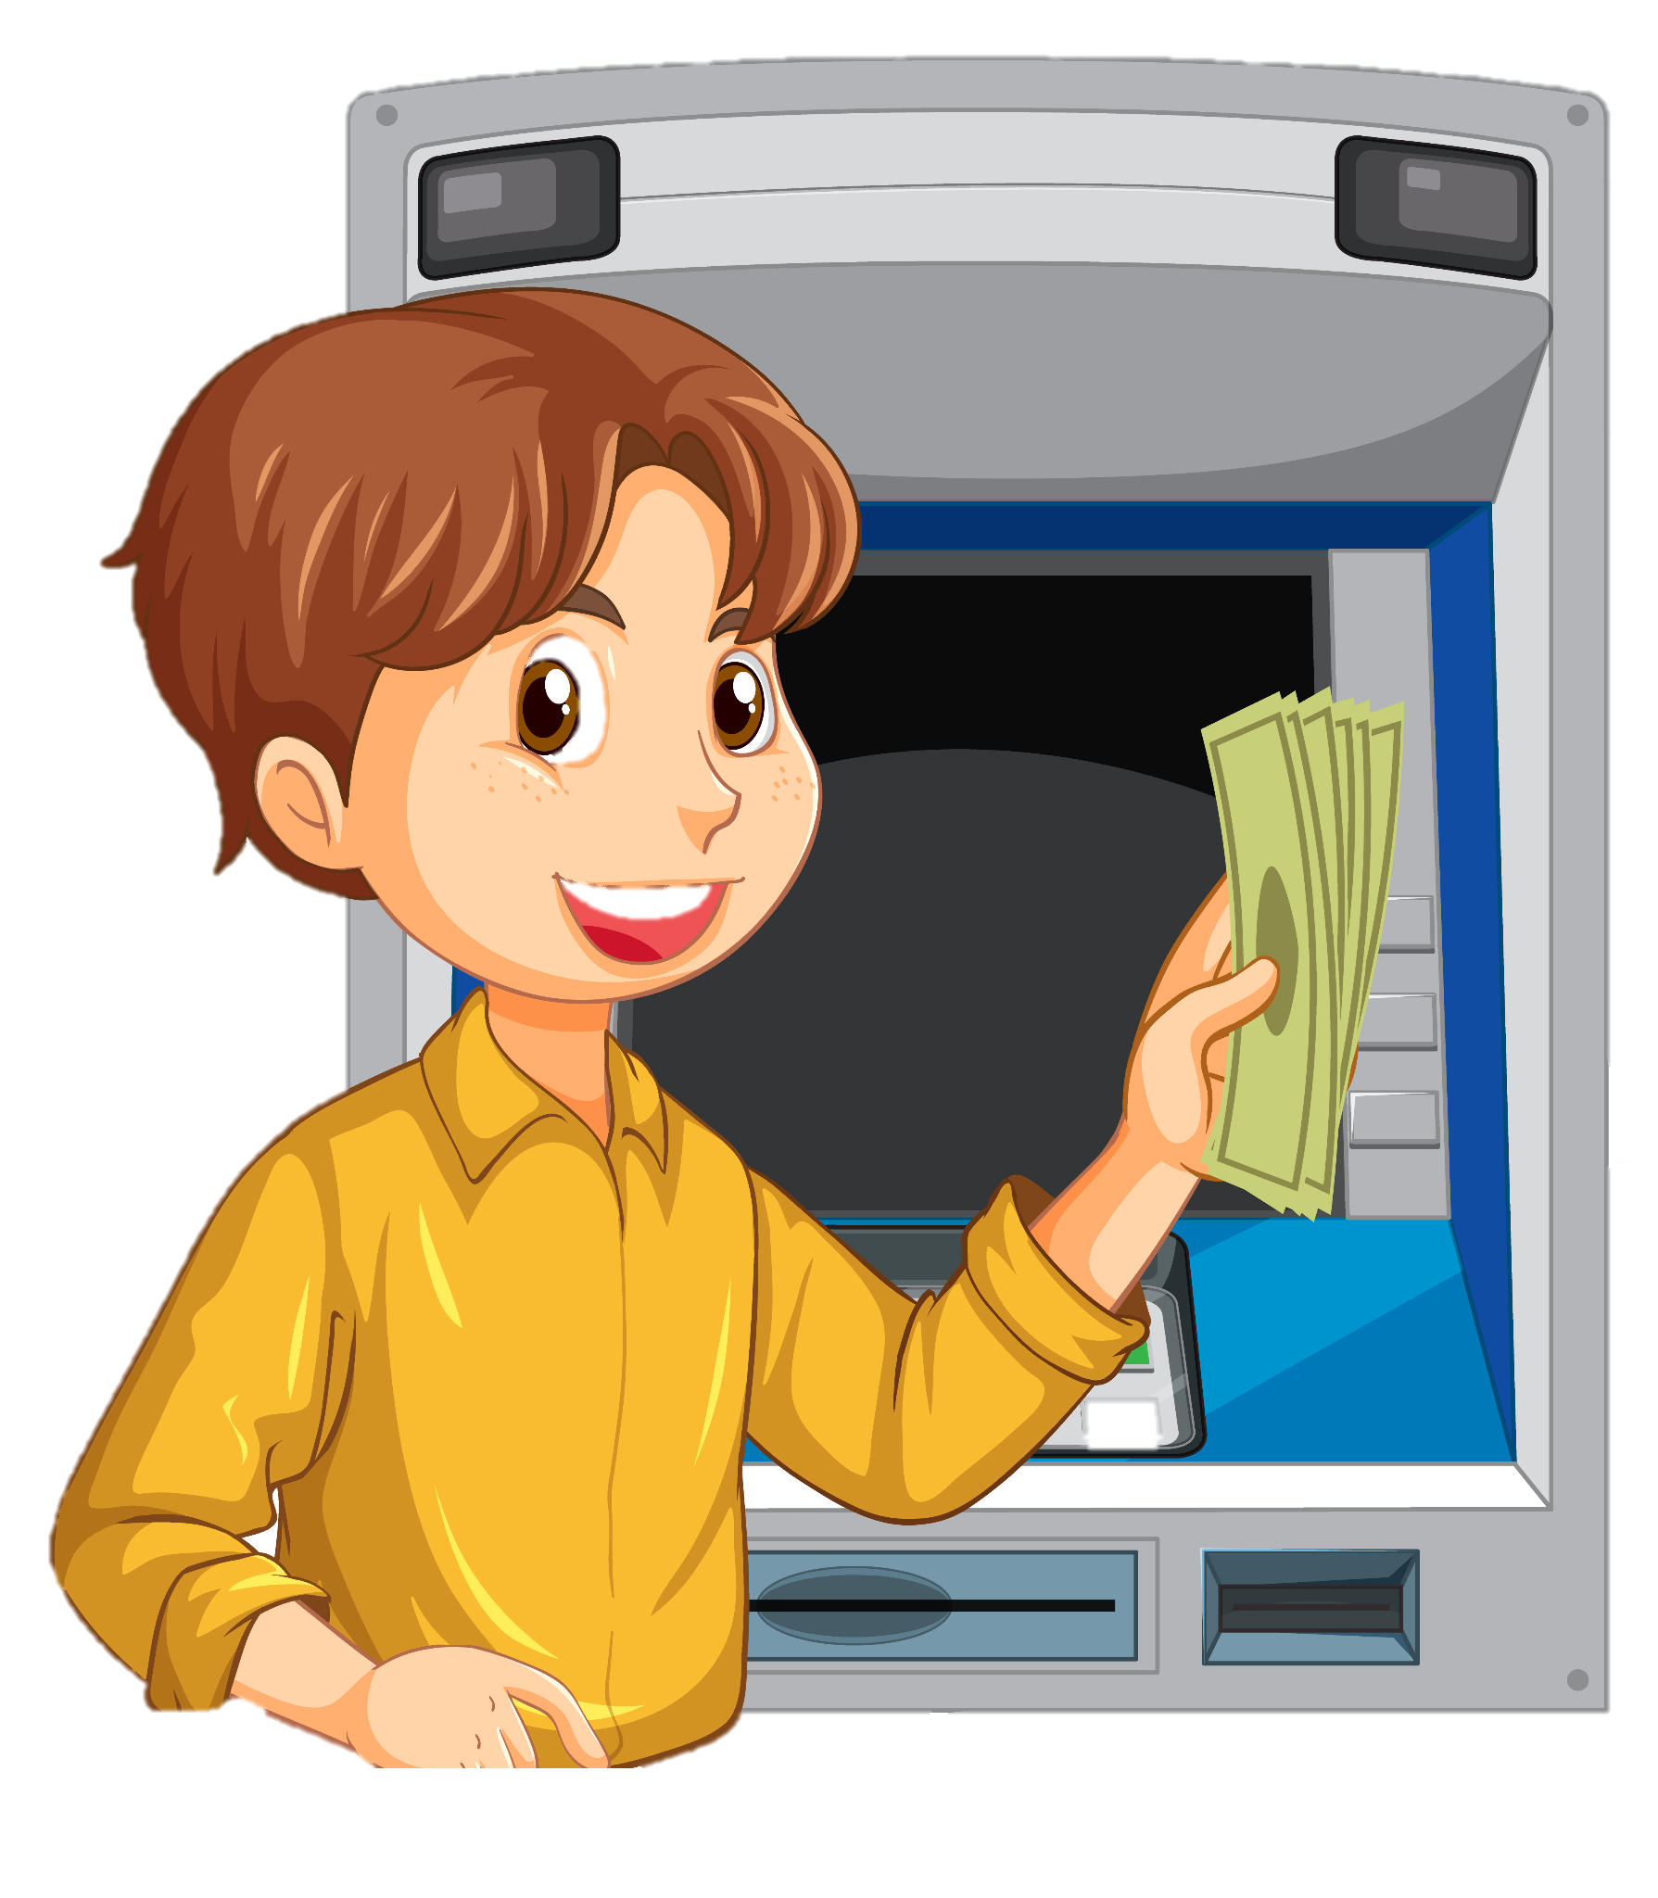
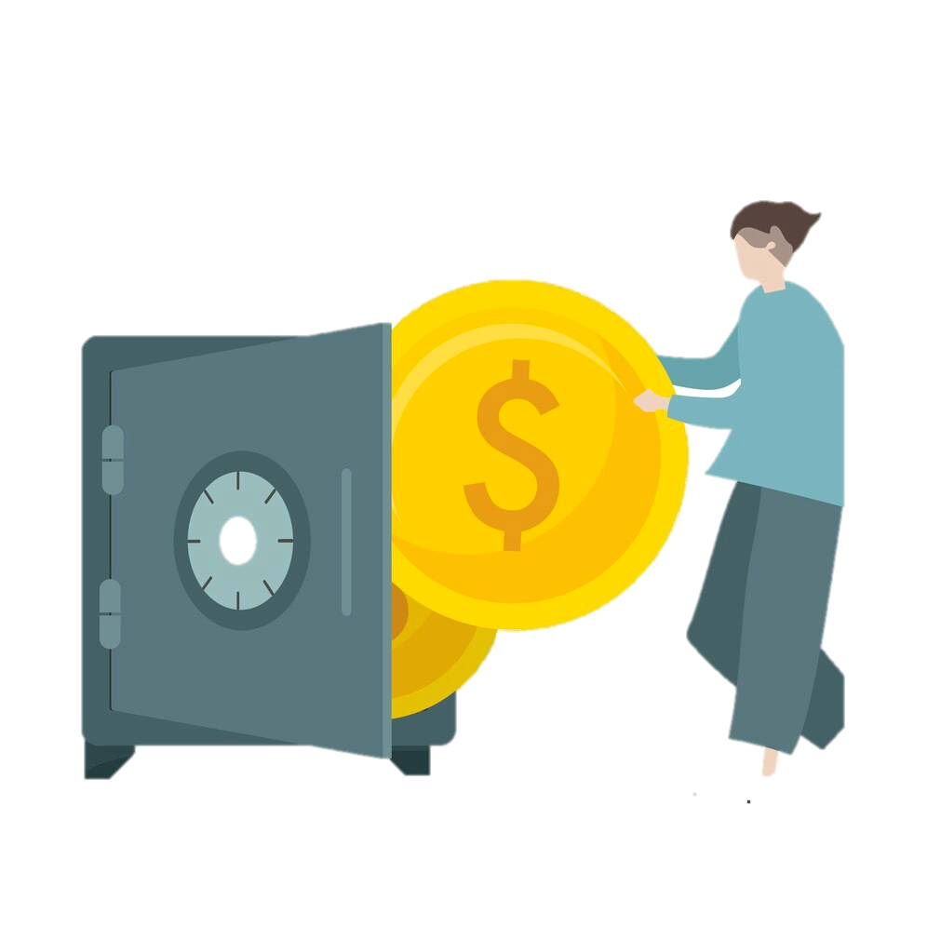
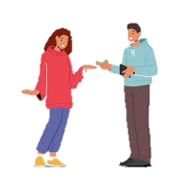
Match the beginning and end of each sentence.
He deposits money
10. He withdraws money
11. He lends money
12. She borrows money
I. from the ATM.
from him.
into the bank.
to her.
Notes:
2C. Vocabulary
1. Say the beginning of the sentence a few times, as you indicate the picture. For example, say, ”He lends money, he lends money,” Have your students then repeat the phrase after you a few times.
2. Ask students to match the beginning and end of each sentence and say the complete sentence. For example, ”He lends money to her.”
3. Check students’ comprehension further by asking direct questions. For example, “Have you ever borrowed money?”
Answers
9. K
10. I
11. L
12. J

Slide 9
What is a possessive pronoun and when do we use them?
Look at this sentence:
This change is your change, not my change.
Notice we repeat change three times, so it sounds repetitive.
Since we already know we are talking about change, we can replace my change and your change with possessive pronouns:
This change is your change, not my change. Can be shortened to:
This change is yours, not mine.
Now it doesn’t sound repetitive.
Mine, yours, his, hers, ours, and theirs are possessive pronouns.
A possessive pronoun replaces a possessive adjective + noun (your change) to avoid repeating information that is already clear.
Notes:
2D. Grammar – Possessive Pronouns
Possessive pronouns are used to indicate possession or ownership.
Note: We don’t use the possessive pronoun its. We can say, “This change belongs to the store.” but not “This change is its.”

Slide 10
Possessive pronouns can follow or replace a noun.
 | Subject Pronoun | Object Pronoun | Possessive Adjective | Possessive Pronoun | Example
1 | I | me | my | mine | Those are _____.
2 | you | you | your | yours | Are the bills ______?
3 | he | him | his | his | The safe is ____.
4 | she | her | her | hers | This is _____.
5 | we | us | our | ours | That loan is _____.
6 | they | them | their | theirs | The change is _____.
Notes:
2E. Grammar – Possessive Pronouns
Possessive adjectives precede a noun: my change, your loan. Possessive pronouns can follow or replace a noun. The change is mine. It is hers.
Model, Repeat, and Solo the pronunciation of all forms shown on the chart. Ask students to complete the sentences with the blank spaces.
Answers:
Those are mine.
Are the bills yours?
The safe is his.
This is hers.
That loan is ours.
The change is theirs.

Slide 11
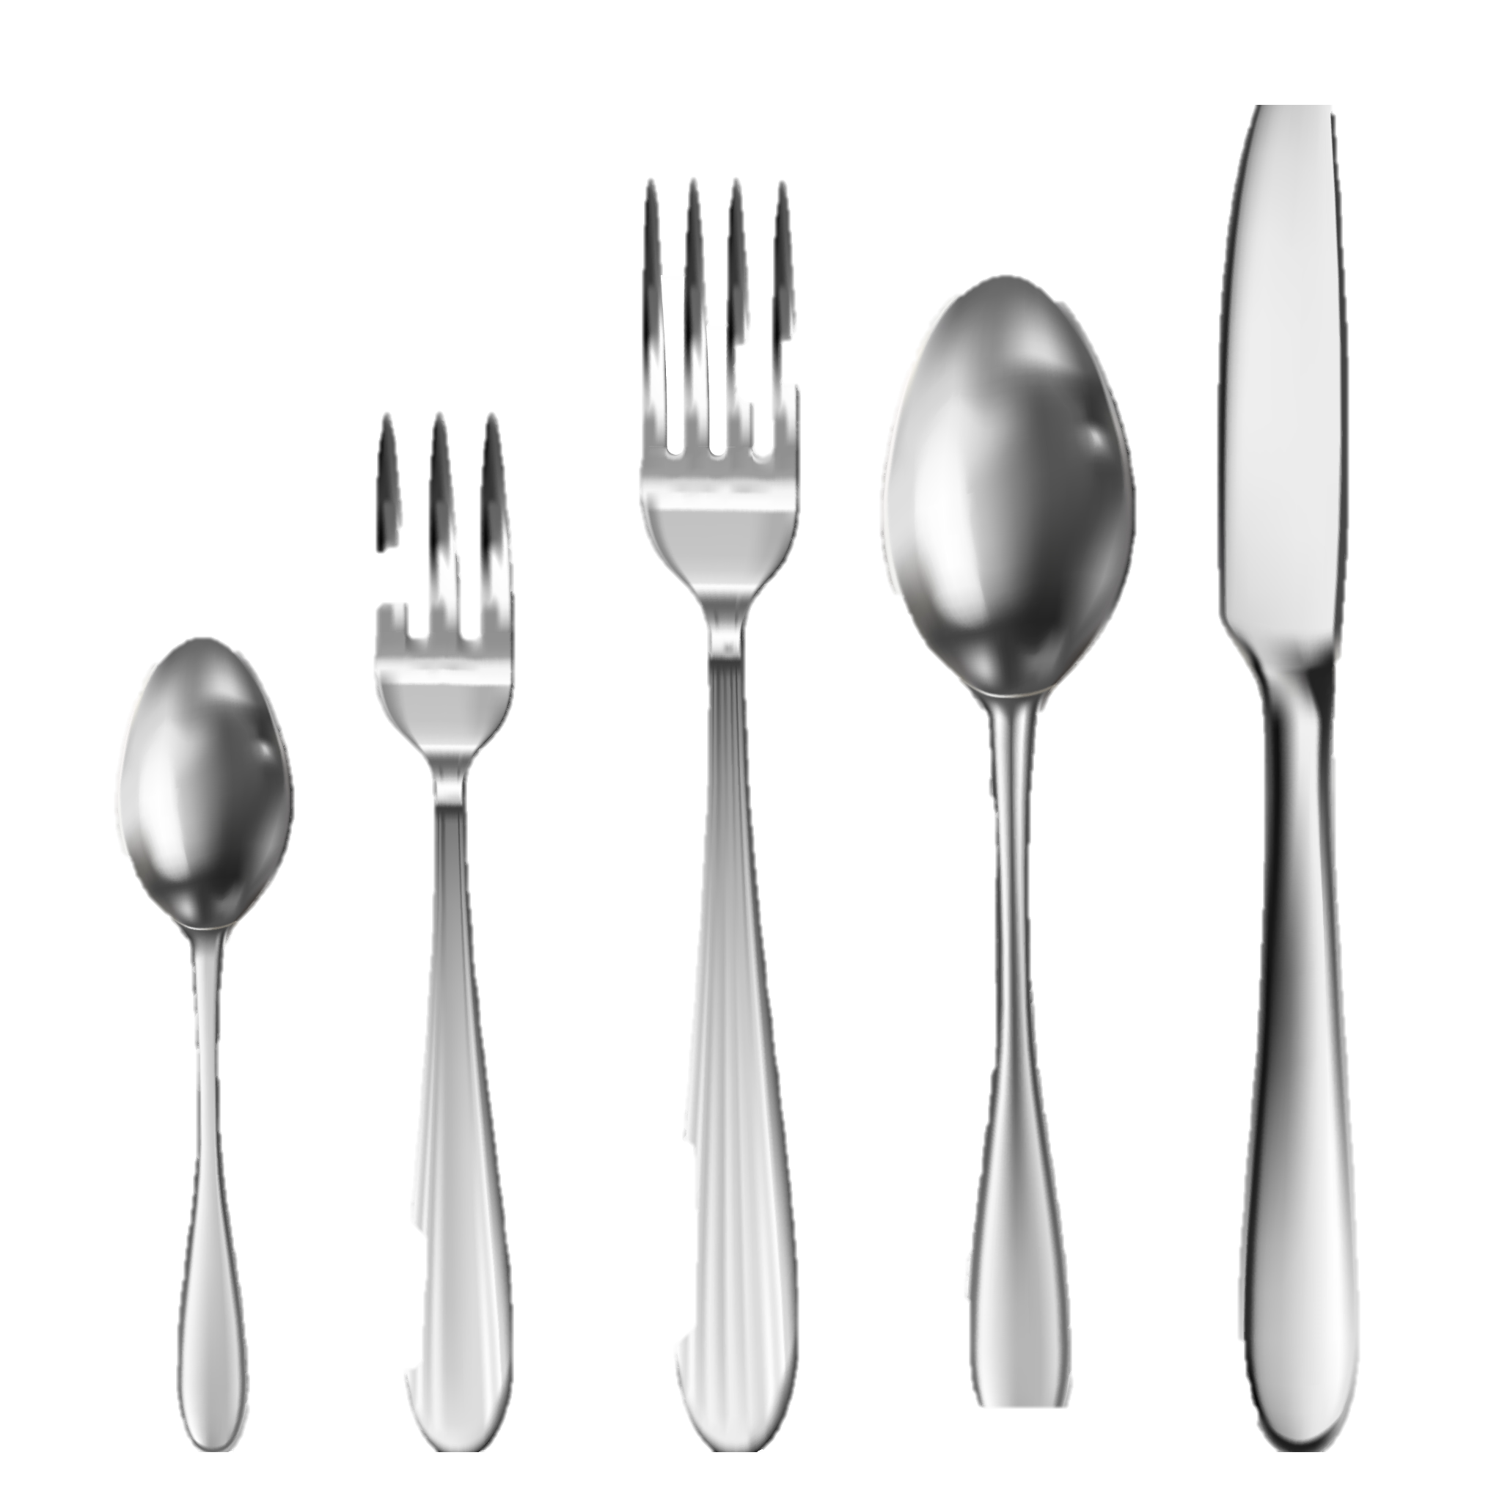


Pronouns can show possession.
 | Subject Pronoun | Object Pronoun | Possessive Adjective | Possessive Pronoun
1 | I have a safe. | That safe belongs to me. | That’s my safe. | That’s mine.
2 | You have change. | That change belongs to you. | That’s your change. | That’s yours.
3 | he | him | his | his
4 | she | her | her | hers
5 | we | us |  | ours
6 | they |  | their | theirs
Notes:
2F. Grammar – Possessive Pronouns
Possessive pronouns are used to indicate possession or ownership.
Model, Repeat, and Solo the pronunciation of all forms shown on the chart. Ask students to complete the sentences with the blank spaces.
Note: Change and silverware are noncount nouns which take singular verbs.
Answers:
3. He has dollar bills. Those bills belong to him. Those are his bills. Those are his.
She has silverware. That silverware belongs to her. That’s her silverware. That’s hers.
We have a document. That document belongs to us. That’s our document. That’s ours.
They have a compass. That compass belongs to them. That’s their compass. That’s theirs.

Slide 12
 | Who | Whose
1 | We use who to ask about or describe a person. | We use whose to find out which person something belongs to. The answer has a possessive.
2 | Examples: -Who is the boss? Sam is. -Who will come early? John and I will. We will. Who has the cash? They have it. | Examples: -Whose car is this? It’s theirs. -Whose notebook is on the desk? It’s my notebook. It’s mine. -In whose car is the box? It’s in Ana’s car. It’s in her car.
Notes:
2G. Grammar – Who and Whose
Model, Repeat, and Solo the pronunciation of all forms shown on the chart.

Slide 13
Pronouns: Who asks about people. Whose asks about belongings.
 | Question: Who or Whose | Answer
1 | Who will come to the bank? | They will come to the bank.
2 | _____ change is this? | The change is _____.
3 | _____ put the dishes away? | _____ put the dishes away.
4 | _____ house is that? | The house is _____.
5 | _____ is this gift for? | It is for _____.
6 | _____ car is behind mine? | _____ car is behind your car.
7 | _____ safe is this? | That is _____ safe.
Notes:
2H. Grammar – Possessive pronouns
Model, Repeat, and Solo number one. Ask students to complete the sentences for numbers 2-7.
Answers will varyː
Whose change is this? mine/hers/his/theirs/ours
Who put the dishes away? She/he/they/we/I/you
Whose house is that? mine/hers/his/theirs/ours
Who is this gift for? me/him/them/her/you/us
Whose car is behind mine? my/his/her/our/their
Whose safe is this? my/his/her/our/their/your

Slide 14
Who’s means “who is” and Whose means “who it belongs to” or “to whom it belongs”
 | Who’s or Whose? | Answer
1 | Who’s the son of God? | Jesus is the son of God.
2 | Whose car is that? | That is my car. Yes, it’s mine.
3 | _____ going to the bank? | _____ is going there at 1:00.
4 | _____ near the fire? | _____ is standing by the fire.
5 | _____ gloves are these? | They are _____.
6 | Is he the man _____ hat is blue? | Yes, _____ is blue.
7 | Is he the man _____ late? | Yes, _____ always late.
Notes:
2I. Grammar – Possessive pronouns
Model, Repeat, and Solo numbers 1 and 2. Ask learners to complete the sentences for numbers 3-7.
1 and 2 are examples. Answers will varyː
3. Who’s going to the bank? Name of person or subject pronoun he/she
4. Who’s near the fire? Name of person or subject pronoun he/she
5. Whose gloves are these? Name of person with ‘s or mine/hers/his/theirs/ours/yours
6. Is he the man whose hat is blue? his
7. Is he the man who’s late? he’s/he is

Slide 15
Listen and repeat.
A: Look, there’s change on my table.
B: Whose change is it?
A: I think it’s Susan’s money. Those glasses are hers, too.
B: Who’s Susan?
A: Susan is my friend. She came here to borrow my bike.
B: Are those her cookies on the table?
A: No, those are mine. Would you like one?
B: Yes, thank you!
Notes:
3. Conversation:
Model: Say both parts of the conversation several times. Use A and B cards, stick figures, or change your physical position to indicate the dual parts. Role-play the parts to convey the meaning of the conversation. Students are to watch and listen.
Repeat: Say one line at a time and have students repeat until they can be understood.
Solo: You begin the conversation and call on individual students to respond. Then reverse the roles (students are A, you are B).
Once students can do both parts, encourage free conversation (students substitute their own words for the blue words).

Slide 16
The prefix under- can mean “not enough;” over- can mean “too much.”
1. /under/ | 2. /Over/ | 3. Challenge
underweight | overweight
underpaid | overpaid
undercooked | overcooked
understaffed | overdone
understated | overreact
4. I think the bank is understaffed. They need more tellers.
5. She overcooked the chicken and now it is too dry.
Notes:
4A. Pronunciation - Sound and Spelling
Note: The prefix /under/ means “not enough”. However, students might be confused about the word “understand” which means that someone does know what someone is saying the prefix /over/ can mean that something is “too much”.
1. Model: Say the sound several times while pointing to it. (For example, point to the /under/ and say /under/ /under/ /under/. Then say the sound and quickly read the entire list, pointing to each item as you read it (‘underweight”, “underpaid”, “undercooked”). Students just watch and listen.
2. Repeat: Say the sound and each word several times, having students repeat each time after you in unison. Be sure to use your normal voice and rate of speed. Then read the sentences.
3. Solo: Call on individuals to say a sound and its word group. Give lots of praise. Then ask students to read the sentences.
4. Challenge: Choose another sound from the lesson that is challenging for your particular students to pronounce. Use words from Parts 1 and 2 of the lesson, and from previous lessons to make a group of 3-5 words. You may repeat the same challenging sounds in several lessons. Students need a lot of practice on sounds that do not exist in their first language.

Slide 17
Listen and repeat.
A. - ▔ | B. - ▔ - | C. ▔-
withdraw | defensive | banker
secure | deposit | patient
explain | expensive | borrow
exchange | example | teller
Notes:
4B. Hum and clap the stress.
Begin by humming the stress of a column of words. Hum higher, longer, and louder for big dashes and lower, shorter, and quieter for small dashes.
You may use hand gestures to indicate that the stressed syllable is higher in pitch, longer in duration, and louder. Invite your students to join in humming the rhythm. Once the class is humming the rhythm in unison, you can begin saying the words. You may also wish to clap the syllables while you say the words.
1. Model: Hum and then say each word in the column several times. Students listen.
2. Repeat: Students repeat words after you in unison.
3. Solo: Call on individuals to read the entire column of words.

Slide 18
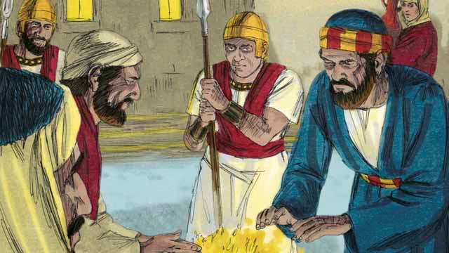
Read Matthew 26:57-27:61 in your own language. Then read the story of how Jesus was crucified.
It was now the middle of the night. The soldiers led Jesus to the house of
the high priest because he wanted to question Jesus. Peter was following far behind them. When the soldiers took Jesus into the house, Peter stayed outside and warmed himself by a fire. Inside the house, the Jewish leaders put Jesus on trial. They brought many false witnesses who lied about him.
Notes:
5A. Bible Reading
Be sure students read this story in their first language before reading it in English. The hyperlinks of the Bible verses connect to https://live.bible.is/ so students can read and hear the scripture in their own languages.
A. Read the story out loud to the class.
B. If students ask about words, give simple definitions.
C. Encourage students to read aloud paragraphs from the story. Encourage students to act out the story.
D. Ask if there are any questions or comments about the story.
E. Ask the story questions and discuss as a group.
F. Optional - You may hide the words and ask students to tell the story again in their own words, using the pictures to help them.

Slide 19
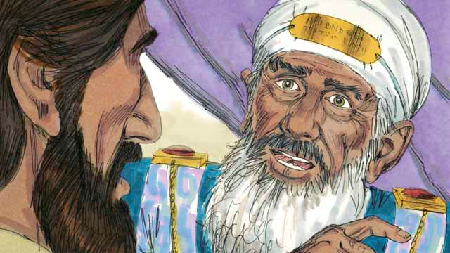
However, their statements did not agree with each other, so the Jewish leaders could not prove he was guilty of anything. Jesus did not say anything. Finally, the high priest
looked directly at Jesus and said, “Tell us, are you the Messiah, the Son of the living God?” Jesus said, “I am, and you will see me seated with God and coming from heaven.” The high priest tore his clothes because he was angry at what Jesus said. He shouted to the other leaders, “We do not need any more witnesses to tell us what this man has done! You yourselves have heard him say that he is the Son of God. What is your decision about him?”
Notes:
5B. Bible Reading
A. Read the story out loud to the class.
B. If students ask about words, give simple definitions.
C. Encourage students to read aloud paragraphs from the story. Encourage them to act the story.

Slide 20
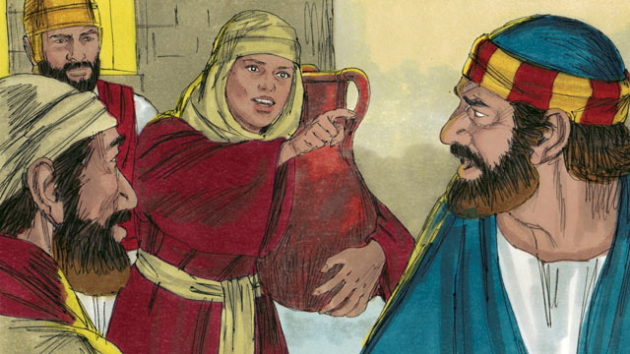
The Jewish leaders all answered the high priest, “He deserves to die!” Then they blindfolded Jesus, spat on him, hit him, and mocked him. As for Peter, he was waiting outside
the house. A servant girl saw him. She said to him, “You also were with Jesus!” Peter denied it. Later, another girl said the same thing, and Peter denied it again. Finally, some people said, “We know that you were with Jesus because you both are from Galilee.” Then Peter said, “May God curse me if I know this man!” Immediately after Peter swore like this, a rooster crowed. Jesus turned around and looked at Peter.
Notes:
5C. Bible Reading
A. Read the story out loud to the class.
B. If students ask about words, give simple definitions.
C. Encourage students to read aloud paragraphs from the story. Encourage them to act the story.

Slide 21
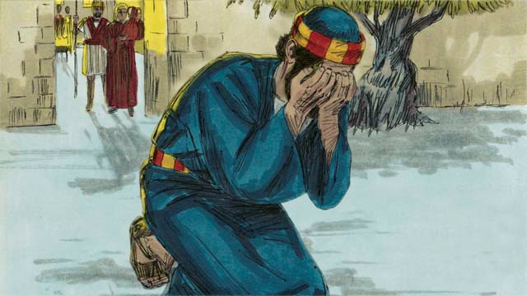
Peter went away and cried bitterly. At the same time, Judas, the one who had betrayed Jesus, saw that the Jewish leaders had condemned Jesus to die. Judas became full of sorrow. He took the 30 silver coins
back to the Jewish leaders and said, “I sinned. I handed over to you an innocent man to be killed.” The leaders refused to take it back. Judas threw the money into the Temple and went away and killed himself.
Notes:
5D. Bible Reading
A. Read the story out loud to the class.
B. If students ask about words, give simple definitions.
C. Encourage students to read aloud paragraphs from the story. Encourage them to act the story.

Slide 22
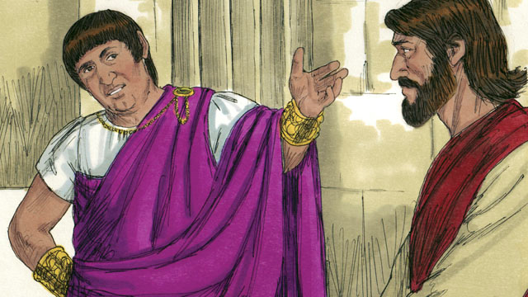
Now Pilate was the governor of Judea. He worked for Rome. The Jewish leaders brought Jesus to him. They wanted Pilate to condemn Jesus and kill him. Pilate asked Jesus, “Are you the king of the Jews?”
Jesus answered, “You have said the truth. But my kingdom is not here on earth. If it were, my servants would fight for me. I have come to earth to tell the truth about God. Everyone who loves the truth listens to me.” Pilate asked, “What is truth?”
Notes:
5E. Bible Reading
A. Read the story out loud to the class.
B. If students ask about words, give simple definitions.
C. Encourage students to read aloud paragraphs from the story. Encourage them to act the story.

Slide 23
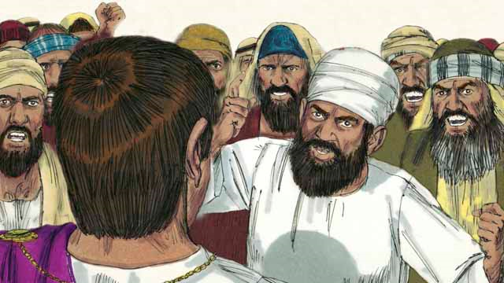
After speaking with Jesus, Pilate went out to the crowd and said, “I cannot find any reason that this man deserves to die.” But the Jewish leaders and the crowd shouted, “Crucify him!”
Pilate replied, “He is not guilty of doing anything wrong.” But they shouted even louder. Then Pilate said a third time, “He is not guilty!” Pilate became afraid that the crowd would begin to riot, so he agreed to have his soldiers crucify Jesus. The Roman soldiers whipped Jesus and put a robe and a crown made of thorns on him. Then they mocked him by saying, “Look, the King of the Jews!”
Notes:
5F. Bible Reading
A. Read the story out loud to the class.
B. If students ask about words, give simple definitions.
C. Encourage students to read aloud paragraphs from the story. Encourage them to act the story.
.

Slide 24
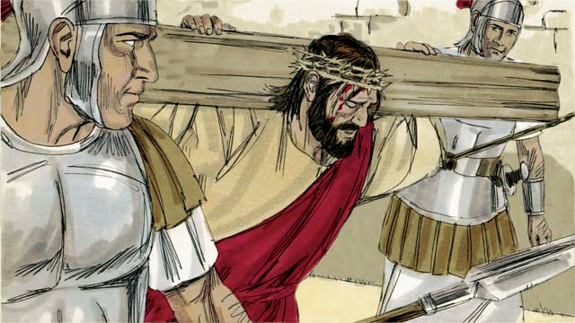
After the soldiers mocked Jesus, they led him away to crucify him.
They made him carry the cross on which he would die. The soldiers brought Jesus to a place called “The Skull” and nailed his hands and
feet to the cross. But Jesus said, “Father, forgive them, because they do not know what they are doing.” They also put a sign on the cross above his head. It said, “King of the Jews.” This is what Pilate had told them to write.
Notes:
5G. Bible Reading
A. Read the story out loud to the class.
B. If students ask about words, give simple definitions.
C. Encourage students to read aloud paragraphs from the story. Encourage them to act the story.

Slide 25
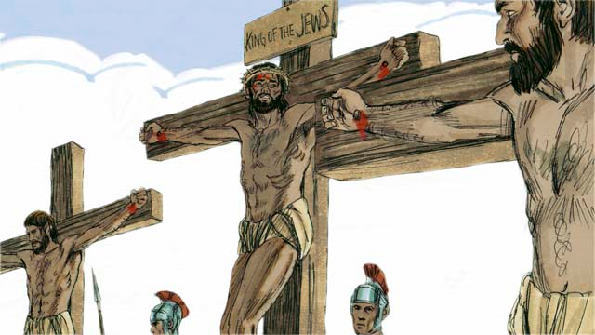
Then the soldiers gambled for Jesus’ clothing. When they did this, they fulfilled a prophecy that said, “They divided my garments among them, and gambled for my clothing.” There were also two robbers whom
the soldiers crucified at the same time, putting them on either side of Jesus. One of the robbers mocked Jesus, but the other said to him, “Do you not fear that God will punish you? We are guilty of doing many bad things, but this man is innocent.” Then he said to Jesus, “Please remember me when you become king in your kingdom.” Jesus answered him, “Today you will be with me in Paradise.”
Notes:
5H. Bible Reading
A. Read the story out loud to the class.
B. If students ask about words, give simple definitions.
C. Encourage students to read aloud paragraphs from the story. Encourage them to act the story.

Slide 26
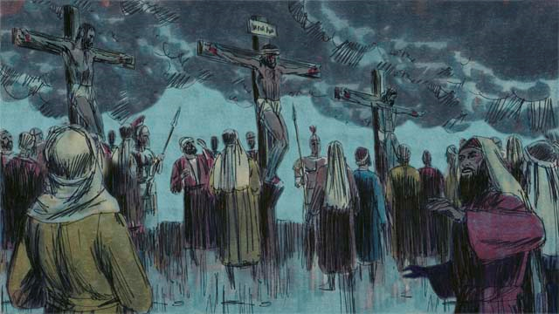
The Jewish leaders and the other people in the crowd mocked Jesus. They said to him, “If you are the Son of God, come down from the cross and save yourself! Then we will believe
you.”
Then the sky over the whole region became completely dark, even though it was the middle of the day. It became dark at noon and stayed dark for three hours.
26
Notes:
5I. Bible Reading
A. Read the story out loud to the class.
B. If students ask about words, give simple definitions.
C. Encourage students to read aloud paragraphs from the story. Encourage them to act the story.

Slide 27
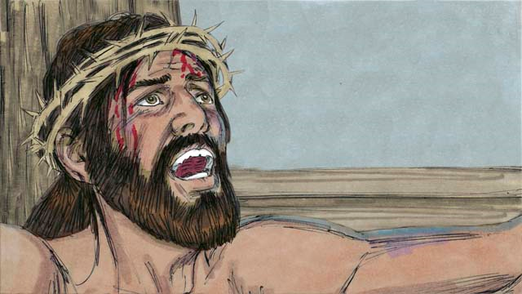
Then Jesus cried out, “It is finished! Father, I am giving my spirit into your hands.” Then he bowed his head and gave up his spirit.
When he died, there was an earthquake. In the Temple, the large curtain that separated the people from the presence of God was torn in two from the top to the bottom. Through his death, Jesus opened the way for people to come to God. When a soldier guarding Jesus saw everything that had happened, he said, “Certainly, this man was innocent. He was the Son of God.”
27
Notes:
5J. Bible Reading
A. Read the story out loud to the class.
B. If students ask about words, give simple definitions.
C. Encourage students to read aloud paragraphs from the story. Encourage them to act the story.

Slide 28
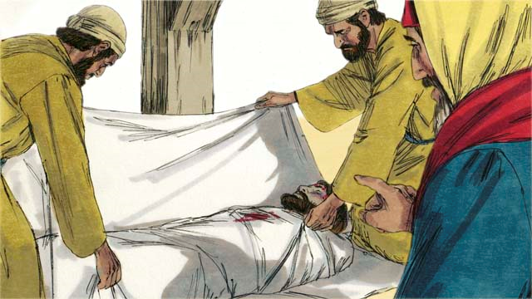
Then two Jewish leaders named Joseph and Nicodemus came and asked Pilate for Jesus’ body. They believed that Jesus was the Messiah. They wrapped his body
in cloth, took it to a tomb cut out of rock and placed it inside. Then they rolled a large stone in front of the tomb to block the opening. However, this is not the end of the story of Jesus, because Jesus rose again and is alive today. We will learn more in the next lesson.
28
Notes:
5K. Bible Reading
A. Read the story out loud to the class.
B. If students ask about words, give simple definitions.
C. Encourage students to read aloud paragraphs from the story. Encourage them to act the story.

Slide 29
Answer the Questions.
What happened to Jesus’ clothing?
What did the sign on the cross above Jesus say?
Why did Pilate give Jesus to the people to crucify?
What happened immediately after Jesus died?
Where was Jesus’ body buried?
Why did Jesus promise the dying thief paradise?
What does Jesus’ death mean to you?
Notes:
5L. Bible Reading Questions
Ask the questions and discuss as a group. For questions 1-4 you may go back to the story to help students find the answer.
Answers:
1. The soldier gambled for Jesus’ clothing.
2. “King of the Jews” was on the sign.
3. He was afraid of the people.
4. There was an earthquake.
5. Jesus’ body was placed in a tomb.
6. Because he confessed his sin
7. Answers may vary.

Slide 30
Listen and Answer the Questions.
Why is Lily unhappy with her first paycheck?
What is her father’s suggestion?
Where does Lily want to take a trip to visit her cousins?
Why does she want to start looking for bus tickets now?
Why is Lily’s father concerned about her mother?
What idea does Lily come up with to include her parents?
Notes:
6A. Activities – Listening with sound/spelling words /under/ and /Over/
Read the following script at least twice as students listen and write their answers to the questions. Students may NOT look at the script.
Lily: Dad, I got my first paycheck from my new job! I feel like they underpaid me, but I’m happy to have the money. What should I do with it?
Dad: Maybe you can save it. Never underestimate how important it is to put some money aside.
Lily: Oh, Dad. Please don’t overreact. I’d like to spend it on something special.
Dad: Ok, let’s take a walk to talk about it. I need the exercise. My doctor said I am overweight.
Lily: Maybe I could take a trip to visit my cousins in Brazil. I can save my money for a trip. That would be special! I should start looking for bus tickets now so I don’t have to overpay later.
Dad: Your Aunt Tia will be so happy to see you! It’s a trip that’s long overdue! Your mother and I have not seen their family in years. Your mother works so hard at the bank and at home and never takes a vacation. I worry that she’s underweight.
Lily: I have a great idea, Dad! Let’s all plan to visit Aunt Tia and her family next summer.
Dad: Oh, your mother and I would like that very much!
Answers:
She feels they underpaid her.
He suggests that Lily not underestimate how important it is to save her money.
She wants to go to Brazil.
She wants to get a good price on tickets so she doesn’t have to overpay.
She works too hard at the bank, and Lily thinks she is underweight.
She suggests the three of them take the trip to Brazil together.

Slide 31
Role Play – Bank Customer
Questions | Answers
1. How do I deposit money?
2. Where do I sign on the check?
3. How much can I withdraw?
4. How do I exchange currency?
5. What is the exchange rate?
6. Do you have an ATM?
7. Is there anything else I need to do?
Notes:
6B. Activities – Pair work
Partner A will play the part of a bank Teller. Partner B will be the person going to the bank and ask questions from this slide and write Partner B’s answers.
Check answers for correct grammar and punctuation.
Answers for this activity may vary.

Slide 32
Role Play – Bank Teller
Questions | Answers
1. What can I help you with?
2. Do you have an ID?
3. What is your bank account number?
4. Can you write your SSN?
5. Did you sign the back of the check?
6. How much would you like to exchange in this currency?
7. Do you need to notify us for travel?
Notes:
6C. Activities – Pair work
Partner B will play the part of a person going to a bank. Partner B will play the part of the bank Teller and ask questions from this slide and write Partner A’s answers.
Check answers for correct grammar and punctuation.
Answers for this activity may vary.

Slide 33


Song: Nothing But the Blood of Jesus
Verse 1:
What can wash away my sin?
Nothing but the blood of Jesus.
What can make me whole again?
Nothing but the blood of Jesus.
Verse 2:
This is all my hope and peace:
nothing but the blood of Jesus.
This is all my righteousness:
nothing but the blood of Jesus.
Chorus:
O precious is the flow
that makes me white as snow;
no other fount I know;
nothing but the blood of Jesus.
Notes:
7A. Song
Note: This song is by Robert Lowry. It repeats the phrase “Nothing but the blood of Jesus” after each line. You can divide the class into two groups and have the beginner level students sing this phrase and the chorus as you or the higher level students sing the other lines.
Students will learn the new song for the lesson and may also request to sing favorite songs from previous lessons, if time permits.
1. Model: Read the song lyrics out loud to the class. Ask if there are any questions. Highlight words that students ask about and give simple definitions. Then sing the song as the students just listen.
2. Repeat: Sing the selection again, a line or sentence at a time, as students repeat after you. Then play the recording and sing the song together as a class in unison.
3. Solo: The student sings solo (or if shy, can just read the words aloud).

Slide 34
1A. Homework: Write about the pictures using possessive
pronouns.
1. |  | 4.
2. |  | 5.
3. |  | 6.
Notes:
Homework 1A. - Write sentences using the pictured vocabulary words.
Model. Go over each of the homework assignments to be sure the student understands what to do.
Repeat. Encourage students to practice speaking and reading the completed homework assignments with a friend. They may use a bilingual dictionary.
Solo. Students will share their homework when they are finished. After they have shared their homework, be sure to check it for correctness, including spelling. Explain mistakes, while providing praise and encouragement. Answers will vary.
Number one is an example.
Answers may vary, but will start with a capital letter, have the correct verb form and punctuation mark, and use the following words:
1. The safe is his.
2. The loan is hers.
3. The change is theirs.
4. The deposit is his.
5. The withdraw is from his account.
6. The bills are theirs.

Slide 35
1B. Homework: Write about the pictures using vocabulary from the bank.
7. |  | 10.
8. |  | 11.
9. |  | 12.
Notes:
Homework 1B. - Write sentences using the pictured vocabulary words.
Students will write a sentence for each picture to practice the lesson’s vocabulary words.
Answers may vary, but will start with a capital letter, have a punctuation mark at the end, and use the following words:
7. The security guard runs.
8. The Teller asks a question.
9. They exchange money.
10. She borrows money.
11. He withdraws money from the ATM.
12. He lends money to her.

Slide 36
2. Fill in the blanks.
Whose/who | Hers/his/theirs/her/she/he/they
_____ money is that? | The money is ____
2. The ATM has _____ change? | 2. The change from the ATM is _____
3. _____ made a deposit? | 3. ______ made a withdrawal
4. The security guard ran after _____? | 4. ______ ran from the security guard
5. _____ safe was taken? | 5. The safe that was taken is _____
Notes:
Homework 2. -Grammar and Vocabulary Review
Students must fill in the blanks with eight the possessive pronouns/whose or the regular pronouns/who
The first column is whose/who fill in the blanks. The second column is regular versus possessive pronouns.
First column answers:
1. Whose
2. Whose
3. Who
4. Whom
5. Whose
Second Column answers
1. Hers/his/theirs
2. Hers/his/theirs
3. She/he/they
4. She/he/they
5. Hers/his/theirs

Slide 37
3. Ask your partner.
Questions | Answers
1. Where were your friends from? | They were from Croatia.
2. Do you give tips ______
3. How much do you usually spend on ______
4. Did you sign ______
5. How do I deposit _______
6. Have you ever ______
7. Whom would you not ______
Notes:
Homework 3A. – Conversations - Pair work
Students will interview a partner, and write their partner’s answers. Then they will switch and answer their partner’s questions.
Check answers for correct grammar and punctuation.
Number 1 is an example.
Questions and answers will vary, but may include:
2. Do you give tips at a restaurant in your country?
3. How much do you usually spend on food?
4. Did you sign the back of the check?
5. How do I deposit a check?
6. Have you ever borrowed money from someone?
7. Whom would you not lend money to?

Slide 38
4. Fill in the blanks and say the correct words.
underweight
underpaid
overpriced
overdue
undercooked
overlooked
underground
overreact
overworked
Please don’t overreact when you hear the news.
He doesn’t make much money. He’s _______
The bill was due yesterday. Now it’s _______
That meat is still red. It’s _______
Everything is _______ in that store. It’s expensive.
No one noticed the little bird. It was _______
That cat is _________. It’s really skinny.
He is at his job from 7 AM-7 PM every day. He’s _________.
The subway train runs ___________ in a dark tunnel.
Notes:
Homework 4. – Write and say sentences with /under/ and /Over/ words.
Learners will complete the sentences with the correct words. Number 1 is an example.
Answers:
2. underpaid
3. overdue
4. undercooked
5. overpriced
6. overlooked
7. underweight
8. overworked
9. underground

Slide 39
5A. Discuss the Bible story with your partner.
How do you feel about this Bible story?
Which person did you relate to in the story and why?
What was confusing about the story?
What did you learn from the story?
How do you think it applies to your life?
What are two questions you have about the story?
A.
B.
Notes:
Homework 5A. – Bible Reading Review
Ask the students to tell the Bible story to a partner and then interview the partner, and write their partner’s answers. Then they will switch roles and answer their partner’s questions.
Check answers for correct grammar and punctuation.
Answers will vary.

Slide 40
5B. Summarize the Bible lesson using your own
words.
Jesus was killed on a cross.
Peter __________________________________________
Pilate _____________________________________
Judas _______________________________________
The soldiers ____________________________________
Joseph and Nicodemus______________________________
Notes:
Homework 5B. – Bible Reading Review
Students may look back at the story to write their answers.
Answers will vary but may include:
Jesus was killed on a cross. Peter denied him three times. Pilate asked Jesus, “Are you the king of the Jews?” Judas betrayed Jesus and killed himself. The soldiers mocked Jesus and beat him and crucified him. Joseph and Nicodemus put his body in a tomb.

Slide 41
5C. Use these pictures from the story to help you write a one-paragraph summary of the Bible story on the next slide.
Notes:
Homework 5C. – Bible Reading Review
Use these pictures from the story to help you write a one-paragraph summary of the Bible story on the next slide.

Slide 42
5C. Write a paragraph about Jesus’ death on the cross and what it means to you.
Notes:
Homework 5C. – Writing
Model. Write something about how Jesus’ death on the cross has affected you.
Answers will vary.

Slide 43
6A. Homework – Choose one verse to memorize.
Pilate told them to write a sign and put it on the cross. The sign said, “JESUS OF NAZARETH, THE KING OF THE JEWS.” John 19:19 ERV
Jesus answered, “Yes, I am the Son of God. And in the future you will see the Son of Man sitting at the right side of God All-Powerful. And you will see the Son of Man coming on the clouds of heaven.” Mark 14:62 ERV
A
B
Notes:
Homework 6A. – Memorize a Verse
Learners get to choose A, B, or C (on the next slide) to memorize. Please notice that the memory work is not long. Everyone, regardless of skill level, should be able to do it.
1. Model. Recite a verse from memory.
2. Repeat. Encourage students to find someone with whom to practice conversing and reading the completed homework assignment.
3. Solo. Students will recite the verse from memory at the next class.

Slide 44
6B. Homework – Choose one verse to memorize and read the next verses.
These things happened to give full meaning to the Scriptures that said, “None of his bones will be broken.” John 19:36 ERV.
Read the next lesson’s Bible verses:
Matthew 27:62-28:20, Mark 16:1-20, Acts 1:1-11
C
Notes:
Homework 6B. – Memorize a verse and read the next lessons’ verses.
Learners get to choose A, B, or C to memorize.
Students will always read the Bible lesson in their first language (L1) before reading it in English the following lesson. Help them get a Bible in their own language if they don’t have one. They may also use Bible.IS or other Bible translation resources.

Slide 45
7A. Read the letter and answer the questions.
Dear Susan,
How are you? I heard that you are coming to visit Brazil soon. Are you excited? It’s really great living here. I love it. The World Cup is going on, and everyone is taking the day off.
There are a couple of things you might need to know about visiting Brazil. You probably need to go to your bank and let them know you are traveling. They might freeze your credit card if they see purchases from here. You might also want to exchange your U.S. dollars for Brazilian currency. Ask them to withdraw it for you and give you the cash and change. Don’t spend lots of money here. You don’t need to rent a car, you can borrow mine. I look forward to sharing adventures with you soon.
Your Friend,
Beka
Notes:
Homework 7A. – Everyday Reading and Writing
The learners will read the letter from Beka to her friend Susan and answer the questions on the next slide.

Slide 46
7B. Homework – Answer the questions.
Where is Susan visiting?
Why are people taking the day off?
What happens if you don’t let the bank know you are traveling?
What does Susan need to exchange her U.S. dollars for?
What is Beka willing to lend to Susan?
What does it mean if your bank freezes your card?
Notes:
Homework 7B. – Everyday Reading and Writing
The learners will answer these questions from the story.
Answers can vary but may be:
1. Susan is visiting Brazil.
2. The World Cup is happening.
3. If you don’t let the bank know you are traveling, they could freeze your credit card.
4. She needs to exchange U.S. dollars for Brazilian currency.
5. She is willing to lend her car.
6. If your bank freezes your card, you cannot use it to pay for things.

Slide 47
8. Writing
Write a letter to a friend telling what you know about Jesus.
Notes:
Homework 8. – Writing
Model. Write a letter about Jesus such as: Dear Larry, I want to tell you what I learned about Jesus Christ in English class. He was born in Bethlehem. He was crucified for our sins and rose again. He has changed my life.
Answers will vary.

Slide 48
9. Homework – Now I Can….
I can discuss banking and money.
I can use the new words, including _____, _____, _____, _____, _____, _____, _____, _____, _____, _____, _____, and _____.
I can use “who’s” and “whose” and possessive pronouns.
I can understand how Jesus died on the cross for my sins.
Notes:
Homework 9. – I can statements
The student must be able to achieve all of these skills before the next lesson. If not, the lesson can be repeated or additional practice materials can be used.
Review all of the skills at the beginning of the next lesson. Be sure to give lots of praise and encouragement!

Slide 49
Reflections and Closing Prayer
49
Notes:
Reflections and Closing Prayer
You may want to thank the Lord for what we have learned, ask for special prayer requests, then pray for your students and bless them. Students may write reflections and their prayers here.

Slide 50

Help us share the Light of the World!
Thank you for using our materials. If these lessons are a blessing to you, please give or volunteer to help others learn English through the Bible.
For more information, visit LightOfTheWorldLearning.org

Slide 51
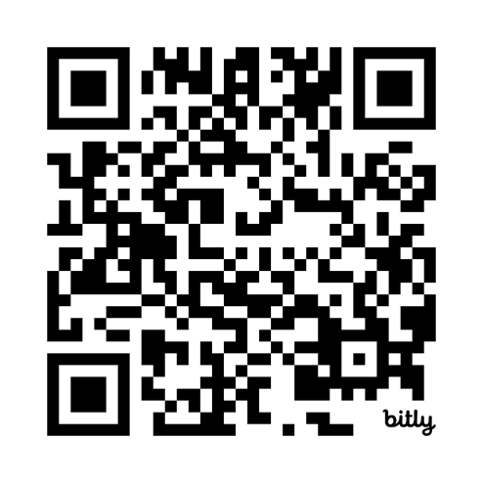
Appendix
Irregular Verb List: bit.ly/ListVerbs
Lesson Downloads: LightOfTheWorldLearning.org
Order Books: bit.ly/BooksLOTW
Share Your Feedback: bit.ly/FeedbackLOTW
Table of Contents: bit.ly/TocLOTW
Videos: bit.ly/A2videos
Vocabulary List: bit.ly/VocabUS
Website: LightOfTheWorldLearning.org
Notes:
51

Slide 52
Acknowledgements
We would like to thank the entire Light of the World volunteer team for their hard work and creativity in making this project possible. For all those around the world who prayed, wrote, edited, narrated, illustrated, sang, tested, and gave generously for this curriculum, we appreciate you sharing the love of Jesus through the gift of English. Our team members include:
Anonymous | Emily Cox | Jill Gramzow | Martha Lane
Jean Ato | Marilyn Dano | Tanya Griffin | Audrey Larsen
Bradley Baurain | Hephzi Davidson | Rachel Grijincu | Aden Lewis
Ana Biederman | Susanna Diallo | Lauren Haines | Bruce Lewis
Bob Biederman | Alyssa Dokolas | Carol Hale | Elena Lewis
Joshua Blake | EasyReadEnglish.com | Emily Hamilton | James Lewis
Rachael Braggs | Don Edic | Patty Hickman | Micah Beth Lewis
Hannah Brendel | Peggy Fergus | Juliette Hyer | Tim Lewis
Larry Buell | MaryBeth Gahan | Lyudmila Ivanyuk | Ward Lewis
Cindy Campbell | Melina Gallo | Debbie Johnson | Cosette Lindsay
Christian Cha | Alicia Gentile | Carey Jo Johnston | Johnny Lukashevich
Olivia Cheney | Prakash Chandra Giri | Nancy Kingdon | Gail MacMillan
Hannah Clark | Ellenor Gopal | Dorothy Konadu | Ivan Mader
Nancy Cobb | Henrietta Grajcar | Macy Lake | Amy Martin
(continued on the next slide)

Slide 53
Acknowledgements - Continued
Diana Martz | Joan Phelps | Lorna Tatomir
Hannah McMahan | Megan Rahn | Darrell Turner
Christy McPherson | Sara Scazzero | Leigha Wachter
Tracy Meddaugh | Hannah Schmokel | Joseph Waite
Barbara Newsome | Ashlyn Shrimplin | Graham Whitmore
Brenda Nielsen | Leah Sprague | Cheri Wilke
Danielle Nowe | Noah Staal | Mackenzie Williams
Deborah O’Donnell | Macie Stuckman | Allison Wright
Evelyn Ocasio | Jia Le Su | Tiffany Yeh
Georg Ort | Carole Svensson | Muchun Yin
Martha Ort | Ellie Talalight | Ted York
Barb Park | Peter Talalight | Tai Lee Young
Deb Payne | Weston Talalight | Abigail Zawisza
Linda Petrie | Rachel Tamang | Anita Zeifert
Bible story and pictures on slides 15-20 adapted from the original work by unfoldingWord available from https://openbiblestories.org
Bible Verses on slides 40-41 Taken from the HOLY BIBLE: EASY-TO-READ VERSION ©2014 by Bible League International. Used by permission.

