Slide 1


Unit A2-44
©2020-2026 Light of the World Learning
Notes:
Teacher’s Notes:
Thank you for using our materials. For more resources and teacher training visit LightOfTheWorldLearning.org or contact Info@LOTWL.org
Preparation:
Pray
Read the Bible passages.
Preview slides and song.
Optional: Bring maps, travel itineraries, and other items related to travel plans.

Slide 2
Pray, Review, and Preview
Bible Reading: God Raises Jesus from Death - Matthew 27:62-66; 28:1-20; Mark 16:1-20; Acts 1:1-11
Theme: Travel Plans
Pronunciation: Word Endings: /les/ spelled -less means “without” and /ful/ spelled -ful means “full of”
Grammar: Present Perfect Tense with For, Since, Never, Ever
Notes:
Pray
Pray for the class. You may want to thank the Lord for the technology that has enabled us to travel freely.
Check Homework and Review
Ask each student to read aloud or recite their homework from the last class. Check written work. Be sure they have read Matthew 27:62-66; 28:1-20; Mark 16:1-20; Acts 1:1-11 in their native languages in preparation for the lesson.
Review the main points of the previous lesson and ask if there are any questions.

Slide 3




What do you see?
SYD-TLV
TLV-SYD
GUIDE
24 DEC
We arrive
Depart
Notes:
1A. Discuss Theme Picture
Ask “What do you see in this picture?” and “What else?” to elicit vocabulary they already know.
Repeat and write their words or show the words on the next slide.
Answers may include: a guidebook, to depart, a coast, a flight, round-trip, to arrive, to laugh, a passport, etc.
More advanced students can be encouraged to make complete sentences:
The plane tickets are round-trip tickets. The flight departs on the 23rd. The flight arrives on December 24th.

Slide 4
What do you see?
5. round-trip
a guidebook
SYD-TLV
TLV-SYD
GUIDE
24 DEC
We arrive
6. to arrive
4. a flight
7. to laugh
Depart
2. to depart
3. a coast
8. a passport
Notes:
1B. Show Words for Theme Picture
Please show the names of the theme picture items to the students briefly.
These words can be studied for homework.

Slide 5



Have you ever traveled to the Holy Land?
I have never been there, but I have planned a wonderful trip for two weeks. I just bought a round-trip ticket from Sydney, Australia to Israel and back to Sydney. It is a long flight. I depart on December 23 and arrive on December 24.
I have wanted to visit the Holy Land since I was a child. I have read guidebooks and planned all the places I want to see: Jerusalem, Bethlehem, Nazareth, and the Sea of Galilee. I’m excited to go sightseeing. I hope to have a meaningful visit there.
Notes:
1C. Description of Theme Picture
Please read the description of the theme picture to the students and point to the pictured vocabulary.
If students ask about words, give simple definitions.
Practice of vocabulary begins with the following slide.

Slide 6



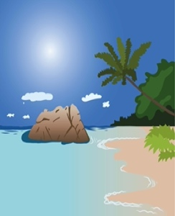
Match the beginning and end of each sentence.
1. I am taking a flight to
2. I have gotten my passport
3. Reading the guidebook has been helpful
4. I have driven to the coast so I
A. in planning our trip.
B. Spain because it is faster than a train.
C. can spend time at the beach.
D. so I have identification for an international trip.
Notes:
2A. Vocabulary
1. Say the beginning of the sentence a few times, as you indicate the picture. For example, say, ”I am taking a flight, I am taking a flight,” Have your students then repeat the phrase after you a few times.
2. Ask students to match the beginning and end of each sentence and say the complete sentence. For example, ”I am taking a flight to Spain because it is faster than a train.”
3. Check students’ comprehension further by asking direct questions. For example, “Which coast would you like to visit?”
Answers
B
D
A
C

Slide 7




Match the beginning and end of each sentence.
5. A jungle is a type
6. The sightseeing bus has taken us on a tour of
7. The one-way flight goes
8. Our round-trip (or return) ticket is for
E. the city.
F. from Chicago to Manila.
G. Canada to Mexico, and back to Canada.
H. of thick forest in warm areas.
Notes:
2B. Vocabulary
1. Say the beginning of the sentence a few times, as you indicate the picture. For example, say, ”A jungle is a type, A jungle is a type,” Have your students then repeat the phrase after you a few times.
2. Ask students to match the beginning and end of each sentence and say the complete sentence. For example, ”A jungle is a type of thick forest in warm areas.”
3. Check students’ comprehension further by asking direct questions. For example, “Have you ever hiked in the jungle?”
Answers
5. H
6. E
7. F
8. G

Slide 8

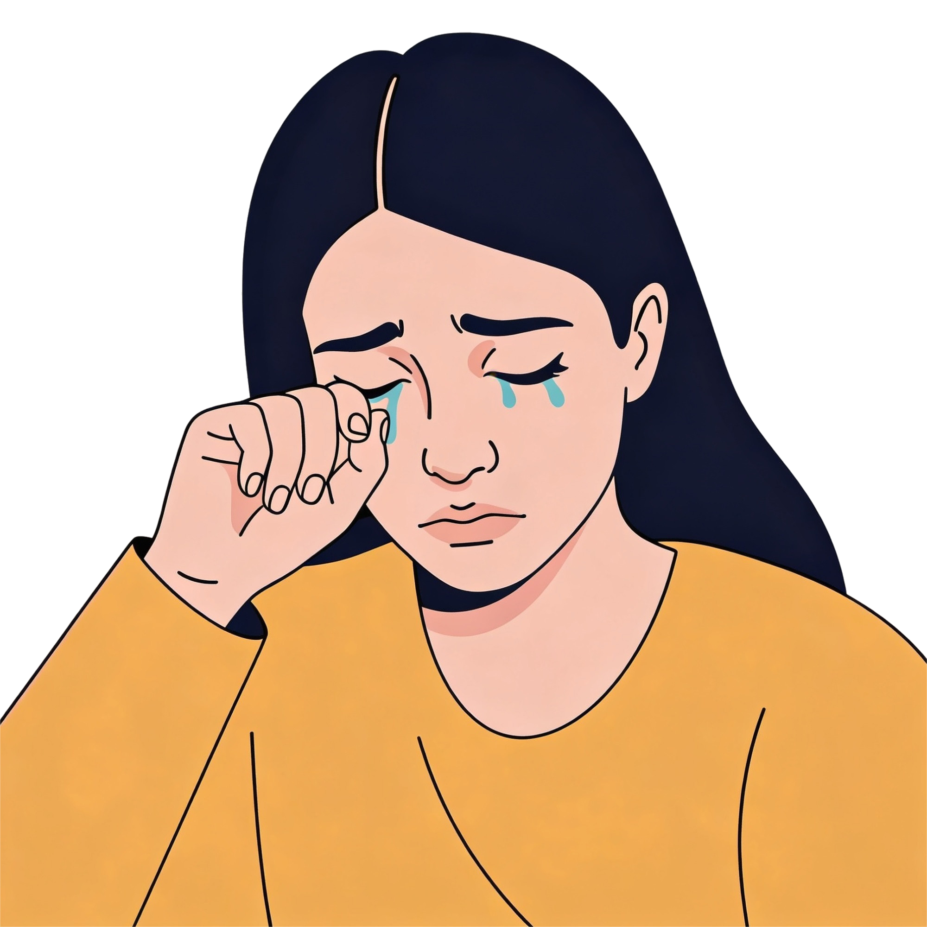

Match the beginning and end of each sentence.
9. Our plane has arrived.
10. We were late and our plane has already left. It
11. I have laughed every time
12. We weep
I. when we are in pain.
J. It just landed here at the airport.
K. departed without us.
L. Sam has told a joke.
Notes:
2C. Vocabulary
1. Say the beginning of the sentence a few times, as you indicate the picture. For example, say, ”Our plane has arrived, Our plane has arrived,” Have your students then repeat the phrase after you a few times.
2. Ask students to match the beginning and end of each sentence and say the complete sentence. For example, ”Our plane has arrived here at the airport.”
3. Check students’ comprehension further by asking direct questions. For example, “Do you like to laugh at funny jokes?”
Answers
9. J
10. K
11. L
12. I

Slide 9
Present Simple, Past Simple, and Present Perfect
Comparison
 | Tense | Question ? | Positive + | Negative -
1. | Present Simple | Do you live in London? | Yes, I live in London. | No, I don’t live in London.
2. | Past Simple | Did you live in London in 2009? | Yes, I lived in London in 2009. | No, I didn’t live in London in 2009.
3. | Present Perfect | Have you lived in London? | Yes, I have lived in London. | No, I haven’t lived in London.
Notes:
2D. Grammar – Comparing Tenses
Model, Repeat and Solo all three rows and explain differences.
Present Simple. For facts and habits.
Past Simple For actions, events, or states finished at a specific time in the past. The action does not continue into the present.
Present Perfect. An action completed at an unspecified time, or an action that started in the past and continues in the present, or a repeated action that is important to the current situation.

Slide 10
Present Perfect Uses
 | Use | Subject | Have/has | Past Participle
1. | Unspecified time in past | I | have | read | the Bible before, but never in English!
2. | Past action continues in present | You | have | been | in India for two weeks now.
3. | Repeated past action | He | has | prayed | many times for help with decisions.
Notes:
2E. Grammar – Present Perfect Uses
Model, Repeat, and Solo rows 1-3. Note: The present perfect tense is used in relation to other actions. There is a connection between a past action or experience and the present situation.
Unspecified: I’ve read the Bible before, but never in English. (The experience of reading the Bible is important, not the time.)
Continues: They have been in France for two weeks now. (They have been in France for two weeks and are still there.)
Repeated: He has prayed many times for help with decisions. (Repetition of a past action that is important to the current situation or conversation.)
Past participles may be regular with -ed (prayed) or irregular (read, been). See irregular verb list linked in the Past Participle column or in the appendix to memorize the irregular forms.

Slide 11
Present Perfect Tense – Fill in the Blanks
 | Question ? | Positive + | Negative -
1. | Have I traveled? | I have traveled. | I have not traveled.
2. | Has he departed? | He has departed. | He has not departed.
3. | Have they arrived? |  | They haven’t arrived.
4. | Has she flown? | She’s flown.
5. |  |  | She hasn’t taught.
6. |  |  | We haven’t camped.
7. |  | They’ve laughed.
8. | Have they wept?
Notes:
2F. Grammar – Present Perfect Tense
Model, Repeat, and Solo numbers 1-2. Ask students to complete the sentences for numbers 3-8.
Answers may use the full forms or contractions:
3. They have arrived.
4. She has not flown.
5. Has she taught? She has taught.
6. Have we camped? We have camped.
7. Have they laughed? They have not laughed.
8. They have wept. They have not wept.

Slide 12
Present Perfect is often used with “for” or “since.”
 | For – Duration of Time | Since – Point in Time
1. | No planes have arrived for weeks. | No planes have arrived since May.
2. | I’ve waited for 2 hours. | I’ve waited since 9:00 AM.
3. | They’ve been married for 5 years. | They’ve been married since they were in college.
4. | She’s lived here ____________ | She’s lived here ______________
5. | I haven’t seen him _____________ | I haven’t seen him ____________
Notes:
2G. Present Perfect with time expressions “For” or “Since”
For and since are used to talk about actions that began in the past and continue to the present.
For is used with a duration or length of time such as minutes, weeks, or years.
Since is used with a specific point in time. It can be used with dates, times, seasons, and past events.
Model, Repeat, and Solo rows 1-3. Then ask learners to complete 4-5 using “for” and “since” with a duration or point in time.
Answers will vary, but must use the correct time expressions.
4. She’s lived here for 6 months. She’s lived here since the summer.
5. I haven’t seen him for hours. I haven’t seen him since yesterday.

Slide 13
Present Perfect with “ever” and “never”
 | Question ? | Positive + | Negative -
1. | Have you ever been to Rome? | Yes, I’ve been to Rome. | No, I’ve never been to Rome.
2. | Has she ever flown over the ocean? | Yes, she has flown over the ocean. | No, she has not ever flown over the ocean.
3. |  | Yes, they have seen the Jesus Film.
4. |  | Yes, he has read the Bible.
5. |  | Yes, we have hiked in the jungle.
Notes:
2H – Grammar – Present Perfect with “ever” and “never.”
Ever and never are used to talk about actions done at any time in a person’s life or in history. Ever is used for questions or negatives (not ever). Never is used for negatives and has the same meaning as not ever.
Model, Repeat, and Solo rows 1-2. Then ask learners to complete the sentences for 3,4, and 5
Answers may vary, but must use the correct time expression (ever, never or not ever).
3. Has she ever flown over the Pacific Ocean? No, she has never flown over the Pacific Ocean.
3. Have they ever seen the Jesus Film? No, they have never seen the Jesus Film. Or, No, they have not ever seen the Jesus Film.
4. Has he ever read the Bible? No, he has never read the Bible. or, No, he has not ever read the Bible.
5. Have you ever hiked in the jungle? No, we have never hiked in the jungle. Or, No, we have not ever hiked in the jungle.

Slide 14
Listen and repeat.
A: Have you ever taken an international flight?
B: No, but now I have got my passport so I can.
A: Where are you going?
B: We are going sightseeing in Europe!
A: Have you been to Europe before?
B: No, I haven’t traveled there before, have you?
A: Yes, I have camped in Greece. It’s beautiful!
B: Wow! I hope that we can visit the coast there.
A: Have a good trip!
Notes:
3. Conversation
1. Model: Say both parts of the conversation several times. Use A and B cards, stick figures, or change your physical position to indicate the dual parts. Role-play the parts to convey the meaning of the conversation. Students are to watch and listen.
2. Repeat: Say one line at a time and have students repeat until they can be understood.
3. Solo: You begin the conversation and call on individual students to respond. Then reverse the roles (students are A, you are B).
4. Once students can do both parts, encourage free conversation (students substitute their own words for the blue words).

Slide 15
The suffix –less can mean “without” and –ful can mean “full of.”
1. /les/ spelled less | 2. /ful/ | 3. Challenge
hopeless | hopeful
careless | careful
helpless | helpful
thoughtless | thoughtful
meaningless | meaningful
joyless | joyful
Do you believe that life is meaningless?
No, I believe that life is meaningful and hopeful with Christ!
Notes:
4A. Pronunciation - Sounds and Spelling
1. Model: Say the sound several times while pointing to it. (For example, point to the /les/ and say /les/ /les/ /les/. Then say the sound and quickly read the entire list, pointing to each item as you read it (/les/ hopeless, careless, helpless, thoughtless, meaningless, joyless). Students just watch and listen.
2. Repeat: Say the sound and each word several times, having students repeat each time after you in unison. Be sure to use your normal voice and rate of speed. Do one column at a time, top to bottom. Then read the sentences.
3. Solo: Call on individuals to say a sound and its word group. Give lots of praise. Then ask students to read the sentences.
4. Challenge: Choose another sound from the lesson that is challenging for your particular students to pronounce. Use words from Parts 1 and 2 of the lesson, and from previous lessons to make a group of 3-5 words. You may repeat the same challenging sounds in several lessons. Students need a lot of practice on sounds that do not exist in their first language.

Slide 16
Listen and repeat.
A. - ▔ | B. ▔ - - | C. ▔ -
a flight | sightseeing | jungle
a coast | beautiful | guidebook
arrive | wonderful | passport
to weep | meaningless | one-way
to laugh | motionless | round-trip
Notes:
4B. Hum and clap the stress
Begin by humming the stress of a column of words. Hum higher, longer, and louder for big dashes and lower, shorter, and quieter for small dashes.
You may use hand gestures to indicate that the stressed syllable is higher in pitch, longer in duration, and louder. Invite your students to join in humming the rhythm. Once the class is humming the rhythm in unison, you can begin saying the words. You may also wish to clap the syllables while you say the words.
1. Model: Hum and then say each word in the column several times. Students listen.
2. Repeat: Students repeat words after you in unison.
3. Solo: Call on individuals to read the entire column of words.

Slide 17
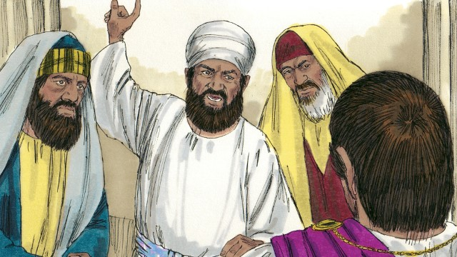
Read Matthew 27:62-66; 28:1-20; Mark 16:1-20; Acts 1:1-11 in your language. Then read the story: God Raises Jesus from Death
After the soldiers crucified Jesus, the Jewish leaders said to Pilate, “That liar, Jesus, said he would rise from the dead after three days. Someone must guard the tomb to make sure that his disciples do not steal the body. If they do, they will say he has risen from the dead.”
Pilate said, “Take some soldiers to guard the tomb as well as you can.” So they placed a seal on the stone at the entrance of the tomb. They also put soldiers there to guard the tomb.
Notes:
5A. Bible Reading
Be sure students read this story in their first language before reading it in English. The hyperlinks of the Bible verses connect to https://live.bible.is/ so students can read and hear the scripture in their own languages.
A. Read the story out loud to the class.
B. If students ask about words, give simple definitions.
C. Encourage students to read aloud paragraphs from the story. Encourage students to act out the story.
D. Ask if there are any questions or comments about the story.
E. Ask the story questions and discuss as a group.
F. Optional - You may hide the words and ask students to tell the story again in their own words, using the pictures to help them.

Slide 18
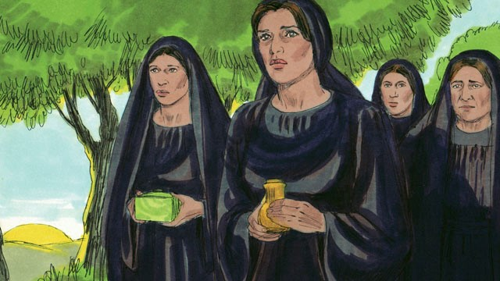
Very early in the morning after the Sabbath, the women came to Jesus’ tomb. They wanted to put more spices on his body.
An angel shining as brightly as lightning came from heaven. He rolled away the stone
that covered the entrance to the tomb and he sat on it. The soldiers at the tomb saw him. They were so afraid that they fell to the ground like dead men.
The angel said to the women “Do not be afraid. Jesus is not here. He has risen from the dead, just like he said he would! Look in the tomb and see.” The women looked into the tomb and saw his body was not there!
Notes:
5B. Bible Reading
A. Read the story out loud to the class.
B. If students ask about words, give simple definitions.
C. Encourage students to read aloud paragraphs from the story. Encourage them to act the story.

Slide 19
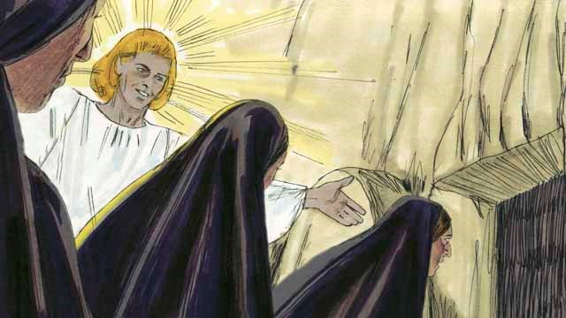
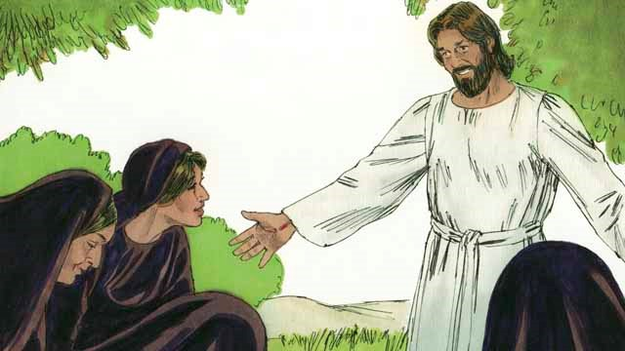
Then the angel told the women, “Go and tell the disciples, ‘Jesus has risen from the dead and he will go to Galilee ahead of you.’”
The women were amazed and very joyful. They ran to tell the disciples the good news.
As the women were on their way to tell the disciples the good news, Jesus appeared to them. They bowed down at his feet. Then Jesus said, “Do not be afraid. Go and tell my disciples to go to Galilee. They will see me there.”
Notes:
5C. Bible Reading
A. Read the story out loud to the class.
B. If students ask about words, give simple definitions.
C. Encourage students to read aloud paragraphs from the story. Encourage them to act the story.

Slide 20
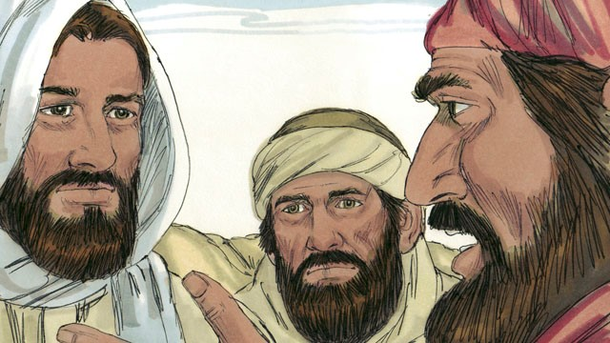
Later that day, two of his disciples were walking to a nearby town. Jesus started walking with them, but they did not recognize him. He asked what they were talking about. They told him they had
hoped that Jesus was the Messiah, but then he was killed and buried. And now the women said he was alive again.
They thought they were talking to a stranger who did not know what had happened in Jerusalem. Then Jesus explained to them what God’s word said about the Messiah.
Notes:
5D. Bible Reading
A. Read the story out loud to the class.
B. If students ask about words, give simple definitions.
C. Encourage students to read aloud paragraphs from the story. Encourage them to act the story.

Slide 21
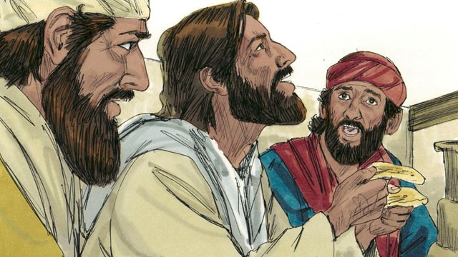
When they arrived at the town, they invited Jesus to stay with them, so he went into a house with them. They sat down to eat their evening meal.
Jesus picked up a loaf of bread, thanked God for it, and then broke it. He began to give the bread to them.
Suddenly, they recognized that he was Jesus. But at that moment, he disappeared from their sight. The two men said to each other, “That was Jesus! That is why we were so excited when he explained God’s word to us!”
Notes:
5E. Bible Reading
A. Read the story out loud to the class.
B. If students ask about words, give simple definitions.
C. Encourage students to read aloud paragraphs from the story. Encourage them to act the story.

Slide 22
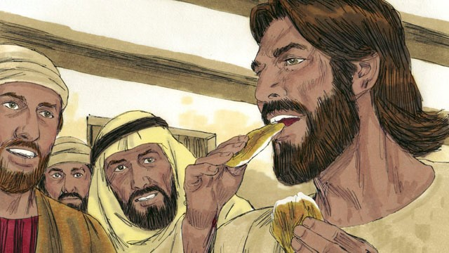
Immediately they left and went back to Jerusalem. When they arrived, they told the disciples, “Jesus is alive! We have seen him!” As the disciples were talking, Jesus suddenly appeared in the room with them.
He said, “Peace to you!” The disciples thought he was a ghost, but Jesus said, “Why are you afraid? Why do you not think it is really me, Jesus? Look at my hands and feet. Touch me and see. Ghosts do not have bodies like I do.” Then he asked for something to eat. They gave him a piece of fish, and he ate it.
Notes:
5F. Bible Reading
A. Read the story out loud to the class.
B. If students ask about words, give simple definitions.
C. Encourage students to read aloud paragraphs from the story. Encourage them to act the story.

Slide 23
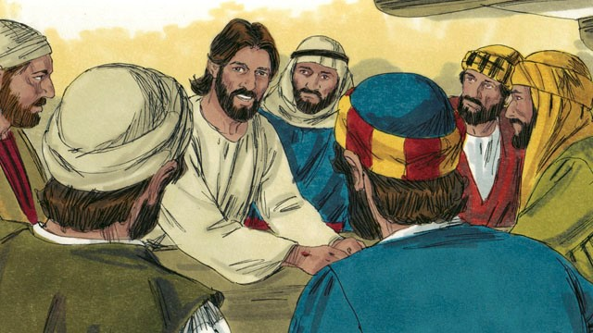
Jesus said, “Everything about me that
God’s word says will happen, I have told you that it must happen.”
Then Jesus made them understand
God’s word better. He said, “It is
written that the Messiah would be
killed and rise from death on the third day. You saw these things happen—you are witnesses. You must go and tell people that they must change and turn to God, which will bring them his forgiveness. You must start from Jerusalem and tell this message in my name to the people of all nations. Remember that I will send you the one my Father promised. Stay in the city until you are given that power from heaven.”
Notes:
5G. Bible Reading
A. Read the story out loud to the class.
B. If students ask about words, give simple definitions.
C. Encourage students to read aloud paragraphs from the story. Encourage them to act the story.

Slide 24
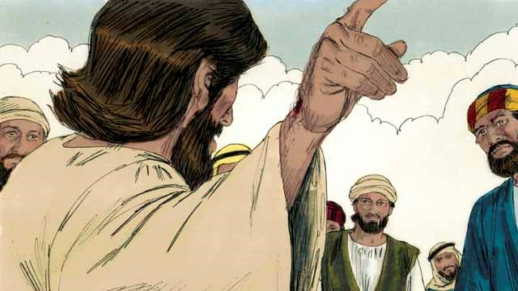
During the next 40 days, Jesus appeared to his disciples many times. Once, he even appeared to more than 500 people at the same time. In many ways, he proved to his disciples that he was alive and he taught them about the kingdom of God.
Jesus said to his disciples, “All authority in heaven and on earth is given to me. So go and make followers of all people in the world. Baptize them in the name of the Father and the Son and the Holy Spirit. Teach them to obey everything that I have told you to do. You can be sure that I will be with you always. I will continue with you until the end of time.”
Notes:
5H. Bible Reading
A. Read the story out loud to the class.
B. If students ask about words, give simple definitions.
C. Encourage students to read aloud paragraphs from the story. Encourage them to act the story.

Slide 25
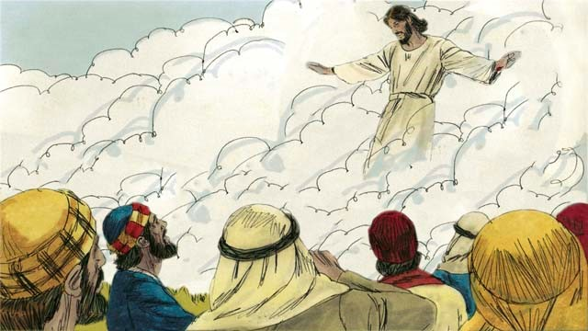
Forty days after Jesus rose from the
dead, he told his disciples, “Stay in
Jerusalem until my Father gives you
power. He will do this by sending the
Holy Spirit upon you.”
Then Jesus went up to heaven, and a cloud hid him from their sight.
Jesus is now seated in heaven at the right hand of God to rule over all things.
Notes:
5I. Bible Reading
A. Read the story out loud to the class.
B. If students ask about words, give simple definitions.
C. Encourage students to read aloud paragraphs from the story. Encourage them to act the story.

Slide 26
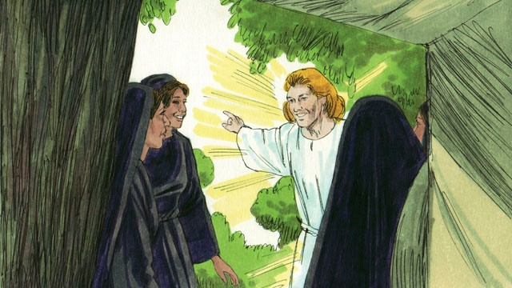
Answer the questions.
What did the women plan to do at the tomb?
What did they see at the tomb?
Why did Pilate order soldiers and guards to guard the entrance of the tomb?
Why do you think Jesus went up to heaven after his resurrection?
How does Jesus’ resurrection change your life?
Notes:
5J. Bible Reading Questions
Ask the questions and discuss as a group. You may go back to the story to help students find the answer.
Answers:
1. They wanted to put more spices on Jesus’ body (Mark 16:1).
2. Answers may vary (Matthew 28:2-10).
3. Answers may vary, but may include: To make sure no one can steal the body of Jesus, because he said that he will rise again from the dead on the third day (Matthew 27:62-66).
4. Answers may vary, but may include: So the helper, the Holy Spirit will come to us (John 16:7)(Acts 1:8-9). Jesus went ahead to also prepare a place for us (John 14:3); to intercede for us (Romans 8:34); and to give gifts to us (Ephesians 4:8).
5. Answers may vary (Mark 16:1-20).

Slide 27
Listen and answer the questions.
What is the most helpful thing to do before you travel?
How will learning the local language be useful?
Why do you need to be careful when you travel?
What would be careless to do as you travel?
How can you discourage thoughtless thieves?
Notes:
6A. Activities – Listening with sound/spelling words /les/ and /ful/
Read the following script at least twice as students listen and write their answers to the questions. Students may NOT look at the script.
It is fun to travel to a new country and learn something new at the same time. One of the most helpful things to prepare for travel is learning to speak some words in the local language. It will be useful in meeting the people who live there. For example, it is less stressful to know how to ask for directions in their language. This will help you to have a more meaningful and beautiful experience. It will also be useful when you get lost or feel helpless in a situation.
You need to be careful when you travel because thieves sometimes steal from tourists. Don’t be careless and put your bag loosely over your shoulder. Rather, be careful and keep your bag close to your body. This will help discourage thoughtless thieves from stealing your bag. You will enjoy your visit more when you feel safe and prepared.
Answers:
1. It is helpful to learn some words in the local language. 2. It will be useful in asking for directions and make the experience less stressful. 3. You need to be careful because thieves may steal from tourists. 4. It would be careless to put your bag loosely over your shoulder. 5. To discourage thoughtless thieves keep your bag close to your body when you travel.

Slide 28




Ask your partner present perfect questions. Example: Where has Mark gone? He’s gone to Asia
People | Questions | Answers | Participles
Mark | Where/go? How long/be there? What/see? |  | traveled saw gone visited brought bought eaten felt done flew stayed been
Bob & Ana |  | Brazil April a jungle painting
John | Where/fly? What/eat? How/feel?
Kathy |  | a lot of sightseeing a suitcase and a guitar her cousin
Notes:
6B. Activities – Pair work
Partner A will ask questions from this slide and write Partner B’s answers.
Check answers for correct grammar and punctuation.
Where has Mark gone? He has gone to Asia.
How long has Mark been there? He’s been there for six months.
What has Mark seen? He’s seen the jungle.
Where have Bob and Ana traveled? They’ve traveled to Brazil.
How long have they stayed? They’ve stayed since April.
What have they bought? They’ve bought a jungle painting.
Where has John flown? He’s flown to Kenya.
What has John eaten? He’s eaten rice.
How has he felt? He’s felt healthy and happy.
What has Kathy done? She’s done a lot of sightseeing.
What has she brought? She’s brought a suitcase and a guitar.
Who has she visited? She’s visited her cousin.

Slide 29
Ask your partner present perfect questions. Example: Where has Mark gone? He’s gone to Asia
People | Questions | Answers | Participles
Mark |  | Asia six months the jungle | traveled seen gone visited brought bought eaten felt done flew stayed been
Bob & Ana | Where/travel? How long/stay? What/buy?
John |  | Kenya rice healthy and happy
Kathy | What/done? What/bring? Who/visit?
Notes:
6C. Activities – Pair work
Partner B will ask questions from this slide and write Partner A’s answers.
Check answers for correct grammar and punctuation.
Where has Mark gone? He has gone to Asia.
How long has Mark been there? He’s been there for six months.
What has Mark seen? He’s seen the jungle.
Where have Bob and Ana traveled? They’ve traveled to Brazil.
How long have they stayed? They’ve stayed since April.
What have they bought? They’ve bought a jungle painting.
Where has John flown? He’s flown to Kenya.
What has John eaten? He’s eaten rice.
How has he felt? He’s felt healthy and happy.
What has Kathy done? She’s done a lot of sightseeing.
What has she brought? She’s brought a suitcase and a guitar.
Who has she visited? She’s visited her cousin.

Slide 30
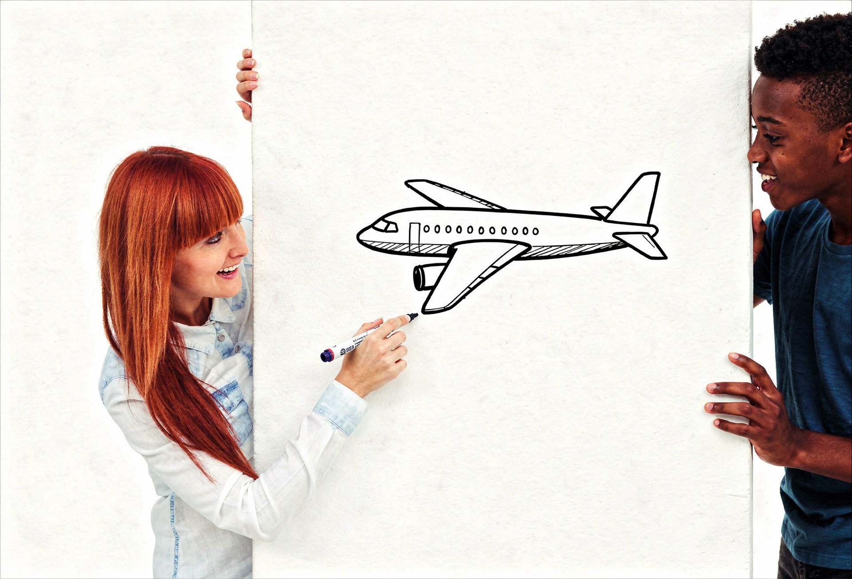
Game: Guess the pictures with the present perfect!
Guess what I have done.
You have flown in an airplane!
Notes:
7. Game – Guess the Pictures
Use paper, a board, or a virtual whiteboard to draw.
Learners take turns making simple line drawings of 5 things they have done and 5 things they have never done. They may use vocabulary words from this lesson and previous lessons. You may give them a list of vocabulary words (see appendix for link) or flashcards to prompt them.
Then other learners try to describe the picture with a complete sentence using the present perfect: “Sara has flown in an airplane.” “Joe has never wept at a movie.”
The learner that says the most correct sentences in 5 minutes wins.
Words may include: flight, jungle, guidebook, sightseeing, passport, one-way, round-trip, arrive, depart, coast, laugh, weep, paragraph, period, question mark, comma, document, menu, manager, tip, etc.

Slide 31

1A. Homework: Write about the pictures using the present perfect tense with for/since/ever/never.
1.? | Has he ever gone on a flight? | 4.?
2.- |  | 5.+
3.- |  | 6.?
Notes:
Homework 1A. - Write sentences using the pictured vocabulary words.
Model. Go over each of the homework assignments to be sure the student understands what to do.
Repeat. Encourage students to practice speaking and reading the completed homework assignments with a friend. They may use a bilingual dictionary.
Solo. Students will share their homework when they are finished. After they have shared their homework, be sure to check it for correctness, including spelling. Explain mistakes, while providing praise and encouragement.
Number one is an example.
Answers may vary, but will start with a capital letter, have the correct verb form and punctuation mark, and use the following words along with a time expression (for/since/ever/never):
2. a passport (haven’t/hasn’t), 3. a guidebook (haven’t/hasn’t), 4. a jungle (have/has), 5. sightseeing (have/has), 6. a coast (have/has)

Slide 32

1B. Write about the pictures using the present perfect tense with questions ? positives + or negatives -.
7.- |  | 10.-
8.+ |  | 11.-
9.+ |  | 12.?
Notes:
Homework 1B. - Write sentences using the pictured vocabulary words.
Students will write a sentence for each picture to practice the lesson’s vocabulary words.
Answers may vary, but will start with a capital letter, have a punctuation mark at the end, and use the following words:
#7 is an example.
7. I haven’t driven down a one-way road. (haven’t/hasn’t)
8. round-trip (have/has)
9. arrive (have/has)
10. depart (haven’t/hasn’t)
11. laugh (haven’t/hasn’t)
12. weep (have/has)

Slide 33


2. Fill in the blanks using the present perfect tense
and circle For, Since, Never, or Ever.
(live) Have you lived near the jungle (for/since) a long time?
(create) God _________ the heavens and the earth to declare His glory.
(weep) I _________ not (ever/never) ___________ during sad movies.
(promise) The Lord_______________to be with us always.
(eat) John _____________ (ever/never) _____ a raspberry.
(see) We (ever/never) _______________ that museum before.
(travel) _____she ______(ever/never) traveled to Egypt?
(be) He ________a teacher __________(for/since) 30 years.
(know) I ___________ the Lord _______(for/since) I was a child.
Notes:
Homework 2. – Grammar and Vocabulary Review
Learners must write the correct present perfect form of the verbs - the auxiliary verb (have/has) and the past participle. They must also circle the correct time expressions (ever/never/for/since).
2. God has created the heavens and the earth to declare His glory.
3. I have not ever wept during sad movies.
4. The Lord has promised to be with us always
5. John has never eaten a raspberry.
6. We never have seen that museum before.
7. Has she ever traveled to Egypt?
8. He has been a teacher for 30 years.
9. I have known the Lord since I was a child.

Slide 34
3. Write questions in the present perfect and ask a partner.
Questions | Answers
1. Has the guidebook helped you decide where to go? | Yes, the guidebook suggested going to the Eiffel Tower.
2. ___________ sightseeing ______
3. _______________ lost _______
4. ____________ one-way _______
5. _____________ jungle ________
6. _____________ laughed _______
7. _____________ arrived _______
Notes:
Homework 3. – Conversations - Pair work
First, students complete writing the questions with their own words in the present perfect. Then ask students to interview a partner, and write their partner’s answers. Then they will switch roles and answer their partner’s questions.
Check answers for correct grammar and punctuation.
Number 1 is an example.
Questions and answers will vary, but may include:
2. Have you ever taken a sightseeing tour in an open-top bus?
3. Has Millie lost her passport?
4. Have you ever purchased a one-way ticket?
5. Has she ever hiked in the jungle during the rainy season?
6. Have you ever laughed at a good joke?
7. Have they arrived yet?

Slide 35
4. Write and say present perfect sentences using the words in the box.
fearful restless beautiful joyful
helpful hopeless cheerful careless
A. Have you ever been fearful of anything? Yes, I have been fearful of snakes!
B.
C.
D.
E.
F.
G.
Notes:
Homework 4. – Write and say sentences with the new sounds
This homework practices writing, spelling, and pronouncing the /-les/ and /-ful/ sounds.
Answers will vary but should include the present perfect tense and the vocabulary words with correct sentence structure. Some examples are:
B. When have you felt restless?
C. Have you ever been somewhere beautiful before?
D. Haven’t you ever been joyful?
E. Have you ever gotten helpful advice?
F. When have you felt hopeless?
G. Have you always been cheerful?
©2020-2026 Light of the World Learning
35

Slide 36
5. Discuss the Bible story with your partner.
What was your favorite part of the Bible story?
Where have you seen “40 days” in other Bible stories?
What did you learn about Jesus in this story?
Why was the women’s role in this story important?
What are two questions you have about the story?
What may change in your life because of something you learned from this story?
Notes:
Homework 5. – Bible Reading Review
Ask the students to tell the Bible story to a partner and then interview the partner, and write their partner’s answers. Then they will switch roles and answer their partner’s questions.
Check answers for correct grammar and punctuation.
Answers will vary, but number 2 could include: Jesus fasted for 40 days and nights (Matthew 4:2). At the end of 40 days Noah opened the window of the ark (Genesis 8:6). Moses went up on Mount Sinai to receive the 10 commandments, and stayed there for 40 days and nights (Exodus 24:18).

Slide 37
6A. Homework – Choose one verse to memorize.
A
He said to them, “Go everywhere in the world. Tell the Good News to everyone. Whoever believes and is baptized will be saved. But those who do not believe will be judged guilty.”
Mark 16:15-16 ERV
Jesus said to them, “Remember when I was with you before? I said that everything written about me must happen—everything written in the Law of Moses, the books of the prophets, and the Psalms.”
Luke 24:44 ERV
B
Notes:
Homework 6A. – Memorize a Verse
Learners get to choose A, B, or C (on the next slide) to memorize. Please notice that the memory work is not long. Everyone, regardless of skill level, should be able to do it.
1. Model. Recite a verse from memory.
2. Repeat. Encourage students to find someone with whom to practice conversing and reading the completed homework assignment.
3. Solo. Students will recite the verse from memory at the next class.

Slide 38
6B. Homework – Choose one verse to memorize, and read the next verses.
C
So he came to them and said, “All authority in heaven and on earth is given to me. So go and make followers of all people in the world. Baptize them in the name of the Father and the Son and the Holy Spirit. Teach them to obey everything that I have told you to do. You can be sure that I will be with you always. I will continue with you until the end of time.” Matthew 28:18-20 ERV
          Read the next lesson’s Bible verses in your language: Acts 1:12-14; Acts 2; Acts 3; Acts 4:1-22
Notes:
Homework 6B. – Memorize a verse and read the next lesson’s verses
Learners get to choose A, B, or C to memorize.
Learners will always read the Bible lesson in their first language before reading it in English the following lesson. Help them get a Bible in their own language if they don’t have one. They may also use Bible.IS or other Bible translation resources.

Slide 39
7A. Read and answer the questions.
Subject: East Jetway Flight Confirmation and Tickets
Dear Mrs. Smith,
Thank you for choosing to book your flight through East Jetway Airlines! We appreciate your ongoing loyalty to our airline and we are happy to have you travel with us. We promise to give you a safe and pleasant flight each time you travel. We hope that you will book another flight through us. Because of your loyalty to us we are pleased to offer you two extra reward points on your next round-trip flight booked through our official website. We hope that will be soon.
Notes:
Homework 7A. – Everyday Reading and Writing
The learners will read the flight confirmation email on this slide and the following slide.

Slide 40
Your flight #EJ-2749, will depart from Chicago Midway International Airport (MDW) at 3:25 pm on Friday, November 22. Your confirmation number is DGB54. Please remember this number because you will need it for your check-in. You may check into your one-way flight to Istanbul on our website or by mobile app, 24 hours before your departure time.
Kindly ensure you arrive at the airport at least four hours before your time of departure to check your bags and go through passport control. Please don’t forget your passport and other travel documents! We wish you a pleasant journey.
Thank you for flying with us!
East Jetway Airlines
Notes:
Homework 7A. – Everyday Reading and Writing
The learners will read the flight confirmation email and answer the questions on the next slide.

Slide 41
7B. Answer the questions.
A. What is the name of the airline Mrs. Smith is using?
B. Where is she traveling?
C. What reward has she earned for her loyalty?
D. Why should Mrs. Smith arrive at the airport early?
E. What is the difference between a one-way flight ticket and a round-trip flight ticket?
F. What two things would you do in preparation for an international flight?
Notes:
Homework 7B. – Everyday Reading and Writing
The learners will read the confirmation email and answer the questions.
Answers:
A. Mrs. Smith is using East Jetway Airlines.
B. She is traveling to Istanbul.
C. She has earned two extra points on her next round-trip flight.
D. She should arrive early to check her bags and go through passport control.
E. A one-way ticket takes you only to your destination. A round-trip ticket takes you both to your destination and then later on a return flight to your original departing city.
F. Answers may vary.

Slide 42
8. Writing – Use the present perfect tense.
Write about the best place you have ever traveled. Or write about somewhere you have never visited but want to visit.
Notes:
Homework 8. – Writing
Model. Write something about somewhere that you would also like to travel.
Example: I have always dreamed of going to St. Petersburg, Russia. I love architecture, and there are some amazing old buildings there.
Answers will vary.

Slide 43
9. Homework – Now I Can….
I can talk about travel plans now.
I can use the new words including _____, _____, _____, _____, _____, _____, _____, _____, _____, _____, _____, and _____.
I can use the present perfect tense with for, since, never, and ever.
I can understand how God raised Jesus from the dead.
I can understand that Jesus is alive today.
Notes:
Homework 9. – I can statements
The student must be able to achieve all of these skills before the next lesson. If not, the lesson can be repeated or additional practice materials can be used.
Review all of the skills at the beginning of the next lesson. Be sure to give lots of praise and encouragement!

Slide 44
Reflections and Closing Prayer
Notes:
Reflections and Closing Prayer
You may want to thank the Lord for what we have learned, ask for special prayer requests, then pray for your students and bless them. Students may write reflections and their prayers here.

Slide 45

Help us share the Light of the World!
Thank you for using our materials. If these lessons are a blessing to you, please give or volunteer to help others learn English through the Bible.
For more information, visit LightOfTheWorldLearning.org

Slide 46
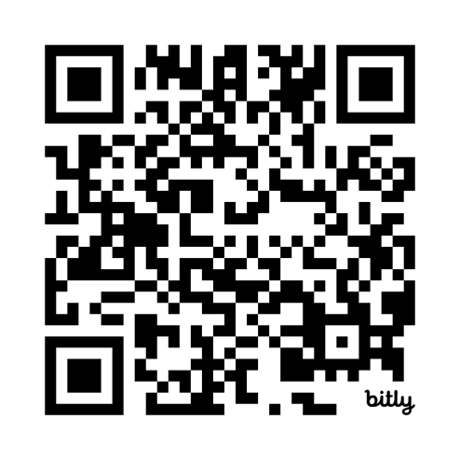
Appendix
How to Use Lessons: bit.ly/UseLOTW
Irregular Verb List: bit.ly/ListVerbs
Lesson Downloads: LightOfTheWorldLearning.org
Order Books: bit.ly/BooksLOTW
Share Your Feedback: bit.ly/FeedbackLOTW
Table of Contents: bit.ly/TocLOTW
Video Channel: youtube.com/@LightOfTheWorldLearning
Vocabulary List: bit.ly/VocabUS
Website: LightOfTheWorldLearning.org

Slide 47
Acknowledgements
We would like to thank the entire Light of the World volunteer team for their hard work and creativity in making this project possible. For all those around the world who prayed, wrote, edited, narrated, illustrated, sang, tested, and gave generously for this curriculum, we appreciate you sharing the love of Jesus through the gift of English. Our team members include:
Anonymous | Emily Cox | Jill Gramzow | Martha Lane
Jean Ato | Marilyn Dano | Tanya Griffin | Audrey Larsen
Bradley Baurain | Hephzi Davidson | Rachel Grijincu | Aden Lewis
Ana Biederman | Susanna Diallo | Lauren Haines | Bruce Lewis
Bob Biederman | Alyssa Dokolas | Carol Hale | Elena Lewis
Joshua Blake | EasyReadEnglish.com | Emily Hamilton | James Lewis
Rachael Braggs | Don Edic | Patty Hickman | Micah Beth Lewis
Hannah Brendel | Peggy Fergus | Juliette Hyer | Tim Lewis
Larry Buell | MaryBeth Gahan | Lyudmila Ivanyuk | Ward Lewis
Cindy Campbell | Melina Gallo | Debbie Johnson | Cosette Lindsay
Christian Cha | Alicia Gentile | Carey Jo Johnston | Johnny Lukashevich
Olivia Cheney | Prakash Chandra Giri | Nancy Kingdon | Gail MacMillan
Hannah Clark | Ellenor Gopal | Dorothy Konadu | Ivan Mader
Nancy Cobb | Henrietta Grajcar | Macy Lake | Amy Martin
(continued on the next slide)

Slide 48
Acknowledgements - Continued
Diana Martz | Joan Phelps | Lorna Tatomir
Hannah McMahan | Megan Rahn | Darrell Turner
Christy McPherson | Sara Scazzero | Leigha Wachter
Tracy Meddaugh | Hannah Schmokel | Joseph Waite
Barbara Newsome | Ashlyn Shrimplin | Graham Whitmore
Brenda Nielsen | Leah Sprague | Cheri Wilke
Danielle Nowe | Noah Staal | Mackenzie Williams
Deborah O’Donnell | Macie Stuckman | Allison Wright
Evelyn Ocasio | Jia Le Su | Tiffany Yeh
Georg Ort | Carole Svensson | Muchun Yin
Martha Ort | Ellie Talalight | Ted York
Barb Park | Peter Talalight | Tai Lee Young
Deb Payne | Weston Talalight | Abigail Zawisza
Linda Petrie | Rachel Tamang | Anita Zeifert
Bible story and pictures on slides 17-26 adapted from the original work by unfoldingWord available from https://openbiblestories.org
Bible Verses on slides 37-38 Taken from the HOLY BIBLE: EASY-TO-READ VERSION ©2014 by Bible League International. Used by permission.
Notes:
49

